Slide 1
Section 14.5
Multiple Regression Models with Qualitative Independent Variables

Slide 2
Multiple Regression Models with Qualitative Independent Variables
Throughout Chapter 13 and this chapter, we have discussed quantitative variables in the regression models. Quantitative variables take on values on a well-defined scale, such as number of pizzas, miles to destination, income, age, and temperature. Many variables of interest, however, are not quantitative, but qualitative. Examples of qualitative variables are type of college (public or private), season of the year (spring, summer, fall, and winter), and type of investment (stocks, mutual funds, or bonds).

Slide 3
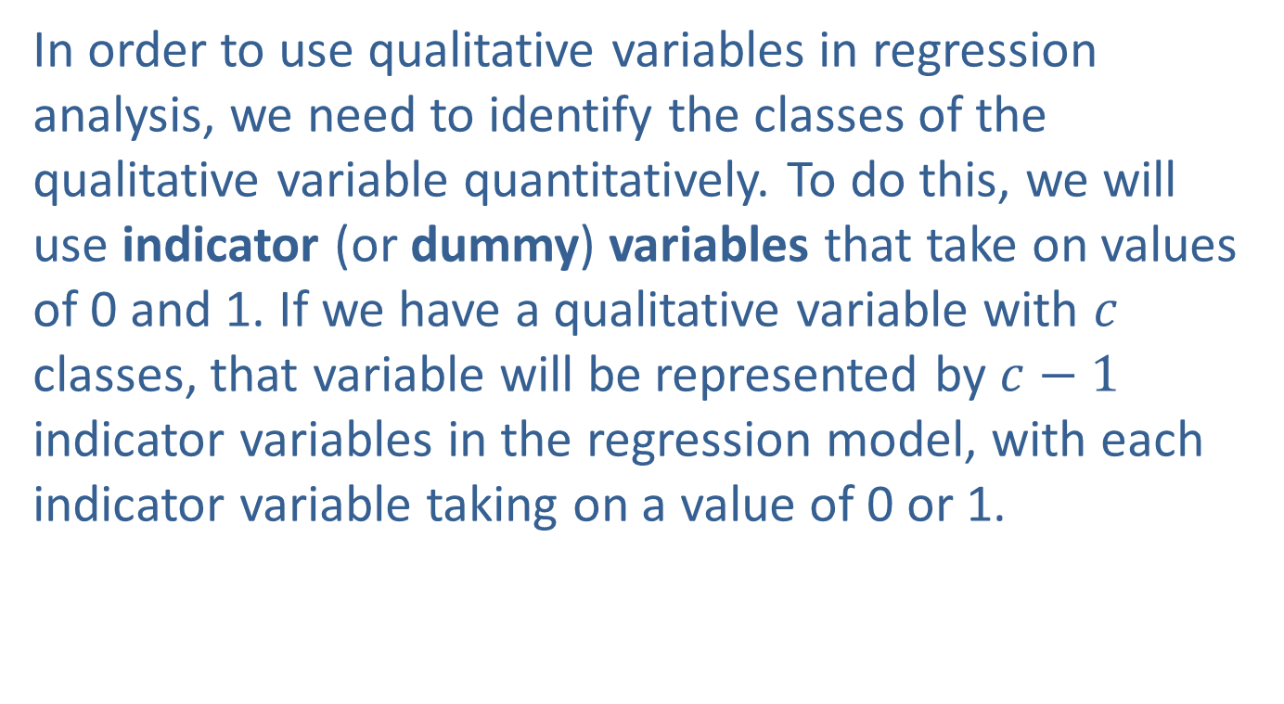
Multiple Regression Models with Qualitative Independent Variables (cont.)
In order to use qualitative variables in regression analysis, we need to identify the classes of the qualitative variable quantitatively. To do this, we will use indicator (or dummy) variables that take on values of 0 and 1. If we have a qualitative variable with $c$ classes, that variable will be represented by $c−1$ indicator variables in the regression model, with each indicator variable taking on a value of 0 or 1.

Slide 4
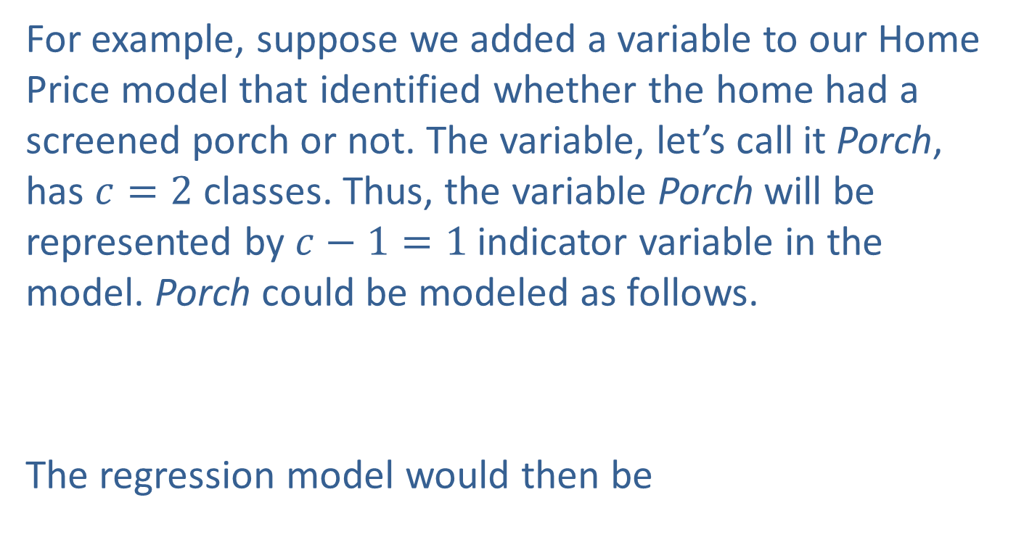
Multiple Regression Models with Qualitative Independent Variables (cont.)
For example, suppose we added a variable to our Home Price model that identified whether the home had a screened porch or not. The variable, let’s call it Porch, has $c=2$ classes. Thus, the variable Porch will be represented by $c−1=1$indicator variable in the model. Porch could be modeled as follows.
The regression model would then be

Slide 5
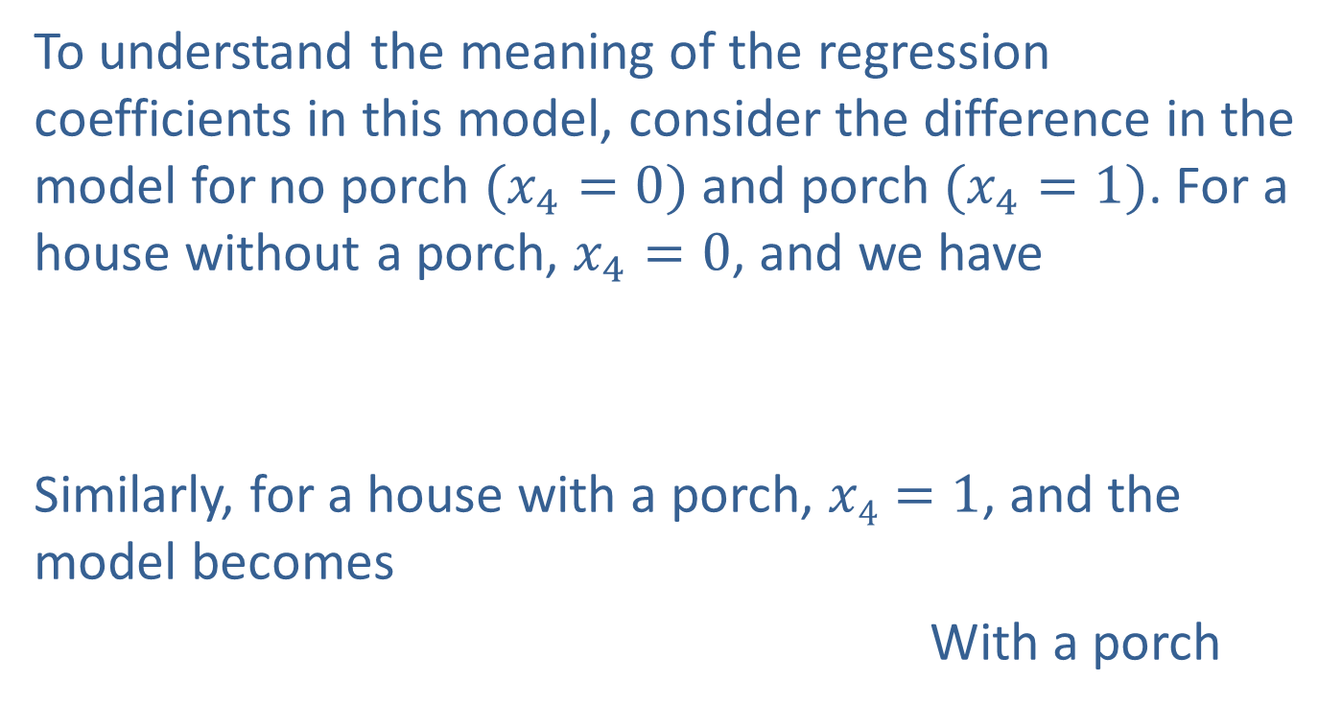
Multiple Regression Models with Qualitative Independent Variables (cont.)
To understand the meaning of the regression coefficients in this model, consider the difference in the model for no porch $(x_{4}=0)$ and porch $(x_{4}=1)$. For a house without a porch, $x_{4}=0$, and we have
Similarly, for a house with a porch, $x4=1$, and the model becomes
With a porch
No porch

Slide 6
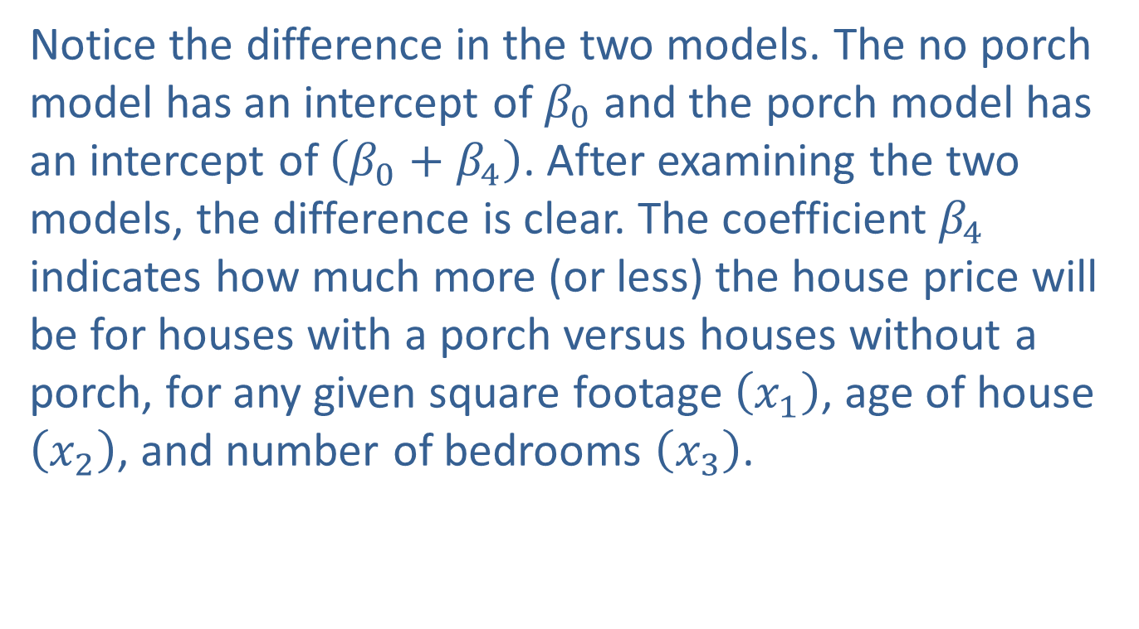
Multiple Regression Models with Qualitative Independent Variables (cont.)
Notice the difference in the two models. The no porch model has an intercept of $β_{0}$ and the porch model has an intercept of $\left(β_{0}+β_{4}\right)$. After examining the two models, the difference is clear. The coefficient $β_{4}$ indicates how much more (or less) the house price will be for houses with a porch versus houses without a porch, for any given square footage $\left(x_{1}\right)$, age of house $\left(x_{2}\right)$, and number of bedrooms $\left(x_{3}\right)$.

Slide 7

Multiple Regression Models with Qualitative Independent Variables (cont.)
Thus, $β_{4}$ measures the differential effect of having a porch. In general, $β_{4}$ shows how much higher (or lower) the plane of best fit is for the class coded 1 than the class coded 0, for any given level of $x_{1}$, $x_{2}$, and $x_{3}$.

Slide 8
Example 14.5.1: Determining the Significance of a Qualitative Variable in a Multiple Regression Model
The table below contains a portion of the real estate data set from Section 14.1, but with the added column of the variable Porch, indicating whether the house has a screened porch or not.
Mount Pleasant Real Estate Data
List Price | Square Feet | Age | Bedrooms | Porch | Screened Porch?
$350,000 | 2592 | 8 | 3 | 1 | Yes
$119,900 | 777 | 17 | 1 | 1 | Yes
$179,900 | 1137 | 17 | 2 | 0 | No
$124,900 | 777 | 17 | 1 | 0 | No
$349,999 | 2151 | 4 | 4 | 0 | No
. . .

Slide 9
Example 14.5.1: Determining the Significance of a Qualitative Variable in a Multiple Regression Model (cont.)
You may recall that we are interested in modeling List Price as a function of the following variables.
x₁ = Square Footage
x₂ = Age
x₃ = Bedrooms
The multiple regression model is given by

Slide 10
Example 14.5.1: Determining the Significance of a Qualitative Variable in a Multiple Regression Model (cont.)
The fitted regression model is as follows.
List Price = 16,3626.79 + 114.95 Square Footage − 6152.36 Age − 1358.31 Bedrooms − 13,506.64 Porch
SUMMARY OUTPUT
Regression Statistics
Multiple R | 0.983153945
R Square | 0.96659168
Adjusted R Square | 0.961983636
Standard Error | 21275.07421
Observations | 34

Slide 11
Example 14.5.1: Determining the Significance of a Qualitative Variable in a Multiple Regression Model (cont.)
ANOVA
 | df | SS | MS | F | Signiﬁcance F
Regression | 4 | 3.79777E+11 | 94944231937 | 209.7618082 | 5.92154E-21
Residual | 29 | 13126234702 | 452628782.8
Total | 33 | 3.92903E+11
 | Coeﬃcients | Standard Error | t Stat | P-value | Lower 95% | Upper 95%
Intercept | 163626.7916 | 20421.30079 | 8.012554798 | 7.76213E-09 | 121860.5419 | 205393.0413
Square Feet | 114.9454965 | 9.88474698 | 11.62857246 | 1.93724E-12 | 94.72891896 | 135.162074
Age | −6152.363638 | 750.6484437 | −8.196065268 | 4.89101E-09 | −7687.612086 | −4617.11519
Number of Bedrooms | −1358.306077 | 7327.914624 | −0.185360522 | 0.854236625 | −16345.57428 | 13628.96213
Porch | −13506.63879 | 8148.538447 | −1.657553545 | 0.108188125 | −30172.27116 | 3158.993583

Slide 12
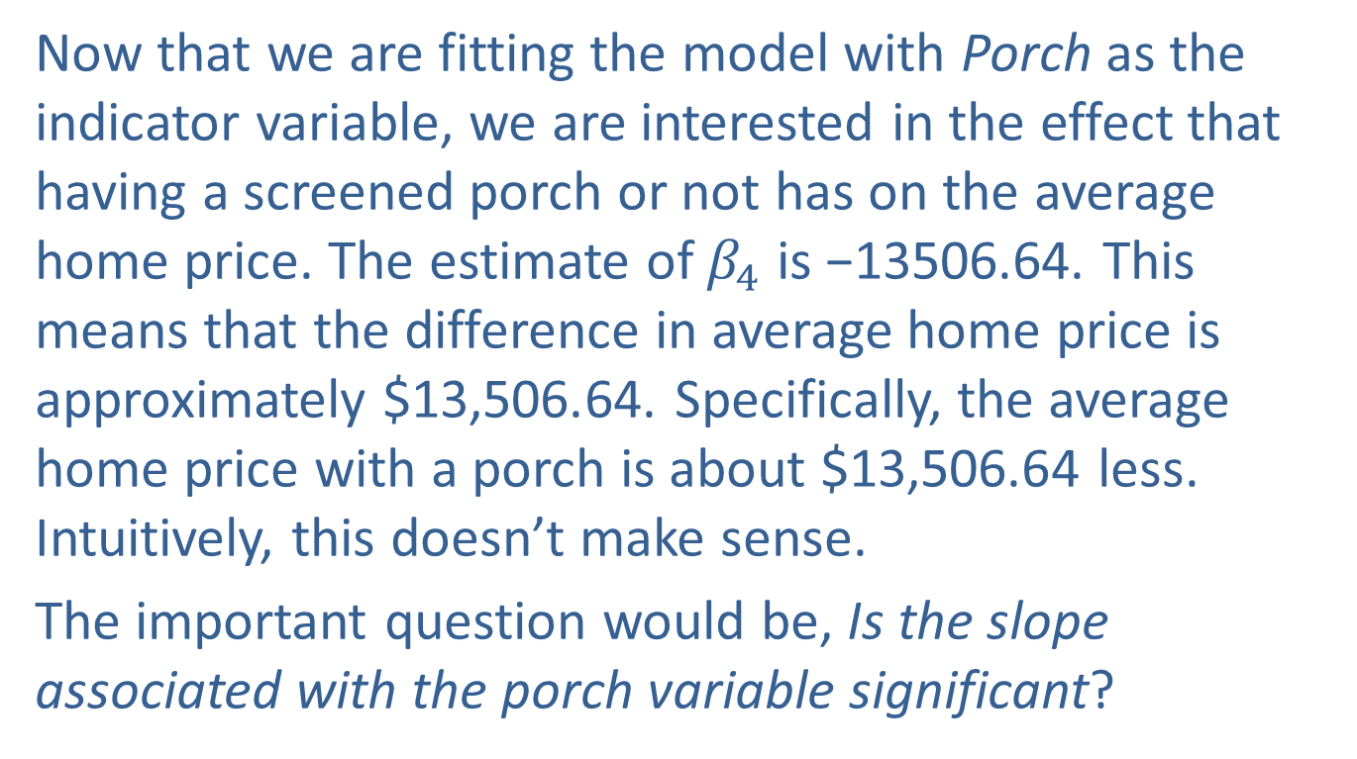
Example 14.5.1: Determining the Significance of a Qualitative Variable in a Multiple Regression Model (cont.)
Now that we are fitting the model with Porch as the indicator variable, we are interested in the effect that having a screened porch or not has on the average home price. The estimate of $β_{4}$ is −13506.64. This means that the difference in average home price is approximately $13,506.64. Specifically, the average home price with a porch is about $13,506.64 less. Intuitively, this doesn’t make sense.
The important question would be, Is the slope associated with the porch variable significant?

Slide 13
Example 14.5.1: Determining the Significance of a Qualitative Variable in a Multiple Regression Model (cont.)
The formal test can be carried out just as we did in Section 14.3. That is, our hypotheses are the following.
H₀: β₄ = 0 Implies Porch is not a useful predictor of List Price.
H_{a}: β₄ ≠ 0 Implies Porch is a useful predictor of List price.
According to the Excel output, we have a t-statistic of −1.658 with a P-value of 0.1082. Given the large
P-value associated with this test statistic, we would fail to reject the null hypothesis and conclude that the Porch variable is not a useful predictor of List Price.

Slide 14
Example 14.5.2: Determining a Multiple Regression Model with Qualitative Variables
A real estate investor wants to study the relationship between annual return on his commercial retail shops (measured in thousands of dollars) as it relates to their location and the number of homes near the shops. Specifically, the investor has collected data on the annual return of the shops, the number of households within 15 miles of the shops (measured in thousands), and the location of the shops (whether the shops are in a suburban area, near a shopping mall, or downtown). The annual return data are given in the following table.

Slide 15
Example 14.5.2: Determining a Multiple Regression Model with Qualitative Variables (cont.)
Shop Data
Shop | Location | Annual Return (Thousands of Dollars) | Number of Households (Thousands)
1 | Mall | 185.69 | 163
2 | Suburban | 203.00 | 215
3 | Mall | 245.81 | 232
4 | Mall | 137.07 | 108
5 | Suburban | 207.36 | 220
6 | Suburban | 146.12 | 150
7 | Downtown | 111.21 | 102
. . .
Solution
Given the data, we can define our variables as follows.
x₁ = Number of Households

Slide 16
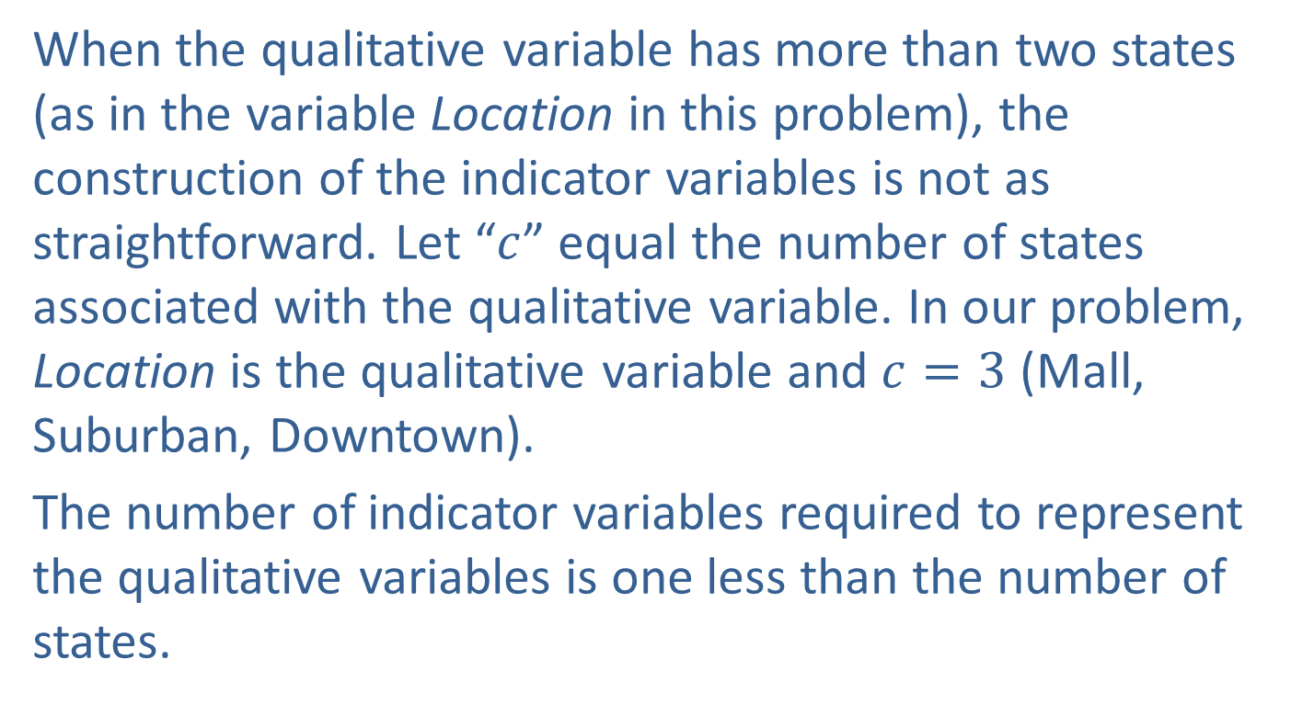
Example 14.5.2: Determining a Multiple Regression Model with Qualitative Variables (cont.)
When the qualitative variable has more than two states (as in the variable Location in this problem), the construction of the indicator variables is not as straightforward. Let “$c$” equal the number of states associated with the qualitative variable. In our problem, Location is the qualitative variable and $c=3$ (Mall, Suburban, Downtown).
The number of indicator variables required to represent the qualitative variables is one less than the number of states.

Slide 17
Example 14.5.2: Determining a Multiple Regression Model with Qualitative Variables (cont.)
Since Location is a qualitative variable and there are three locations, we will use c − 1 = 3 − 1 = 2 indicator variables to represent the locations. How you choose the indicator variables to represent the states is somewhat arbitrary. You select two of the states (in our problem we have chosen Mall and Downtown) and have coded them as below.

Slide 18
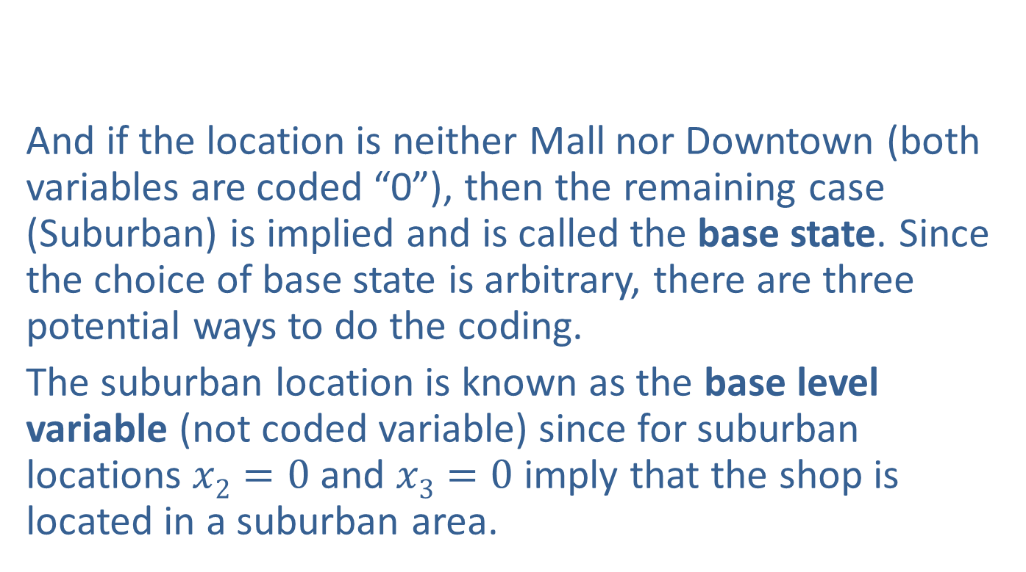
Example 14.5.2: Determining a Multiple Regression Model with Qualitative Variables (cont.)
And if the location is neither Mall nor Downtown (both variables are coded “0”), then the remaining case (Suburban) is implied and is called the base state. Since the choice of base state is arbitrary, there are three potential ways to do the coding.
The suburban location is known as the base level variable (not coded variable) since for suburban locations $x2=0$ and $x3=0$ imply that the shop is located in a suburban area.

Slide 19
Note
The dummy variable construction we have selected is arbitrary. We could have coded Downtown and Suburban as 1 and made Mall the base level variable.

Slide 20
Example 14.5.2: Determining a Multiple Regression Model with Qualitative Variables (cont.)
The coefficients estimated for the x₂ and x₃ indicator variables will represent a difference between the mall and downtown locations and the suburban location.
The multiple regression model for annual return is given by
The fitted regression model is
Annual Return = 15.5071 + 0.8704 Number of Households + 27.8186 Mall + 6.7185 Downtown.

Slide 21
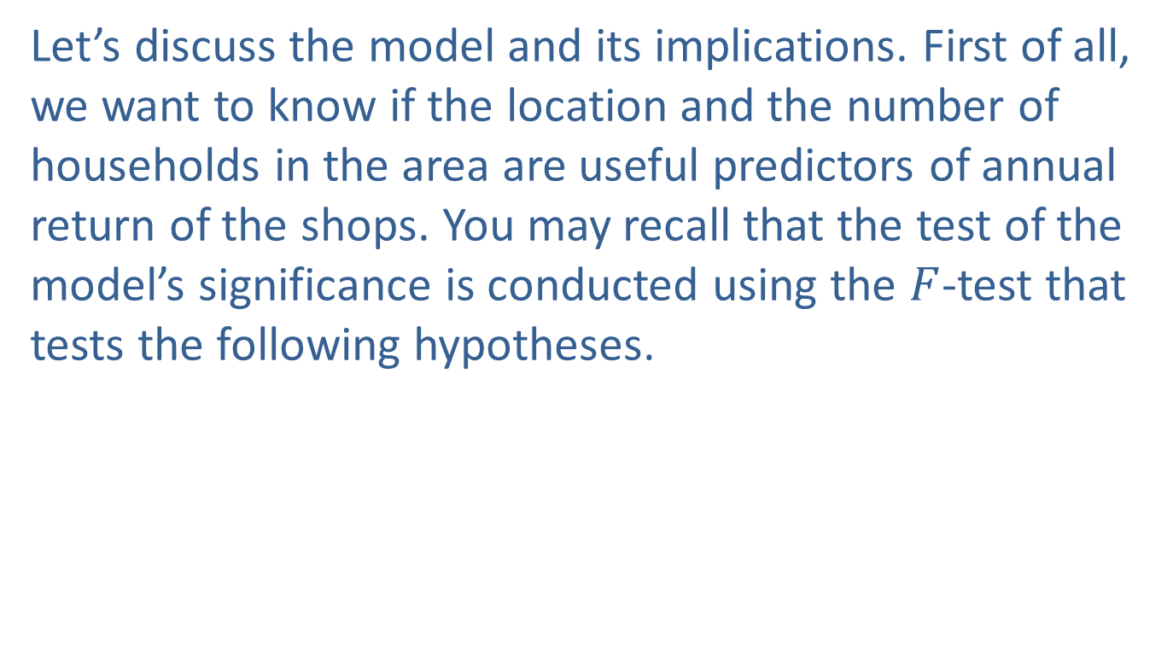
Example 14.5.2: Determining a Multiple Regression Model with Qualitative Variables (cont.)
Let’s discuss the model and its implications. First of all, we want to know if the location and the number of households in the area are useful predictors of annual return of the shops. You may recall that the test of the model’s significance is conducted using the $F$-test that tests the following hypotheses.

Slide 22
Example 14.5.2: Determining a Multiple Regression Model with Qualitative Variables (cont.)
SUMMARY OUTPUT
Regression Statistics
Multiple R | 0.999974838
R Square | 0.999949677
Adjusted R Square | 0.999943871
Standard Error | 0.288707033
Observations | 30
ANOVA
 | df | SS | MS | F | Signiﬁcance F
Regression | 3 | 43062.89567 | 14354.29856 | 172213.5214 | 5.5533E-56
Residual | 26 | 2.167145526 | 0.083351751
Total | 29 | 43065.06282

Slide 23
Example 14.5.2: Determining a Multiple Regression Model with Qualitative Variables (cont.)
Examining the Excel output, we see that the F-statistic for the test is 172,213.5214 with a P-value near zero. This is evidence that we reject H₀ and conclude that at least one of the slopes in the model is significantly different from zero, and the model can be useful in predicting the variability of Annual Return.
 | Coeﬃcients | Standard Error | t Stat | P-value | Lower 95% | Upper 95%
Intercept | 15.50707387 | 0.261037514 | 59.40553771 | 2.6636E-29 | 14.97050357 | 16.04364416
Number of Households | 0.870441943 | 0.001225001 | 710.5645401 | 2.77306E-57 | 0.867923919 | 0.872959968
Mall | 27.81856958 | 0.138873816 | 200.3154397 | 5.45545E-44 | 27.53311037 | 28.1040288
Downtown | 6.718542409 | 0.13223228 | 50.80864057 | 1.49967E-27 | 6.446735064 | 6.990349754

Slide 24
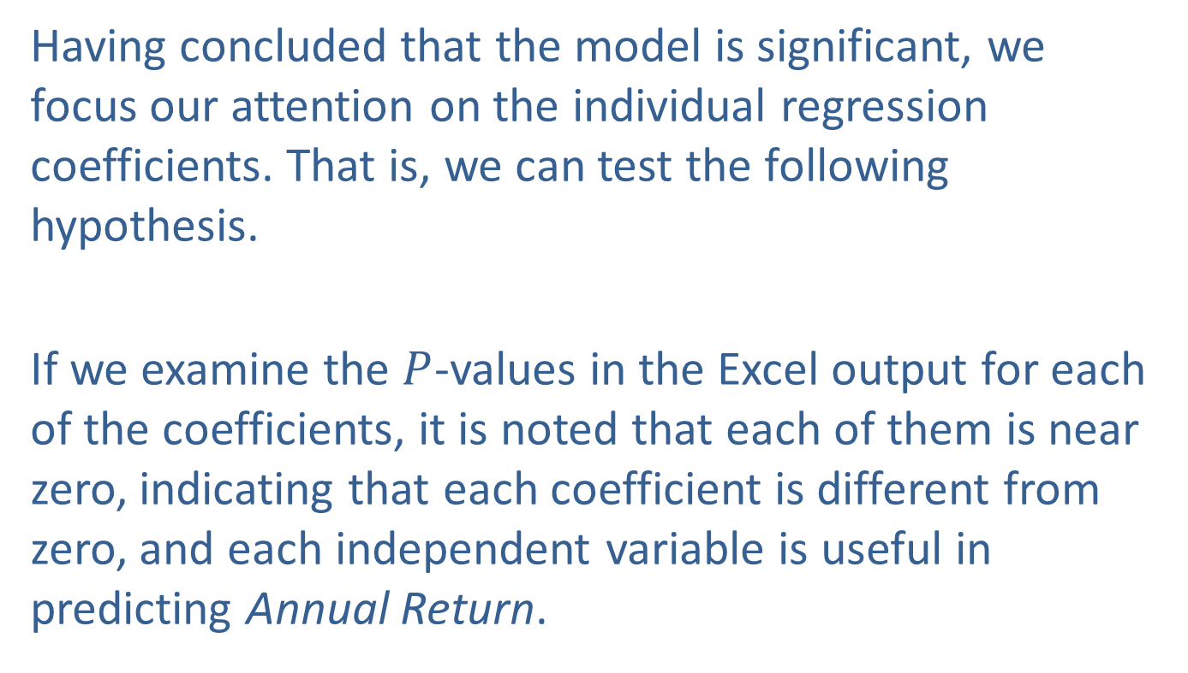
Example 14.5.2: Determining a Multiple Regression Model with Qualitative Variables (cont.)
Having concluded that the model is significant, we focus our attention on the individual regression coefficients. That is, we can test the following hypothesis.
If we examine the $P$-values in the Excel output for each of the coefficients, it is noted that each of them is near zero, indicating that each coefficient is different from zero, and each independent variable is useful in predicting Annual Return.

Slide 25
Example 14.5.2: Determining a Multiple Regression Model with Qualitative Variables (cont.)
If you are just interested in prediction you can simply substitute the values associated with each variable in the equation and calculate the resulting prediction.
However, if you wish to interpret the effect of each dummy variable on the dependent variable you must untangle the relationship of the coded variables with the base level variable. We can examine the average annual return of the investments as a function of the location of the shops (i.e., whether they are near a mall, downtown, or in a suburban area).

Slide 26
Example 14.5.2: Determining a Multiple Regression Model with Qualitative Variables (cont.)
The estimated models can be written as follows.
For the mall location (x₂ = 1, x₃ = 0):
Annual Return = (b₀ + b₂) + b₁ Number of Households
(15.5071 + 27.8186) + 0.8704 Number of Households.
For the downtown location (x₂ = 0, x₃ = 1):
Annual Return = (b₀ + b₃) + b₁ Number of Households
= (15.5071 + 6.7185) + 0.8704 Number of Households.

Slide 27
Example 14.5.2: Determining a Multiple Regression Model with Qualitative Variables (cont.)
For the suburban location (x₂ = 0, x₃ = 0):
Annual Return = b₀ + b₁ Number of Households
15.5071 + 0.8704 Number of Households.
Notice that the best fit line for each location has a different intercept value, but the same slope. Plotting the three lines illustrates this difference.

Slide 28
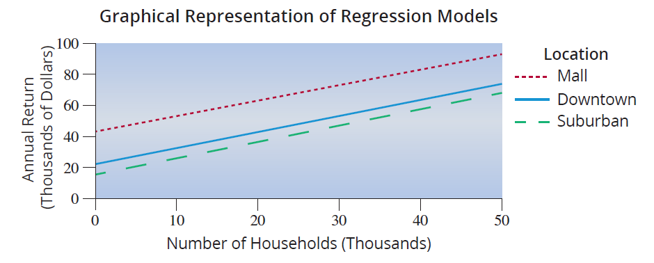
Example 14.5.2: Determining a Multiple Regression Model with Qualitative Variables (cont.)
So, modeling with the qualitative variables allows us to compare the average difference in annual return of the shops by location.

Slide 29
Example 14.5.2: Determining a Multiple Regression Model with Qualitative Variables (cont.)
That is, in order to compare the mall and suburban locations, the difference (as can be seen in the graph above) is
Therefore, the estimate of β₂ (which is 27.8186) represents the difference between the average annual return for shops in the mall locations having x₁ households in the area and the average annual return for shops in the suburban locations having x₁ households in the area.

Slide 30
Example 14.5.2: Determining a Multiple Regression Model with Qualitative Variables (cont.)
Thus, we can say that for any number of households in a given area, the average annual return in a mall location will be approximately $27,818.60 greater than the average annual return in a suburban location.
Similarly, to compare downtown and suburban returns, we get

Slide 31
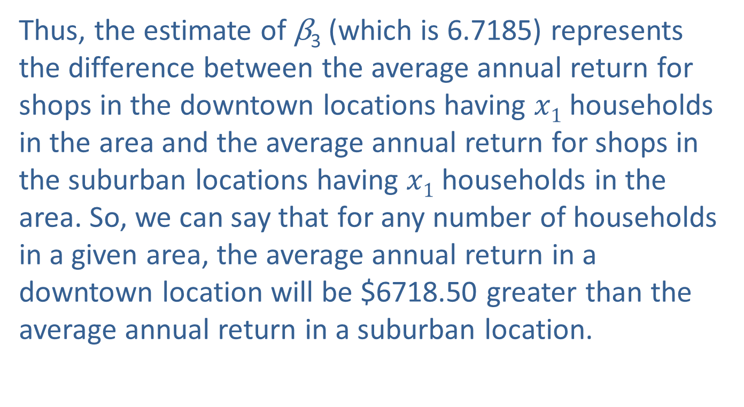
Example 14.5.2: Determining a Multiple Regression Model with Qualitative Variables (cont.)
Thus, the estimate of β₃ (which is 6.7185) represents the difference between the average annual return for shops in the downtown locations having $x1$ households in the area and the average annual return for shops in the suburban locations having $x1$ households in the area. So, we can say that for any number of households in a given area, the average annual return in a downtown location will be $6718.50 greater than the average annual return in a suburban location.

Slide 32
Example 14.5.2: Determining a Multiple Regression Model with Qualitative Variables (cont.)
Lastly, to compare mall and downtown locations, we look at
The estimated difference between β₂ and β₃ is given by β₂ − β₃ ( 21.1001) which represents the difference between the average annual return for shops in the mall locations having x₁ households in the area and the average annual return for shops in the downtown locations having x₁ households in the area.

Slide 33
Example 14.5.2: Determining a Multiple Regression Model with Qualitative Variables (cont.)
In terms of the problem, we can say that for any number of households in a given area, the average annual return in a mall area will be $21,100.10 greater than the average annual return in a downtown location.

Slide 34
Multiple Regression Models with Qualitative Independent Variables (cont.)
There are three potential issues to keep in mind when using these regression results.
These results are only meaningful within the relevant range of the data that was used to estimate the regression equation. For example, using the model in Example 14.5.2 to predict annual return for a shop with 1000 households or 1,000,000 households in the surrounding area would likely yield an unreliable point estimate.

Slide 35
Multiple Regression Models with Qualitative Independent Variables (cont.)
The regression lines for the three locations in Example 14.5.2 are assumed to have the same slope, but in reality they could have very different slopes. Using a regression model with interaction terms allows the slopes for the regression lines to differ.
The regression lines estimated in this example are all linear. This implies that annual return increases by the same amount for each additional thousand households within 15 miles of the shops. This assumption is sometimes unrealistic. This issue can be addressed using polynomial (or nonlinear) regression models.

Slide 36
Multiple Regression Models with Qualitative Independent Variables (cont.)
Regression models with interaction terms and polynomial regression models are beyond the scope of this text and are not discussed in detail. Multiple regression is a complex topic that involves many methods of estimation. We only present the basics in this text.

