Slide 1
Section 14.4
Inference Concerning the Model’s Prediction

Slide 2
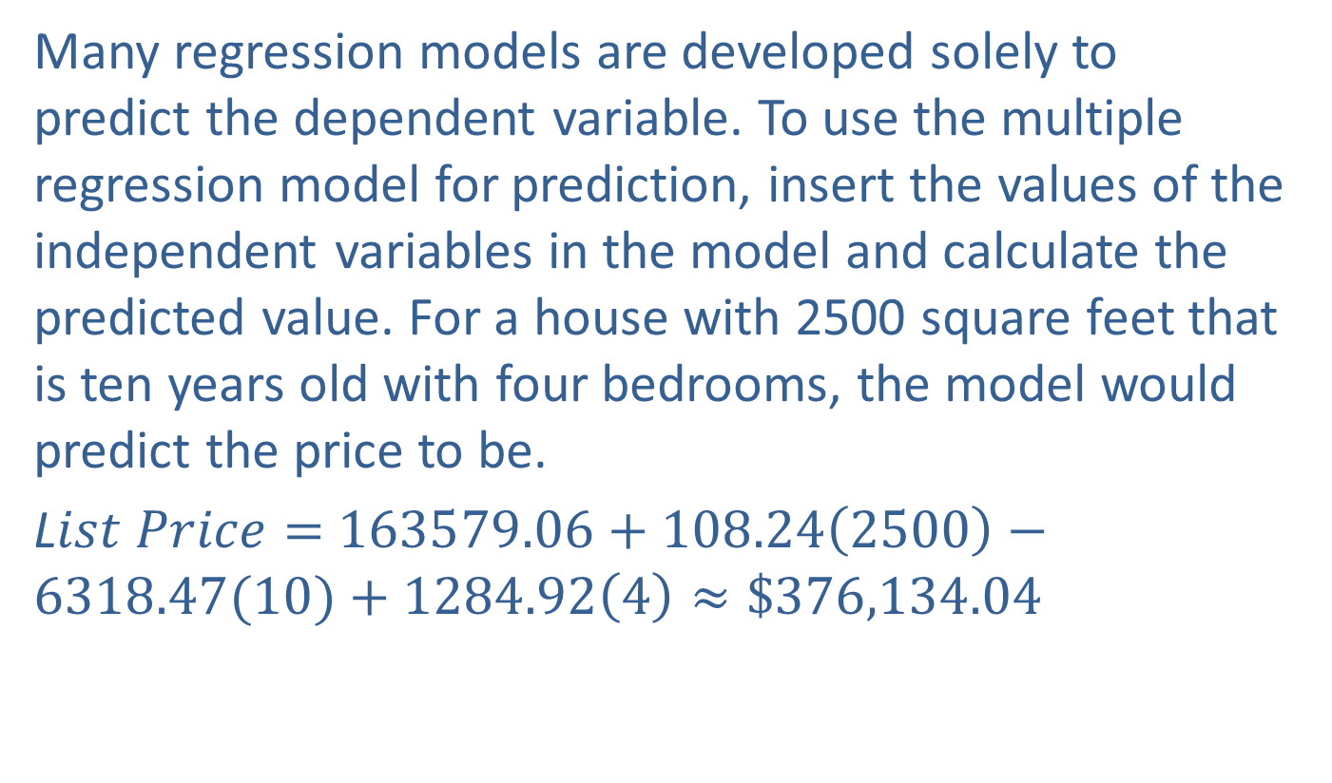
Inference Concerning the Model’s Prediction
Many regression models are developed solely to predict the dependent variable. To use the multiple regression model for prediction, insert the values of the independent variables in the model and calculate the predicted value. For a house with 2500 square feet that is ten years old with four bedrooms, the model would predict the price to be.
L$ist Price=$ $163579.06+108.24\left(2500\right)−6318.47(10)+1284.92\left(4\right)≈\$376,134.04$

Slide 3
Inference Concerning the Model’s Prediction (cont.)
This is the point estimate. How good is this estimate? The answer to this question depends on what you are trying to predict. Are you trying to predict the average price for all 2500 square foot homes that are ten years old with four bedrooms, or are you trying to predict the price of a particular home of this type?

Slide 4
Note
The value of $376,134 for a 2500 square foot home that is 10 years old and has 4 bedrooms that is estimated using the Home Price model differs slightly from the value calculated in the Minitab output ($376,142) due to rounding.

Slide 5
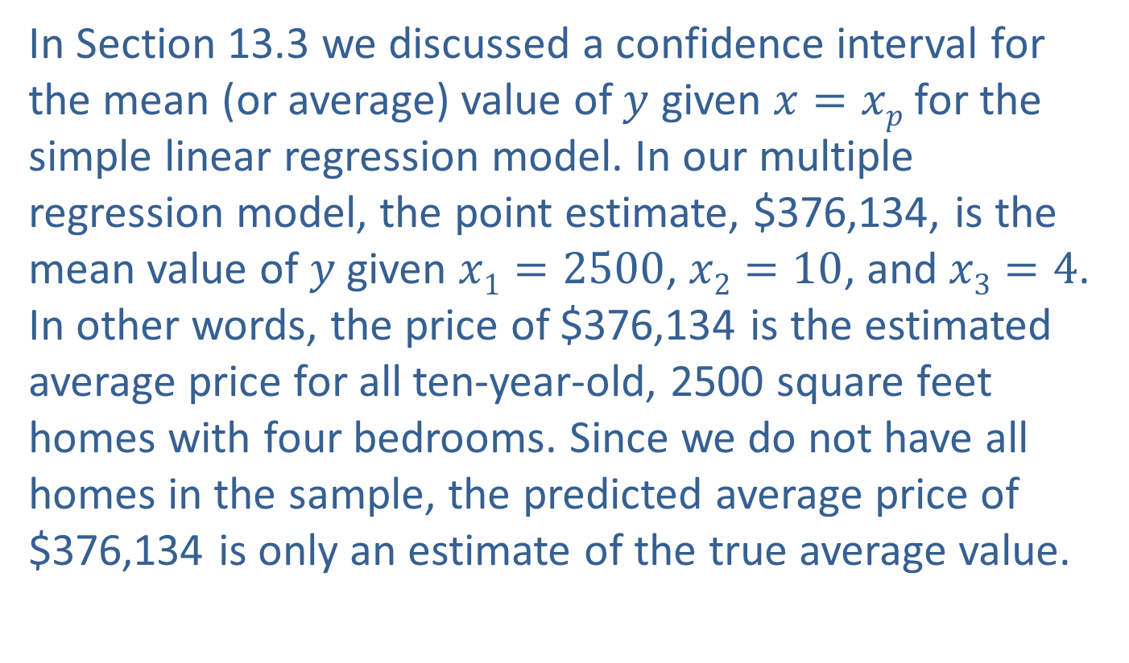

Confidence Intervals for the Mean Value of $y$ Given $x$
In Section 13.3 we discussed a confidence interval for the mean (or average) value of $y$ given $x=xp$for the simple linear regression model. In our multiple regression model, the point estimate, $376,134, is the mean value of $y$given $x1=2500$, $x2=10$, and $x3=4$. In other words, the price of $376,134 is the estimated average price for all ten-year-old, 2500 square feet homes with four bedrooms. Since we do not have all homes in the sample, the predicted average price of $376,134 is only an estimate of the true average value.

Slide 6
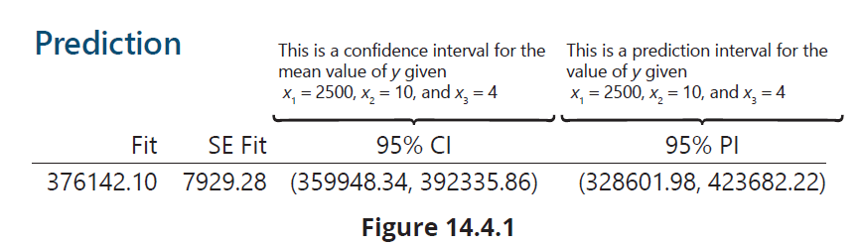


Confidence Intervals for the Mean Value of $y$ Given $x$ (cont.)
How good is the estimate? For multiple regression, the expression for the confidence interval of the mean value of $y$ given $x$is beyond the scope of an introductory text.

Slide 7
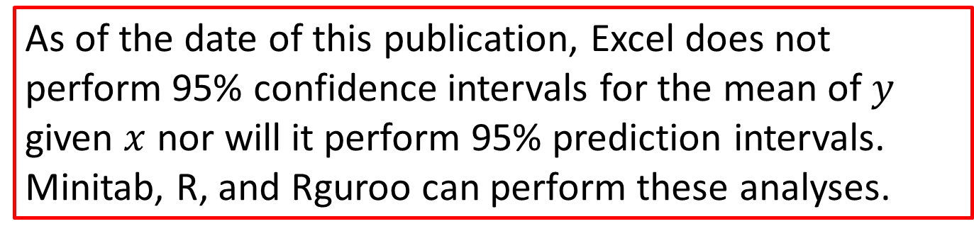
Note
As of the date of this publication, Excel does not perform 95% confidence intervals for the mean of $y$ given $x$ nor will it perform 95% prediction intervals. Minitab, R, and Rguroo can perform these analyses.

Slide 8
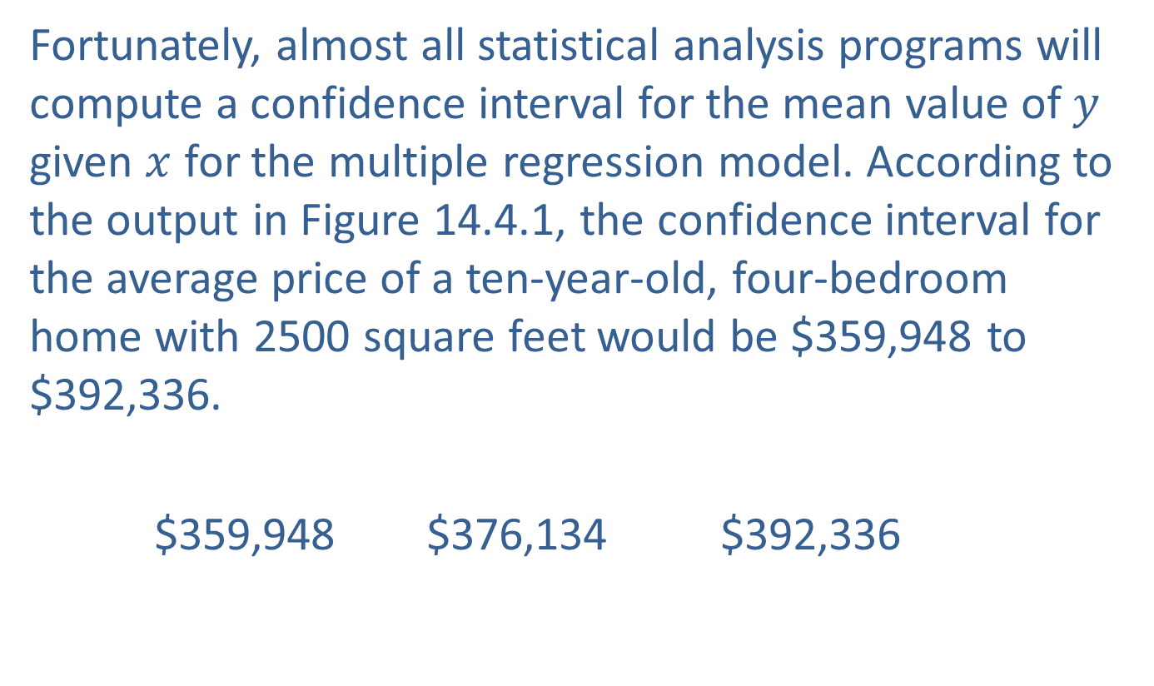
Confidence Intervals for the Mean Value of $y$ Given $x$ (cont.)
Fortunately, almost all statistical analysis programs will compute a confidence interval for the mean value of $y$ given $x$ for the multiple regression model. According to the output in Figure 14.4.1, the confidence interval for the average price of a ten-year-old, four-bedroom home with 2500 square feet would be $359,948 to $392,336.
$359,948 $376,134 $392,336

Slide 9

Confidence Intervals for the Predicted Value of $y$ Given $x$
Suppose you own a home that has 2500 square feet, is ten years old, and has four bedrooms. You may not be especially interested in the average price for such a home. Instead, it would be preferable to create a confidence interval for the price of your home. Once again, for multiple regression, the expression for the prediction interval is beyond the scope of the text. Fortunately, most statistical analysis programs will also compute a prediction interval.

Slide 10

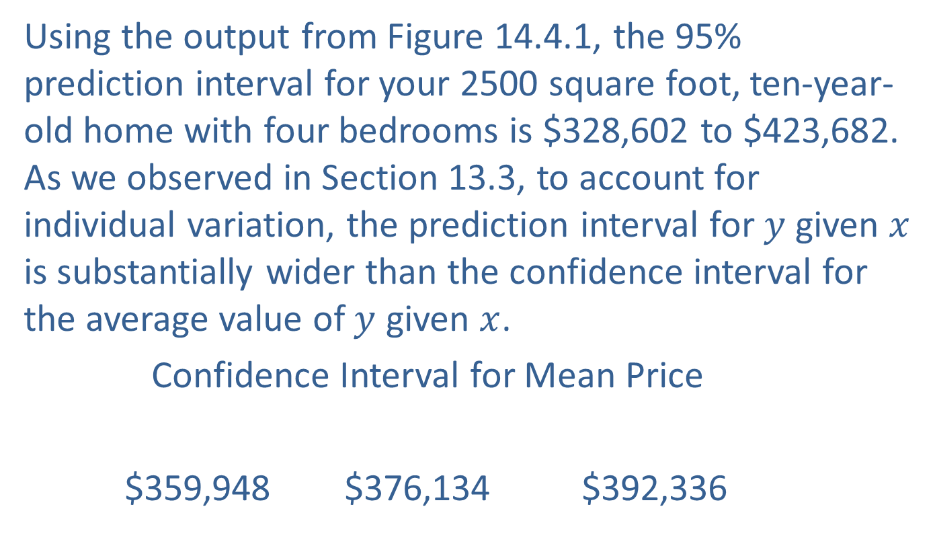
Confidence Intervals for the Predicted Value of $y$ Given $x$ (cont.)
Using the output from Figure 14.4.1, the 95% prediction interval for your 2500 square foot, ten-year-old home with four bedrooms is $328,602 to $423,682. As we observed in Section 13.3, to account for individual variation, the prediction interval for $y$ given $x$ is substantially wider than the confidence interval for the average value of $y$ given $x$.
Confidence Interval for Mean Price
$359,948 $376,134 $392,336

Slide 11
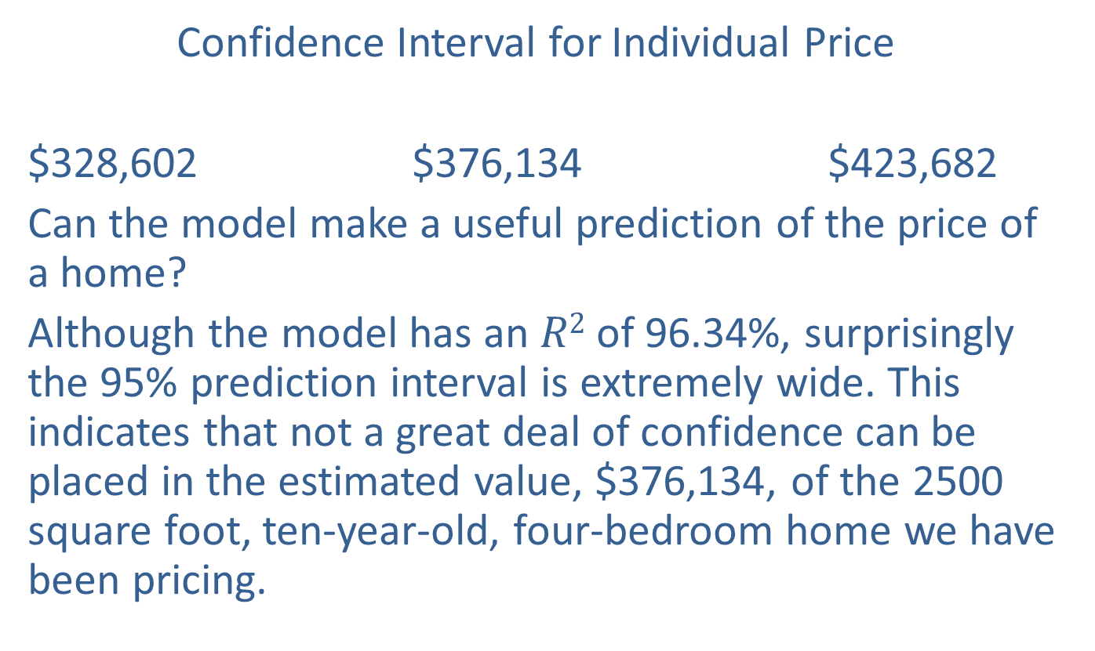
Confidence Intervals for the Predicted Value of $y$ Given $x$ (cont.)
Confidence Interval for Individual Price
$328,602 $376,134 $423,682
Can the model make a useful prediction of the price of a home?
Although the model has an $R2$ of 96.34%, surprisingly the 95% prediction interval is extremely wide. This indicates that not a great deal of confidence can be placed in the estimated value, $376,134, of the 2500 square foot, ten-year-old, four-bedroom home we have been pricing.

Slide 12
Confidence Intervals for the Predicted Value of $y$ Given $x$ (cont.)
The prediction interval provides a sense of the degree of confidence you can place in the model’s predictive performance. Wide prediction intervals would suggest the efficacy of the model is questionable. However, if you are using a model for predictive purposes, you will judge the model by whether or not it helps you perform a predictive task.
The author was the cofounder of a firm that performed automated stock trading. Initially we used multiple regression modeling to predict real time stock prices.

Slide 13
Confidence Intervals for the Predicted Value of $y$ Given $x$ (cont.)
The question for the firm was whether the predictions we were planning on using would produce profits if trades were made using the model’s prediction of future prices of a given stock. In case you are wondering, the model eventually worked. Before the company was sold it was trading six percent of all trades on the New York Stock Exchange and the NASDAQ. Regression modeling is an incredibly effective tool for modeling real-world phenomena, but if you’re interested in a career in model building, it’s also worth exploring machine learning.

Slide 14
Confidence Intervals for the Predicted Value of $y$ Given $x$ (cont.)
Both machine learning and statistical modeling are data-driven, but what sets machine learning apart, particularly in terms of modeling, is its emphasis on a model’s ability to perform predictive tasks and its capacity to utilize multiple modeling techniques to accomplish this objective. The ultimate goal of machine learning is to determine the optimal model for a given predictive task.

