Slide 1
Section 14.3
Inference Concerning the Multiple Regression Model and Its Coefficients

Slide 2
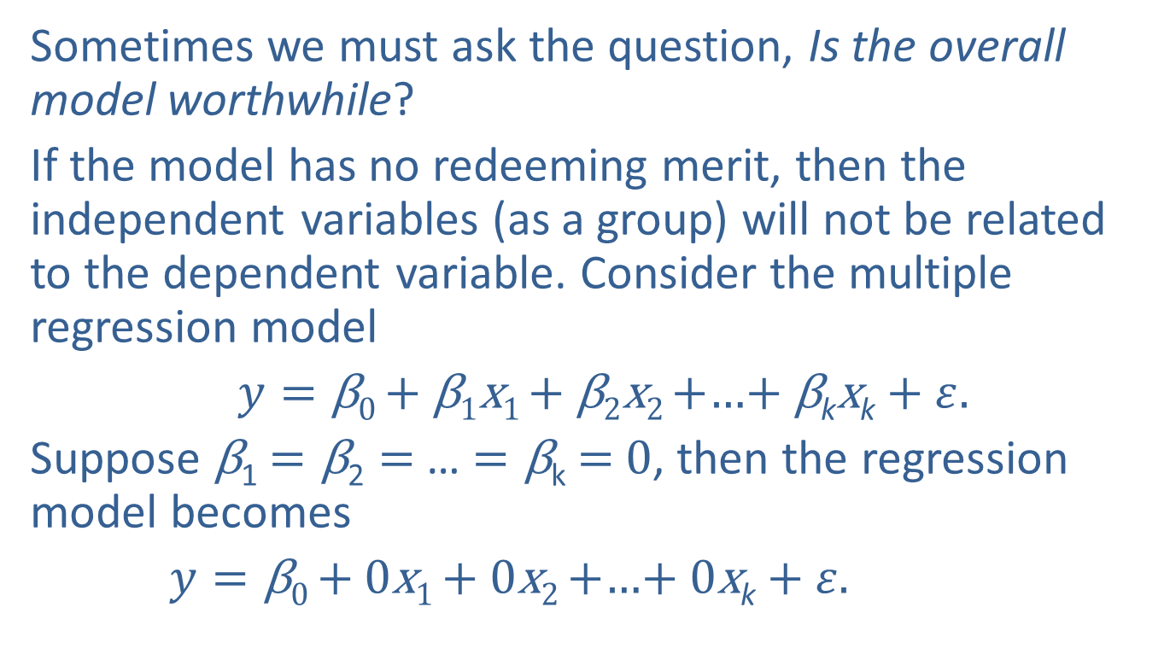
Inference Concerning the Multiple Regression Model and Its Coefficients
Sometimes we must ask the question, Is the overall model worthwhile?
If the model has no redeeming merit, then the independent variables (as a group) will not be related to the dependent variable. Consider the multiple regression model
$y=\text{β}\text{0 }\text{+}$ β₁x₁ + β₂x₂ +…$+$ β_{k}x_{k}$+ ε.$
Suppose β₁ $=\text{β}\text{2}=$… $=\text{β}\text{k}$ $=$0, then the regression model becomes
$y=\text{β}\text{0 }\text{+}$ 0x₁ + 0x₂ +…$+$ 0x_{k}$+ ε.$

Slide 3
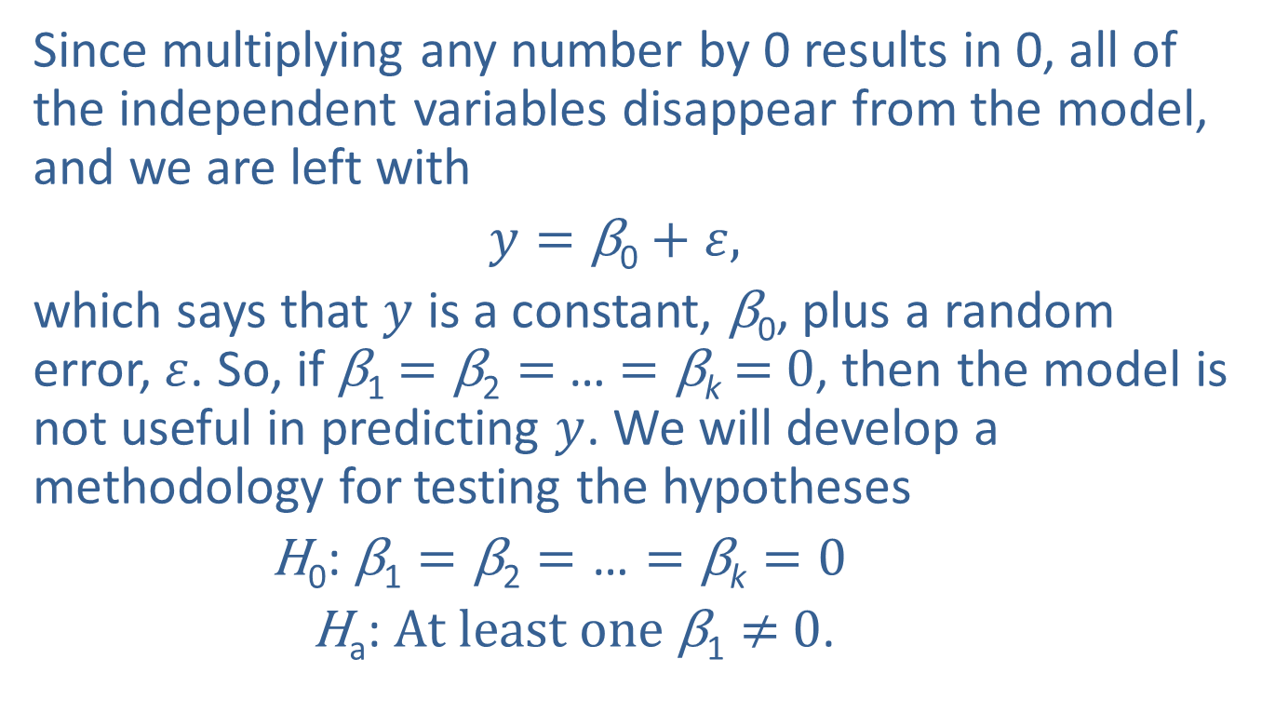
Inference Concerning the Multiple Regression Model and Its Coefficients (cont.)
Since multiplying any number by 0 results in 0, all of the independent variables disappear from the model, and we are left with
$y=\text{β}\text{0}+ε,$
which says that $y$ is a constant, $\text{β}\text{0}$, plus a random error,$ε$. So, if β₁ $=\text{β}\text{2}=$… $=\text{β}\text{k}$ $=$0, then the model is not useful in predicting $y$. We will develop a methodology for testing the hypotheses
$\text{H}\text{0}\text{: }\text{β}\text{1}=\text{β}\text{2}=\text{…}=\text{β}\text{k}=\text{0}$
$\text{H}\text{a}\text{:} At least one \text{β}\text{1}≠$ 0.

Slide 4
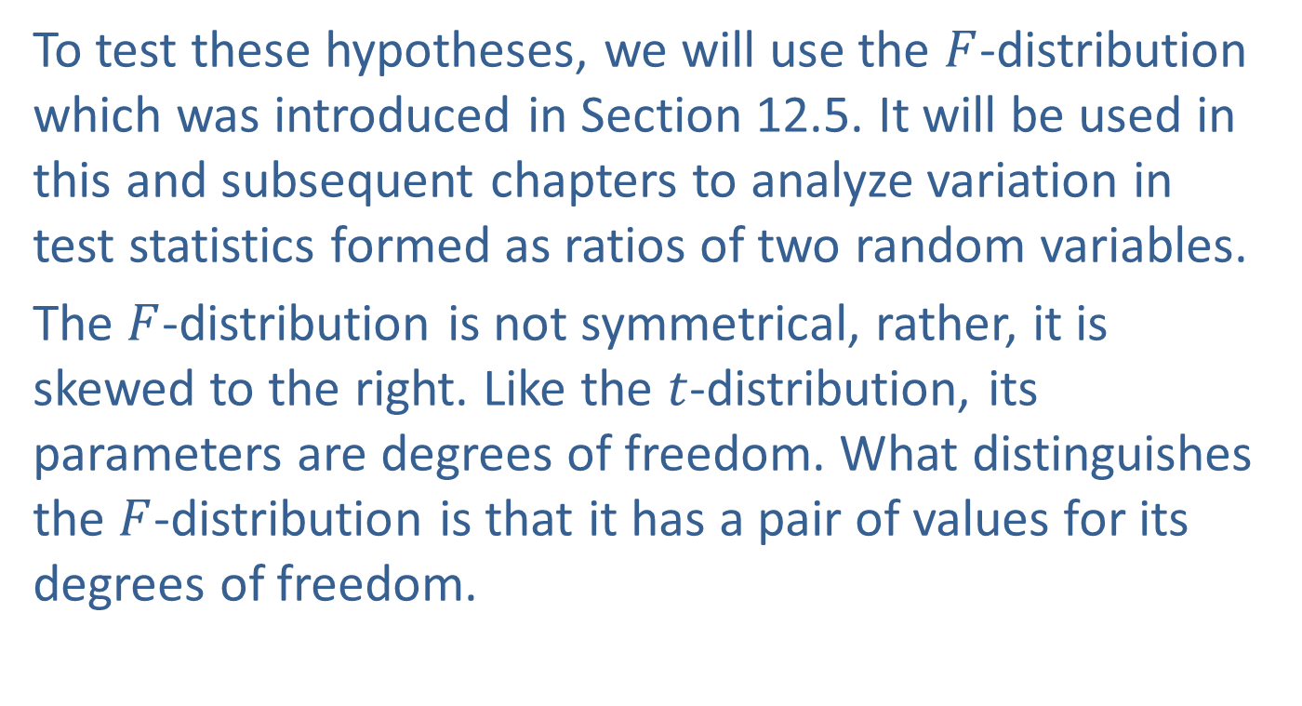
Inference Concerning the Multiple Regression Model and Its Coefficients (cont.)
To test these hypotheses, we will use the $F$-distribution which was introduced in Section 12.5. It will be used in this and subsequent chapters to analyze variation in test statistics formed as ratios of two random variables.
The $F$-distribution is not symmetrical, rather, it is skewed to the right. Like the $t$-distribution, its parameters are degrees of freedom. What distinguishes the $F$-distribution is that it has a pair of values for its degrees of freedom.

Slide 5
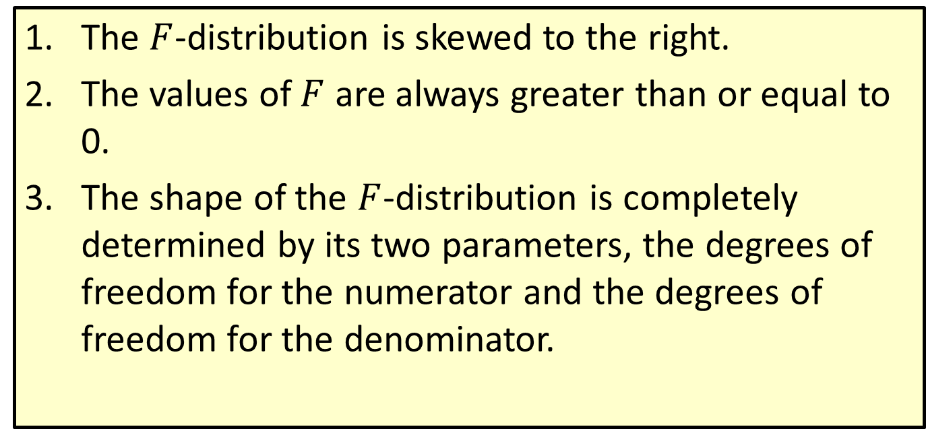

Properties: Properties of an $F$-Distribution
The $F$-distribution is skewed to the right.
The values of $F$ are always greater than or equal to 0.
The shape of the $F$-distribution is completely determined by its two parameters, the degrees of freedom for the numerator and the degrees of freedom for the denominator.

Slide 6
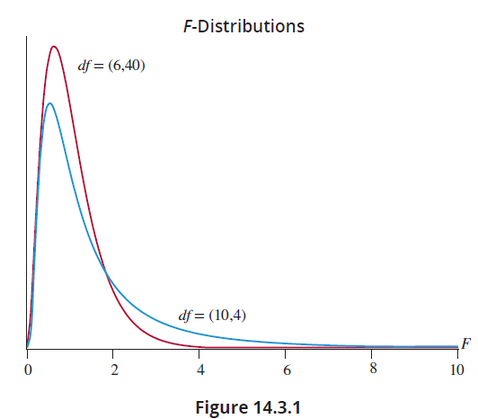

Inference Concerning the Multiple Regression Model and Its Coefficients (cont.)
The shape of the $F$-distribution is a function of its degrees of freedom. The following figure shows two examples of the $F$-distribution.

Slide 7
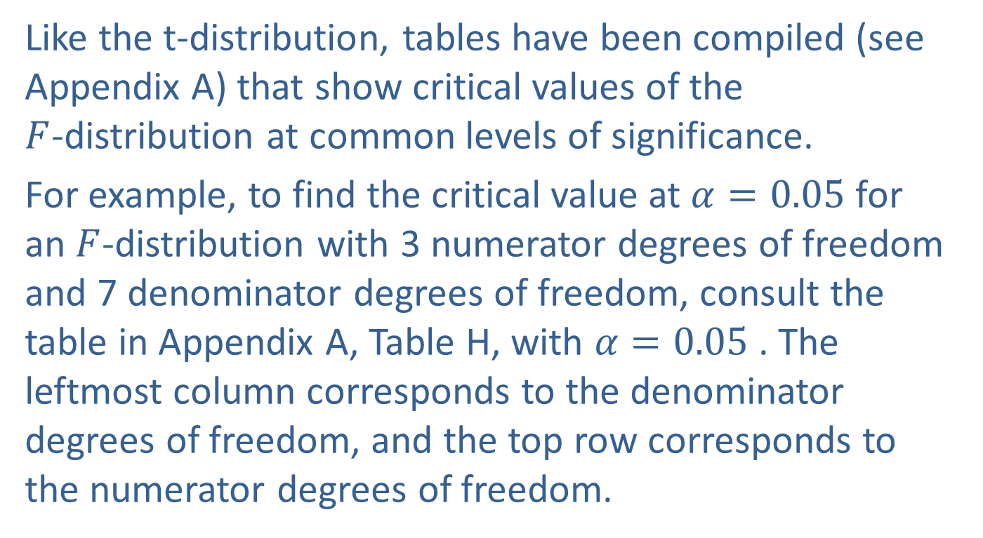
Inference Concerning the Multiple Regression Model and Its Coefficients (cont.)
Like the t-distribution, tables have been compiled (see Appendix A) that show critical values of the $F$-distribution at common levels of significance.
For example, to find the critical value at $α=0.05$ for an $F$-distribution with 3 numerator degrees of freedom and 7 denominator degrees of freedom, consult the table in Appendix A, Table H, with $α=0.05$ . The leftmost column corresponds to the denominator degrees of freedom, and the top row corresponds to the numerator degrees of freedom.

Slide 8
Inference Concerning the Multiple Regression Model and Its Coefficients (cont.)
 |  | Numerator Degrees of Freedom
 |  | 1 | 2 | 3 | 4
Denominator Degrees of Freedom | 1 | 161.4476 | 199.5000 | 215.7073 | 224.5832
 | 2 | 18.5128 | 19.0000 | 19.1643 | 19.2468
 | 3 | 10.1280 | 9.5521 | 9.2766 | 9.1172
 | 4 | 7.7086 | 6.9443 | 6.5914 | 6.3882
 | 5 | 6.6079 | 5.7861 | 5.4095 | 5.1922
 | 6 | 5.9874 | 5.1433 | 4.7571 | 4.5337
 | 7 | 5.5914 | 4.7374 | 4.3468 | 4.1203
 | 8 | 5.3177 | 4.4590 | 4.0662 | 3.8379

Slide 9
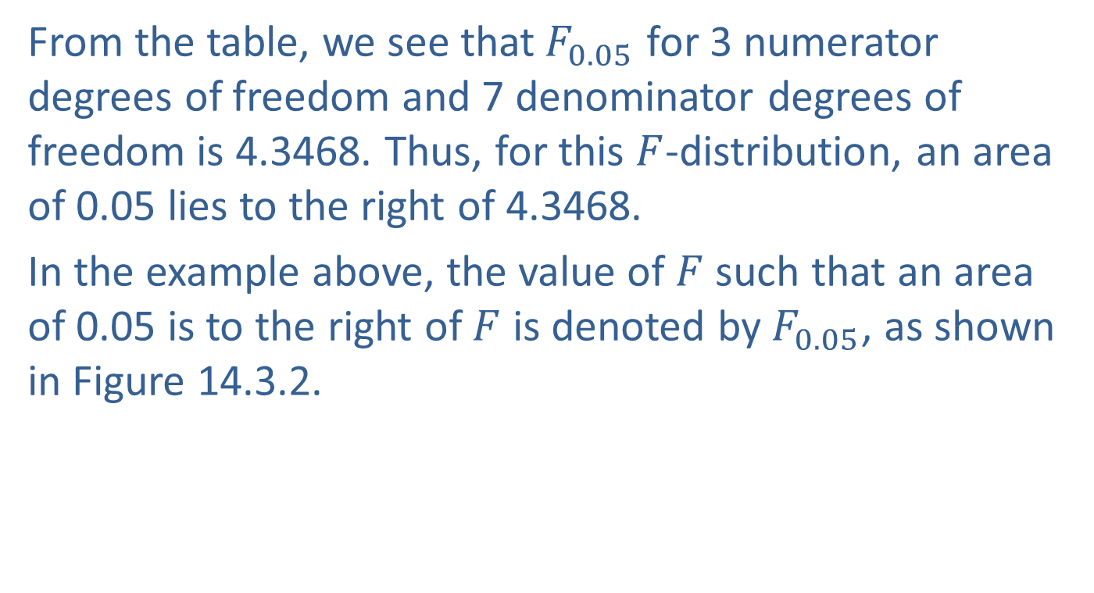
Inference Concerning the Multiple Regression Model and Its Coefficients (cont.)
From the table, we see that${ F}_{0.05}$ for 3 numerator degrees of freedom and 7 denominator degrees of freedom is 4.3468. Thus, for this $F$-distribution, an area of 0.05 lies to the right of 4.3468.
In the example above, the value of $F$ such that an area of 0.05 is to the right of $F$ is denoted by${ F}_{0.05}$, as shown in Figure 14.3.2.

Slide 10
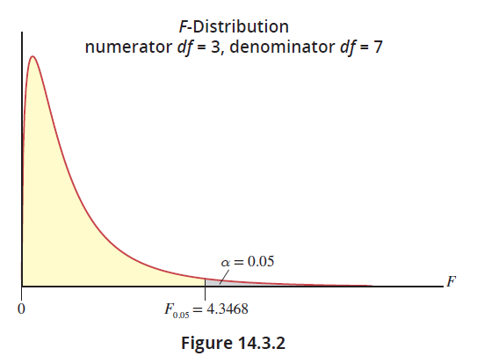
Inference Concerning the Multiple Regression Model and Its Coefficients (cont.)

Slide 11
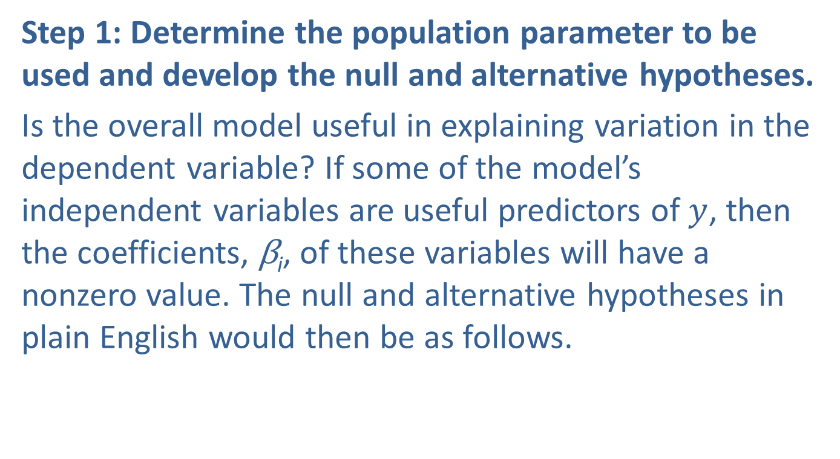
Steps in the Test of Hypothesis
Step 1: Determine the population parameter to be used and develop the null and alternative hypotheses.
Is the overall model useful in explaining variation in the dependent variable? If some of the model’s independent variables are useful predictors of $y$, then the coefficients, $\text{β}\text{i}$, of these variables will have a nonzero value. The null and alternative hypotheses in plain English would then be as follows.

Slide 12
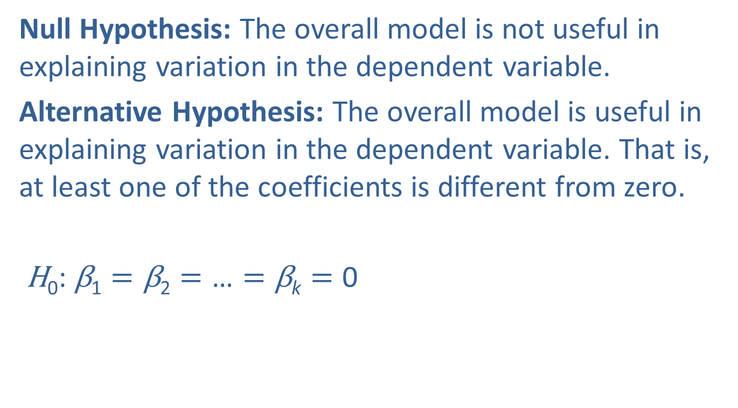
Steps in the Test of Hypothesis (cont.)
Null Hypothesis: The overall model is not useful in explaining variation in the dependent variable.
Alternative Hypothesis: The overall model is useful in explaining variation in the dependent variable. That is, at least one of the coefficients is different from zero.
$\text{H}\text{0}\text{: }\text{β}\text{1}=\text{β}\text{2}=\text{…}=\text{β}\text{k}=\text{0}$
Implies the overall model is not useful. Specifically, that the independent variables (as a group) are not useful predictors of the dependent variable.

Slide 13
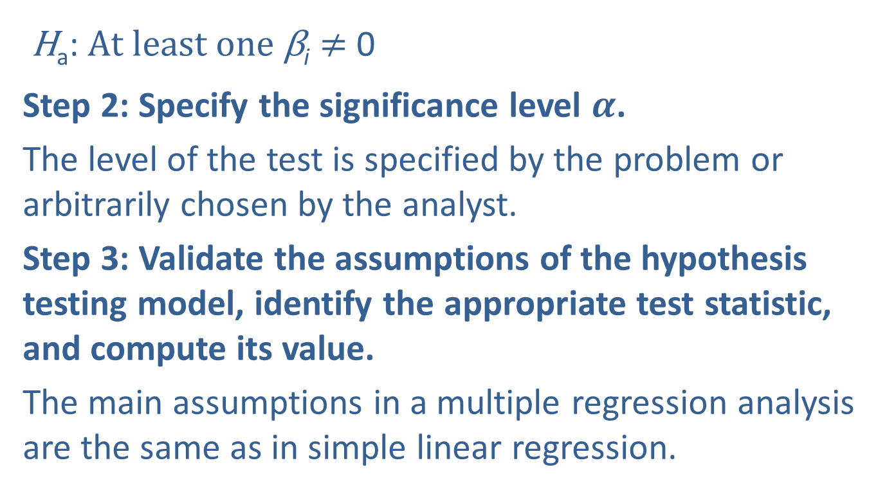
Steps in the Test of Hypothesis (cont.)
Implies at least one of the variables is a useful predictor.
$\text{H}\text{a}\text{:} At least one \text{β}\text{i}≠$ 0
Step 2: Specify the significance level $α$.
The level of the test is specified by the problem or arbitrarily chosen by the analyst.
Step 3: Validate the assumptions of the hypothesis testing model, identify the appropriate test statistic, and compute its value.
The main assumptions in a multiple regression analysis are the same as in simple linear regression.

Slide 14
Steps in the Test of Hypothesis (cont.)
The error terms are presumed to be normally distributed with a mean of 0 and a constant variance. Also, the errors are presumed to be independent of each other. The validity of these assumptions can be examined after performing a multiple regression by doing a residual analysis, which is beyond the scope of this book.
In all of the previous hypothesis tests, the test statistic involved the sample estimate of the corresponding population measure.

Slide 15
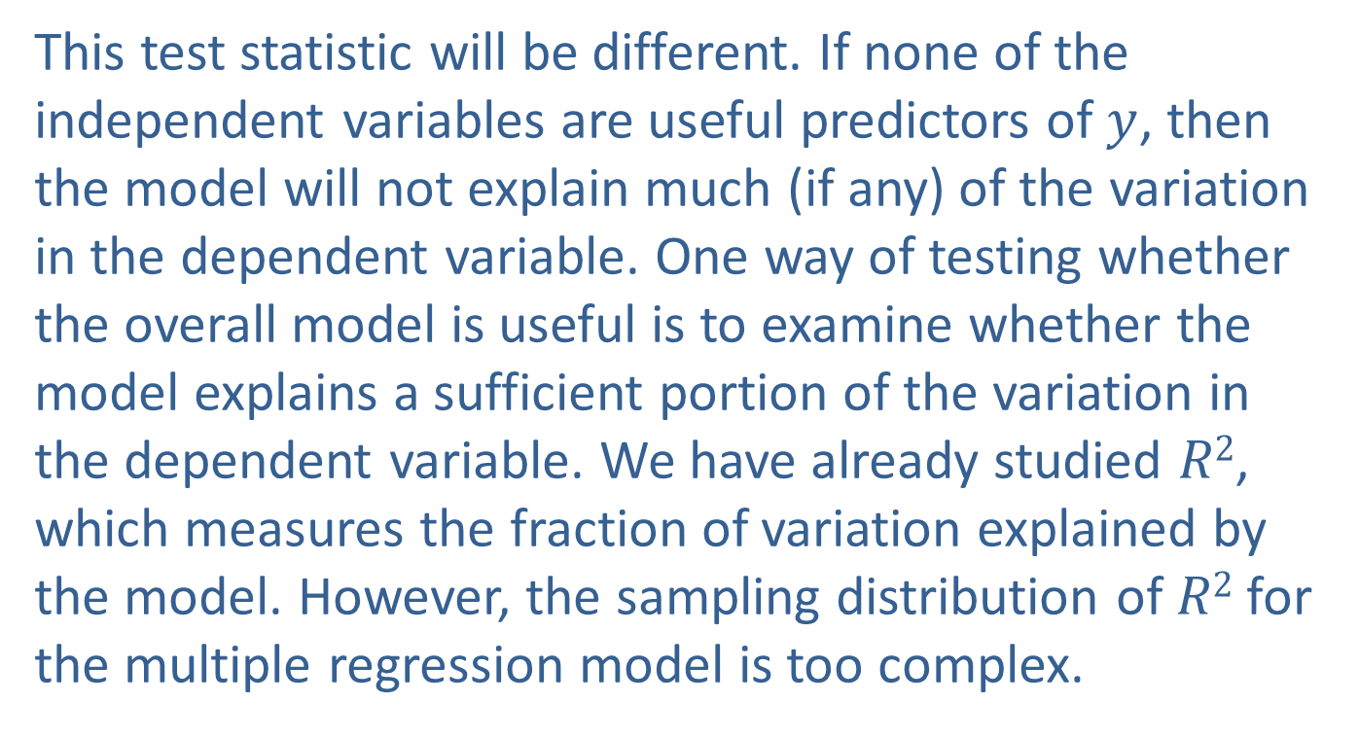
Steps in the Test of Hypothesis (cont.)
This test statistic will be different. If none of the independent variables are useful predictors of $y$, then the model will not explain much (if any) of the variation in the dependent variable. One way of testing whether the overall model is useful is to examine whether the model explains a sufficient portion of the variation in the dependent variable. We have already studied $R2$, which measures the fraction of variation explained by the model. However, the sampling distribution of $R2$ for the multiple regression model is too complex.

Slide 16
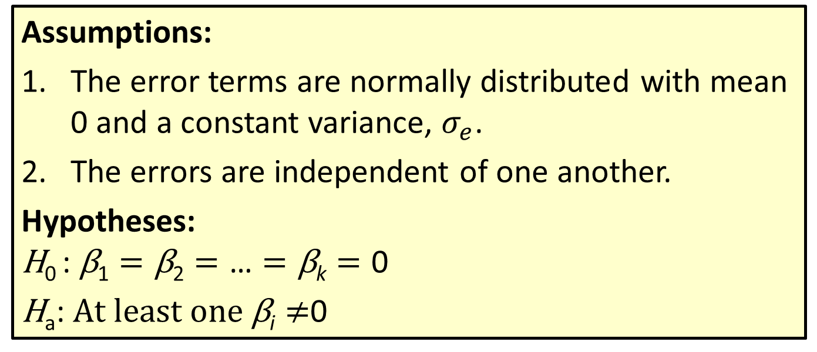
Procedure: Testing the Multiple Regression Model
Assumptions:
The error terms are normally distributed with mean 0 and a constant variance, $σ_{e}$.
The errors are independent of one another.
Hypotheses:
$$\text{H}\text{0 }\text{:} \text{β}\text{1}=\text{β}\text{2}=\text{…}=\text{β}\text{k}=\text{0}$$
$\text{H}\text{a}\text{:} At least one \text{β}\text{i}≠$0

Slide 17
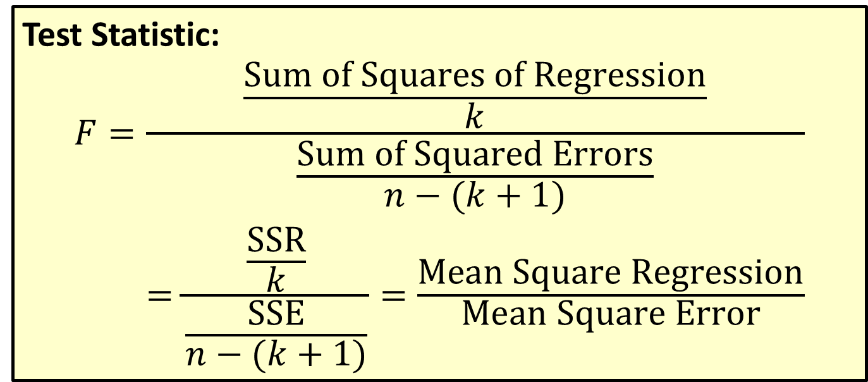
Procedure: Testing the Multiple Regression Model (cont.)
Test Statistic:
$$F=\frac{\frac{Sum of Squares of Regression}{k}}{\begin{aligned}\frac{Sum of Squared Errors}{n−(k+1)} \\ =\frac{\frac{SSR}{k}}{\frac{SSE}{n−(k+1)}}=\frac{Mean Square Regression}{Mean Square Error}\end{aligned}}$$

Slide 18
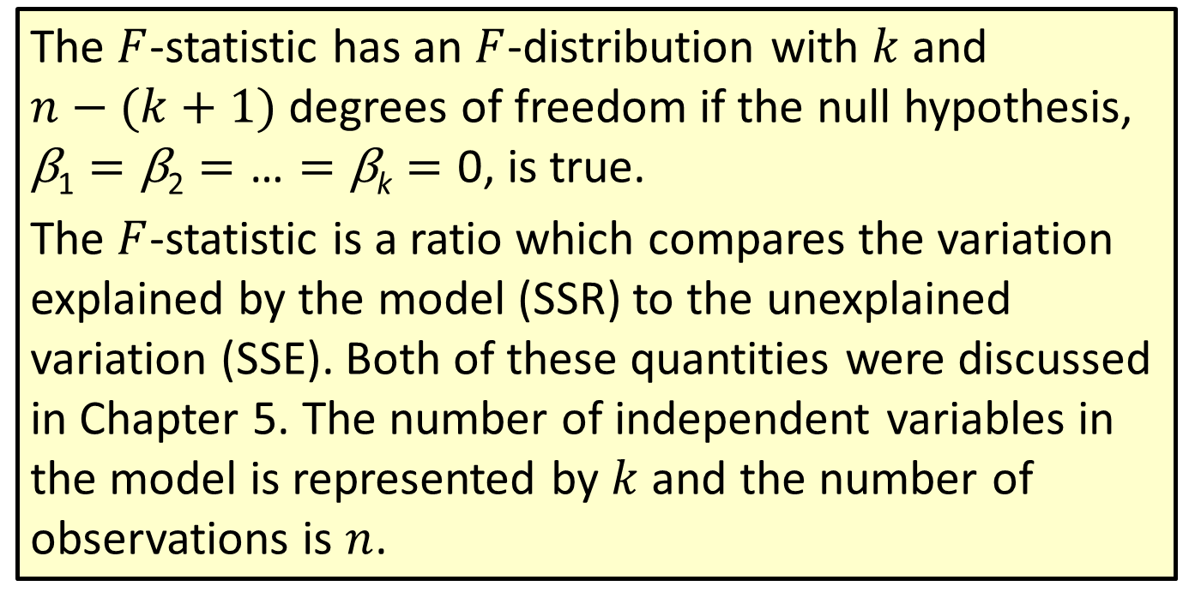
Procedure: Testing the Multiple Regression Model (cont.)
The $F$-statistic has an $F$-distribution with $k$ and $n−(k+1)$ degrees of freedom if the null hypothesis, $\text{β}\text{1}=\text{β}\text{2}=\text{…}=\text{β}\text{k}=\text{0}$, is true.
The $F$-statistic is a ratio which compares the variation explained by the model (SSR) to the unexplained variation (SSE). Both of these quantities were discussed in Chapter 5. The number of independent variables in the model is represented by $k$ and the number of observations is $n$.

Slide 19
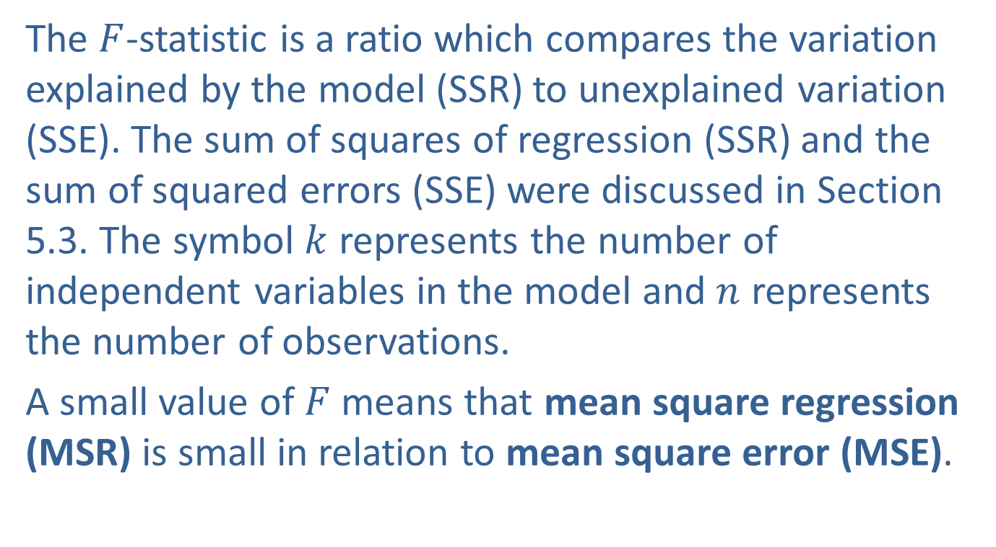
Steps in the Test of Hypothesis (cont.)
The $F$-statistic is a ratio which compares the variation explained by the model (SSR) to unexplained variation (SSE). The sum of squares of regression (SSR) and the sum of squared errors (SSE) were discussed in Section 5.3. The symbol $k$ represents the number of independent variables in the model and $n$ represents the number of observations.
A small value of $F$ means that mean square regression (MSR) is small in relation to mean square error (MSE).

Slide 20
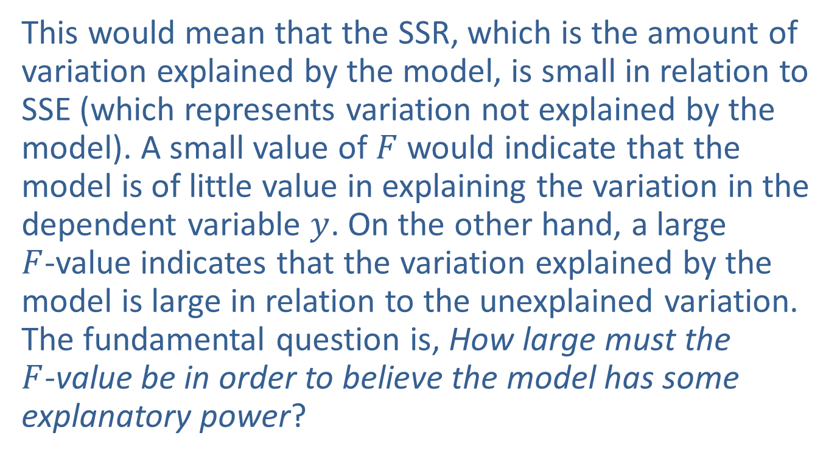
Steps in the Test of Hypothesis (cont.)
This would mean that the SSR, which is the amount of variation explained by the model, is small in relation to SSE (which represents variation not explained by the model). A small value of $F$ would indicate that the model is of little value in explaining the variation in the dependent variable $y$. On the other hand, a large $F$-value indicates that the variation explained by the model is large in relation to the unexplained variation. The fundamental question is, How large must the $F$-value be in order to believe the model has some explanatory power?

Slide 21
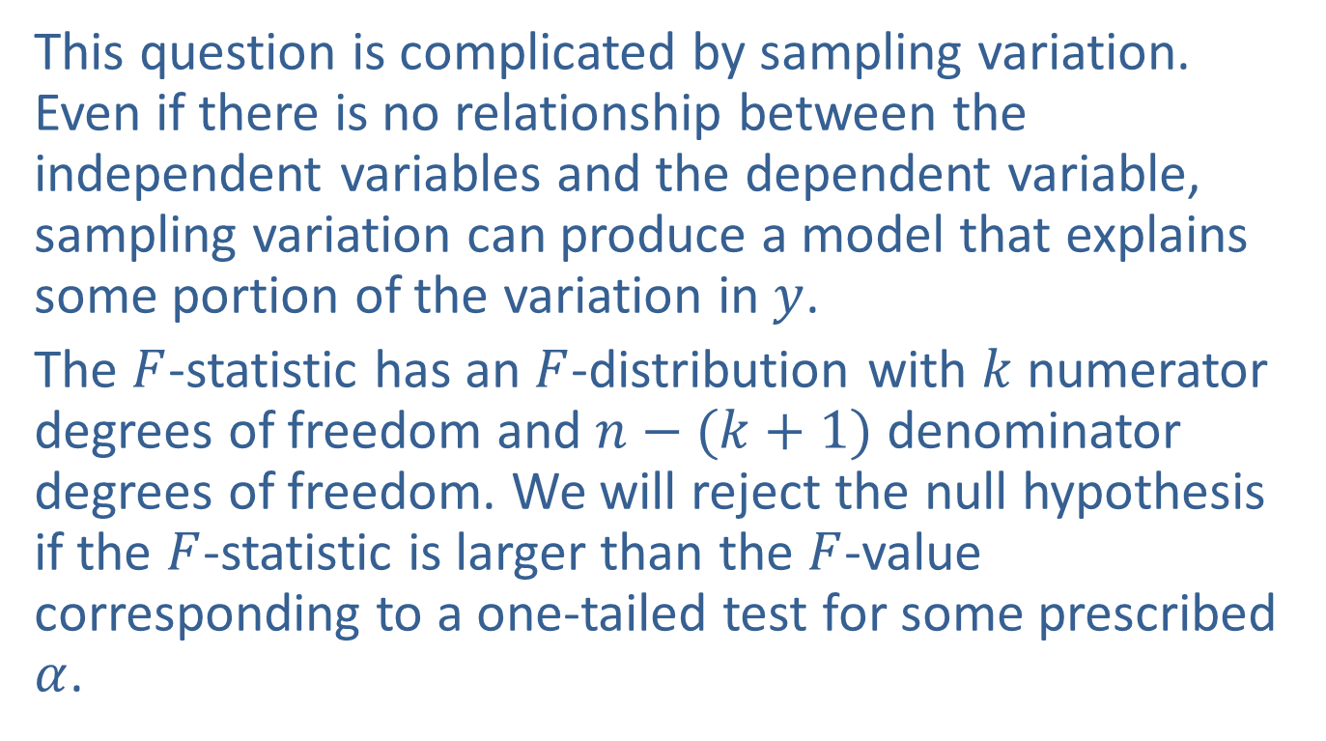
Steps in the Test of Hypothesis (cont.)
This question is complicated by sampling variation. Even if there is no relationship between the independent variables and the dependent variable, sampling variation can produce a model that explains some portion of the variation in $y$.
The $F$-statistic has an $F$-distribution with $k$ numerator degrees of freedom and $n−(k+1)$ denominator degrees of freedom. We will reject the null hypothesis if the $F$-statistic is larger than the $F$-value corresponding to a one-tailed test for some prescribed $α$.

Slide 22
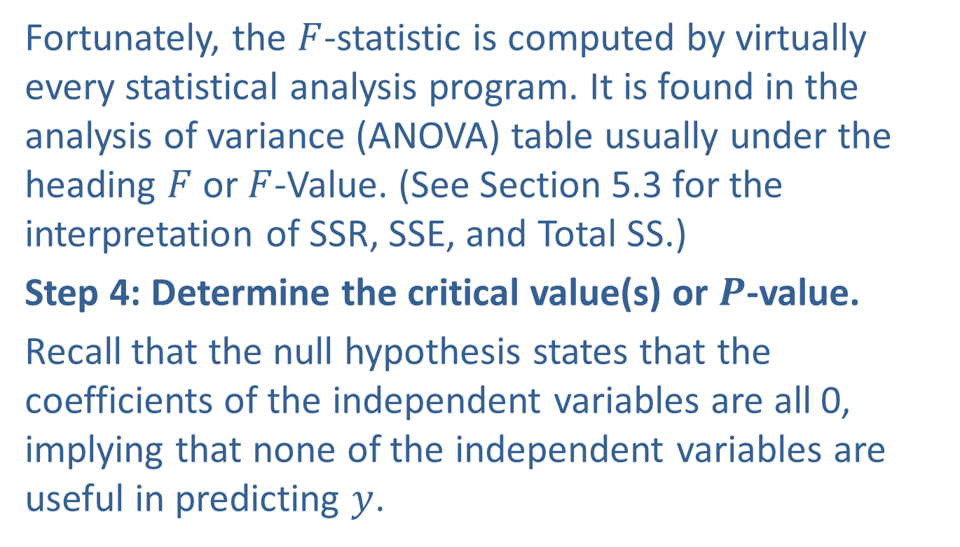
Steps in the Test of Hypothesis (cont.)
Fortunately, the $F$-statistic is computed by virtually every statistical analysis program. It is found in the analysis of variance (ANOVA) table usually under the heading $F$ or $F$-Value. (See Section 5.3 for the interpretation of SSR, SSE, and Total SS.)
Step 4: Determine the critical value(s) or $P$-value.
Recall that the null hypothesis states that the coefficients of the independent variables are all 0, implying that none of the independent variables are useful in predicting $y$.

Slide 23
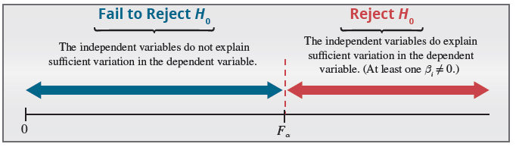
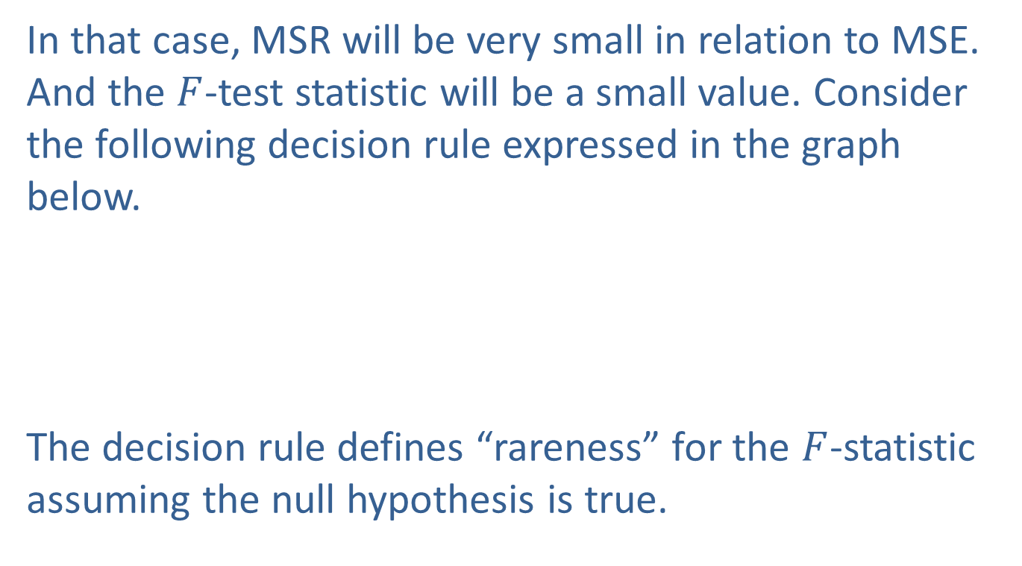
Steps in the Test of Hypothesis (cont.)
In that case, MSR will be very small in relation to MSE. And the $F$-test statistic will be a small value. Consider the following decision rule expressed in the graph below.
The decision rule defines “rareness” for the $F$-statistic assuming the null hypothesis is true.

Slide 24
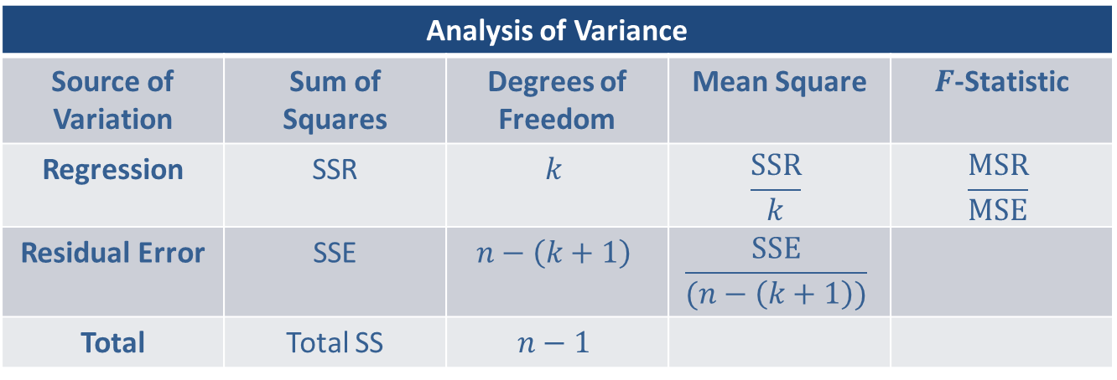

Steps in the Test of Hypothesis (cont.)
Essentially what the rule says is that $F$-values larger than $Fα$ would be too rare for us to believe that the null hypothesis is reasonable. When such a value occurs, the null hypothesis will be rejected in favor of the alternative.
Analysis of Variance
Source of Variation | Sum of Squares | Degrees of Freedom | Mean Square | $F$-Statistic
Regression | SSR | $$k$$ | $$\frac{SSR}{k}$$ | $$\frac{MSR}{MSE}$$
Residual Error | SSE | $$n−\left(k+1\right)$$ | $$\frac{SSE}{(n−\left(k+1\right))}$$
Total | Total SS | $$n−1$$

Slide 25
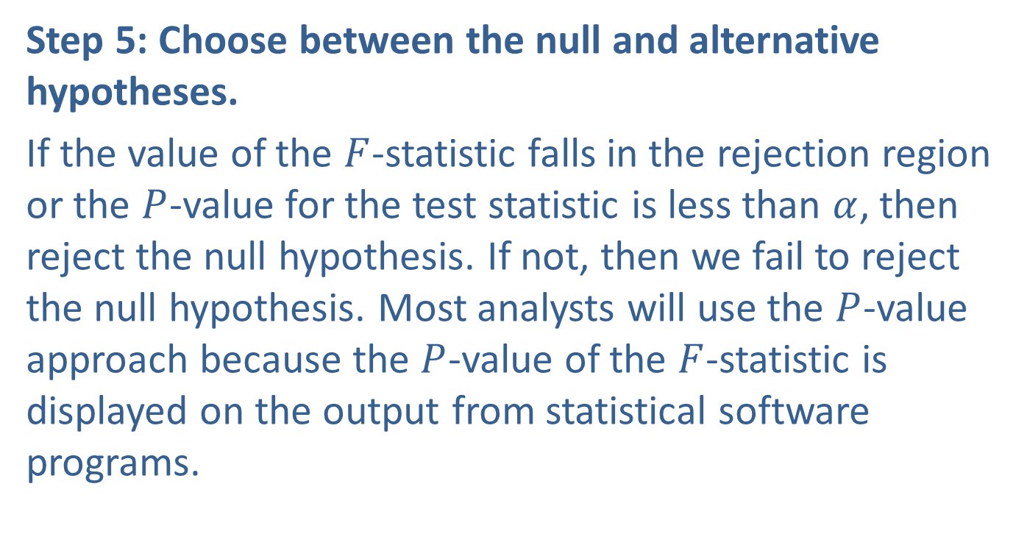
Steps in the Test of Hypothesis (cont.)
Step 5: Choose between the null and alternative hypotheses.
If the value of the $F$-statistic falls in the rejection region or the $P$-value for the test statistic is less than $α$, then reject the null hypothesis. If not, then we fail to reject the null hypothesis. Most analysts will use the $P$-value approach because the $P$-value of the $F$-statistic is displayed on the output from statistical software programs.

Slide 26
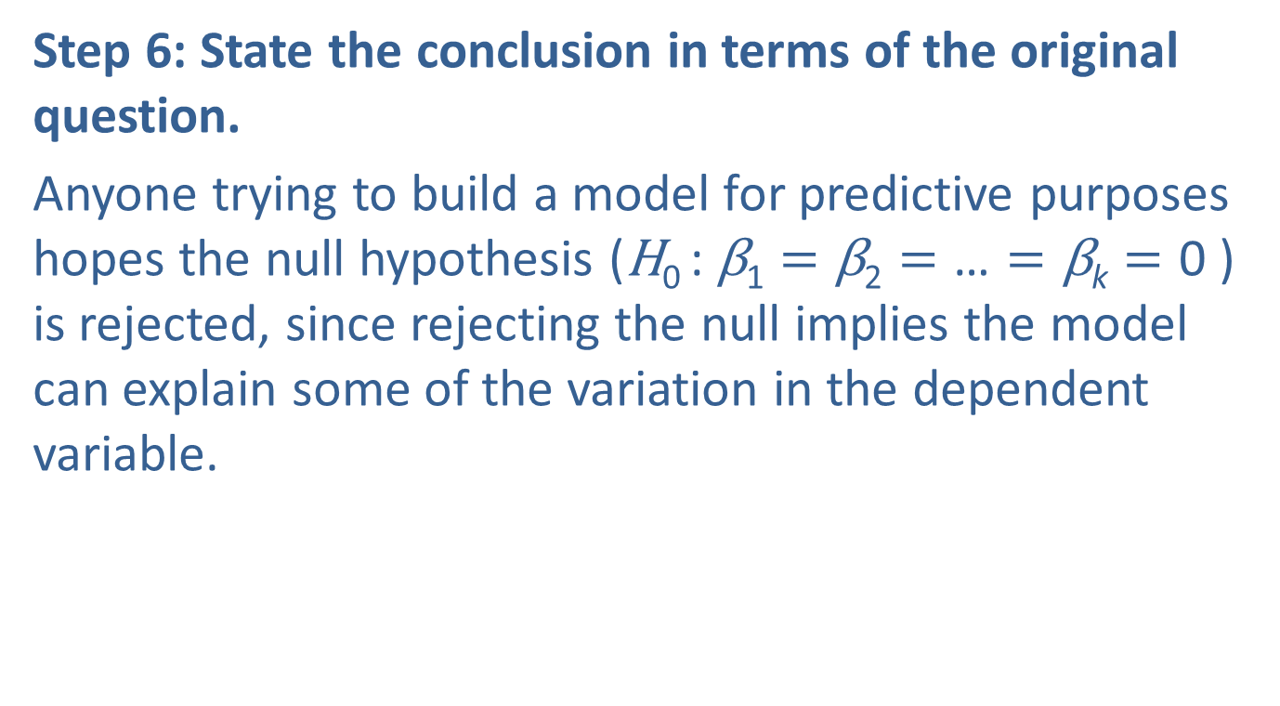
Steps in the Test of Hypothesis (cont.)
Step 6: State the conclusion in terms of the original question.
Anyone trying to build a model for predictive purposes hopes the null hypothesis ($\text{H}\text{0 }\text{: }\text{β}\text{1}=\text{β}\text{2}=\text{…}=\text{β}\text{k}=\text{0}$ ) is rejected, since rejecting the null implies the model can explain some of the variation in the dependent variable.

Slide 27
Example 14.3.1: Determining Model Significance
For the Mount Pleasant Real Estate data in Table 14.1.1, determine if there is sufficient evidence at the 0.05 significance level that the overall model is useful in explaining the variation in home prices.
Solution
Step 1: Determine the population parameter to be used and develop the null and alternative hypotheses.
Is the overall model useful in explaining the variation in home prices?

Slide 28
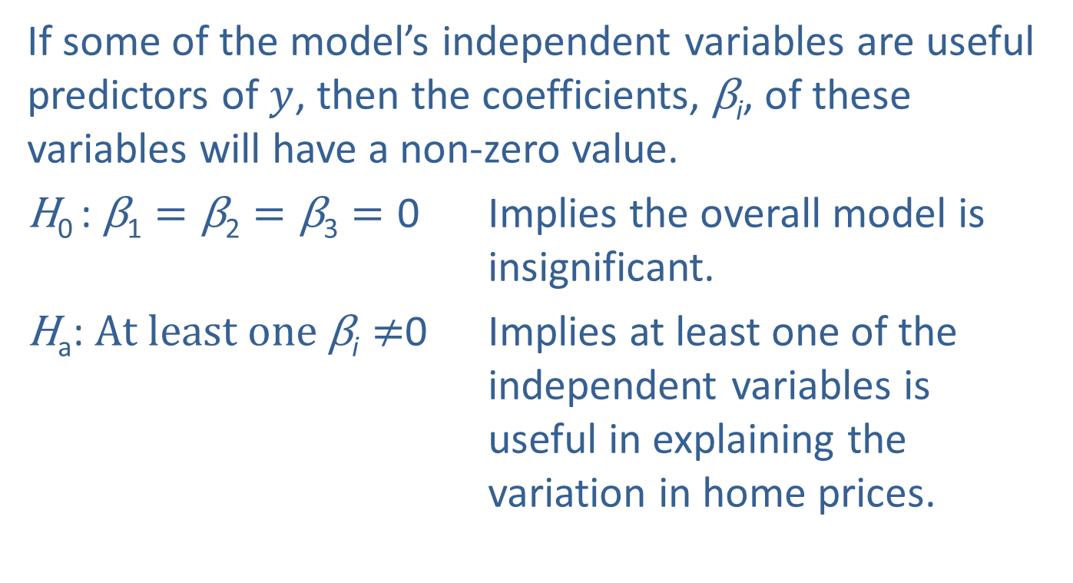
Example 14.3.1: Determining Model Significance (cont.)
If some of the model’s independent variables are useful predictors of $y$, then the coefficients, $\text{β}\text{i}$, of these variables will have a non-zero value.
$\text{H}\text{0 }\text{:} \text{β}\text{1}=\text{β}\text{2}=\text{β}\text{3}=\text{0}$ Implies the overall model is insignificant.
$\text{H}\text{a}\text{:} At least one \text{β}\text{i}≠$0 Implies at least one of the independent variables is useful in explaining the variation in home prices.

Slide 29
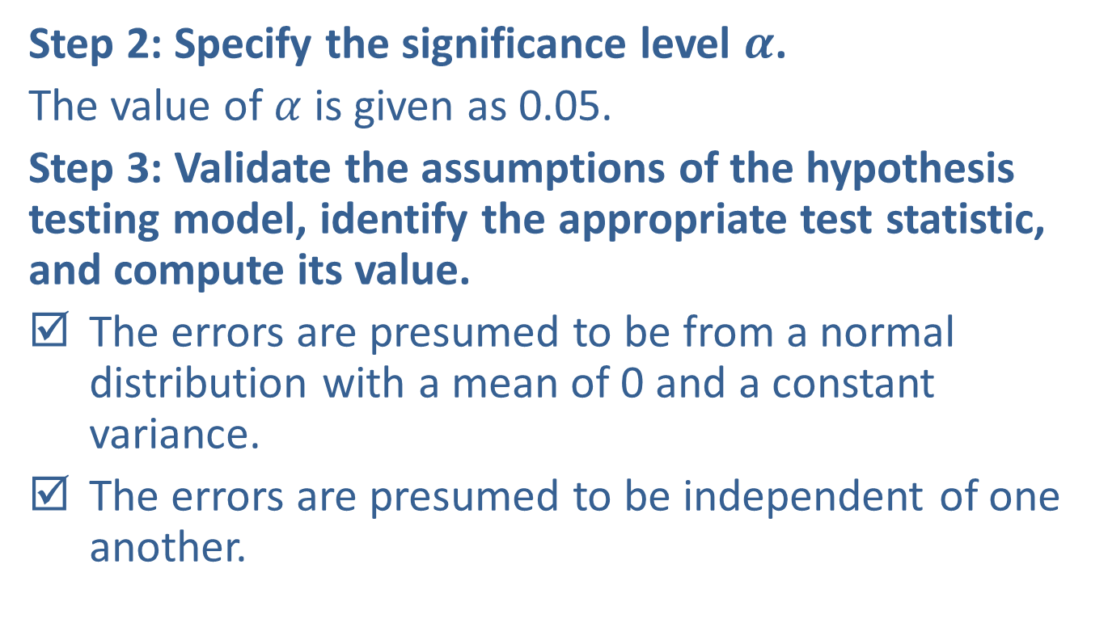
Example 14.3.1: Determining Model Significance (cont.)
Step 2: Specify the significance level $α$.
The value of $α$ is given as 0.05.
Step 3: Validate the assumptions of the hypothesis testing model, identify the appropriate test statistic, and compute its value.
The errors are presumed to be from a normal distribution with a mean of 0 and a constant variance.
The errors are presumed to be independent of one another.

Slide 30
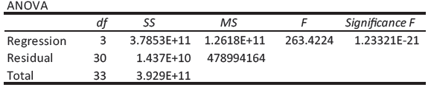
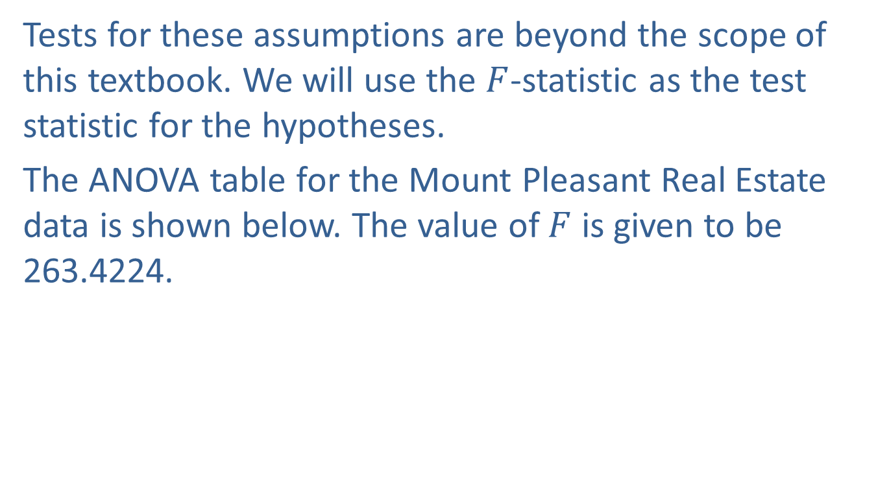
Example 14.3.1: Determining Model Significance (cont.)
Tests for these assumptions are beyond the scope of this textbook. We will use the $F$-statistic as the test statistic for the hypotheses.
The ANOVA table for the Mount Pleasant Real Estate data is shown below. The value of $F$ is given to be 263.4224.

Slide 31
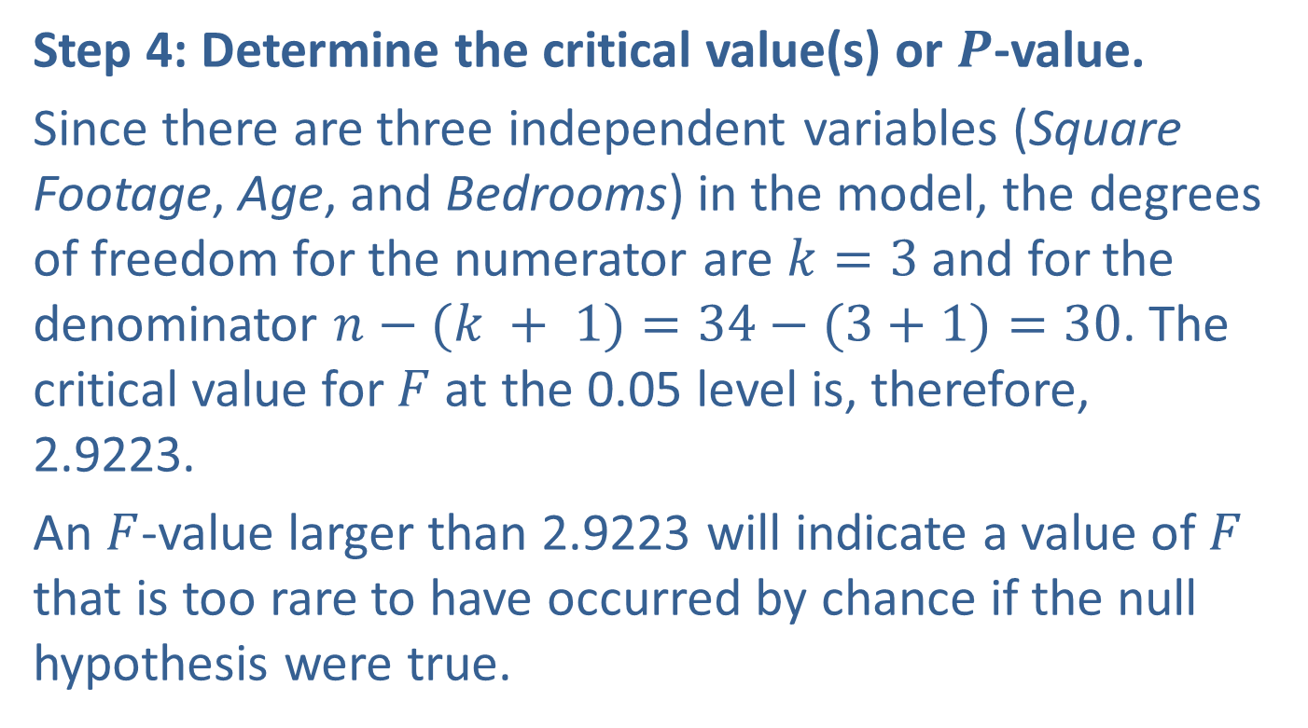
Example 14.3.1: Determining Model Significance (cont.)
Step 4: Determine the critical value(s) or $P$-value.
Since there are three independent variables (Square Footage, Age, and Bedrooms) in the model, the degrees of freedom for the numerator are $k=3$ and for the denominator $n−(k + 1)=34−(3+1)=30$. The critical value for $F$ at the 0.05 level is, therefore, 2.9223.
An $F$-value larger than 2.9223 will indicate a value of $F$ that is too rare to have occurred by chance if the null hypothesis were true.

Slide 32
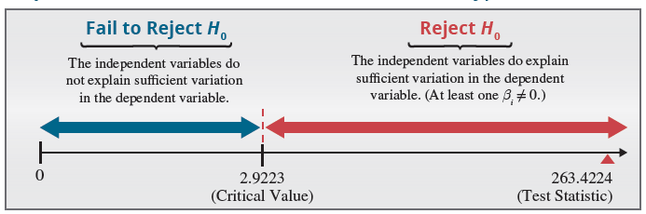
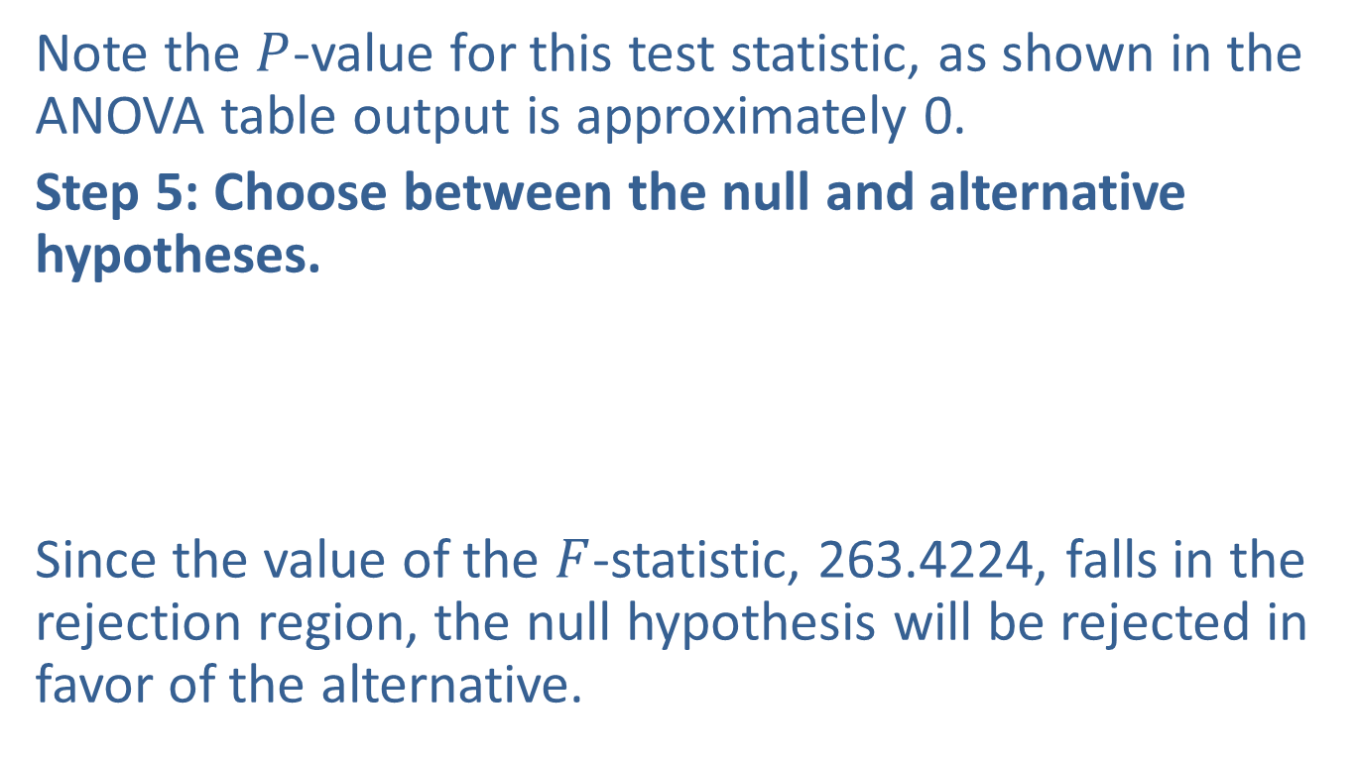
Example 14.3.1: Determining Model Significance (cont.)
Note the $P$-value for this test statistic, as shown in the ANOVA table output is approximately 0.
Step 5: Choose between the null and alternative hypotheses.
Since the value of the $F$-statistic, 263.4224, falls in the rejection region, the null hypothesis will be rejected in favor of the alternative.

Slide 33
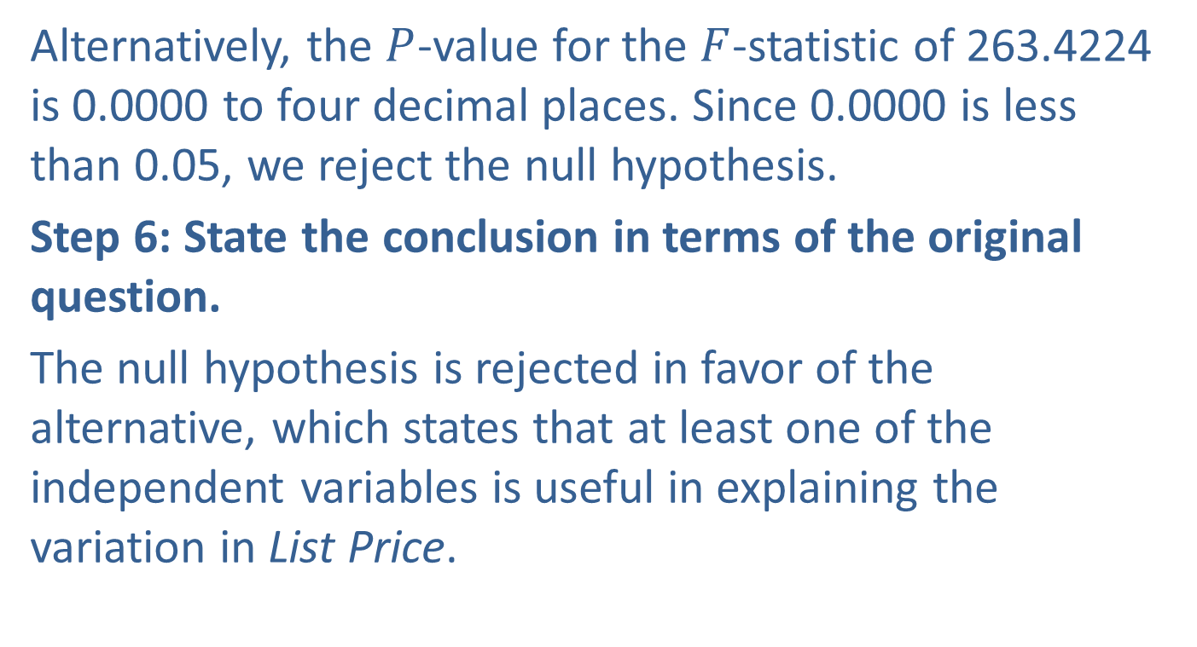
Example 14.3.1: Determining Model Significance (cont.)
Alternatively, the $P$-value for the $F$-statistic of 263.4224 is 0.0000 to four decimal places. Since 0.0000 is less than 0.05, we reject the null hypothesis.
Step 6: State the conclusion in terms of the original question.
The null hypothesis is rejected in favor of the alternative, which states that at least one of the independent variables is useful in explaining the variation in List Price.

Slide 34

Confidence Intervals for Individual Coefficients
Confidence intervals for individual $\text{β}\text{i}$ in a multiple regression model are almost identical to the confidence interval for $\text{β}\text{1}$ in the simple regression model found in Section 13.2.

Slide 35
Definition: 100(1 − 𝛼)% Confidence Interval for Each Coefficient
The 100(1 − α)% confidence interval for each coefficient, β_{i}, in a multiple regression model is given by

Slide 36
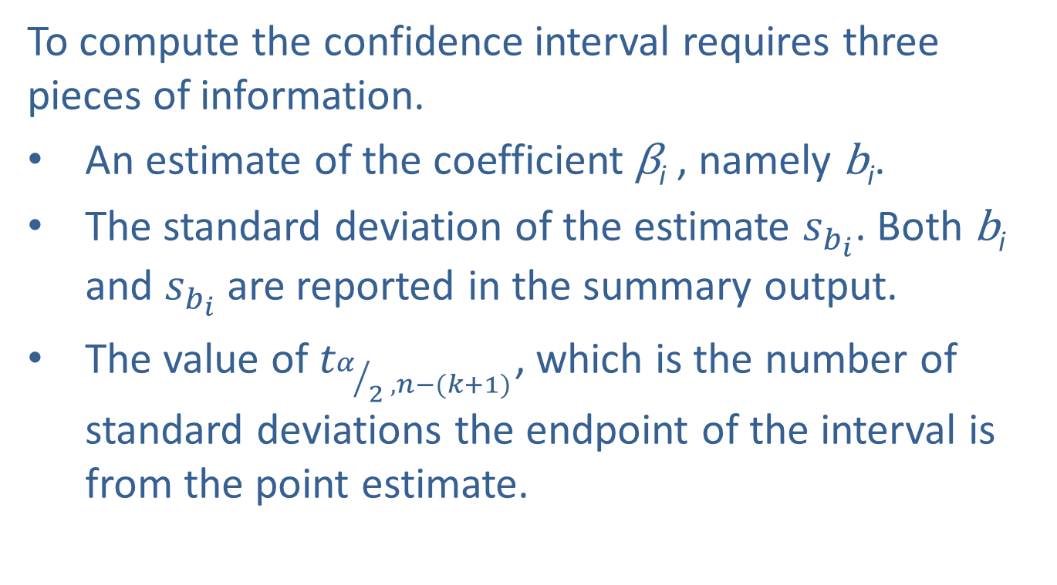
Confidence Intervals for Individual Coefficients (cont.)
To compute the confidence interval requires three pieces of information.
An estimate of the coefficient $\text{β}\text{i}$ , namely $\text{b}\text{i}$.
The standard deviation of the estimate $s_{b_{i}}$. Both $\text{b}\text{i}$ and $s_{b_{i}}$ are reported in the summary output.
The value of $t_{α/{2 ^{,n−(k+1)}}}$, which is the number of standard deviations the endpoint of the interval is from the point estimate.

Slide 37

Confidence Intervals for Individual Coefficients (cont.)
(The degrees of freedom of this $t$ is $n−(k+1)$, which is the same as the degrees of freedom associated with the error terms in the ANOVA table.)

Slide 38
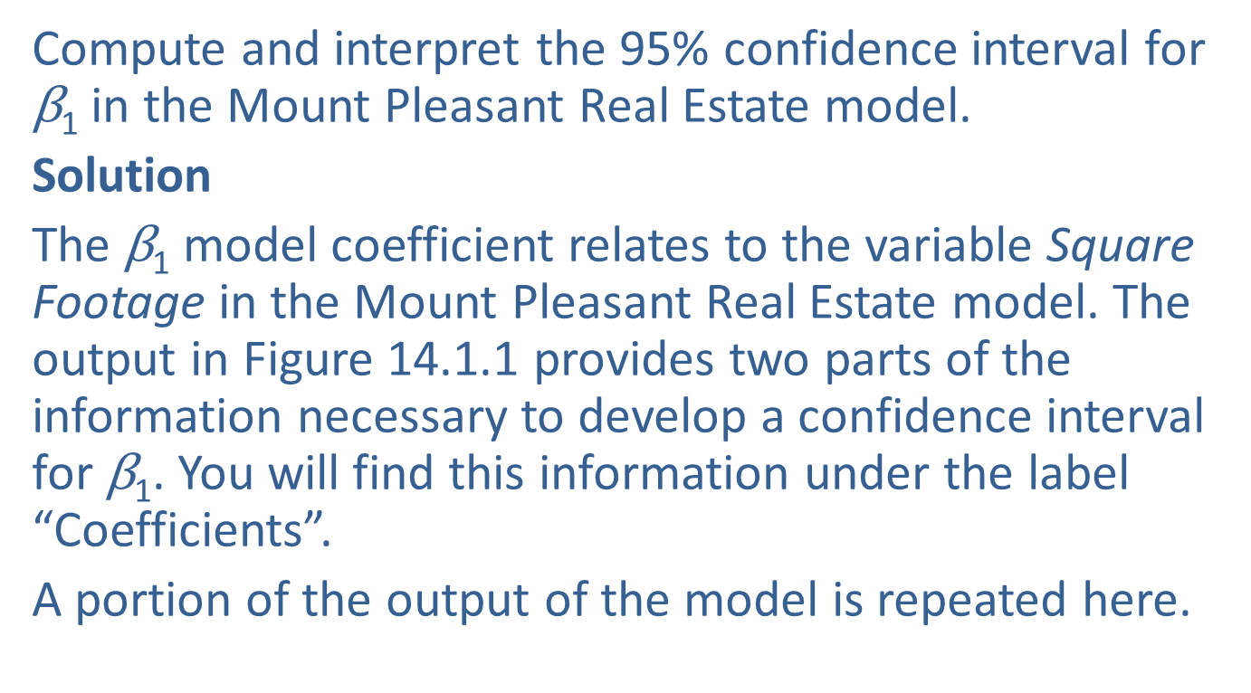
Example 14.3.2: Determining a Confidence Interval for a Model Coefficient
Compute and interpret the 95% confidence interval for $\text{β}\text{1}$ in the Mount Pleasant Real Estate model.
Solution
The $\text{β}\text{1}$ model coefficient relates to the variable Square Footage in the Mount Pleasant Real Estate model. The output in Figure 14.1.1 provides two parts of the information necessary to develop a confidence interval for $\text{β}\text{1}$. You will find this information under the label “Coefficients”.
A portion of the output of the model is repeated here.

Slide 39
Example 14.3.2: Determining a Confidence Interval for a Model Coefficient (cont.)
 | Coefficients | Standard Error | t Stat
Intercept | 163579.0641 | 21007.627 | 7.7866512
Square Footage | 108.2432396 | 9.27888589 | 11.6655427
Age | -6318.474786 | 765.288909 | -8.2563261
Bedrooms | 1284.921167 | 7357.66135 | 0.17463717
 | P-value | Lower 95% | Upper 95% | Lower 95.0%
Intercept | 1.09E-08 | 120675.7661 | 206482.3621 | 120675.7661
Square Footage | 1.13E-12 | 89.29322647 | 127.1932526 | 89.29322647
Age | 3.24E-09 | -7881.403246 | -4755.546326 | -7881.403246
Bedrooms | 0.862538 | -13741.42795 | 16311.27029 | -13741.42795

Slide 40
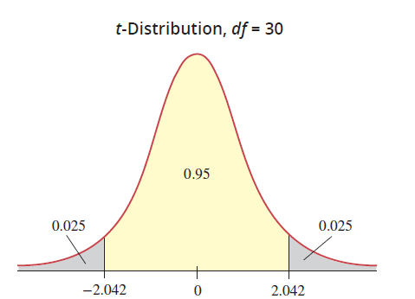

Example 14.3.2: Determining a Confidence Interval for a Model Coefficient (cont.)
$\text{b}\text{1}$ is given in the output to be 108.24.
$s_{b_{1}}$ is given in the output to be 9.28.

Slide 41
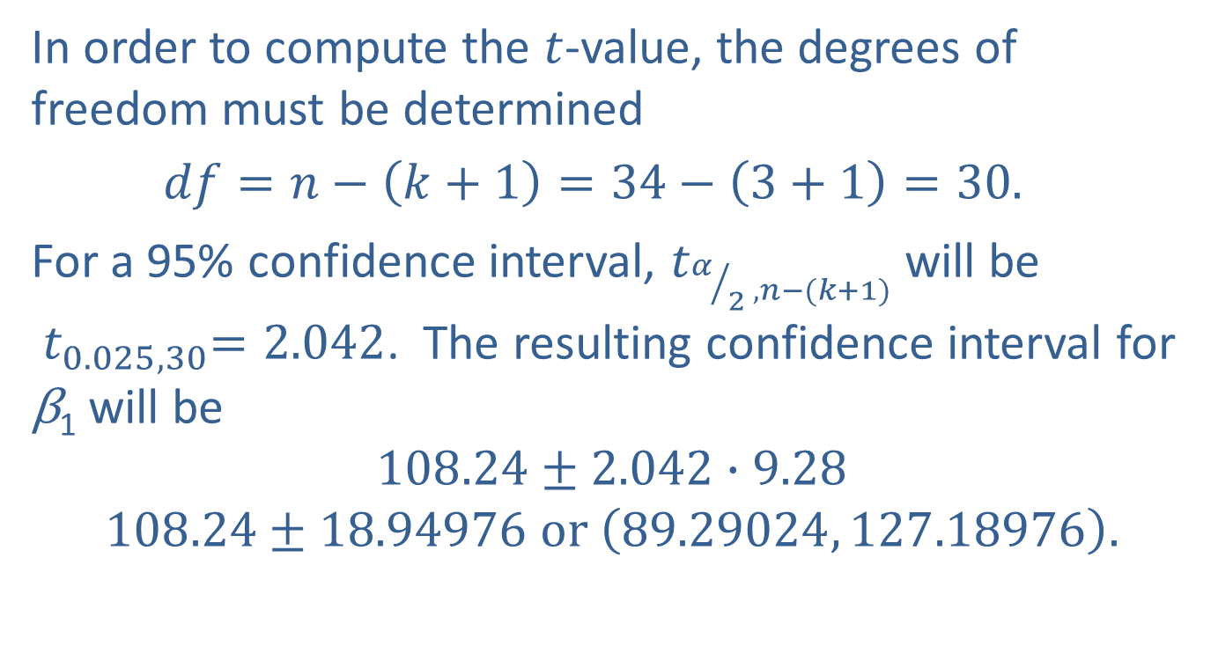
Example 14.3.2: Determining a Confidence Interval for a Model Coefficient (cont.)
In order to compute the $t$-value, the degrees of freedom must be determined
$df=n−\left(k+1\right)=34−\left(3+1\right)=30.$
For a 95% confidence interval, $t_{α/{2 ^{,n−(k+1)}}}$will be ${ t}_{0.025,30}=2.042$. The resulting confidence interval for $\text{β}\text{1}$ will be
$$108.24±2.042∙9.28$$
$$108.24±18.94976 or \left(89.29024, 127.18976\right).$$

Slide 42

Example 14.3.2: Determining a Confidence Interval for a Model Coefficient (cont.)
We are 95% confident that the true value of $\text{β}\text{1}$, the increase in the price of a house per square foot given a particular number of bedrooms and age, will be between $89.29 and $127.19.

Slide 43
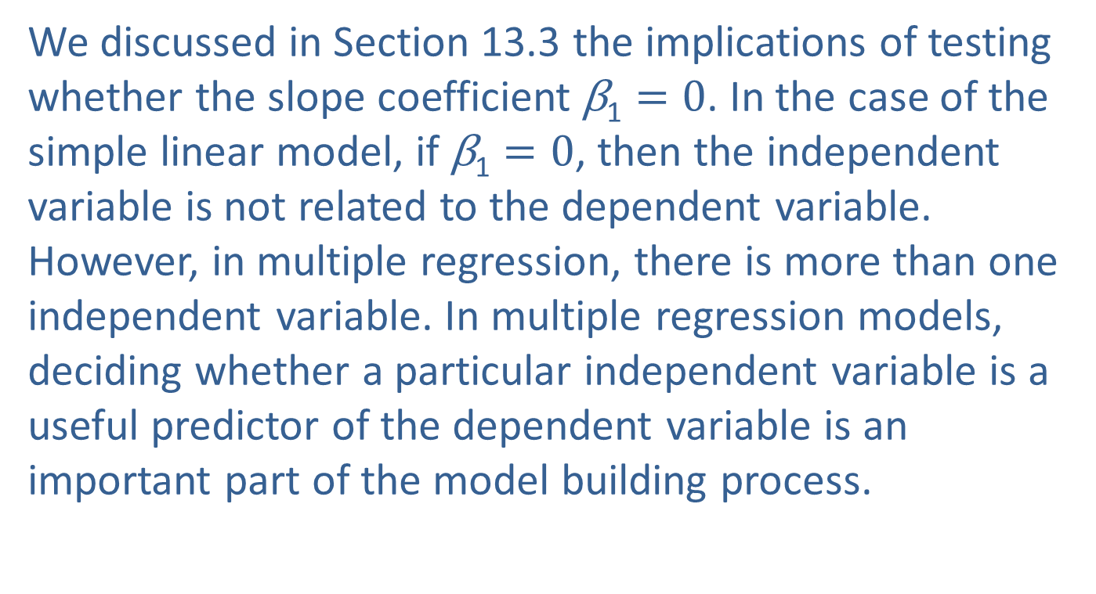

Testing Hypotheses on Individual $\text{β}\text{i}$
We discussed in Section 13.3 the implications of testing whether the slope coefficient $\text{β}\text{1}=0$. In the case of the simple linear model, if $\text{β}\text{1}=0$, then the independent variable is not related to the dependent variable. However, in multiple regression, there is more than one independent variable. In multiple regression models, deciding whether a particular independent variable is a useful predictor of the dependent variable is an important part of the model building process.

Slide 44
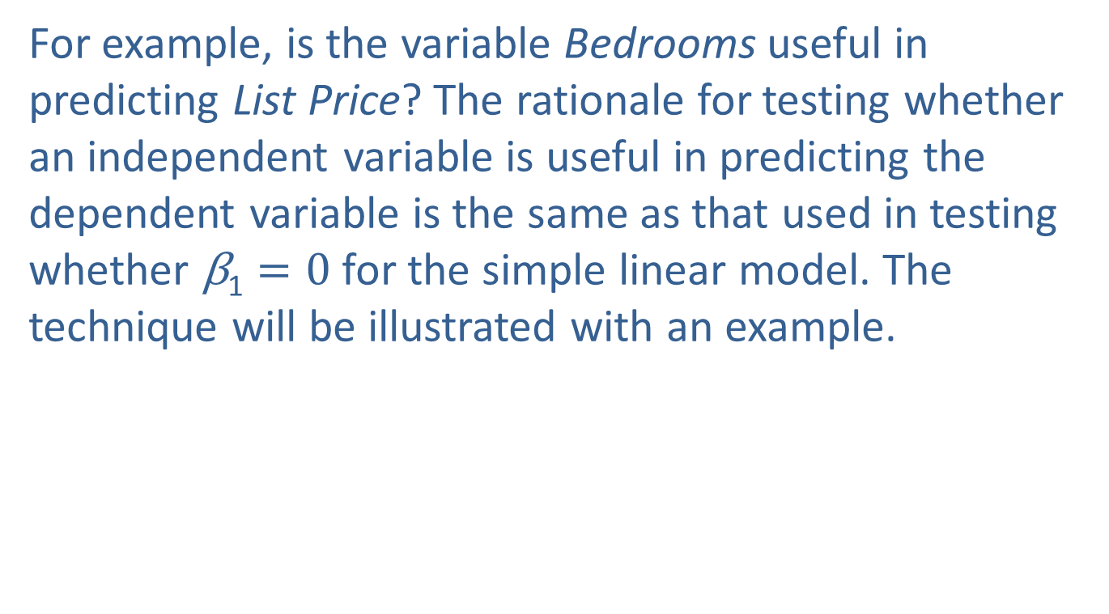

Testing Hypotheses on Individual $\text{β}\text{i}$ (cont.)
For example, is the variable Bedrooms useful in predicting List Price? The rationale for testing whether an independent variable is useful in predicting the dependent variable is the same as that used in testing whether $\text{β}\text{1}=0$for the simple linear model. The technique will be illustrated with an example.

Slide 45
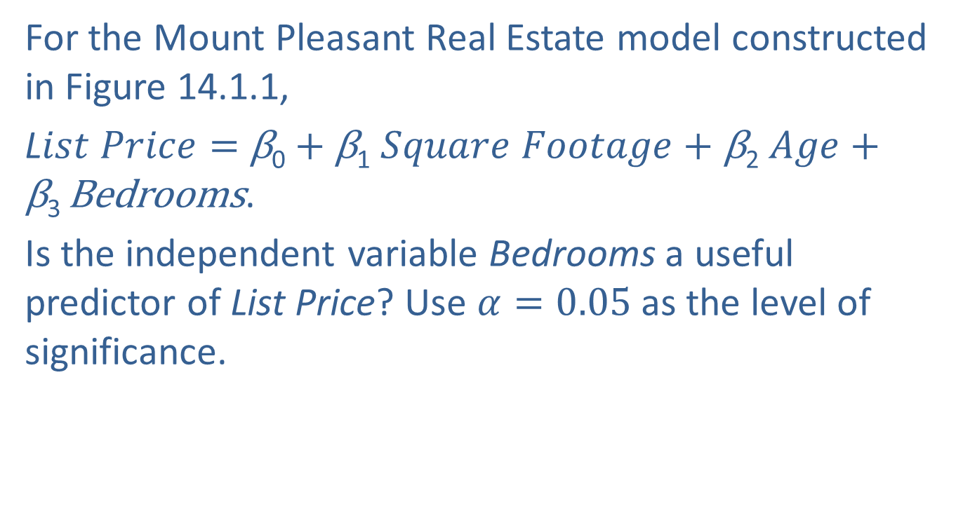
Example 14.3.3: Determining the Significance of a Model Coefficient
For the Mount Pleasant Real Estate model constructed in Figure 14.1.1,
L$ist Price=$ β₀ $+$ β₁ $Square Footage+\text{β}\text{2}$ $Age+\text{β}\text{3 }$Bedrooms.
Is the independent variable Bedrooms a useful predictor of List Price? Use $α=0.05$as the level of significance.

Slide 46
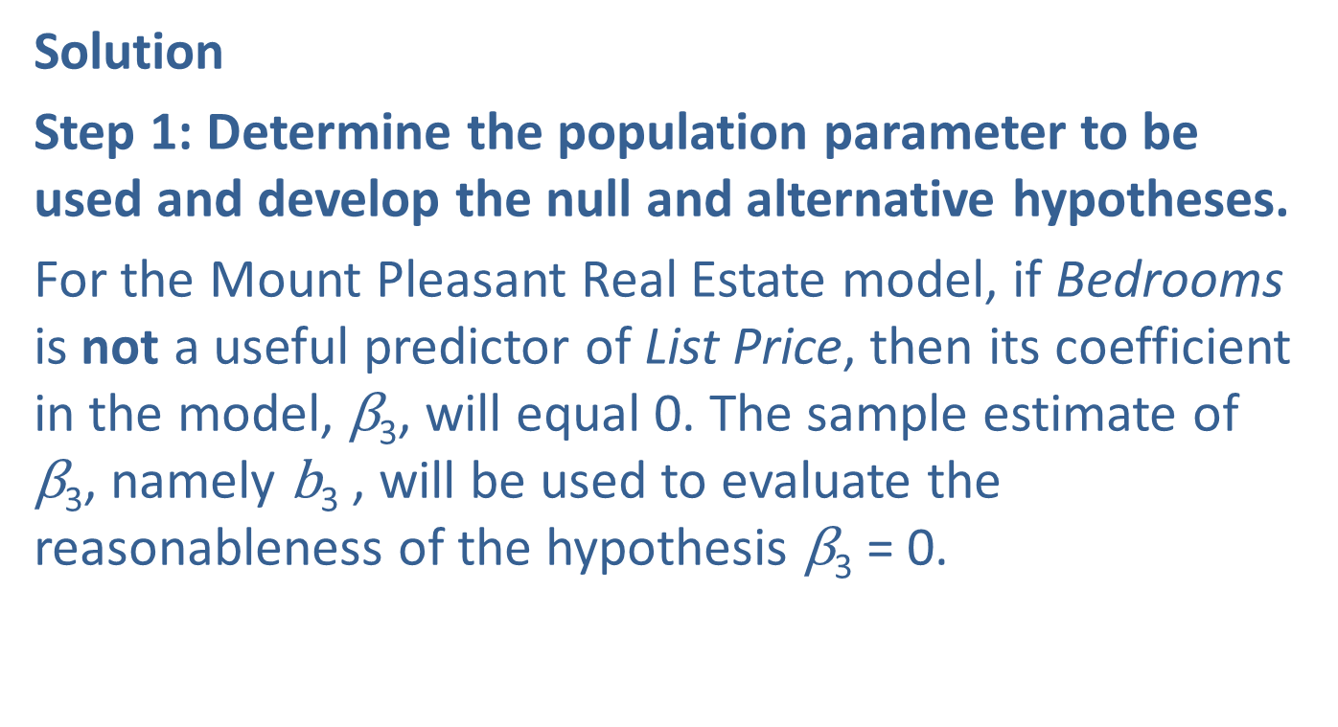
Example 14.3.3: Determining the Significance of a Model Coefficient (cont.)
Solution
Step 1: Determine the population parameter to be used and develop the null and alternative hypotheses.
For the Mount Pleasant Real Estate model, if Bedrooms is not a useful predictor of List Price, then its coefficient in the model, $\text{β}\text{3}$, will equal 0. The sample estimate of $\text{β}\text{3}$, namely $\text{b}\text{3}$ , will be used to evaluate the reasonableness of the hypothesis $\text{β}\text{3}$ = 0.

Slide 47
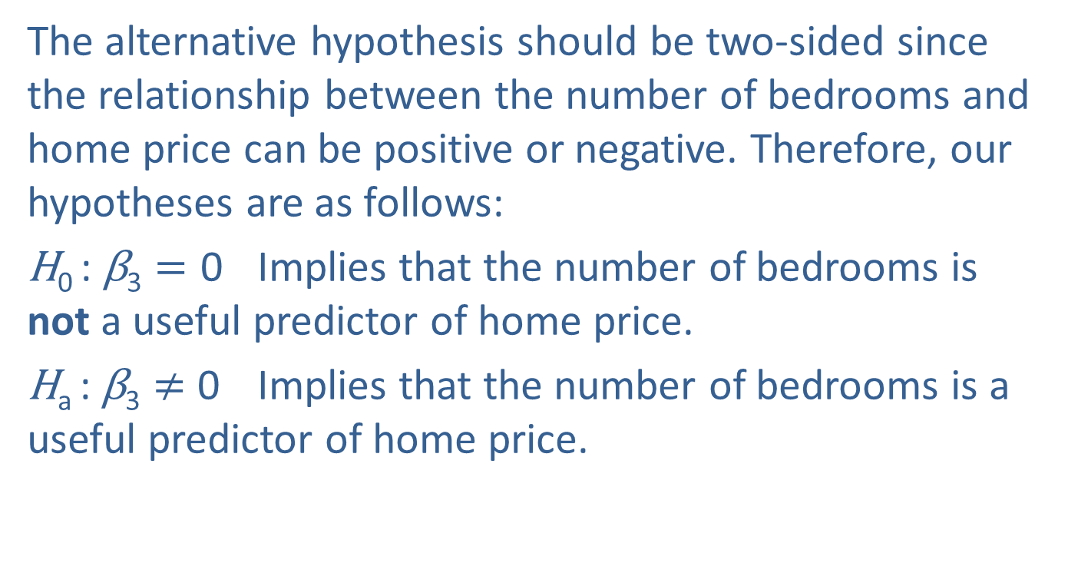
Example 14.3.3: Determining the Significance of a Model Coefficient (cont.)
The alternative hypothesis should be two-sided since the relationship between the number of bedrooms and home price can be positive or negative. Therefore, our hypotheses are as follows:
$\text{H}\text{0 }\text{: }\text{β}\text{3}=\text{0}$ Implies that the number of bedrooms is not a useful predictor of home price.
$\text{H}\text{a} \text{:}$ $\text{β}\text{3}≠$ 0 Implies that the number of bedrooms is a useful predictor of home price.

Slide 48
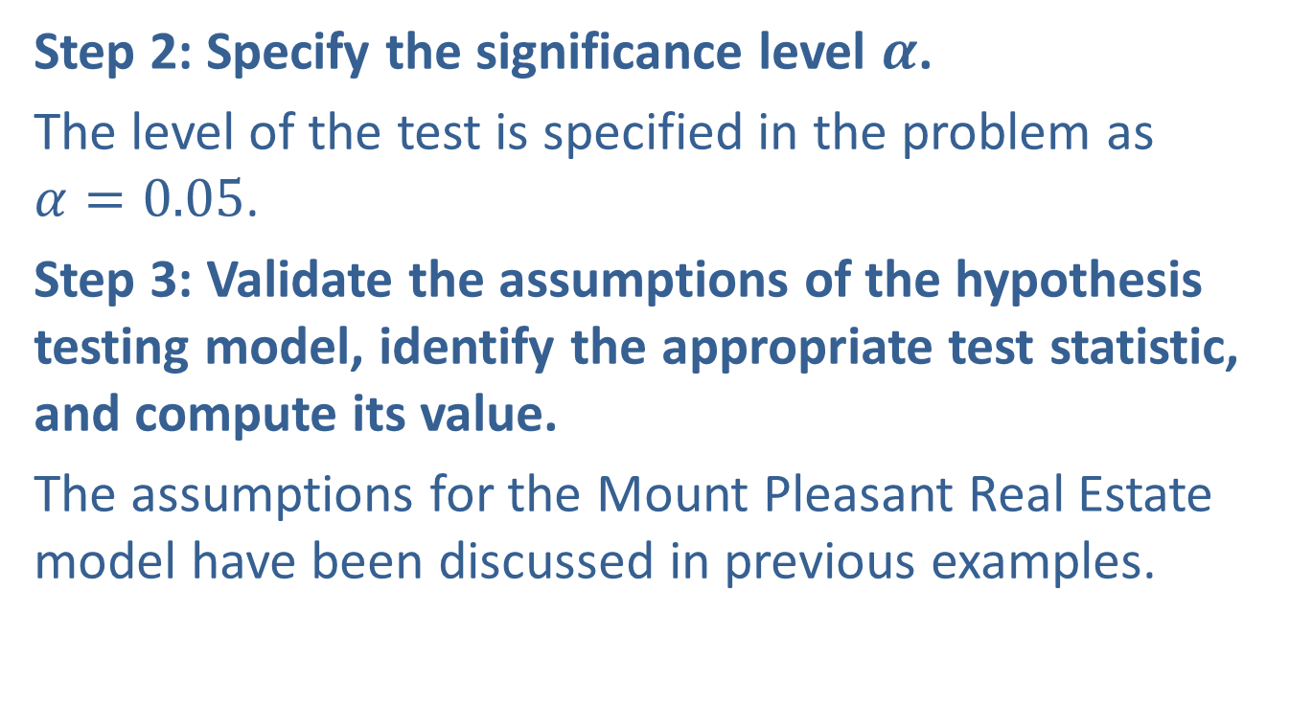
Example 14.3.3: Determining the Significance of a Model Coefficient (cont.)
Step 2: Specify the significance level $α$.
The level of the test is specified in the problem as $α=0.05$.
Step 3: Validate the assumptions of the hypothesis testing model, identify the appropriate test statistic, and compute its value.
The assumptions for the Mount Pleasant Real Estate model have been discussed in previous examples.

Slide 49
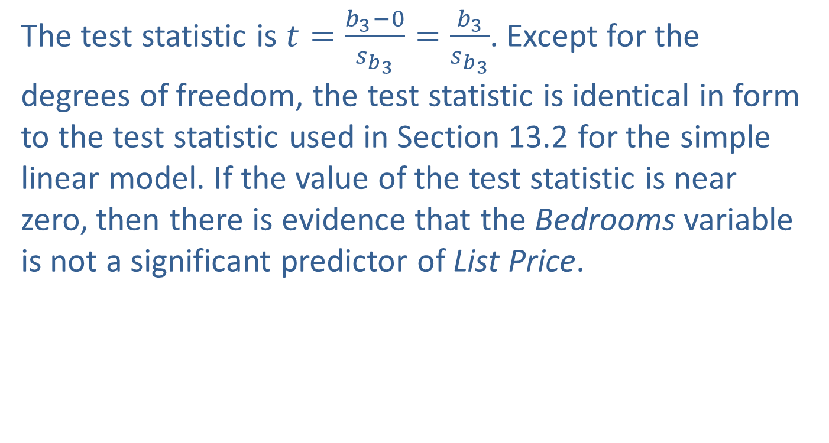
Example 14.3.3: Determining the Significance of a Model Coefficient (cont.)
The test statistic is $t=\frac{b_{3}−0}{s_{b_{3}}}=\frac{b_{3}}{s_{b_{3}}}$. Except for the degrees of freedom, the test statistic is identical in form to the test statistic used in Section 13.2 for the simple linear model. If the value of the test statistic is near zero, then there is evidence that the Bedrooms variable is not a significant predictor of List Price.

Slide 50
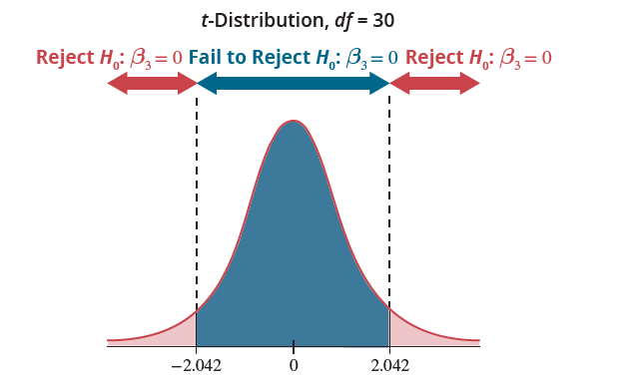
Example 14.3.3: Determining the Significance of a Model Coefficient (cont.)

Slide 51

Example 14.3.3: Determining the Significance of a Model Coefficient (cont.)
A portion of the output from Figure 14.1.1 is repeated here.
Using the output we find that

Slide 52


Example 14.3.3: Determining the Significance of a Model Coefficient (cont.)
The estimated value of $b_{3}$ is 0.175 standard deviations from zero. Is this persuasive evidence that $\text{β}\text{3}$ $≠$ 0?
Step 4: Determine the critical value(s) or $P$-value.
This criteria is defined by the critical value of the test statistic. Since the test is two-tailed and $α=0.05$then $α/2={0.05}/2=0.025.$The test statistic has a $t$-distribution with $df=34−(3+1)=30$.

Slide 53

Example 14.3.3: Determining the Significance of a Model Coefficient (cont.)
The critical value corresponds to ${ t}_{0.025,30}=2.042.$The $P$-value for the number of bedrooms is given in the output as 0.8625.
Step 5: Choose between the null and alternative hypotheses.
Since the value of the test statistic falls into the Fail to Reject region, there is insufficient evidence at the 0.05 level to reject the null hypothesis $\text{β}\text{3}=0$. Alternatively, since the $P$-value of 0.8625 is greater than $α=0.05$, we fail to reject the null hypothesis.

Slide 54

Example 14.3.3: Determining the Significance of a Model Coefficient (cont.)
Step 6: State the conclusion in terms of the original question.
Since we did not reject the null hypothesis $\text{H}\text{0 }\text{:} \text{β}\text{3}=\text{0}$, then the variable Bedrooms is not a significant predictor of List Price, given the other variables currently in the model.
We apply the exact same $t$-test to the other variables in the model. Both $b_{1}$ and $b_{2}$ , the coefficients of the variables Square Footage and Age, are significant.

Slide 55
Example 14.3.3: Determining the Significance of a Model Coefficient (cont.)
This suggests that a model with only two independent variables, Square Footage and Age, may produce a model almost as good as the one containing three variables.

