Slide 1
Section 14.2
The Coefficient of Determination and Adjusted R²

Slide 2
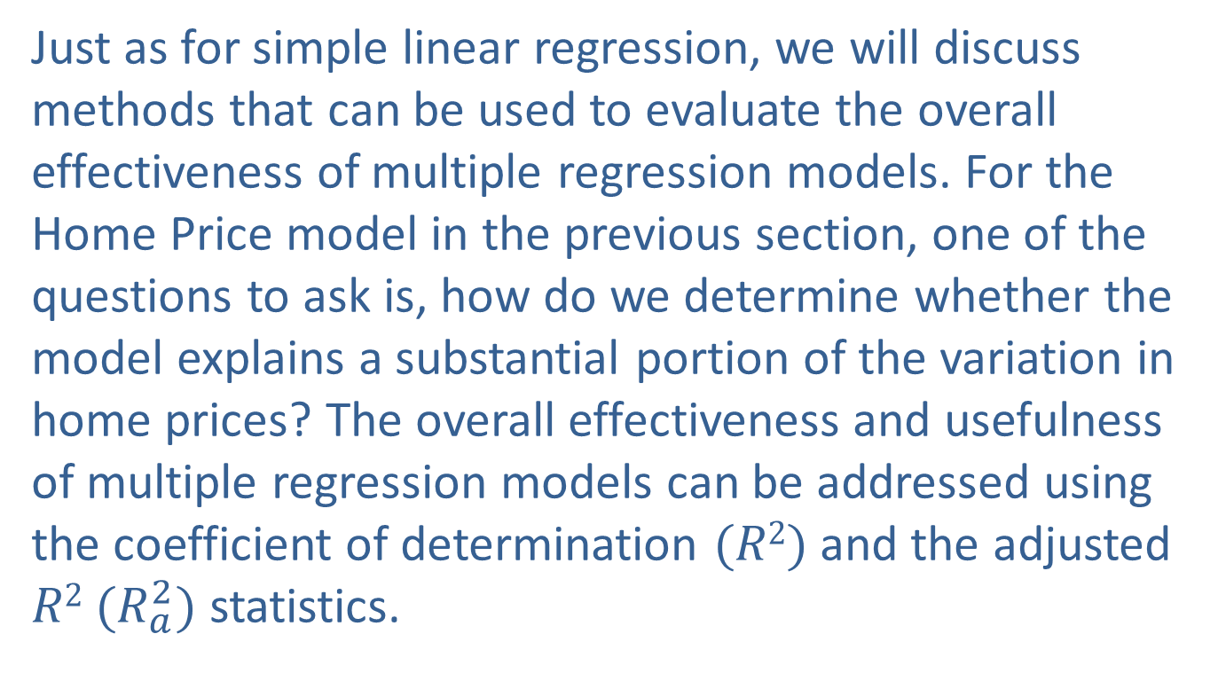

The Coefficient of Determination and Adjusted $R$²
Just as for simple linear regression, we will discuss methods that can be used to evaluate the overall effectiveness of multiple regression models. For the Home Price model in the previous section, one of the questions to ask is, how do we determine whether the model explains a substantial portion of the variation in home prices? The overall effectiveness and usefulness of multiple regression models can be addressed using the coefficient of determination $(R2)$ and the adjusted $R2$ $(R_{a}^{2})$ statistics.

Slide 3
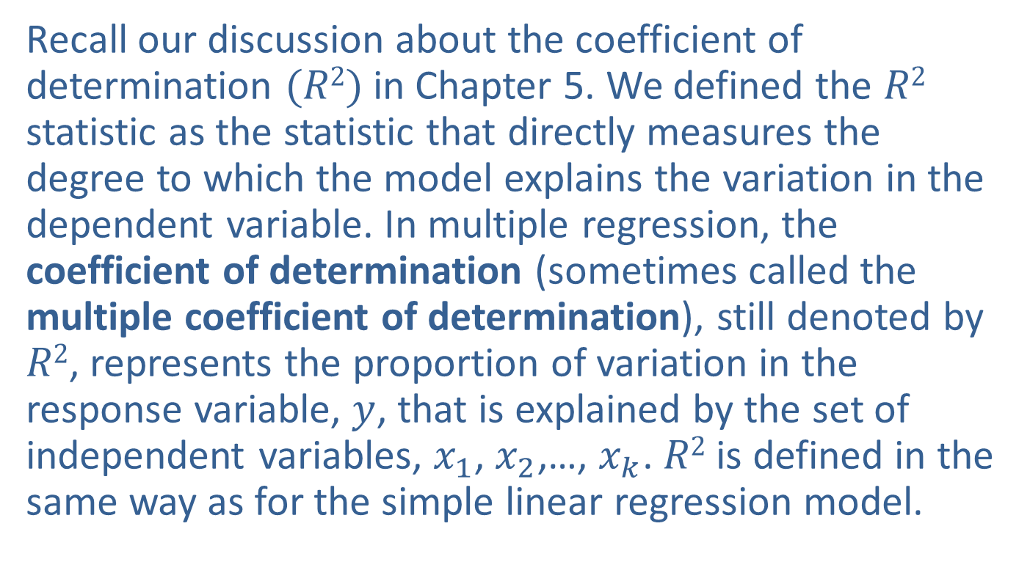

Coefficient of Determination ($R$²)
Recall our discussion about the coefficient of determination $(R2)$in Chapter 5. We defined the $R2$ statistic as the statistic that directly measures the degree to which the model explains the variation in the dependent variable. In multiple regression, the coefficient of determination (sometimes called the multiple coefficient of determination), still denoted by $R2$, represents the proportion of variation in the response variable, $y$, that is explained by the set of independent variables, $x_{1}$, $x_{2}$,…, $x_{k}$. $R2$ is defined in the same way as for the simple linear regression model.

Slide 4
Definition: Coefficient of Determination
The coefficient of determination, R², is given by
where
SSR = the sum of squares of regression,
SSE = the sum of squared errors, and
Total SS = the total sum of squares.
R² represents the proportion of variation in the dependent variable explained by the set of independent variables in a multiple regression model.

Slide 5
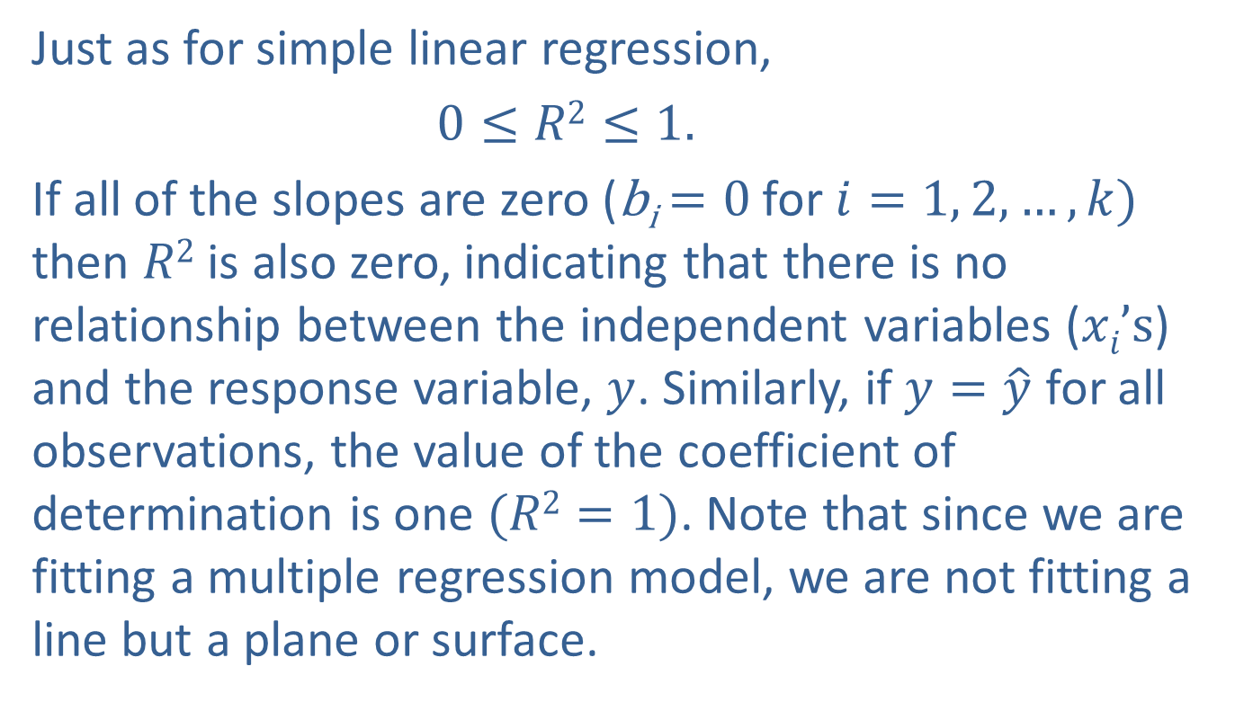

Coefficient of Determination ($R$₂) (cont.)
Just as for simple linear regression,
$0≤R2≤1.$
If all of the slopes are zero (b_{i}$=0$ for $i=1, 2,…,k)$ then $R2$ is also zero, indicating that there is no relationship between the independent variables ($xi’s$) and the response variable, $y$. Similarly, if $y=\hat{y}$ for all observations, the value of the coefficient of determination is one $(R2=1)$. Note that since we are fitting a multiple regression model, we are not fitting a line but a plane or surface.

Slide 6
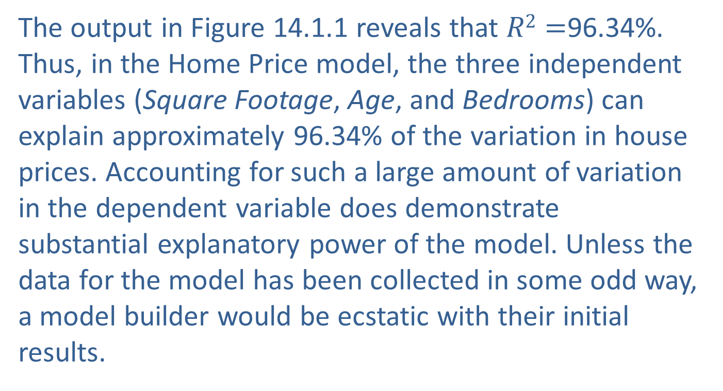
Coefficient of Determination ($R$₂) (cont.)
The output in Figure 14.1.1 reveals that $R2=$96.34%. Thus, in the Home Price model, the three independent variables (Square Footage, Age, and Bedrooms) can explain approximately 96.34% of the variation in house prices. Accounting for such a large amount of variation in the dependent variable does demonstrate substantial explanatory power of the model. Unless the data for the model has been collected in some odd way, a model builder would be ecstatic with their initial results.

Slide 7
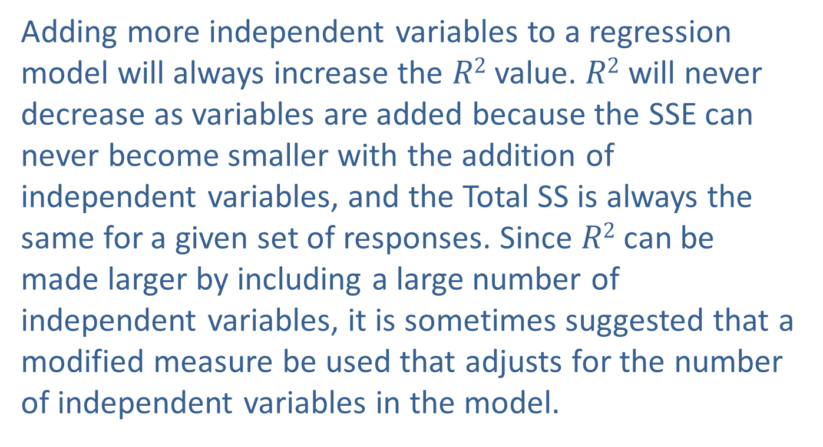

Adjusted $R2$ ($R_{a}^{2}$)
Adding more independent variables to a regression model will always increase the $R2$ value. $R2$ will never decrease as variables are added because the SSE can never become smaller with the addition of independent variables, and the Total SS is always the same for a given set of responses. Since $R2$ can be made larger by including a large number of independent variables, it is sometimes suggested that a modified measure be used that adjusts for the number of independent variables in the model.

Slide 8


Adjusted $R2$ ($R_{a}^{2}$) (cont.)
The adjusted coefficient of determination (denoted by $R_{a}^{2}$) adjusts $R2$ by dividing each sum of squares by its associated degrees of freedom. Thus, $R_{a}^{2}$ is given by the following formula.

Slide 9
Definition: Adjusted R²
The adjusted R² statistic takes into account the number of independent variables in the model by dividing each sum of squares by its associated degrees of freedom.
where n is the number of observations and k is the number of independent variables in the model.

Slide 10
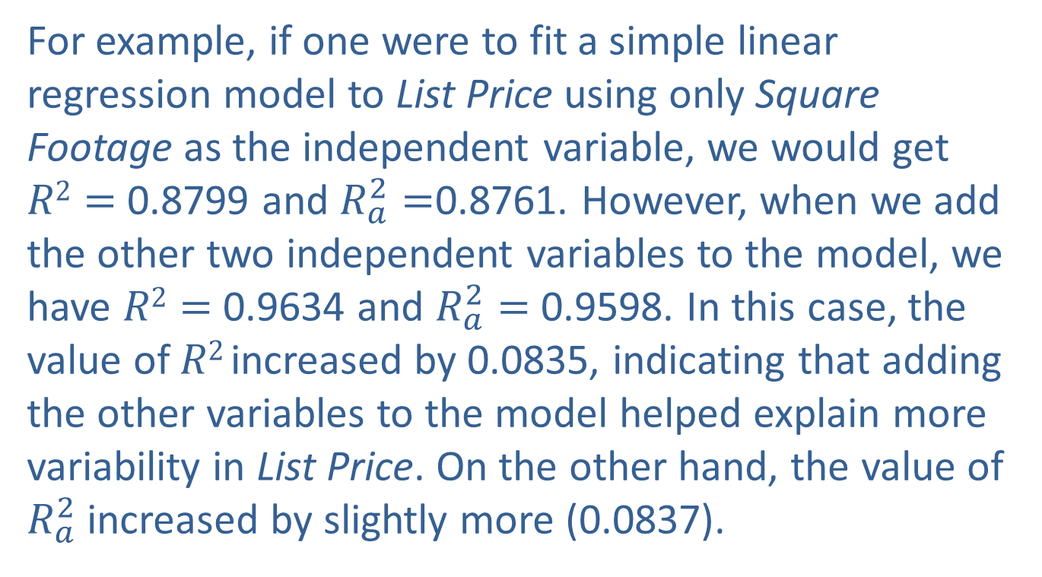

Adjusted $R2$ ($R_{a}^{2}$) (cont.)
For example, if one were to fit a simple linear regression model to List Price using only Square Footage as the independent variable, we would get $R2=$ 0.8799 and $R_{a}^{2}=$0.8761. However, when we add the other two independent variables to the model, we have $R2=$ 0.9634 and $R_{a}^{2}=$0.9598. In this case, the value of $R2$increased by 0.0835, indicating that adding the other variables to the model helped explain more variability in List Price. On the other hand, the value of $R_{a}^{2}$increased by slightly more (0.0837).

Slide 11
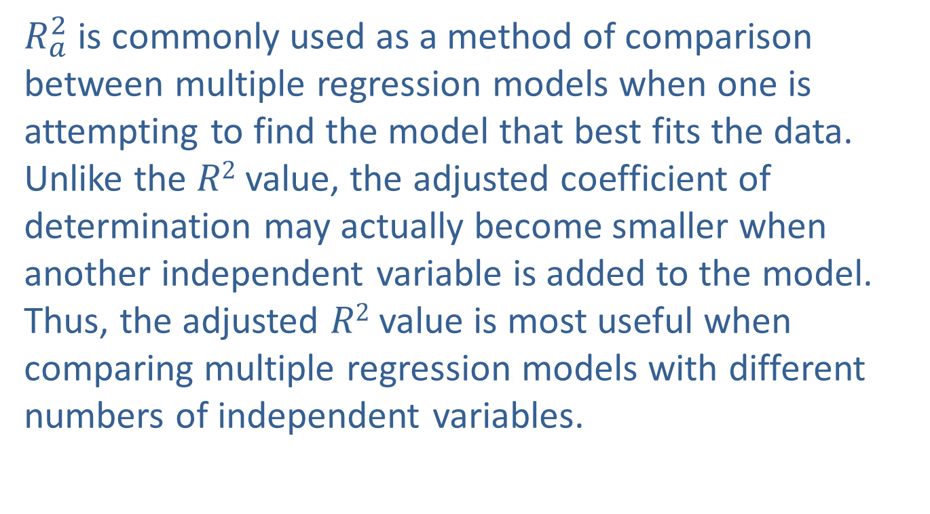
Adjusted $R2$ ($R_{a}^{2}$) (cont.)
$R_{a}^{2}$ is commonly used as a method of comparison between multiple regression models when one is attempting to find the model that best fits the data. Unlike the $R2$ value, the adjusted coefficient of determination may actually become smaller when another independent variable is added to the model. Thus, the adjusted $R2$ value is most useful when comparing multiple regression models with different numbers of independent variables.

