Slide 1
Section 14.1
The Multiple Regression Model

Slide 2
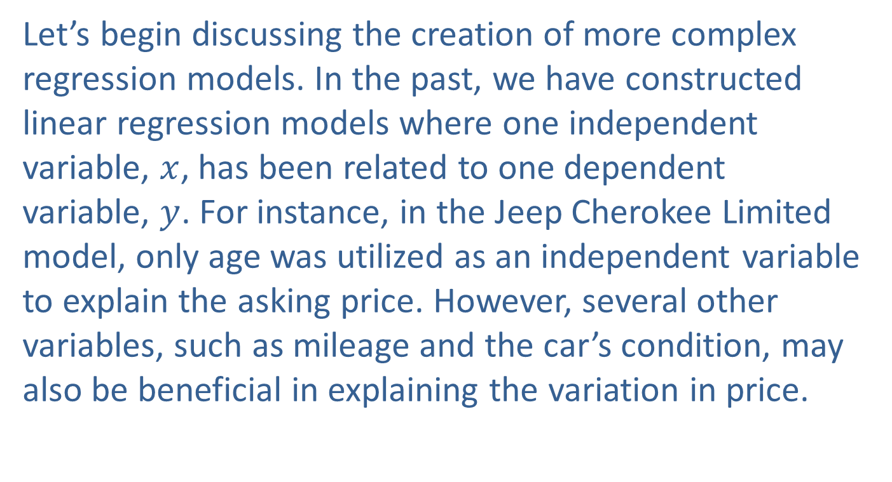
The Multiple Regression Model
Let’s begin discussing the creation of more complex regression models. In the past, we have constructed linear regression models where one independent variable, $x$, has been related to one dependent variable, $y$. For instance, in the Jeep Cherokee Limited model, only age was utilized as an independent variable to explain the asking price. However, several other variables, such as mileage and the car’s condition, may also be beneficial in explaining the variation in price.

Slide 3
The Multiple Regression Model (cont.)
To create a model that accurately represents real-world phenomena, it must have the potential to accommodate many independent variables. Multiple regression is a technique that extends simple regression methods by allowing the inclusion of more than one independent variable.

Slide 4
Definition: The Multiple Regression Model
The multiple regression model is given by
where
are the model’s parameters. (They are unknown constants which will require estimation.)
x₁, x₂, ..., x_{k} are independent variables which are measured without error.

Slide 5
Definition: The Multiple Regression Model (cont.)
ε is a random error which is normally distributed with a mean of zero and a standard deviation σ_{e}. (The errors are independent of each other.)

Slide 6
The Multiple Regression Model (cont.)
The multiple regression model contains additional parameters which must be estimated. Recall from Chapter 13 that the method of least squares is used to find the estimated regression line that minimizes the sum of squared errors, Even though we are now discussing multiple regression, least squares will remain the method of estimation. Because of the complexity of the calculations, formulas for the least squares coefficients will not be presented.

Slide 7
The Multiple Regression Model (cont.)
Instead, estimates of the model’s parameters will be obtained from one of the many statistical analysis programs that perform multiple regression analysis. Although the format of the output varies among the programs, the program outputs all contain the same fundamental information.
Just as with the simple linear regression model, it is not often that an entire population is available.

Slide 8
The Multiple Regression Model (cont.)
Therefore, we must estimate the parameters of the multiple regression model using sample data. Using data from the sample, we can estimate the coefficients of the estimated multiple regression equation.

Slide 9
Definition: The Estimated Multiple Regression Equation
The estimated multiple regression equation is
where b₀, b₁, b₂, ..., b_{k} are estimates of their population counterparts. Specifically, b₀ is an estimate of β₀, b₁ is an estimate of β₁, b₂ is an estimate of β₂, etc.
is the predicted value of y for given values of x₁, x₂, ..., x_{k}, and is pronounced y-hat. The symbol y is reserved for the observed value of the dependent variable.

Slide 10
The Multiple Regression Model (cont.)
Model building is a process. The greatest challenge in building a multiple regression model is in determining the appropriate variables needed to explain the variation in the dependent variable. In practical applications, this usually requires a great deal of experimentation with the model, deleting and adding independent variables, and examining the effects.

Slide 11
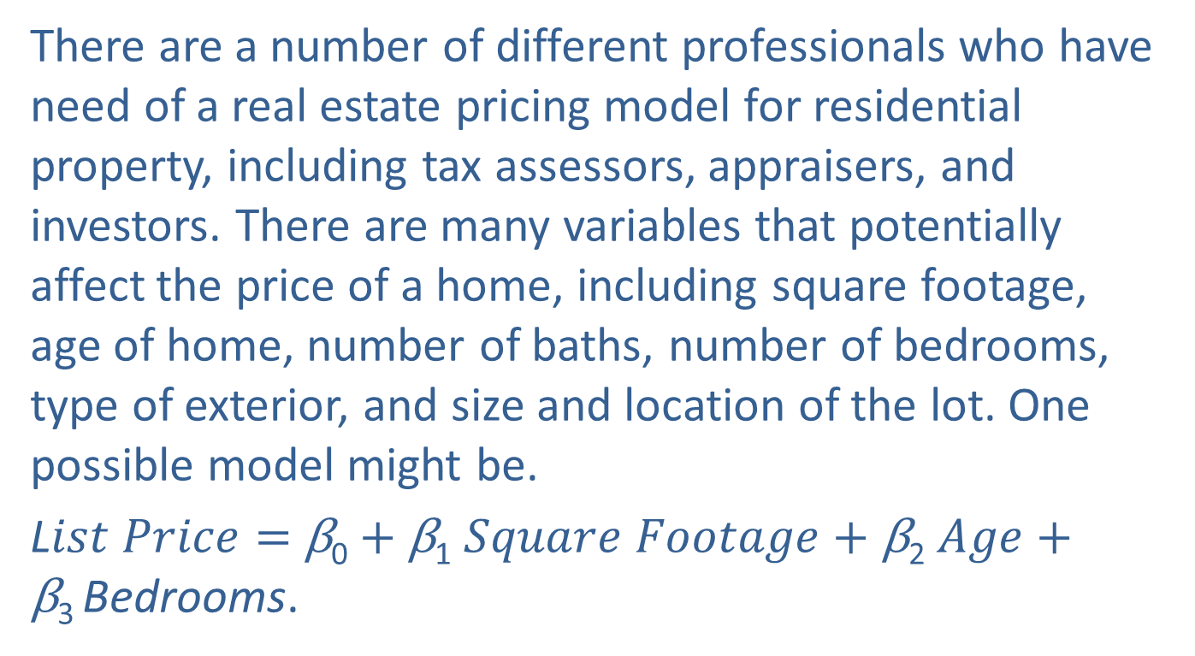
A Real Estate Pricing Model
There are a number of different professionals who have need of a real estate pricing model for residential property, including tax assessors, appraisers, and investors. There are many variables that potentially affect the price of a home, including square footage, age of home, number of baths, number of bedrooms, type of exterior, and size and location of the lot. One possible model might be.
L$ist Price=$ β₀ $+$ β₁ $Square Footage+\text{β}\text{2}$ $Age+\text{β}\text{3 }$Bedrooms.

Slide 12
A Real Estate Pricing Model (cont.)
To have a useful model, the parameters β₀, β₁, β₂, and β₃ must be estimated. Estimating these parameters requires the collection of historical data on home prices, square footage, age of home, and number of bedrooms. If inferences concerning the model’s predicted values or parameters are desired, then random sampling methods must be employed during data collection. Assume the data in Table 14.1.1 has been collected using random sampling methods.

Slide 13
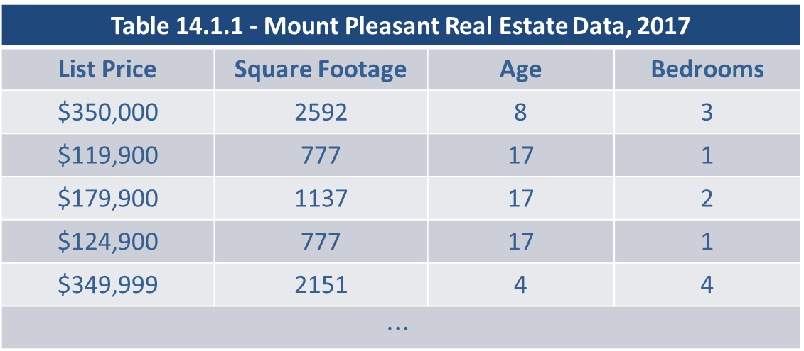
A Real Estate Pricing Model (cont.)
Table 14.1.1 - Mount Pleasant Real Estate Data, 2017
List Price | Square Footage | Age | Bedrooms
$350,000 | 2592 | 8 | 3
$119,900 | 777 | 17 | 1
$179,900 | 1137 | 17 | 2
$124,900 | 777 | 17 | 1
$349,999 | 2151 | 4 | 4
$$⋯$$

Slide 14
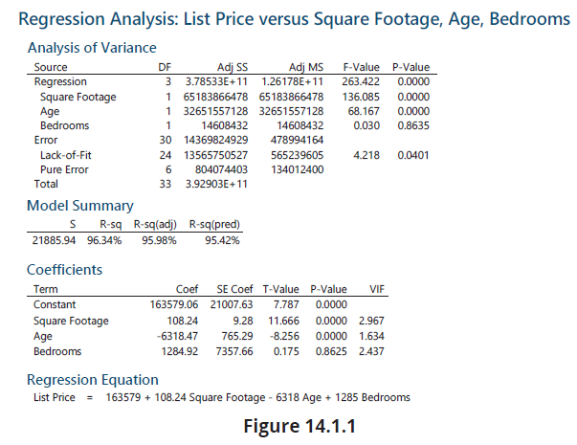
A Real Estate Pricing Model (cont.)

Slide 15
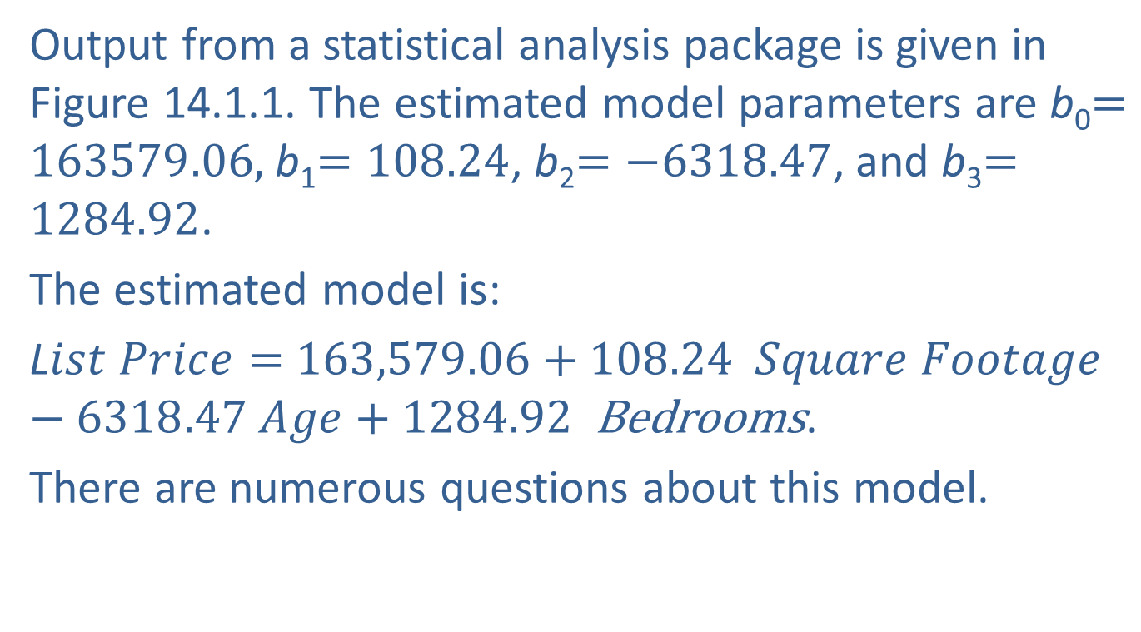
A Real Estate Pricing Model (cont.)
Output from a statistical analysis package is given in Figure 14.1.1. The estimated model parameters are b₀$=163579.06,$b₁$=108.24$, b₂$=−6318.47$, and b₃$=1284.92$.
The estimated model is:
L$ist Price=$ $163,579.06+108.24$ $Square Footage$ $−6318.47 Age+1284.92$ Bedrooms.
There are numerous questions about this model.

Slide 16
A Real Estate Pricing Model (cont.)
Can the model explain a substantial portion of the variation in home prices? If not, it may not be very useful.
Do the signs and magnitudes of the estimated coefficients appear to be reasonable?
Are the estimates of the coefficients reliable, or do the estimates have substantial sampling variation?
Are all three independent variables necessary? Do any of the variables not contribute to the explanation of the price of a home?

Slide 17
A Real Estate Pricing Model (cont.)
Are there other independent variables that could be included that would enhance the model’s ability to accurately predict home prices?
Can the model make a useful prediction of the price of a home? How much confidence can be placed in the prediction?
How do we determine whether a model explains a substantial portion of the variation in home prices? We will address this in the next section.

Slide 18
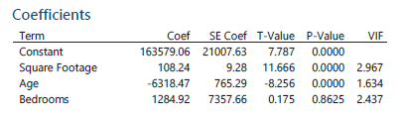
Interpreting the Coefficients of the Multiple
Regression Model
In interpreting the coefficients of the model, we ask the question, Do the signs and magnitudes of the estimated coefficients appear to be reasonable?
A portion of the output from Figure 14.1.1 is repeated here.
In simple linear regression, the estimated coefficient, b₁, is the slope of the line.

Slide 19
Interpreting the Coefficients of the Multiple
Regression Model (cont.)
It is interpreted to be the change in the dependent variable associated with a one-unit change in the independent variable. This interpretation remains basically valid for the multiple regression model as well. The coefficient, b₁, is the estimated change in List Price for a one-unit increase in Square Footage for a given Age and number of Bedrooms. For this 2017 real estate data, is it reasonable to believe that each additional square foot of living space would cost an additional $108.24?

Slide 20
Interpreting the Coefficients of the Multiple
Regression Model (cont.)
While the cost of construction varies, $108.24 per square foot seems sensible given the other variables in the model.
The coefficient, b₂, is the estimated change in List Price for a one-unit increase in Age for a given Square Footage and number of Bedrooms. Houses are like people—they deteriorate with age. Thus, all other conditions being equal, it might be reasonable to expect a negative coefficient for b₂, which would mean as Age increases, home price decreases. According to the estimated model, this is the case in this instance.

Slide 21
Interpreting the Coefficients of the Multiple
Regression Model (cont.)
The coefficient for b₂ is −6318.47, which means that for each year of Age the price of the home decreases by $6318.47, all other things being equal. Intuitively, this coefficient has the correct sign. It is difficult to evaluate whether $6318.47 is a reasonable magnitude, so later, we will rely on statistical inference to evaluate the accuracy of the estimate.
The coefficient, b₃, is the estimated change in List Price for an additional bedroom for a given square footage and age.

Slide 22
Interpreting the Coefficients of the Multiple
Regression Model (cont.)
Intuitively, we would expect this coefficient to be positive since additional finishing costs are associated with adding a bedroom. The coefficient for b₃ is 1284.92, which means that the price of a home will increase by $1284.92 for each bedroom, all else remaining equal. It is difficult to evaluate whether $1284.92 is a reasonable magnitude, so we will rely on statistical inference to evaluate the coefficients in the next section.

