Slide 1
Section 13.3
Inference Concerning the Model’s Prediction

Slide 2
Inference Concerning the Model’s Prediction
The vast majority of regression models are developed for predictive purposes. For example, if you built the model relating the price of a Jeep Cherokee Limited to its age, it was probably because you want to use it to predict prices. While it is important to evaluate b₁, the estimate of the slope, the real concern of the model builder is the accuracy of a model’s predictions. In the case of the Jeep Cherokee Limited model, how accurate are the prices that the model predicts?

Slide 3
Inference Concerning the Model’s Prediction (cont.)
If the assumptions of the linear model (detailed in Section 13.1) have been met, then it is possible to make inferences as to the quality of a model’s predictions.

Slide 4
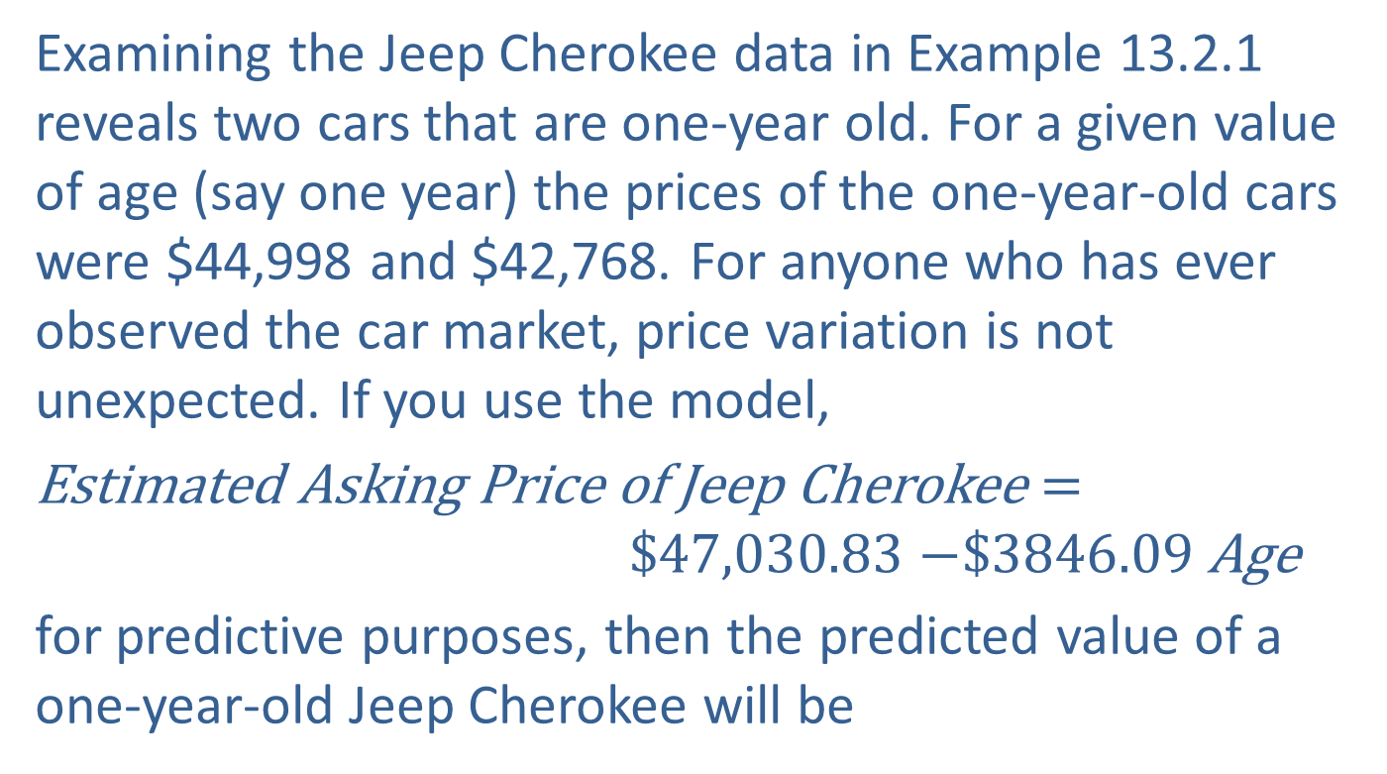

The Regression Line as the Mean Value of
$y$ Given $x$
Examining the Jeep Cherokee data in Example 13.2.1 reveals two cars that are one-year old. For a given value of age (say one year) the prices of the one-year-old cars were $44,998 and $42,768. For anyone who has ever observed the car market, price variation is not unexpected. If you use the model,
Estimated Asking Price of Jeep Cherokee $=$ $47,030.83 $−\$3846.09$Age
for predictive purposes, then the predicted value of a one-year-old Jeep Cherokee will be

Slide 5
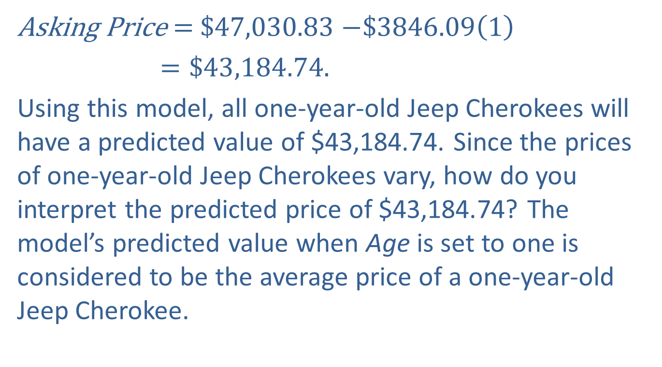

The Regression Line as the Mean Value of
$y$ Given $x$ (cont.)
Asking Price $=$$47,030.83 $−\$3846.09\left(1\right)$
$=\$43,184.74.$
Using this model, all one-year-old Jeep Cherokees will have a predicted value of $43,184.74. Since the prices of one-year-old Jeep Cherokees vary, how do you interpret the predicted price of $43,184.74? The model’s predicted value when Age is set to one is considered to be the average price of a one-year-old Jeep Cherokee.

Slide 6
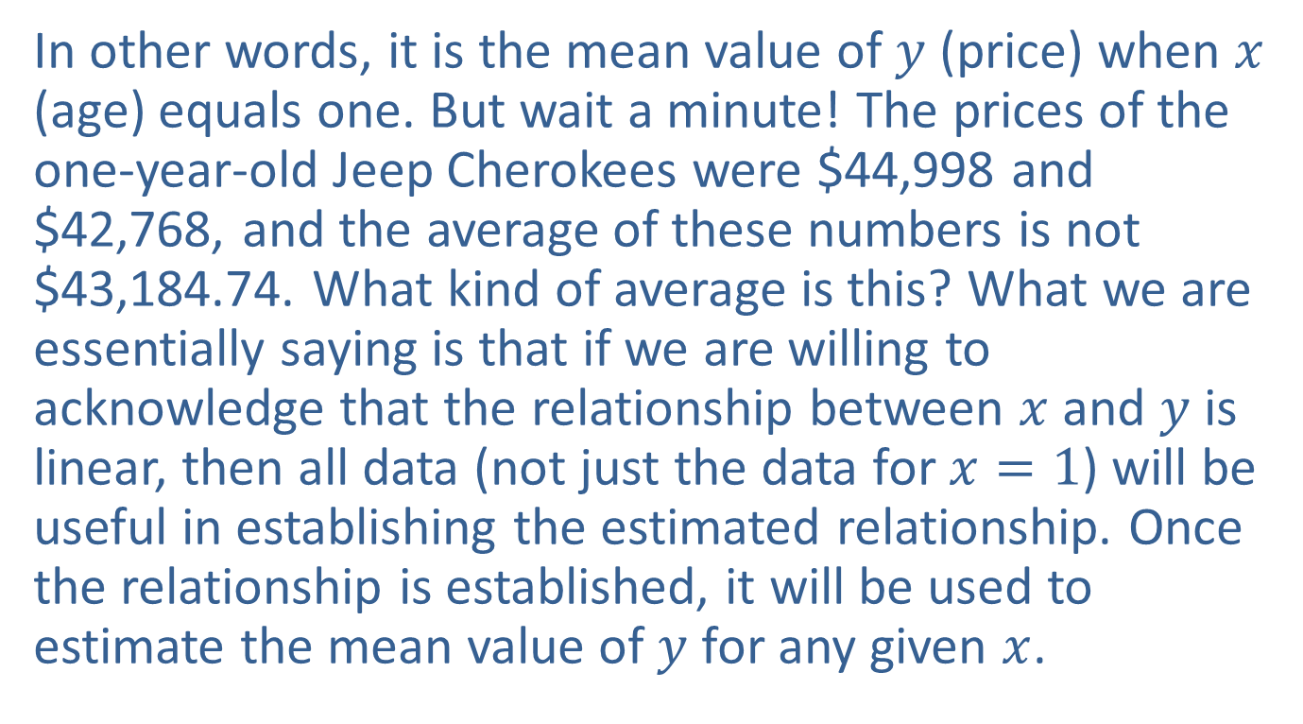
The Regression Line as the Mean Value of
$y$ Given $x$ (cont.)
In other words, it is the mean value of $y$ (price) when $x$ (age) equals one. But wait a minute! The prices of the one-year-old Jeep Cherokees were $44,998 and $42,768, and the average of these numbers is not $43,184.74. What kind of average is this? What we are essentially saying is that if we are willing to acknowledge that the relationship between $x$ and $y$ is linear, then all data (not just the data for $x=1$) will be useful in establishing the estimated relationship. Once the relationship is established, it will be used to estimate the mean value of $y$ for any given $x$.

Slide 7
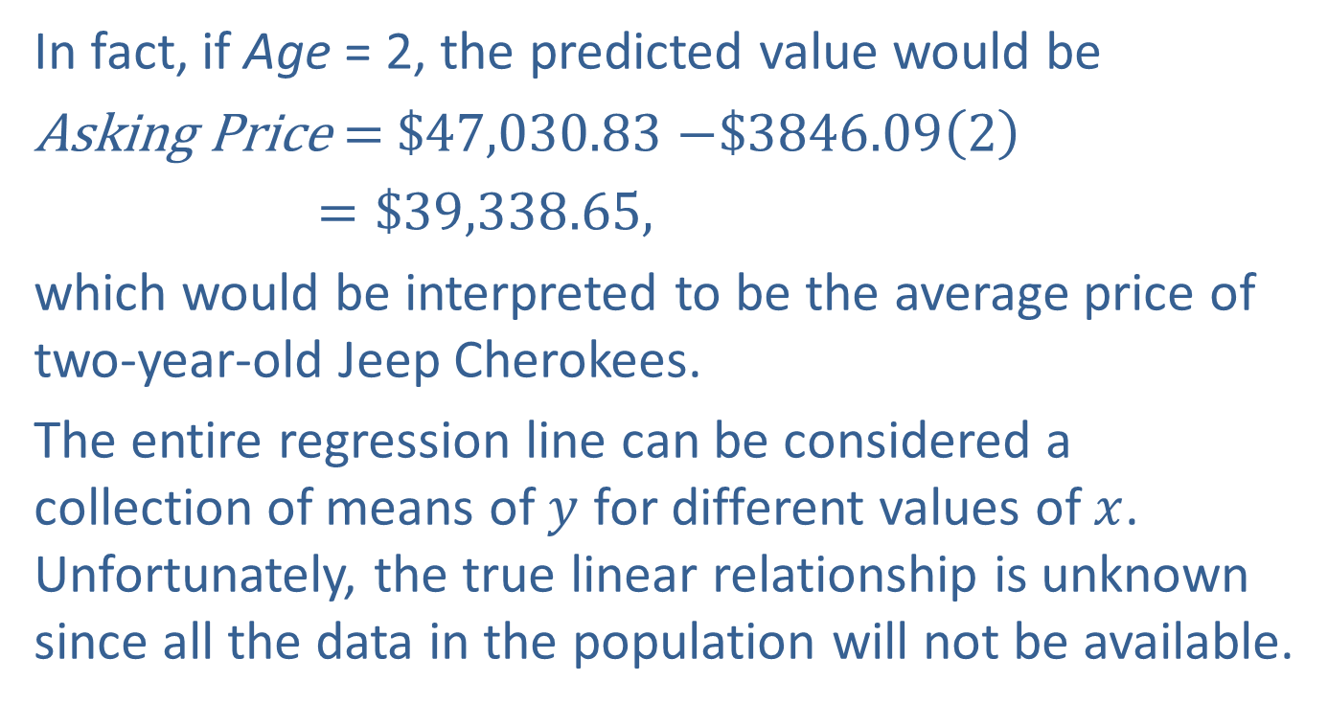
The Regression Line as the Mean Value of
$y$ Given $x$ (cont.)
In fact, if Age = 2, the predicted value would be
Asking Price $=$$47,030.83 $−\$3846.09\left(2\right)$
$=\$39,338.65,$
which would be interpreted to be the average price of two-year-old Jeep Cherokees.
The entire regression line can be considered a collection of means of $y$ for different values of $x$. Unfortunately, the true linear relationship is unknown since all the data in the population will not be available.

Slide 8
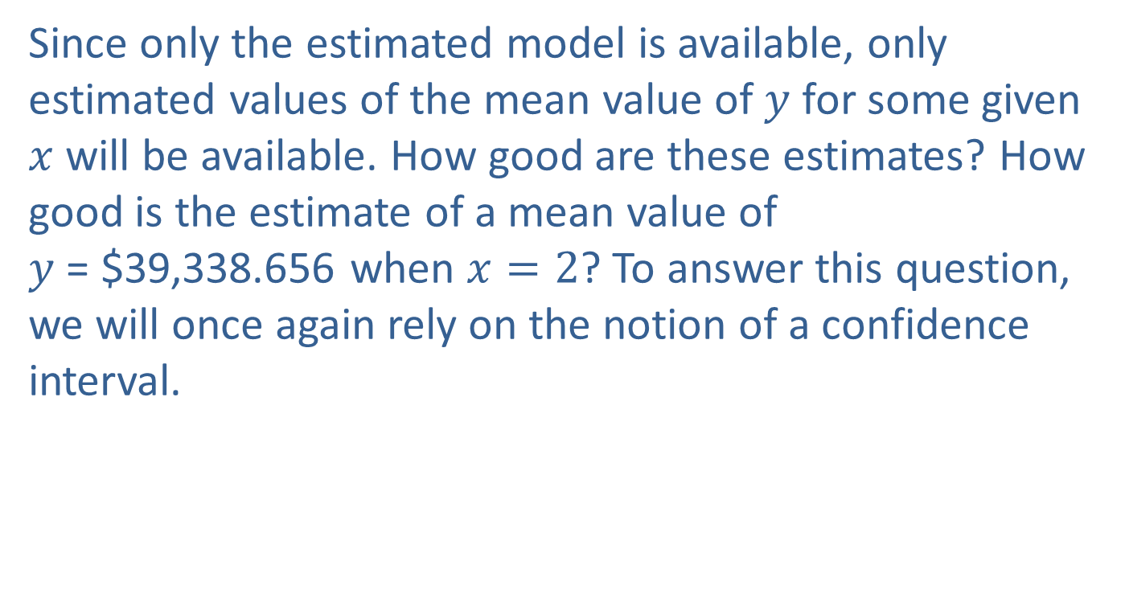
The Regression Line as the Mean Value of
$y$ Given $x$ (cont.)
Since only the estimated model is available, only estimated values of the mean value of $y$ for some given $x$ will be available. How good are these estimates? How good is the estimate of a mean value of $y$ = $39,338.656 when $x=2$? To answer this question, we will once again rely on the notion of a confidence interval.

Slide 9
Formula: 100(1 − α)% Confidence Interval for the Mean Value of y Given x
If x_{p} is a value of x for which we wish to know the mean value of y, then the 100(1 − α)% confidence interval is given by
where is the predicted value of y when
is the t-value associated with 1 − α confidence (the same t used in constructing confidence intervals for β₁),

Slide 10
Formula: 100(1 − α)% Confidence Interval for the Mean Value of y Given x (cont.)
s_{e} is the standard deviation of the error terms, and
measures how far x_{p} is from in relation
to the total variation of the x's. The further that x_{p} is from the larger this ratio will become and consequently the wider the confidence interval.

Slide 11
Example 13.3.1: Determining a Confidence Interval for the Mean Price
For the Jeep Cherokee Limited model, calculate the 95% confidence interval for the mean value of price when age equals two years.
Solution
Four pieces of information are required to calculate a confidence interval for the mean value of y given x = x_{p}:
Use the estimated regression line to calculate for the value given for x = x_{p},

Slide 12
Example 13.3.1: Determining a Confidence Interval for the Mean Price (cont.)
Find a t-value corresponding to the level of confidence and the degrees of freedom associated with the data used to estimate the model,
Determine the standard deviation of the error terms,
Compute the term

Slide 13
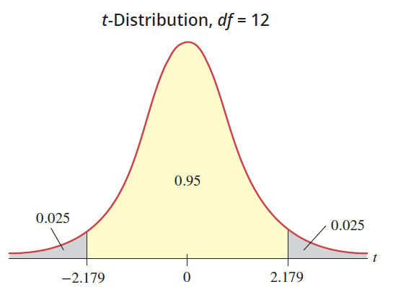
Example 13.3.1: Determining a Confidence Interval for the Mean Price (cont.)
In Example 13.2.1, x_{p} = 2 and the predicted value of y for this given x is

Slide 14
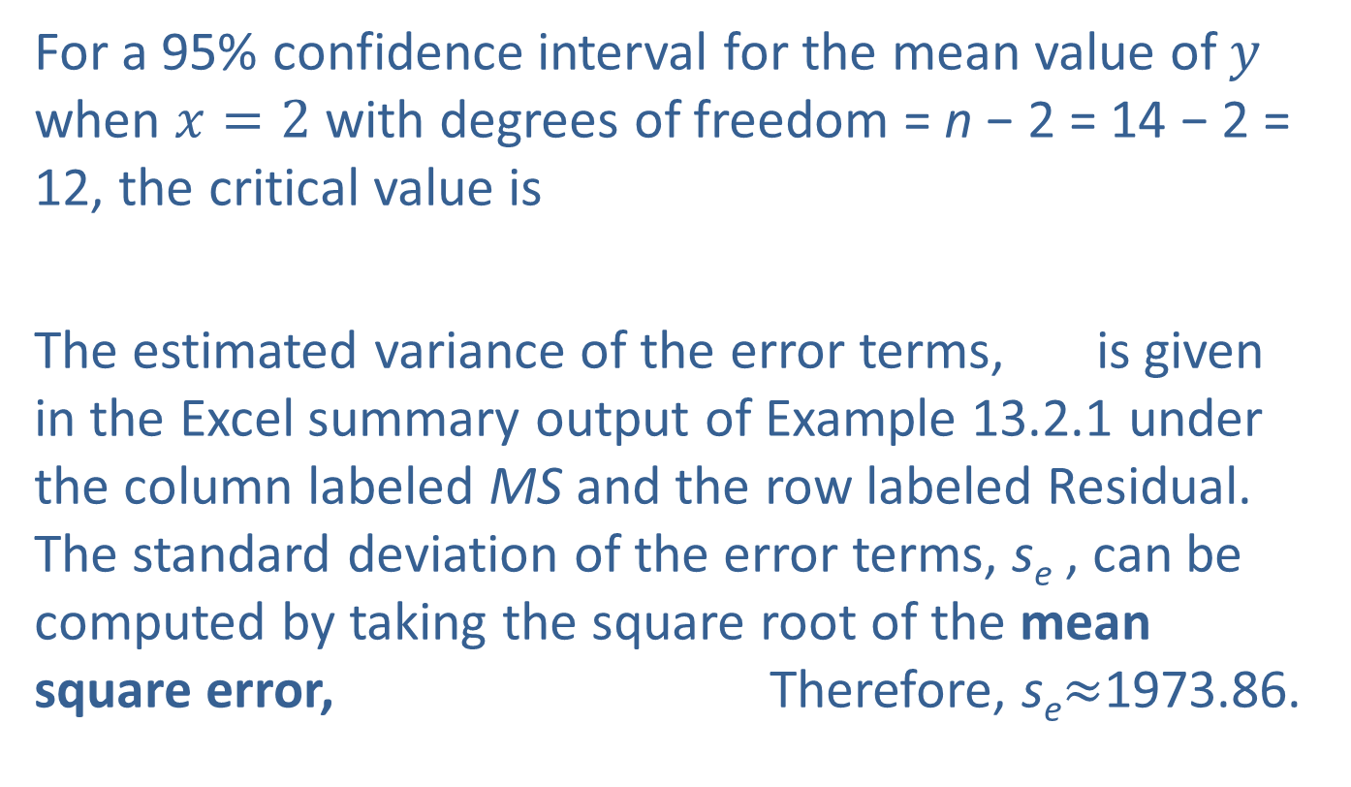
Example 13.3.1: Determining a Confidence Interval for the Mean Price (cont.)
For a 95% confidence interval for the mean value of $y$ when $x=2$ with degrees of freedom = n − 2 = 14 − 2 = 12, the critical value is
The estimated variance of the error terms, is given in the Excel summary output of Example 13.2.1 under the column labeled MS and the row labeled Residual. The standard deviation of the error terms, s_{e} , can be computed by taking the square root of the mean square error, Therefore, s_{e}$≈$1973.86.

Slide 15
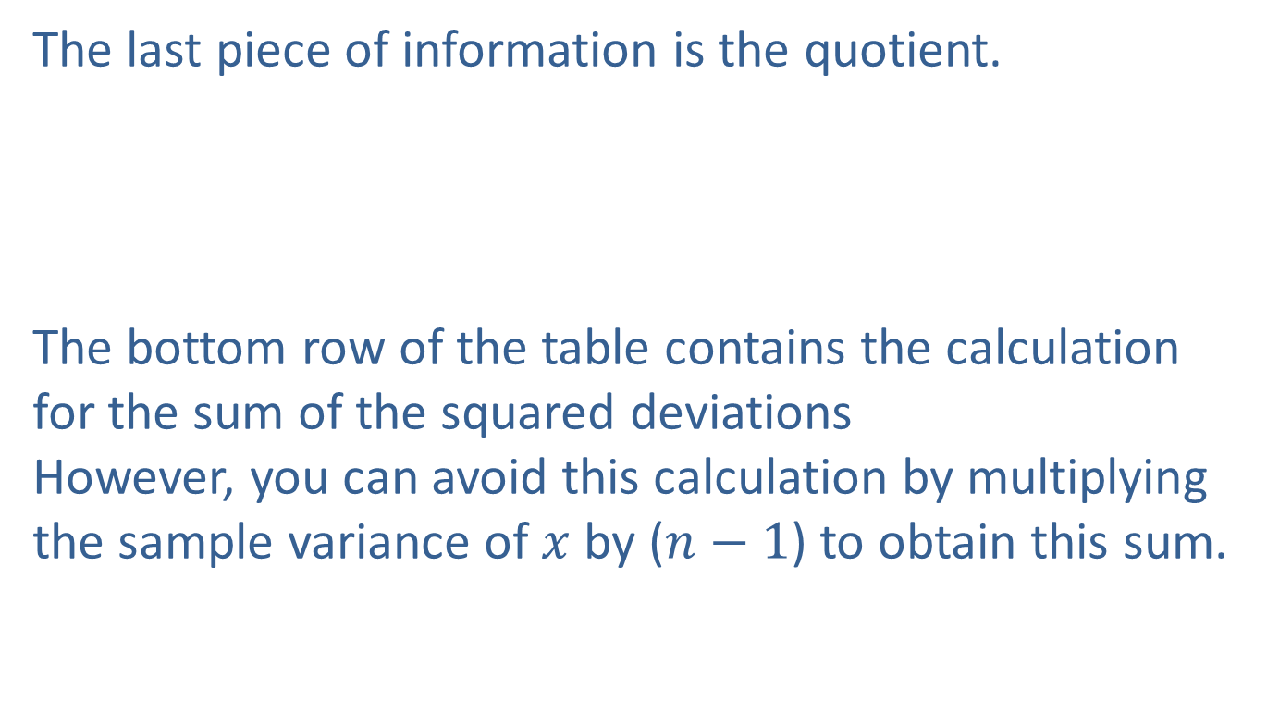
Example 13.3.1: Determining a Confidence Interval for the Mean Price (cont.)
The last piece of information is the quotient.
The bottom row of the table contains the calculation for the sum of the squared deviations However, you can avoid this calculation by multiplying the sample variance of $x$ by ($n−1$) to obtain this sum.

Slide 16
Example 13.3.1: Determining a Confidence Interval for the Mean Price (cont.)
Age (Years) x | Sum of Squared Deviations
1 | (1−3.57)²
1 | (1−3.57)²
2 | (2−3.57)²
2 | (2−3.57)²
2 | (2−3.57)²
3 | (3−3.57)²
3 | (3−3.57)²
4 | (4−3.57)²
4 | (4−3.57)²
5 | (5−3.57)²
5 | (5−3.57)²

Slide 17
Example 13.3.1: Determining a Confidence Interval for the Mean Price (cont.)
Age (Years) x | Sum of Squared Deviations
6 | (6−3.57)²
6 | (6−3.57)²
6 | (6−3.57)²
Total
Assembling the pieces for the 95% confidence interval, we have

Slide 18
Example 13.3.1: Determining a Confidence Interval for the Mean Price (cont.)
$37,798.49 $39,338.65 $40,878.81

Slide 19
Example 13.3.1: Determining a Confidence Interval for the Mean Price (cont.)
The confidence interval can be interpreted in two ways.
We are 95% confident that the mean price of a two-year-old Jeep Cherokee is between $37,798.49 and $40,878.81. (Note, like all confidence intervals, the confidence is in the method—not in a particular interval.)
We are 95% confident that the maximum error of estimation for the mean price of a two-year-old Jeep Cherokee is $1540.16.

Slide 20
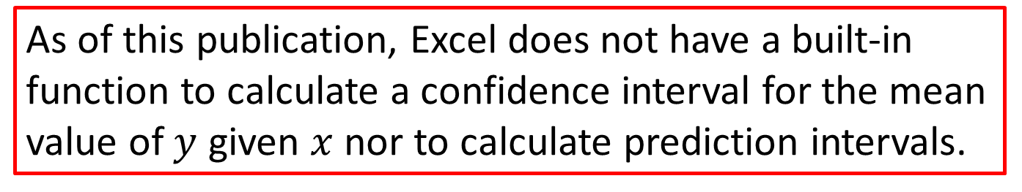
Note
As of this publication, Excel does not have a built-in function to calculate a confidence interval for the mean value of $y$ given $x$ nor to calculate prediction intervals.

Slide 21
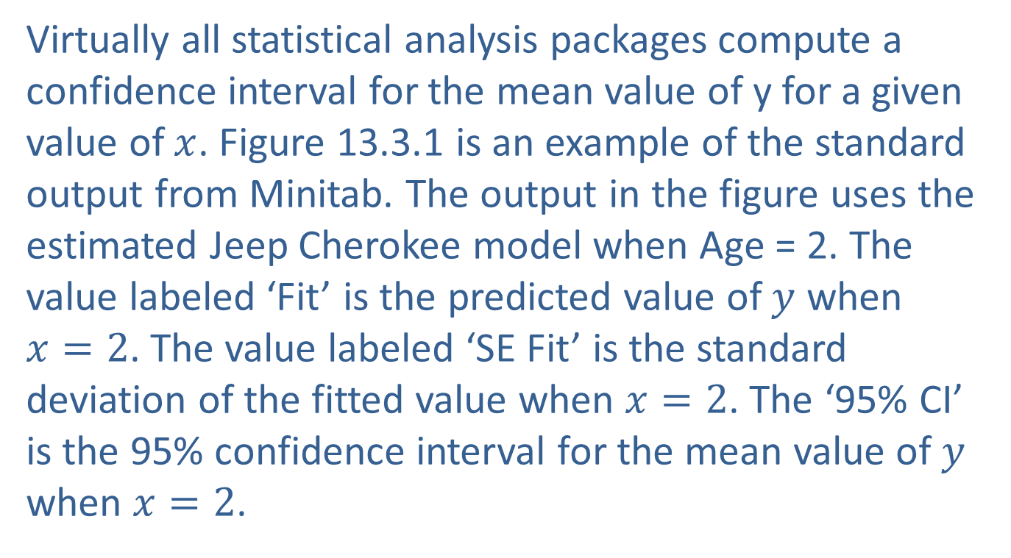

Confidence Intervals for the Mean Value of
$y$ Given $x$
Virtually all statistical analysis packages compute a confidence interval for the mean value of y for a given value of $x$. Figure 13.3.1 is an example of the standard output from Minitab. The output in the figure uses the estimated Jeep Cherokee model when Age = 2. The value labeled ‘Fit’ is the predicted value of $y$ when $x=2$. The value labeled ‘SE Fit’ is the standard deviation of the fitted value when $x=2$. The ‘95% CI’ is the 95% confidence interval for the mean value of $y$ when $x=2$.

Slide 22

Confidence Intervals for the Mean Value of
$y$ Given $x$ (cont.)
Note that the confidence interval from Minitab has slightly different endpoints than the one we calculated above due to the rounding of intermediate calculations.

Slide 23
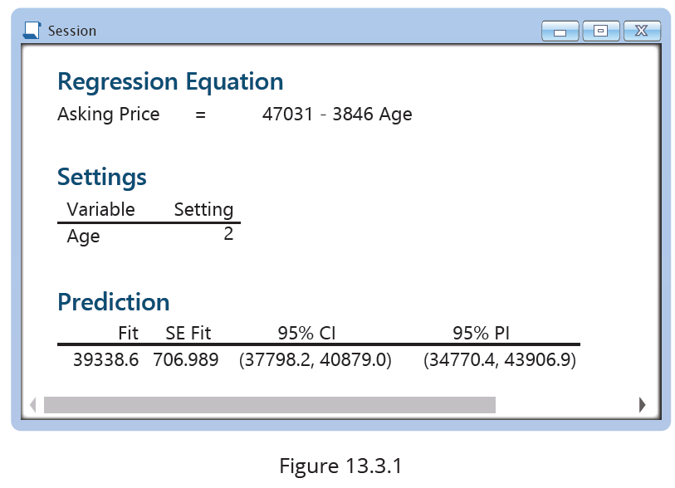
Confidence Intervals for the Mean Value of
$y$ Given $x$ (cont.)

Slide 24
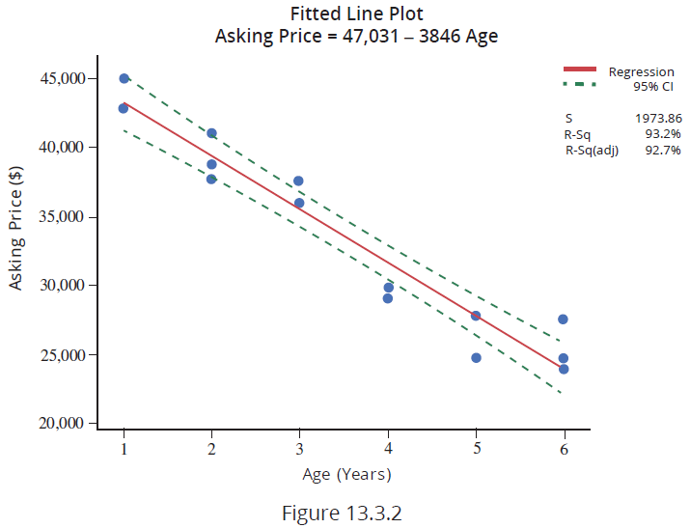
Confidence Intervals for the Mean Value of
$y$ Given $x$ (cont.)

Slide 25
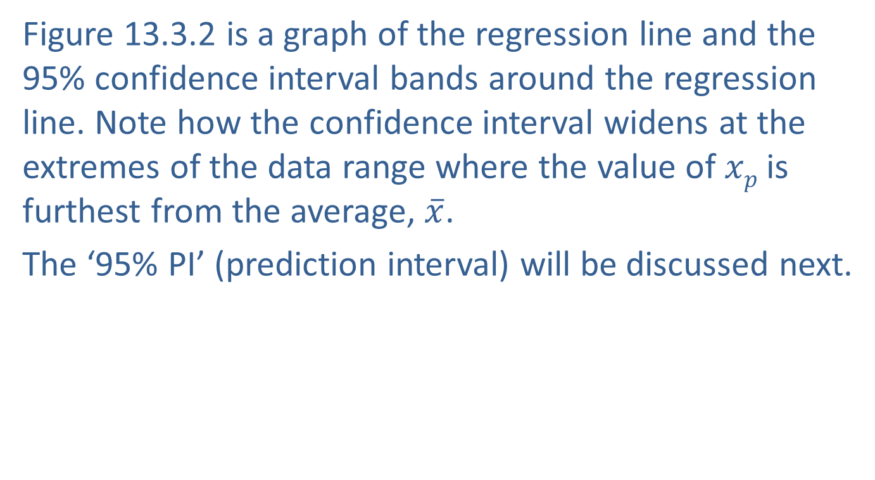
Confidence Intervals for the Mean Value of
$y$ Given $x$ (cont.)
Figure 13.3.2 is a graph of the regression line and the 95% confidence interval bands around the regression line. Note how the confidence interval widens at the extremes of the data range where the value of $xp$ is furthest from the average, $\overline{x}$.
The ‘95% PI’ (prediction interval) will be discussed next.

Slide 26
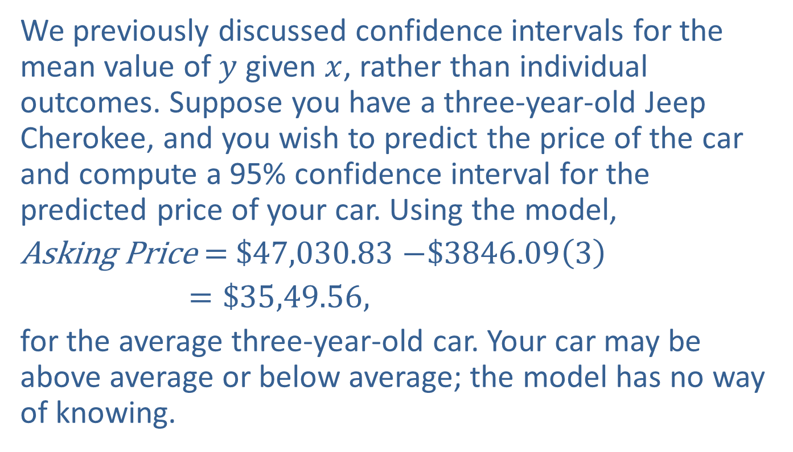

Confidence Intervals for the Predicted Value of
$y$ Given $x$
We previously discussed confidence intervals for the mean value of $y$ given $x$, rather than individual outcomes. Suppose you have a three-year-old Jeep Cherokee, and you wish to predict the price of the car and compute a 95% confidence interval for the predicted price of your car. Using the model,
Asking Price $=$$47,030.83 $−\$3846.09\left(3\right)$
$=\$35,49.56,$
for the average three-year-old car. Your car may be above average or below average; the model has no way of knowing.

Slide 27
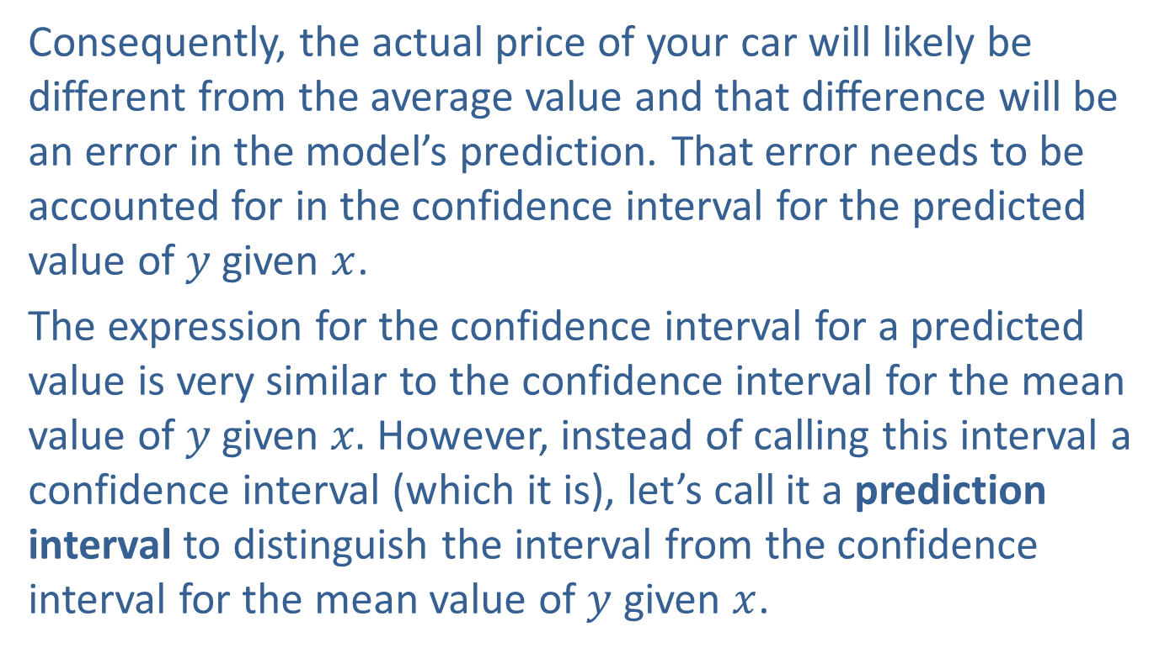

Confidence Intervals for the Predicted Value of
$y$ Given $x$ (cont.)
Consequently, the actual price of your car will likely be different from the average value and that difference will be an error in the model’s prediction. That error needs to be accounted for in the confidence interval for the predicted value of $y$ given $x$.
The expression for the confidence interval for a predicted value is very similar to the confidence interval for the mean value of $y$given $x.$ However, instead of calling this interval a confidence interval (which it is), let’s call it a prediction interval to distinguish the interval from the confidence interval for the mean value of $y$ given $x$.

Slide 28
Formula: 100(1 − α)% Confidence Interval for the Predicted Value of y Given x
A 100(1 − α)% confidence interval for the predicted value of y given x, also known as a prediction interval, is given by

Slide 29
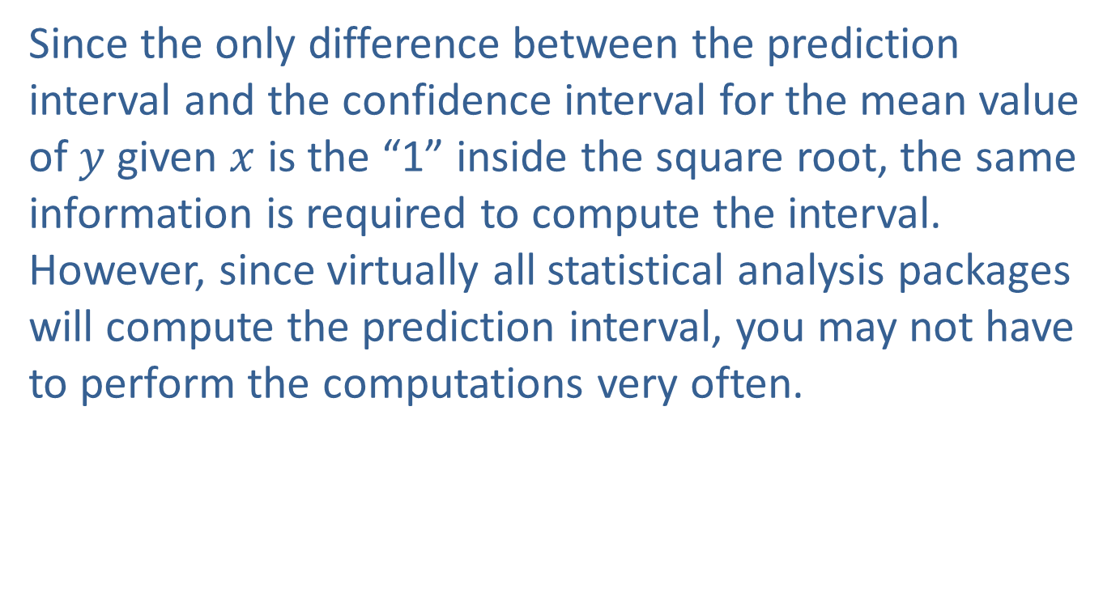
Confidence Intervals for the Predicted Value of
$y$ Given $x$ (cont.)
Since the only difference between the prediction interval and the confidence interval for the mean value of $y$ given $x$ is the “1” inside the square root, the same information is required to compute the interval. However, since virtually all statistical analysis packages will compute the prediction interval, you may not have to perform the computations very often.

Slide 30
Example 13.3.2: Determining a Prediction Interval for Price
Suppose you have a two-year-old Jeep Cherokee Limited you are considering selling. Compute the 95% prediction interval for the price of your Jeep Cherokee.
Solution
The predicted price of your two-year-old Jeep Cherokee is given by
Asking Price = $47,030.83 − $3846.09(2) = $39,338.65,
and

Slide 31
Example 13.3.2: Determining a Prediction Interval for Price (cont.)
and
Computing the interval, we have

Slide 32
Example 13.3.2: Determining a Prediction Interval for Price (cont.)
We are 95% confident that the actual price of your two-year-old Jeep Cherokee will be within $4568.48 of the average price for two-year-old Jeep Cherokee , $39,338.65. Specifically, we are 95% confident that the price of your Jeep Cherokee will be between $34,770.17 and $43,907.13.

Slide 33
Note
These values differ slightly from the 95% prediction interval shown in Figure 13.3.1 due to rounding of the values used in the example.

Slide 34
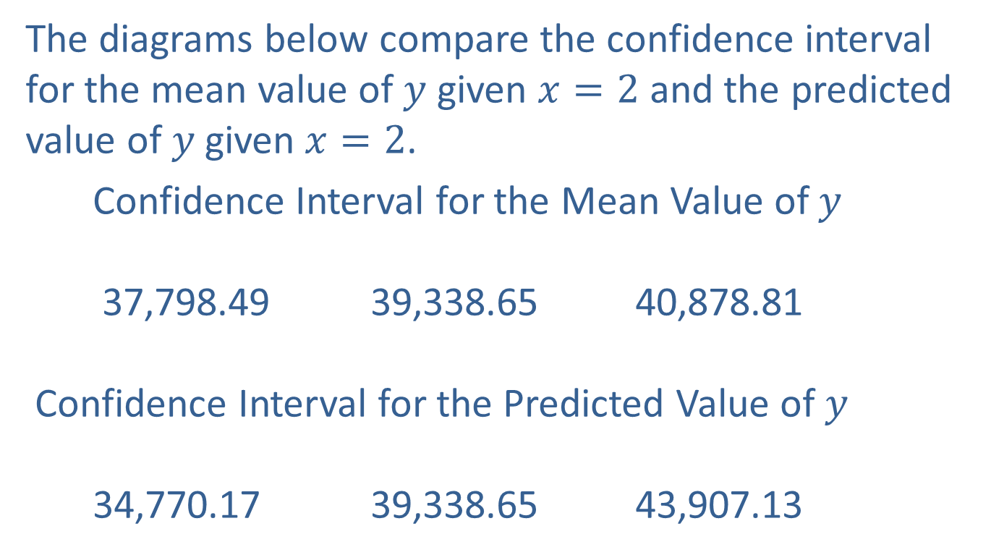
Confidence Intervals for the Predicted Value of
$y$ Given $x$ (cont.)
The diagrams below compare the confidence interval for the mean value of $y$ given $x=2$ and the predicted value of$y$given $x=2$.
Confidence Interval for the Mean Value of $y$
37,798.49 39,338.65 40,878.81
Confidence Interval for the Predicted Value of $y$
34,770.17 39,338.65 43,907.13

Slide 35
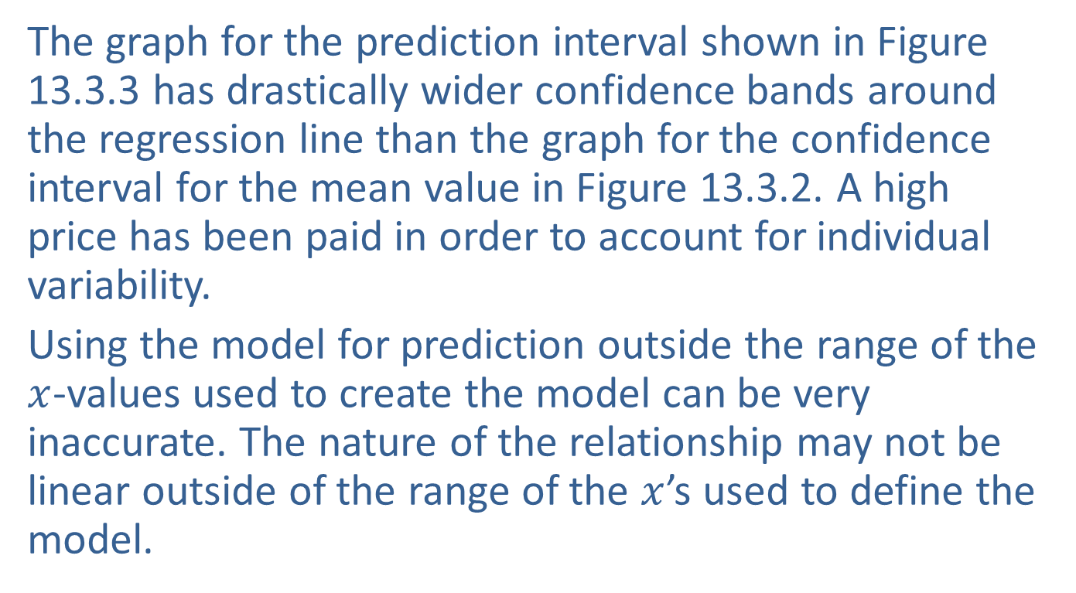
Confidence Intervals for the Predicted Value of
$y$ Given $x$ (cont.)
The graph for the prediction interval shown in Figure 13.3.3 has drastically wider confidence bands around the regression line than the graph for the confidence interval for the mean value in Figure 13.3.2. A high price has been paid in order to account for individual variability.
Using the model for prediction outside the range of the $x$-values used to create the model can be very inaccurate. The nature of the relationship may not be linear outside of the range of the $x$’s used to define the model.

Slide 36
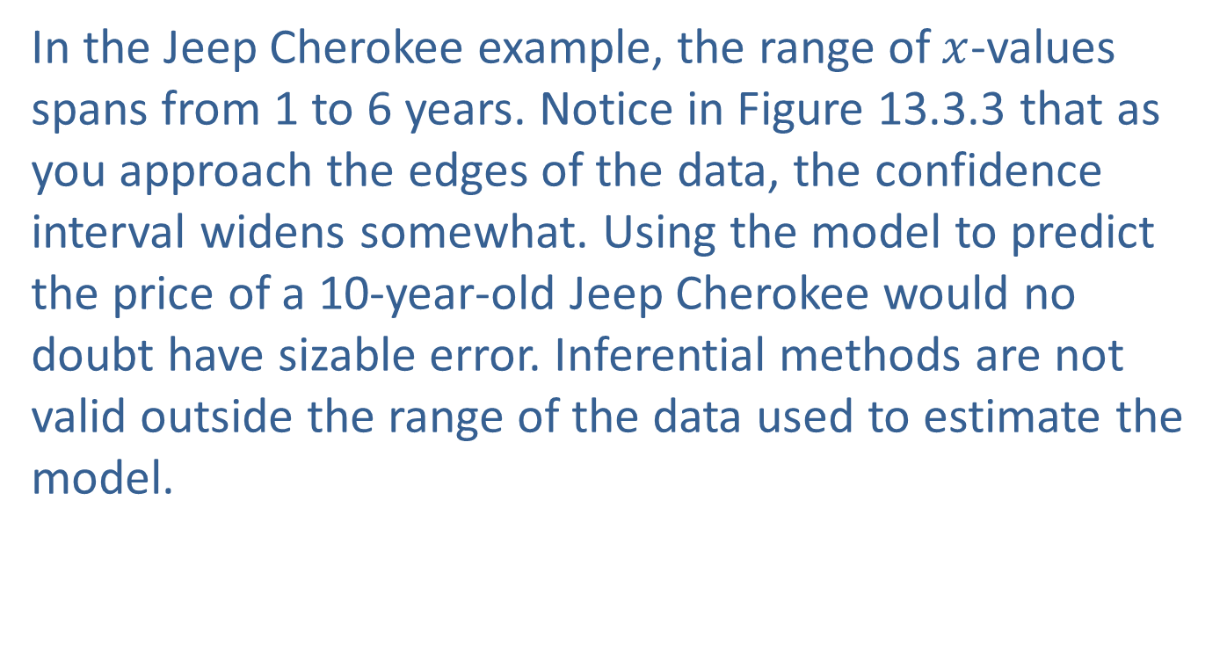
Confidence Intervals for the Predicted Value of
$y$ Given $x$ (cont.)
In the Jeep Cherokee example, the range of $x$-values spans from 1 to 6 years. Notice in Figure 13.3.3 that as you approach the edges of the data, the confidence interval widens somewhat. Using the model to predict the price of a 10-year-old Jeep Cherokee would no doubt have sizable error. Inferential methods are not valid outside the range of the data used to estimate the model.

Slide 37
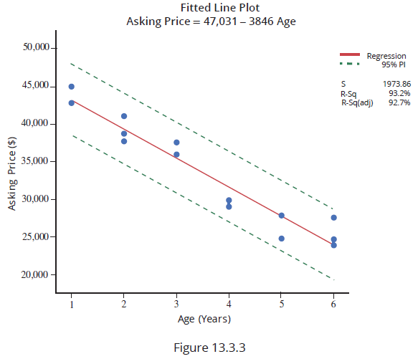
Confidence Intervals for the Predicted Value of
$y$ Given $x$ (cont.)

