Slide 1
Section 13.2
Inference Concerning β₁

Slide 2
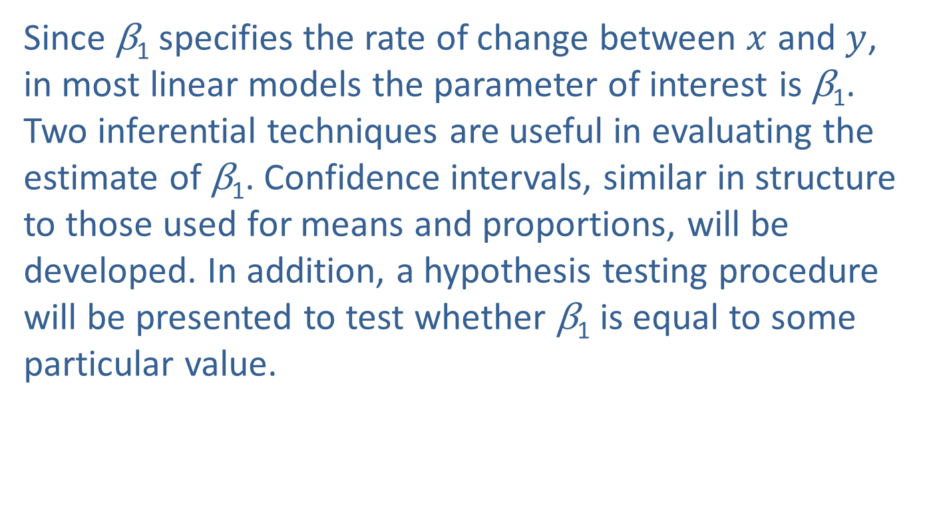

Inference Concerning $β$₁
Since β₁ specifies the rate of change between $x$ and $y$, in most linear models the parameter of interest is β₁. Two inferential techniques are useful in evaluating the estimate of β₁. Confidence intervals, similar in structure to those used for means and proportions, will be developed. In addition, a hypothesis testing procedure will be presented to test whether β₁ is equal to some particular value.

Slide 3

The Confidence Interval for$β$₁
Developing a confidence interval for β₁ requires thinking about the estimate b₁ as a random variable. Each random sample from the population will produce different data and hence different least squares estimates of b₀ and b₁. The confidence interval will serve two purposes, to place bounds on the location of β₁ as well as to provide information about the quality of the point estimate b₁. The form of the confidence interval is familiar.

Slide 4


The Confidence Interval for$β$₁ (cont.)
± .
The sample estimate of β₁ is b₁. The variance of b₁ is given by
but like all population measurements, $σ_{b_{1}}^{2}$ usually has to be estimated from the data.
Sample estimate of parameter
A certain number of standard deviations units depending on the desired confidence
The standard deviation of the sample estimate

Slide 5
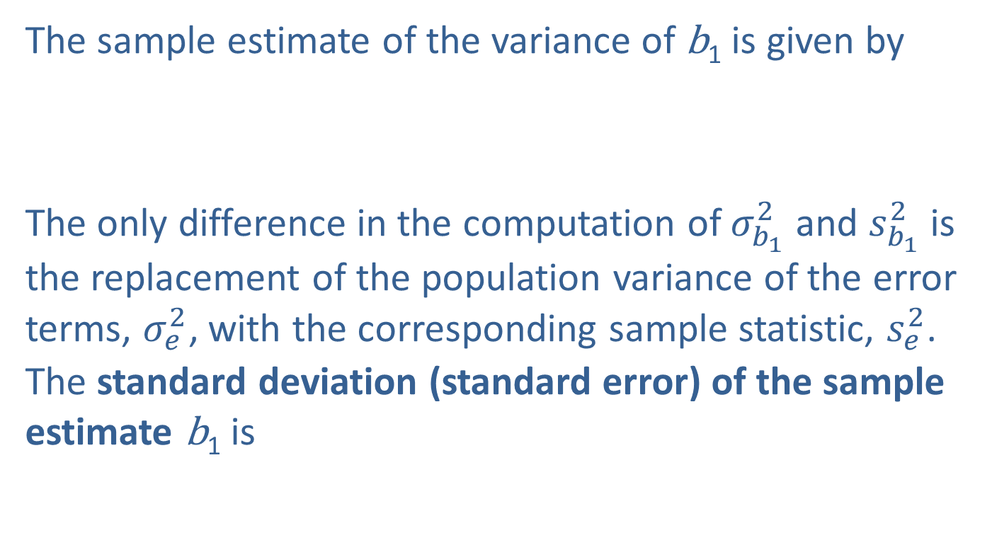
The Confidence Interval for$β$₁ (cont.)
The sample estimate of the variance of b₁ is given by
The only difference in the computation of $σ_{b_{1}}^{2}$and $s_{b_{1}}^{2}$is the replacement of the population variance of the error terms, $σ_{e_{ }}^{2}$, with the corresponding sample statistic, $s_{e_{ }}^{2}$. The standard deviation (standard error) of the sample estimate b₁ is

Slide 6
Definition: 100(1 − 𝛼)% Confidence Interval for β₁
The 100(1 − α)% confidence interval for β₁ is given by
where is the critical value for a t-distribution with n − 2 degrees of freedom.

Slide 7
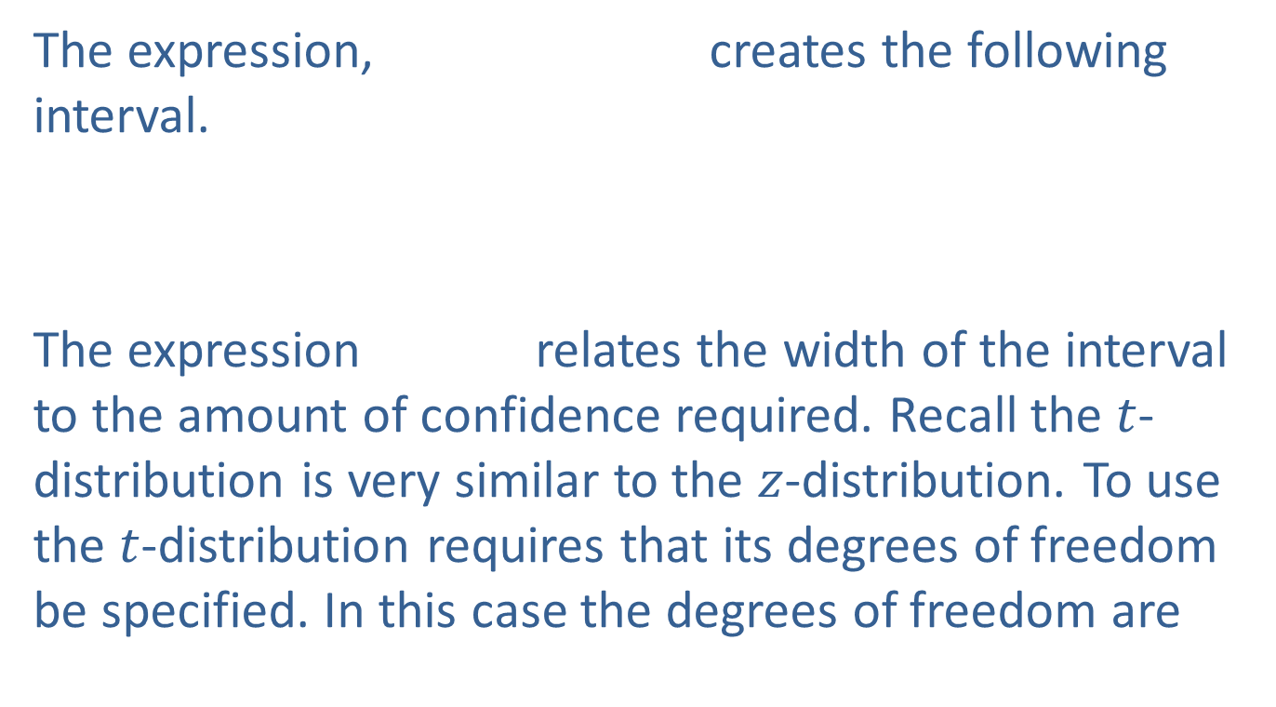
The Confidence Interval for$β$₁ (cont.)
The expression, creates the following interval.
The expression relates the width of the interval to the amount of confidence required. Recall the $t$-distribution is very similar to the $z$-distribution. To use the $t$-distribution requires that its degrees of freedom be specified. In this case the degrees of freedom are

Slide 8

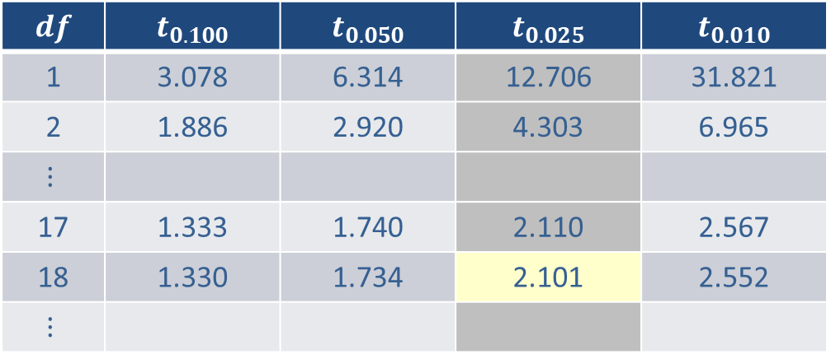
The Confidence Interval for$β$₁ (cont.)
If a 95% confidence is desired, then $1−α=0.95$, which implies $α=0.05$and $α/2={0.05}/2=0.025.$ Suppose the sample size is $n=20$. Using the tables for the $t$-distribution in the appendix, would be.
$$df$$ | $$t_{0.100}$$ | $$t_{0.050}$$ | $$t_{0.025}$$ | $$t_{0.010}$$
1 | 3.078 | 6.314 | 12.706 | 31.821
2 | 1.886 | 2.920 | 4.303 | 6.965
$$⋮$$
17 | 1.333 | 1.740 | 2.110 | 2.567
18 | 1.330 | 1.734 | 2.101 | 2.552
$$⋮$$

Slide 9
The Confidence Interval for$β$₁ (cont.)
Hence, to be 95% confident of capturing the true value of β₁ in the confidence interval will require placing the interval endpoints 2.101 standard deviation units from the point estimate, b₁.

Slide 10
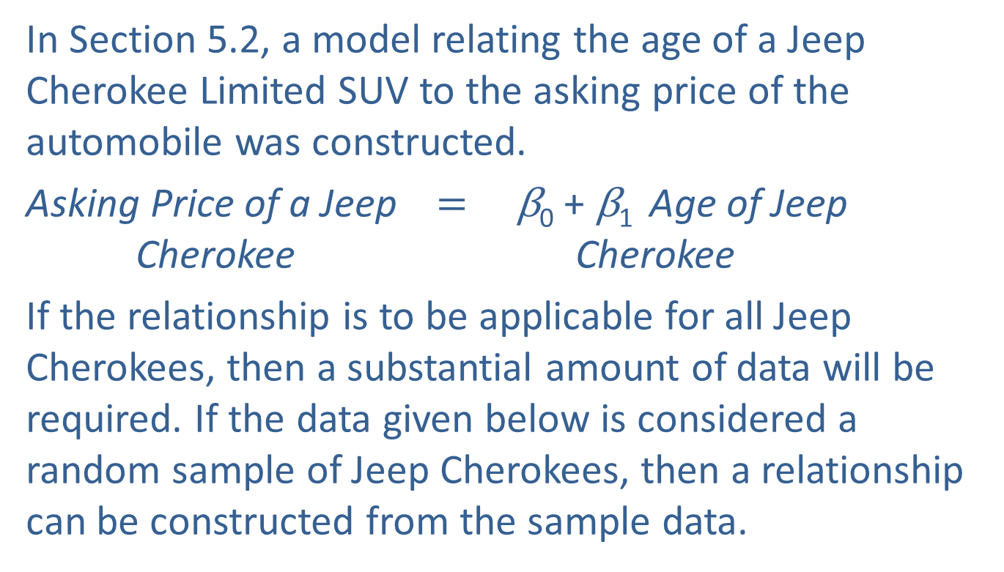
Example 13.2.1: Estimating a Confidence Interval for the Slope
In Section 5.2, a model relating the age of a Jeep Cherokee Limited SUV to the asking price of the automobile was constructed.
Asking Price of a Jeep $=$ β₀ + β₁ Age of Jeep Cherokee Cherokee
If the relationship is to be applicable for all Jeep Cherokees, then a substantial amount of data will be required. If the data given below is considered a random sample of Jeep Cherokees, then a relationship can be constructed from the sample data.

Slide 11
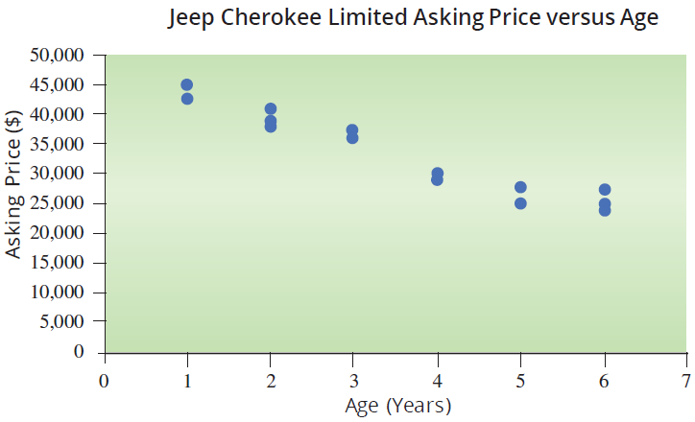
Example 13.2.1: Estimating a Confidence Interval for the Slope (cont.)
Price of a Jeep Cherokee Limited SUV
Age (Years) | Asking Price
1 | $44,998
1 | $42,768
2 | $38,731
2 | $40,999
2 | $37,619
3 | $37,573
3 | $35,955
4 | $28,997
4 | $29,850
5 | $24,750
5 | $27,799
6 | $23,899
6 | $27,500
6 | $24,689

Slide 12
Example 13.2.1: Estimating a Confidence Interval for the Slope (cont.)
To use the method of least squares to estimate the model parameters from the sample data, we must verify the assumptions. It is evident from the scatterplot, that there is a definite linear relationship between the variables age and asking price. It is also apparent from a normal probability plot that the error terms (residuals) are normally distributed.

Slide 13
Example 13.2.1: Estimating a Confidence Interval for the Slope (cont.)
The sample is a random sample of paired data.
Error terms are normally distributed and independent (assumed).
If we are fitting a simple linear model, the scatterplot should suggest a linear relationship between the variables.

Slide 14
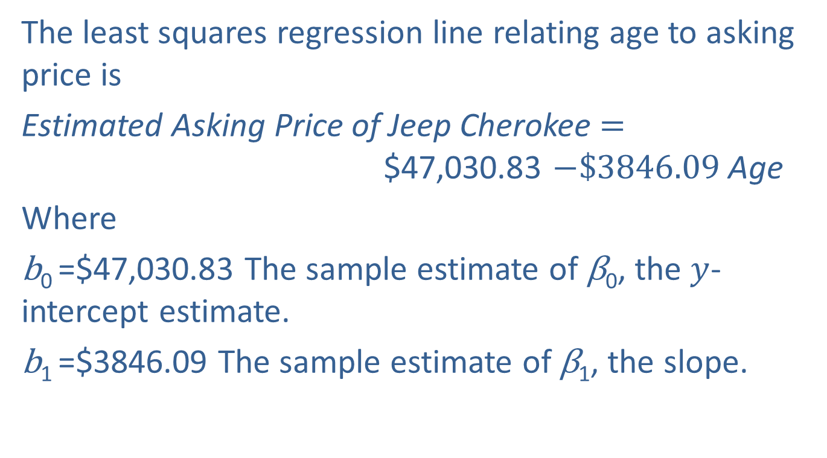
Example 13.2.1: Estimating a Confidence Interval for the Slope (cont.)
The least squares regression line relating age to asking price is
Estimated Asking Price of Jeep Cherokee $=$ $47,030.83 $−\$3846.09$Age
Where
b₀ =$47,030.83 The sample estimate of β₀, the $y$-intercept estimate.
b₁ =$3846.09 The sample estimate of β₁, the slope.

Slide 15
Example 13.2.1: Estimating a Confidence Interval for the Slope (cont.)
To draw conclusions about the relationship between asking price and age for the entire population of Jeep Cherokee Limiteds, statistical inference must be applied. We will begin by estimating a 95% confidence interval for β₁.

Slide 16
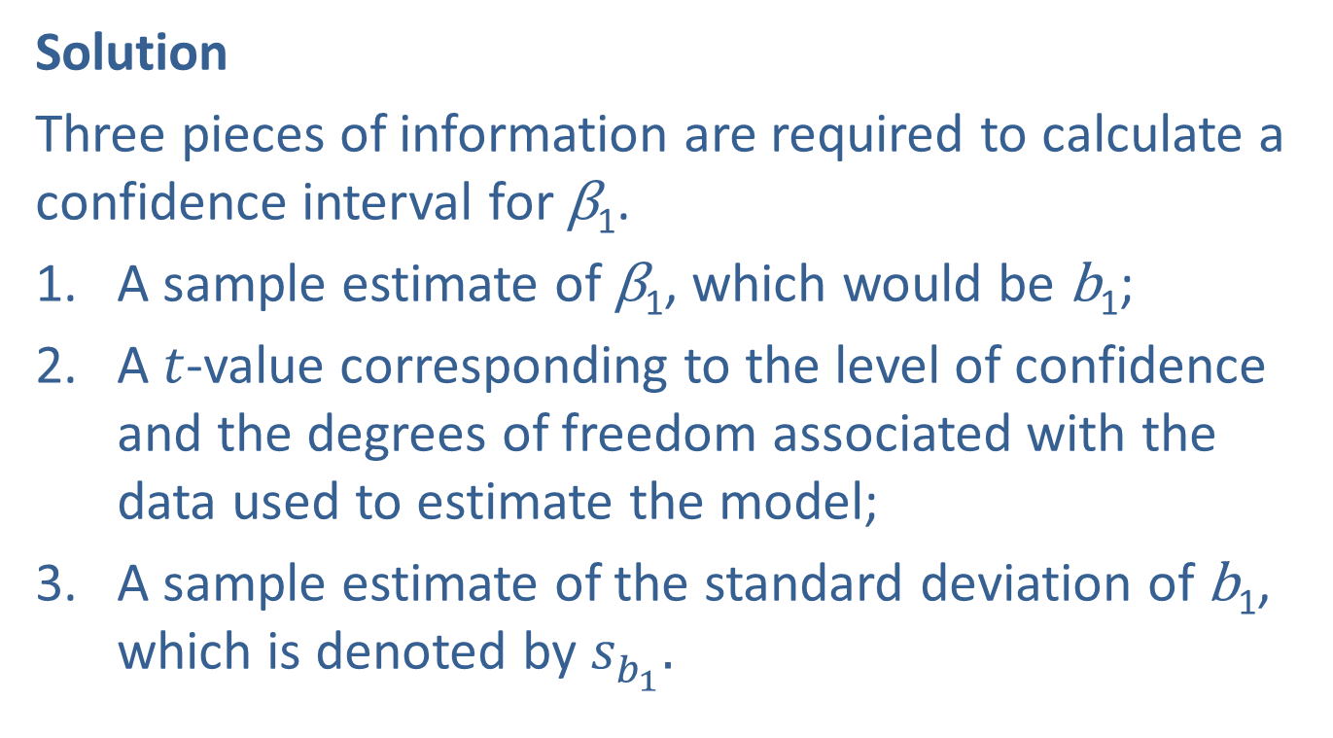
Example 13.2.1: Estimating a Confidence Interval for the Slope (cont.)
Solution
Three pieces of information are required to calculate a confidence interval for β₁.
A sample estimate of β₁, which would be b₁;
A $t$-value corresponding to the level of confidence and the degrees of freedom associated with the data used to estimate the model;
A sample estimate of the standard deviation of b₁, which is denoted by $s_{b_{1}}^{ }.$

Slide 17
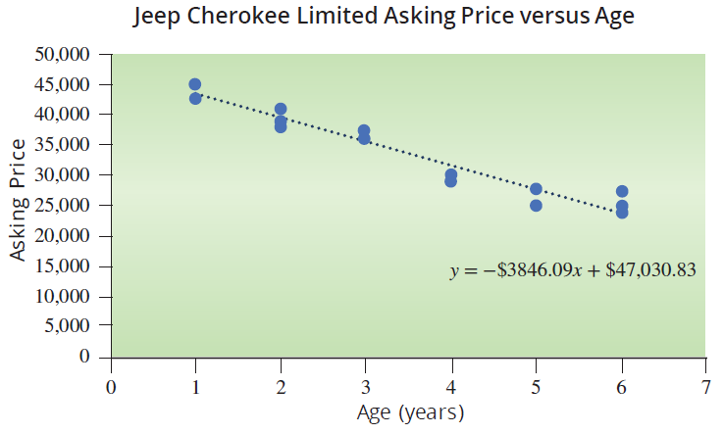
Example 13.2.1: Estimating a Confidence Interval for the Slope (cont.)

Slide 18
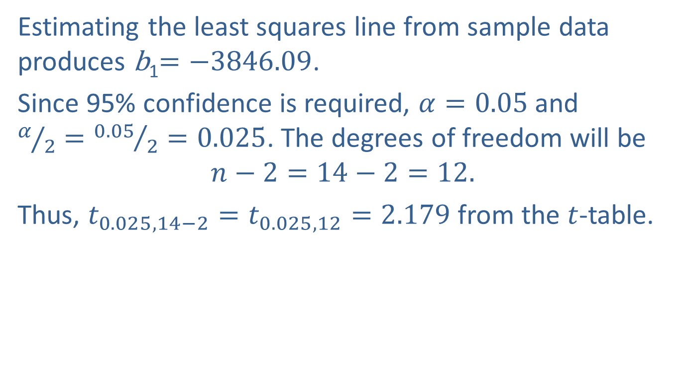
Example 13.2.1: Estimating a Confidence Interval for the Slope (cont.)
Estimating the least squares line from sample data produces b₁$=−3846.09$.
Since 95% confidence is required, $α=0.05$and $α/2={0.05}/2=0.025$. The degrees of freedom will be
$$n−2=14−2=12.$$
Thus, $t_{0.025,14−2}=t_{0.025, 12}=2.179$ from the $t$-table.

Slide 19
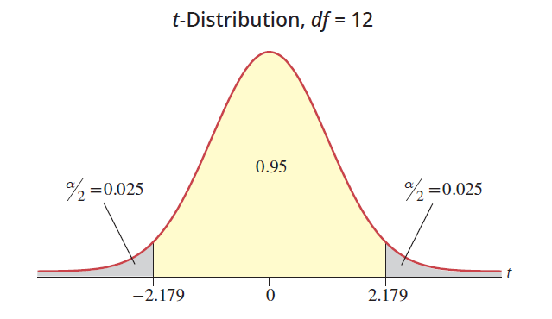
Example 13.2.1: Estimating a Confidence Interval for the Slope (cont.)

Slide 20
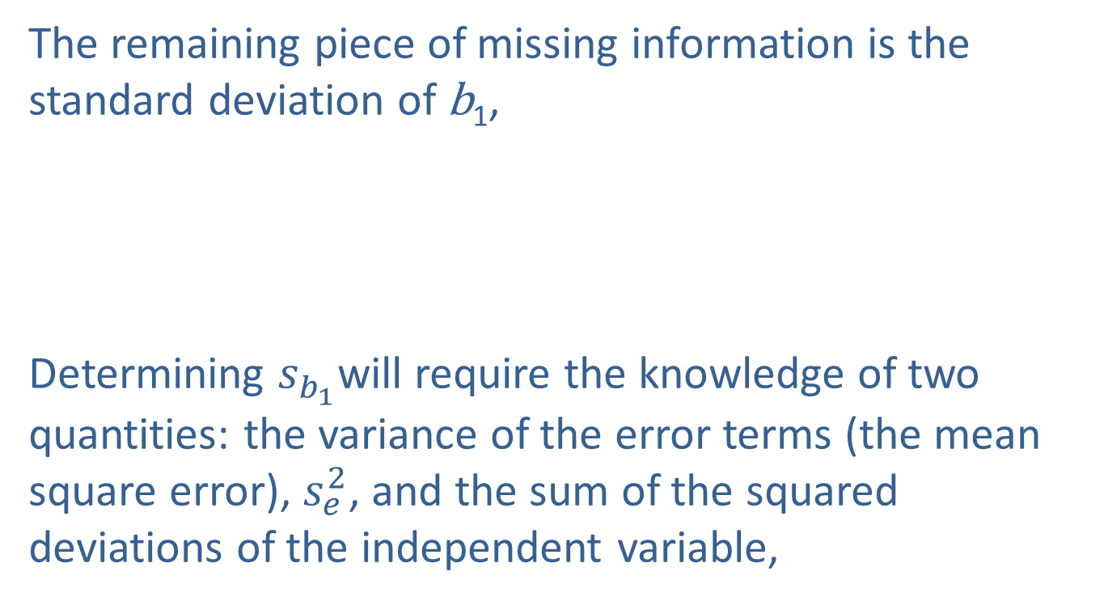
Example 13.2.1: Estimating a Confidence Interval for the Slope (cont.)
The remaining piece of missing information is the standard deviation of b₁,
Determining $s_{b_{1}}$will require the knowledge of two quantities: the variance of the error terms (the mean square error), $s_{e}^{2}$, and the sum of the squared deviations of the independent variable,

Slide 21
Example 13.2.1: Estimating a Confidence Interval for the Slope (cont.)
The mean square error was computed in Section 5.3 as follows,
The sum of the squared deviations of the independent variable (age), is given in the bottom row of the table. Thus, the standard deviation of b₁ is calculated as follows.

Slide 22
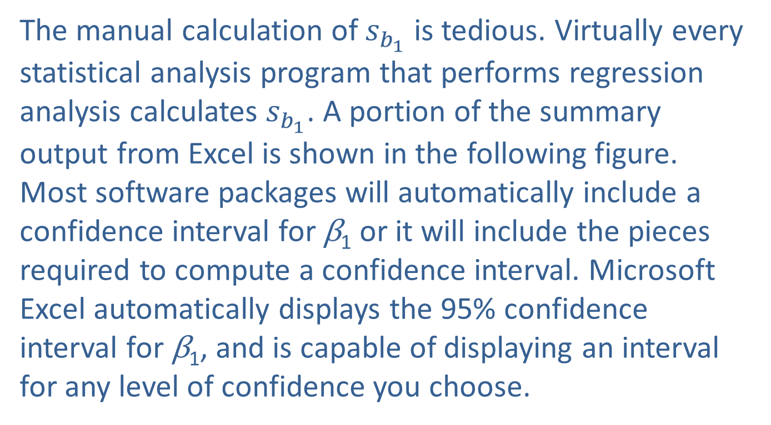
Example 13.2.1: Estimating a Confidence Interval for the Slope (cont.)
The manual calculation of $s_{b_{1}}$ is tedious. Virtually every statistical analysis program that performs regression analysis calculates $s_{b_{1}}$. A portion of the summary output from Excel is shown in the following figure. Most software packages will automatically include a confidence interval for β₁ or it will include the pieces required to compute a confidence interval. Microsoft Excel automatically displays the 95% confidence interval for β₁, and is capable of displaying an interval for any level of confidence you choose.

Slide 23
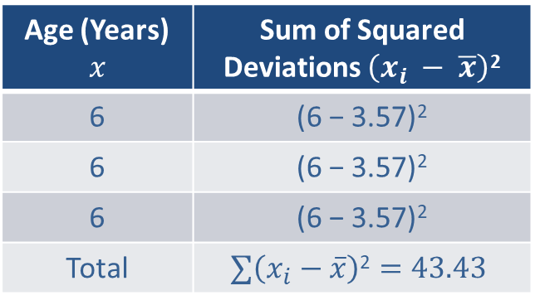
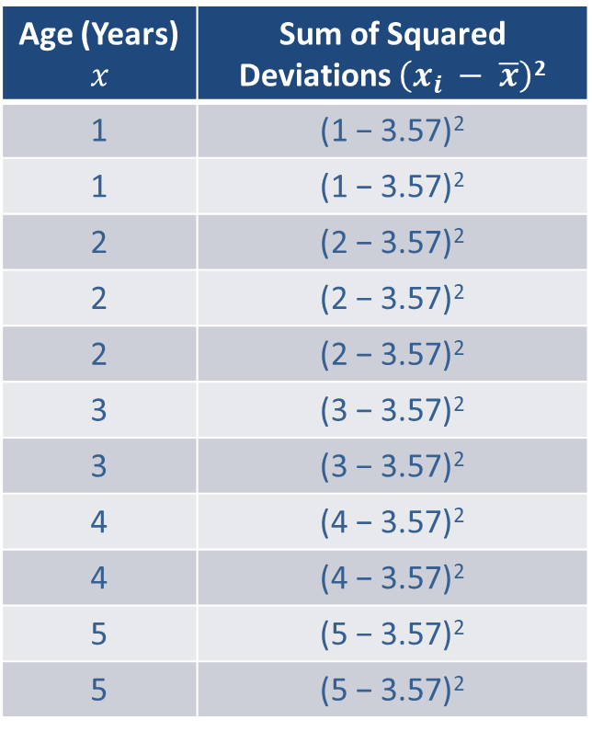
Example 13.2.1: Estimating a Confidence Interval for the Slope (cont.)
Age (Years) $$x$$ | Sum of Squared Deviations $\left(x_{i} − \overline{x}\right)$²
1 | (1 − 3.57)²
1 | (1 − 3.57)²
2 | (2 − 3.57)²
2 | (2 − 3.57)²
2 | (2 − 3.57)²
3 | (3 − 3.57)²
3 | (3 − 3.57)²
4 | (4 − 3.57)²
4 | (4 − 3.57)²
5 | (5 − 3.57)²
5 | (5 − 3.57)²
Age (Years) $$x$$ | Sum of Squared Deviations $\left(x_{i} − \overline{x}\right)$²
6 | (6 − 3.57)²
6 | (6 − 3.57)²
6 | (6 − 3.57)²
Total | $$∑\left(x_{i}−\overline{x}\right)\text{2}=43.43$$

Slide 24
Example 13.2.1: Estimating a Confidence Interval for the Slope (cont.)
ANOVA
 | df | SS | MS | F | Signiﬁcance F
Regression | 1 | 642413863.2256 | 642413863.2256 | 164.8850 | 2.26608E-08
Residual | 12 | 46753593.1316 | 3896132.7610
Total | 13 | 689167456.3571
 | Coeﬃcients | Standard Error | t Stat | P-value | Lower 95% | Upper 95%
Intercept | 47030.8289 | 1192.7284 | 39.4313 | 0.0000 | 44432.09694 | 49629.56095
Age (Years) |  |  | −12.8408 | 0.0000 | −4498.695045 | −3193.489166

Slide 25
Note
Since the hand calculation of the confidence interval for β₁ used values that were rounded, the interval varies slightly from what is reported by Minitab or Microsoft Excel.

Slide 26
Formula: 100(1 − α)% Confidence Interval for β₁

Slide 27
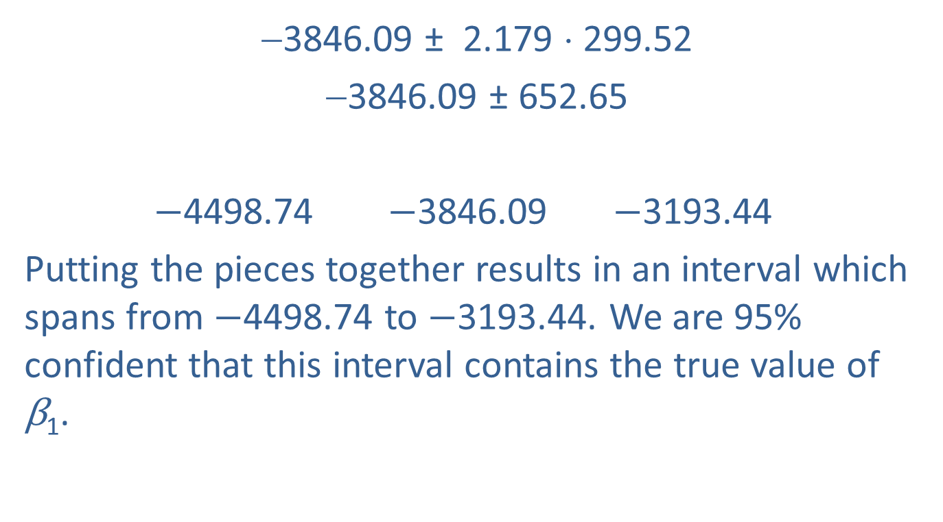
Example 13.2.1: Estimating a Confidence Interval for the Slope (cont.)
−3846.09 ± 2.179 ⋅ 299.52
−3846.09 ± 652.65
$−$4498.74 $−$3846.09 $−$3193.44
Putting the pieces together results in an interval which spans from $−$4498.74 to $−$3193.44. We are 95% confident that this interval contains the true value of
β₁.

Slide 28
Example 13.2.1: Estimating a Confidence Interval for the Slope (cont.)
There are two possible interpretations of this interval
We are 95% confident that the true decrease in the price of a Jeep Cherokee Limited for a one-year increase in the age of the car is between $3193.44 and $4498.74.
We are 95% confident that the maximum error of the point estimate (b₁ = −3846.09) in estimating the unknown β₁ (the true decrease in the price of a Jeep Cherokee Limited for a one-year increase in the age of the car) is at most $652.65.

Slide 29
Example 13.2.2: Constructing a Confidence Interval for the Slope
Construct a 99% confidence interval for β₁ using the model described in Example 13.2.1.
Solution
The difference between a 95% confidence interval and a 99% confidence interval is expressed in the value of
For 99% confidence 1 − α = 0.99, which implies
α = 0.01; hence,
The degrees of freedom will remain n − 2 = 14 − 2 = 12.

Slide 30
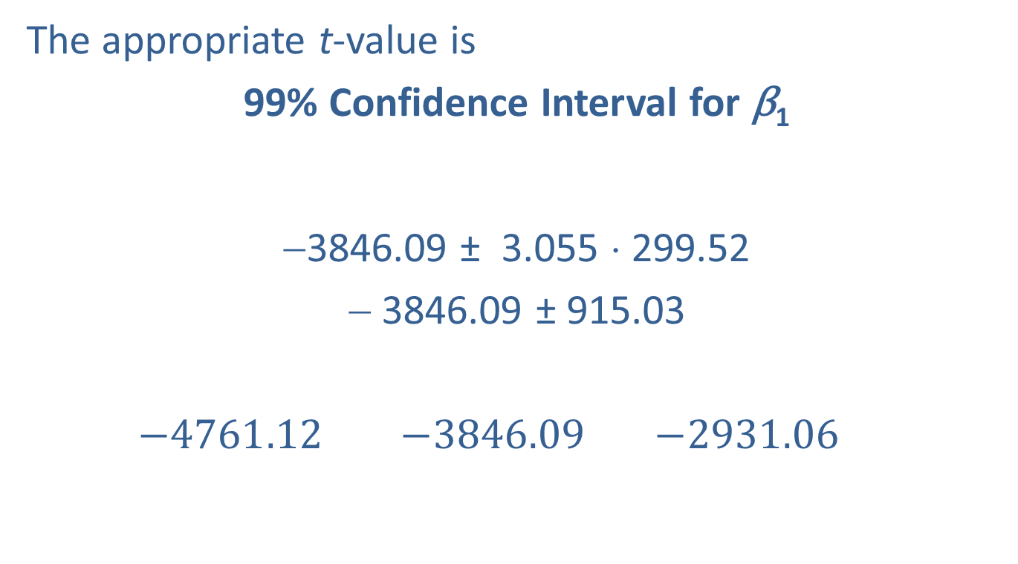
Example 13.2.2: Constructing a Confidence Interval for the Slope (cont.)
The appropriate t-value is
99% Confidence Interval for β₁
−3846.09 ± 3.055 ⋅ 299.52
− 3846.09 ± 915.03
$−4761.12$ $−3846.09$ $−2931.06$

Slide 31
Example 13.2.2: Constructing a Confidence Interval for the Slope (cont.)
Requiring more confidence in the interval results in a much wider interval. The trade-off is less precision (interval with wider width) for more confidence.
It is important to remember that the assumptions of the linear model given in Section 13.1 must hold in order to retain the specified degree of confidence in the interval.

Slide 32
Example 13.2.3: Constructing a Confidence Interval for the Slope in the GPA Model
In Section 5.3 we examined a model relating SAT score to graduating GPA. A portion of the data is repeated here.
SAT Scores and Graduating GPA
Student | SAT Verbal | SAT Math | SAT Total | College GPA
1 | 680 | 554 | 1234 | 3.42
2 | 486 | 562 | 1048 | 2.37
3 | 500 | 564 | 1064 | 2.52
4 | 501 | 564 | 1065 | 2.25
5 | 503 | 583 | 1086 | 2.90
. . .

Slide 33
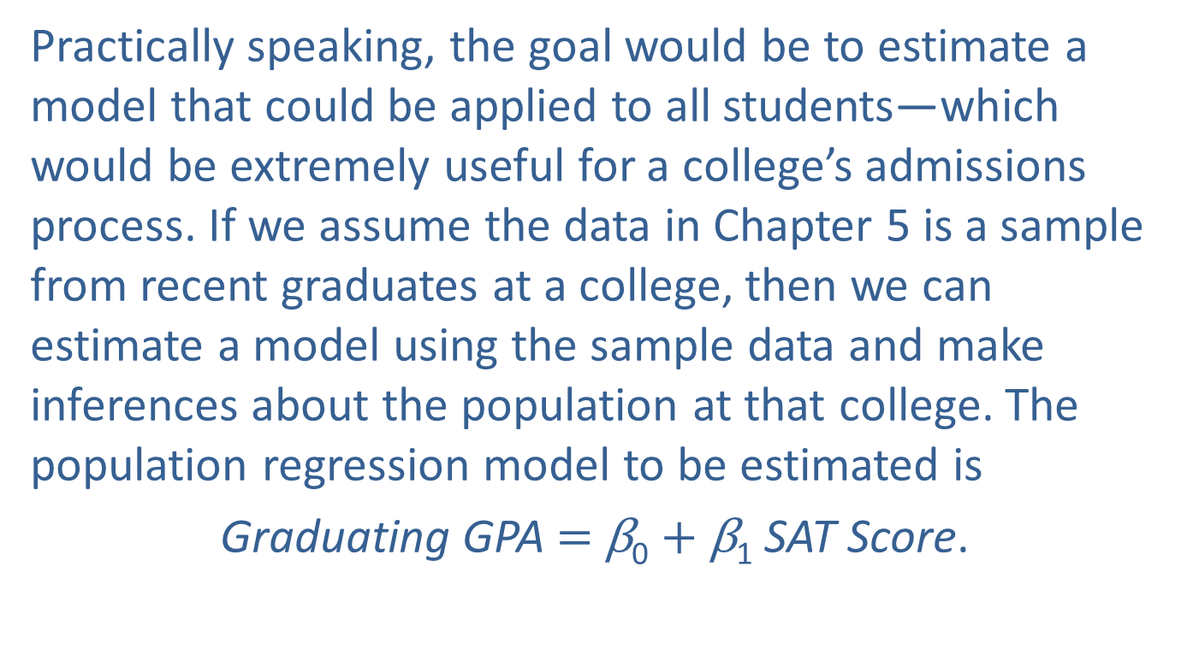
Example 13.2.3: Constructing a Confidence Interval for the Slope in the GPA Model (cont.)
Practically speaking, the goal would be to estimate a model that could be applied to all students—which would be extremely useful for a college’s admissions process. If we assume the data in Chapter 5 is a sample from recent graduates at a college, then we can estimate a model using the sample data and make inferences about the population at that college. The population regression model to be estimated is
Graduating GPA $=$ β₀ $+$ β₁ SAT Score.

Slide 34
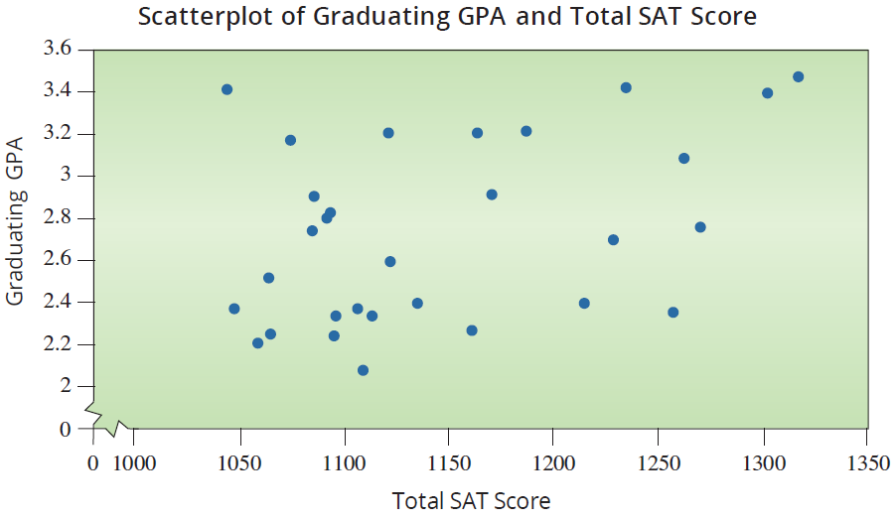
Example 13.2.3: Constructing a Confidence Interval for the Slope in the GPA Model (cont.)
We will begin by making an inference concerning β₁. Construct a 95% confidence interval for β₁.

Slide 35

Example 13.2.3: Constructing a Confidence Interval for the Slope in the GPA Model (cont.)
Solution
As noted in section 5.3, the paired data on SAT score and graduating GPA are taken from a random sample of students. The scatterplot does not show an overwhelming linear pattern, but a slight linear trend is apparent.
The sample is a random sample of paired data
Error terms are normally distributed and independent (assumed).

Slide 36
Example 13.2.3: Constructing a Confidence Interval for the Slope in the GPA Model (cont.)
If we are fitting a simple linear model, the scatterplot should show a linear relationship between the variables.
Using Excel’s statistical analysis package to estimate the linear regression model, the output is given below.
ANOVA
 | df | SS | MS | F | Signiﬁcance F
Regression | 1 | 0.854832198 | 0.854832198 | 5.321848064 | 0.028670474
Residual | 28 | 4.497554469 | 0.160626945
Total | 29 | 5.352386667

Slide 37
Example 13.2.3: Constructing a Confidence Interval for the Slope in the GPA Model (cont.)
 | Coeﬃcients | Standard Error | t Stat | P-value | Lower 95% | Upper 95%
Intercept | 0.273342604 | 1.067710391 | 0.256008189 | 0.799816021 | −1.913762987 | 2.460448195
SAT Score | 0.002144823 |  | 2.306913103 | 0.028670474 | 0.000240343 | 0.004049304

Slide 38
Note
In the summary output from Excel, the confidence interval is already given (see the highlighted values above), but some technologies may require you to pull the pieces from the output to calculate the confidence interval.

Slide 39
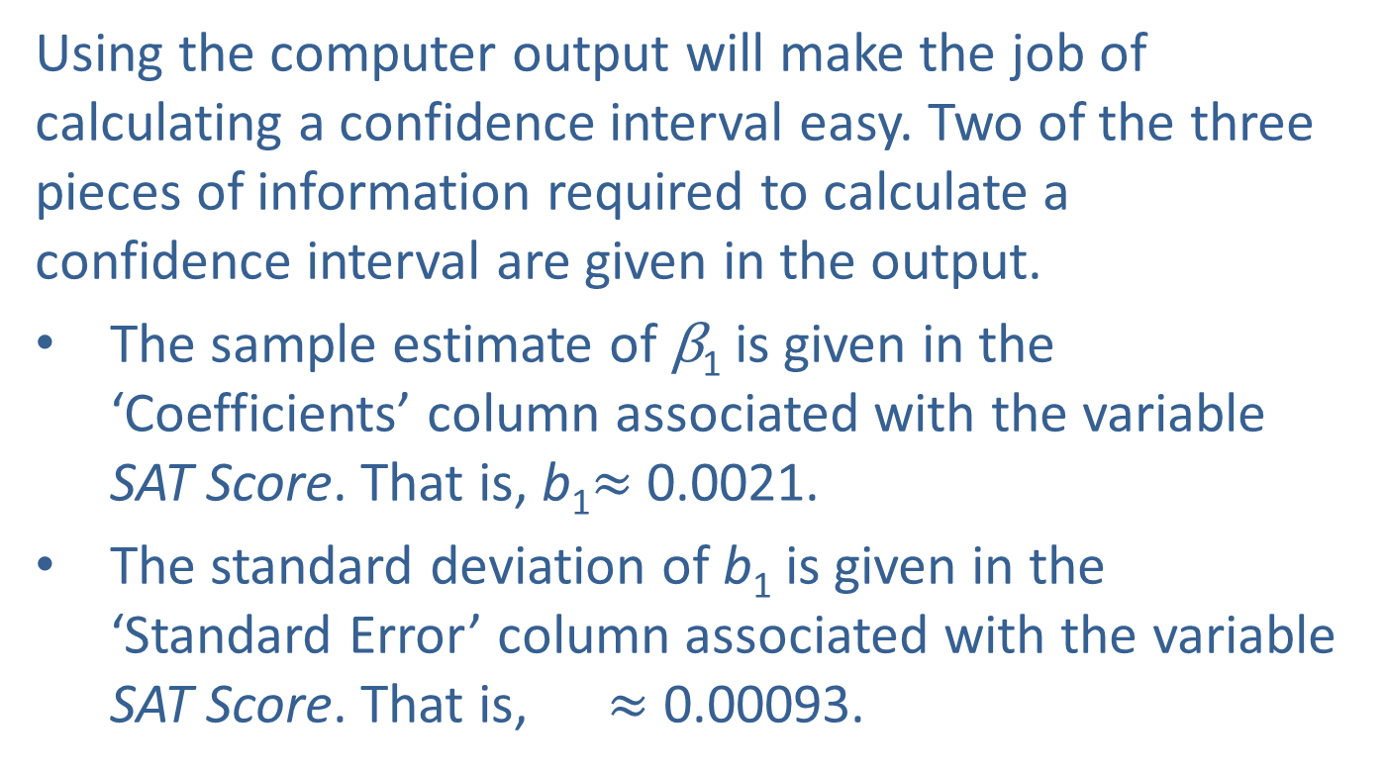
Example 13.2.3: Constructing a Confidence Interval for the Slope in the GPA Model (cont.)
Using the computer output will make the job of calculating a confidence interval easy. Two of the three pieces of information required to calculate a confidence interval are given in the output.
The sample estimate of β₁ is given in the ‘Coefficients’ column associated with the variable SAT Score. That is, b₁$≈$ 0.0021.
The standard deviation of b₁ is given in the ‘Standard Error’ column associated with the variable SAT Score. That is, $≈$ 0.00093.

Slide 40
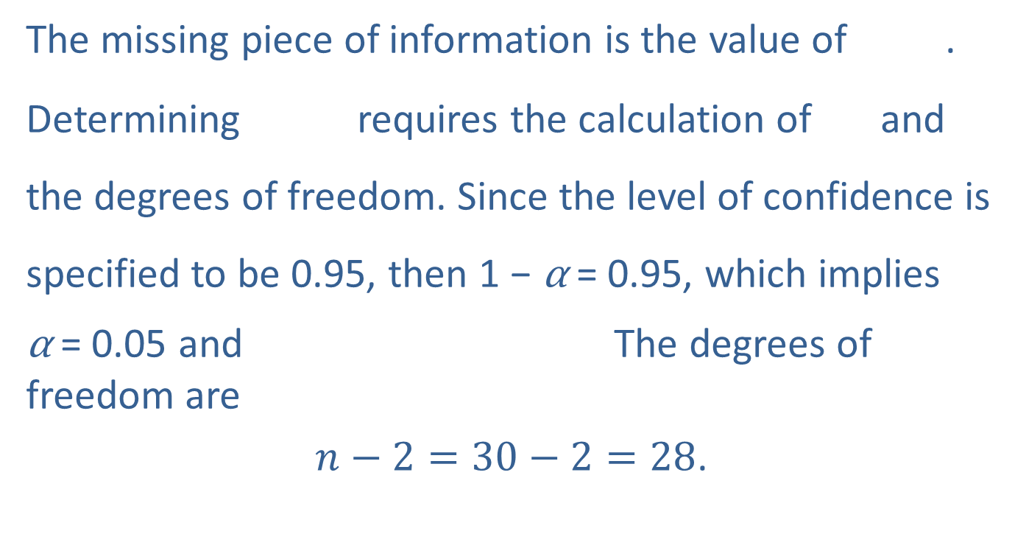
Example 13.2.3: Constructing a Confidence Interval for the Slope in the GPA Model (cont.)
The missing piece of information is the value of .
Determining requires the calculation of and the degrees of freedom. Since the level of confidence is specified to be 0.95, then 1 − α = 0.95, which implies
α = 0.05 and The degrees of freedom are
$n−2=30−2=28$.

Slide 41
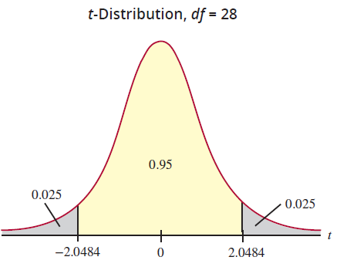
Example 13.2.3: Constructing a Confidence Interval for the Slope in the GPA Model (cont.)
Consequently, using technology

Slide 42
Example 13.2.3: Constructing a Confidence Interval for the Slope in the GPA Model (cont.)
Now, let's assemble all the pieces. The 100(1 − α)% confidence interval for β₁ is
0.0021 ± 2.0484 · 0.00093
0.0021 ± 0.001905
0.0002 0.0021 0.0040
We are 95% confident that the interval contains the true value of β₁. There are two possible interpretations of this interval.

Slide 43
Example 13.2.3: Constructing a Confidence Interval for the Slope in the GPA Model (cont.)
We are 95% confident that the true increase in GPA for a one-point increase in SAT scores is between 0.0002 and 0.0040.
We are 95% confident the maximum error of the point estimate (b₁ = 0.0021) in estimating the unknown β₁ is at most 0.001905.

Slide 44
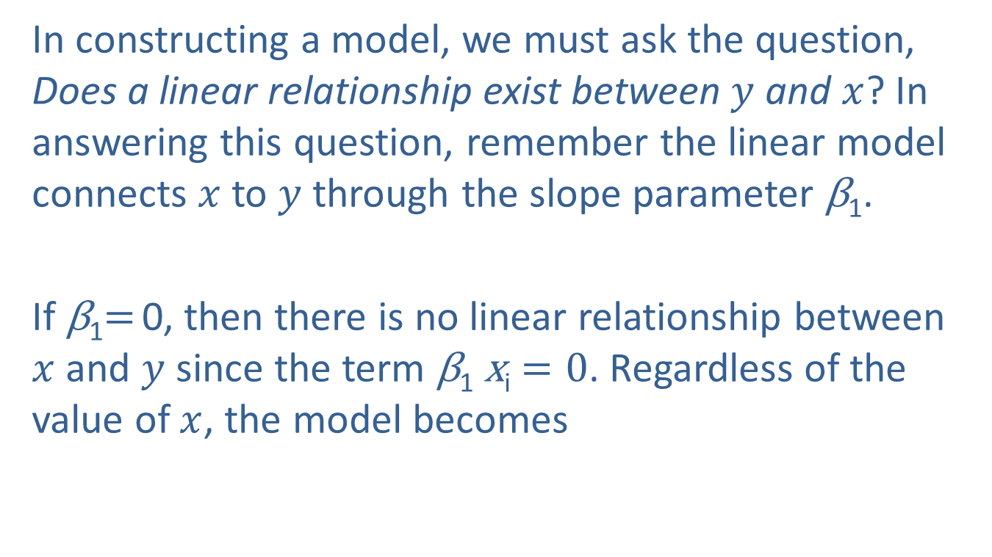

Testing a Hypothesis Concerning $β$₁
In constructing a model, we must ask the question, Does a linear relationship exist between $y$ and $x$? In answering this question, remember the linear model connects $x$ to $y$ through the slope parameter β₁.
If β₁$=$ 0, then there is no linear relationship between $x$ and $y$ since the term β₁ x_{i} $=0$. Regardless of the value of $x$, the model becomes

Slide 45
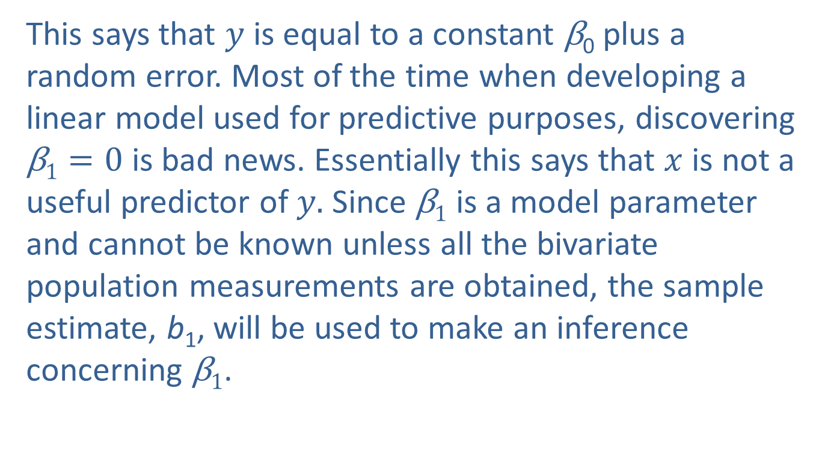

Testing a Hypothesis Concerning $β$₁ (cont.)
This says that $y$ is equal to a constant β₀ plus a random error. Most of the time when developing a linear model used for predictive purposes, discovering β$1=0$ is bad news. Essentially this says that $x$ is not a useful predictor of $y.$ Since β$1$ is a model parameter and cannot be known unless all the bivariate population measurements are obtained, the sample estimate, b₁, will be used to make an inference concerning β$1$.

Slide 46

Testing a Hypothesis Concerning $β$₁ (cont.)
If the assumptions of the linear model have been met sufficiently, statistical inference methods can be used to aid in answering the question, Is b₁ close enough to 0 to believe that $β1=0$? We will follow the hypothesis testing procedure used in Chapter 11.

Slide 47
Procedure: Testing a Hypothesis about the Slope
Assumptions:
The sample is a random sample of paired data, (x, y).
The error terms are normally distributed with mean 0 and a constant variance,
The errors are independent of one another.
The scatterplot shows that the sample points appear to follow a linear pattern.
Hypotheses:

Slide 48
Procedure: Testing a Hypothesis about the Slope (cont.)
Test Statistic:
The test statistic follows a t-distribution with n − 2 degrees of freedom.
where
b₁ is the estimated value of the slope β₁, is the standard deviation of b₁, and 0 is the hypothesized
value of β₁ in H₀.

Slide 49
Example 13.2.4: Conducting a Hypothesis Test of the Slope
Using the data in Example 13.2.1, determine if there is overwhelming evidence at the α = 0.05 level of a relationship between the price of a Jeep Cherokee and its age.
Solution
Step 1: Determine the population parameter to be used and develop the null and alternative hypotheses.
Is there a linear relationship between the age of a Jeep Cherokee and its price?

Slide 50
Example 13.2.4: Conducting a Hypothesis Test of the Slope (cont.)
Implies there is no linear relationship between age and price.
Step 2: Specify the significance level α.
The level of the test has been defined in the problem statement as the 0.05 level.
Step 3: Validate the assumptions of the hypothesis testing model, identify the appropriate test statistic and compute its value.
Implies a linear relationship exists between age and price.

Slide 51
Example 13.2.4: Conducting a Hypothesis Test of the Slope (cont.)
The assumptions for conducting a linear regression of the Jeep Cherokee data were verified before constructing a confidence interval for β₁ in Example 13.2.1. Therefore, a test of the slope parameter, b₁, can proceed.
The test statistic is similar in nature to the other test statistics developed in Chapter 11. It measures how far b₁ is from the hypothesized value of β₁, which is 0. This distance is measured in standard deviation units.

Slide 52
Example 13.2.4: Conducting a Hypothesis Test of the Slope (cont.)
If t is "close" to 0, then b₁ is "close" to 0 and H₀: β₁ = 0 is the more reasonable conclusion. However, if t is far from zero (measured in standard deviation units) then b₁ is far from its hypothesized value and H_{a}: β₁ ≠ 0 would seem more reasonable.

Slide 53
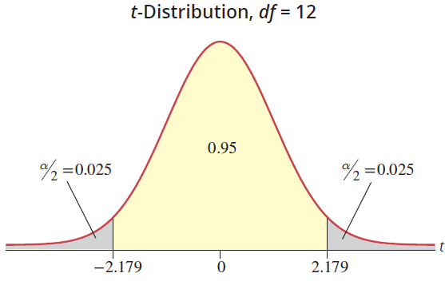
Example 13.2.4: Conducting a Hypothesis Test of the Slope (cont.)

Slide 54
Example 13.2.4: Conducting a Hypothesis Test of the Slope (cont.)
SUMMARY OUTPUT
Regression Statistics
Multiple R | 0.9655
R Square | 0.9322
Adjusted R Square | 0.9265
Standard Error | 1973.8624
Observations | 14
ANOVA
 | df | SS | MS | F | Signiﬁcance F
Regression | 1 | 642413863.2256 | 642413863.2256 | 164.8850 | 2.26608E-08
Residual | 12 | 46753593.1316 | 3896132.7610
Total | 13 | 689167456.3571

Slide 55
Example 13.2.4: Conducting a Hypothesis Test of the Slope (cont.)
The estimated value of b₁ is over twelve standard deviations from zero. This is very persuasive evidence in favor of β₁ ≠ 0.
 | Coeﬃcients | Standard Error | t Stat | P-value | Lower 95% | Upper 95%
Intercept | 47030.8289 | 1192.7284 | 39.4313 | 0.0000 | 44432.09694 | 49629.560951
Age (Years) | −3846.0921 | 299.5223 | −12.8408 | 0.0000 | −4498.695045 | −3193.489166

Slide 56

Note
The $P$-values reported by most forms of technology are already adjusted (doubled) for a two-tailed test.

Slide 57
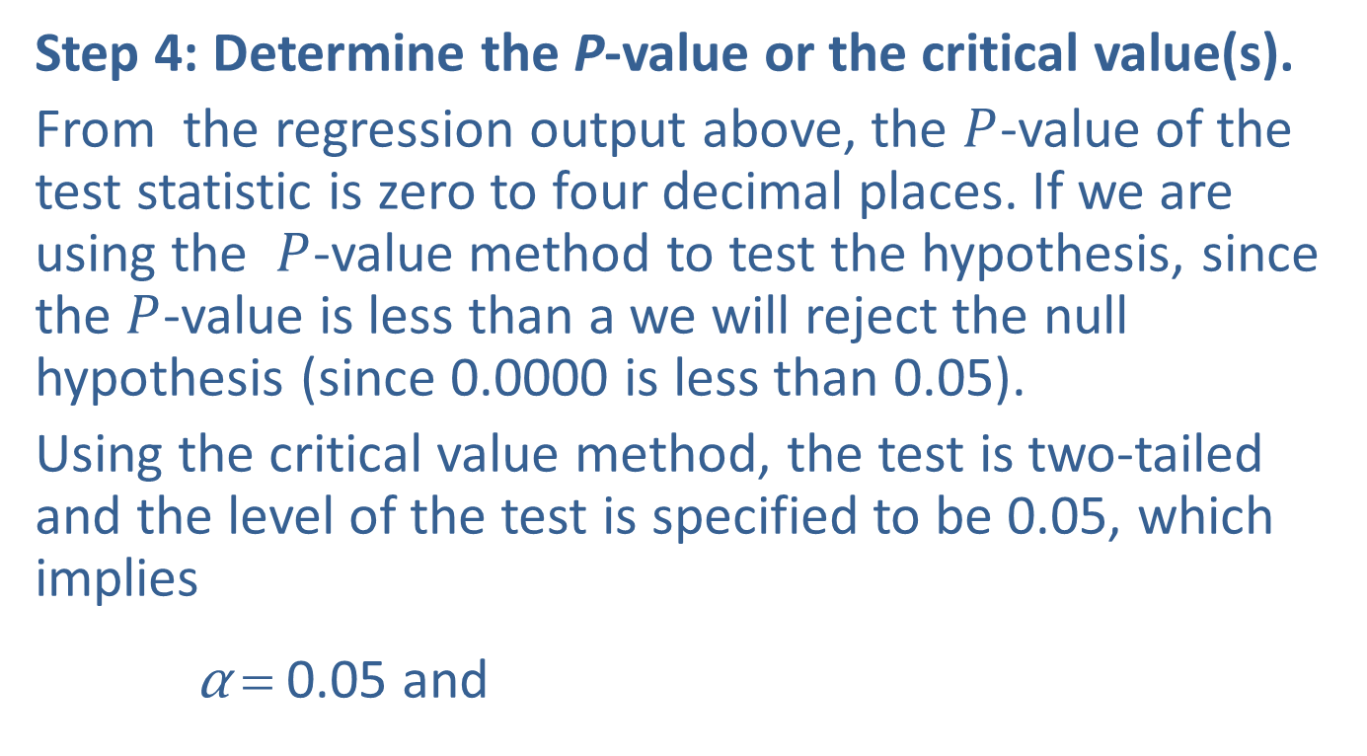
Example 13.2.4: Conducting a Hypothesis Test of the Slope (cont.)
Step 4: Determine the P-value or the critical value(s).
From the regression output above, the $P$-value of the test statistic is zero to four decimal places. If we are using the $P$-value method to test the hypothesis, since the $P$-value is less than a we will reject the null hypothesis (since 0.0000 is less than 0.05).
Using the critical value method, the test is two-tailed and the level of the test is specified to be 0.05, which implies
α = 0.05 and

Slide 58
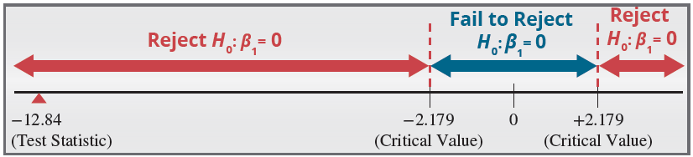
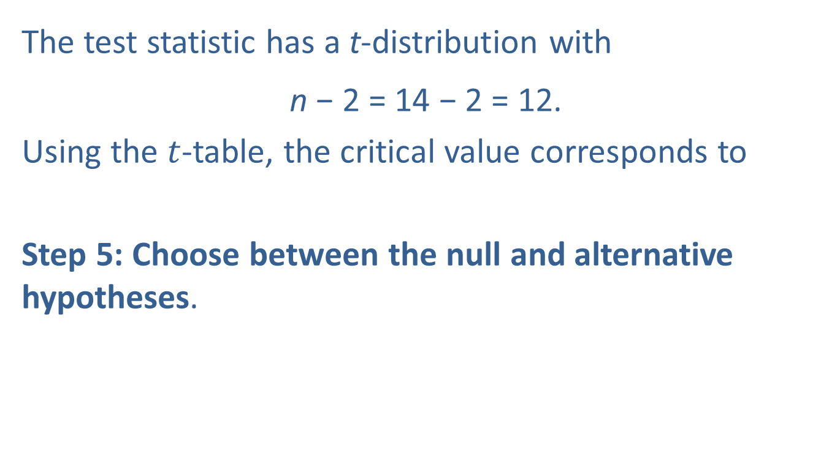
Example 13.2.4: Conducting a Hypothesis Test of the Slope (cont.)
The test statistic has a t-distribution with
n − 2 = 14 − 2 = 12.
Using the $t$-table, the critical value corresponds to
Step 5: Choose between the null and alternative hypotheses.

Slide 59
Example 13.2.4: Conducting a Hypothesis Test of the Slope (cont.)
Since the value of the test statistic falls into the rejection region, reject the null hypothesis in favor of the alternative.
Step 6: State the conclusion in terms of the original problem.
There is overwhelming evidence at the 0.05 level that H_{a}: β₁ ≠ 0. This implies that it is reasonable to believe (at the 0.05 level) that there is a linear relationship between the age and the price of a Jeep Cherokee.

Slide 60
Example 13.2.4: Conducting a Hypothesis Test of the Slope (cont.)
In fact, there appears to be a negative linear relationship between the age and the price of a Jeep Cherokee. However, our hypothesis test did not address the issue of a negative relationship, so we cannot make this conclusion.

Slide 61
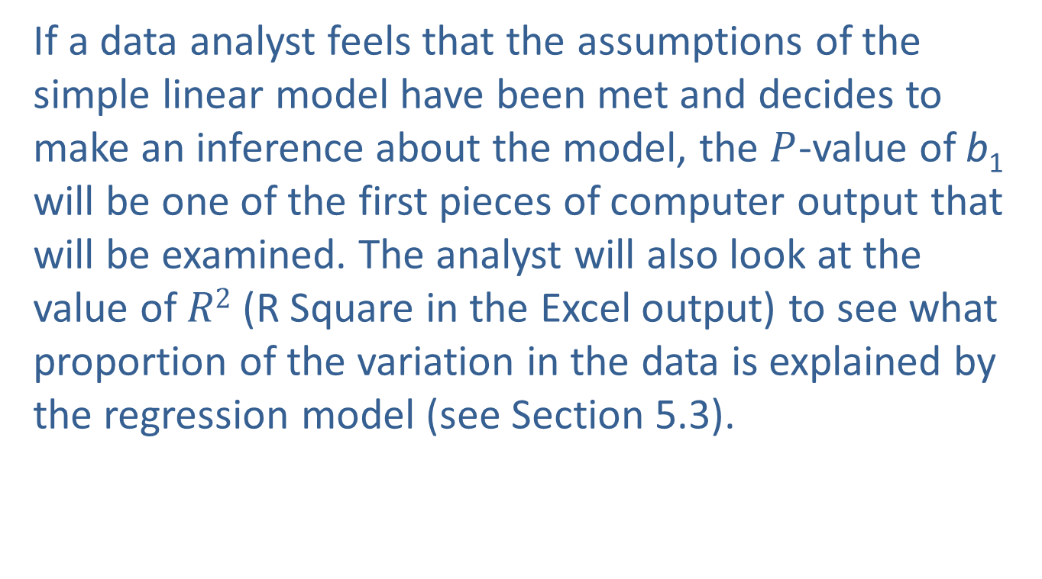
Testing a Hypothesis Concerning $β$₁ (cont.)
If a data analyst feels that the assumptions of the simple linear model have been met and decides to make an inference about the model, the $P$-value of b₁ will be one of the first pieces of computer output that will be examined. The analyst will also look at the value of $R2$ (R Square in the Excel output) to see what proportion of the variation in the data is explained by the regression model (see Section 5.3).

Slide 62
Testing a Hypothesis Concerning $β$₁ (cont.)
Thus far, the focus in this chapter has been inference on β₁. What about β₀? Since β₀ is merely a constant term, in most problems its value is not of great concern. However, if a confidence interval or test of hypothesis is needed, the methods used would be virtually identical to those presented for analyzing β₁.

