Slide 1
Section 13.1
Assumptions of the Simple Linear Model

Slide 2
Introduction
The regression line discussed in Chapter 5 was given by the familiar linear equation:
Intercept
Independent Variable
Dependent Variable
Slope

Slide 3
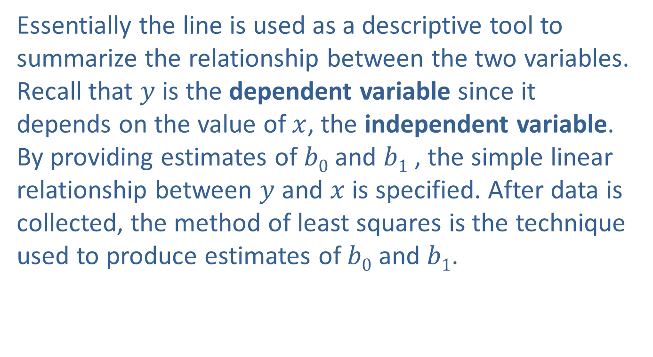
Introduction
Essentially the line is used as a descriptive tool to summarize the relationship between the two variables. Recall that $y$ is the dependent variable since it depends on the value of $x$, the independent variable. By providing estimates of $b0$ and $b1$ , the simple linear relationship between $y$ and $x$ is specified. After data is collected, the method of least squares is the technique used to produce estimates of $b0$ and $b1$.

Slide 4
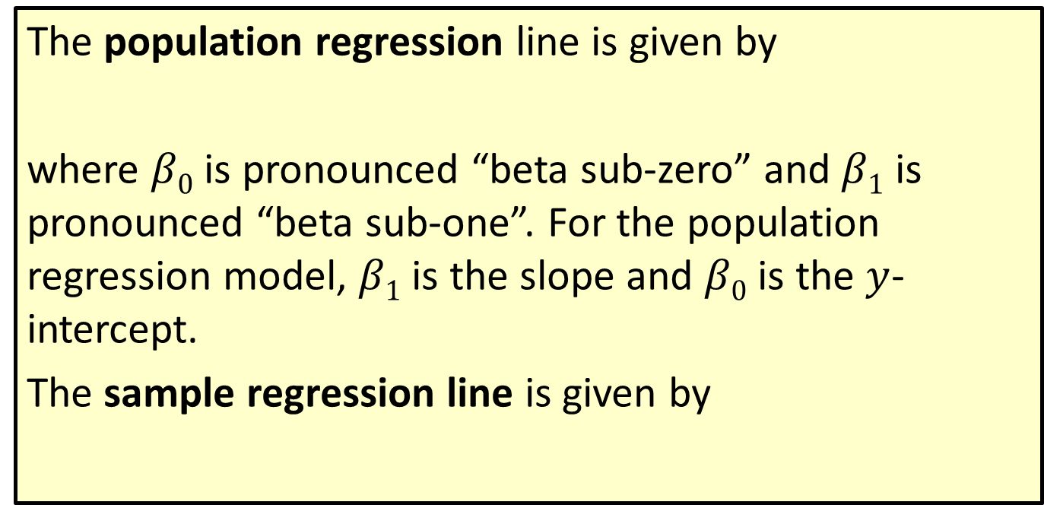
Definition: Regression Lines: Population versus Sample
The population regression line is given by
where $β0$ is pronounced “beta sub-zero” and $β1$ is pronounced “beta sub-one”. For the population regression model, $β1$ is the slope and $β0$ is the $y$-intercept.
The sample regression line is given by

Slide 5
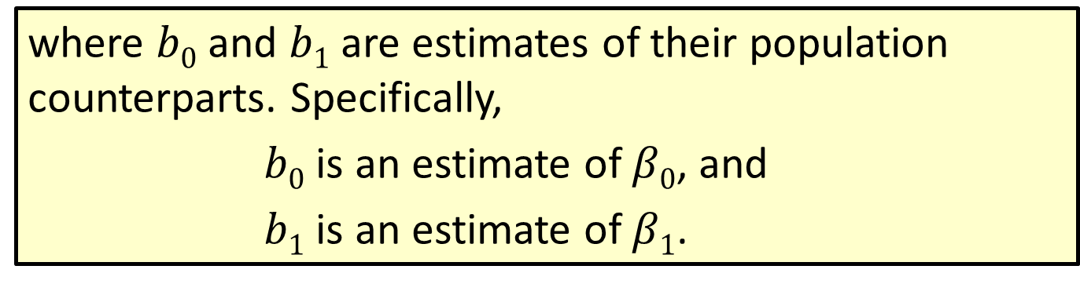
Definition: Regression Lines: Population versus Sample (cont.)
where $b0$ and $b1$ are estimates of their population counterparts. Specifically,
$b0$ is an estimate of $β0$, and
$b1$ is an estimate of $β1$.

Slide 6
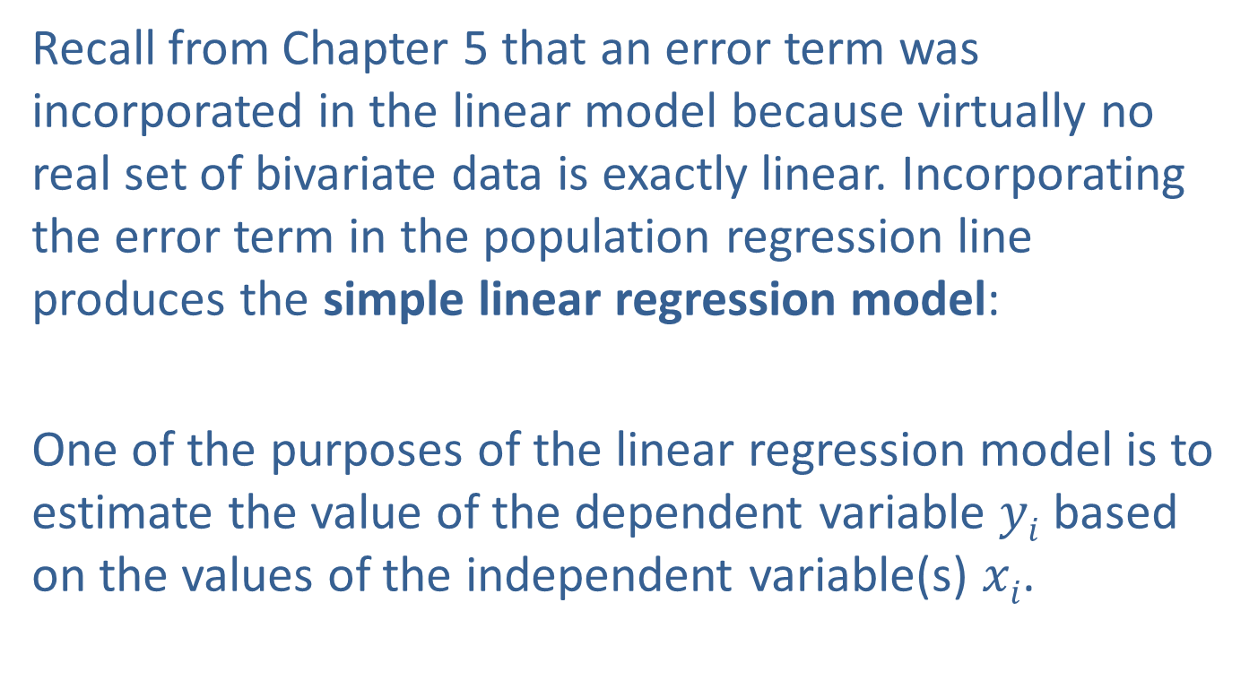
Assumptions of the Simple Linear Model
Recall from Chapter 5 that an error term was incorporated in the linear model because virtually no real set of bivariate data is exactly linear. Incorporating the error term in the population regression line produces the simple linear regression model:
One of the purposes of the linear regression model is to estimate the value of the dependent variable $yi$ based on the values of the independent variable(s) $xi$.

Slide 7
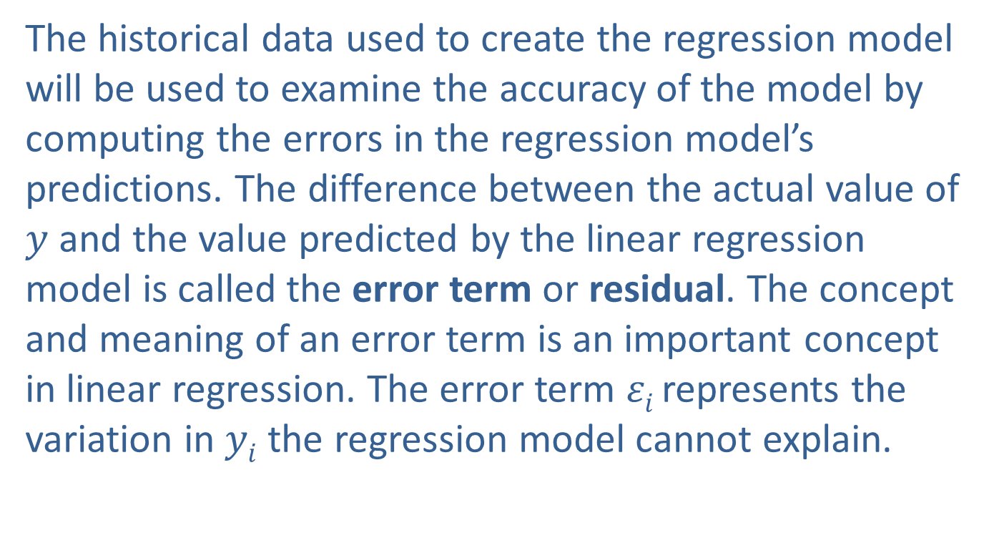
Assumptions of the Simple Linear Model (cont.)
The historical data used to create the regression model will be used to examine the accuracy of the model by computing the errors in the regression model’s predictions. The difference between the actual value of $y$ and the value predicted by the linear regression model is called the error term or residual. The concept and meaning of an error term is an important concept in linear regression. The error term $εi$ represents the variation in $yi$ the regression model cannot explain.

Slide 8
Assumptions of the Simple Linear Model (cont.)
The error term will be useful in assessing the a accuracy of the linear regression model. Later in the chapter, it will help analyze the statistical significance of the independent variables.
In order to perform inference on the linear model, some assumptions about the nature of the error terms are required.

Slide 9
Properties: Assumptions about the Error Term in the Linear Model
The ε_{i} are presumed to be normally distributed with a mean of 0 and a variance of
The ε_{i} are presumed to be independent of each other.

Slide 10
Note
See page 223 for a quick review of how to obtain the sample estimates for the linear regression model. The estimates can also be obtained using technology.

Slide 11
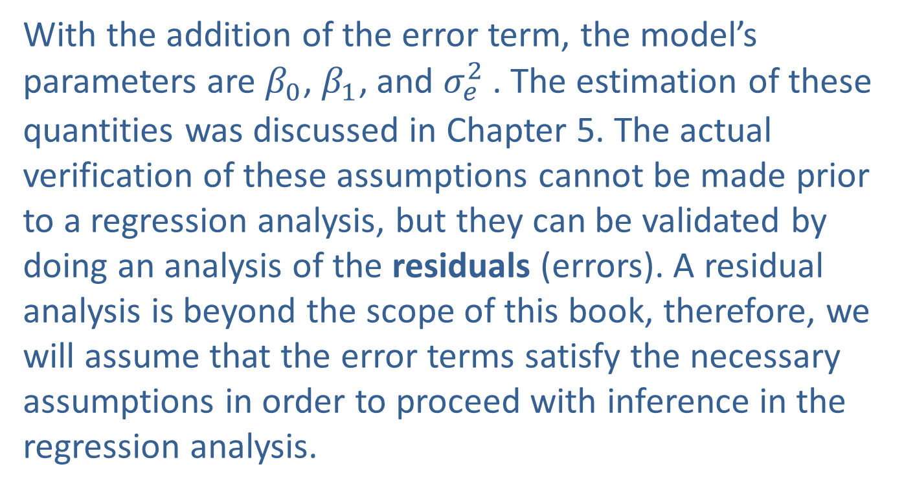
Assumptions of the Simple Linear Model (cont.)
With the addition of the error term, the model’s parameters are $β_{0}$, $β_{1}$, and ${σ_{e}^{2}}_{ }$. The estimation of these quantities was discussed in Chapter 5. The actual verification of these assumptions cannot be made prior to a regression analysis, but they can be validated by doing an analysis of the residuals (errors). A residual analysis is beyond the scope of this book, therefore, we will assume that the error terms satisfy the necessary assumptions in order to proceed with inference in the regression analysis.

Slide 12
Assumptions of the Simple Linear Model (cont.)
In addition to the formal assumptions stated above, a linear model should be used to fit data that appears to be reasonably linearly related. Because of the wide availability of computer programs that calculate least squares estimates, you will not need to manually calculate estimates very often.

