Slide 1
Section 12.5
Inference about Two Population Variances

Slide 2
Inference about Two Population Variances
Having introduced and performed tests comparing means and proportions, it’s a natural transition to discuss comparing variances. This is especially useful given that when we compare two population means, we make the assumption that the variances are either equal or unequal and then perform the test accordingly. An interesting question is, When do we even care if the variances (or variability) of two populations are equal or not? This question often arises in manufacturing or production industries.

Slide 3
Inference about Two Population Variances (cont.)
For example, one may be interested in whether the variability in the number of products from a production line differs significantly between the morning shift and the night shift. Specifically, an automobile tire manufacturer may be interested in the variability of the number of tires produced at one plant versus another. As another example, a financial advisor may measure the risk of a portfolio by examining the variance of the portfolio.

Slide 4
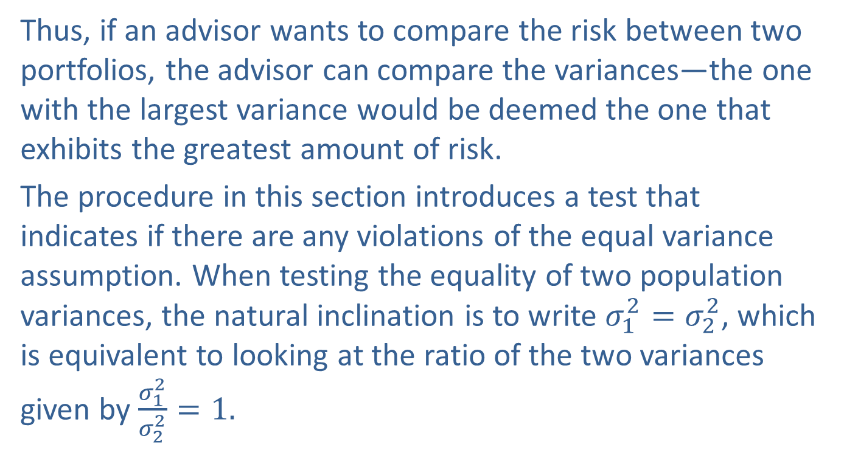
Inference about Two Population Variances (cont.)
Thus, if an advisor wants to compare the risk between two portfolios, the advisor can compare the variances—the one with the largest variance would be deemed the one that exhibits the greatest amount of risk.
The procedure in this section introduces a test that indicates if there are any violations of the equal variance assumption. When testing the equality of two population variances, the natural inclination is to write $σ_{1}^{2}=σ_{2}^{2}$, which is equivalent to looking at the ratio of the two variances given by $\frac{σ_{1}^{2}}{σ_{2}^{2}}=1.$

Slide 5
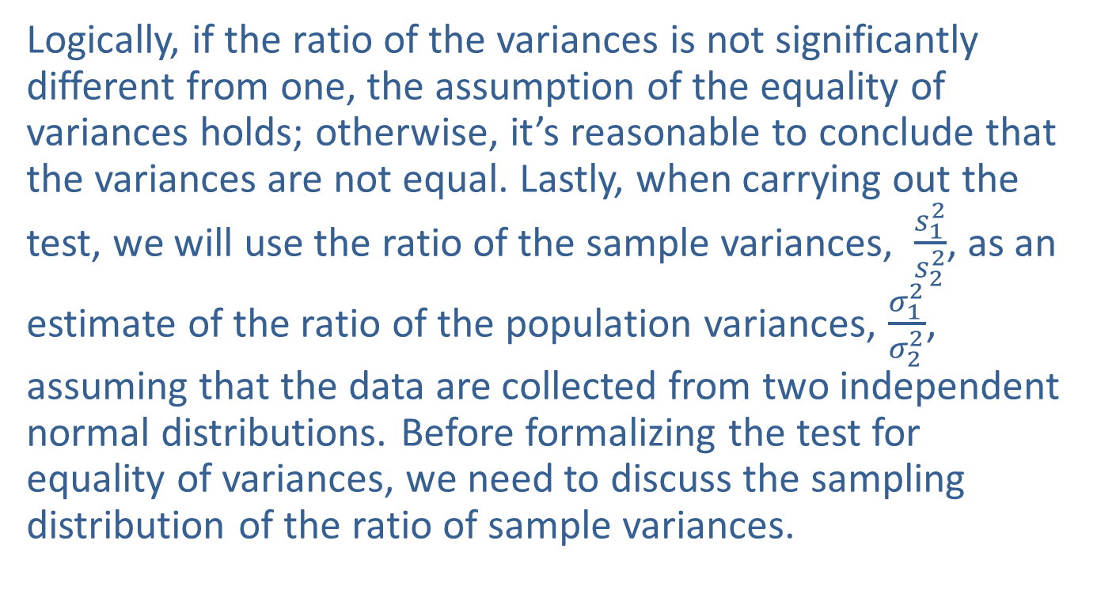
Inference about Two Population Variances (cont.)
Logically, if the ratio of the variances is not significantly different from one, the assumption of the equality of variances holds; otherwise, it’s reasonable to conclude that the variances are not equal. Lastly, when carrying out the test, we will use the ratio of the sample variances, $\frac{s_{1}^{2}}{s_{2}^{2}}$, as an estimate of the ratio of the population variances, $\frac{σ_{1}^{2}}{σ_{2}^{2}}$, assuming that the data are collected from two independent normal distributions. Before formalizing the test for equality of variances, we need to discuss the sampling distribution of the ratio of sample variances.

Slide 6
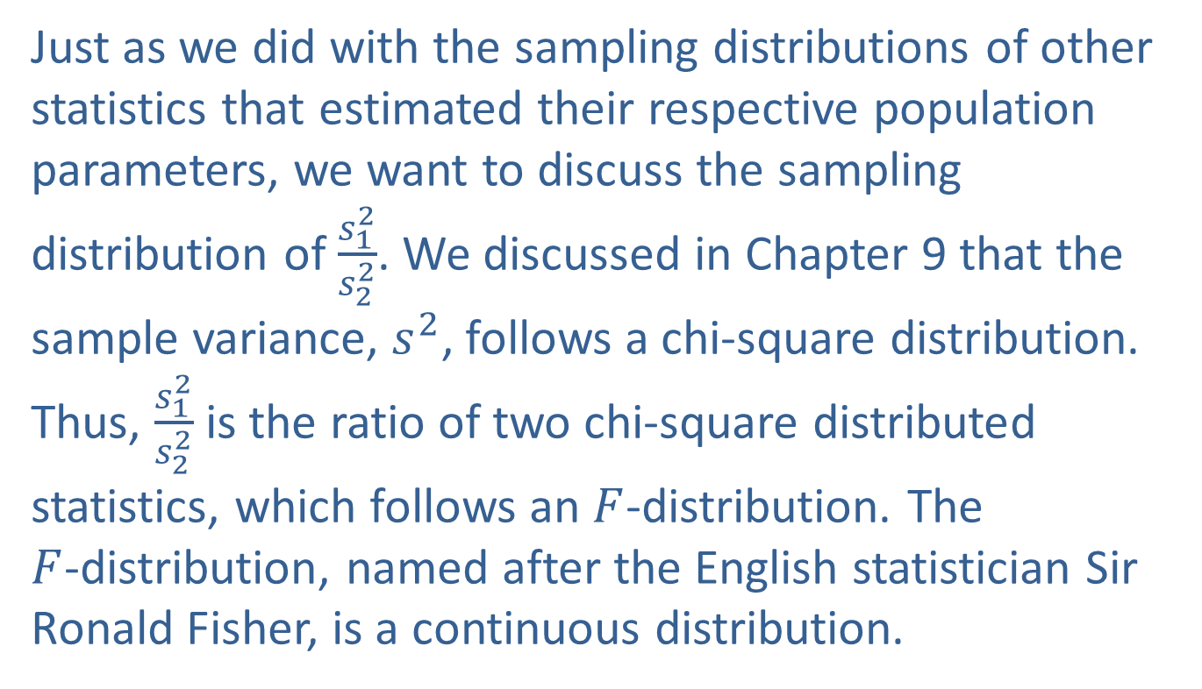

The Sampling Distribution of $\frac{s_{1}^{2}}{s_{2}^{2}}$
Just as we did with the sampling distributions of other statistics that estimated their respective population parameters, we want to discuss the sampling distribution of $\frac{s_{1}^{2}}{s_{2}^{2}}$. We discussed in Chapter 9 that the sample variance, $s_{ }^{2}$, follows a chi-square distribution. Thus, $\frac{s_{1}^{2}}{s_{2}^{2}}$ is the ratio of two chi-square distributed statistics, which follows an $F$-distribution. The $F$-distribution, named after the English statistician Sir Ronald Fisher, is a continuous distribution.

Slide 7
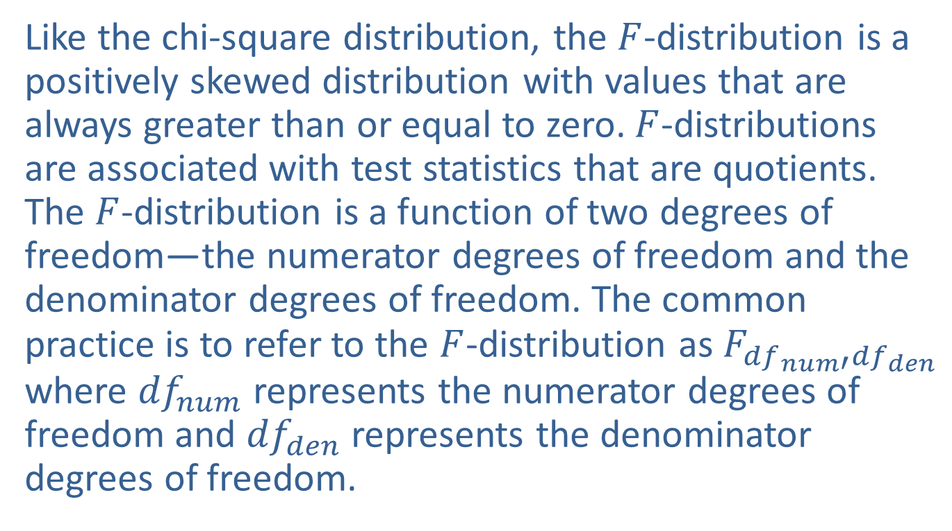

The Sampling Distribution of $\frac{s_{1}^{2}}{s_{2}^{2}}$ (cont.)
Like the chi-square distribution, the $F$-distribution is a positively skewed distribution with values that are always greater than or equal to zero. $F$-distributions are associated with test statistics that are quotients. The $F$-distribution is a function of two degrees of freedom—the numerator degrees of freedom and the denominator degrees of freedom. The common practice is to refer to the $F$-distribution as $F_{{df}_{ num′}{df}_{den}}$ where ${df}_{num}$ represents the numerator degrees of freedom and ${df}_{den}$ represents the denominator degrees of freedom.

Slide 8
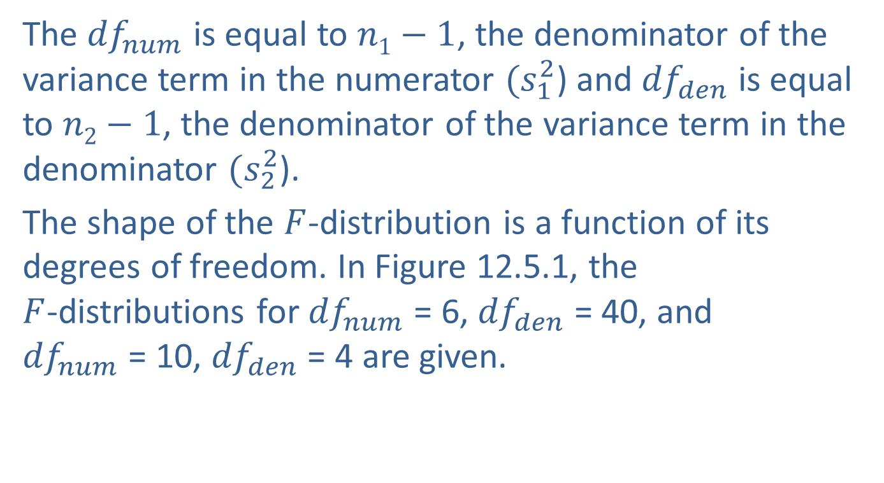
The Sampling Distribution of $\frac{s_{1}^{2}}{s_{2}^{2}}$ (cont.)
The ${df}_{num}$ is equal to $n1−1$, the denominator of the variance term in the numerator $(s_{1}^{2}$) and ${df}_{den}$ is equal to $n2−1$, the denominator of the variance term in the denominator $(s_{2}^{2}$).
The shape of the $F$-distribution is a function of its degrees of freedom. In Figure 12.5.1, the $F$-distributions for ${df}_{num}$ = 6, ${df}_{den}$ = 40, and ${df}_{num}$ = 10, ${df}_{den}$ = 4 are given.

Slide 9
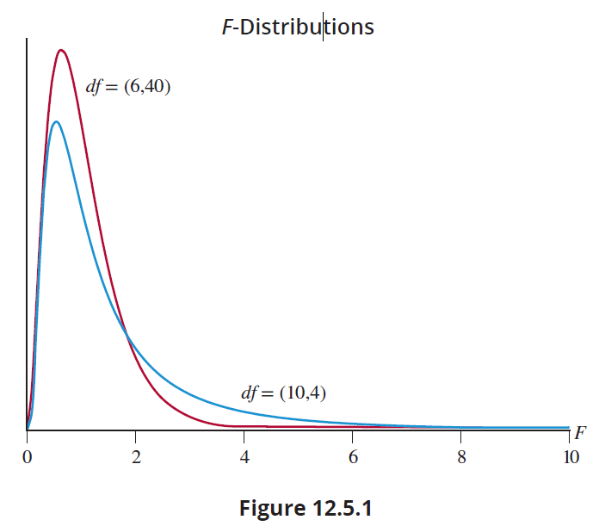
The Sampling Distribution of $\frac{s_{1}^{2}}{s_{2}^{2}}$ (cont.)

Slide 10

The Sampling Distribution of $\frac{s_{1}^{2}}{s_{2}^{2}}$ (cont.)
Tables have been compiled (see Appendix A) that show critical values of the $F$-distribution at common levels of significance. The notation $Fα$ will indicate the value of $F$ such that $α$ of the area under the curve lies to the right of this value.

Slide 11
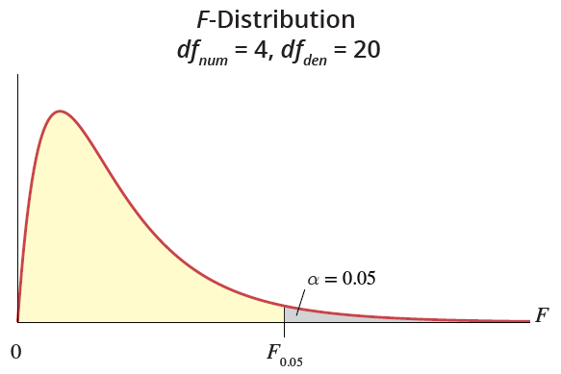


Example 12.5.1: Finding an $F$-Critical Value
Find a value on the $F$-distribution with ${df}_{num}$= 4 and ${df}_{den}$ = 20 such that 0.05 of the area lies to the right of this value.

Slide 12
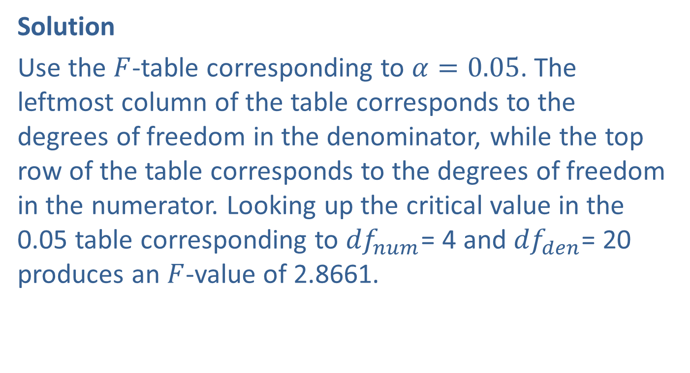

Example 12.5.1: Finding an $F$-Critical Value (cont.)
Solution
Use the $F$-table corresponding to $α=0.05$. The leftmost column of the table corresponds to the degrees of freedom in the denominator, while the top row of the table corresponds to the degrees of freedom in the numerator. Looking up the critical value in the 0.05 table corresponding to ${df}_{num}$= 4 and ${df}_{den}$= 20 produces an $F$-value of 2.8661.

Slide 13
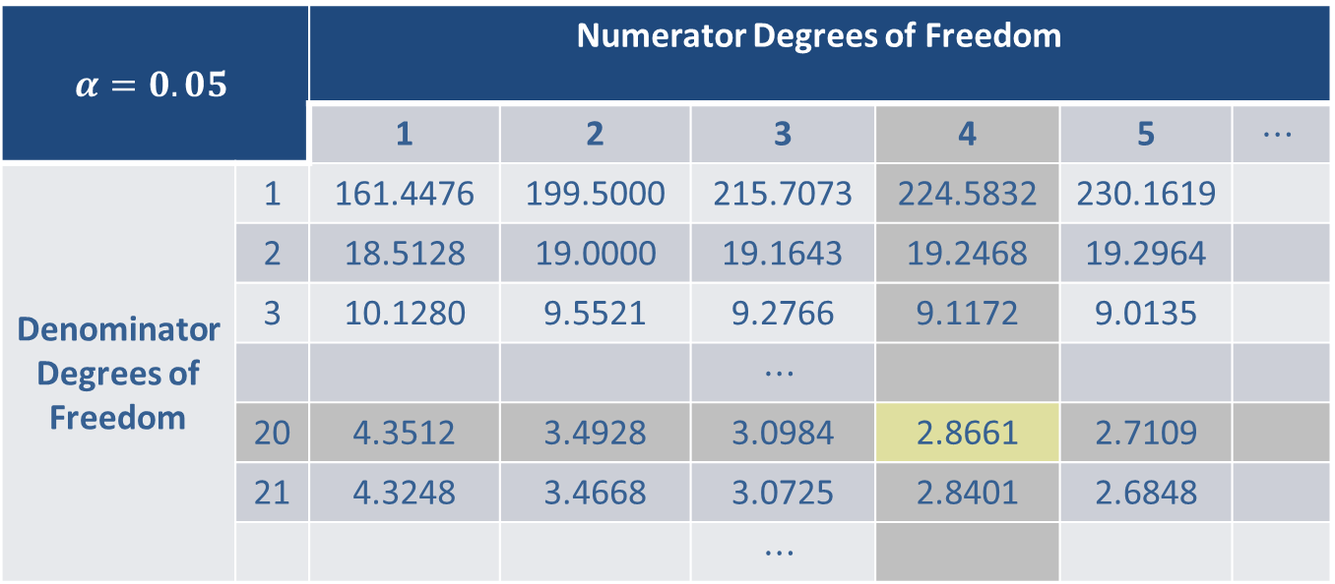
Example 12.5.1: Finding an $F$-Critical Value (cont.)
$$α=0.05$$ |  | Numerator Degrees of Freedom
 |  | 1 | 2 | 3 | 4 | 5 | $$⋯$$
Denominator Degrees of Freedom | 1 | 161.4476 | 199.5000 | 215.7073 | 224.5832 | 230.1619
 | 2 | 18.5128 | 19.0000 | 19.1643 | 19.2468 | 19.2964
 | 3 | 10.1280 | 9.5521 | 9.2766 | 9.1172 | 9.0135
 |  |  |  | $$⋯$$
 | 20 | 4.3512 | 3.4928 | 3.0984 | 2.8661 | 2.7109
 | 21 | 4.3248 | 3.4668 | 3.0725 | 2.8401 | 2.6848
 |  |  |  | $$⋯$$

Slide 14
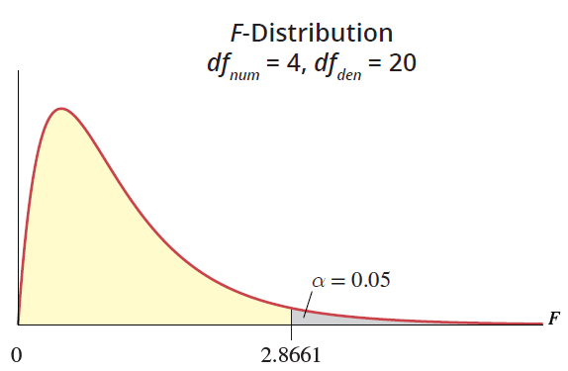
Example 12.5.1: Finding an $F$-Critical Value (cont.)

Slide 15
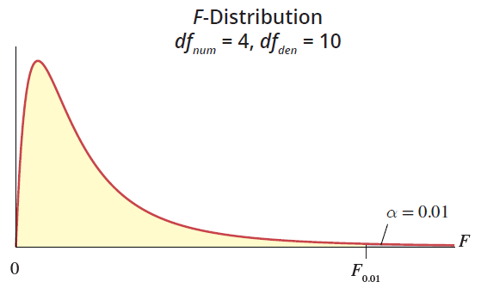


Example 12.5.2: Finding an $F$-Critical Value
Find a value on the $F$-distribution with 4 numerator degrees of freedom and 10 denominator degrees of freedom such that 0.01 of the area lies to the right.

Slide 16
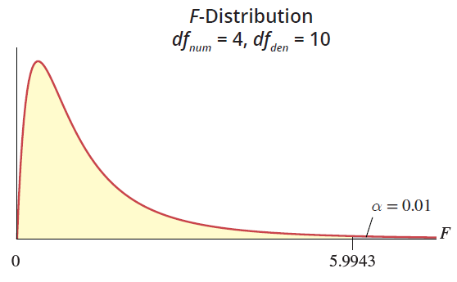


Example 12.5.2: Finding an $F$-Critical Value (cont.)
Solution
Using the $F$-table for $α=0.01$corresponding to ${df}_{num}$= 4 and ${df}_{den}$= 10 results in an $F$-value of 5.9943.

Slide 17

The Sampling Distribution of $\frac{s_{1}^{2}}{s_{2}^{2}}$ (cont.)
Now that we know the sampling distribution of $\frac{s_{1}^{2}}{s_{2}^{2}} ,$
we can make inferences about the ratio of two population variances, as well as construct confidence intervals and perform hypothesis testing.

Slide 18
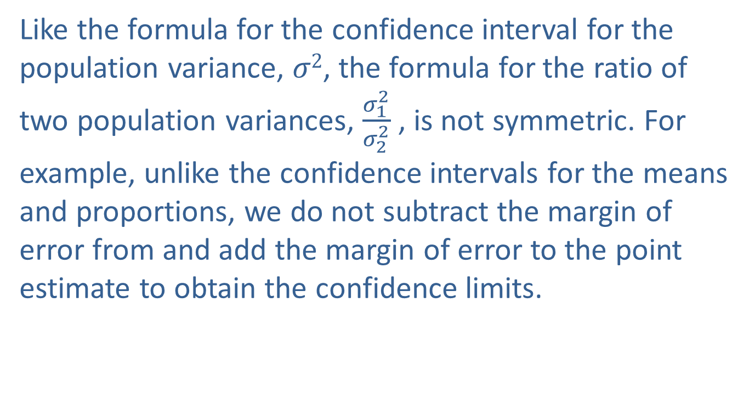
Interval Estimation of the Ratio of Two Population Variances
Like the formula for the confidence interval for the population variance, $σ2$, the formula for the ratio of two population variances, $\frac{σ_{1}^{2}}{σ_{2}^{2}}$ , is not symmetric. For example, unlike the confidence intervals for the means and proportions, we do not subtract the margin of error from and add the margin of error to the point estimate to obtain the confidence limits.

Slide 19
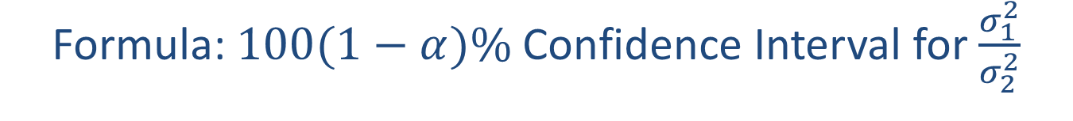
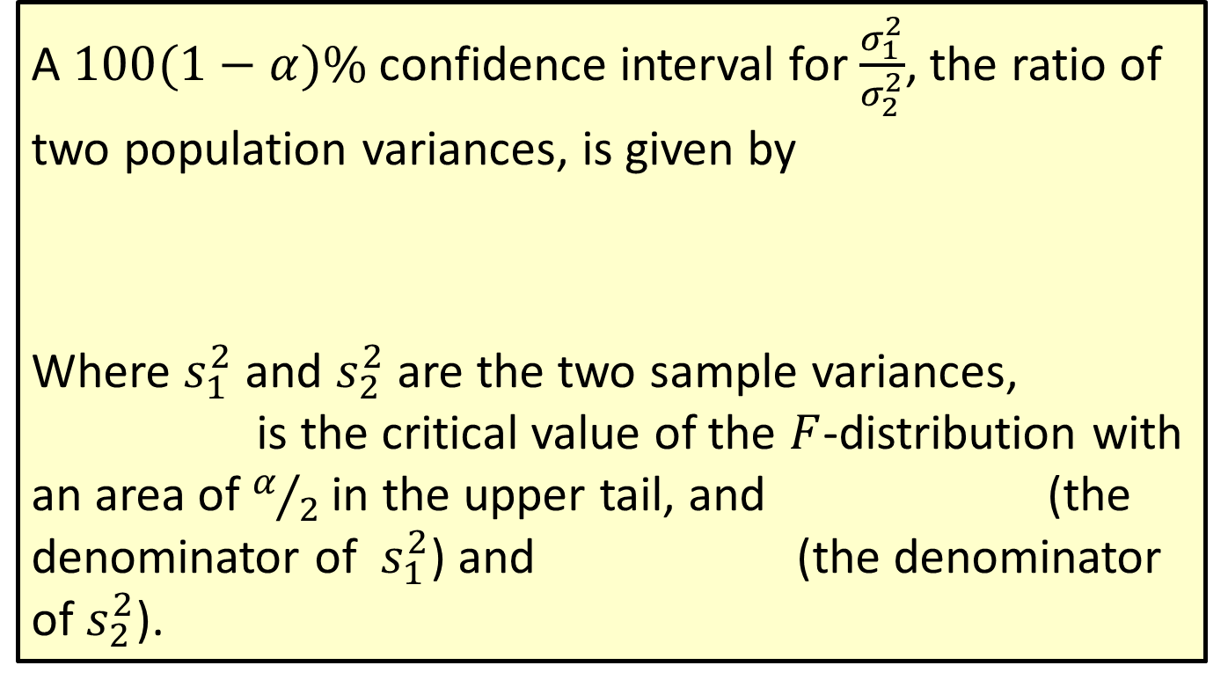
Formula: $100(1−α)\%$Confidence Interval for $\frac{σ_{1}^{2}}{σ_{2}^{2}}$
A $100(1−α)\%$confidence interval for $\frac{σ_{1}^{2}}{σ_{2}^{2}}$, the ratio of two population variances, is given by
Where $s_{1}^{2}$ and $s_{2}^{2}$ are the two sample variances, is the critical value of the $F$-distribution with an area of $α/2$ in the upper tail, and (the denominator of $s_{1}^{2}$) and (the denominator of $s_{2}^{2}$).

Slide 20
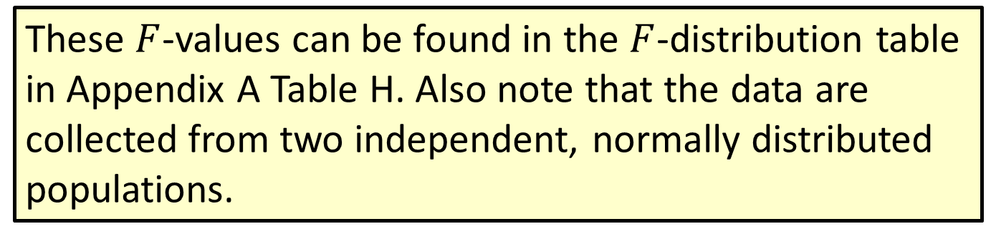
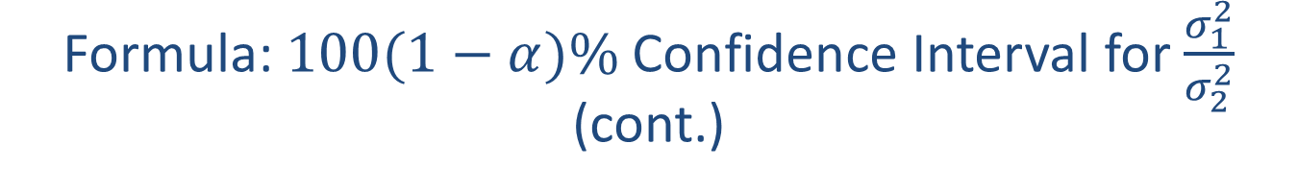
Formula: $100(1−α)\%$Confidence Interval for $\frac{σ_{1}^{2}}{σ_{2}^{2}}$ (cont.)
These $F$-values can be found in the $F$-distribution table in Appendix A Table H. Also note that the data are collected from two independent, normally distributed populations.

Slide 21
Example 12.5.3: Constructing a Confidence Interval for the Ratio of Variation in Box Office Revenues
A Hollywood studio believes that a movie that is considered a drama will draw a larger crowd on average than a movie that is a comedy. Thus, the studio expects that the spread in revenue will be quite large between dramas and comedies. To test this theory the studio randomly selects several movies that are classified as dramas and several movies that are classified as comedies and determines the box office revenue for each movie. The results of the survey follow. Construct a 95% confidence interval for the ratio of population variances.

Slide 22
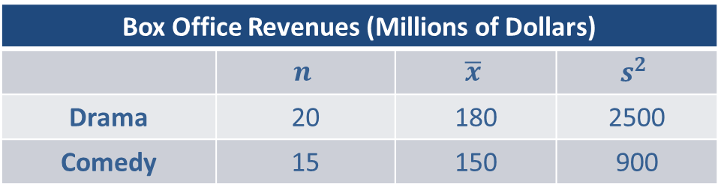
Example 12.5.3: Constructing a Confidence Interval for the Ratio of Variation in Box Office Revenues (cont.)
Assume that the samples are collected from two independent normal populations.
Solution
Before solving the problem, let and let . Also note that the sample variances are estimates of the population variances
Box Office Revenues (Millions of Dollars)
 | $$n$$ | $$\overline{x}$$ | $$s^{2}$$
Drama | 20 | 180 | 2500
Comedy | 15 | 150 | 900

Slide 23
Example 12.5.3: Constructing a Confidence Interval for the Ratio of Variation in Box Office Revenues (cont.)
The point estimate for the ratio of the two population variances is the ratio of the sample variances and would be calculated as
While it appears that the variability of the revenue for dramas is more than twice that of the revenue for comedies, let’s examine the confidence interval to see if that gives us a bit more information. The following formula is used to construct a 95% confidence interval on the ratio of variances for the box office revenues.

Slide 24
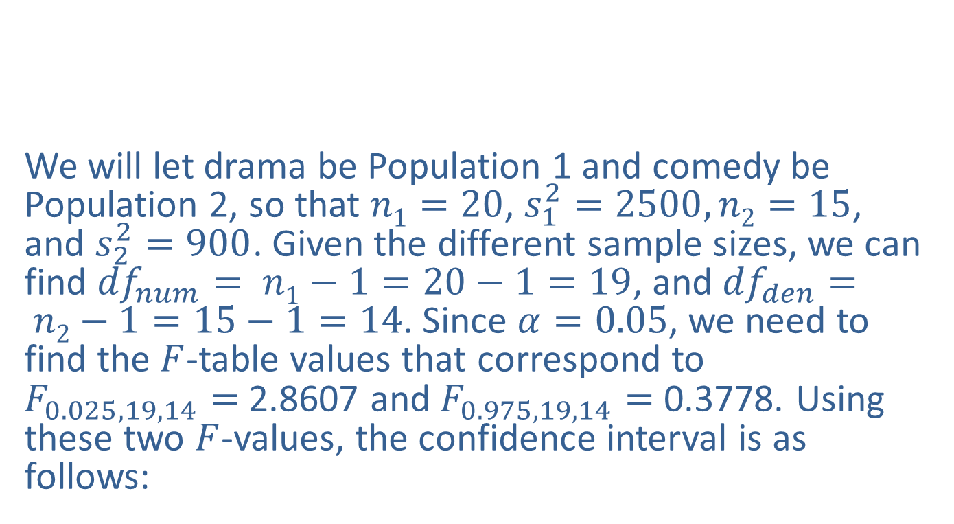
Example 12.5.3: Constructing a Confidence Interval for the Ratio of Variation in Box Office Revenues (cont.)
We will let drama be Population 1 and comedy be Population 2, so that $n1=20$, $s_{1}^{2}=2500, n2=15$, and $s_{2}^{2}=900$. Given the different sample sizes, we can find ${df}_{num}= n1−1=20−1=19$, and ${df}_{den}= n2−1=15−1=14$. Since $α=0.05$, we need to find the $F$-table values that correspond to $F_{0.025, 19, 14}=$2.8607 and $F_{0.975, 19, 14}=$0.3778. Using these two $F$-values, the confidence interval is as follows:

Slide 25
Example 12.5.3: Constructing a Confidence Interval for the Ratio of Variation in Box Office Revenues (cont.)
Thus, we are 95% confident that the ratio of the two population variances is between 0.9710 and 7.3525. Note that the interval (0.9710, 7.3525) includes 1. This means that the ratio of the two variances is not significantly different from 1. Therefore, there is insufficient evidence of a difference between the population variances.

Slide 26
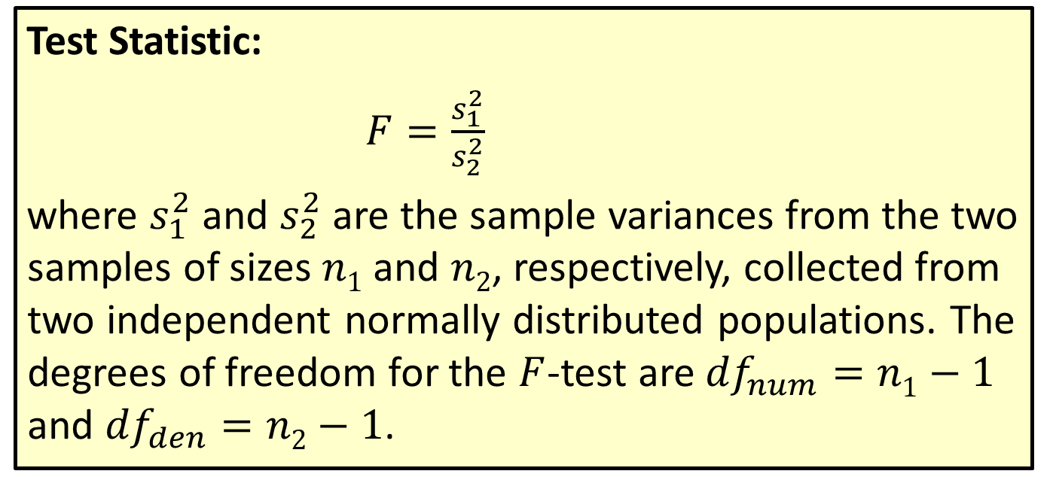

Hypothesis Testing of $\frac{σ_{1}^{2}}{σ_{2}^{2}}$
Test Statistic:
$F=\frac{s_{1}^{2}}{s_{2}^{2}}$
where $s_{1}^{2}$ and $s_{2}^{2}$ are the sample variances from the two samples of sizes $n1$ and $n2$, respectively, collected from two independent normally distributed populations. The degrees of freedom for the $F$-test are ${df}_{num}=n1−1$ and ${df}_{den}=n2−1$.

Slide 27
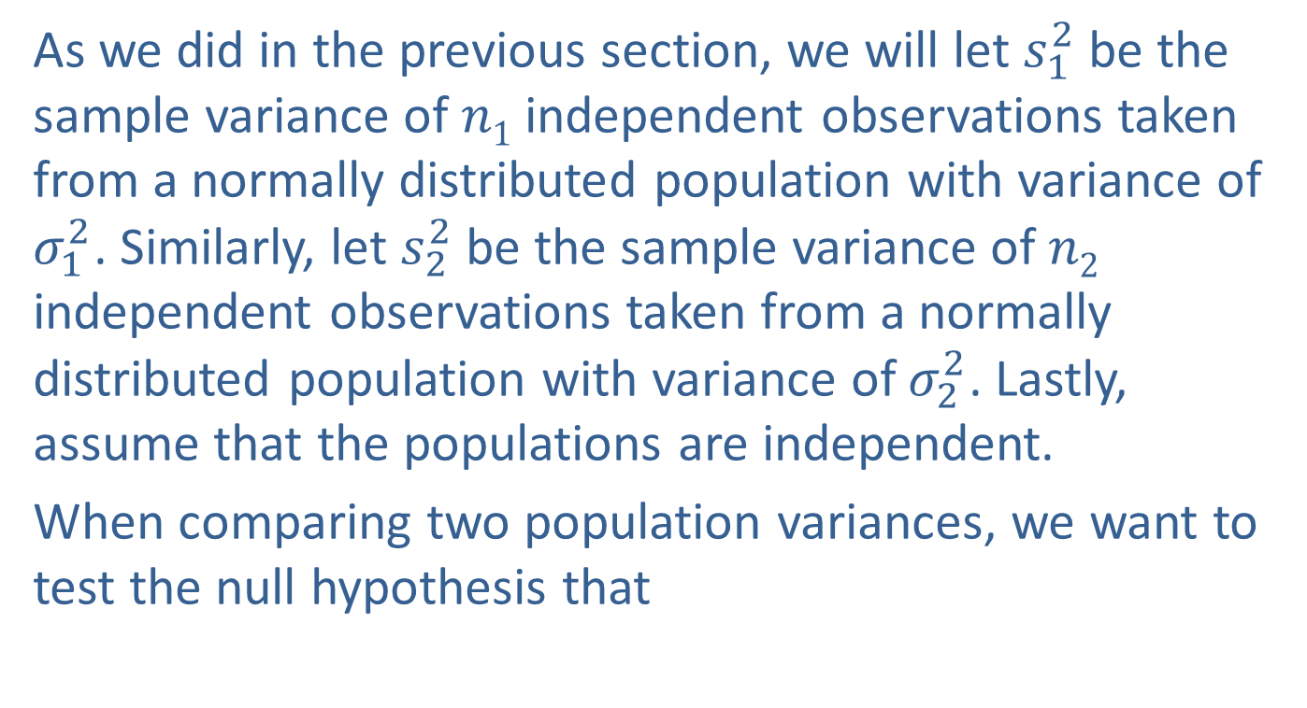
Hypothesis Testing of the Ratio of Two Population Variances
As we did in the previous section, we will let $s_{1}^{2}$ be the sample variance of $n1$ independent observations taken from a normally distributed population with variance of $σ_{1}^{2}$. Similarly, let $s_{2}^{2}$ be the sample variance of $n2$ independent observations taken from a normally distributed population with variance of $σ_{2}^{2}$. Lastly, assume that the populations are independent.
When comparing two population variances, we want to test the null hypothesis that

Slide 28
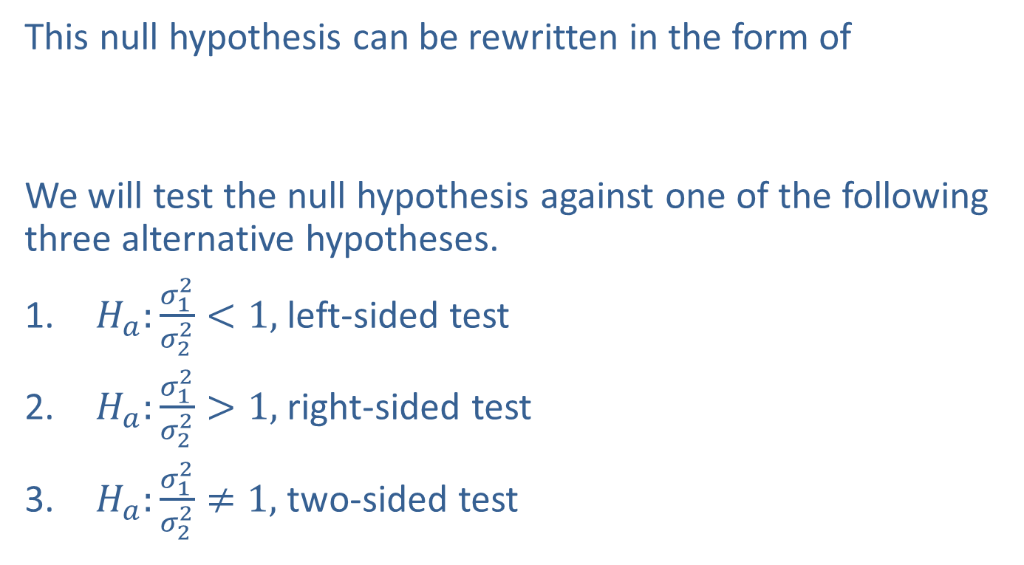
Hypothesis Testing of the Ratio of Two Population Variances (cont.)
This null hypothesis can be rewritten in the form of
We will test the null hypothesis against one of the following three alternative hypotheses.
$H_{a}:\frac{σ_{1}^{2}}{σ_{2}^{2}}<1,$ left-sided test
$H_{a}:\frac{σ_{1}^{2}}{σ_{2}^{2}}>1,$ right-sided test
$H_{a}:\frac{σ_{1}^{2}}{σ_{2}^{2}}≠1,$ two-sided test

Slide 29
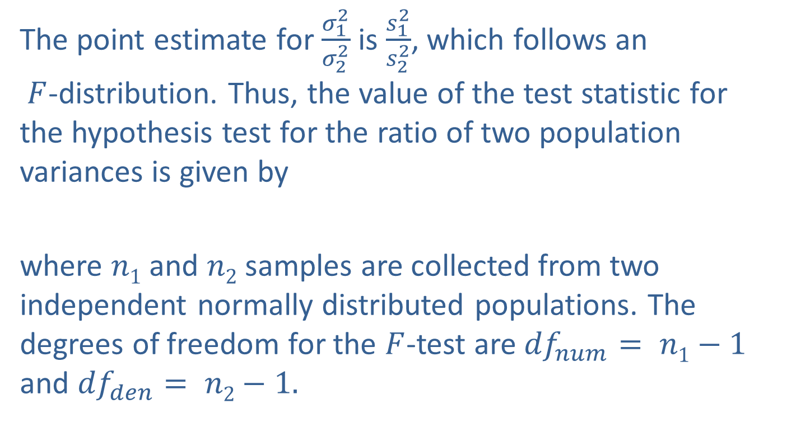
Hypothesis Testing of the Ratio of Two Population Variances (cont.)
The point estimate for $\frac{σ_{1}^{2}}{σ_{2}^{2}}$ is $\frac{s_{1}^{2}}{s_{2}^{2}}$, which follows an $F$-distribution. Thus, the value of the test statistic for the hypothesis test for the ratio of two population variances is given by
where $n1$ and $n2$ samples are collected from two independent normally distributed populations. The degrees of freedom for the $F$-test are ${df}_{num}= n1−1$ and ${df}_{den}= n2−1.$

Slide 30
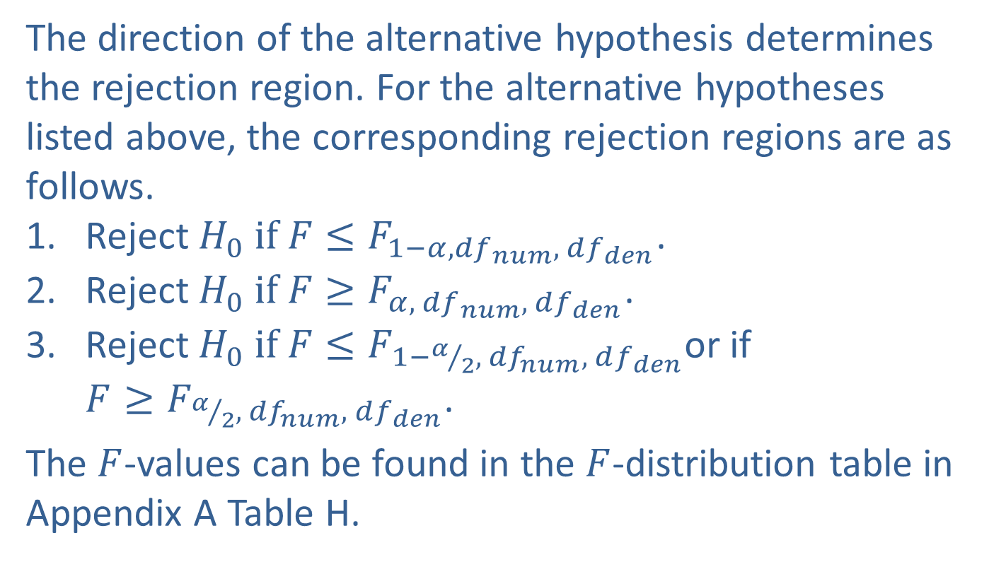
Hypothesis Testing of the Ratio of Two Population Variances (cont.)
The direction of the alternative hypothesis determines the rejection region. For the alternative hypotheses listed above, the corresponding rejection regions are as follows.
Reject $H_{0} if F≤F_{1−α, {df}_{ num}, df_{den}}$.
Reject $H_{0} if F≥F_{α, { df}_{ num}, df_{den}}$.
Reject $H_{0} if F≤F_{1−α/2, {df}_{num}, df_{den}}$or if $F≥F_{α/2, { df}_{num}, df_{den}}$.
The $F$-values can be found in the $F$-distribution table in Appendix A Table H.

Slide 31
Example 12.5.4: Performing a Hypothesis Test of Variances for Box Office Revenues
Using the Hollywood studio data in Example 12.5.3, determine whether the variances of the two revenue streams (drama and comedy) differ using a 5% level of significance.
Solution
We will follow the same six steps as we did in the previous sections of this chapter (as well as in Chapter 11) to work through this example.

Slide 32
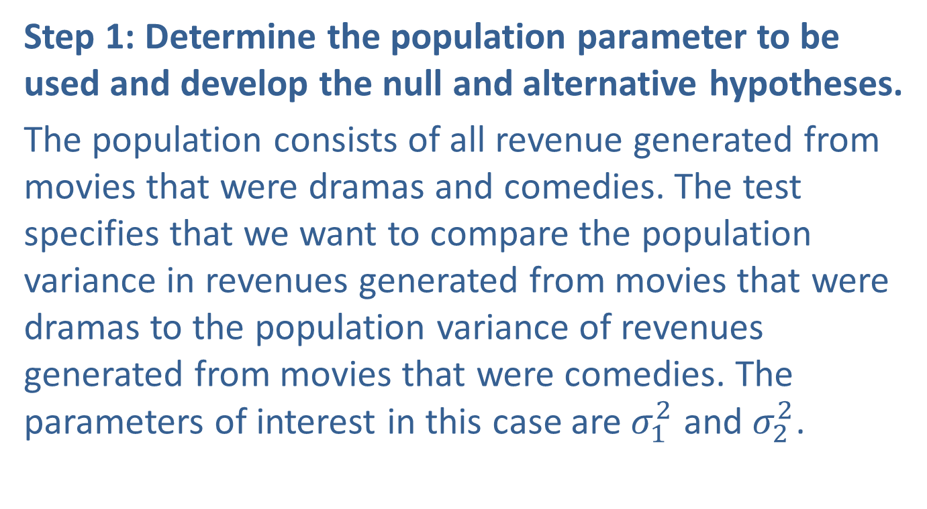
Example 12.5.4: Performing a Hypothesis Test of Variances for Box Office Revenues (cont.)
Step 1: Determine the population parameter to be used and develop the null and alternative hypotheses.
The population consists of all revenue generated from movies that were dramas and comedies. The test specifies that we want to compare the population variance in revenues generated from movies that were dramas to the population variance of revenues generated from movies that were comedies. The parameters of interest in this case are $σ_{1}^{2}$ and $σ_{2}^{2}$.

Slide 33
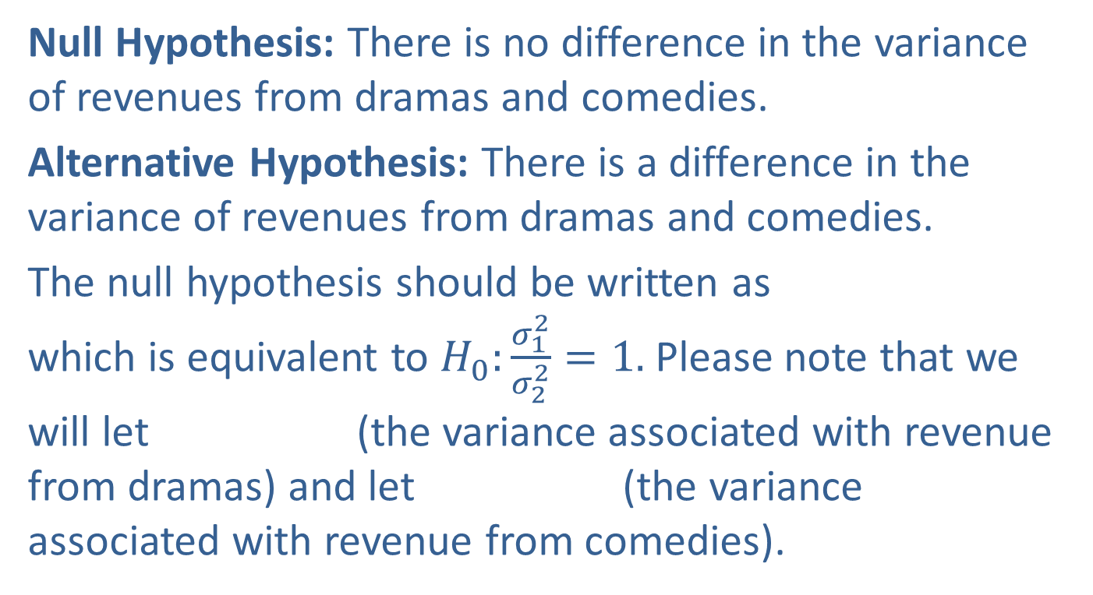
Example 12.5.4: Performing a Hypothesis Test of Variances for Box Office Revenues (cont.)
Null Hypothesis: There is no difference in the variance of revenues from dramas and comedies.
Alternative Hypothesis: There is a difference in the variance of revenues from dramas and comedies.
The null hypothesis should be written as which is equivalent to $H_{0}:\frac{σ_{1}^{2}}{σ_{2}^{2}}=1.$Please note that we will let (the variance associated with revenue from dramas) and let (the variance associated with revenue from comedies).

Slide 34
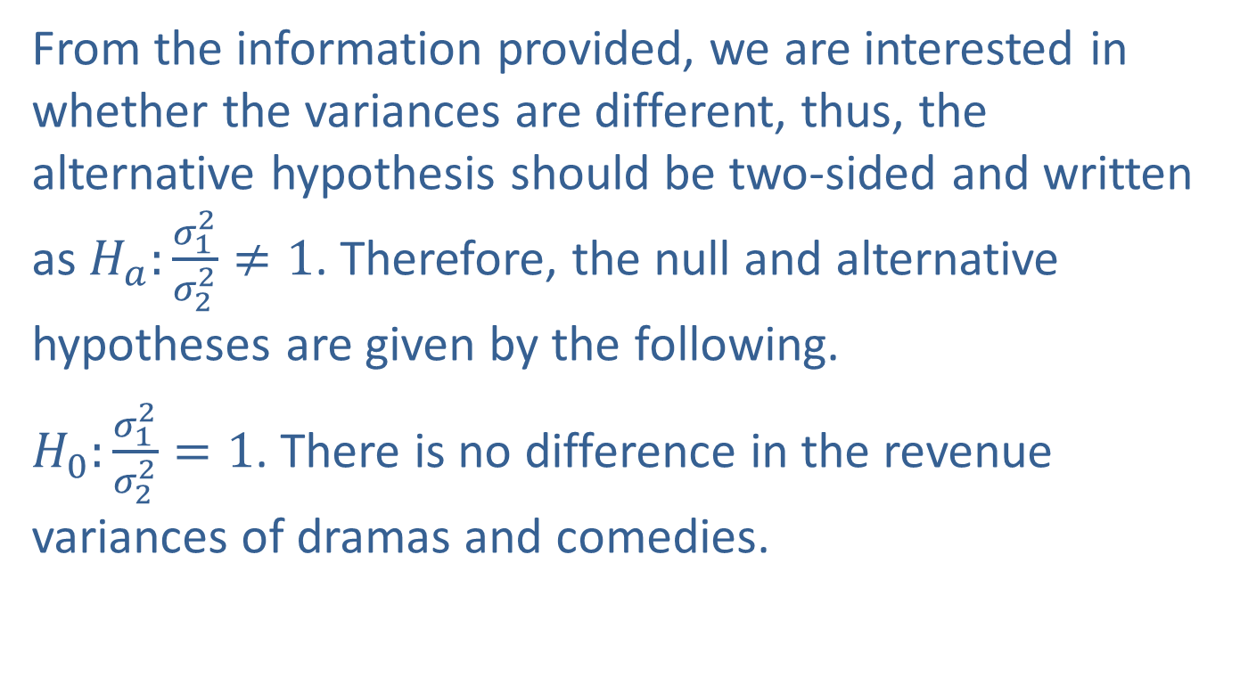
Example 12.5.4: Performing a Hypothesis Test of Variances for Box Office Revenues (cont.)
From the information provided, we are interested in whether the variances are different, thus, the alternative hypothesis should be two-sided and written as $H_{a}:\frac{σ_{1}^{2}}{σ_{2}^{2}}≠1$. Therefore, the null and alternative hypotheses are given by the following.
$H_{0}:\frac{σ_{1}^{2}}{σ_{2}^{2}}=1$. There is no difference in the revenue variances of dramas and comedies.

Slide 35
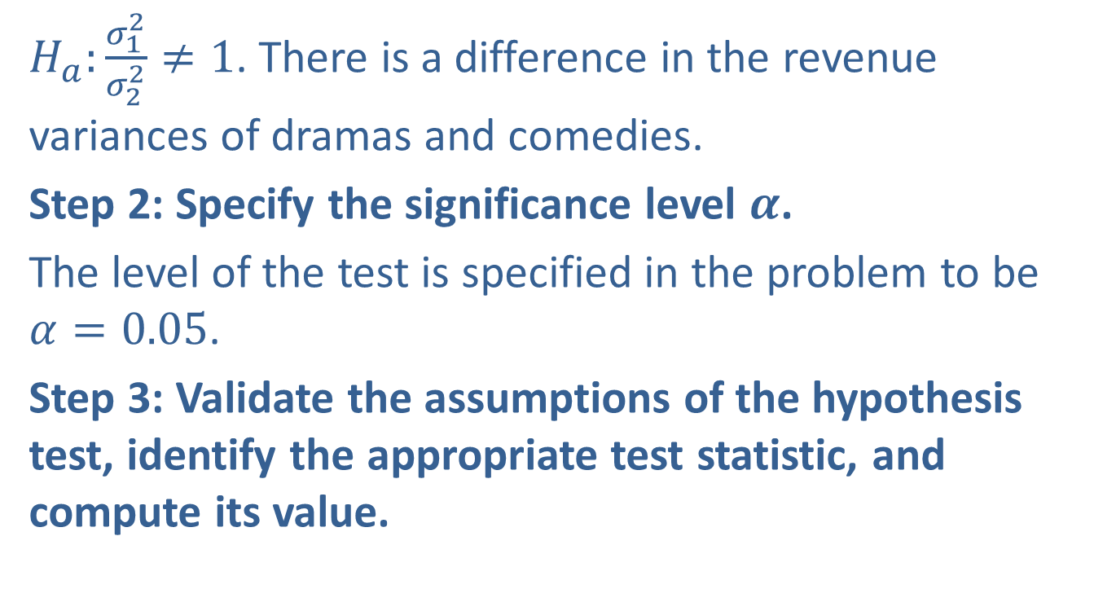
Example 12.5.4: Performing a Hypothesis Test of Variances for Box Office Revenues (cont.)
$H_{a}:\frac{σ_{1}^{2}}{σ_{2}^{2}}≠1$. There is a difference in the revenue variances of dramas and comedies.
Step 2: Specify the significance level $α$.
The level of the test is specified in the problem to be $α=0.05$.
Step 3: Validate the assumptions of the hypothesis test, identify the appropriate test statistic, and compute its value.

Slide 36
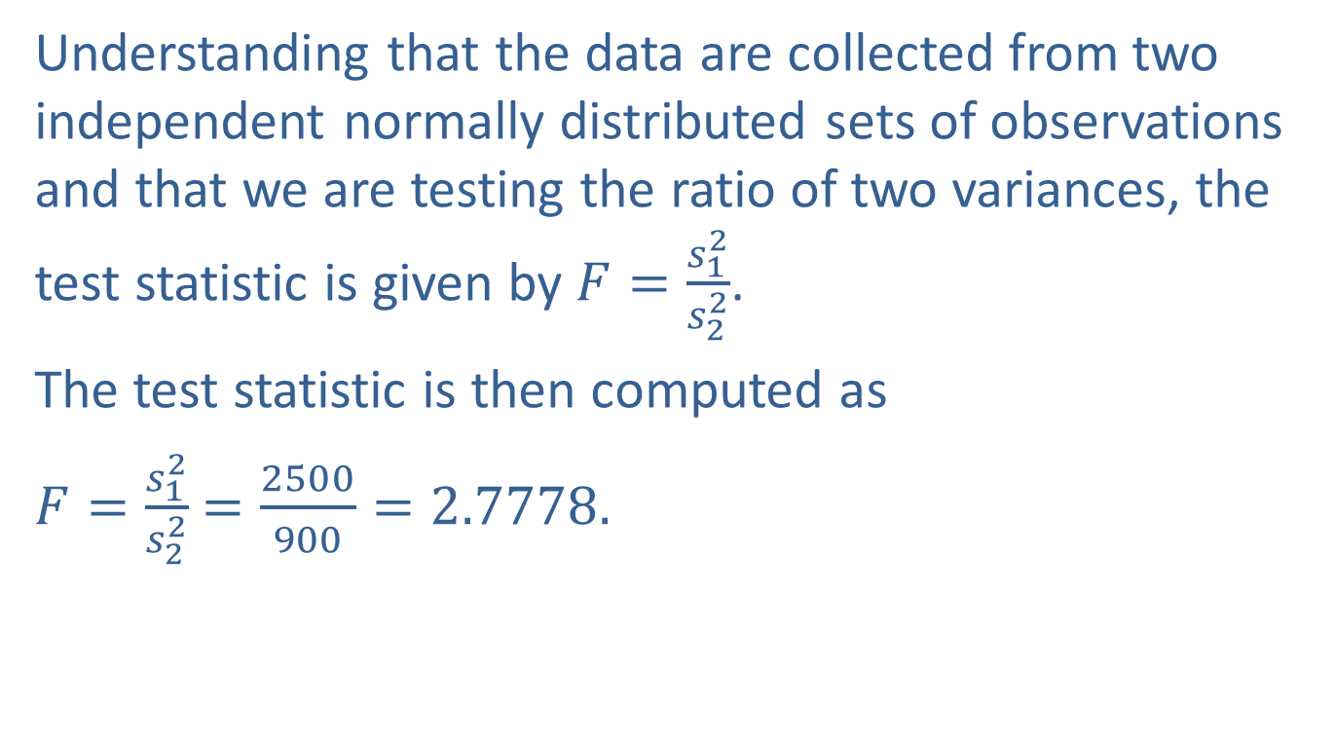
Example 12.5.4: Performing a Hypothesis Test of Variances for Box Office Revenues (cont.)
Understanding that the data are collected from two independent normally distributed sets of observations and that we are testing the ratio of two variances, the test statistic is given by $F=\frac{s_{1}^{2}}{s_{2}^{2}}$.
The test statistic is then computed as
$F=\frac{s_{1}^{2}}{s_{2}^{2}}$ $=\frac{2500}{900}=2.7778.$

Slide 37
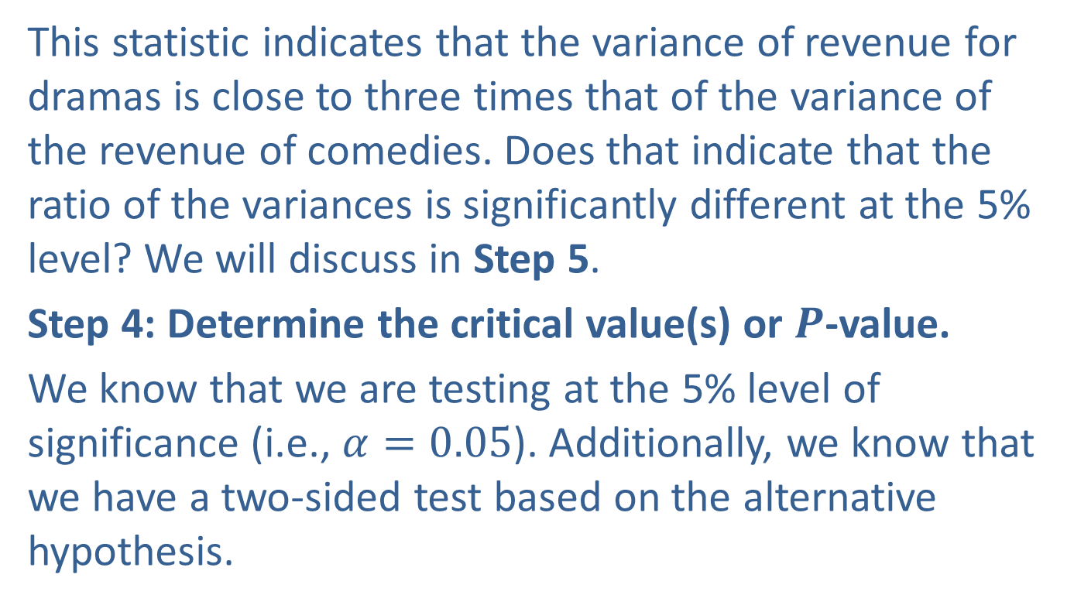
Example 12.5.4: Performing a Hypothesis Test of Variances for Box Office Revenues (cont.)
This statistic indicates that the variance of revenue for dramas is close to three times that of the variance of the revenue of comedies. Does that indicate that the ratio of the variances is significantly different at the 5% level? We will discuss in Step 5.
Step 4: Determine the critical value(s) or $P$-value.
We know that we are testing at the 5% level of significance (i.e., $α=0.05$). Additionally, we know that we have a two-sided test based on the alternative hypothesis.

Slide 38
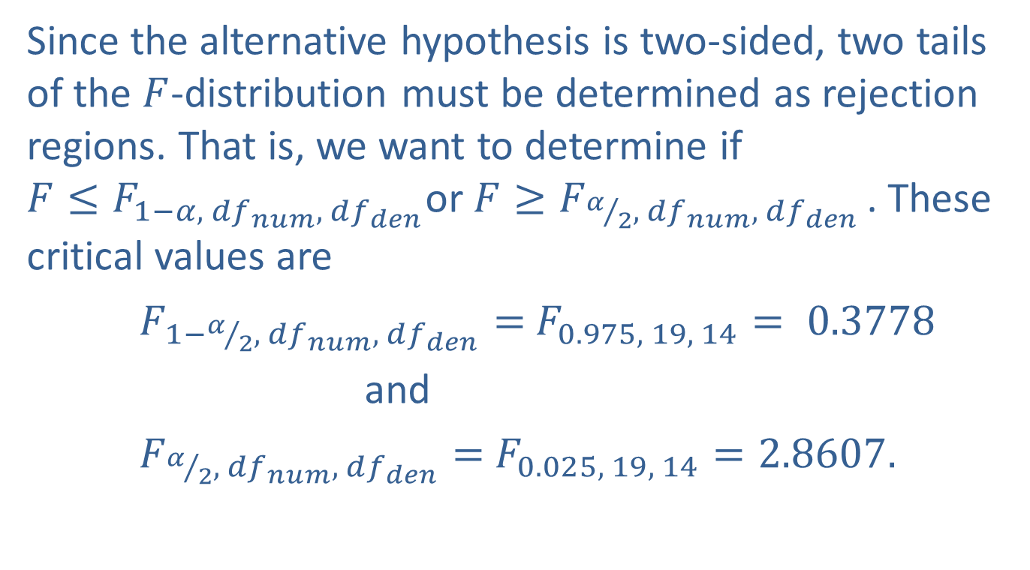
Example 12.5.4: Performing a Hypothesis Test of Variances for Box Office Revenues (cont.)
Since the alternative hypothesis is two-sided, two tails of the $F$-distribution must be determined as rejection regions. That is, we want to determine if $F≤F_{1−α, { df}_{ num}, df_{den}}$or $F≥F_{α/2,{ df}_{ num}, df_{den}}$. These critical values are
$F_{1−α/2,{ df}_{ num}, df_{den}}=$ $F_{0.975, 19, 14}= 0.3778$
and
$F_{α/2,{ df}_{ num}, df_{den}}=$ $F_{0.025, 19, 14}=2.8607.$

Slide 39

Example 12.5.4: Performing a Hypothesis Test of Variances for Box Office Revenues (cont.)
The rejection region is that we will reject the null hypothesis if the $F$-test statistic is less than or equal to 0.3778, or if the $F$-test statistic is greater than or equal to 2.8607.

Slide 40
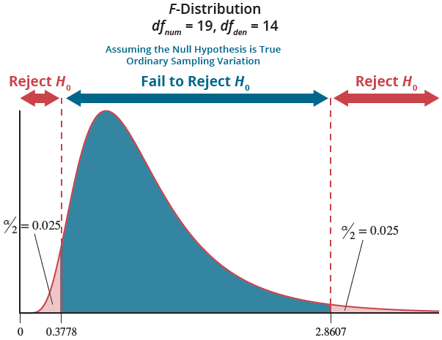

Example 12.5.4: Performing a Hypothesis Test of Variances for Box Office Revenues (cont.)
Using the $P$-value approach, we want to find $2P(F>2.7778)$since this is a two-tailed test. This results in a $P$-value of 0.0564.

Slide 41
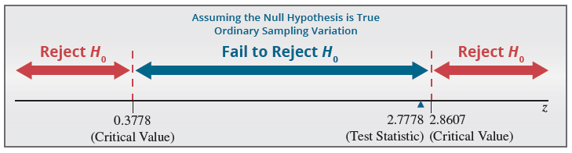
Example 12.5.4: Performing a Hypothesis Test of Variances for Box Office Revenues (cont.)
Step 5: Choose between the null and alternative hypotheses.
Since the test statistic value of 2.7778 does not fall in the rejection region, we fail to reject the null hypothesis.

Slide 42
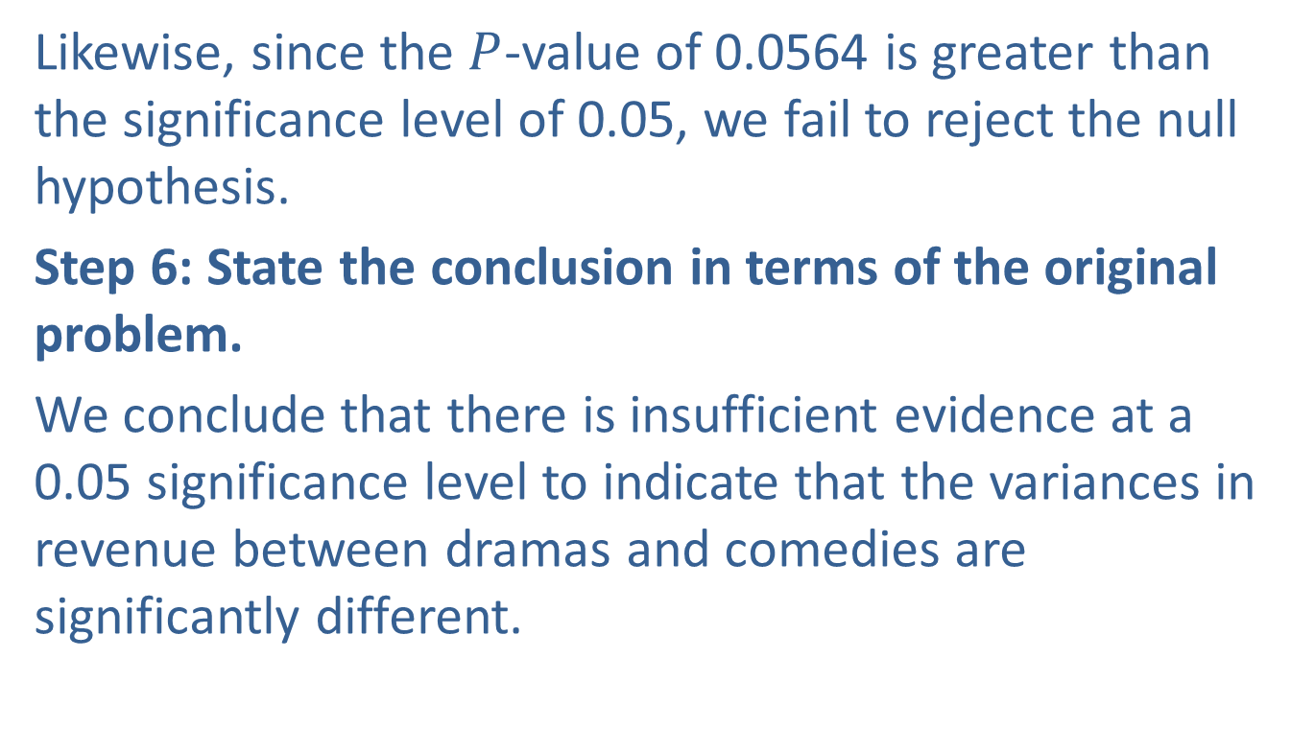
Example 12.5.4: Performing a Hypothesis Test of Variances for Box Office Revenues (cont.)
Likewise, since the $P$-value of 0.0564 is greater than the significance level of 0.05, we fail to reject the null hypothesis.
Step 6: State the conclusion in terms of the original problem.
We conclude that there is insufficient evidence at a 0.05 significance level to indicate that the variances in revenue between dramas and comedies are significantly different.

Slide 43
Hypothesis Testing of the Ratio of Two Population Variances (cont.)
Please note that the methods presented in this section work very poorly when the normality assumption is violated. It is very important to validate the assumption of normality before developing confidence intervals or performing hypothesis tests on the ratio of the variances.

