Slide 1
Section 12.4
Inference about Two Population Proportions

Slide 2
Inference about Two Population Proportions
Techniques are developed in this section for comparing two population proportions. A methodology for comparing two population proportions is particularly useful because proportions are among the few measures that can be used for summarizing categorical data. For a more extensive treatment of comparisons for categorical data, see Chapter 16.
There are many situations where comparing two population proportions may be of interest.

Slide 3
Inference about Two Population Proportions (cont.)
For example, a sociologist may be interested in comparing the proportion of females who believe that it is okay to cry in public to the proportion of males who think it is okay to cry in public. A marketing manager may be interested in comparing the proportion of customers who favor Product A to the proportion of customers who favor Product B.

Slide 4
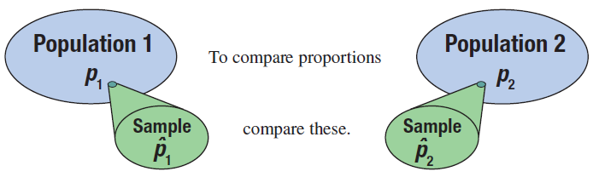
Inference about Two Population Proportions (cont.)
In order to perform a comparison of two population proportions, the assumptions outlined below must be met.

Slide 5
Assumptions: Assumptions for Comparing Two Population Proportions
The sample proportions are from two simple random samples.
The samples are independent (not paired).
The samples are large enough such that there are at least 10 successes and 10 failures for each sample, i.e.,

Slide 6
Assumptions: Assumptions for Comparing Two Population Proportions (cont.)
where and n₁ are the sample proportion and sample size, respectively, from the first population, and and n₂ are the sample proportion and sample size, respectively, from the second population.

Slide 7

Formula: 100(1 −α)% Confidence Interval for $p1−p2$
We can construct a 100(1 − α)% confidence interval estimate for the difference between two population proportions using the following.
where and n₁ are the sample proportion and sample size, respectively, from the first population, and n₂ are the sample proportion and sample size, respectively, from the second population,

Slide 8

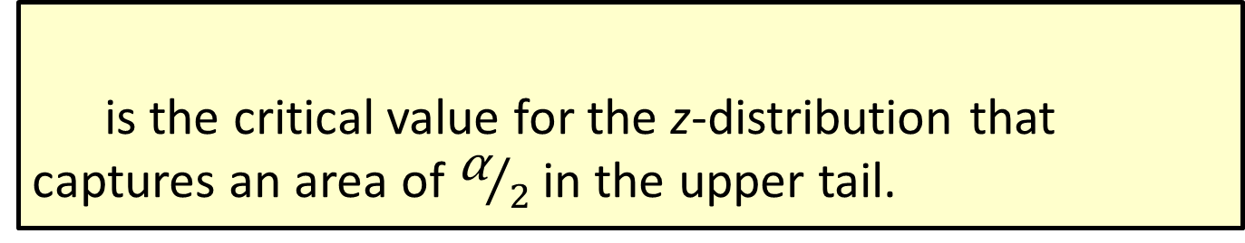
Formula: 100(1 −α)% Confidence Interval for $p1−p2$ (cont.)
is the critical value for the z-distribution that captures an area of ${\text{α}}/2$ in the upper tail.

Slide 9

Hypothesis Testing about $p1−p2$
Table 12.4.1 gives a short summary of the possible hypothesis tests that can be conducted when you want to compare two proportions.
The hypothesis testing procedure and the confidence interval calculation for comparing two population proportions is developed in Example 12.4.1.

Slide 10
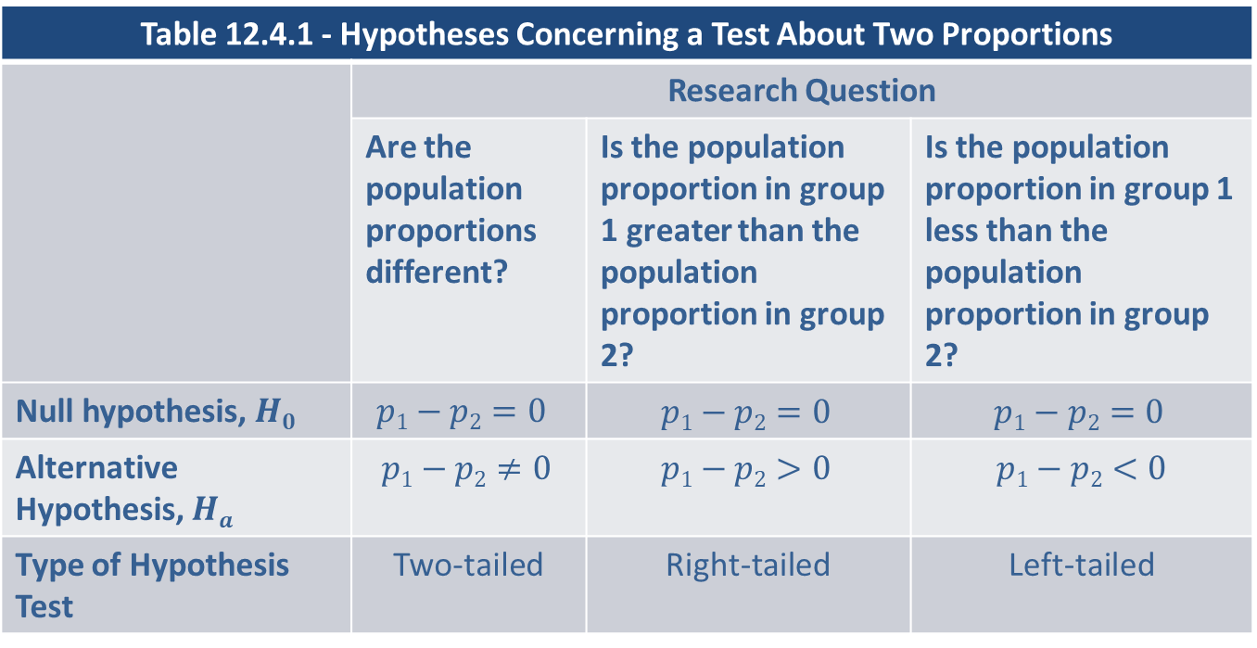
Hypothesis Testing about p₁-p₂ (cont.)
Table 12.4.1 - Hypotheses Concerning a Test About Two Proportions
 | Research Question
 | Are the population proportions different? | Is the population proportion in group 1 greater than the population proportion in group 2? | Is the population proportion in group 1 less than the population proportion in group 2?
Null hypothesis, $H0$ | $$p1−p2=0$$ | $$p1−p2=0$$ | $$p1−p2=0$$
Alternative Hypothesis, $Ha$ | $$p1−p2≠0$$ | $$p1−p2>0$$ | $$p1−p2<0$$
Type of Hypothesis Test | Two-tailed | Right-tailed | Left-tailed

Slide 11
Note
In the null hypothesis
p₁ = p₂ is equivalent to p₁ − p₂ = 0.

Slide 12
Procedure: Testing a Hypothesis about Two Population Proportions
Assumptions:
The sample proportions are from two simple random samples.
The samples are independent (not paired).
The samples are large enough such that there are at least 10 successes and 10 failures for each sample, i.e.,

Slide 13
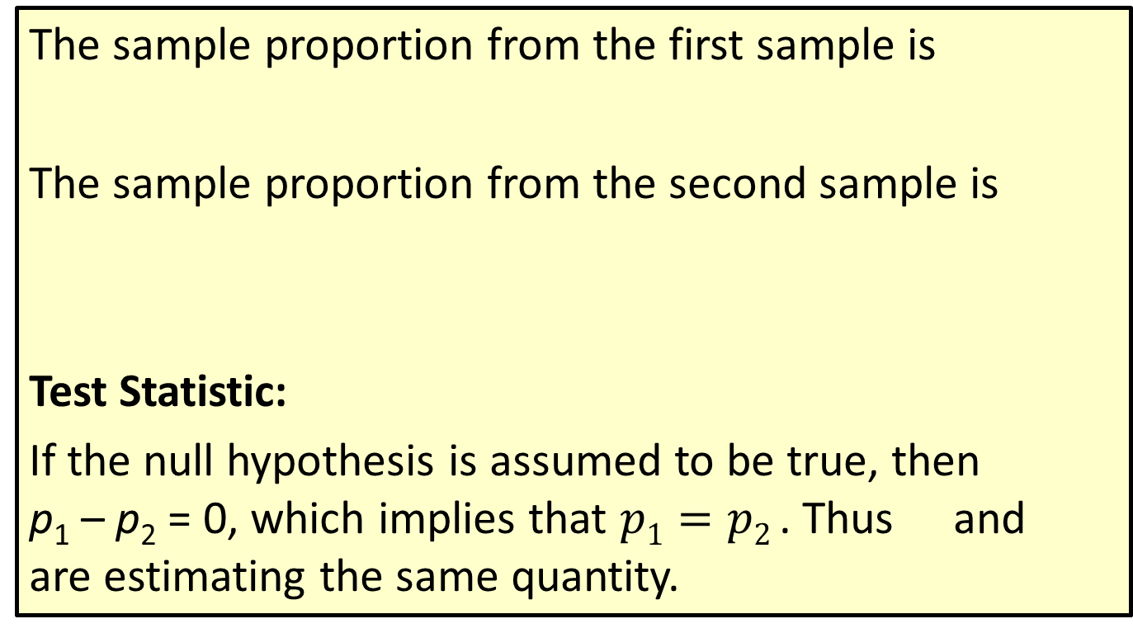
Procedure: Testing a Hypothesis about Two Population Proportions (cont.)
The sample proportion from the first sample is
The sample proportion from the second sample is
Test Statistic:
If the null hypothesis is assumed to be true, then p₁ – p₂ = 0, which implies that $p1=p2$. Thus and are estimating the same quantity.

Slide 14
Procedure: Testing a Hypothesis about Two Population Proportions (cont.)
Therefore, and are pooled to derive a better estimate of the population proportion. The test statistic is a standard normal random variable and is given by
where the pooled sample proportion is calculated as

Slide 15
Procedure: Testing a Hypothesis about Two Population Proportions (cont.)
For Population 1
p₁ = the population proportion,
x₁ = the number of successes in the first sample, and
n₁ = the sample size of the first sample.
For Population 2
p₂ = the population proportion,
x₂ = the number of successes in the second sample, and
n₂ = the sample size of the second sample.

Slide 16
Example 12.4.1: Determining a Confidence Interval and Performing a Hypothesis Test for the Difference in the Proportion of Defective Phones
A cell phone executive has recently been bombarded with complaints from their customers about defective cell phones. There are two plants which produce cell phones, and the executive is not sure where the defective phones are coming from. In the past, the plants have had good control over the number of defective phones produced. Because of the recent flurry of complaints, there is concern that one of the plants may have lost control over its production process.

Slide 17
Example 12.4.1: Determining a Confidence Interval and Performing a Hypothesis Test for the Difference in the Proportion of Defective Phones (cont.)
To test this theory, 200 phones from each plant are randomly selected and the number of defective phones is counted. The results of the survey are displayed in the table. Let Population 1 be Plant A and Population 2 be Plant B.
Cell Phone Survey Data
 | Number Sampled | Number of Defectives
Plant A | 200 | 12
Plant B | 200 | 10

Slide 18
Example 12.4.1: Determining a Confidence Interval and Performing a Hypothesis Test for the Difference in the Proportion of Defective Phones (cont.)
Are the sample sizes large enough to assume that the sample proportions are approximately normally distributed? Why is this necessary?
Calculate a 95% confidence interval for the difference between the proportions of defective phones from Plant A and Plant B.
Is there sufficient evidence for the cell phone executive to conclude that there is a difference in the proportion of defective cell phones produced by the two plants at α = 0.10?

Slide 19
Example 12.4.1: Determining a Confidence Interval and Performing a Hypothesis Test for the Difference in the Proportion of Defective Phones (cont.)
Solution
Let = the sample proportion of defective phones produced in Plant A,
= the sample proportion of defective phones produced in Plant B,
x₁ = the sample number of defective phone produced in Plant A,
x₂ = the sample number of defective phones produced in Plant B,

Slide 20
Example 12.4.1: Determining a Confidence Interval and Performing a Hypothesis Test for the Difference in the Proportion of Defective Phones (cont.)
n₁ = the number of phones sample from Plant A, and
n₂ = the number of phones sampled from plant B.
Before we can determine a confidence interval or perform a hypothesis test for the difference between the population proportions, we need to be sure that the sample sizes are large enough.

Slide 21
Example 12.4.1: Determining a Confidence Interval and Performing a Hypothesis Test for the Difference in the Proportion of Defective Phones (cont.)
Recall, that when dealing with single samples of proportions, the sample size, n, must be large enough such that the sampling distribution of the sample proportion will be approximately normal. To determine whether the sample sizes are large enough, we need to show that are all greater than or equal to 10. If both samples are large enough, then we know that the sampling distribution of the difference between the sample proportions is approximately normal, and we can proceed with

Slide 22
Example 12.4.1: Determining a Confidence Interval and Performing a Hypothesis Test for the Difference in the Proportion of Defective Phones (cont.)
constructing the confidence interval and performing the hypothesis test. First, we need to calculate the sample proportions for the defective phones produced in Plant A and Plant B.

Slide 23
Example 12.4.1: Determining a Confidence Interval and Performing a Hypothesis Test for the Difference in the Proportion of Defective Phones (cont.)
Now, we can use the sample proportions along with the sample sizes to verify that the samples are large enough such that the sampling distribution of the difference between the sample proportions is approximately normal.

Slide 24
Example 12.4.1: Determining a Confidence Interval and Performing a Hypothesis Test for the Difference in the Proportion of Defective Phones (cont.)
Since are all greater than or equal to 10, we can conclude that has an approximately normal distribution.
The sample proportions are from simple random samples.
The samples are independent of one another.
The samples are large enough such that there are at least 10 successes and 10 failures for each sample, i.e.,

Slide 25
Example 12.4.1: Determining a Confidence Interval and Performing a Hypothesis Test for the Difference in the Proportion of Defective Phones (cont.)
Now that we have verified the conditions required to proceed with the calculation of a confidence interval, we can find the 95% confidence interval for the difference between the population proportions.
In part a. we calculated the sample proportions for the defective phones produced in Plant A and Plant B to be 0.06 and 0.05 respectively.
For a 95% confidence interval, α = 0.05 and

Slide 26
Example 12.4.1: Determining a Confidence Interval and Performing a Hypothesis Test for the Difference in the Proportion of Defective Phones (cont.)
Therefore, the 95% confidence interval is calculated as follows.
Thus, we are 95% confident that the true difference in the proportion of defectives between Plant A and Plant B is between −0.0347 and 0.0547

Slide 27
Example 12.4.1: Determining a Confidence Interval and Performing a Hypothesis Test for the Difference in the Proportion of Defective Phones (cont.)
To perform the hypothesis test we proceed as follows.
Step 1: Determine the population parameter to be used and develop the null and alternative hypotheses.
The hypotheses from the problem can be stated in words as follows.
Null Hypothesis: There is no difference in the proportion of defective cell phones produced at the two plants.

Slide 28
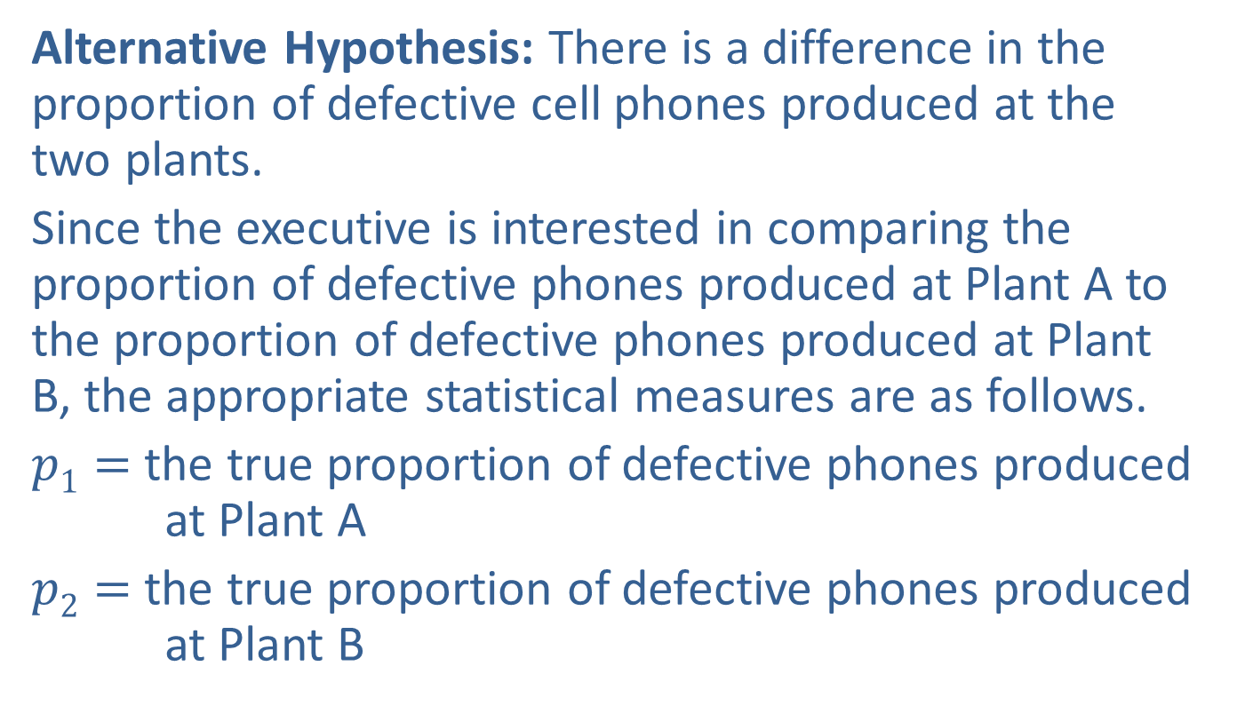
Example 12.4.1: Determining a Confidence Interval and Performing a Hypothesis Test for the Difference in the Proportion of Defective Phones (cont.)
Alternative Hypothesis: There is a difference in the proportion of defective cell phones produced at the two plants.
Since the executive is interested in comparing the proportion of defective phones produced at Plant A to the proportion of defective phones produced at Plant B, the appropriate statistical measures are as follows.
$p1=$ the true proportion of defective phones produced at Plant A
$p2=$ the true proportion of defective phones produced at Plant B

Slide 29
Example 12.4.1: Determining a Confidence Interval and Performing a Hypothesis Test for the Difference in the Proportion of Defective Phones (cont.)
The executive’s interest is in whether or not there is a difference in the proportion of defective phones produced between the two plants. Thus, the alternative hypothesis is two-sided and this is a two-tailed test.
Since the executive is interested in comparing the two population proportions, a natural way to perform this comparison is to look at the difference between the two population proportions. Hence, the null and alternative hypotheses are as follows:

Slide 30
Note
In order for the following hypothesis procedure to be valid, the hypothesized difference between the two population proportions in the null hypothesis must be 0.

Slide 31
Example 12.4.1: Determining a Confidence Interval and Performing a Hypothesis Test for the Difference in the Proportion of Defective Phones (cont.)
(There is no difference in the proportion of defective phones produced at the two plants.)
(There is a difference in the proportion of defective phones produced at the two plants. )
Step 2: Specify the significance level α.
The level of the test is specified in the problem to be α = 0.10.

Slide 32
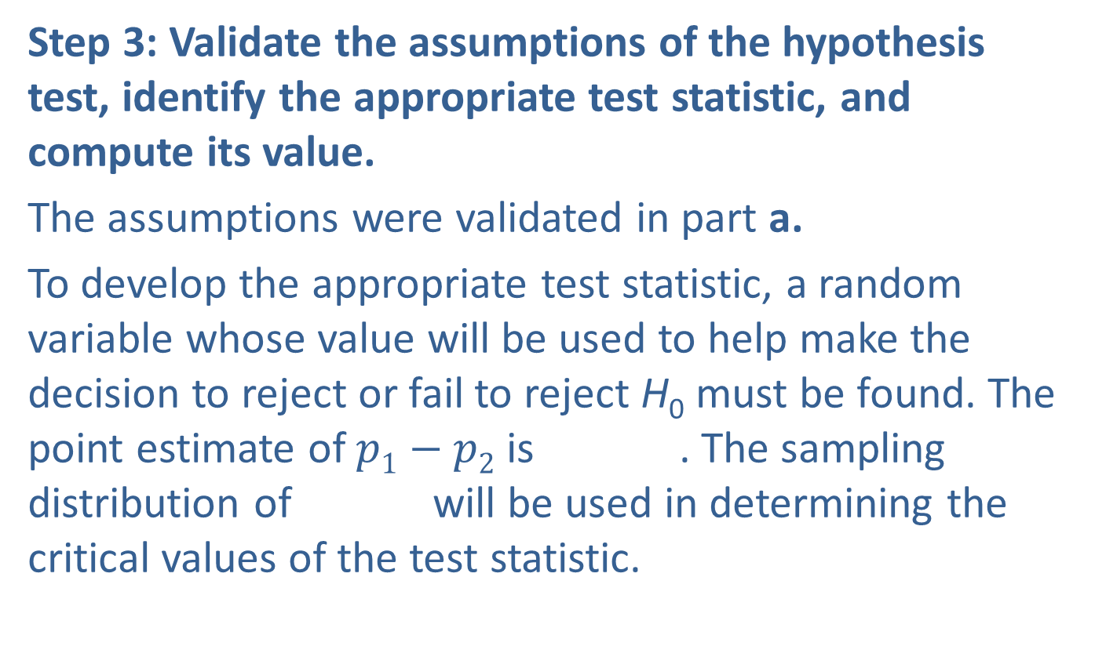
Example 12.4.1: Determining a Confidence Interval and Performing a Hypothesis Test for the Difference in the Proportion of Defective Phones (cont.)
Step 3: Validate the assumptions of the hypothesis test, identify the appropriate test statistic, and compute its value.
The assumptions were validated in part a.
To develop the appropriate test statistic, a random variable whose value will be used to help make the decision to reject or fail to reject H₀ must be found. The point estimate of $p1−p2$ is . The sampling distribution of will be used in determining the critical values of the test statistic.

Slide 33
Example 12.4.1: Determining a Confidence Interval and Performing a Hypothesis Test for the Difference in the Proportion of Defective Phones (cont.)
If the assumptions outlined above are met, and we assume the null hypothesis is true, the sampling distribution of has an approximately normal distribution with mean, 0, and standard deviation,

Slide 34
Example 12.4.1: Determining a Confidence Interval and Performing a Hypothesis Test for the Difference in the Proportion of Defective Phones (cont.)
Note that is the weighted average of the two sample proportion estimates, and In hypothesis tests comparing two population proportions, we will always assume that the hypothesized difference between the two proportions is zero.
Therefore, the test statistic will be as follows.

Slide 35
Example 12.4.1: Determining a Confidence Interval and Performing a Hypothesis Test for the Difference in the Proportion of Defective Phones (cont.)
If the null hypothesis is true, z has an approximately normal distribution. If the observed value of is significantly different from 0, this will produce a value of the test statistic significantly different from 0, causing us to question whether the null hypothesis is true.
Based on the data given in the problem, the computed value of the test statistic is given by

Slide 36
Example 12.4.1: Determining a Confidence Interval and Performing a Hypothesis Test for the Difference in the Proportion of Defective Phones (cont.)
where
Step 4: Determine the critical value(s) or P-value.
The role of the critical value in this test is exactly the same as for all of the hypothesis tests discussed earlier.

Slide 37
Example 12.4.1: Determining a Confidence Interval and Performing a Hypothesis Test for the Difference in the Proportion of Defective Phones (cont.)
It defines a range of values for the test statistic, the rejection region, that will be so rare that it is unlikely that it occurred from ordinary sampling variability assuming H₀ is true. The level of the test defines the size of the rejection region. Should the computed value of the test statistic fall in the rejection region, the null hypothesis will be rejected.
If the null hypothesis is true, the test statistic has an approximately standard normal distribution.

Slide 38
Example 12.4.1: Determining a Confidence Interval and Performing a Hypothesis Test for the Difference in the Proportion of Defective Phones (cont.)
Thus the critical value is determined in the same way as for the other tests of hypotheses where the test statistic had an approximately standard normal distribution. The rejection region for a two-sided test with α = 0.10 is displayed in the following figure. We will reject the null hypothesis if the computed value of the test statistic is larger than 1.645 or smaller than −1.645.
If the null hypothesis is true and the assumptions of the test are valid, the probability of obtaining a value of the test statistic above 0.4386 is 0.33047.

Slide 39
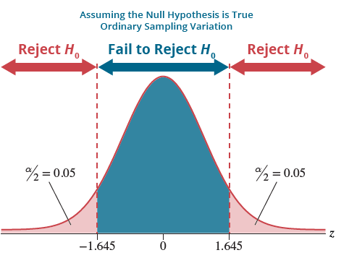
Example 12.4.1: Determining a Confidence Interval and Performing a Hypothesis Test for the Difference in the Proportion of Defective Phones (cont.)
Since this is a two-sided test, this probability must be doubled to obtain the P-value. Therefore the P-value is 0.6609.

Slide 40
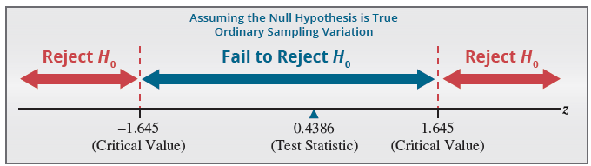
Example 12.4.1: Determining a Confidence Interval and Performing a Hypothesis Test for the Difference in the Proportion of Defective Phones (cont.)
Step 5: Choose between the null and alternative hypotheses.
As shown above, the value of the test statistic does not fall in the rejection region because −1.645 < 0.4386 < 1.645. Thus, the difference between the observed value and the hypothesized value is likely due to ordinary sampling variation. We fail to reject the null hypothesis at α = 0.10.

Slide 41
Example 12.4.1: Determining a Confidence Interval and Performing a Hypothesis Test for the Difference in the Proportion of Defective Phones (cont.)
The P-value of 0.6609 is much greater than α = 0.10, so the null hypothesis is not rejected.
Step 6: State the conclusion in terms of the original problem.
There is insufficient evidence at α = 0.10 for the cell phone executive to conclude that the proportion of defective phones produced differs between the two plants.

