Slide 1
Section 12.3
Inference about Two Population Means: Dependent Samples (Paired Difference)

Slide 2
Inference about Two Population Means: Dependent Samples (Paired Difference)
We are interested in comparing the durability of the soles of two brands of tennis shoes, Spikes and Kickers. One approach to making this comparison is the independent experimental design discussed in Sections 12.1 and 12.2. Using this design, one may randomly select 10 people to wear the Spikes brand of shoes for six months and then randomly select 10 other people to wear the Kickers brand of shoes for six months. After the six-month period, the average wear for the 10 pairs of Spikes shoes is measured and compared to the average wear for the 10 pairs of Kickers tennis shoes.

Slide 3
Inference about Two Population Means: Dependent Samples (Paired Difference) (cont.)
While this is a perfectly reasonable approach, it does have shortcomings. For example, what if one of the people selected to wear the Spikes brand of shoes is a cross-country runner? Certainly, the wear on the runner’s pair of shoes will be much greater than the wear on the shoes for someone who just wears the shoes in the evenings after work. Many factors could have a large effect on the observed wear of the tennis shoes.

Slide 4
Inference about Two Population Means: Dependent Samples (Paired Difference) (cont.)
What can we do to help reduce the effect of factors that cloud the issue of tennis shoe durability? One approach is to have each person wear a Spikes brand of shoe on one foot and a Kickers brand of shoe on the other foot, where the feet are randomly selected. After six months, the wear on the Spikes shoe would be compared to the wear on the Kickers shoe for each person. By designing the experiment in this fashion, the external effects of weight, amount of usage, and so forth, have been significantly reduced when comparing the two brands of tennis shoes.

Slide 5
Inference about Two Population Means: Dependent Samples (Paired Difference) (cont.)
This type of design is an example of a paired difference experimental design. This methodology is extremely useful in reducing the effects of confounding variables.
In a paired design, experimental units are paired such that units within a pair are much more alike than in the population as a whole. If we have been successful at significantly reducing the variation among the sample observations by pairing, we will create very potent data to make decisions.

Slide 6
Inference about Two Population Means: Dependent Samples (Paired Difference) (cont.)
The paired difference design is frequently used in experiments where we are interested in the average response of an experimental unit before and after some treatment. For example, a physician might be interested in comparing a patient’s heart rate before and after treatment with some drug. A state legislator may be interested in comparing a person’s reaction time before and after drinking one ounce of 100-proof alcohol. An instructor may be interested in comparing a student’s math skills before and after being taught a particular course.

Slide 7
Inference about Two Population Means: Dependent Samples (Paired Difference) (cont.)
Generally, the sample size for a paired difference experimental design is small, and we must make several assumptions for the test to be valid. These assumptions are outlined below.

Slide 8
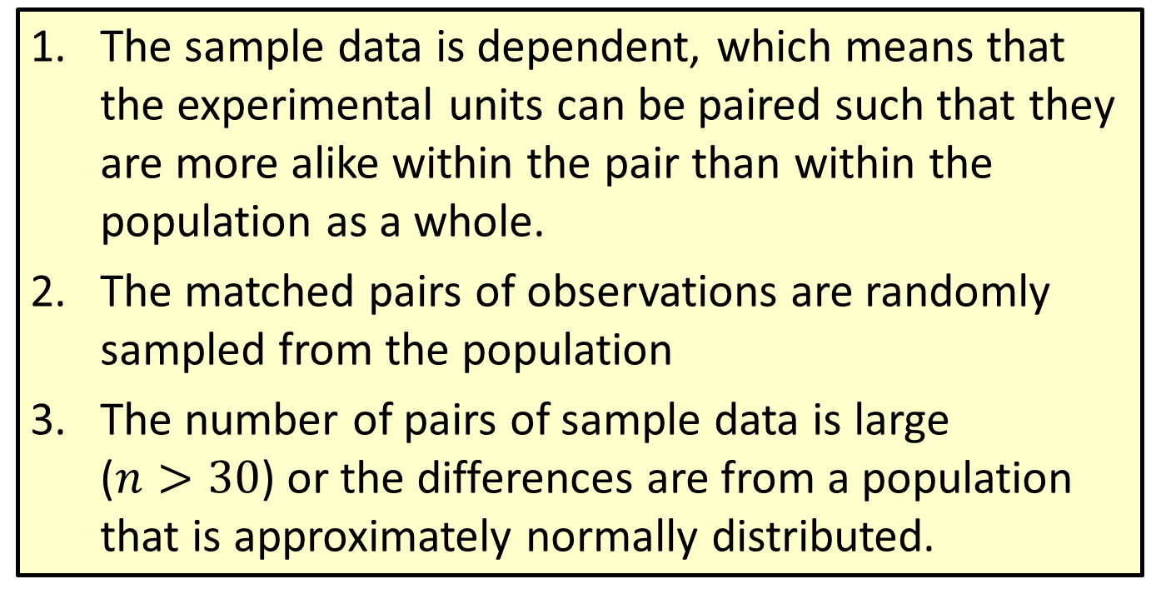
Assumptions
The sample data is dependent, which means that the experimental units can be paired such that they are more alike within the pair than within the population as a whole.
The matched pairs of observations are randomly sampled from the population
The number of pairs of sample data is large ($n>30$) or the differences are from a population that is approximately normally distributed.

Slide 9

Inference about Two Population Means: Dependent Samples (Paired Difference) (cont.)
To test the mean difference between two related population means, we treat the difference scores, denoted by $di$, as values from a single sample. The general data setup is shown in the following table.

Slide 10
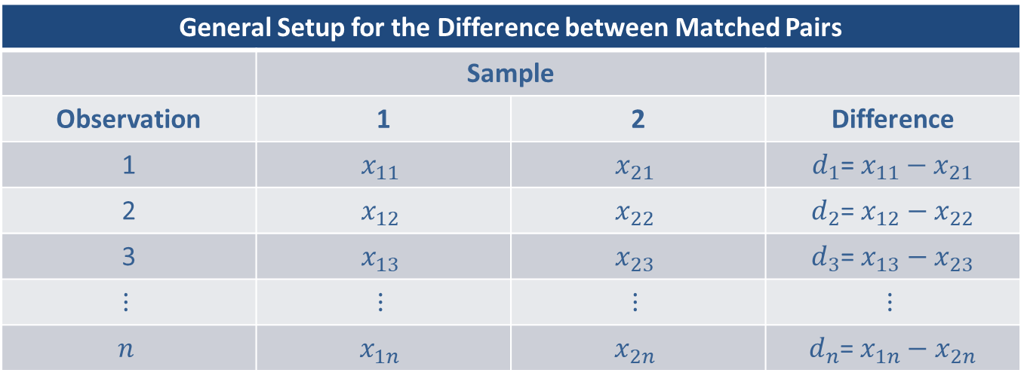

Inference about Two Population Means: Dependent Samples (Paired Difference) (cont.)
Note that $d_{i}$ is the difference between the $ith$ observation in each sample.
General Setup for the Difference between Matched Pairs
 | Sample
Observation | 1 | 2 | Difference
1 | $$x_{11}$$ | $$x_{21}$$ | $d_{1}$= $x_{11}{− x}_{21}$
2 | $$x_{12}$$ | $$x_{22}$$ | $d_{2}$= $x_{12}{− x}_{22}$
3 | $$x_{13}$$ | $$x_{23}$$ | $d_{3}$= $x_{13}{− x}_{23}$
$$⋮$$ | $$⋮$$ | $$⋮$$ | $$⋮$$
$$n$$ | $$x_{1n}$$ | $$x_{2n}$$ | $d_{n}$= $x_{1n}{− x}_{2n}$

Slide 11
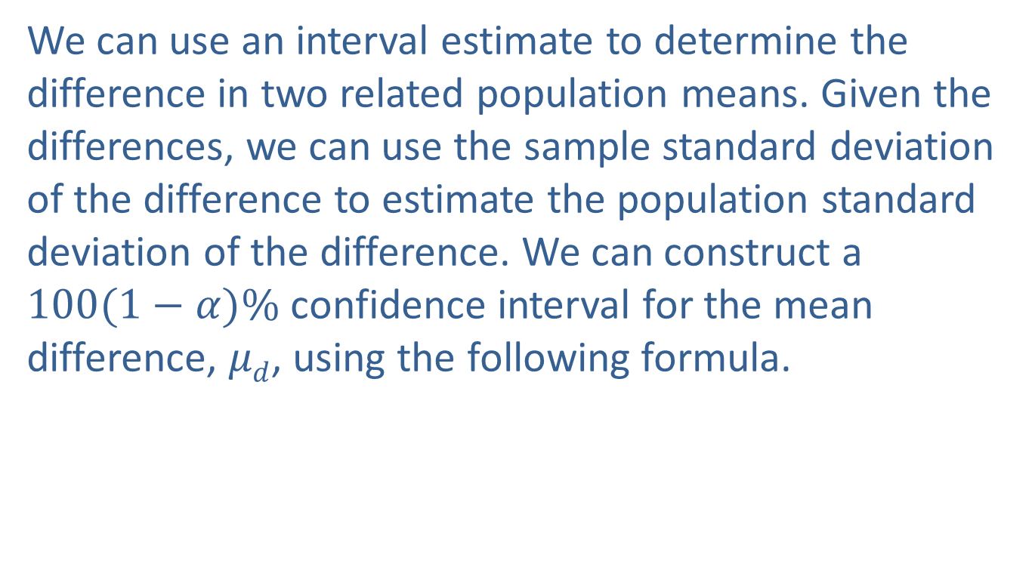
Inference about Two Population Means: Dependent Samples (Paired Difference) (cont.)
We can use an interval estimate to determine the difference in two related population means. Given the differences, we can use the sample standard deviation of the difference to estimate the population standard deviation of the difference. We can construct a $100(1−α)\%$ confidence interval for the mean difference, $μd$, using the following formula.

Slide 12
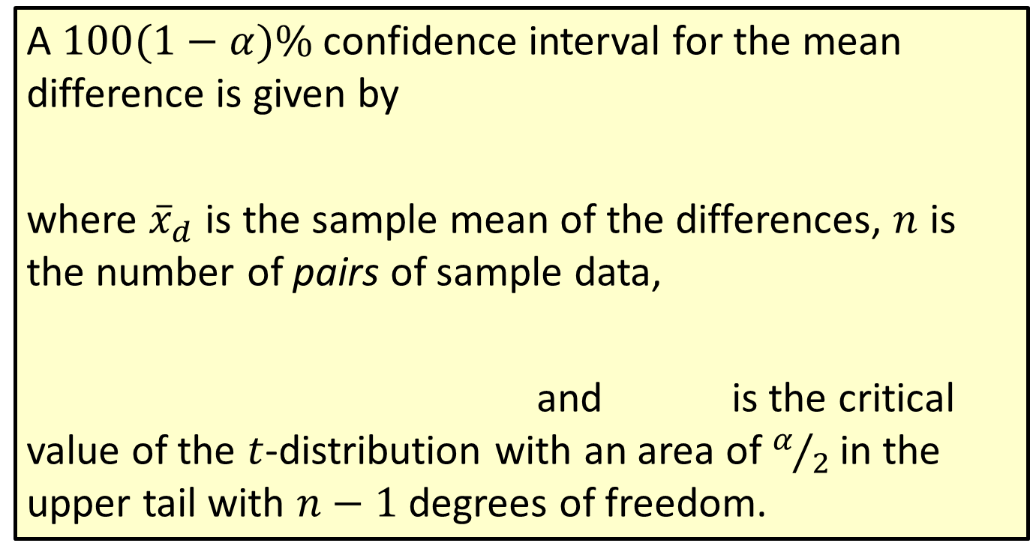

Formula: $100(1−α)\%$Confidence Interval for $μd$
A $100(1−α)\%$confidence interval for the mean difference is given by
where ${\overline{x}}_{d}$ is the sample mean of the differences, $n$ is the number of pairs of sample data,
and is the critical value of the $t$-distribution with an area of $α/2$ in the upper tail with $n−1$ degrees of freedom.

Slide 13
Inference about Two Population Means: Dependent Samples (Paired Difference) (cont.)
The hypothesis test for testing two dependent population means is summarized as follows.

Slide 14
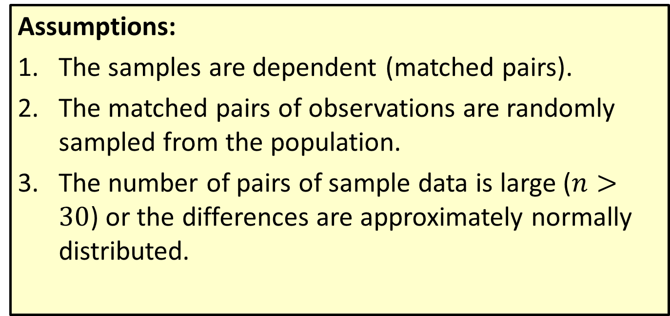
Procedure: Testing a Hypothesis about Two Dependent Population Means
Assumptions:
The samples are dependent (matched pairs).
The matched pairs of observations are randomly sampled from the population.
The number of pairs of sample data is large ($n>30$) or the differences are approximately normally distributed.

Slide 15
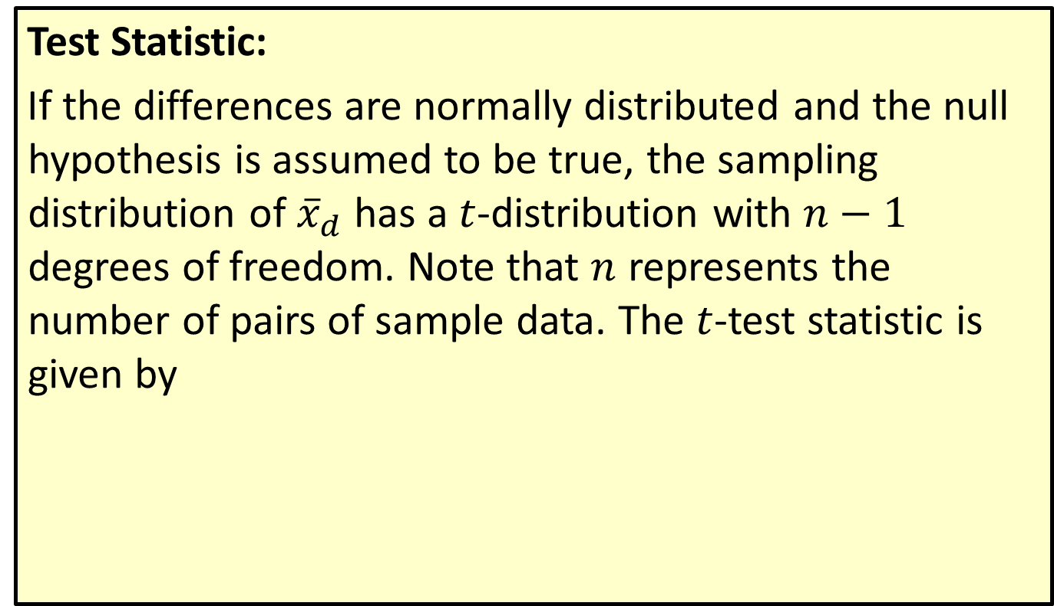
Procedure: Testing a Hypothesis about Two Dependent Population Means (cont.)
Test Statistic:
If the differences are normally distributed and the null hypothesis is assumed to be true, the sampling distribution of ${\overline{x}}_{d}$ has a $t$-distribution with $n−1$ degrees of freedom. Note that $n$ represents the number of pairs of sample data. The $t$-test statistic is given by

Slide 16
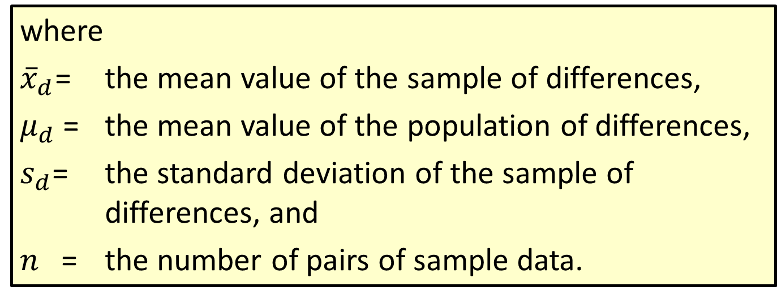
Procedure: Testing a Hypothesis about Two Dependent Population Means (cont.)
where
${\overline{x}}_{d}$= the mean value of the sample of differences,
$μ_{d}$= the mean value of the population of differences,
$s_{d}$= the standard deviation of the sample of differences, and
$n$= the number of pairs of sample data.

Slide 17
Inference about Two Population Means: Dependent Samples (Paired Difference) (cont.)
The methodology for the paired difference test of hypothesis and the calculation of the confidence interval for the paired difference will be presented in Example 12.3.1.

Slide 18
Example 12.3.1: Determining a Confidence Interval and Performing a Hypothesis Test for the Difference in Restaurant Sales
Bull & Bones Brewhaus is a microbrewery that has two restaurants located within 15 miles of each other. The owner of the microbrewery wants to compare the average daily food sales of the two restaurants. To do so, the owner randomly selects 10 days over a five-month period (college football season) and records the daily food sales. The results are given in the table below.

Slide 19
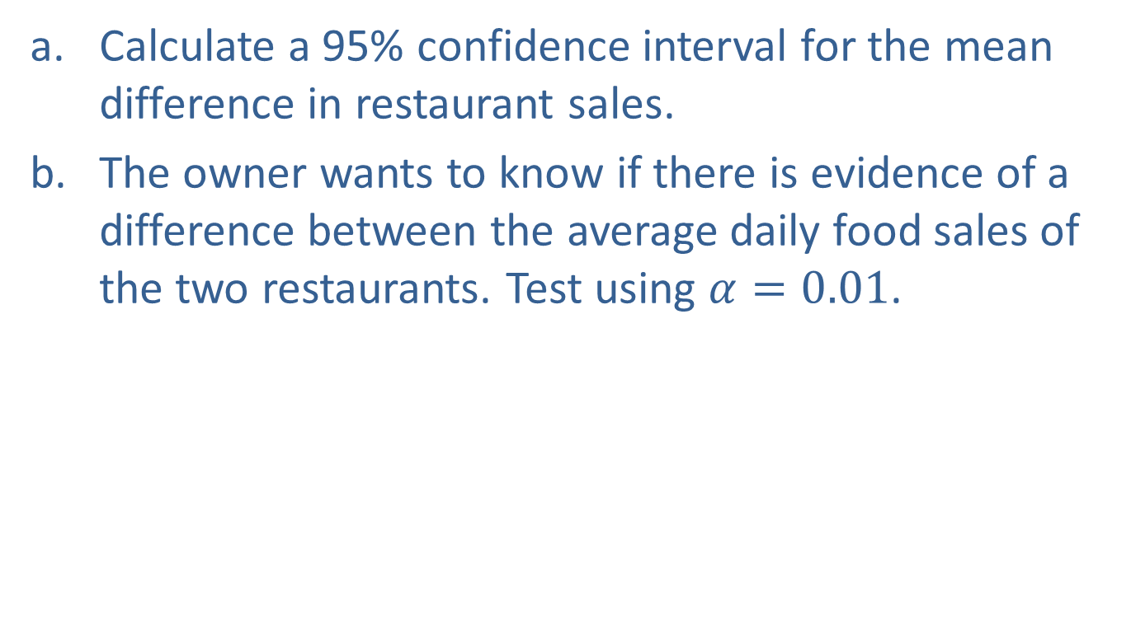
Example 12.3.1: Determining a Confidence Interval and Performing a Hypothesis Test for the Difference in Restaurant Sales (cont.)
Calculate a 95% confidence interval for the mean difference in restaurant sales.
The owner wants to know if there is evidence of a difference between the average daily food sales of the two restaurants. Test using $α=0.01$.

Slide 20
Example 12.3.1: Determining a Confidence Interval and Performing a Hypothesis Test for the Difference in Restaurant Sales (cont.)
Daily Food Sales for Two Restaurants ($)
Day | Restaurant 1 | Restaurant 2 | Difference = Restaurant 1 – Restaurant 2
1 | 5828 | 7894 | −2066
2 | 9836 | 11,573 | −1737
3 | 3984 | 5319 | −1335
4 | 5845 | 6389 | −544
5 | 5210 | 6055 | −845
6 | 9668 | 10,631 | −963
7 | 6768 | 7866 | −1098
8 | 6726 | 7976 | −1250
9 | 4399 | 5652 | −1253
10 | 6692 | 8083 | −1391

Slide 21
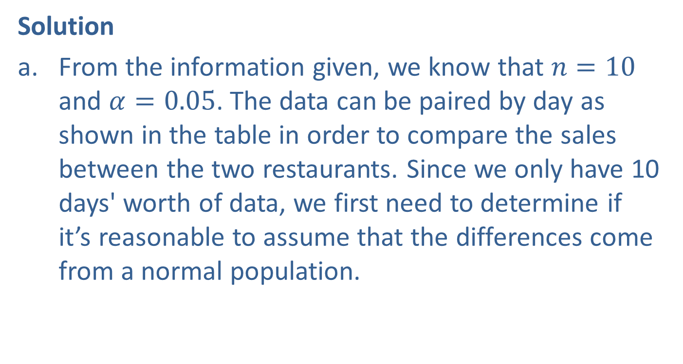
Example 12.3.1: Determining a Confidence Interval and Performing a Hypothesis Test for the Difference in Restaurant Sales (cont.)
Solution
From the information given, we know that $n=10$ and $α=0.05$. The data can be paired by day as shown in the table in order to compare the sales between the two restaurants. Since we only have 10 days' worth of data, we first need to determine if it’s reasonable to assume that the differences come from a normal population.

Slide 22
Example 12.3.1: Determining a Confidence Interval and Performing a Hypothesis Test for the Difference in Restaurant Sales (cont.)
Based on the normal probability plot and the histogram below, it appears that the differences are approximately normal and it is safe to calculate the confidence interval for the mean difference in sales using a paired difference approach.

Slide 23
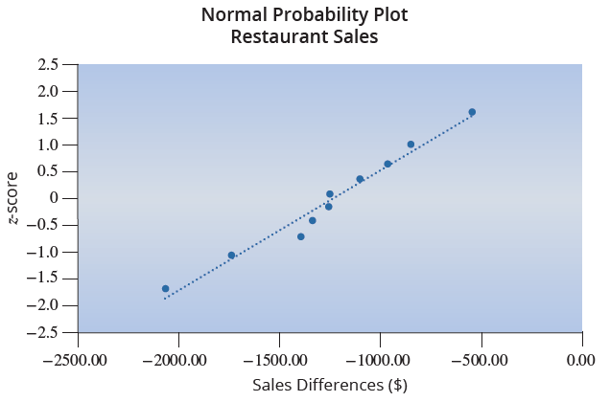
Example 12.3.1: Determining a Confidence Interval and Performing a Hypothesis Test for the Difference in Restaurant Sales (cont.)

Slide 24
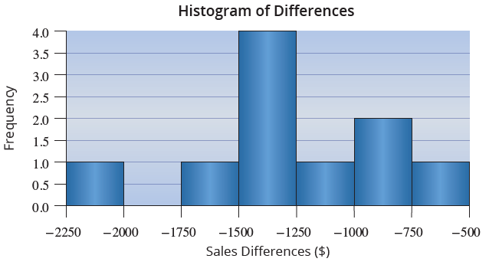
Example 12.3.1: Determining a Confidence Interval and Performing a Hypothesis Test for the Difference in Restaurant Sales (cont.)

Slide 25
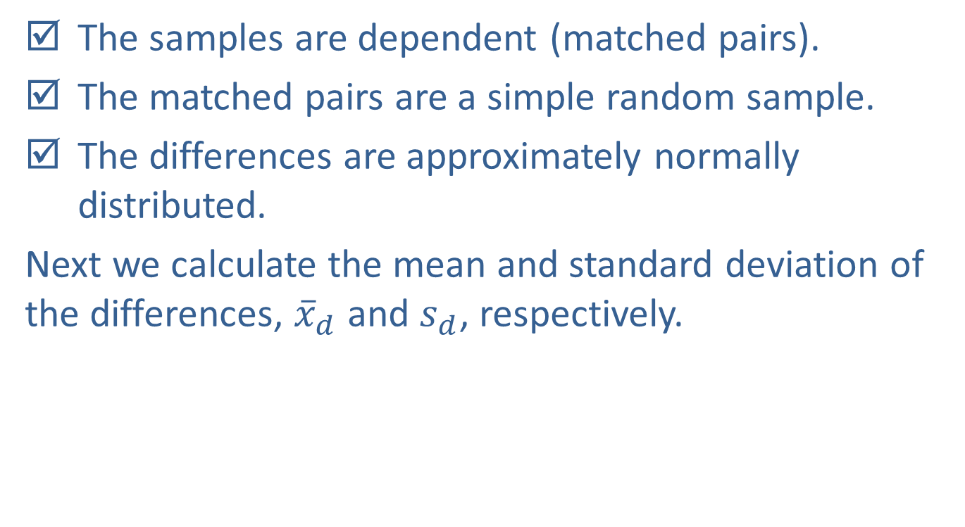
Example 12.3.1: Determining a Confidence Interval and Performing a Hypothesis Test for the Difference in Restaurant Sales (cont.)
The samples are dependent (matched pairs).
The matched pairs are a simple random sample.
The differences are approximately normally distributed.
Next we calculate the mean and standard deviation of the differences, ${\overline{x}}_{d}$ and $s_{d}$, respectively.

Slide 26
Example 12.3.1: Determining a Confidence Interval and Performing a Hypothesis Test for the Difference in Restaurant Sales (cont.)

Slide 27
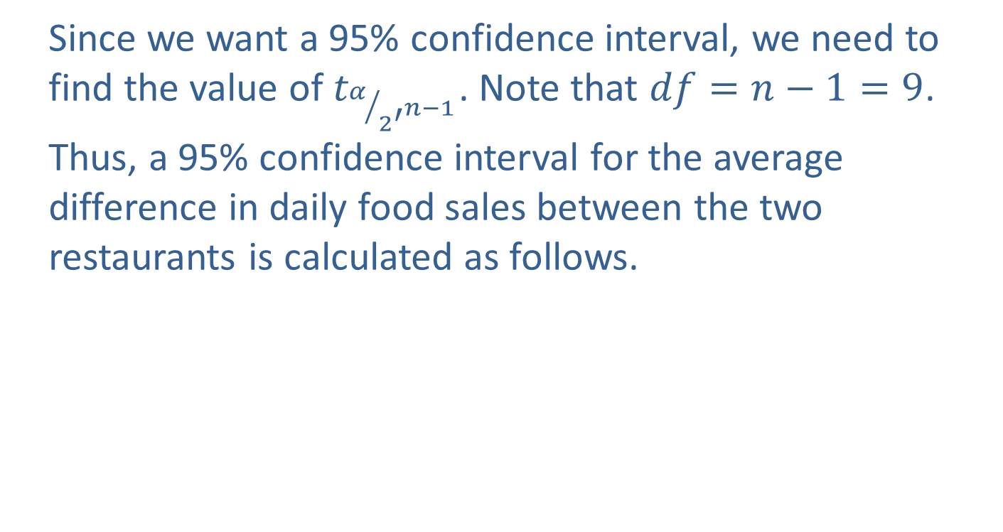
Example 12.3.1: Determining a Confidence Interval and Performing a Hypothesis Test for the Difference in Restaurant Sales (cont.)
Since we want a 95% confidence interval, we need to
find the value of $t_{α/{2^{′^{n−1}}}}$. Note that $df=n−1=9$.
Thus, a 95% confidence interval for the average
difference in daily food sales between the two
restaurants is calculated as follows.

Slide 28
Note
Since the confidence interval does not include zero, we already know which hypothesis we will be selecting (see Section 11.4).

Slide 29
Example 12.3.1: Determining a Confidence Interval and Performing a Hypothesis Test for the Difference in Restaurant Sales (cont.)
We are 95% confident that the true mean difference
in sales between Restaurant 1 and Restaurant 2 is
between −$1558.90 and −$937.50. That is, on
average, Restaurant 2 averages between $937.50
and $1558.90 more in daily sales.
Based on the histogram and normal probability plot in part a., it appears that the differences are approximately normally distributed and it is safe to proceed with the paired difference hypothesis test.

Slide 30
Example 12.3.1: Determining a Confidence Interval and Performing a Hypothesis Test for the Difference in Restaurant Sales (cont.)
Step 1: Determine the population parameter to be
used and develop the null and alternative
hypotheses.
Null Hypothesis: There is no difference in the average sales between the two restaurants on a given day.
Alternative Hypothesis: There is a difference in the
average sales between the two restaurants on a given day.

Slide 31
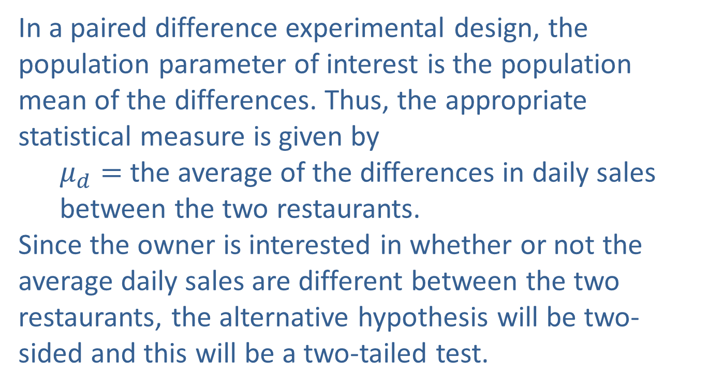
Example 12.3.1: Determining a Confidence Interval and Performing a Hypothesis Test for the Difference in Restaurant Sales (cont.)
In a paired difference experimental design, the population parameter of interest is the population
mean of the differences. Thus, the appropriate
statistical measure is given by
$μ_{d}=$ the average of the differences in daily sales
between the two restaurants.
Since the owner is interested in whether or not the average daily sales are different between the two restaurants, the alternative hypothesis will be two-sided and this will be a two-tailed test.

Slide 32
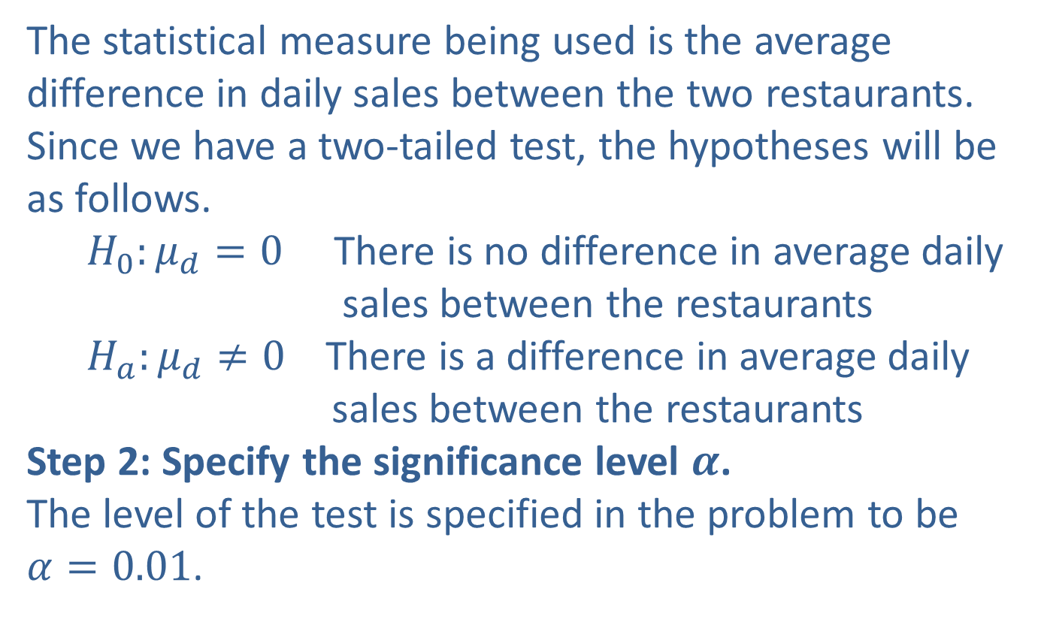
Example 12.3.1: Determining a Confidence Interval and Performing a Hypothesis Test for the Difference in Restaurant Sales (cont.)
The statistical measure being used is the average difference in daily sales between the two restaurants. Since we have a two-tailed test, the hypotheses will be as follows.
$H_{0}:μ_{d}=0$ There is no difference in average daily sales between the restaurants
$H_{a}:μ_{d}≠0$ There is a difference in average daily sales between the restaurants
Step 2: Specify the significance level $α$.
The level of the test is specified in the problem to be $α=0.01$.

Slide 33
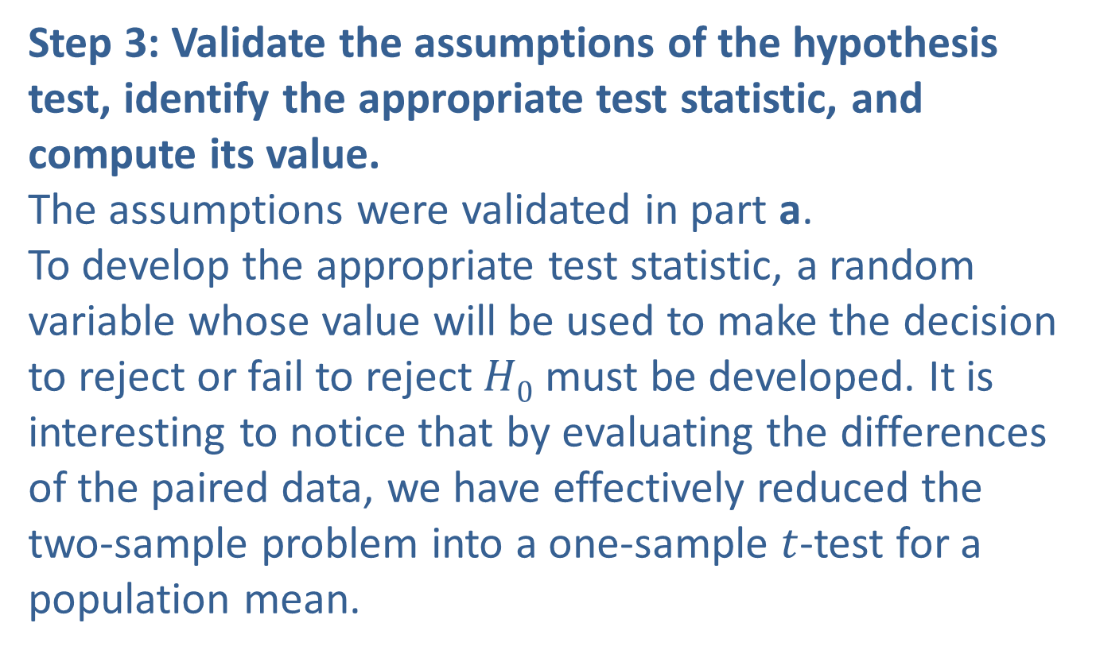
Example 12.3.1: Determining a Confidence Interval and Performing a Hypothesis Test for the Difference in Restaurant Sales (cont.)
Step 3: Validate the assumptions of the hypothesis test, identify the appropriate test statistic, and compute its value.
The assumptions were validated in part a.
To develop the appropriate test statistic, a random variable whose value will be used to make the decision to reject or fail to reject $H0$ must be developed. It is interesting to notice that by evaluating the differences of the paired data, we have effectively reduced the two-sample problem into a one-sample $t$-test for a population mean.

Slide 34
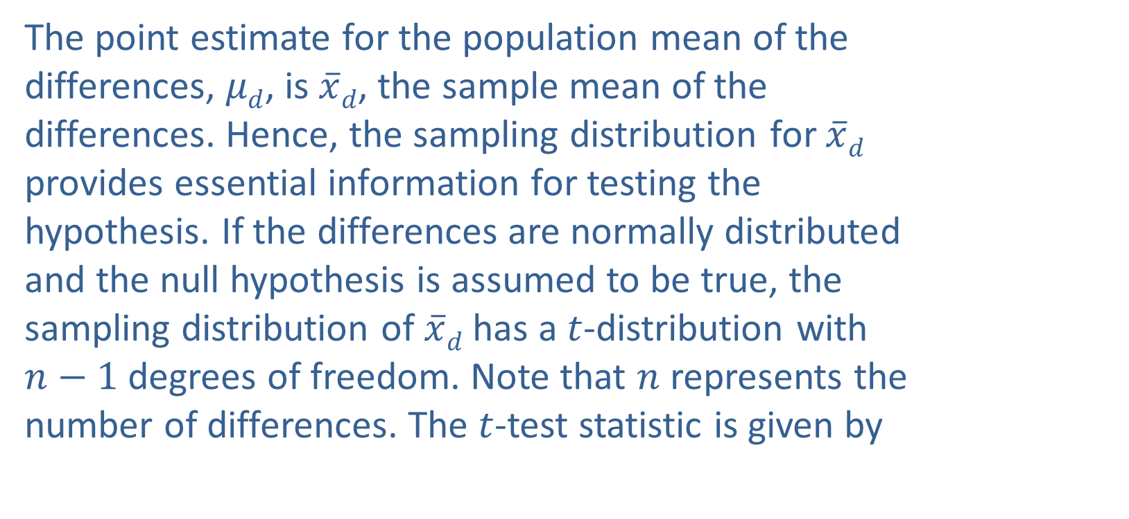
Example 12.3.1: Determining a Confidence Interval and Performing a Hypothesis Test for the Difference in Restaurant Sales (cont.)
The point estimate for the population mean of the differences, $μd$, is $\overline{x}d$, the sample mean of the differences. Hence, the sampling distribution for $\overline{x}d$ provides essential information for testing the hypothesis. If the differences are normally distributed and the null hypothesis is assumed to be true, the sampling distribution of $\overline{x}d$ has a $t$-distribution with $n−1$ degrees of freedom. Note that $n$ represents the number of differences. The $t$-test statistic is given by

Slide 35
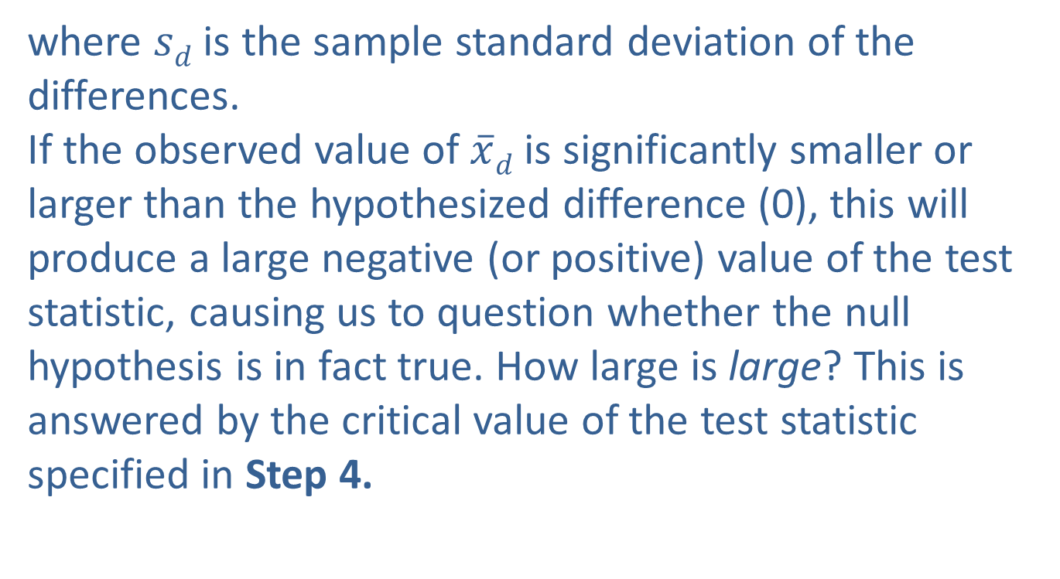
Example 12.3.1: Determining a Confidence Interval and Performing a Hypothesis Test for the Difference in Restaurant Sales (cont.)
where $sd$ is the sample standard deviation of the differences.
If the observed value of $\overline{x}d$ is significantly smaller or larger than the hypothesized difference (0), this will produce a large negative (or positive) value of the test statistic, causing us to question whether the null hypothesis is in fact true. How large is large? This is answered by the critical value of the test statistic specified in Step 4.

Slide 36
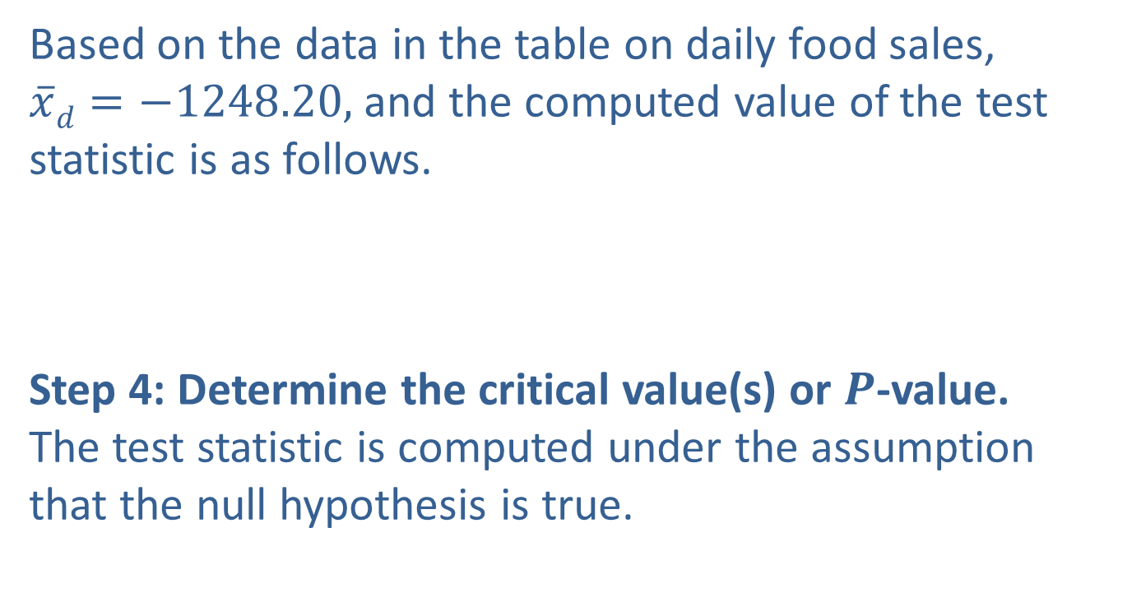
Example 12.3.1: Determining a Confidence Interval and Performing a Hypothesis Test for the Difference in Restaurant Sales (cont.)
Based on the data in the table on daily food sales, $\overline{x}d=−1248.20,$ and the computed value of the test statistic is as follows.
Step 4: Determine the critical value(s) or $P$-value.
The test statistic is computed under the assumption that the null hypothesis is true.

Slide 37
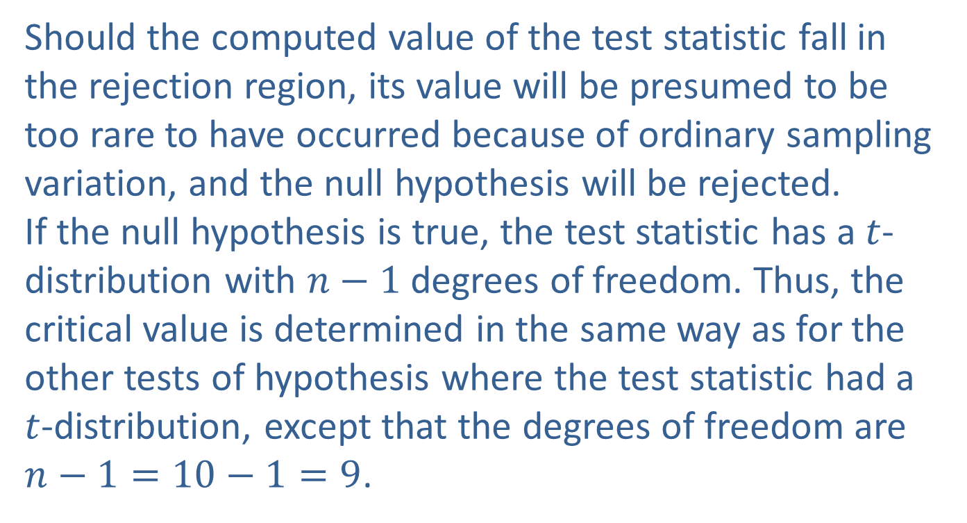
Example 12.3.1: Determining a Confidence Interval and Performing a Hypothesis Test for the Difference in Restaurant Sales (cont.)
Should the computed value of the test statistic fall in the rejection region, its value will be presumed to be too rare to have occurred because of ordinary sampling variation, and the null hypothesis will be rejected.
If the null hypothesis is true, the test statistic has a $t$-distribution with $n−1$ degrees of freedom. Thus, the critical value is determined in the same way as for the other tests of hypothesis where the test statistic had a $t$-distribution, except that the degrees of freedom are $n−1=10−1=9$.

Slide 38

Example 12.3.1: Determining a Confidence Interval and Performing a Hypothesis Test for the Difference in Restaurant Sales (cont.)
The rejection region for the alternative hypothesis, $H_{a}:μ_{d}≠0$ with $α=0.01$and 9 degrees of freedom is displayed in the figure below. Because we have a two-sided hypothesis, we reject $H_{0}$ if the test statistic is less than –3.250 or if it is greater than 3.250.

Slide 39
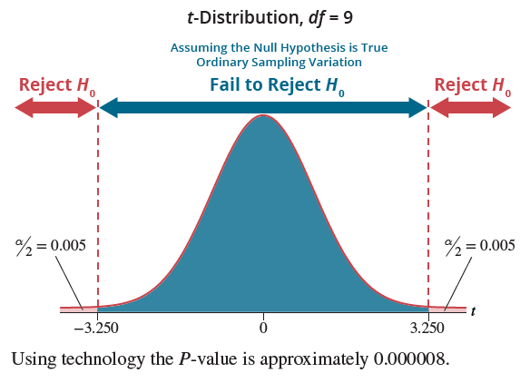
Example 12.3.1: Determining a Confidence Interval and Performing a Hypothesis Test for the Difference in Restaurant Sales (cont.)

Slide 40
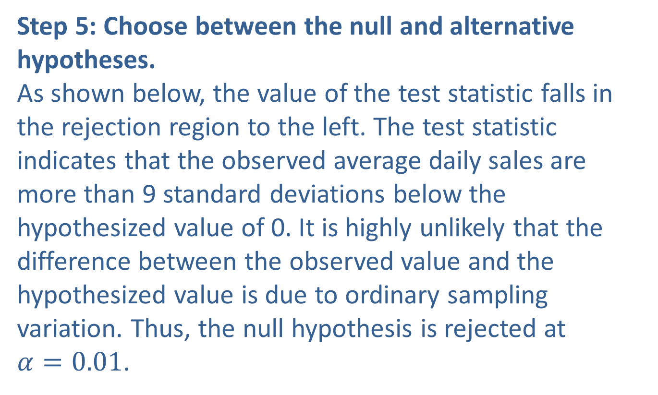
Example 12.3.1: Determining a Confidence Interval and Performing a Hypothesis Test for the Difference in Restaurant Sales (cont.)
Step 5: Choose between the null and alternative hypotheses.
As shown below, the value of the test statistic falls in the rejection region to the left. The test statistic indicates that the observed average daily sales are more than 9 standard deviations below the hypothesized value of 0. It is highly unlikely that the difference between the observed value and the hypothesized value is due to ordinary sampling variation. Thus, the null hypothesis is rejected at $α=0.01$.

Slide 41
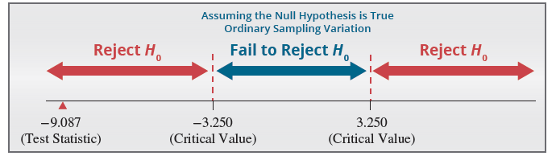
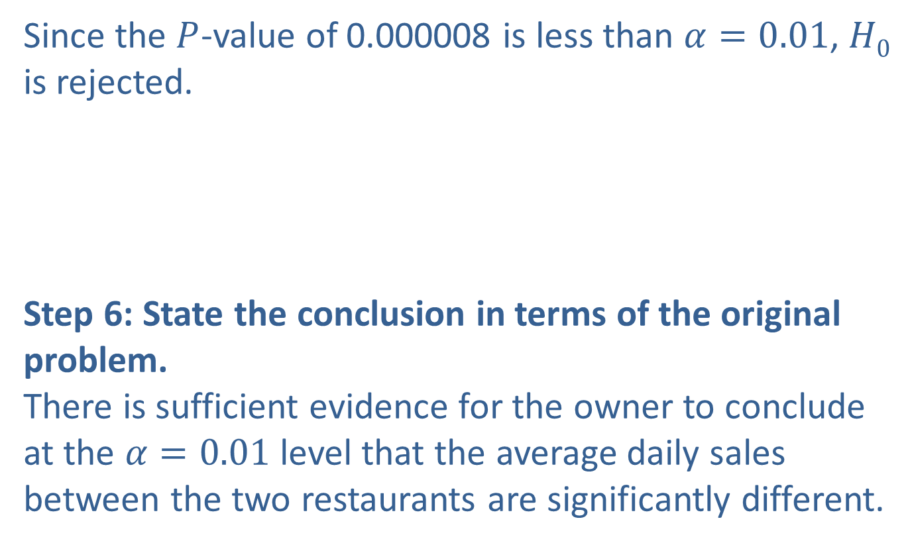
Example 12.3.1: Determining a Confidence Interval and Performing a Hypothesis Test for the Difference in Restaurant Sales (cont.)
Since the $P$-value of 0.000008 is less than $α=0.01$, $H0$ is rejected.
Step 6: State the conclusion in terms of the original problem.
There is sufficient evidence for the owner to conclude at the $α=0.01$level that the average daily sales between the two restaurants are significantly different.

Slide 42
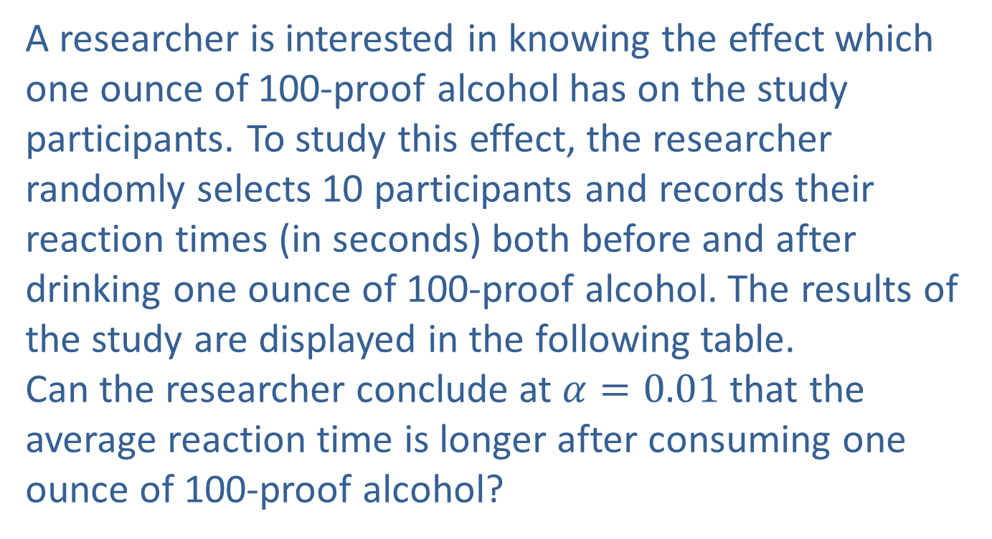
Example 12.3.2: Performing a Hypothesis Test for the Difference in Reaction Times
A researcher is interested in knowing the effect which one ounce of 100-proof alcohol has on the study participants. To study this effect, the researcher randomly selects 10 participants and records their reaction times (in seconds) both before and after
drinking one ounce of 100-proof alcohol. The results of the study are displayed in the following table.
Can the researcher conclude at $α=0.01$that the average reaction time is longer after consuming one ounce of 100-proof alcohol?

Slide 43
Example 12.3.2: Performing a Hypothesis Test for the Difference in Reaction Times (cont.)
Reaction Times (in seconds)
Participant | Before | After | Difference
1 | 0.4 | 0.5 | ─0.1
2 | 0.5 | 0.5 | 0.0
3 | 0.6 | 0.7 | ─0.1
4 | 0.4 | 0.6 | ─0.2
5 | 0.5 | 0.6 | ─0.1
6 | 0.4 | 0.4 | 0.0
7 | 0.4 | 0.5 | ─0.1
8 | 0.5 | 0.7 | ─0.2
9 | 0.6 | 0.8 | ─0.2
10 | 0.4 | 0.5 | ─0.1

Slide 44
Example 12.3.2: Performing a Hypothesis Test for the Difference in Reaction Times (cont.)
Solution
Step 1: Determine the population parameter to be used and develop the null and alternative hypotheses.
In plain English the hypotheses would be stated as follows.
Null hypothesis: There is no difference in average reaction time before versus after drinking one ounce of 100-proof alcohol.
Alternate hypothesis: The reaction time is significantly longer after drinking one-ounce of 100-proof alcohol.

Slide 45
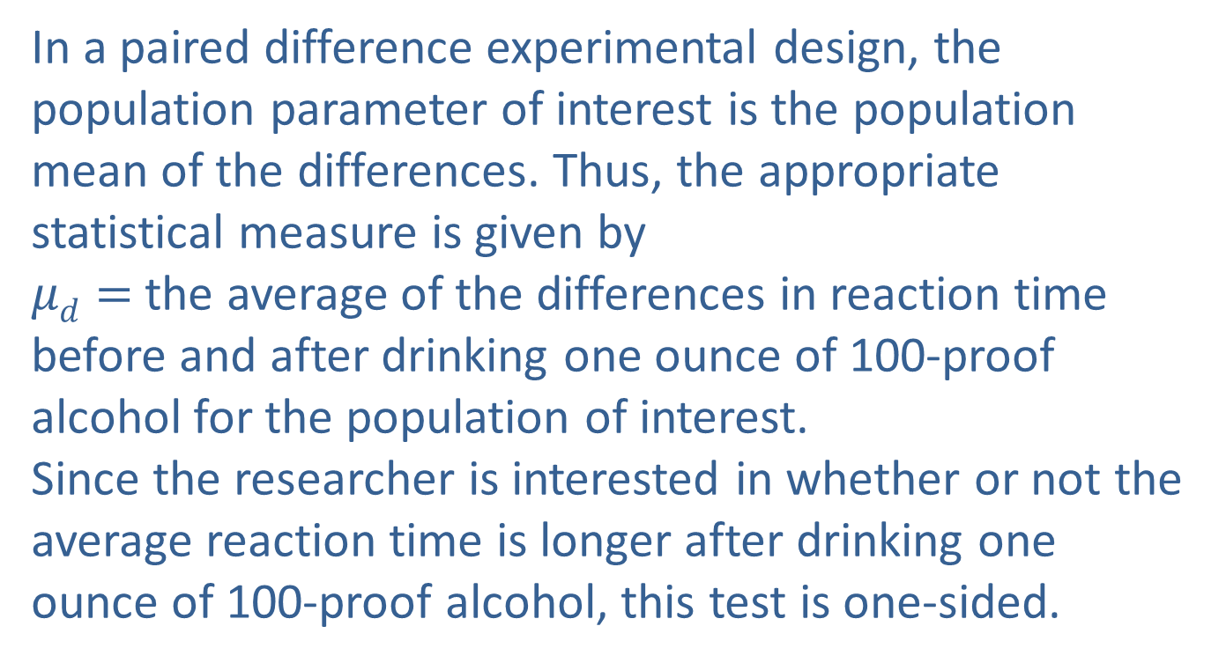
Example 12.3.2: Performing a Hypothesis Test for the Difference in Reaction Times (cont.)
In a paired difference experimental design, the population parameter of interest is the population mean of the differences. Thus, the appropriate statistical measure is given by
$μd=$ the average of the differences in reaction time before and after drinking one ounce of 100-proof alcohol for the population of interest.
Since the researcher is interested in whether or not the average reaction time is longer after drinking one ounce of 100-proof alcohol, this test is one-sided.

Slide 46
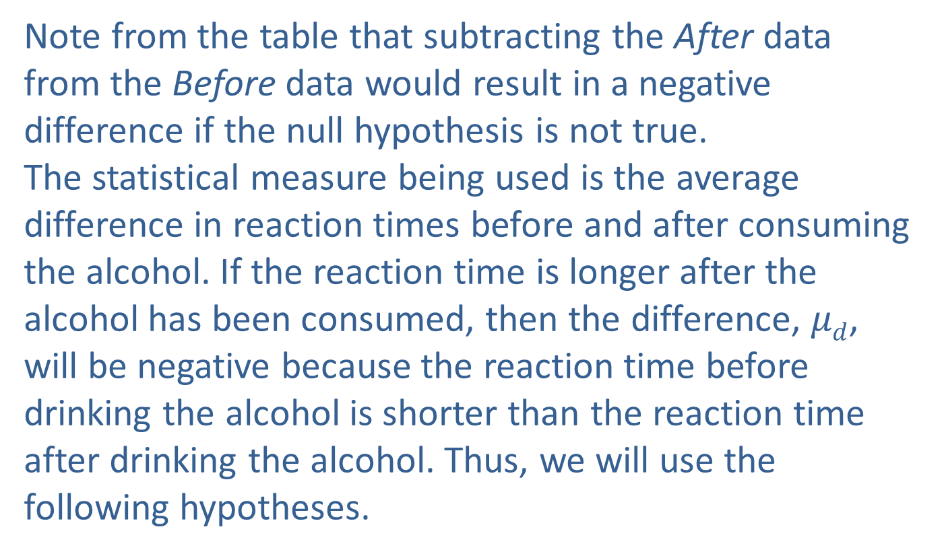
Example 12.3.2: Performing a Hypothesis Test for the Difference in Reaction Times (cont.)
Note from the table that subtracting the After data from the Before data would result in a negative difference if the null hypothesis is not true.
The statistical measure being used is the average difference in reaction times before and after consuming the alcohol. If the reaction time is longer after the alcohol has been consumed, then the difference, $μd$, will be negative because the reaction time before drinking the alcohol is shorter than the reaction time after drinking the alcohol. Thus, we will use the following hypotheses.

Slide 47
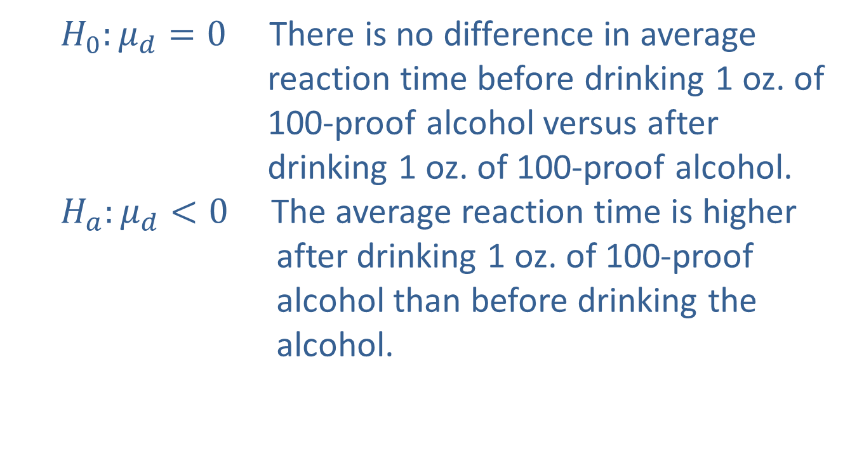
Example 12.3.2: Performing a Hypothesis Test for the Difference in Reaction Times (cont.)
$H_{0}:μ_{d}=0$ There is no difference in average reaction time before drinking 1 oz. of 100-proof alcohol versus after drinking 1 oz. of 100-proof alcohol.
$H_{a}:μ_{d}<0$ The average reaction time is higher after drinking 1 oz. of 100-proof alcohol than before drinking the alcohol.

Slide 48
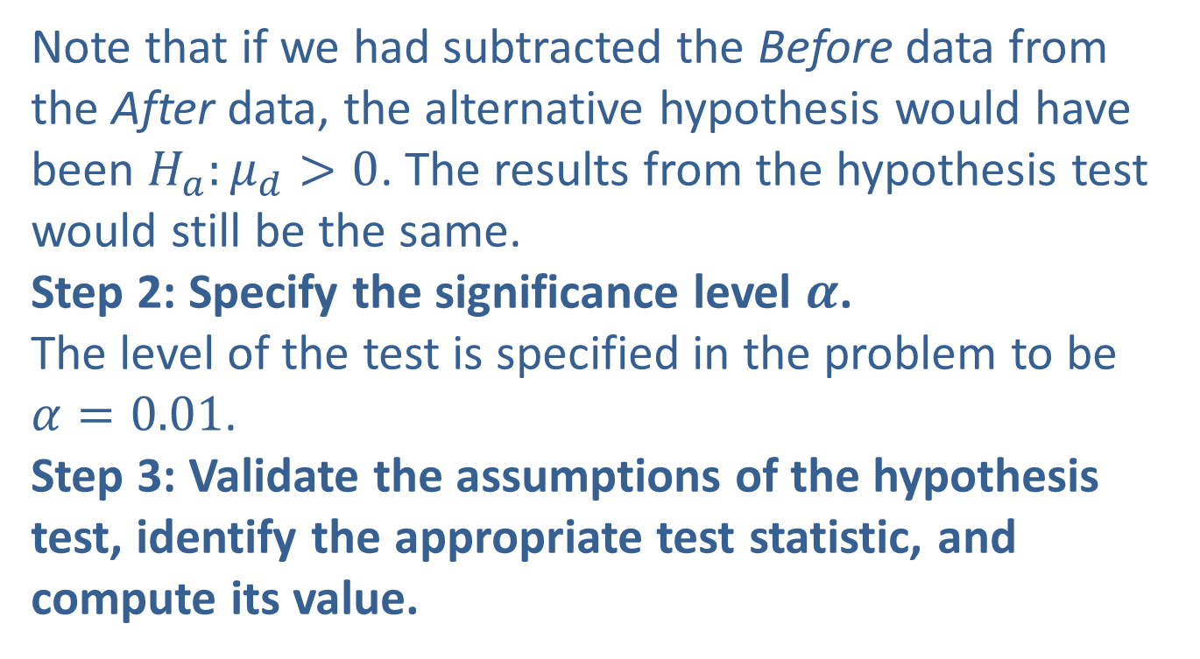
Example 12.3.2: Performing a Hypothesis Test for the Difference in Reaction Times (cont.)
Note that if we had subtracted the Before data from the After data, the alternative hypothesis would have been $H_{a}:μ_{d}>0$. The results from the hypothesis test would still be the same.
Step 2: Specify the significance level $α$.
The level of the test is specified in the problem to be $α=0.01$.
Step 3: Validate the assumptions of the hypothesis test, identify the appropriate test statistic, and compute its value.

Slide 49
Example 12.3.2: Performing a Hypothesis Test for the Difference in Reaction Times (cont.)
Before continuing with the test of hypothesis, let’s make sure that the assumption that the differences have a normal distribution is reasonable for the reaction time data. A histogram of the differences is shown below. Based on this histogram, it appears that the differences are approximately normal and it is safe to proceed with the paired difference test.

Slide 50
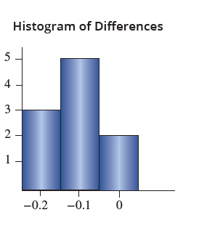
Example 12.3.2: Performing a Hypothesis Test for the Difference in Reaction Times (cont.)

Slide 51
Example 12.3.2: Performing a Hypothesis Test for the Difference in Reaction Times (cont.)
The samples are dependent (matched pairs).
The matched pairs are a simple random sample.
The differences are approximately normally distributed.
Based on the assumptions above being met, the test statistic for the differences is computed using the sample statistics as

Slide 52
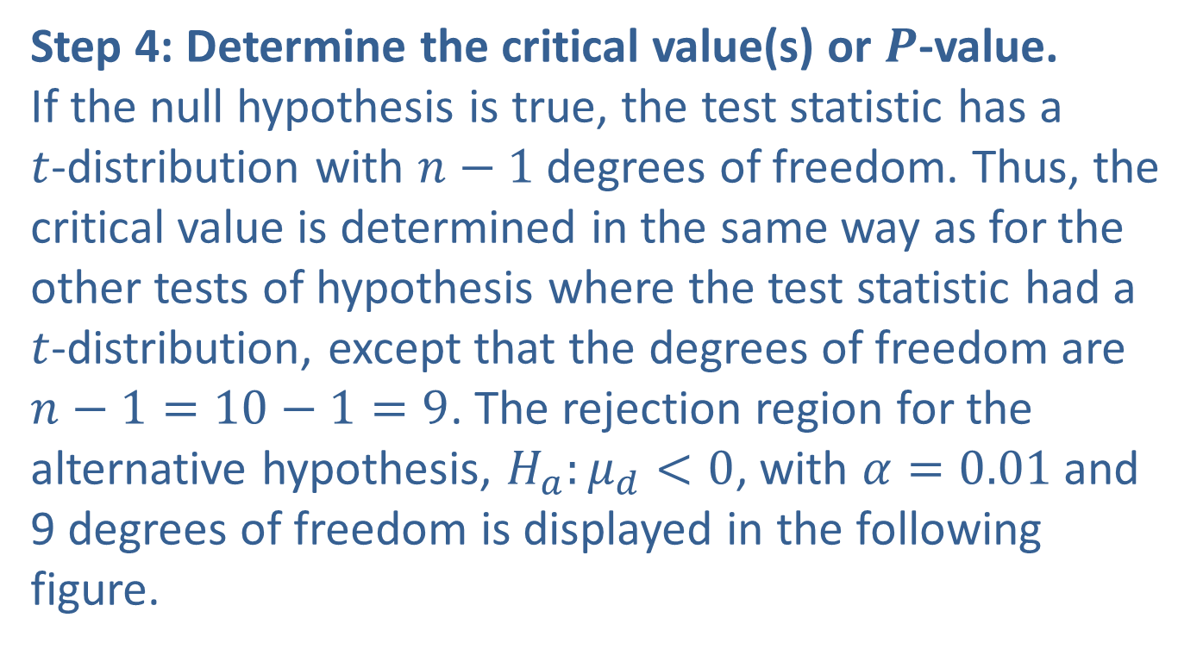
Example 12.3.2: Performing a Hypothesis Test for the Difference in Reaction Times (cont.)
Step 4: Determine the critical value(s) or $P$-value.
If the null hypothesis is true, the test statistic has a $t$-distribution with $n−1$ degrees of freedom. Thus, the critical value is determined in the same way as for the other tests of hypothesis where the test statistic had a $t$-distribution, except that the degrees of freedom are $n−1=10−1=9$. The rejection region for the alternative hypothesis, $H_{a}:μ_{d}<0$, with $α=0.01$and 9 degrees of freedom is displayed in the following figure.

Slide 53
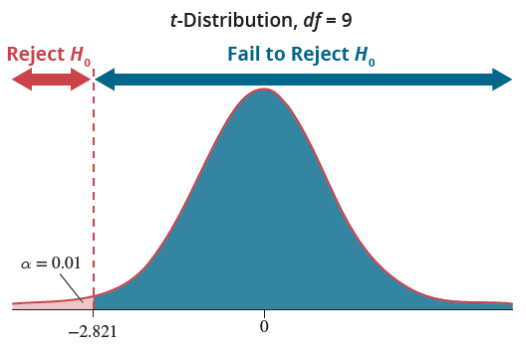
Example 12.3.2: Performing a Hypothesis Test for the Difference in Reaction Times (cont.)

Slide 54
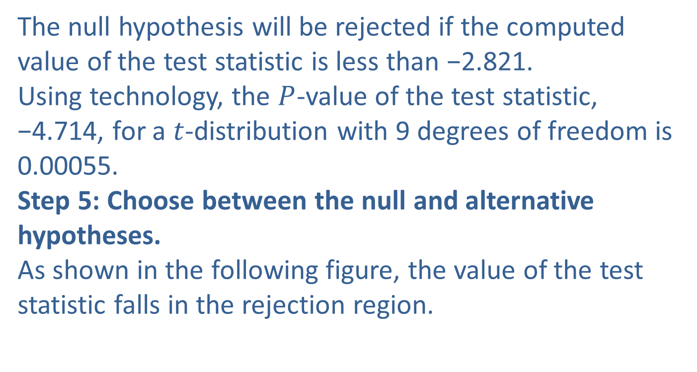
Example 12.3.2: Performing a Hypothesis Test for the Difference in Reaction Times (cont.)
The null hypothesis will be rejected if the computed value of the test statistic is less than −2.821.
Using technology, the $P$-value of the test statistic, −4.714, for a $t$-distribution with 9 degrees of freedom is 0.00055.
Step 5: Choose between the null and alternative hypotheses.
As shown in the following figure, the value of the test statistic falls in the rejection region.

Slide 55
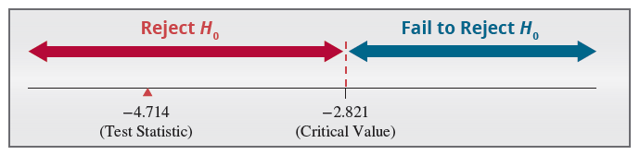
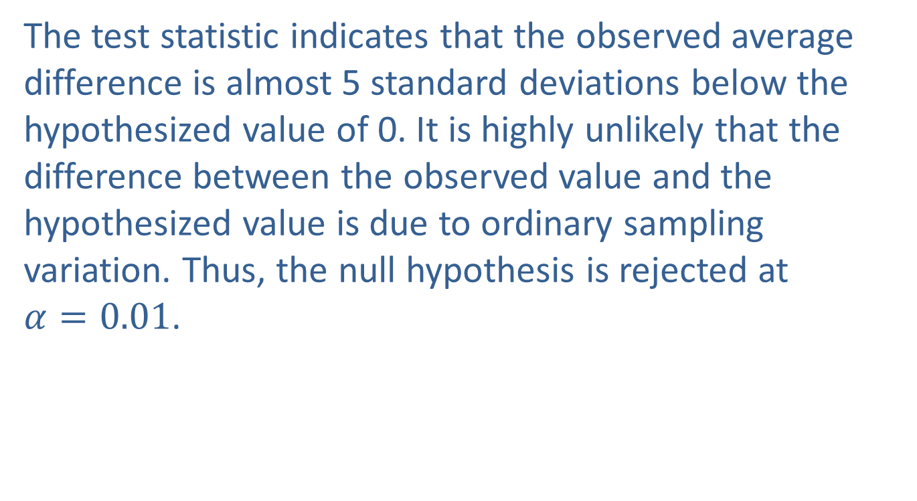
Example 12.3.2: Performing a Hypothesis Test for the Difference in Reaction Times (cont.)
The test statistic indicates that the observed average difference is almost 5 standard deviations below the hypothesized value of 0. It is highly unlikely that the
difference between the observed value and the hypothesized value is due to ordinary sampling variation. Thus, the null hypothesis is rejected at $α=0.01$.

Slide 56
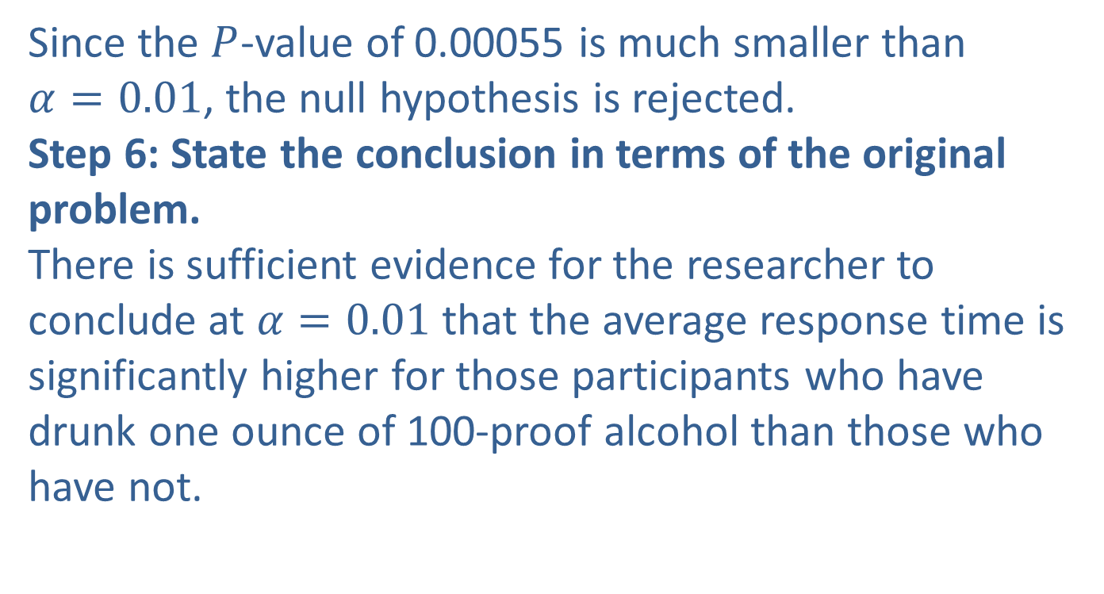
Example 12.3.2: Performing a Hypothesis Test for the Difference in Reaction Times (cont.)
Since the $P$-value of 0.00055 is much smaller than $α=0.01$, the null hypothesis is rejected.
Step 6: State the conclusion in terms of the original problem.
There is sufficient evidence for the researcher to conclude at $α=0.01$that the average response time is significantly higher for those participants who have drunk one ounce of 100-proof alcohol than those who have not.

