Slide 1
Section 12.2
Inference about Two Population Means: Independent Samples, σ₁ and σ₂ Unknown

Slide 2

Inferences About the Mean of Two Independent Populations, $σ1$ and $σ2$ Unknown and Assumed Equal
Inference about two means with equal but unknown variances is a common statistical method used to test whether there is a significant difference between the means of two independent populations. This technique is used when we have two independent samples from the two populations, and the variances of the populations are assumed to be equal but unknown. Inference about two means is widely used in a variety of fields, including business, economics, health sciences, social sciences, and engineering, among others.

Slide 3

Inferences About the Mean of Two Independent Populations, $σ1$ and $σ2$ Unknown and Assumed Equal (cont.)
The method allows researchers and decision-makers to draw conclusions about the populations based on information from the samples, and to make informed decisions about which population has a higher mean or is more effective. This section provides a statistical framework for comparing two means, testing hypotheses, and constructing confidence intervals, and is an important tool for making data-driven decisions in a wide range of applications.

Slide 4
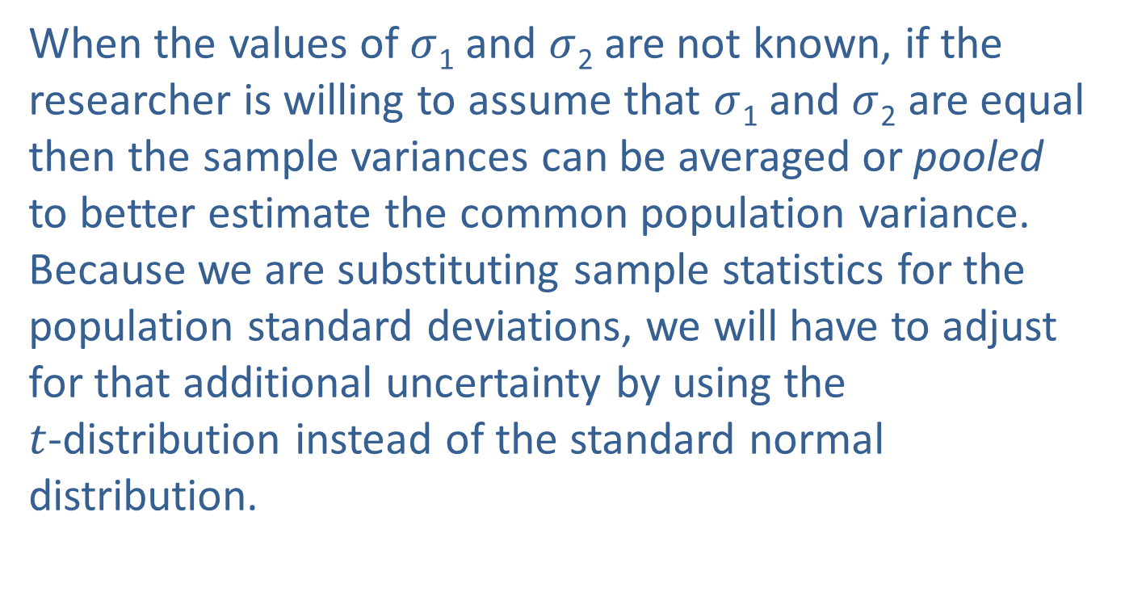
Inferences About the Mean of Two Independent Populations, $σ1$ and $σ2$ Unknown and Assumed Equal (cont.)
When the values of $σ$₁ and $σ$₂ are not known, if the researcher is willing to assume that $σ$₁ and $σ$₂ are equal then the sample variances can be averaged or pooled to better estimate the common population variance. Because we are substituting sample statistics for the population standard deviations, we will have to adjust for that additional uncertainty by using the $t$-distribution instead of the standard normal distribution.

Slide 5
Inferences About the Mean of Two Independent Populations, $σ1$ and $σ2$ Unknown and Assumed Equal (cont.)
To examine the equal variance assumption, we can compare the variances of the samples drawn from the populations using box plots of the data from each of the distributions and looking at the spread of the box plots. If the spread (difference between Q₁ and Q₃) of the box plots looks approximately the same, it is reasonable to assume that the variances of the two distributions are approximately equal. Figure 12.2.1 displays two box plots of sample data from populations with approximately equal variances, but with different means.

Slide 6
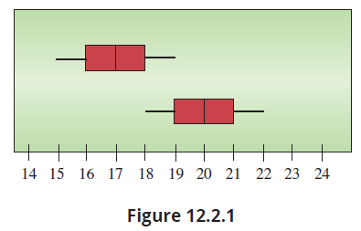
Inferences About the Mean of Two Independent Populations, $σ1$ and $σ2$ Unknown and Assumed Equal (cont.)

Slide 7

Interval Estimation
To construct a $100(1−α)$% confidence interval for the difference in two means from populations with equal but unknown variances we must make the following assumptions.

Slide 8
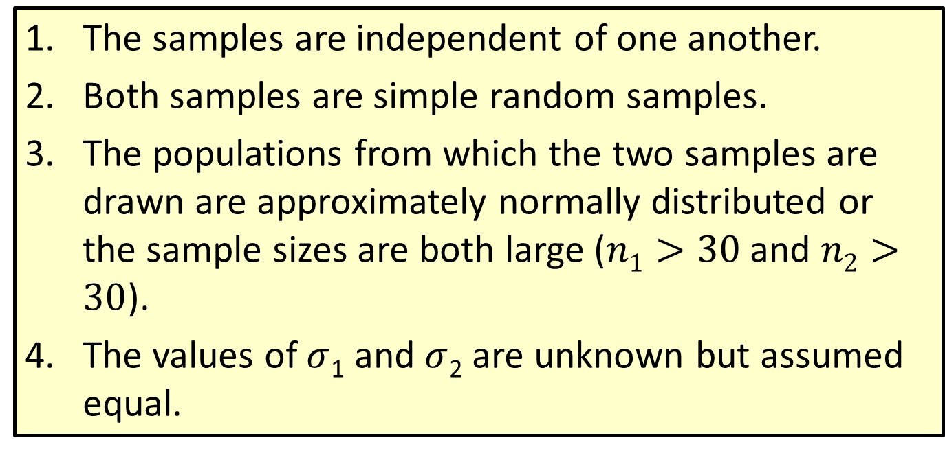
Assumptions: Assumptions
The samples are independent of one another.
Both samples are simple random samples.
The populations from which the two samples are drawn are approximately normally distributed or the sample sizes are both large ($n1>30$ and $n2>30$).
The values of $σ$₁ and $σ$₂ are unknown but assumed equal.

Slide 9
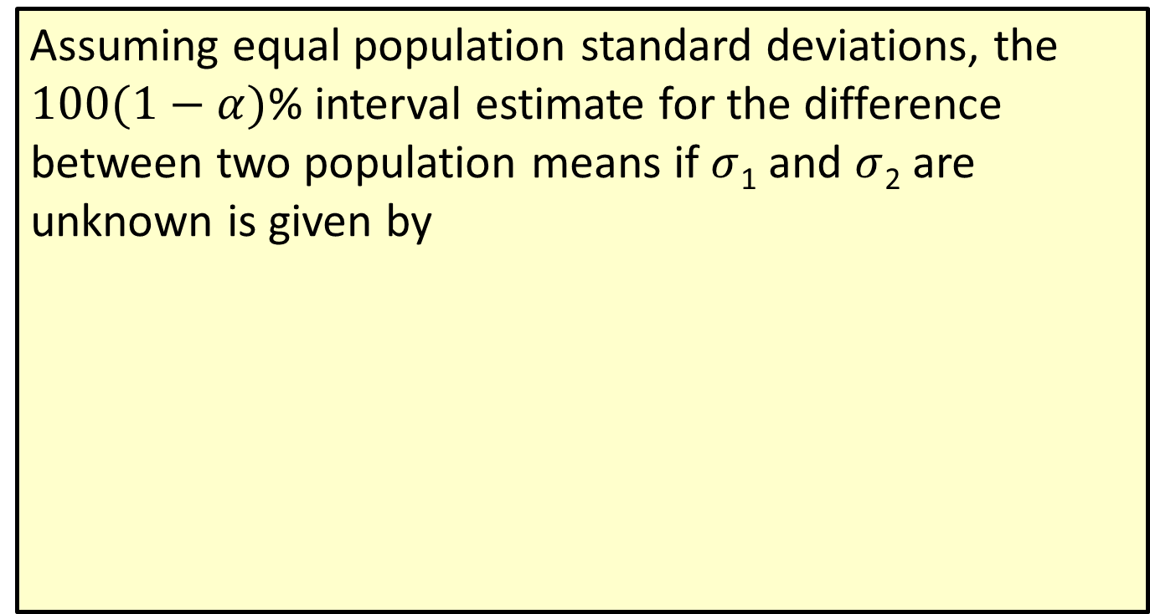
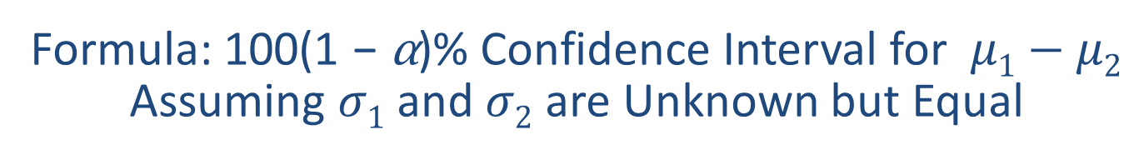
Formula: 100(1 − α)% Confidence Interval for $μ1−μ2$ Assuming $σ1$ and $σ2$ are Unknown but Equal
Assuming equal population standard deviations, the $100(1−α)$% interval estimate for the difference between two population means if $σ$₁ and $σ$₂ are unknown is given by

Slide 10
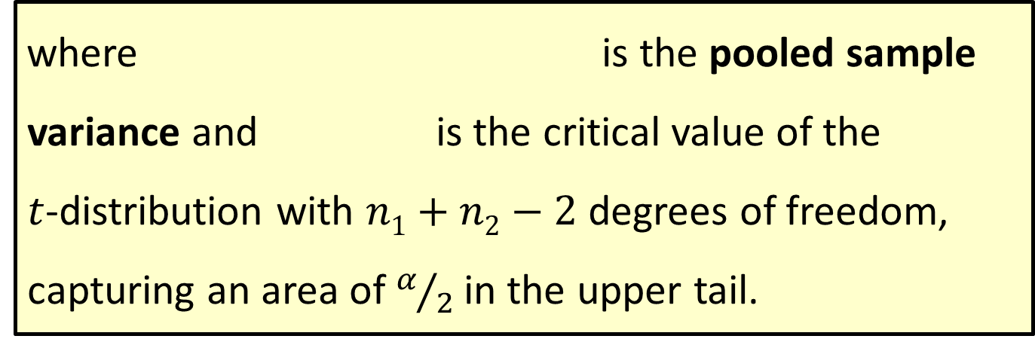
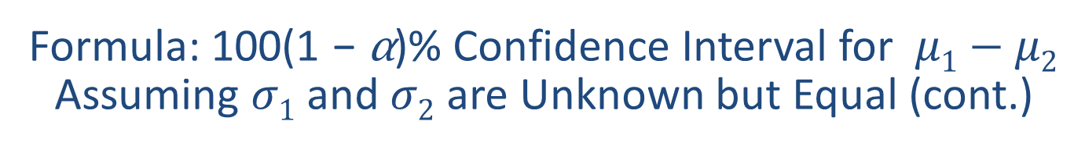
Formula: 100(1 − α)% Confidence Interval for $μ1−μ2$ Assuming $σ1$ and $σ2$ are Unknown but Equal (cont.)
where is the pooled sample variance and is the critical value of the $t$-distribution with $n1+n2−2$ degrees of freedom, capturing an area of $α/2$ in the upper tail.

Slide 11
Example 12.2.1: Determining a Confidence Interval and Performing a Hypothesis Test for Retail Sales
For a consumer product, the mean dollar sales per retail outlet last year in a random sample of 15 stores was $3425 with a standard deviation of $200. For a second product, the mean dollar sales per outlet in a random sample of 16 stores was $3250 with a standard deviation of $175. The sales amounts per outlet are assumed to be approximately normally distributed for both products. Assume that the population variances are equal.

Slide 12
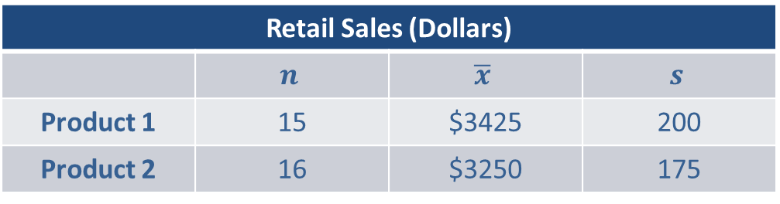
Example 12.2.1: Determining a Confidence Interval and Performing a Hypothesis Test for Retail Sales (cont.)
Retail Sales (Dollars)
 | $$n$$ | $$\overline{x}$$ | $$s$$
Product 1 | 15 | $3425 | 200
Product 2 | 16 | $3250 | 175
Calculate a 95% confidence interval for the difference in average dollar sales between the two products.
Solution
From the information given in the problem, we know that

Slide 13
Example 12.2.1: Determining a Confidence Interval and Performing a Hypothesis Test for Retail Sales (cont.)
Independent random samples (assumed)
The two samples are drawn from populations that are approximately normally distributed.
◻ σ₁ and σ₂ are known or
σ₁ and σ₂ are unknown
☑ The population standard deviations are assumed equal.

Slide 14
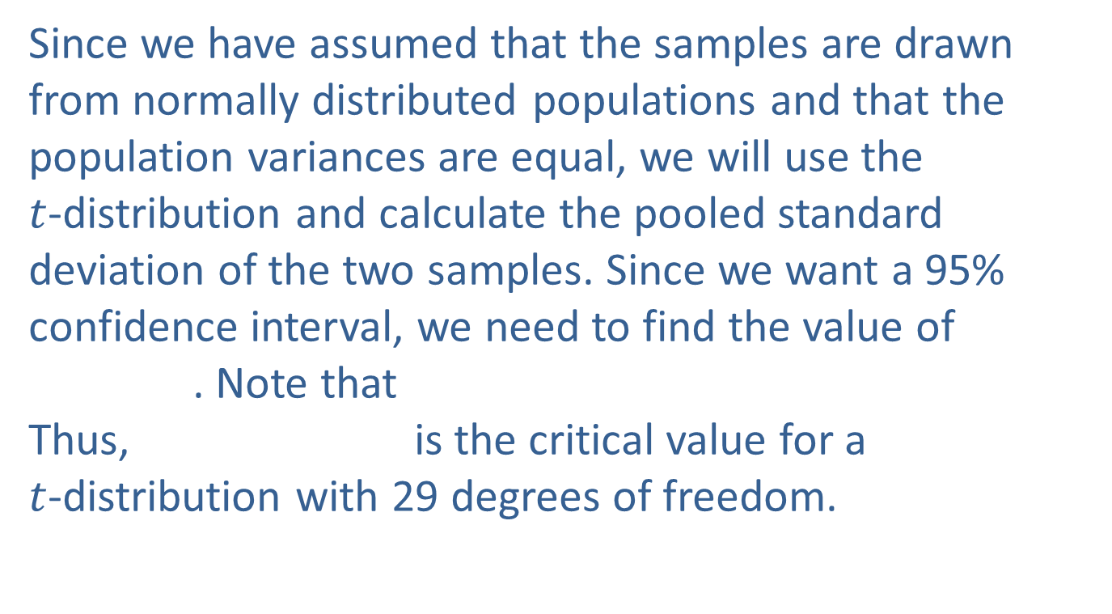
Example 12.2.1: Determining a Confidence Interval and Performing a Hypothesis Test for Retail Sales (cont.)
Since we have assumed that the samples are drawn from normally distributed populations and that the population variances are equal, we will use the $t$-distribution and calculate the pooled standard deviation of the two samples. Since we want a 95% confidence interval, we need to find the value of . Note that Thus, is the critical value for a $t$-distribution with 29 degrees of freedom.

Slide 15

Example 12.2.1: Determining a Confidence Interval and Performing a Hypothesis Test for Retail Sales (cont.)
A 95% confidence interval for the difference in average dollar sales between the two products is given by
First we need to calculate $s_{p}^{2}$.

Slide 16
Example 12.2.1: Determining a Confidence Interval and Performing a Hypothesis Test for Retail Sales (cont.)
A 95% confidence interval is then calculated as follows.

Slide 17
Example 12.2.1: Determining a Confidence Interval and Performing a Hypothesis Test for Retail Sales (cont.)
Thus, we are 95% confident that the true mean difference in dollar sales between Product 1 and Product 2 is between $37.20 and $312.80. That is, on average, Product 1 generates between $37.20 and $312.80 more dollar sales per outlet than Product 2.

Slide 18
Hypothesis Testing
To construct a hypothesis test about the difference between two means from populations with equal but unknown variances we must make the following assumptions.

Slide 19
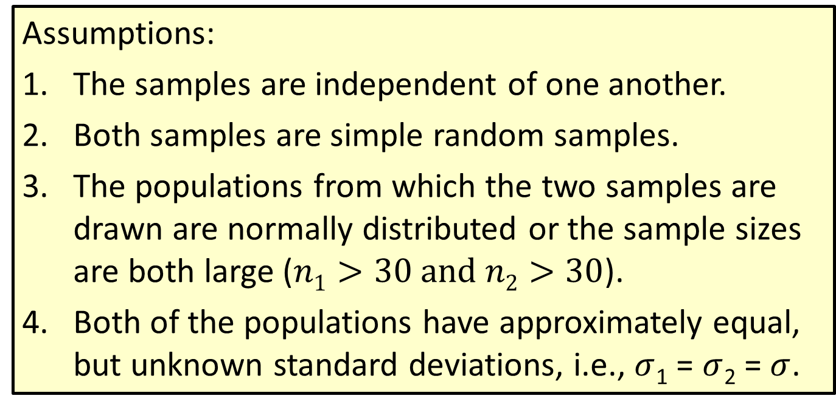

Procedure: Testing a Hypothesis about Two Independent Population Means, $σ1$ and $σ2$ Unknown but Equal
Assumptions:
The samples are independent of one another.
Both samples are simple random samples.
The populations from which the two samples are drawn are normally distributed or the sample sizes are both large ($n1>30 and n2>30$).
Both of the populations have approximately equal, but unknown standard deviations, i.e., $σ$₁ = $σ$₂ = $σ$.

Slide 20
Hypothesis Testing (cont.)
The test statistic associated with the hypothesis test for a difference in means from populations with equal but unknown variances is given below.

Slide 21
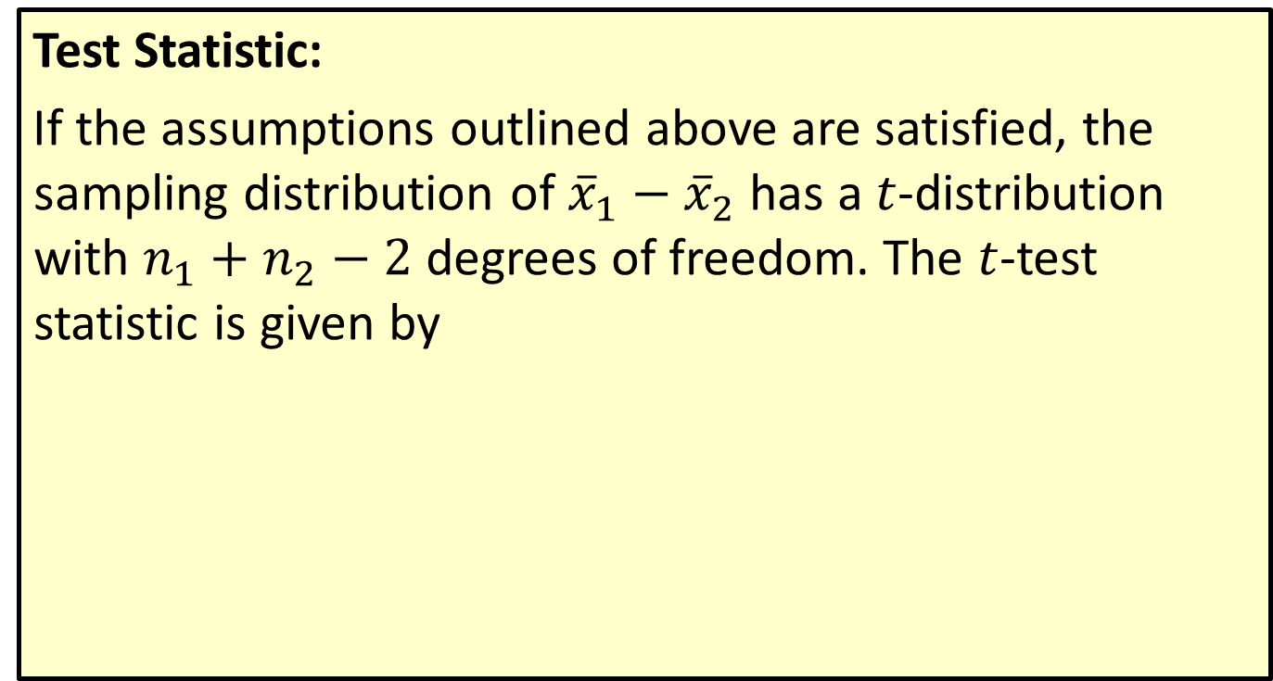
Procedure: Testing a Hypothesis about Two Independent Population Means, $σ1$ and $σ2$ Unknown but Equal
Test Statistic:
If the assumptions outlined above are satisfied, the sampling distribution of ${\overline{x}}_{1}−{\overline{x}}_{2}$ has a $t$-distribution with $n_{1}+n_{2}−2$ degrees of freedom. The $t$-test statistic is given by

Slide 22
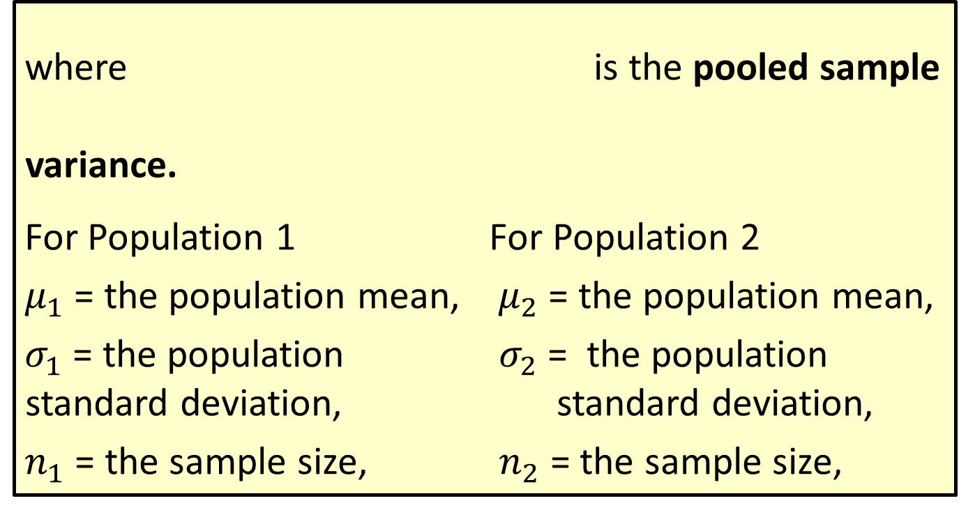

Procedure: Testing a Hypothesis about Two Independent Population Means, $σ1$ and $σ2$ Unknown but Equal (cont.)
where is the pooled sample variance.
For Population 1 For Population 2
$μ_{1}$ = the population mean, $μ_{2}$ = the population mean,
$σ_{1}$ = the population $σ_{2}$ = the population standard deviation, standard deviation,
$n_{1}$ = the sample size, $n_{2}$ = the sample size,

Slide 23
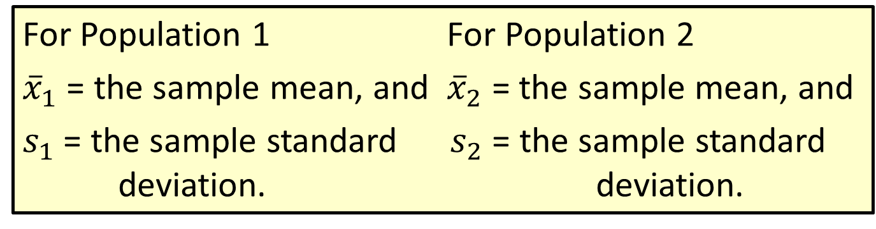
Procedure: Testing a Hypothesis about Two Independent Population Means, $σ1$ and $σ2$ Unknown but Equal (cont.)
For Population 1 For Population 2
${\overline{x}}_{1}$ = the sample mean, and ${\overline{x}}_{2}$ = the sample mean, and
$s_{1}$ = the sample standard $s_{2}$ = the sample standard deviation. deviation.

Slide 24
Hypothesis Testing (cont.)
Provided that the assumptions above have been met, the test procedure developed in Example 12.2.2 may be used for making comparisons between two population means.

Slide 25
Example 12.2.2: Performing a Hypothesis Test for the Difference in Life Expectancy
A cancer researcher believes that there may be an increase in the life expectancy of women diagnosed with terminal breast cancer if they attend group therapy to discuss their illness. He randomly selects 40 women with breast cancer. Twenty of the women are randomly assigned to a group that attends a group therapy session one day per week. The other 20 women do not attend therapy and are designated as the control group. The life expectancy, in number of years, from diagnosis until death is measured for each of the women.

Slide 26
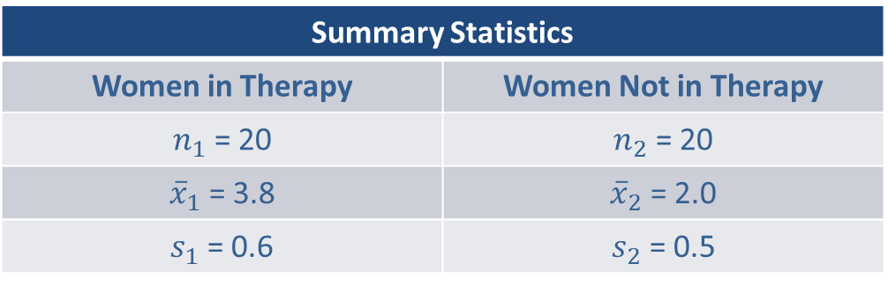
Example 12.2.2: Performing a Hypothesis Test for the Difference in Life Expectancy (cont.)
Usually life expectancy data of this type has a normal distribution. The results of the study are shown in the following tables.
Summary Statistics
Women in Therapy | Women Not in Therapy
$n_{1}$ = 20 | $n_{2}$ = 20
${\overline{x}}_{1}$ = 3.8 | ${\overline{x}}_{2}$ = 2.0
$s_{1}$ = 0.6 | $s_{2}$ = 0.5

Slide 27
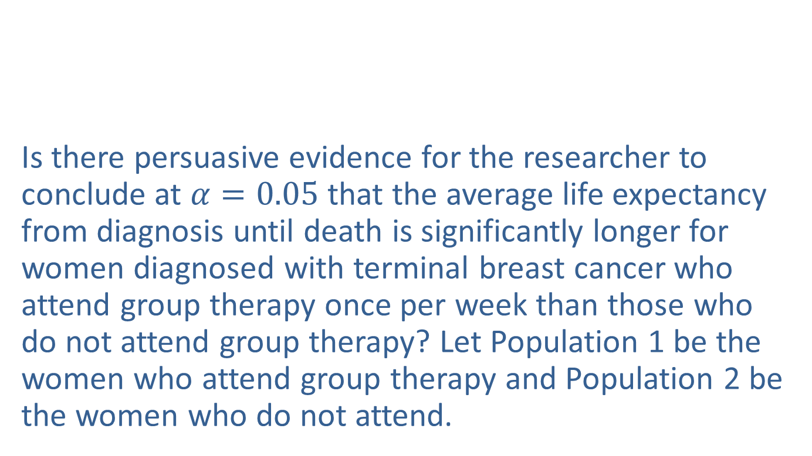
Example 12.2.2: Performing a Hypothesis Test for the Difference in Life Expectancy (cont.)
Women in Therapy
4.7 | 3.8 | 4.0 | 3.5 | 3.3
2.9 | 3.5 | 4.2 | 2.8 | 3.1
4.7 | 4.4 | 3.4 | 3.2 | 4.1
4.2 | 3.7 | 3.4 | 3.6 | 4.8
Women Not in Therapy
2.0 | 2.3 | 2.7 | 1.8 | 1.2
1.6 | 1.7 | 2.4 | 1.5 | 1.6
1.9 | 2.5 | 1.7 | 1.1 | 2.9
2.4 | 2.2 | 1.4 | 2.2 | 2.1
Is there persuasive evidence for the researcher to conclude at $α=0.05$that the average life expectancy from diagnosis until death is significantly longer for women diagnosed with terminal breast cancer who attend group therapy once per week than those who do not attend group therapy? Let Population 1 be the women who attend group therapy and Population 2 be the women who do not attend.

Slide 28
Example 12.2.2: Performing a Hypothesis Test for the Difference in Life Expectancy (cont.)
Solution
Step 1: Determine the population parameter to be used and develop the null and alternative hypotheses.
Null Hypothesis: There is no difference in average life expectancy from diagnosis until death for women with terminal breast cancer whether or not they attend therapy.
Alternative Hypothesis: For women who have been diagnosed with terminal breast cancer the average life expectancy from diagnosis until death is greater for those women who attend weekly group therapy meetings than those who do not.

Slide 29
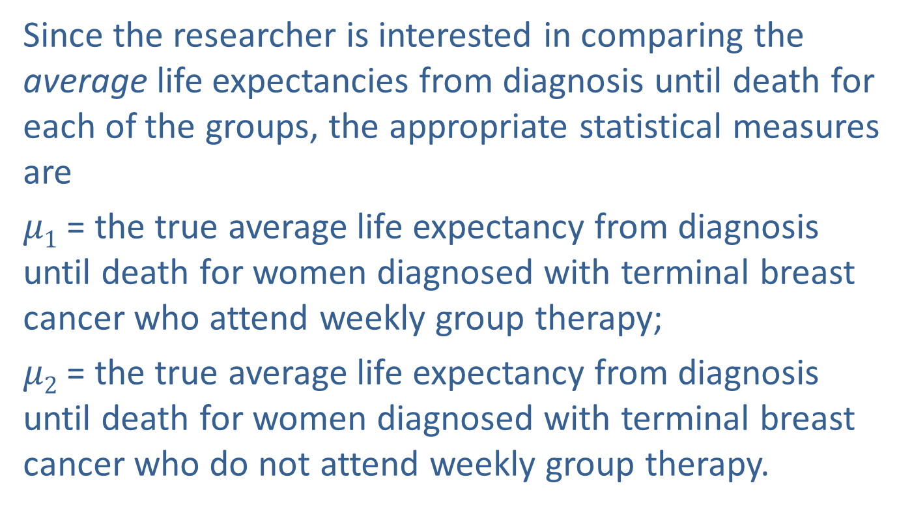
Example 12.2.2: Performing a Hypothesis Test for the Difference in Life Expectancy (cont.)
Since the researcher is interested in comparing the average life expectancies from diagnosis until death for each of the groups, the appropriate statistical measures are
$μ1$ = the true average life expectancy from diagnosis until death for women diagnosed with terminal breast cancer who attend weekly group therapy;
$μ2$ = the true average life expectancy from diagnosis until death for women diagnosed with terminal breast cancer who do not attend weekly group therapy.

Slide 30
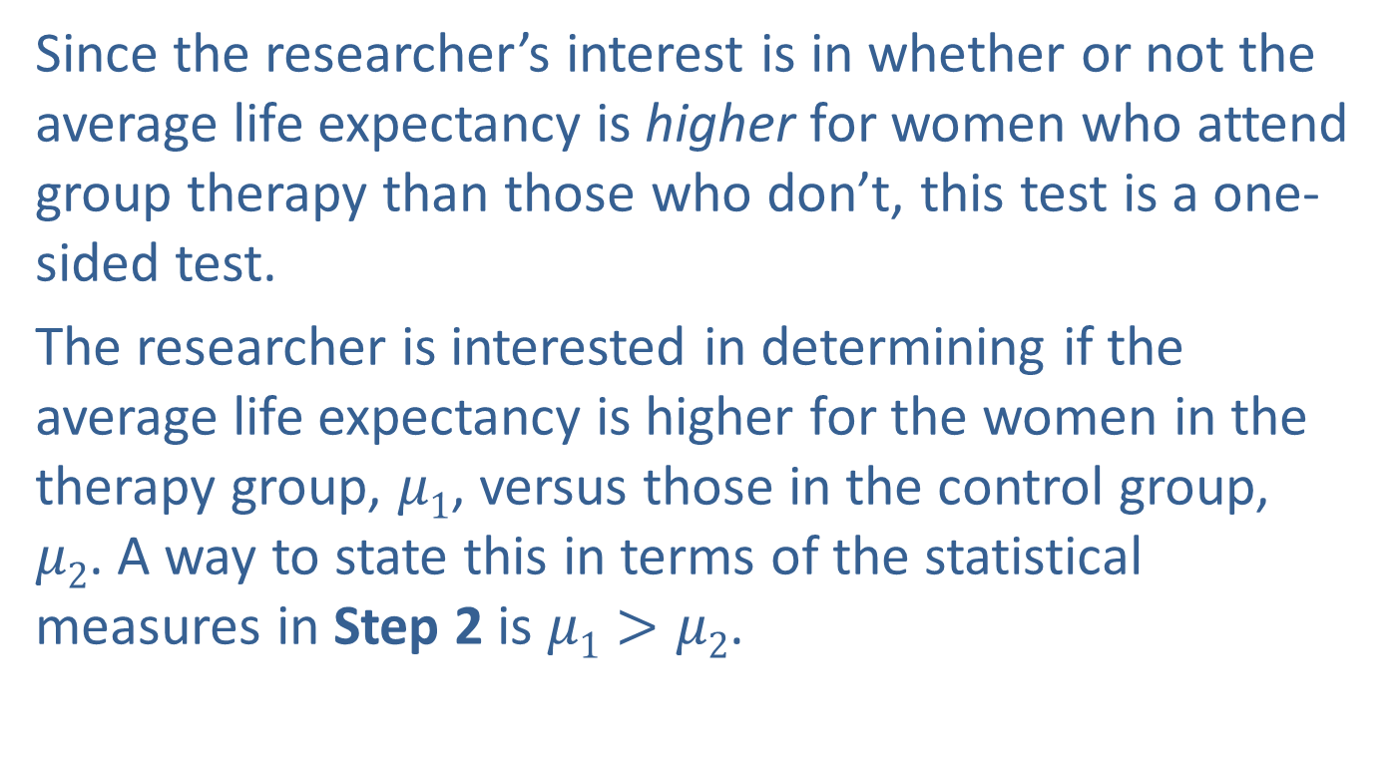
Example 12.2.2: Performing a Hypothesis Test for the Difference in Life Expectancy (cont.)
Since the researcher’s interest is in whether or not the average life expectancy is higher for women who attend group therapy than those who don’t, this test is a one-sided test.
The researcher is interested in determining if the average life expectancy is higher for the women in the therapy group, $μ1$, versus those in the control group, $μ2$. A way to state this in terms of the statistical measures in Step 2 is $μ1>μ2$.

Slide 31
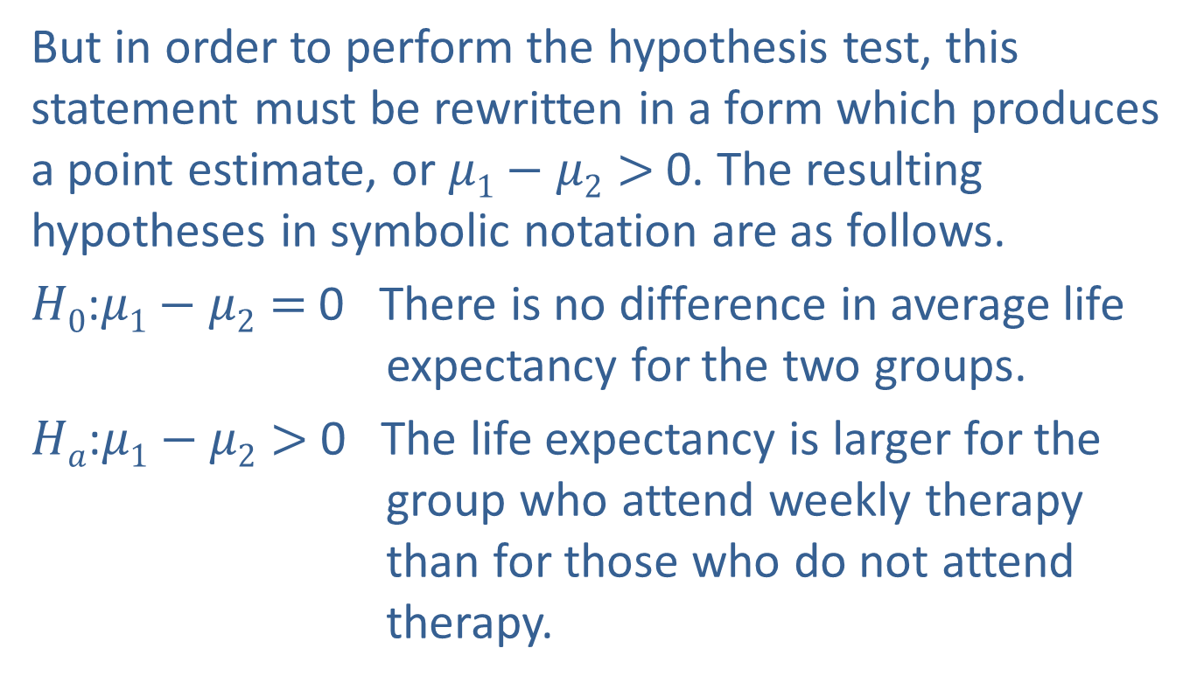
Example 12.2.2: Performing a Hypothesis Test for the Difference in Life Expectancy (cont.)
But in order to perform the hypothesis test, this statement must be rewritten in a form which produces a point estimate, or $μ1−μ2>$0. The resulting hypotheses in symbolic notation are as follows.
$H0$:$μ1−μ2=$0 There is no difference in average life expectancy for the two groups.
$Ha$:$μ1−μ2>$ 0 The life expectancy is larger for the group who attend weekly therapy than for those who do not attend therapy.

Slide 32
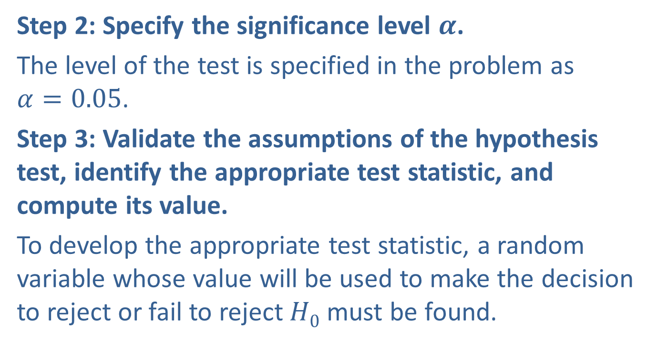
Example 12.2.2: Performing a Hypothesis Test for the Difference in Life Expectancy (cont.)
Step 2: Specify the significance level $α$.
The level of the test is specified in the problem as $α=0.05$.
Step 3: Validate the assumptions of the hypothesis test, identify the appropriate test statistic, and compute its value.
To develop the appropriate test statistic, a random variable whose value will be used to make the decision to reject or fail to reject $H0$ must be found.

Slide 33
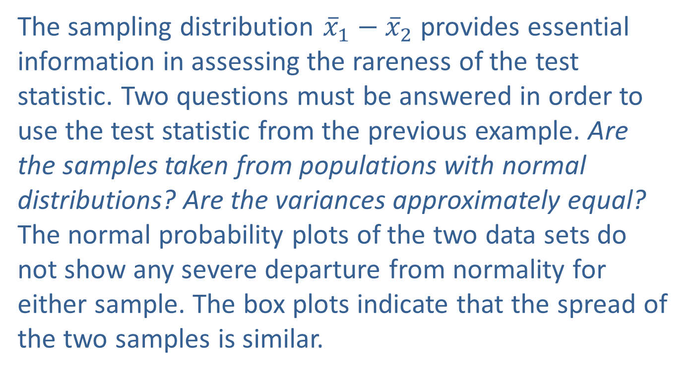
Example 12.2.2: Performing a Hypothesis Test for the Difference in Life Expectancy (cont.)
The sampling distribution ${\overline{x}}_{1}−{\overline{x}}_{2}$ provides essential information in assessing the rareness of the test statistic. Two questions must be answered in order to use the test statistic from the previous example. Are the samples taken from populations with normal distributions? Are the variances approximately equal? The normal probability plots of the two data sets do not show any severe departure from normality for either sample. The box plots indicate that the spread of the two samples is similar.

Slide 34
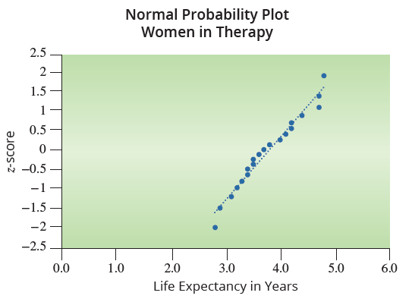

Example 12.2.2: Performing a Hypothesis Test for the Difference in Life Expectancy (cont.)
Thus we can use a $t$-distribution and pool the variances of the two samples. This combined sample variance is referred to as the pooled variance, $s_{p}^{2}$.

Slide 35
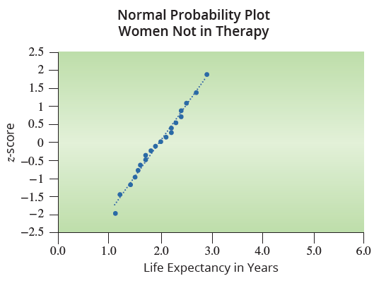
Example 12.2.2: Performing a Hypothesis Test for the Difference in Life Expectancy (cont.)

Slide 36
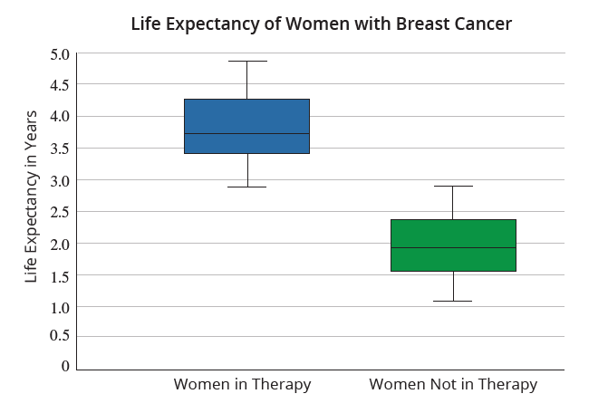
Example 12.2.2: Performing a Hypothesis Test for the Difference in Life Expectancy (cont.)

Slide 37
Example 12.2.2: Performing a Hypothesis Test for the Difference in Life Expectancy (cont.)
Therefore, the assumptions for the test are as follows:
Independent random samples
The two samples are drawn from populations that are approximately normally distributed.
◻ σ₁ and σ₂ are known or
σ₁ and σ₂ are unknown
☑ The population standard deviations are assumed equal.

Slide 38
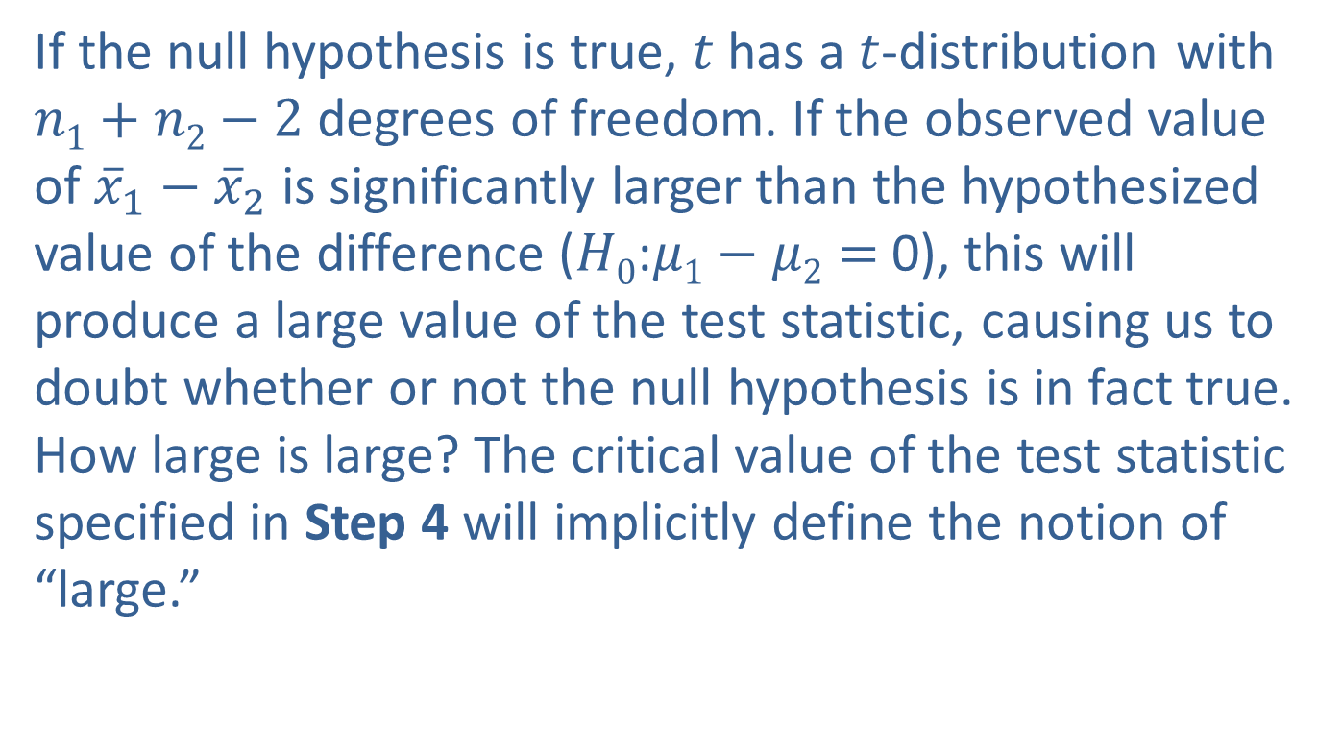
Example 12.2.2: Performing a Hypothesis Test for the Difference in Life Expectancy (cont.)
If the null hypothesis is true, $t$ has a $t$-distribution with $n1+n2−2$ degrees of freedom. If the observed value of ${\overline{x}}_{1}−{\overline{x}}_{2}$ is significantly larger than the hypothesized value of the difference ($H0$:$μ1−μ2=$0), this will produce a large value of the test statistic, causing us to doubt whether or not the null hypothesis is in fact true. How large is large? The critical value of the test statistic specified in Step 4 will implicitly define the notion of “large.”

Slide 39
Example 12.2.2: Performing a Hypothesis Test for the Difference in Life Expectancy (cont.)
Based on the data given to us in the problem, the computed value of the test statistic is

Slide 40
Note
We are using a pooled variance since the standard
deviations are assumed to be equal.

Slide 41
Example 12.2.2: Performing a Hypothesis Test for the Difference in Life Expectancy (cont.)
Step 4: Determine the critical value(s) or P-value.
The role of the critical value in this test is exactly the same as for all of the hypothesis tests discussed earlier. It defines a range of values for the test statistic, the rejection region, that will be so rare that it is unlikely that values in this range occurred from ordinary sampling variability if the null hypothesis is true. The level of the test defines the size of the rejection region.

Slide 42
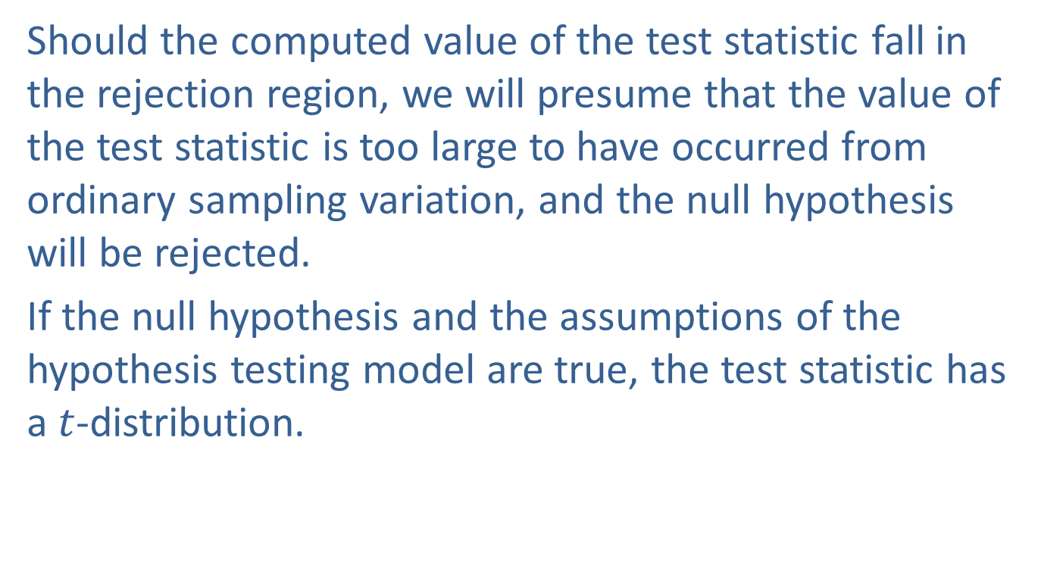
Example 12.2.2: Performing a Hypothesis Test for the Difference in Life Expectancy (cont.)
Should the computed value of the test statistic fall in the rejection region, we will presume that the value of the test statistic is too large to have occurred from ordinary sampling variation, and the null hypothesis will be rejected.
If the null hypothesis and the assumptions of the hypothesis testing model are true, the test statistic has a $t$-distribution.

Slide 43
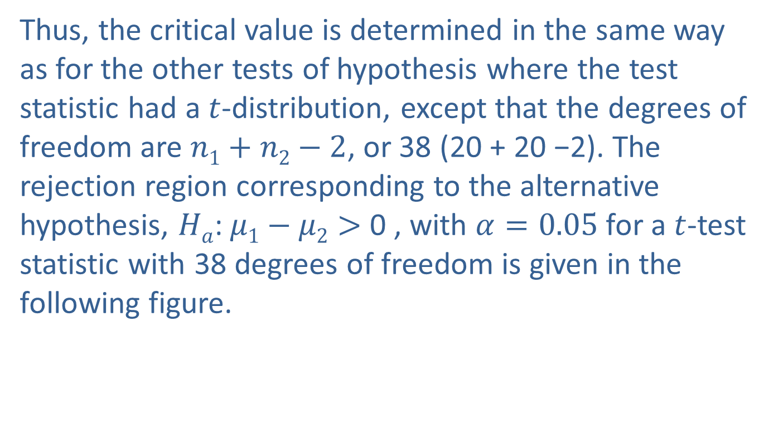
Example 12.2.2: Performing a Hypothesis Test for the Difference in Life Expectancy (cont.)
Thus, the critical value is determined in the same way as for the other tests of hypothesis where the test statistic had a $t$-distribution, except that the degrees of freedom are $n1+n2−2$, or 38 (20 + 20 −2). The rejection region corresponding to the alternative hypothesis, $Ha$: $μ1−μ2>$ 0 , with $α=0.05$for a $t$-test statistic with 38 degrees of freedom is given in the following figure.

Slide 44
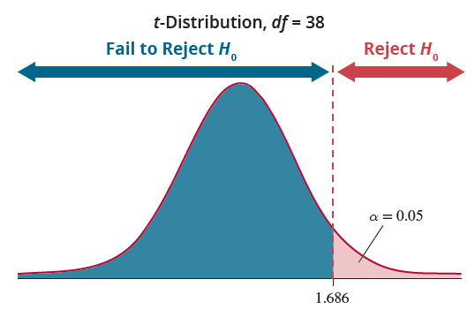
Example 12.2.2: Performing a Hypothesis Test for the Difference in Life Expectancy (cont.)

Slide 45
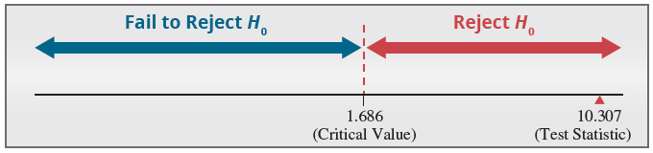
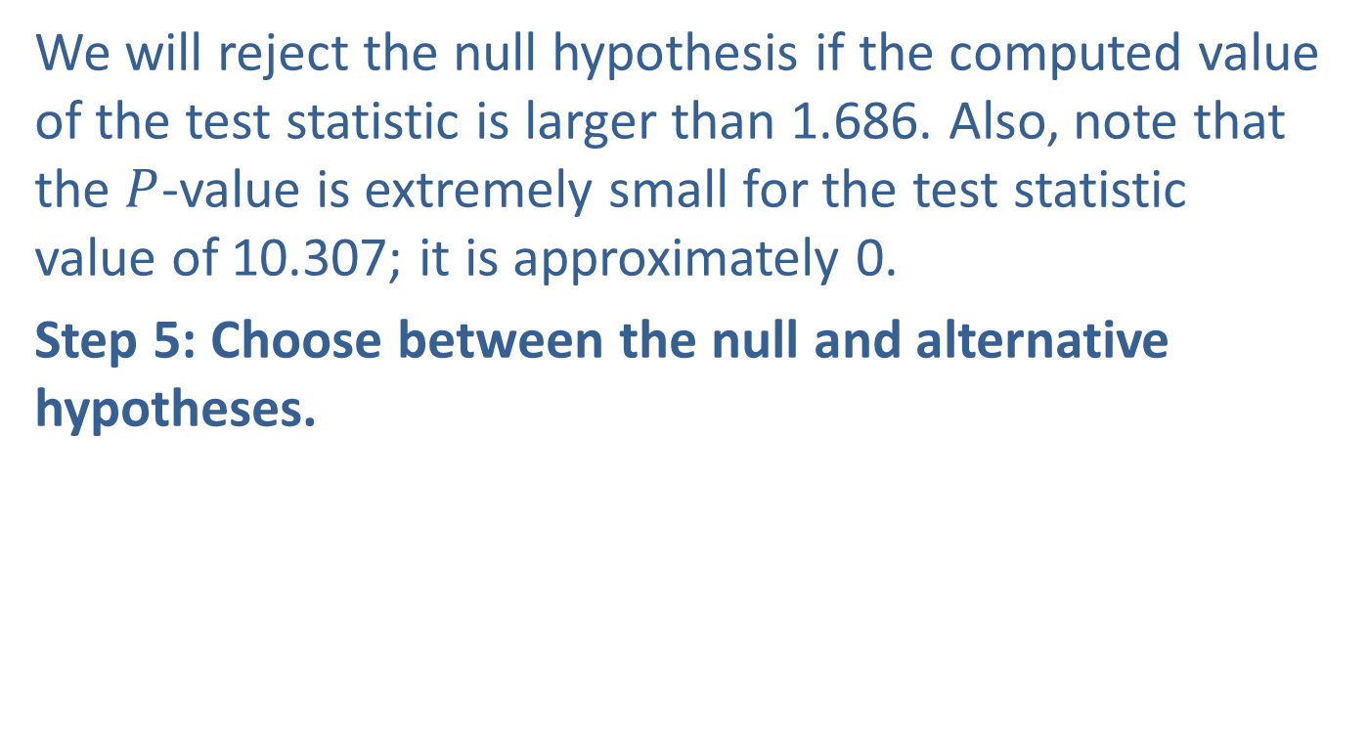
Example 12.2.2: Performing a Hypothesis Test for the Difference in Life Expectancy (cont.)
We will reject the null hypothesis if the computed value of the test statistic is larger than 1.686. Also, note that the $P$-value is extremely small for the test statistic value of 10.307; it is approximately 0.
Step 5: Choose between the null and alternative hypotheses.

Slide 46
Example 12.2.2: Performing a Hypothesis Test for the Difference in Life Expectancy (cont.)
As displayed in the figure above, the value of the test statistic does fall in the rejection region. In fact, a test statistic of 10.307 says that the observed difference between the means is over 10 standard deviations higher than the hypothesized difference of zero. It is highly unlikely that the difference between the observed value and the hypothesized value is due to ordinary sampling variation given the null hypothesis is true. So, we would reject the null hypothesis in favor of the alternative.

Slide 47
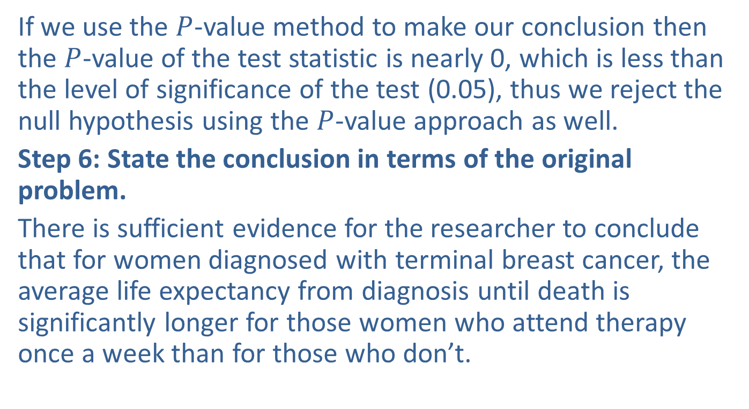
Example 12.2.2: Performing a Hypothesis Test for the Difference in Life Expectancy (cont.)
If we use the $P$-value method to make our conclusion then the $P$-value of the test statistic is nearly 0, which is less than the level of significance of the test (0.05), thus we reject the null hypothesis using the $P$-value approach as well.
Step 6: State the conclusion in terms of the original problem.
There is sufficient evidence for the researcher to conclude that for women diagnosed with terminal breast cancer, the average life expectancy from diagnosis until death is significantly longer for those women who attend therapy once a week than for those who don’t.

Slide 48

Inferences about the Means of Two Independent Populations, $σ1$ and $σ2$ Unknown and Assumed Unequal
The assumptions for the test where the unknown population standard deviations are assumed to be unequal are outlined below.

Slide 49
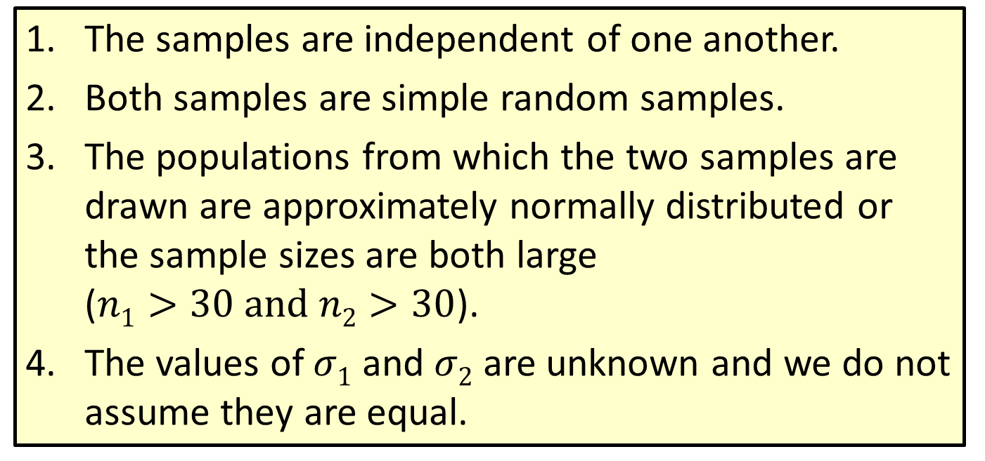
Assumptions: Assumptions
The samples are independent of one another.
Both samples are simple random samples.
The populations from which the two samples are drawn are approximately normally distributed or the sample sizes are both large ($n1>30 and n2>30$).
The values of $σ1$ and $σ2$ are unknown and we do not assume they are equal.

Slide 50
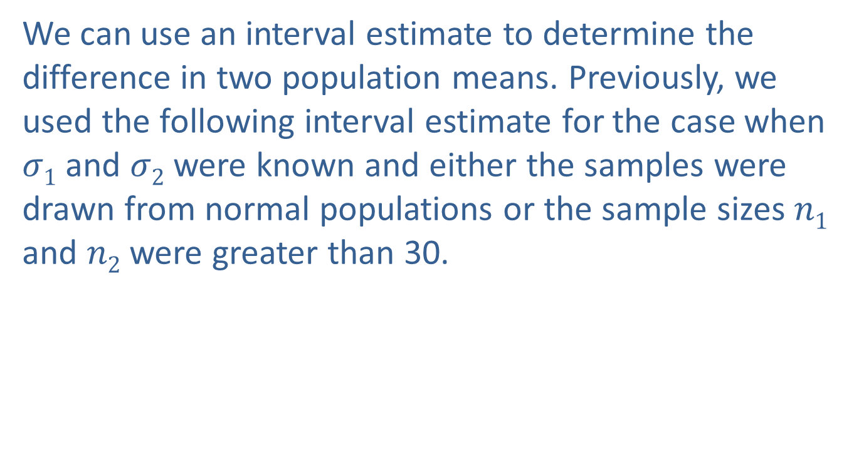
Interval Estimation
We can use an interval estimate to determine the difference in two population means. Previously, we used the following interval estimate for the case when $σ1$ and $σ2$ were known and either the samples were drawn from normal populations or the sample sizes $n1$ and $n2$ were greater than 30.

Slide 51

Interval Estimation (cont.)
Assuming that the population standard deviations, $σ1$ and $σ2$ are unknown, we will use the sample standard deviations, $s1$ and $s2$ to estimate the population standard deviations.

Slide 52
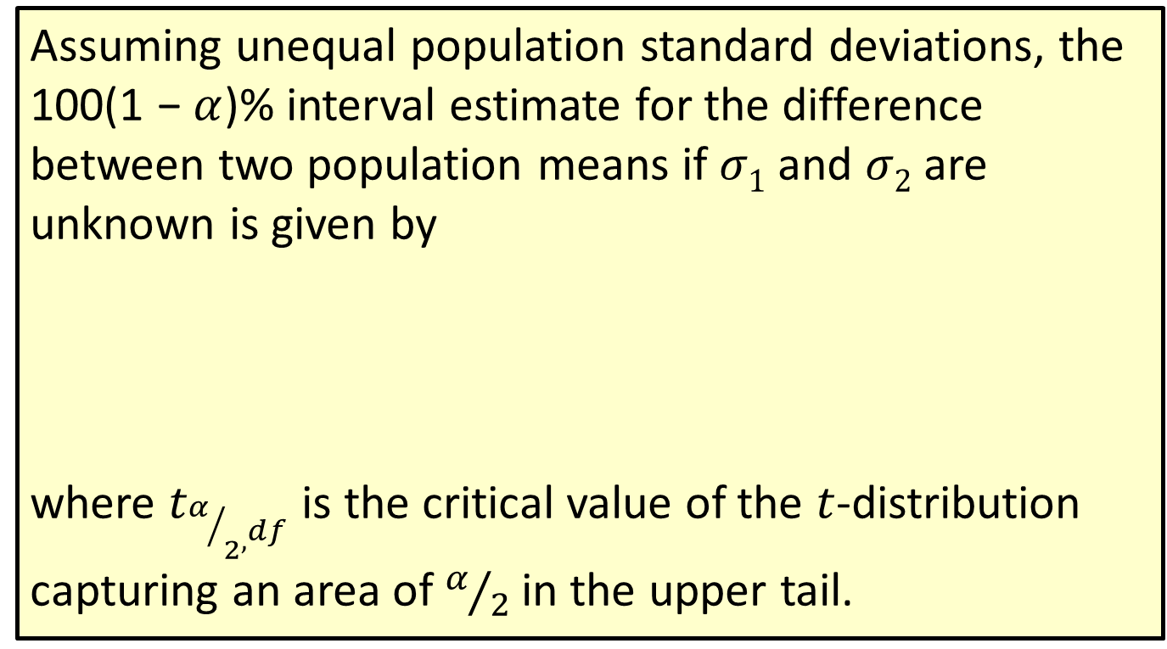
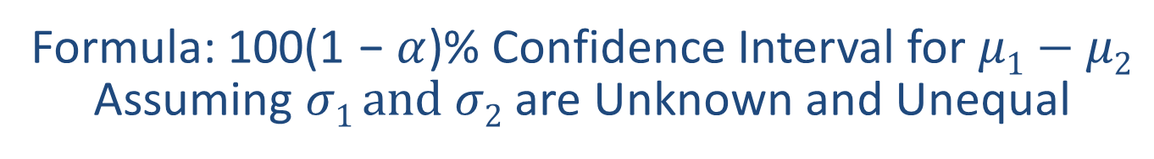
Formula: 100(1 − $α$)% Confidence Interval for $μ1−μ2$ Assuming $σ1 and σ2$ are Unknown and Unequal
Assuming unequal population standard deviations, the 100(1 − $α$)% interval estimate for the difference between two population means if $σ1$ and $σ2$ are unknown is given by
where $t_{α/{2^{,^{df}}}}$ is the critical value of the $t$-distribution capturing an area of $α/2$ in the upper tail.

Slide 53
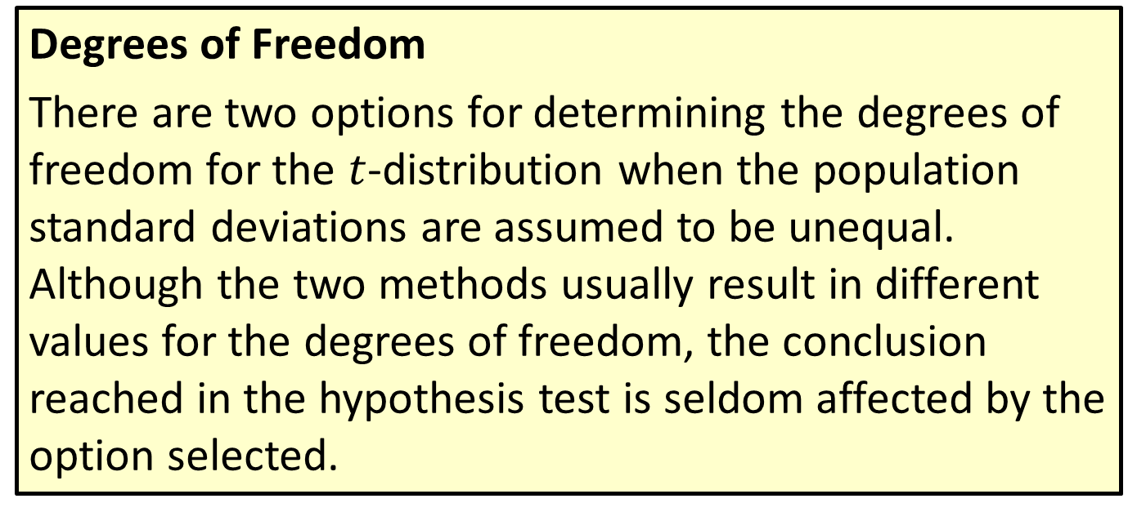
Formula: 100(1 − $α$)% Confidence Interval for $μ1−μ2$ Assuming $σ1 and σ2$ are Unknown and Unequal
Degrees of Freedom
There are two options for determining the degrees of freedom for the $t$-distribution when the population standard deviations are assumed to be unequal. Although the two methods usually result in different values for the degrees of freedom, the conclusion reached in the hypothesis test is seldom affected by the option selected.

Slide 54
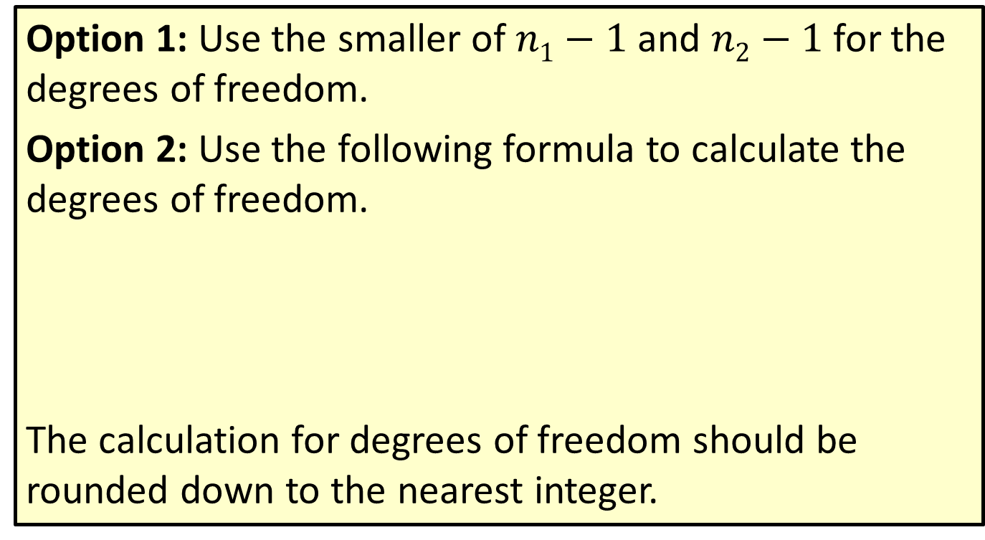
Formula: 100(1 − $α$)% Confidence Interval for $μ1−μ2$ Assuming $σ1 and σ2$ are Unknown and Unequal
Option 1: Use the smaller of $n1−1$and $n2−1$for the degrees of freedom.
Option 2: Use the following formula to calculate the degrees of freedom.
The calculation for degrees of freedom should be rounded down to the nearest integer.

Slide 55
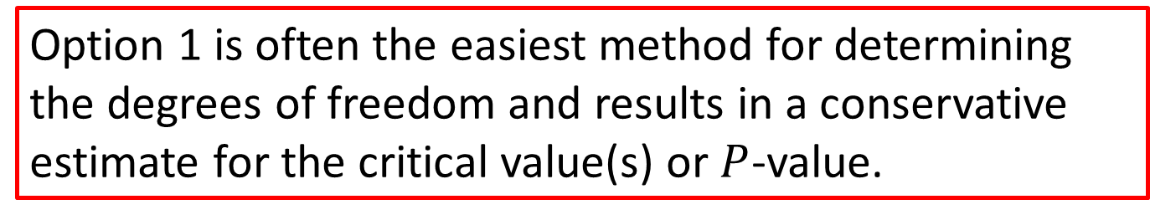
Note
Option 1 is often the easiest method for determining the degrees of freedom and results in a conservative estimate for the critical value(s) or $P$-value.

Slide 56
Note
The calculation of the degrees of freedom as shown in Option 2 is known as Satterthwaite’s Approximation. This approximation is what is used by most statistical software.

Slide 57
Example 12.2.3: Determining a Confidence Interval for the Difference in Instructional Methodology
A statistics instructor wants to know if using the courseware that accompanied her statistics textbook will improve students' test scores. Since she is teaching two sections of a statistics course this term, she decides to use the courseware in one class and not the other. The courseware contained premade homework assignments for each section of the book, so she had the students in one of her classes do the online homework. For the other class she gave them a similar homework assignment from the textbook.

Slide 58
Example 12.2.3: Determining a Confidence Interval for the Difference in Instructional Methodology (cont.)
The instructor believes that the immediate feedback from the online courseware on homework assignments will likely improve students’ performance on tests. For the first test she gave the students in both classes the same test. She took a simple random sample of 16 students’ test scores on the first test from each class. One student subsequently dropped the class, so that student’s test score was omitted from the data. The results were as follows.

Slide 59
Example 12.2.3: Determining a Confidence Interval for the Difference in Instructional Methodology (cont.)
Calculate a 95% confidence interval for the mean difference between the test scores for the two statistics classes. Let Population 1 be the test scores from the class using the courseware and let Population 2 be the test scores from the class that is not using the courseware.
Test Scores Using Courseware
73 | 75 | 76 | 78 | 78 | 80 | 82 | 83
84 | 85 | 87 | 88 | 88 | 92 | 93
Test Scores Not Using Courseware
60 | 62 | 65 | 67 | 72 | 74 | 74 | 75
77 | 79 | 79 | 80 | 81 | 85 | 88 | 93

Slide 60
Example 12.2.3: Determining a Confidence Interval for the Difference in Instructional Methodology (cont.)
Solution
Before calculating the confidence interval we must first check that the assumptions have been satisfied. The samples were simple random samples taken from two statistics classes containing a different set of students, so the samples are independent of one another.
A normal probability plot of each sample is shown below. The plots do not show any significant departures from normality for either sample.

Slide 61
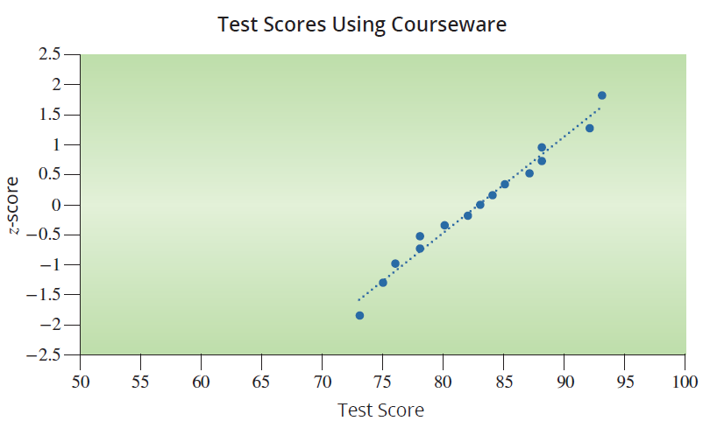
Example 12.2.3: Determining a Confidence Interval for the Difference in Instructional Methodology (cont.)

Slide 62
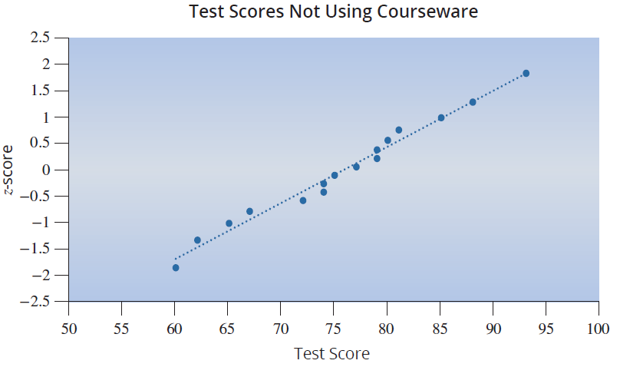
Example 12.2.3: Determining a Confidence Interval for the Difference in Instructional Methodology (cont.)

Slide 63
Example 12.2.3: Determining a Confidence Interval for the Difference in Instructional Methodology (cont.)
Independent random samples
The two samples are drawn from populations that are approximately normally distributed.
◻ σ₁ and σ₂ are known or
σ₁ and σ₂ are unknown
☑ The population standard deviations are assumed to be unequal.

Slide 64
Example 12.2.3: Determining a Confidence Interval for the Difference in Instructional Methodology (cont.)
Now we can proceed to calculate the confidence interval estimate for the difference in mean test scores between the two classes. By calculating the summary statistics for each set of data above, we find that
The normal probability plots suggest that assuming normality for the population of student scores is a reasonable assumption.

Slide 65
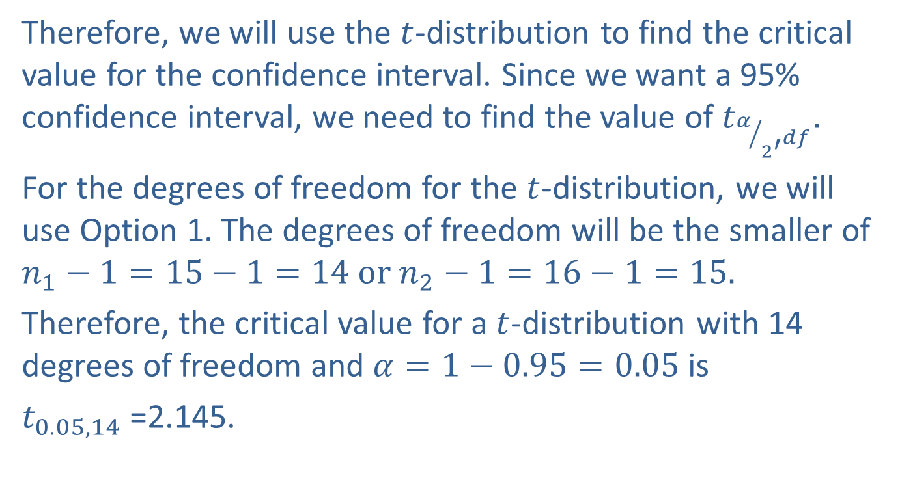
Example 12.2.3: Determining a Confidence Interval for the Difference in Instructional Methodology (cont.)
Therefore, we will use the $t$-distribution to find the critical value for the confidence interval. Since we want a 95% confidence interval, we need to find the value of $t_{α/{2^{′^{df}}}}.$
For the degrees of freedom for the $t$-distribution, we will use Option 1. The degrees of freedom will be the smaller of $n_{1}−1=15−1=14 or n_{2}−1=16−1=15.$
Therefore, the critical value for a $t$-distribution with 14 degrees of freedom and $α=1−0.95=0.05$is
$t_{0.05,14}$=2.145.

Slide 66
Example 12.2.3: Determining a Confidence Interval for the Difference in Instructional Methodology (cont.)
A 95% confidence interval for the difference in mean test scores is given by
The confidence interval is then calculated as follows.

Slide 67
Note
We are not using a pooled variance since the standard deviations are not assumed to be equal.

Slide 68
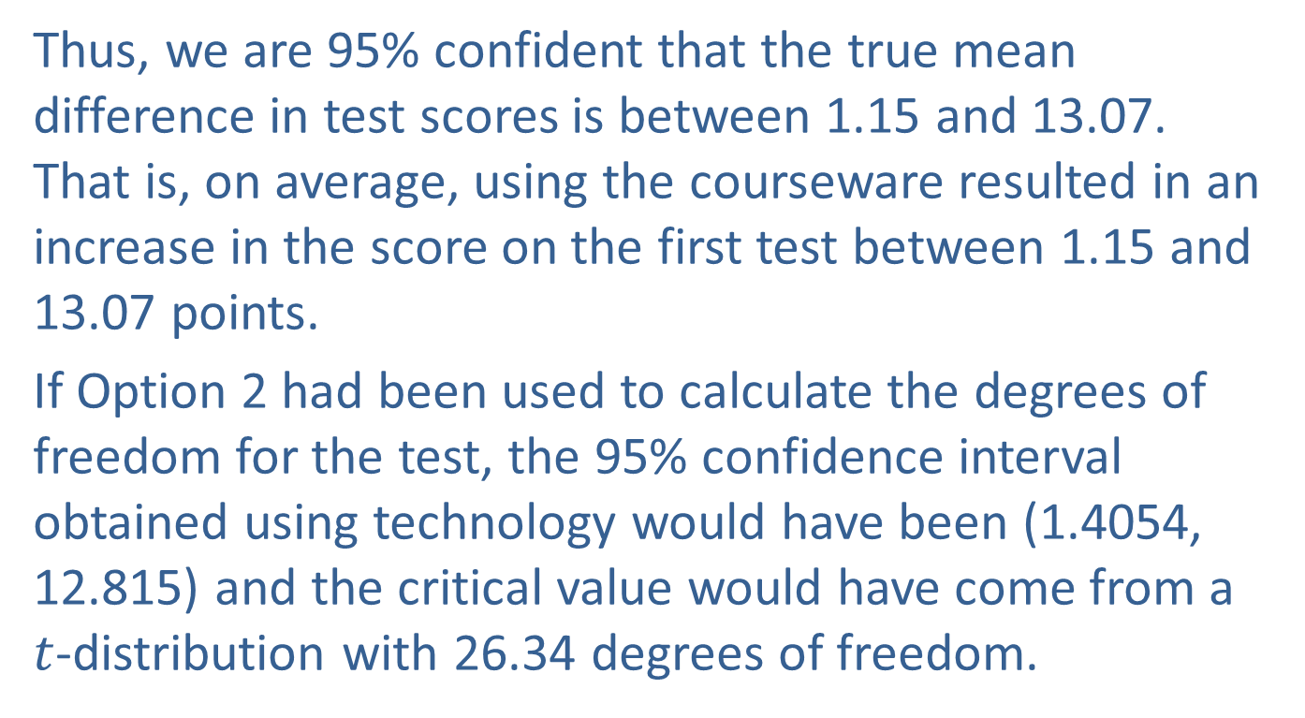
Example 12.2.3: Determining a Confidence Interval for the Difference in Instructional Methodology (cont.)
Thus, we are 95% confident that the true mean difference in test scores is between 1.15 and 13.07. That is, on average, using the courseware resulted in an increase in the score on the first test between 1.15 and 13.07 points.
If Option 2 had been used to calculate the degrees of freedom for the test, the 95% confidence interval obtained using technology would have been (1.4054, 12.815) and the critical value would have come from a $t$-distribution with 26.34 degrees of freedom.

Slide 69
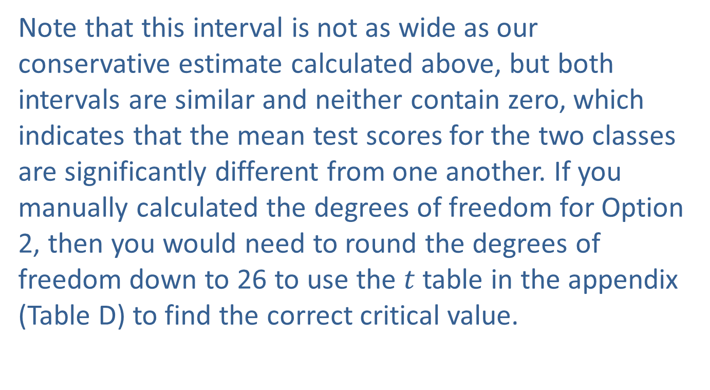
Example 12.2.3: Determining a Confidence Interval for the Difference in Instructional Methodology (cont.)
Note that this interval is not as wide as our conservative estimate calculated above, but both intervals are similar and neither contain zero, which indicates that the mean test scores for the two classes are significantly different from one another. If you manually calculated the degrees of freedom for Option 2, then you would need to round the degrees of freedom down to 26 to use the $t$ table in the appendix (Table D) to find the correct critical value.

Slide 70
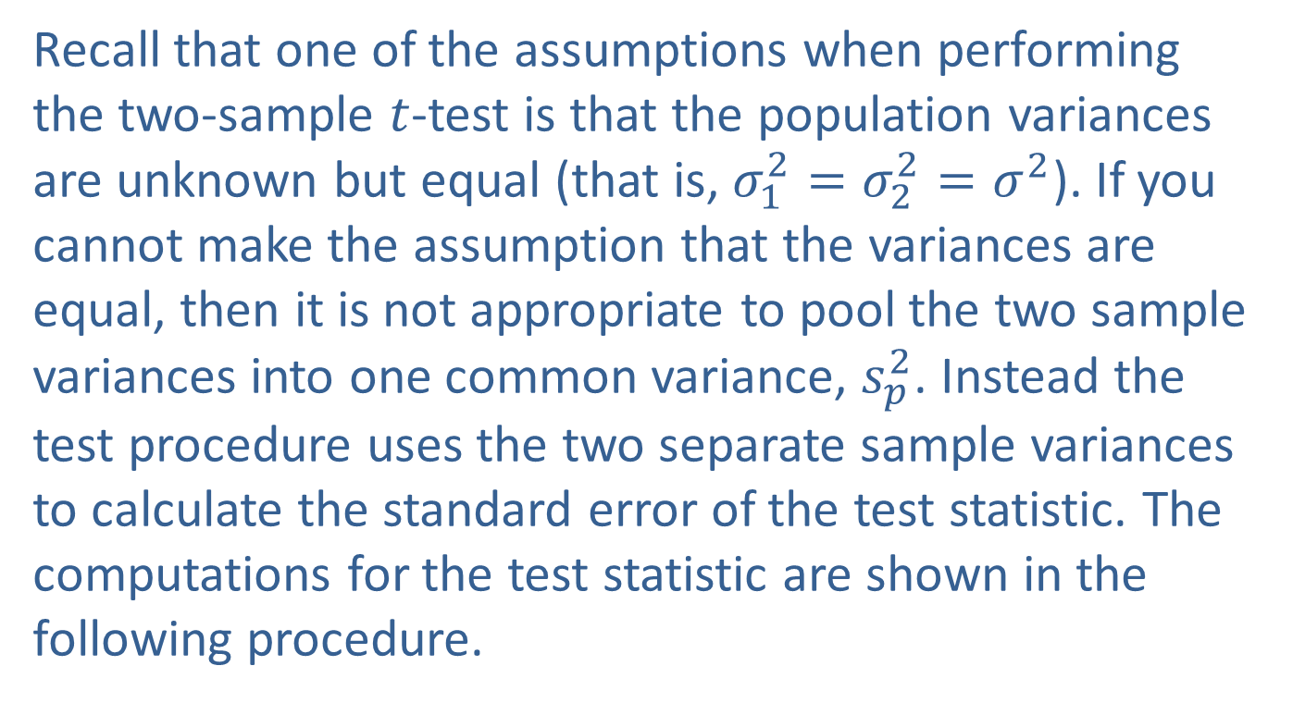
Hypothesis Testing
Recall that one of the assumptions when performing the two-sample $t$-test is that the population variances are unknown but equal (that is, $σ_{1}^{2}=σ_{2}^{2}=σ_{ }^{2}$). If you cannot make the assumption that the variances are equal, then it is not appropriate to pool the two sample variances into one common variance, $s_{p}^{2}$. Instead the test procedure uses the two separate sample variances to calculate the standard error of the test statistic. The computations for the test statistic are shown in the following procedure.

Slide 71
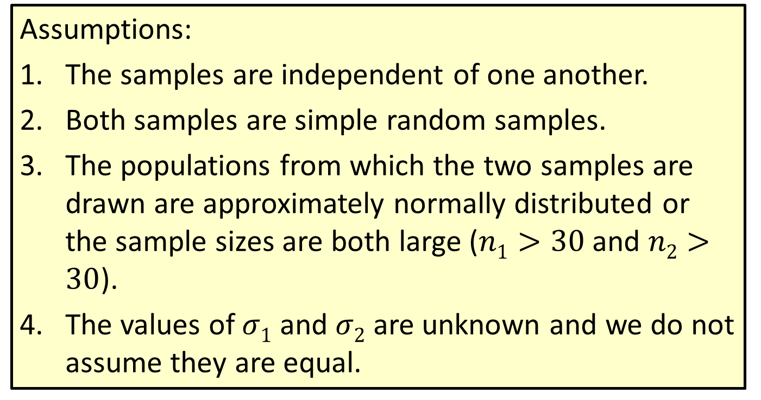

Procedure: Hypothesis Testing of $μ1−μ2$ with $σ1$ and $σ2$ Unknown and Unequal
Assumptions:
The samples are independent of one another.
Both samples are simple random samples.
The populations from which the two samples are drawn are approximately normally distributed or the sample sizes are both large ($n1>30$and $n2>30$).
The values of $σ1$ and $σ2$ are unknown and we do not assume they are equal.

Slide 72
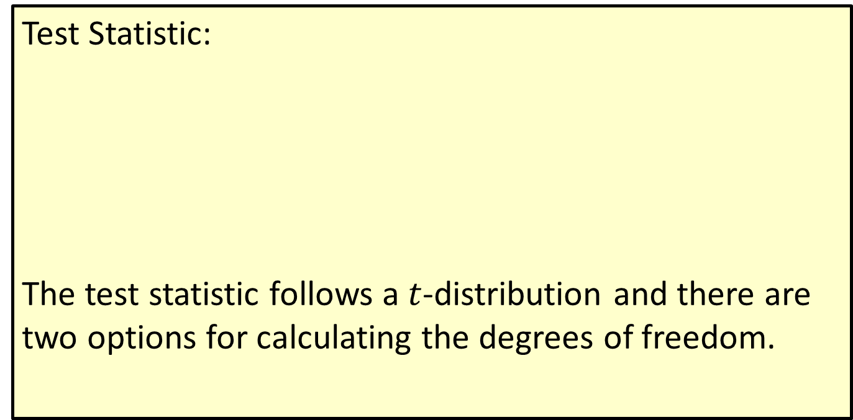
Procedure: Hypothesis Testing of $μ1−μ2$ with $σ1$ and $σ2$ Unknown and Unequal
Test Statistic:
The test statistic follows a $t$-distribution and there are two options for calculating the degrees of freedom.

Slide 73
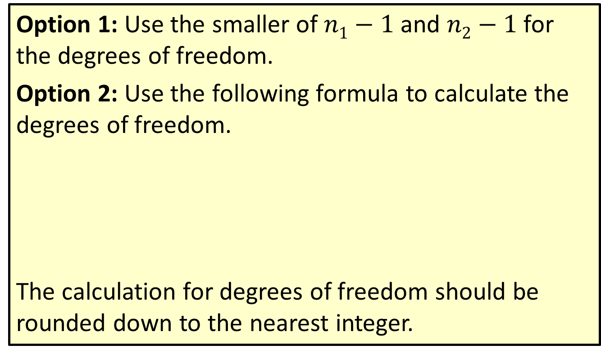
Procedure: Hypothesis Testing of $μ1−μ2$ with $σ1$ and $σ2$ Unknown and Unequal
Option 1: Use the smaller of $n1−1$and $n2−1$ for the degrees of freedom.
Option 2: Use the following formula to calculate the degrees of freedom.
The calculation for degrees of freedom should be rounded down to the nearest integer.

Slide 74
Example 12.2.4: Performing a Hypothesis Test for the Difference in Blue Crab Weights
A biologist is interested in comparing the size of blue crabs in two river basins: Stono River (Population 1) and Cooper River (Population 2). Based on the health of the rivers, she believes the crabs in the Stono will have a higher average weight. She samples 32 crabs from the Stono River, and this sample has a mean weight of 800 g with a standard deviation of 225 g. She takes a random sample of 35 crabs from the Cooper River and finds the crabs have a mean weight of 700 g with a standard deviation of 175 g.

Slide 75


Example 12.2.4: Performing a Hypothesis Test for the Difference in Blue Crab Weights (cont.)
Is there persuasive evidence at $α=0.01$in support of the biologist’s belief?

Slide 76
Example 12.2.4: Performing a Hypothesis Test for the Difference in Blue Crab Weights (cont.)
Solution
Step 1: Determine the population parameter to be used and develop the null and alternative hypotheses.
This is a one-sided test, since the biologist wants to know if the average crab weights are higher in the Stono River than the Cooper. The biologist is interested in comparing two population means, so we formulate the null and alternative hypotheses to look at the difference between the two population means.

Slide 77

Example 12.2.4: Performing a Hypothesis Test for the Difference in Blue Crab Weights (cont.)
Let $μ1$ equal the average weight of Stono River crabs and $μ2$ equal the average weight of Cooper River crabs.
$H0$:$μ1−μ2=$0 There is no difference in average crab weight.
$Ha$:$μ1−μ2>$ 0 The average crab weights in the Stono River are higher.
Step 2: Specify the significance level $α$.
The significance level is specified to be $α$ = 0.01.

Slide 78
Example 12.2.4: Performing a Hypothesis Test for the Difference in Blue Crab Weights (cont.)
Step 3: Validate the assumptions of the hypothesis test, identify the appropriate test statistic, and compute its value.
Looking at the box plots, the data for each sample appears to be roughly symmetric and the variances do not appear to be equal (the spreads of the two boxes are different). Also, the samples are from independent random samples.

Slide 79

Example 12.2.4: Performing a Hypothesis Test for the Difference in Blue Crab Weights (cont.)
Independent random samples
The samples sizes are large ($n1>30$ and $n2>30$).
◻ σ₁ and σ₂ are known or
σ₁ and σ₂ are unknown
☑ The population standard deviations are assumed unequal.
Since the assumptions are validated we can proceed with the hypothesis test. We use the $t$-test statistic given by

Slide 80

Example 12.2.4: Performing a Hypothesis Test for the Difference in Blue Crab Weights (cont.)
Based on the sample statistics, the computed value of the test statistic is
Using Option 1 for the degrees of freedom, our test statistic has $n1$− 1 = 32 − 1 = 31 degrees of freedom.

Slide 81


Example 12.2.4: Performing a Hypothesis Test for the Difference in Blue Crab Weights (cont.)
Step 4: Determine the critical value(s) or $P$-value.
The rejection region corresponding to the alternative hypothesis, $Ha$:$μ1−μ2>$ 0 , with $α=0.01$for a $t$-test statistic with 31 degrees of freedom is given in the figure below.

Slide 82

Example 12.2.4: Performing a Hypothesis Test for the Difference in Blue Crab Weights (cont.)
We will reject the null hypothesis if the computed value of the test statistic is larger than 2.453.
We find the $P$-value to be $P$($t>2.0174$) ≈ 0.0262 for 31 degrees of freedom.
Step 5: Choose between the null and alternative hypotheses.
The value of the test statistic does not fall in the rejection region. Also, the $P$-value is greater than 0.01, so we fail to reject the null hypothesis.

Slide 83
Example 12.2.4: Performing a Hypothesis Test for the Difference in Blue Crab Weights (cont.)
Step 6: State the conclusion in terms of the original problem.
There is insufficient evidence for the biologist to conclude that the average weight of blue crabs is higher in the Stono River than in the Cooper River at the 0.01 significance level.

