Slide 1
Section 12.1
Inference about Two Population Means: Independent Samples, σ₁ and σ₂ Known

Slide 2

Inference about Two Population Means: Independent Samples, $σ1$ and $σ2$ Known
When observations are randomly selected from two independent populations or experimental units are randomly assigned to two different treatments where the variation between experimental units is small, the sampling design is called an independent experimental design or a completely randomized design.

Slide 3
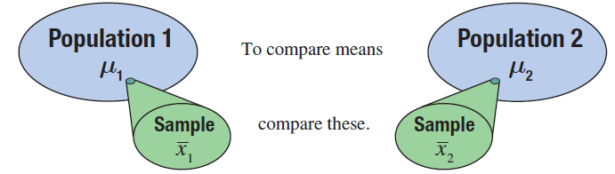
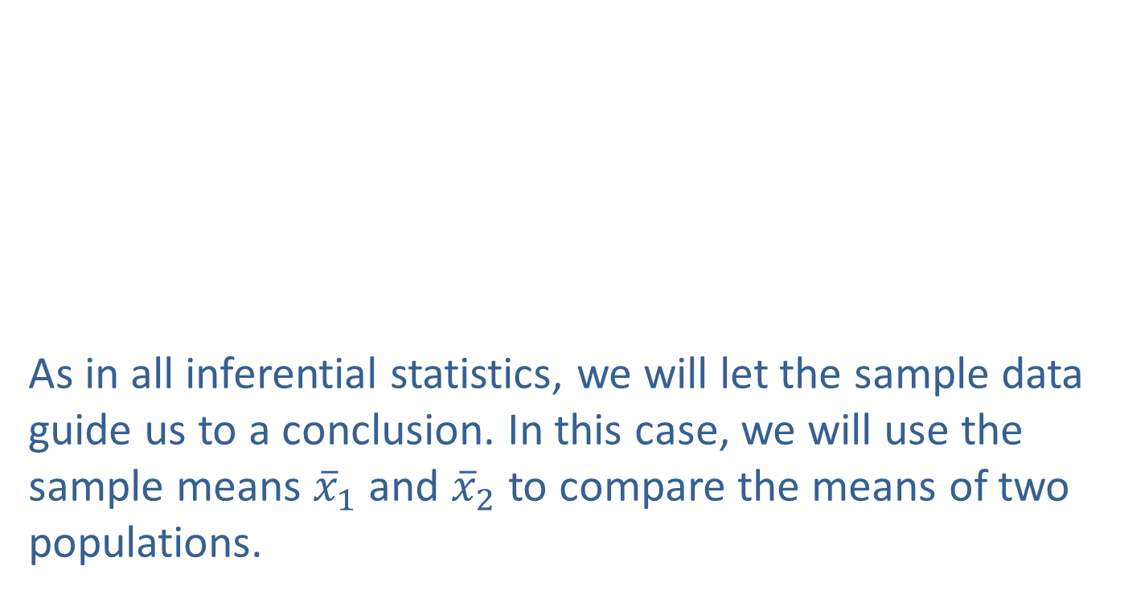

Inferences about the Means of Two Independent Populations, $σ1$ and $σ2$ Known
As in all inferential statistics, we will let the sample data guide us to a conclusion. In this case, we will use the sample means ${\overline{x}}_{1}$ and ${\overline{x}}_{2}$ to compare the means of two populations.

Slide 4
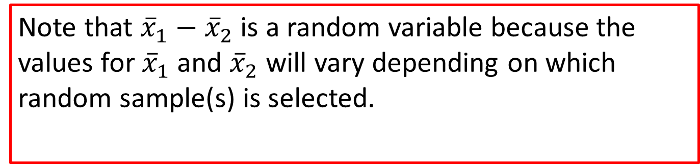
Note
Note that ${\overline{x}}_{1}−{\overline{x}}_{2}$ is a random variable because the values for ${\overline{x}}_{1}$and ${\overline{x}}_{2}$ will vary depending on which random sample(s) is selected.

Slide 5
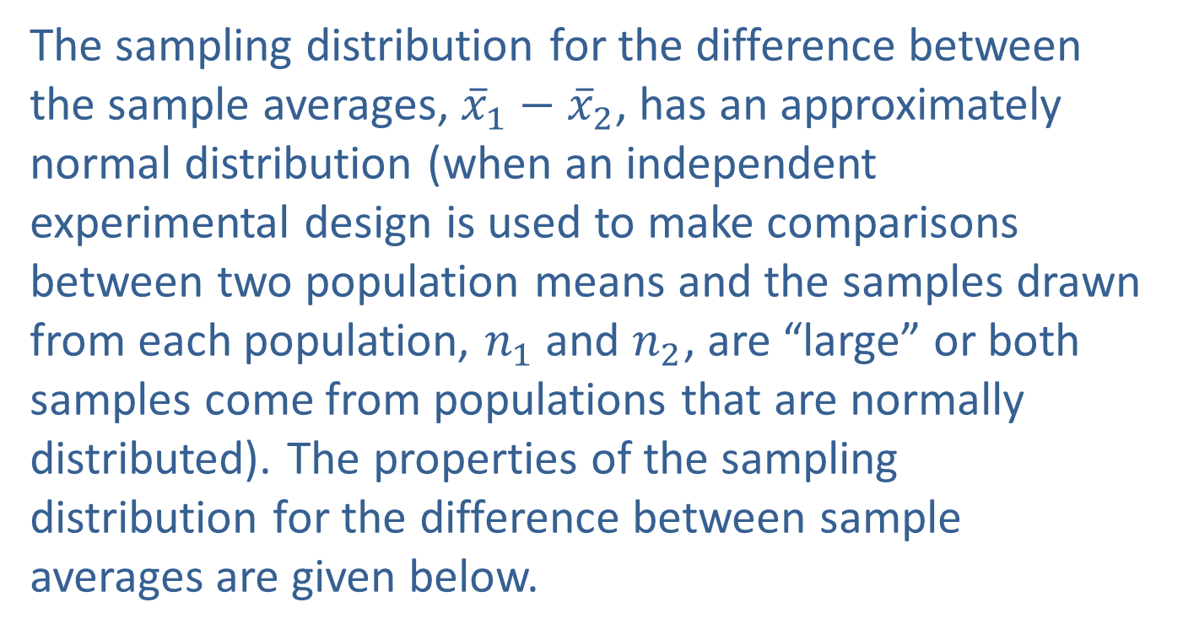

Inferences about the Means of Two Independent Populations, $σ1$ and $σ2$ Known (cont.)
The sampling distribution for the difference between the sample averages, ${\overline{x}}_{1}−{\overline{x}}_{2}$, has an approximately normal distribution (when an independent experimental design is used to make comparisons between two population means and the samples drawn from each population, $n_{1}$ and $n_{2}$, are “large” or both samples come from populations that are normally distributed). The properties of the sampling distribution for the difference between sample averages are given below.

Slide 6

Properties: Properties of the Sampling Distribution of ${\overline{x}}_{1}−{\overline{x}}_{2}$
If n₁ > 30 and n₂ > 30, the sampling distribution of has an approximately normal distribution. As well, the sampling distribution of for any sample size is normally distributed if both samples come from populations that are normally distributed.
if the two samples are independent, and

Slide 7

Inferences about the Means of Two Independent Populations, $σ1$ and $σ2$ Known (cont.)
The sampling distribution of ${\overline{x}}_{1}−{\overline{x}}_{2}$will be used in the development of the confidence interval and test statistic for comparing two population means.

Slide 8

Interval Estimation
Given the sampling distribution of ${\overline{x}}_{1}−{\overline{x}}_{2}$, we can develop the confidence interval estimate of the difference between two population means.

Slide 9
Formula: 100(1 − α)% Confidence Interval for μ₁ − μ₂
The 100(1 −α)% confidence interval estimate for the difference in the population means of two independent populations is given by
where z_{α/2} is the critical value of the standard normal distribution with an area of α/2 in the upper tail. σ₁ and σ₂ are known, and the independent samples are drawn from normally distributed populations or the samples sizes are large; i.e., n₁ > 30 and n₂ > 30.

Slide 10
Hypothesis Testing
Table 12.1.1 gives a short summary of the possible hypothesis tests that can be conducted when you want to compare two means. These choices are the same regardless of the underlying distribution of the test statistic used.

Slide 11
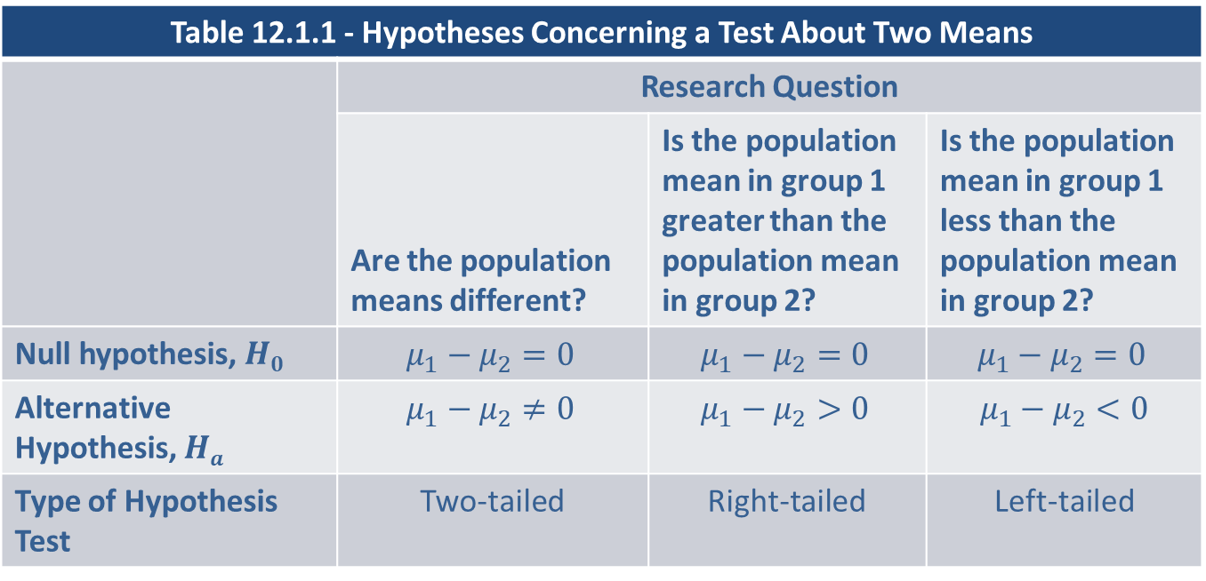
Hypothesis Testing (cont.)
Table 12.1.1 - Hypotheses Concerning a Test About Two Means
 | Research Question
 | Are the population means different? | Is the population mean in group 1 greater than the population mean in group 2? | Is the population mean in group 1 less than the population mean in group 2?
Null hypothesis, $H0$ | $$μ_{1}−μ_{2}=0$$ | $$μ_{1}−μ_{2}=0$$ | $$μ_{1}−μ_{2}=0$$
Alternative Hypothesis, $Ha$ | $$μ_{1}−μ_{2}≠0$$ | $$μ_{1}−μ_{2}>0$$ | $$μ_{1}−μ_{2}<0$$
Type of Hypothesis Test | Two-tailed | Right-tailed | Left-tailed

Slide 12
Hypothesis Testing (cont.)
When comparing two population means in which the standard deviation (or variance) of both populations are known, the following procedure should be followed, taking care to make sure that the assumptions of the test are satisfied.

Slide 13
Procedure: Testing a Hypothesis about Two Independent Population Means, σ₁ and σ₂ Known
Assumptions:
The samples are independent of one another.
Both samples are simple random samples.
The populations from which the two samples are drawn are normally distributed or the sample sizes are both large (n₁ > 30 and n₂ > 30).
The population standard deviations, σ₁ and σ₂, are known.

Slide 14
Procedure: Testing a Hypothesis about Two Independent Population Means, σ₁ and σ₂ Known (cont.)
Test Statistic:
The test statistic for a hypothesis test about μ₁− μ₂ is given by

Slide 15
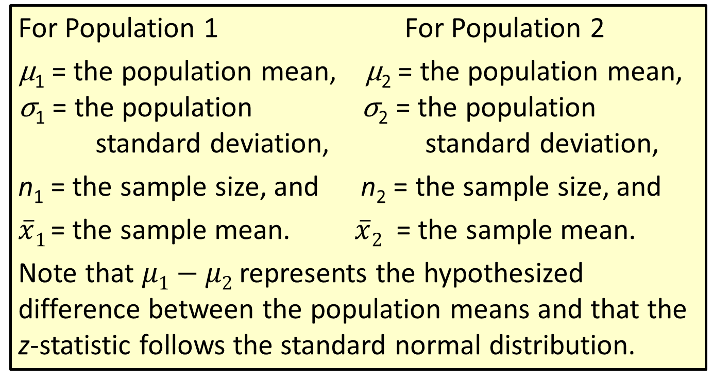
Procedure: Testing a Hypothesis about Two Independent Population Means, σ₁ and σ₂ Known (cont.)
For Population 1 For Population 2
μ₁ = the population mean, μ₂ = the population mean, σ₁ = the population σ₂ = the population standard deviation, standard deviation,
n₁ = the sample size, and n₂ = the sample size, and
$\overline{x}1$ = the sample mean. $\overline{x}2$ = the sample mean.
Note that $μ1−μ2$represents the hypothesized difference between the population means and that the z-statistic follows the standard normal distribution.

Slide 16
Hypothesis Testing (cont.)
In Example 12.1.1 we will construct a confidence interval and perform a hypothesis test for comparing two population means.

Slide 17
Example 12.1.1: Determining a Confidence Interval and Performing a Hypothesis Test for the Difference in Service Outage Times
A telecommunications analyst is interested in knowing if there is a significant difference in the average service outage times between cable television subscribers and satellite television subscribers. She randomly selects 50 cable subscribers and 50 satellite subscribers for the study. She gives each subscriber a survey and asks them to record the length of time of each service outage for a month. She summarizes the results of the survey and calculates the mean outage for each television service. The results of the study are shown in the following table. Let cable subscribers be Population 1 and satellite subscribers be Population 2.

Slide 18
Example 12.1.1: Determining a Confidence Interval and Performing a Hypothesis Test for the Difference in Service Outage Times (cont.)
Calculate a 95% confidence interval for the mean difference in average service outage time between cable and satellite subscribers.
Is there persuasive evidence for the analyst to conclude at α = 0.05 that there is a difference in mean service outage time between cable and satellite subscribers?
Service Outage Time (in minutes)
 | n |  | σ
Cable | 50 | 8.8 | 3
Satellite | 50 | 9.5 | 2

Slide 19
Example 12.1.1: Determining a Confidence Interval and Performing a Hypothesis Test for the Difference in Service Outage Times (cont.)
Solution
From the information given in the problem, we know the following.
Since both sample sizes are greater than 30, we can invoke the Central Limit Theorem and assume that the sample means are approximately normally distributed.

Slide 20
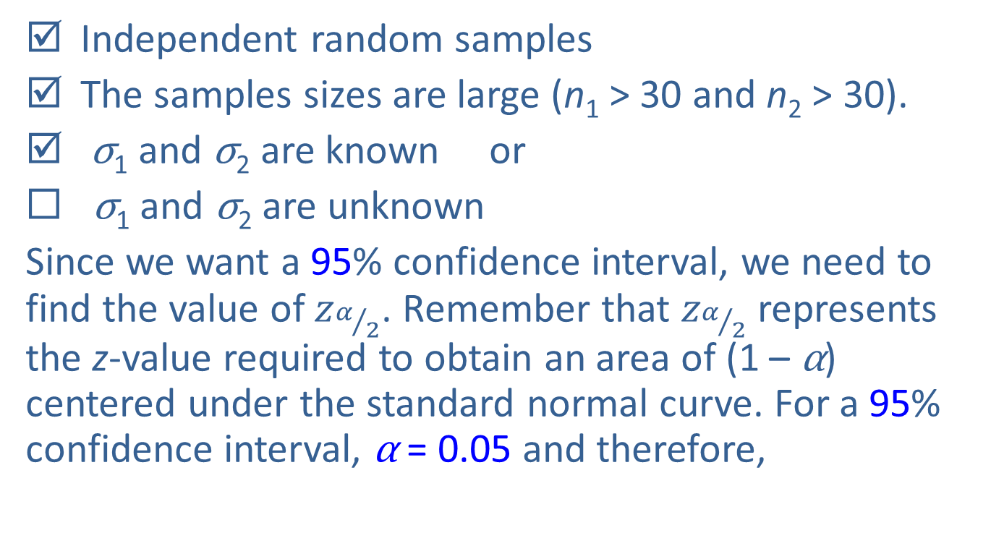
Example 12.1.1: Determining a Confidence Interval and Performing a Hypothesis Test for the Difference in Service Outage Times (cont.)
Independent random samples
The samples sizes are large (n₁ > 30 and n₂ > 30).
σ₁ and σ₂ are known or
◻ σ₁ and σ₂ are unknown
Since we want a 95% confidence interval, we need to find the value of $z_{α/2}$. Remember that $z_{α/2}$ represents the z-value required to obtain an area of (1 – α) centered under the standard normal curve. For a 95% confidence interval, α = 0.05 and therefore,

Slide 21
Example 12.1.1: Determining a Confidence Interval and Performing a Hypothesis Test for the Difference in Service Outage Times (cont.)
A 95% confidence interval for the difference in the average service outage time between cable and satellite providers is given by
This gives,

Slide 22
Example 12.1.1: Determining a Confidence Interval and Performing a Hypothesis Test for the Difference in Service Outage Times (cont.)
Thus, we are 95% confident that the true mean difference in service outage time between cable and satellite subscribers is between −1.7 and 0.3 minutes. Since the confidence interval includes zero, this indicates that the difference in the average service outage time between cable and satellite subscribers is not statistically significant at the 0.05 level.

Slide 23
Example 12.1.1: Determining a Confidence Interval and Performing a Hypothesis Test for the Difference in Service Outage Times (cont.)
The steps for the hypothesis test are as follows.
Step 1: Determine the population parameter to be used and develop the null and alternative hypotheses.
Null Hypothesis: There is no difference in average service outage time between cable and satellite subscribers.
Alternative Hypothesis: There is a difference in average service outage time between cable and satellite subscribers.

Slide 24
Example 12.1.1: Determining a Confidence Interval and Performing a Hypothesis Test for the Difference in Service Outage Times (cont.)
Since the analyst is interested in comparing the average service outage time between cable and satellite subscribers, the appropriate statistical measures are the following.
μ₁ = the true mean service outage time for cable subscribers
μ₂ = the true mean service outage time for satellite subscribers

Slide 25
Example 12.1.1: Determining a Confidence Interval and Performing a Hypothesis Test for the Difference in Service Outage Times (cont.)
The analyst is interested in whether or not there is a difference in the average service outage time between cable and satellite subscribers. Thus, the alternative hypothesis is two-sided and the test is two-tailed.
Since the analyst is interested in comparing the two population means, a natural way to make this comparison is to look at the difference between the two population means. Hence the null and alternative hypotheses are formulated as follows.

Slide 26
Example 12.1.1: Determining a Confidence Interval and Performing a Hypothesis Test for the Difference in Service Outage Times (cont.)
In this situation, the hypothesized difference in average service outage time is 0. However, it is possible to be interested in nonzero differences. For example, if the analyst had been interested in testing if the difference in average service outage time was one minute, the hypothesized difference would have been one.
There is no difference in average service outage time.
There is a difference in average service outage time.

Slide 27
Example 12.1.1: Determining a Confidence Interval and Performing a Hypothesis Test for the Difference in Service Outage Times (cont.)
Step 2: Specify the significance level α.
The level of the test is specified in the problem as α = 0.05.
Step 3: Validate the assumptions of the hypothesis test, identify the appropriate test statistic, and compute its value.
The assumptions for the test were validated in part a.

Slide 28
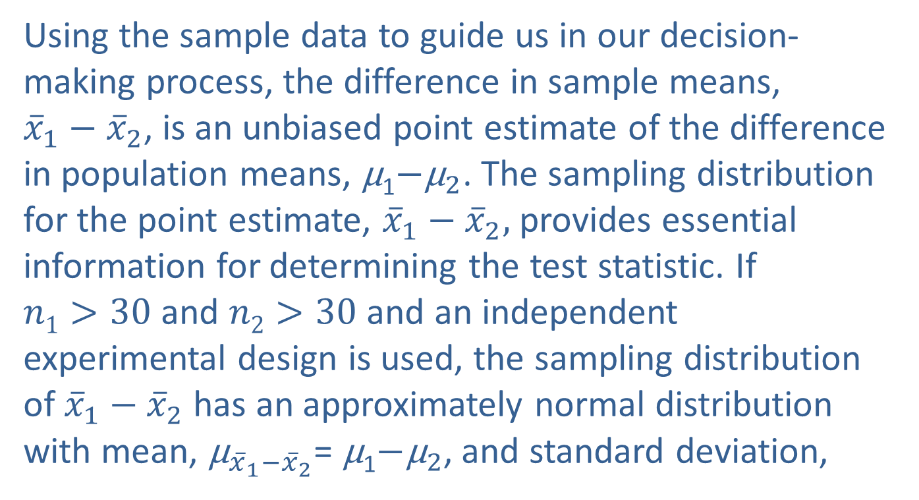
Example 12.1.1: Determining a Confidence Interval and Performing a Hypothesis Test for the Difference in Service Outage Times (cont.)
Using the sample data to guide us in our decision-making process, the difference in sample means, ${\overline{x}}_{1}−{\overline{x}}_{2}$, is an unbiased point estimate of the difference in population means, μ₁$−{\text{μ}}_{2}$. The sampling distribution for the point estimate, ${\overline{x}}_{1}−{\overline{x}}_{2},$provides essential information for determining the test statistic. If $n1>30$ and $n2>30$ and an independent experimental design is used, the sampling distribution of ${\overline{x}}_{1}−{\overline{x}}_{2}$has an approximately normal distribution with mean, ${\text{μ}}_{{\overline{x}}_{1}−{\overline{x}}_{2}}$= μ₁$−{\text{μ}}_{2}$, and standard deviation,

Slide 29
Example 12.1.1: Determining a Confidence Interval and Performing a Hypothesis Test for the Difference in Service Outage Times (cont.)
We will use the familiar z-transformation as the test statistic. Consequently, the test statistic is a standard normal random variable. The test statistic is given by

Slide 30
Note
Recall that this is similar to our initial discussion of z-scores in Chapter 4:

Slide 31
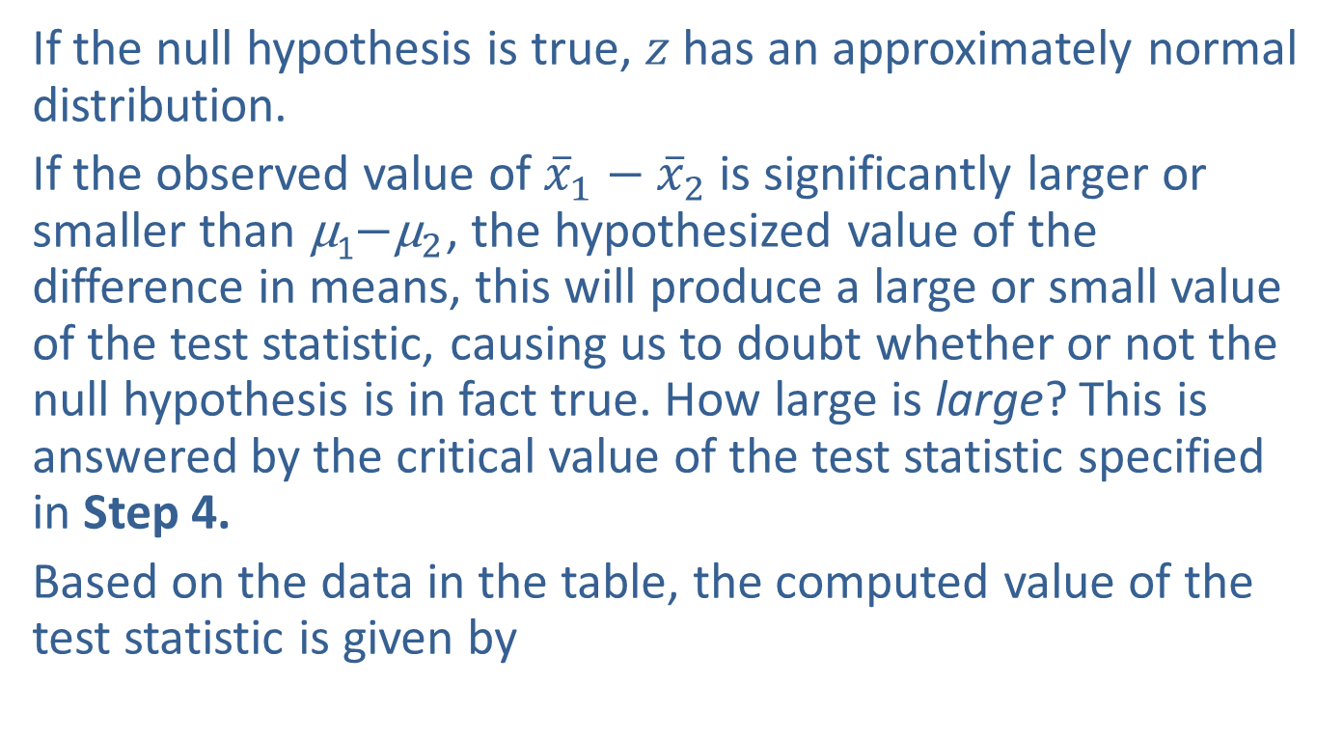
Example 12.1.1: Determining a Confidence Interval and Performing a Hypothesis Test for the Difference in Service Outage Times (cont.)
If the null hypothesis is true, $z$ has an approximately normal distribution.
If the observed value of ${\overline{x}}_{1}−{\overline{x}}_{2}$is significantly larger or smaller than μ₁$−{\text{μ}}_{2}$, the hypothesized value of the difference in means, this will produce a large or small value of the test statistic, causing us to doubt whether or not the null hypothesis is in fact true. How large is large? This is answered by the critical value of the test statistic specified in Step 4.
Based on the data in the table, the computed value of the test statistic is given by

Slide 32
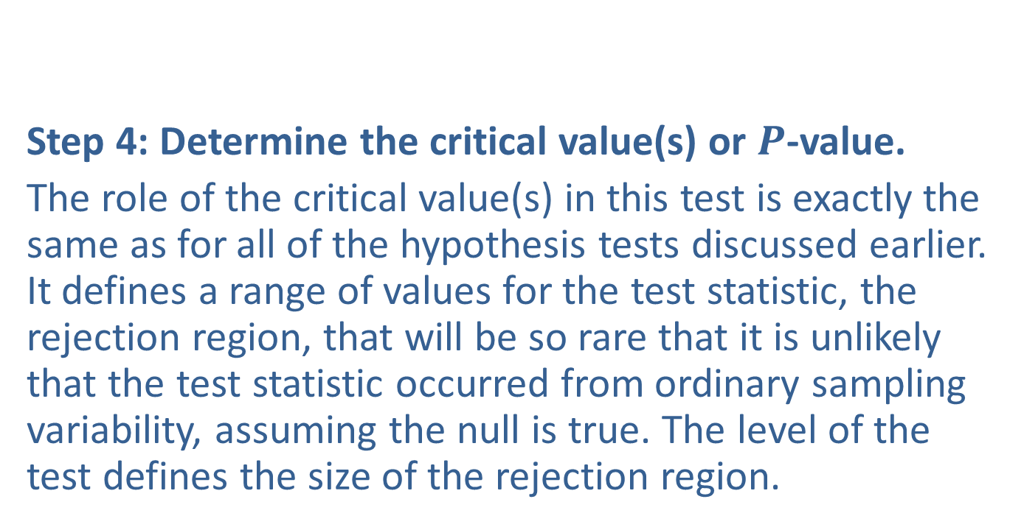
Example 12.1.1: Determining a Confidence Interval and Performing a Hypothesis Test for the Difference in Service Outage Times (cont.)
Step 4: Determine the critical value(s) or $P$-value.
The role of the critical value(s) in this test is exactly the same as for all of the hypothesis tests discussed earlier. It defines a range of values for the test statistic, the rejection region, that will be so rare that it is unlikely that the test statistic occurred from ordinary sampling variability, assuming the null is true. The level of the test defines the size of the rejection region.

Slide 33
Example 12.1.1: Determining a Confidence Interval and Performing a Hypothesis Test for the Difference in Service Outage Times (cont.)
Should the computed value of the test statistic fall within the rejection region, the null hypothesis will be rejected.
If the null hypothesis is true, the test statistic has an approximately normal distribution. Thus the critical value is determined in the same way as for the other tests of hypothesis in which the test statistic had an approximately normal distribution. The rejection region for a two-tailed test with level of significance, 𝛼=0.05, is displayed in the figure below.

Slide 34
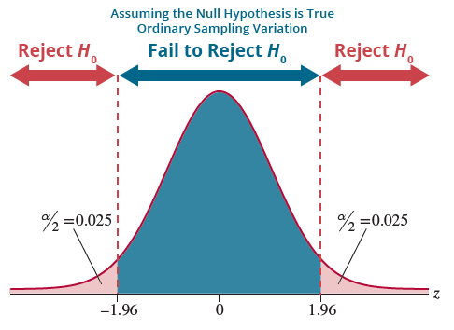
Example 12.1.1: Determining a Confidence Interval and Performing a Hypothesis Test for the Difference in Service Outage Times (cont.)

Slide 35
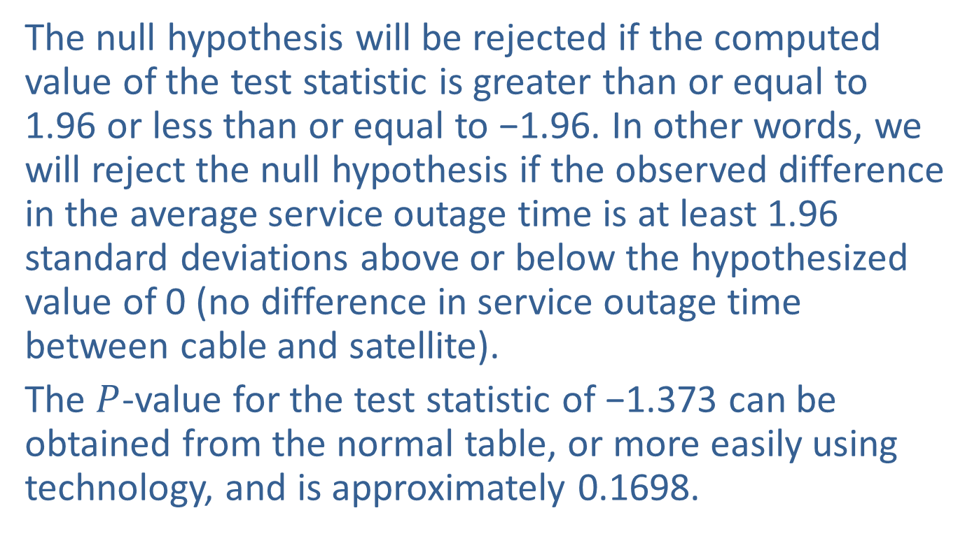
Example 12.1.1: Determining a Confidence Interval and Performing a Hypothesis Test for the Difference in Service Outage Times (cont.)
The null hypothesis will be rejected if the computed value of the test statistic is greater than or equal to 1.96 or less than or equal to −1.96. In other words, we will reject the null hypothesis if the observed difference in the average service outage time is at least 1.96 standard deviations above or below the hypothesized value of 0 (no difference in service outage time between cable and satellite).
The $P$-value for the test statistic of −1.373 can be obtained from the normal table, or more easily using technology, and is approximately 0.1698.

Slide 36
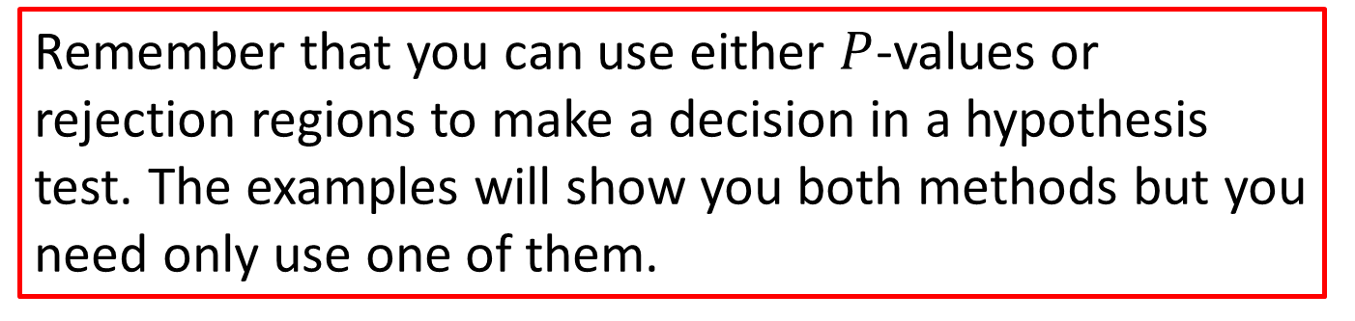
Note
Remember that you can use either $P$-values or rejection regions to make a decision in a hypothesis test. The examples will show you both methods but you need only use one of them.

Slide 37
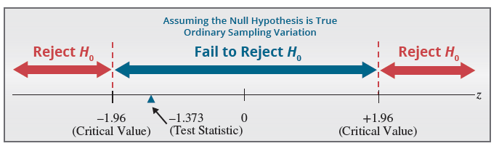
Example 12.1.1: Determining a Confidence Interval and Performing a Hypothesis Test for the Difference in Service Outage Times (cont.)
Step 5: Choose between the null and alternative hypotheses.
As shown above, the calculated value of the test statistic does not fall in the rejection region because −1.373 falls between the critical values −1.96 and 1.96.

Slide 38
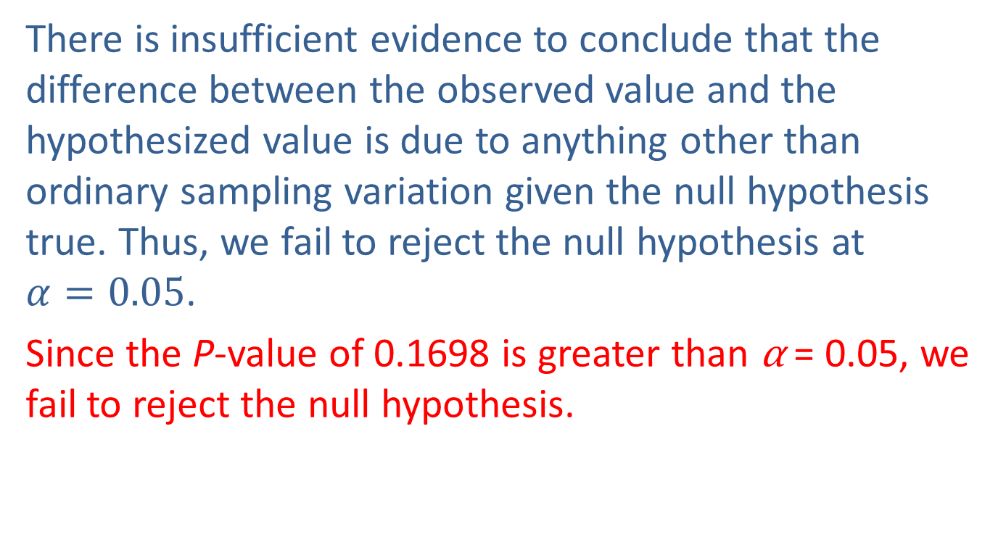
Example 12.1.1: Determining a Confidence Interval and Performing a Hypothesis Test for the Difference in Service Outage Times (cont.)
There is insufficient evidence to conclude that the difference between the observed value and the hypothesized value is due to anything other than ordinary sampling variation given the null hypothesis true. Thus, we fail to reject the null hypothesis at $α=0.05$.
Since the P-value of 0.1698 is greater than α = 0.05, we fail to reject the null hypothesis.

Slide 39
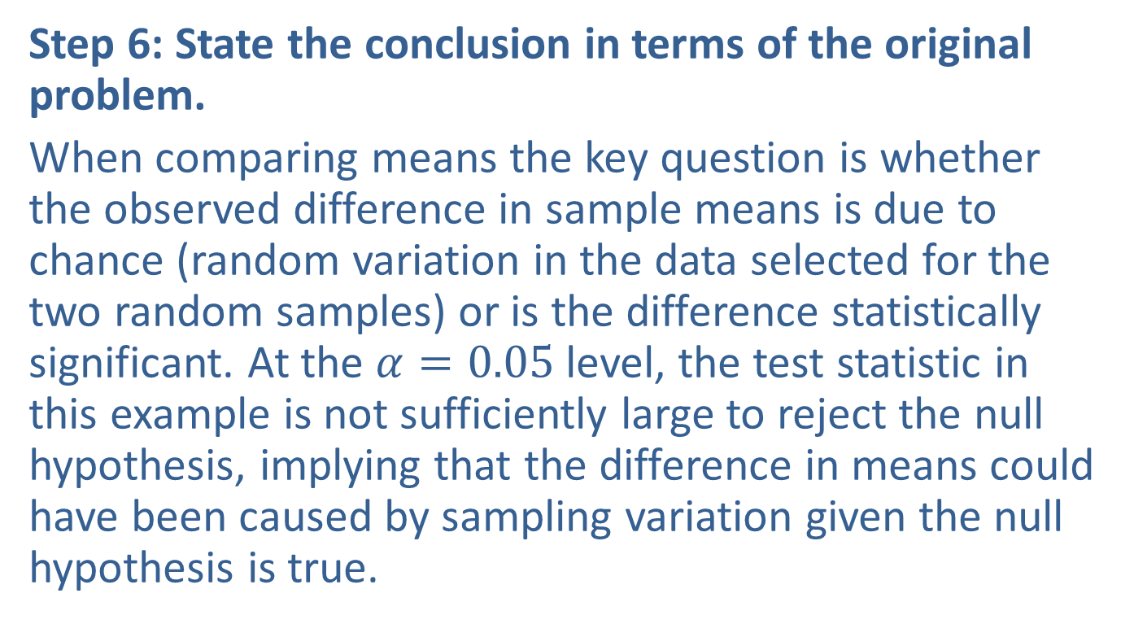
Example 12.1.1: Determining a Confidence Interval and Performing a Hypothesis Test for the Difference in Service Outage Times (cont.)
Step 6: State the conclusion in terms of the original problem.
When comparing means the key question is whether the observed difference in sample means is due to chance (random variation in the data selected for the two random samples) or is the difference statistically significant. At the $α=0.05$level, the test statistic in this example is not sufficiently large to reject the null hypothesis, implying that the difference in means could have been caused by sampling variation given the null hypothesis is true.

Slide 40
Example 12.1.1: Determining a Confidence Interval and Performing a Hypothesis Test for the Difference in Service Outage Times (cont.)
Therefore, there is not sufficient evidence at the 0.05 level to conclude that the average service outage time is significantly different between cable and satellite television subscribers.
The following is another example of performing a hypothesis test about two population means, but with a one-sided alternative hypothesis.

Slide 41
Example 12.1.2: Performing a Hypothesis Test for Reading Time
An elementary school teacher is interested in knowing if fifth-grade girls take longer to read a passage from a book than fifth-grade boys. She randomly selects 40 fifth-grade boys and 40 fifth-grade girls for the study. She gives each student several pages of the same book to read. The time it takes each group to complete the reading is recorded in minutes. The results of the study are shown in the following table.

Slide 42
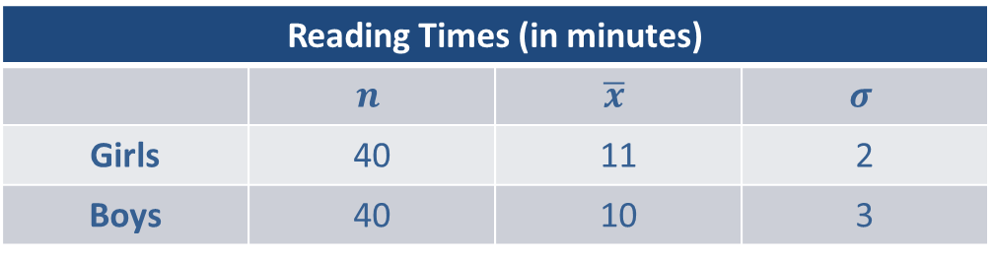
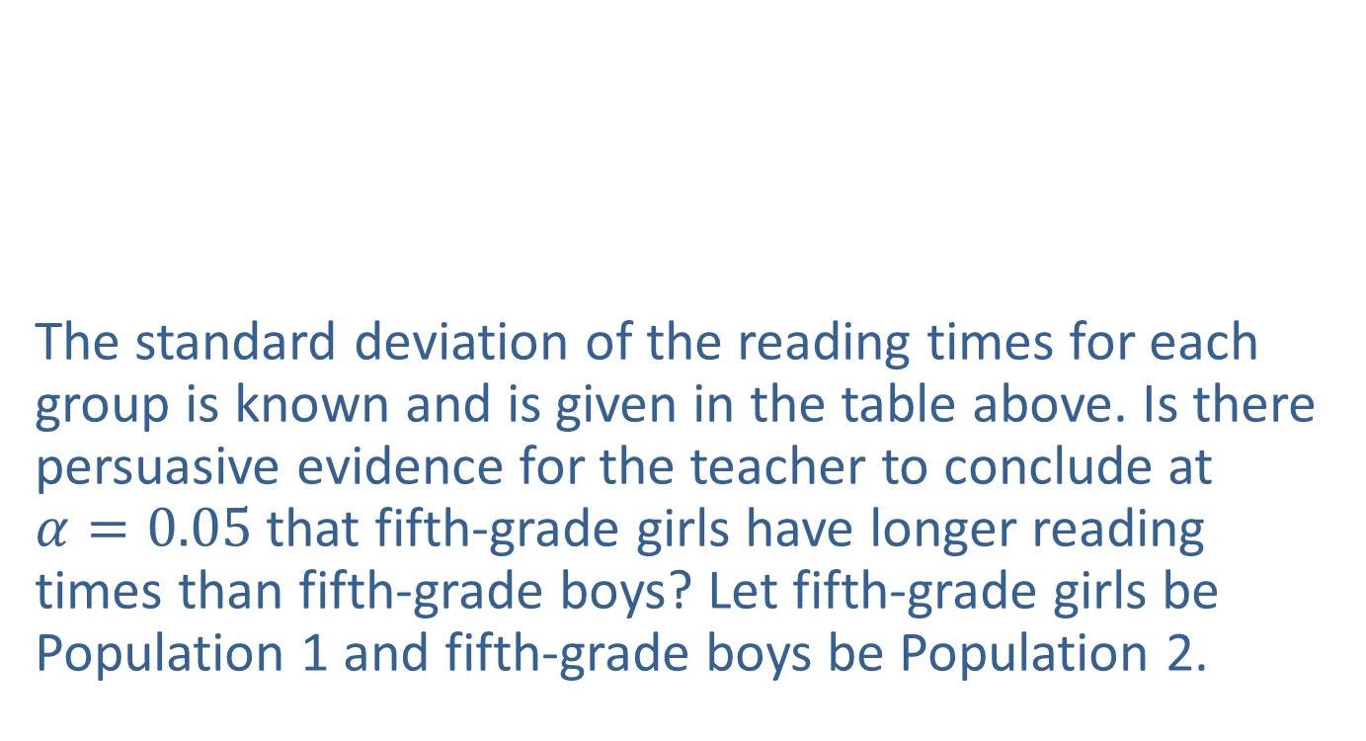
Example 12.1.2: Performing a Hypothesis Test for Reading Time (cont.)
The standard deviation of the reading times for each group is known and is given in the table above. Is there persuasive evidence for the teacher to conclude at $α=0.05$that fifth-grade girls have longer reading times than fifth-grade boys? Let fifth-grade girls be Population 1 and fifth-grade boys be Population 2.
Reading Times (in minutes)
 | $$n$$ | $$\overline{x}$$ | $$σ$$
Girls | 40 | 11 | 2
Boys | 40 | 10 | 3

Slide 43
Example 12.1.2: Performing a Hypothesis Test for Reading Time (cont.)
Solution
Step 1: Determine the population parameter to be used and develop the null and alternative hypotheses.
State the hypotheses in plain English.
Null Hypothesis: There is no difference in the average reading time of fifth-grade boys and girls.
Alternative Hypothesis: The average reading time of fifth-grade girls is longer than that of fifth-grade boys.

Slide 44
Example 12.1.2: Performing a Hypothesis Test for Reading Time (cont.)
Since the teacher is interested in comparing the average reading time of fifth grade boys and fifth grade girls, the appropriate statistical measures are:
μ₁ = the true average reading time of fifth-grade girls;
μ₂ = the true average reading time of fifth-grade boys.
The teacher’s interest is in whether the average reading time of fifth-grade girls is longer than that of fifth-grade boys. Thus, this test is one-sided and the null and alternative hypotheses are formulated as follows.

Slide 45

Example 12.1.2: Performing a Hypothesis Test for Reading Time (cont.)
There is no difference in average reading times.
Step 2: Specify the significance level $α$.
The level of the test is specified in the problem as $α=0.05$.
The average reading time of fifth-grade girls is longer.

Slide 46
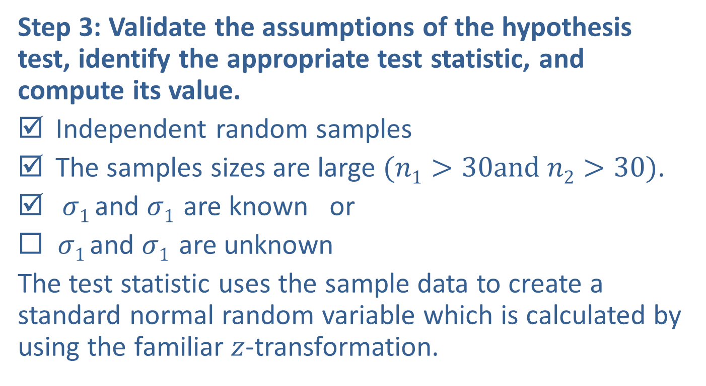
Example 12.1.2: Performing a Hypothesis Test for Reading Time (cont.)
Step 3: Validate the assumptions of the hypothesis test, identify the appropriate test statistic, and compute its value.
Independent random samples
The samples sizes are large $(n1>30and n2>30)$.
$σ1$ and $σ1$ are known or
◻ $σ1$ and $σ1$ are unknown
The test statistic uses the sample data to create a standard normal random variable which is calculated by using the familiar $z$-transformation.

Slide 47
Example 12.1.2: Performing a Hypothesis Test for Reading Time (cont.)
The test statistic is as follows.
Based on the data in the table, the computed value of the test statistic is given by

Slide 48
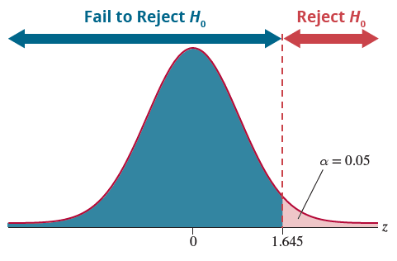

Example 12.1.2: Performing a Hypothesis Test for Reading Time (cont.)
Step 4: Determine the critical value(s) or $P$-value.

Slide 49
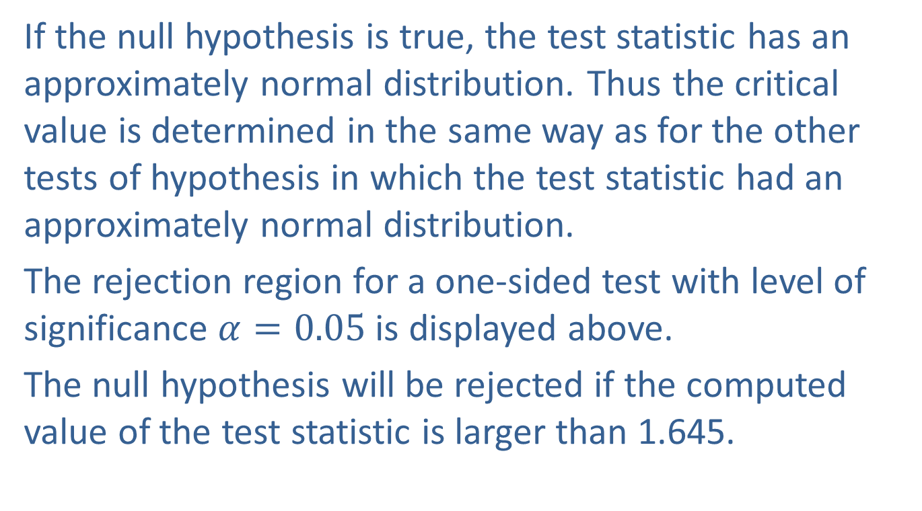
Example 12.1.2: Performing a Hypothesis Test for Reading Time (cont.)
If the null hypothesis is true, the test statistic has an approximately normal distribution. Thus the critical value is determined in the same way as for the other tests of hypothesis in which the test statistic had an approximately normal distribution.
The rejection region for a one-sided test with level of significance $α=0.05$is displayed above.
The null hypothesis will be rejected if the computed value of the test statistic is larger than 1.645.

Slide 50
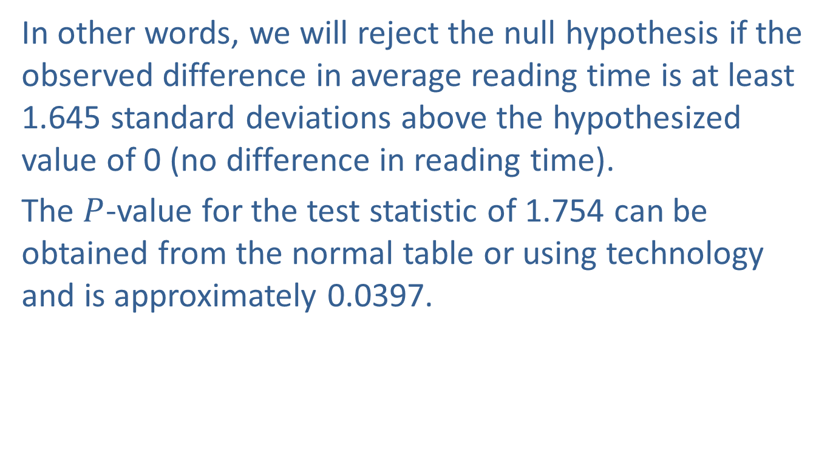
Example 12.1.2: Performing a Hypothesis Test for Reading Time (cont.)
In other words, we will reject the null hypothesis if the observed difference in average reading time is at least 1.645 standard deviations above the hypothesized value of 0 (no difference in reading time).
The $P$-value for the test statistic of 1.754 can be obtained from the normal table or using technology and is approximately 0.0397.

Slide 51
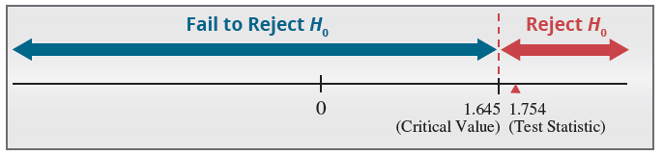
Example 12.1.2: Performing a Hypothesis Test for Reading Time (cont.)
Step 5: Choose between the null and alternative hypotheses.
As shown in the figure above, the calculated value of the test statistic falls in the rejection region because 1.754 is greater than 1.645.

Slide 52
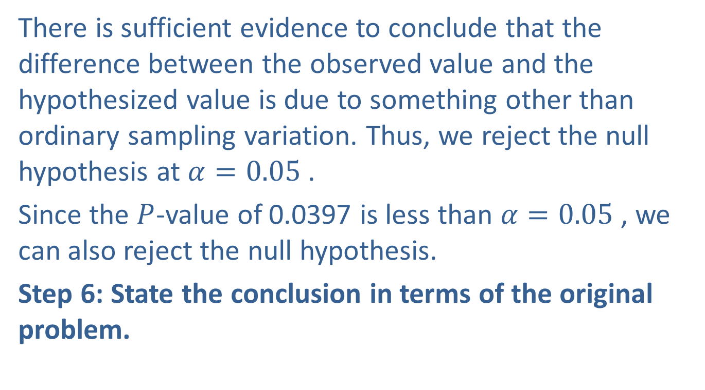
Example 12.1.2: Performing a Hypothesis Test for Reading Time (cont.)
There is sufficient evidence to conclude that the difference between the observed value and the hypothesized value is due to something other than ordinary sampling variation. Thus, we reject the null hypothesis at $α=0.05$.
Since the $P$-value of 0.0397 is less than $α=0.05$, we can also reject the null hypothesis.
Step 6: State the conclusion in terms of the original problem.

Slide 53
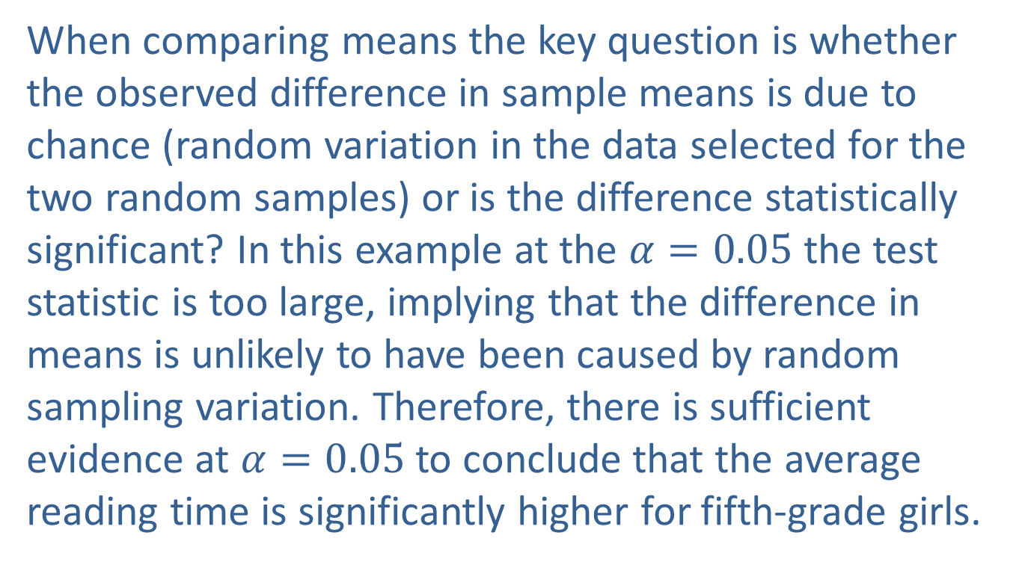
Example 12.1.2: Performing a Hypothesis Test for Reading Time (cont.)
When comparing means the key question is whether the observed difference in sample means is due to chance (random variation in the data selected for the two random samples) or is the difference statistically significant? In this example at the $α=0.05$the test statistic is too large, implying that the difference in means is unlikely to have been caused by random sampling variation. Therefore, there is sufficient evidence at $α=0.05$to conclude that the average reading time is significantly higher for fifth-grade girls.

