Slide 1
Section 11.6
Testing a Hypothesis about a Population Standard Deviation or Variance

Slide 2
Testing a Hypothesis about a Population Standard
Deviation or Variance
In this section we want to adapt the hypothesis testing procedure to test a hypothesis concerning a population variance. Table 11.6.1 contains the correct formulation of the hypotheses for a test of the variance.

Slide 3
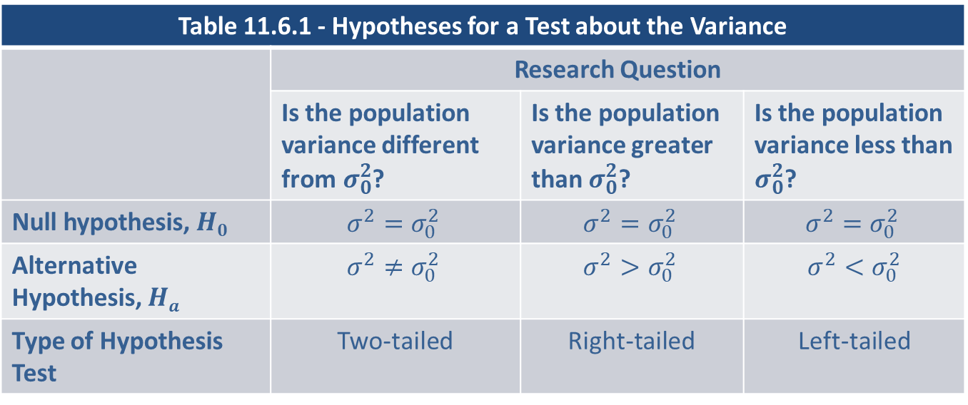
Testing a Hypothesis about a Population Standard
Deviation or Variance (cont.)
Let’s develop the hypothesis test for the variance with an example.
Table 11.6.1 - Hypotheses for a Test about the Variance
 | Research Question
 | Is the population variance different from$σ_{0}^{2}$? | Is the population variance greater than $σ_{0}^{2}$? | Is the population variance less than $σ_{0}^{2}$?
Null hypothesis, $H0$ | $$σ^{2}=σ_{0}^{2}$$ | $$σ^{2}=σ_{0}^{2}$$ | $$σ^{2}=σ_{0}^{2}$$
Alternative Hypothesis, $Ha$ | $$σ^{2}≠σ_{0}^{2}$$ | $$σ^{2}>σ_{0}^{2}$$ | $$σ^{2}<σ_{0}^{2}$$
Type of Hypothesis Test | Two-tailed | Right-tailed | Left-tailed

Slide 4
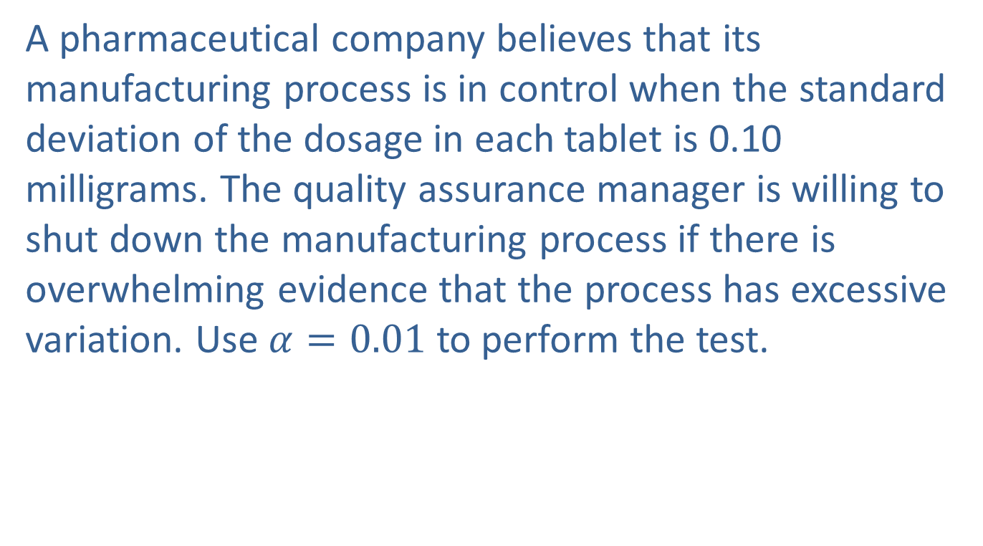
Example 11.6.1: Performing a Hypothesis Test for
Drug Dosage Variation
A pharmaceutical company believes that its manufacturing process is in control when the standard deviation of the dosage in each tablet is 0.10 milligrams. The quality assurance manager is willing to shut down the manufacturing process if there is overwhelming evidence that the process has excessive variation. Use $α=0.01$ to perform the test.

Slide 5
Example 11.6.1: Performing a Hypothesis Test for
Drug Dosage Variation (cont.)
Solution
Step 1: Determine the population parameter to be used and develop the null and alternative hypotheses.
Stating the hypotheses in plain English we have:
Null Hypothesis: The manufacturing process does not have excessive variation.
Alternative Hypothesis: The manufacturing process does have excessive variation.

Slide 6
Example 11.6.1: Performing a Hypothesis Test for
Drug Dosage Variation (cont.)
Since the issue in this example is variation, the hypothesis can be stated in terms of the standard deviation or the variance.
Most hypothesis tests concerning a variance will be one-sided since small variation is desirable, while too much variation is undesirable. Because we are interested in determining if there is evidence that the process has excessive variation, the test will be a right-tailed test.

Slide 7
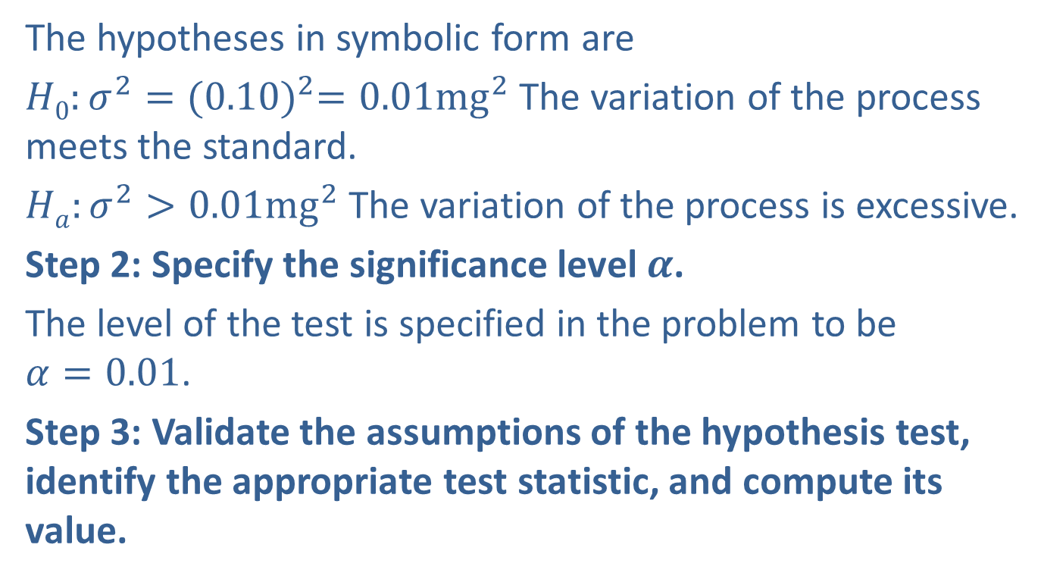
Example 11.6.1: Performing a Hypothesis Test for
Drug Dosage Variation (cont.)
The hypotheses in symbolic form are
$H0:σ^{2}={(0.10)}^{2}=0.01{mg}^{2}$ The variation of the process meets the standard.
$Ha:σ^{2}>0.01{mg}^{2}$The variation of the process is excessive.
Step 2: Specify the significance level $α$.
The level of the test is specified in the problem to be $α=0.01$.
Step 3: Validate the assumptions of the hypothesis test, identify the appropriate test statistic, and compute its value.

Slide 8
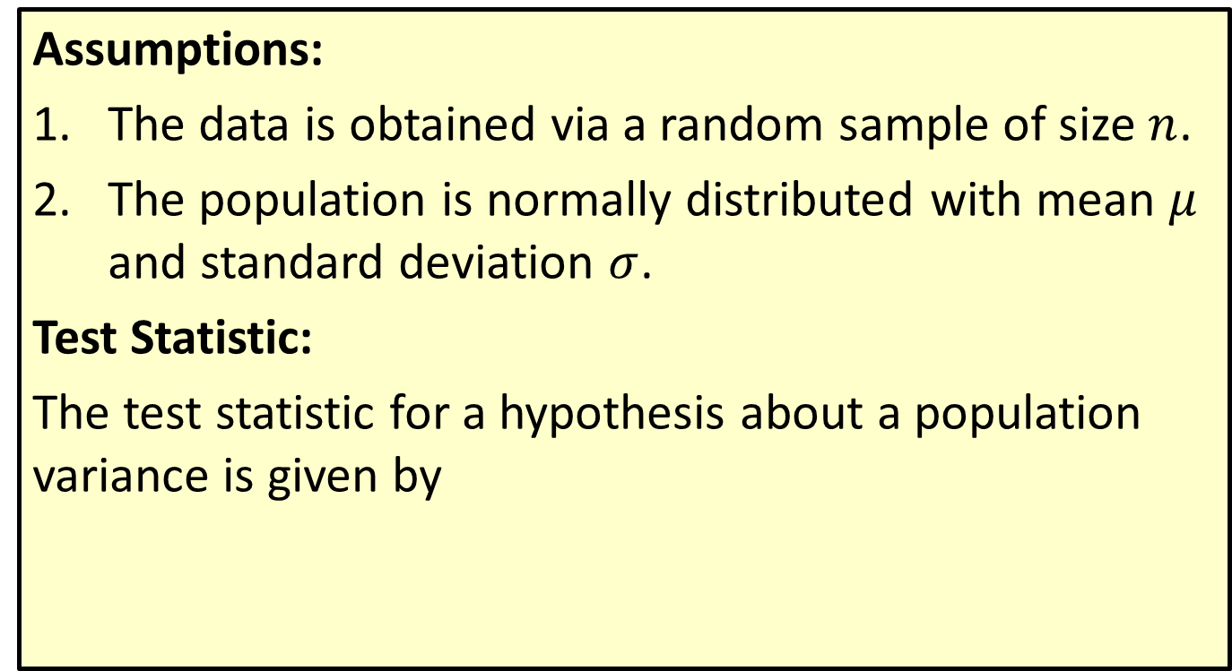
Procedure: Testing a Hypothesis about a Population Variance
Assumptions:
The data is obtained via a random sample of size $n$.
The population is normally distributed with mean $μ$ and standard deviation $σ$.
Test Statistic:
The test statistic for a hypothesis about a population variance is given by

Slide 9
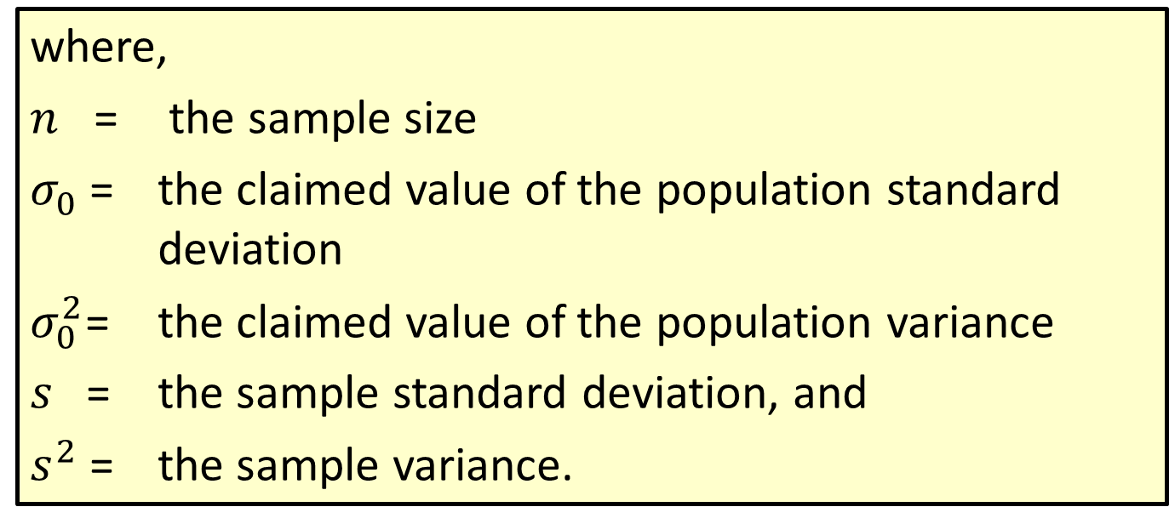
Procedure: Testing a Hypothesis about a Population Variance (cont.)
where,
$n$ = the sample size
$σ_{0}$= the claimed value of the population standard deviation
$σ_{0}^{2}$= the claimed value of the population variance
$s$= the sample standard deviation, and
$s^{2}$ = the sample variance.

Slide 10
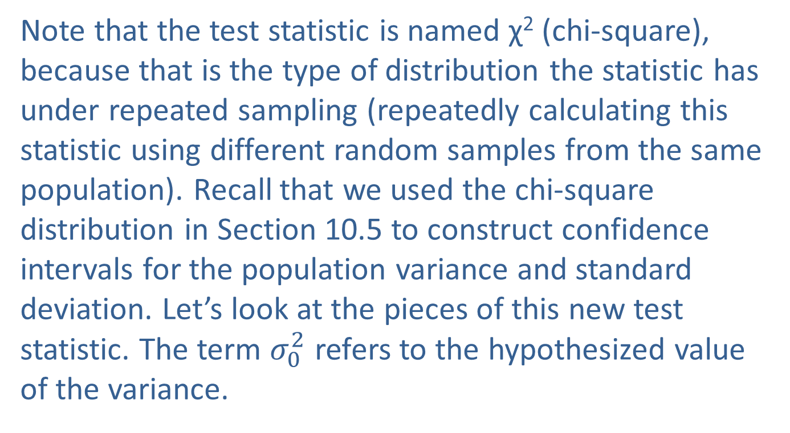
Example 11.6.1: Performing a Hypothesis Test for
Drug Dosage Variation (cont.)
Note that the test statistic is named χ² (chi-square), because that is the type of distribution the statistic has under repeated sampling (repeatedly calculating this statistic using different random samples from the same population). Recall that we used the chi-square distribution in Section 10.5 to construct confidence intervals for the population variance and standard deviation. Let’s look at the pieces of this new test statistic. The term $σ_{0}^{2}$ refers to the hypothesized value of the variance.

Slide 11
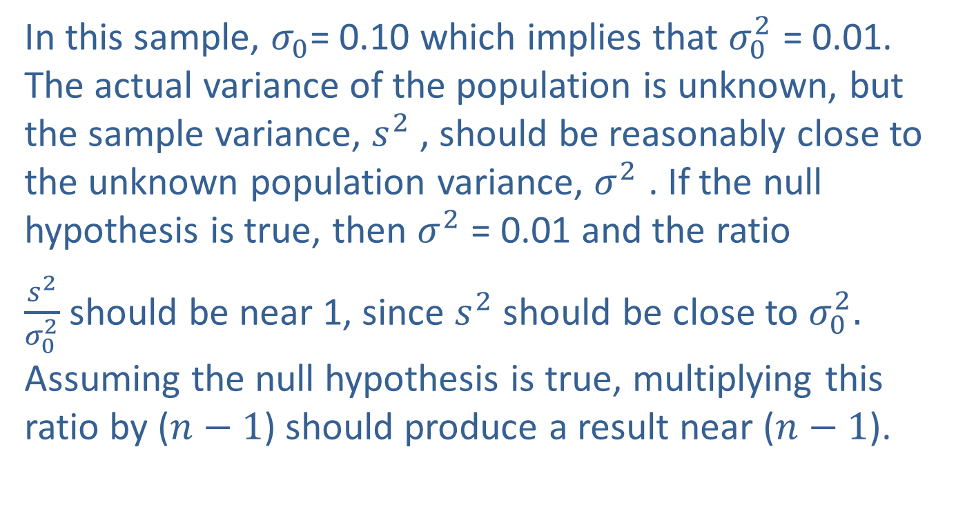
Example 11.6.1: Performing a Hypothesis Test for
Drug Dosage Variation (cont.)
In this sample, $σ_{0}$= 0.10 which implies that $σ_{0}^{2}$ = 0.01. The actual variance of the population is unknown, but the sample variance, $s^{2}$ , should be reasonably close to the unknown population variance, $σ^{2}$ . If the null hypothesis is true, then $σ^{2}$ = 0.01 and the ratio
$\frac{s^{2}}{σ_{0}^{2}}$ should be near 1, since $s^{2}$ should be close to $σ_{0}^{2}.$ Assuming the null hypothesis is true, multiplying this ratio by ($n−1$) should produce a result near ($n−1$).

Slide 12
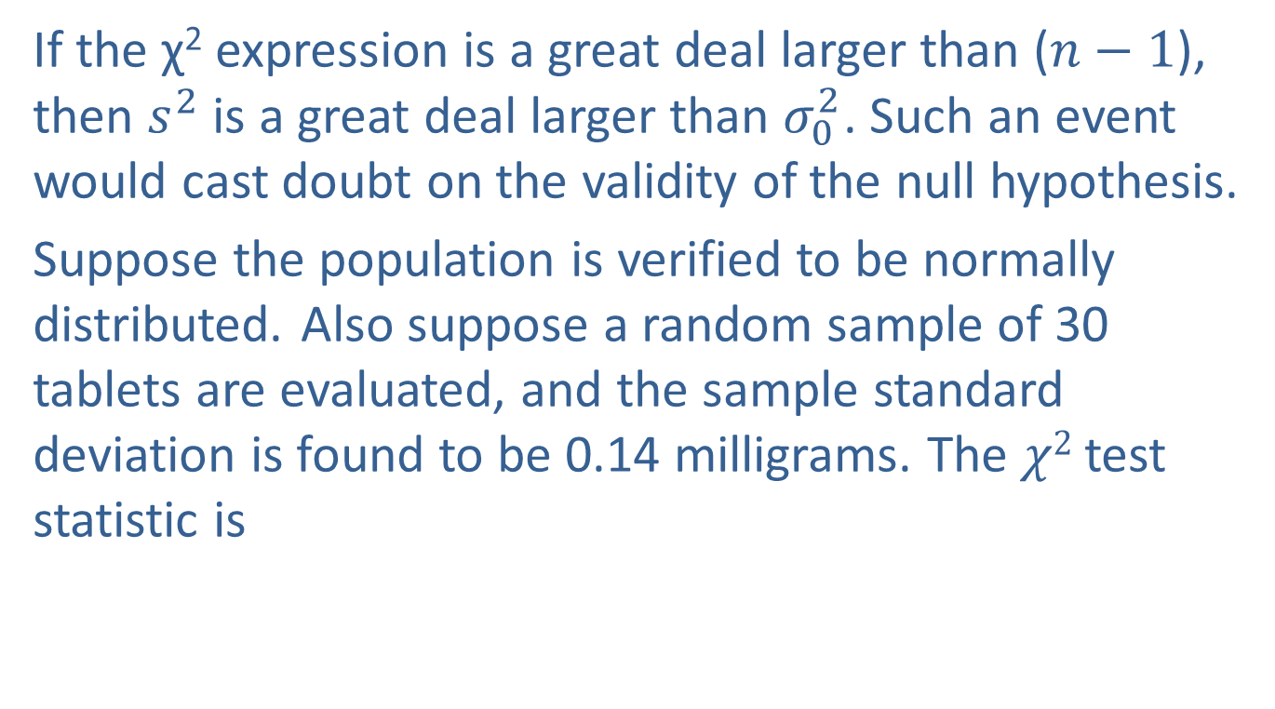
Example 11.6.1: Performing a Hypothesis Test for
Drug Dosage Variation (cont.)
If the χ² expression is a great deal larger than ($n−1$), then $s^{2}$ is a great deal larger than $σ_{0}^{2}$. Such an event would cast doubt on the validity of the null hypothesis.
Suppose the population is verified to be normally distributed. Also suppose a random sample of 30 tablets are evaluated, and the sample standard deviation is found to be 0.14 milligrams. The $χ2$ test statistic is

Slide 13
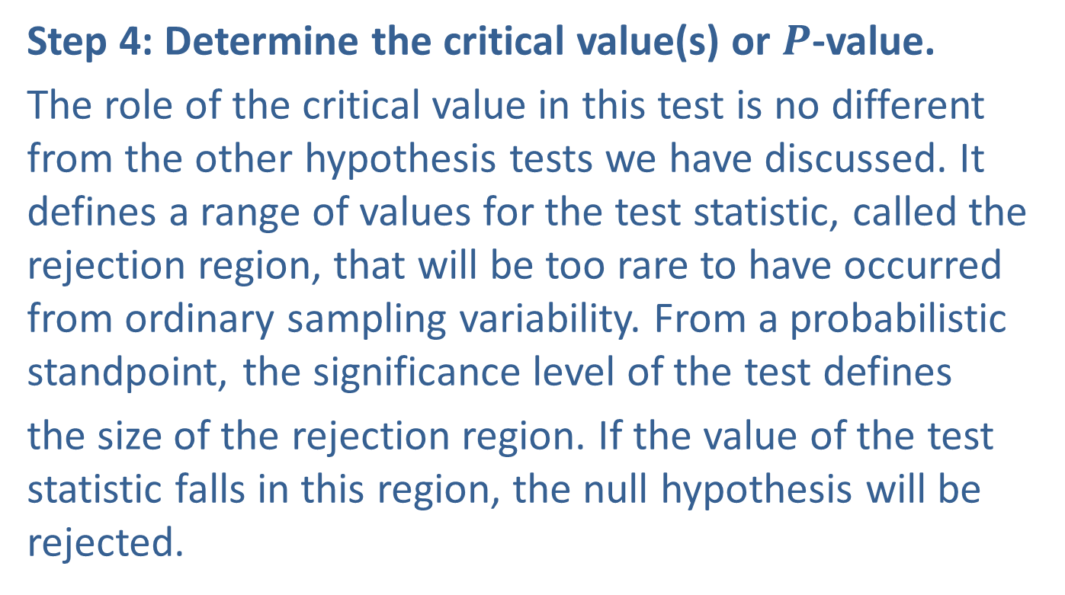
Example 11.6.1: Performing a Hypothesis Test for
Drug Dosage Variation (cont.)
Step 4: Determine the critical value(s) or $P$-value.
The role of the critical value in this test is no different from the other hypothesis tests we have discussed. It defines a range of values for the test statistic, called the rejection region, that will be too rare to have occurred from ordinary sampling variability. From a probabilistic standpoint, the significance level of the test defines
the size of the rejection region. If the value of the test statistic falls in this region, the null hypothesis will be rejected.

Slide 14
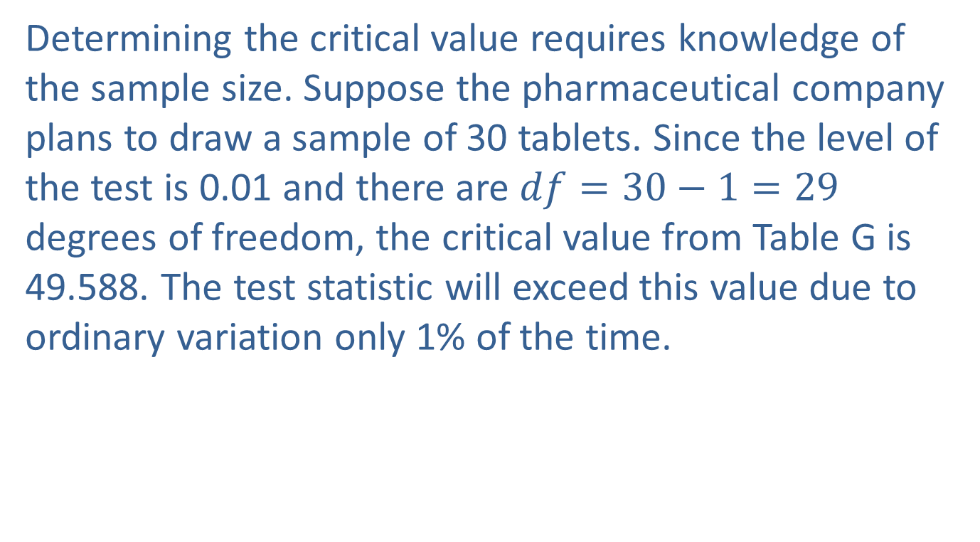
Example 11.6.1: Performing a Hypothesis Test for
Drug Dosage Variation (cont.)
Determining the critical value requires knowledge of the sample size. Suppose the pharmaceutical company plans to draw a sample of 30 tablets. Since the level of the test is 0.01 and there are $df=30−1=29$ degrees of freedom, the critical value from Table G is 49.588. The test statistic will exceed this value due to ordinary variation only 1% of the time.

Slide 15
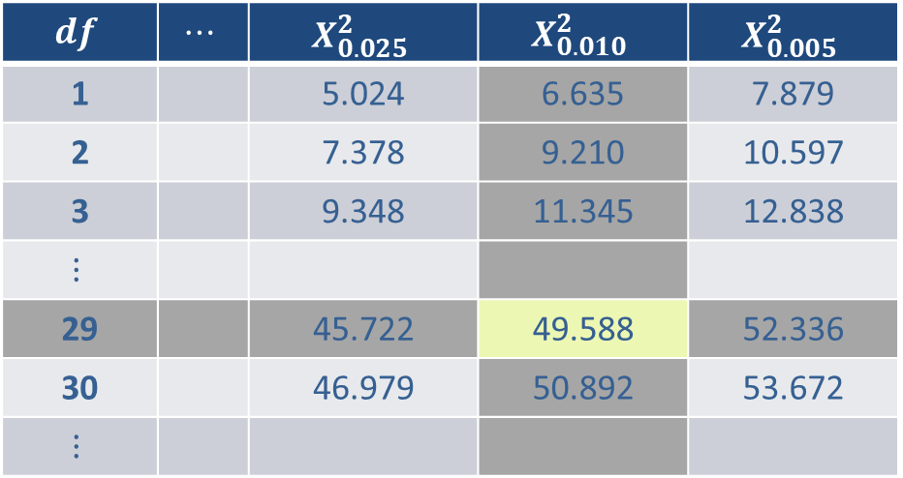
Example 11.6.1: Performing a Hypothesis Test for
Drug Dosage Variation (cont.)
$$df$$ | $$⋯$$ | $$X_{0.025}^{2}$$ | $$X_{0.010}^{2}$$ | $$X_{0.005}^{2}$$
1 |  | 5.024 | 6.635 | 7.879
2 |  | 7.378 | 9.210 | 10.597
3 |  | 9.348 | 11.345 | 12.838
$$⋮$$
29 |  | 45.722 | 49.588 | 52.336
30 |  | 46.979 | 50.892 | 53.672
$$⋮$$

Slide 16
Note
For large degrees of freedom, the chi-square distribution looks very similar to a normal. Notice, however, that the right tail is a bit thicker than the left.

Slide 17
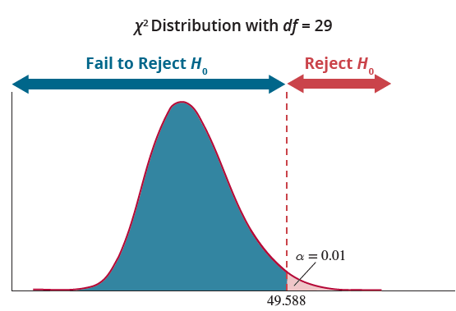
Example 11.6.1: Performing a Hypothesis Test for
Drug Dosage Variation (cont.)

Slide 18
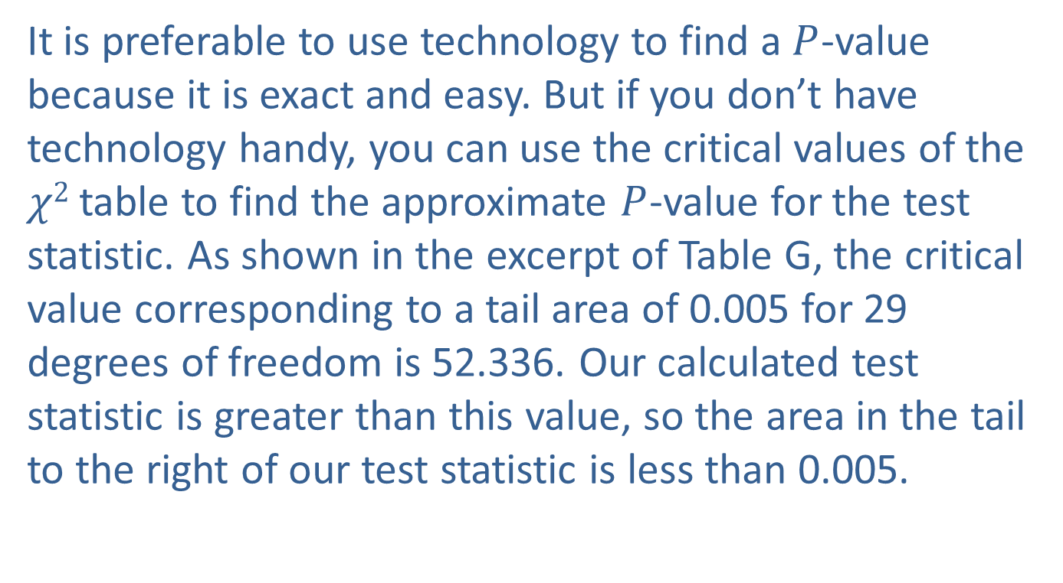
Example 11.6.1: Performing a Hypothesis Test for
Drug Dosage Variation (cont.)
It is preferable to use technology to find a $P$-value because it is exact and easy. But if you don’t have technology handy, you can use the critical values of the $χ2$ table to find the approximate $P$-value for the test statistic. As shown in the excerpt of Table G, the critical value corresponding to a tail area of 0.005 for 29 degrees of freedom is 52.336. Our calculated test statistic is greater than this value, so the area in the tail to the right of our test statistic is less than 0.005.

Slide 19
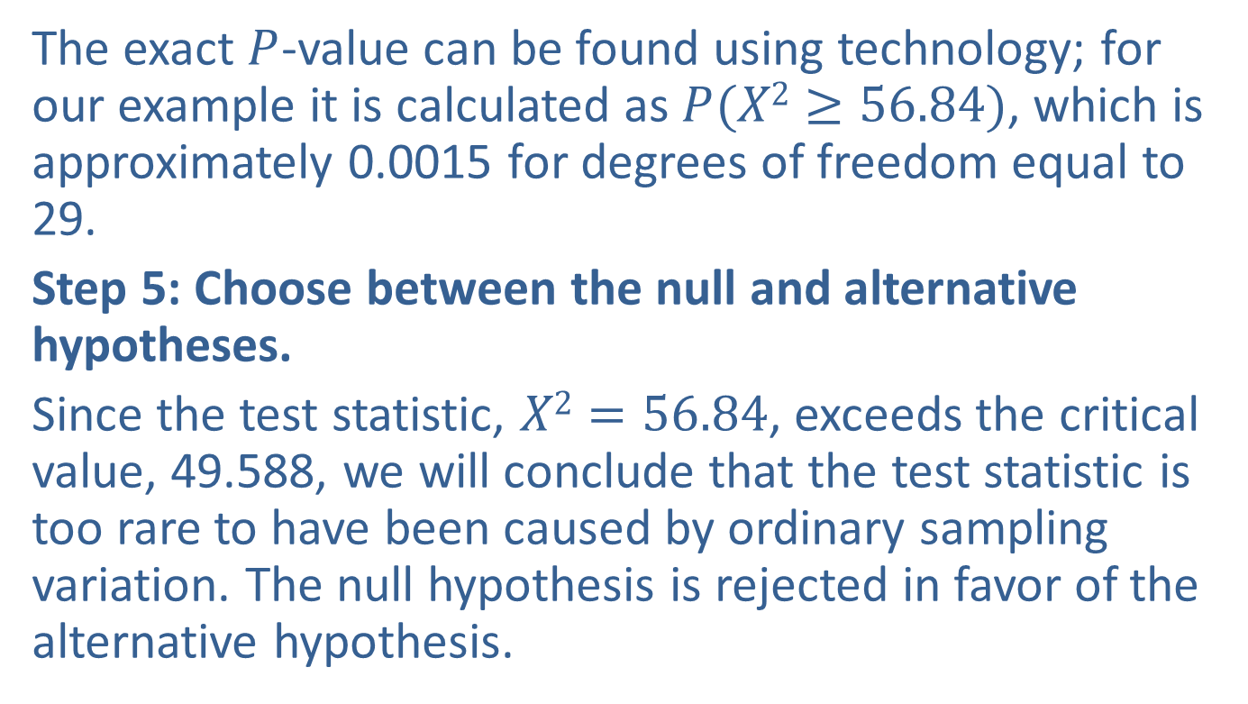
Example 11.6.1: Performing a Hypothesis Test for
Drug Dosage Variation (cont.)
The exact $P$-value can be found using technology; for our example it is calculated as $P(X2≥56.84)$, which is approximately 0.0015 for degrees of freedom equal to 29.
Step 5: Choose between the null and alternative hypotheses.
Since the test statistic, $X2=56.84$, exceeds the critical value, 49.588, we will conclude that the test statistic is too rare to have been caused by ordinary sampling variation. The null hypothesis is rejected in favor of the alternative hypothesis.

Slide 20
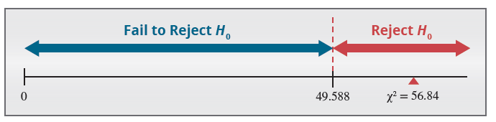

Example 11.6.1: Performing a Hypothesis Test for
Drug Dosage Variation (cont.)
Since the $P$-value of 0.0015 is less than $α=0.01$, we reach the same conclusion; reject the null hypothesis.

Slide 21
Example 11.6.1: Performing a Hypothesis Test for
Drug Dosage Variation (cont.)
Step 6: State the conclusion in terms of the original question.
There is overwhelming evidence that the process variation exceeds the desired level. Therefore, the manager is willing to shut down the manufacturing process at a significance level of 0.01.

