Slide 1
Section 11.5
Testing a Hypothesis about a Population Proportion

Slide 2
Note
Recall from Section 7.4 some examples of binomial random variables were:
The number of lefthanded persons in a sample of 200 unrelated people.
The number of heads in ten tosses of a coin.
The number of winning scratch-off lottery tickets when you purchase 15 of the same type.

Slide 3
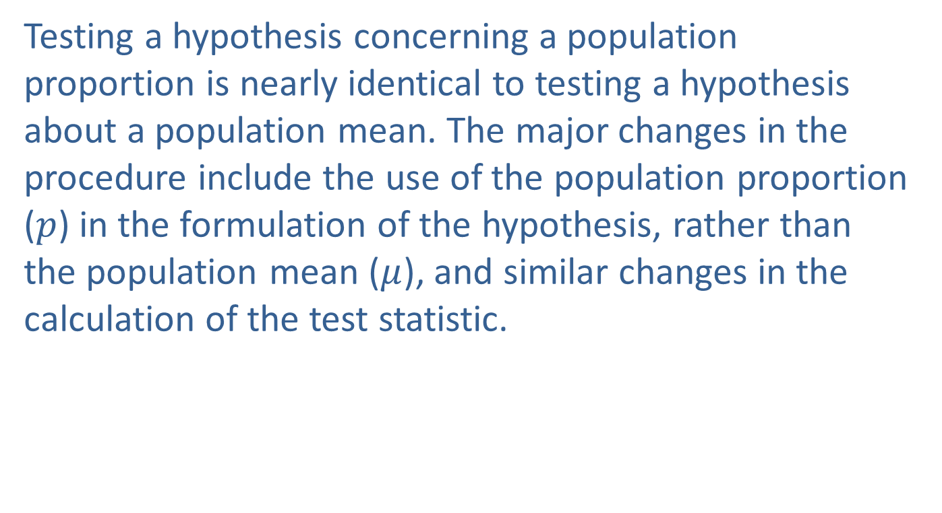
Developing the Test
Testing a hypothesis concerning a population proportion is nearly identical to testing a hypothesis about a population mean. The major changes in the procedure include the use of the population proportion ($p$) in the formulation of the hypothesis, rather than the population mean ($μ$), and similar changes in the calculation of the test statistic.

Slide 4
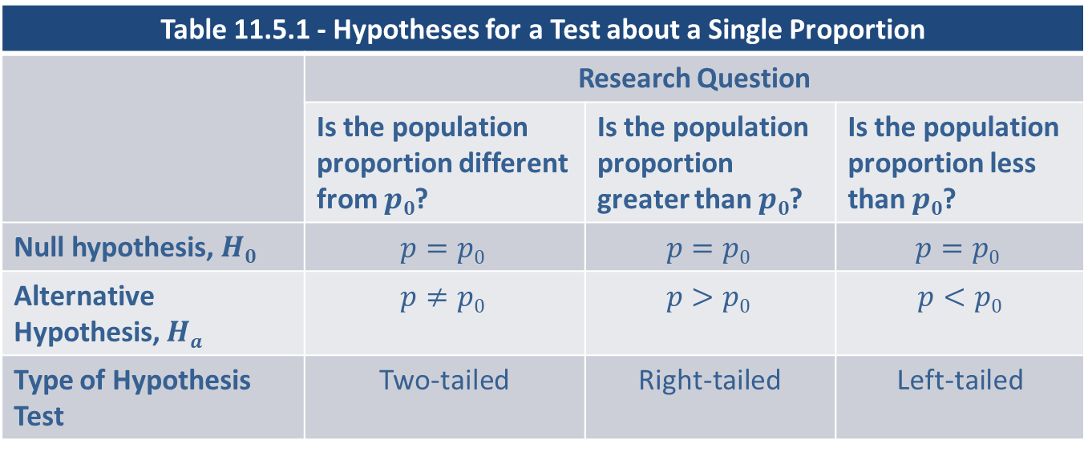
Developing the Test (cont.)
Table 11.5.1 contains the correct formulation of the hypotheses for a test about a single proportion.
Table 11.5.1 - Hypotheses for a Test about a Single Proportion
 | Research Question
 | Is the population proportion different from $p0$? | Is the population proportion greater than $p0$? | Is the population proportion less than $p0$?
Null hypothesis, $H0$ | $$p=p0$$ | $$p=p0$$ | $$p=p0$$
Alternative Hypothesis, $Ha$ | $$p≠p0$$ | $$p>p0$$ | $$p<p0$$
Type of Hypothesis Test | Two-tailed | Right-tailed | Left-tailed

Slide 5
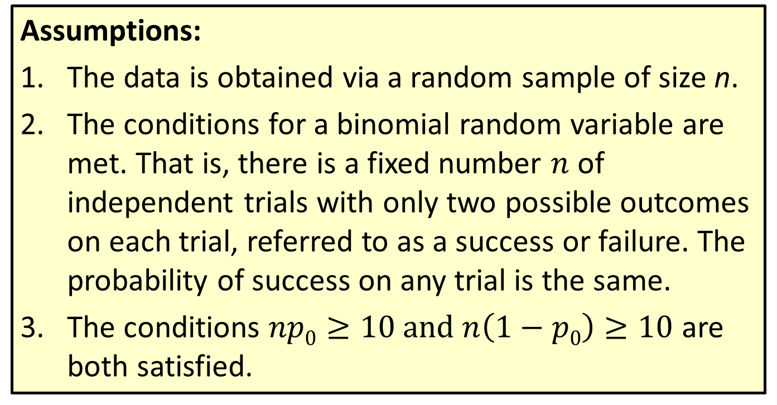

Procedure: Testing a Hypothesis about a Population Proportion, $p$
Assumptions:
The data is obtained via a random sample of size n.
The conditions for a binomial random variable are met. That is, there is a fixed number $n$ of independent trials with only two possible outcomes on each trial, referred to as a success or failure. The probability of success on any trial is the same.
The conditions $np0≥10 and n\left(1−p0\right)≥10$ are both satisfied.

Slide 6
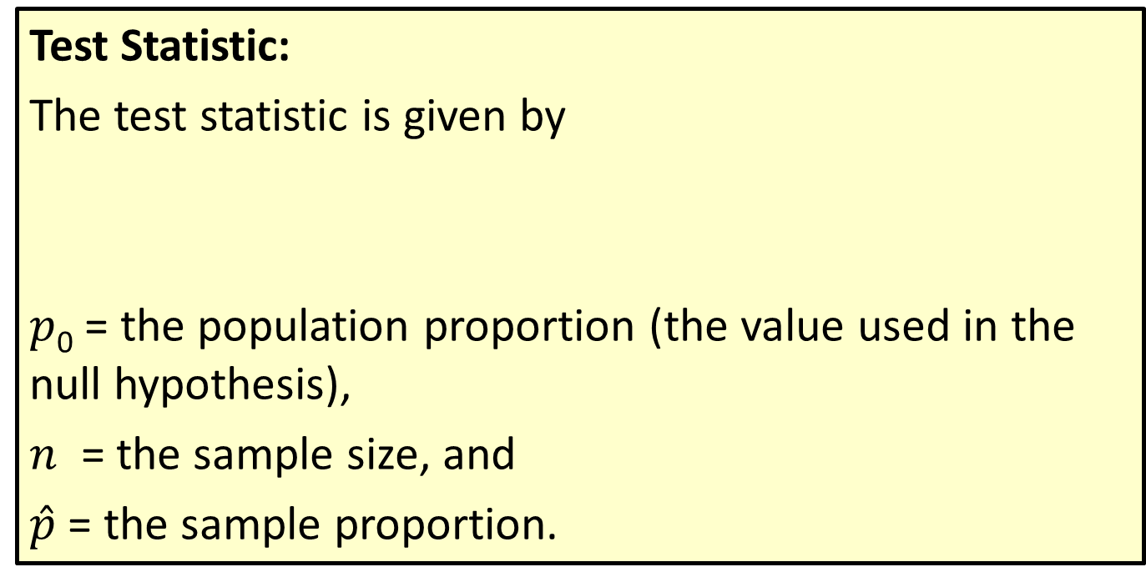

Procedure: Testing a Hypothesis about a Population Proportion, $p$ (cont.)
Test Statistic:
The test statistic is given by
$p$₀ = the population proportion (the value used in the null hypothesis),
$n$ = the sample size, and
$\hat{p}$ = the sample proportion.

Slide 7
Example 11.5.1: Performing a Hypothesis Test for a New Student Registration System
A college is trying a new student registration system and would like to know if there is sufficient evidence to conclude that more than 60% of the students favor the new system.
Solution
Step 1: Determine the population parameter to be used and develop the null and alternative hypotheses.
Let’s first state the hypotheses in plain English.
Null Hypothesis: 60% of students favor the new system.

Slide 8
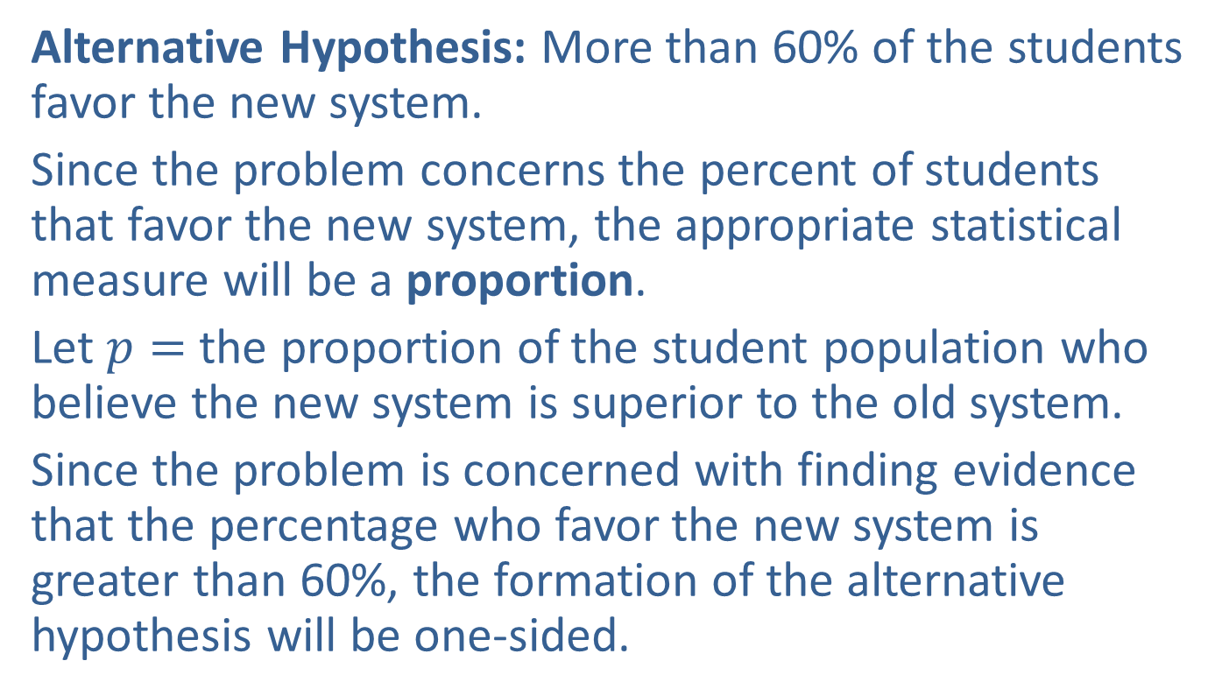
Example 11.5.1: Performing a Hypothesis Test for a New Student Registration System (cont.)
Alternative Hypothesis: More than 60% of the students favor the new system.
Since the problem concerns the percent of students that favor the new system, the appropriate statistical measure will be a proportion.
Let $p=$ the proportion of the student population who believe the new system is superior to the old system.
Since the problem is concerned with finding evidence that the percentage who favor the new system is greater than 60%, the formation of the alternative hypothesis will be one-sided.

Slide 9
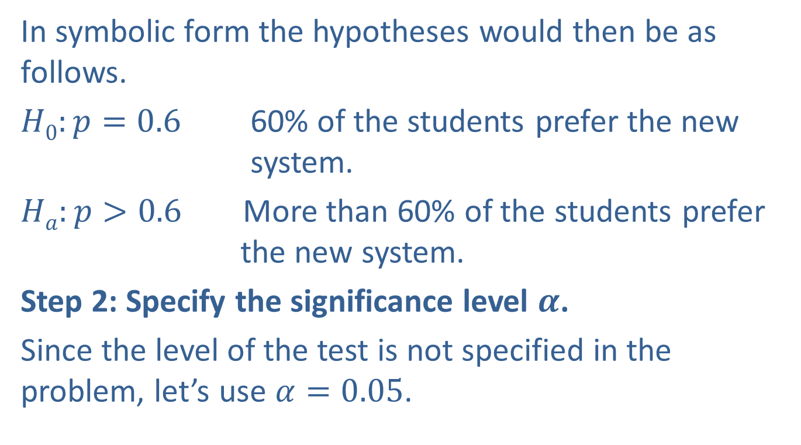
Example 11.5.1: Performing a Hypothesis Test for a New Student Registration System (cont.)
In symbolic form the hypotheses would then be as follows.
$H0:p=0.6$ 60% of the students prefer the new system.
$Ha:p>0.6$ More than 60% of the students prefer the new system.
Step 2: Specify the significance level $α$.
Since the level of the test is not specified in the problem, let’s use $α=0.05$.

Slide 10
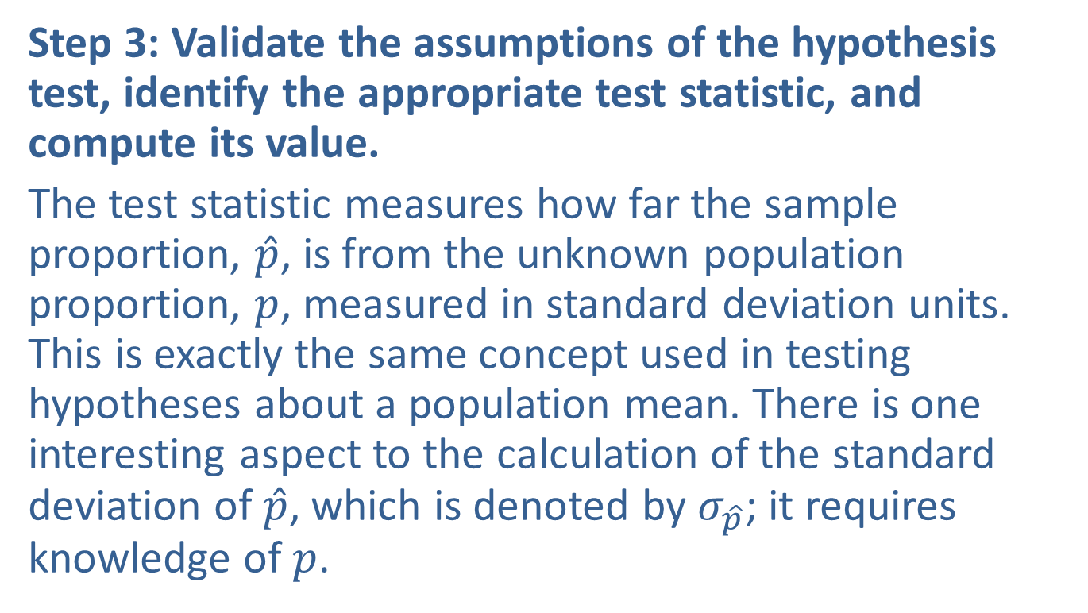
Example 11.5.1: Performing a Hypothesis Test for a New Student Registration System (cont.)
Step 3: Validate the assumptions of the hypothesis test, identify the appropriate test statistic, and compute its value.
The test statistic measures how far the sample proportion, $\hat{p}$, is from the unknown population proportion, $p$, measured in standard deviation units. This is exactly the same concept used in testing hypotheses about a population mean. There is one interesting aspect to the calculation of the standard deviation of $\hat{p}$, which is denoted by $σ_{\hat{p}}$; it requires knowledge of $p$.

Slide 11
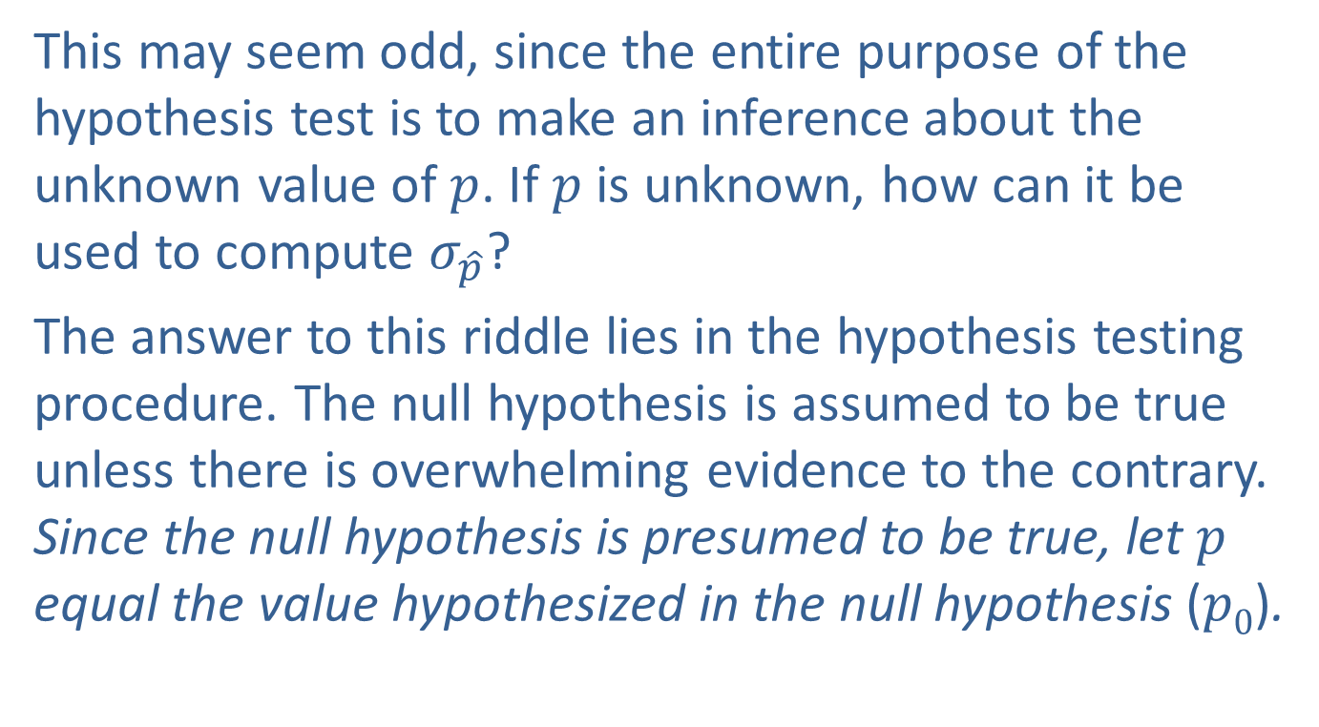
Example 11.5.1: Performing a Hypothesis Test for a New Student Registration System (cont.)
This may seem odd, since the entire purpose of the hypothesis test is to make an inference about the unknown value of $p$. If $p$ is unknown, how can it be used to compute $σ_{\hat{p}}$?
The answer to this riddle lies in the hypothesis testing procedure. The null hypothesis is assumed to be true unless there is overwhelming evidence to the contrary. Since the null hypothesis is presumed to be true, let $p$ equal the value hypothesized in the null hypothesis ($p0$).

Slide 12
Example 11.5.1: Performing a Hypothesis Test for a New Student Registration System (cont.)
In a random sample of 520 students, 352 said that the new registration system is superior.
First, we must check our assumptions.
Random sample
There are only two outcomes for each of the 520 independent trials—a student prefers the new system or does not—so we have a binomial random variable.

Slide 13

Example 11.5.1: Performing a Hypothesis Test for a New Student Registration System (cont.)
We can proceed with the test. The value of $\hat{p}$, is given by
In this case, the difference between $p0$ and $\hat{p}$ is 3.58 standard deviation units.

Slide 14
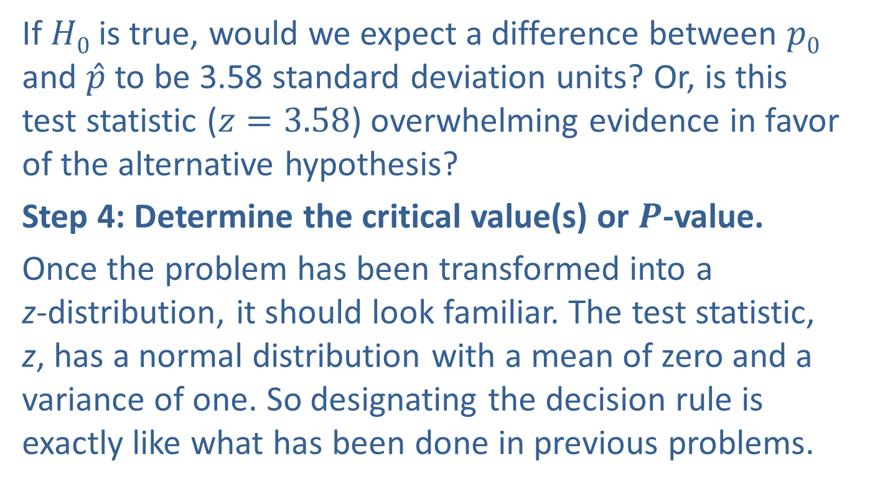
Example 11.5.1: Performing a Hypothesis Test for a New Student Registration System (cont.)
If $H0$ is true, would we expect a difference between $p0$ and $\hat{p}$ to be 3.58 standard deviation units? Or, is this test statistic ($z=3.58$) overwhelming evidence in favor of the alternative hypothesis?
Step 4: Determine the critical value(s) or $P$-value.
Once the problem has been transformed into a z-distribution, it should look familiar. The test statistic, z, has a normal distribution with a mean of zero and a variance of one. So designating the decision rule is exactly like what has been done in previous problems.

Slide 15
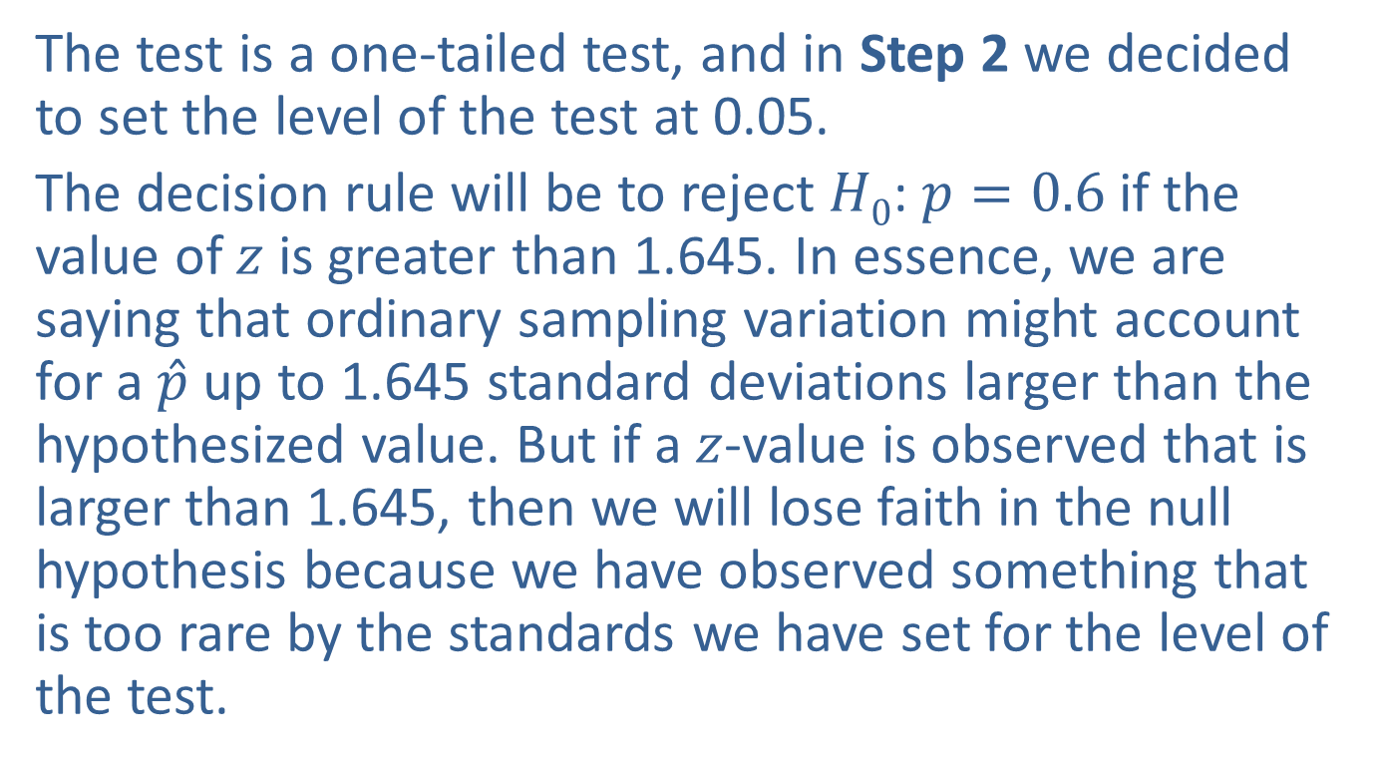
Example 11.5.1: Performing a Hypothesis Test for a New Student Registration System (cont.)
The test is a one-tailed test, and in Step 2 we decided to set the level of the test at 0.05.
The decision rule will be to reject $H0$: $p=0.6$if the value of $z$ is greater than 1.645. In essence, we are saying that ordinary sampling variation might account for a $\hat{p}$ up to 1.645 standard deviations larger than the hypothesized value. But if a $z$-value is observed that is larger than 1.645, then we will lose faith in the null hypothesis because we have observed something that is too rare by the standards we have set for the level of the test.

Slide 16
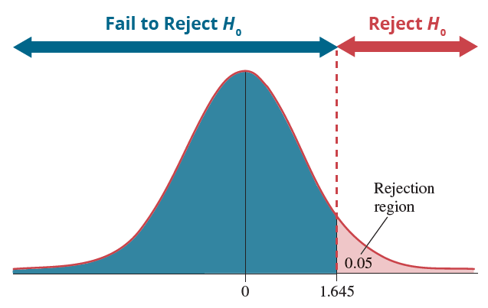

Example 11.5.1: Performing a Hypothesis Test for a New Student Registration System (cont.)
We can use exactly the same idea in determining a $P$-value for a test about a proportion as we did in calculating $P$-values for the test statistic of a hypothesis concerning a population mean.

Slide 17
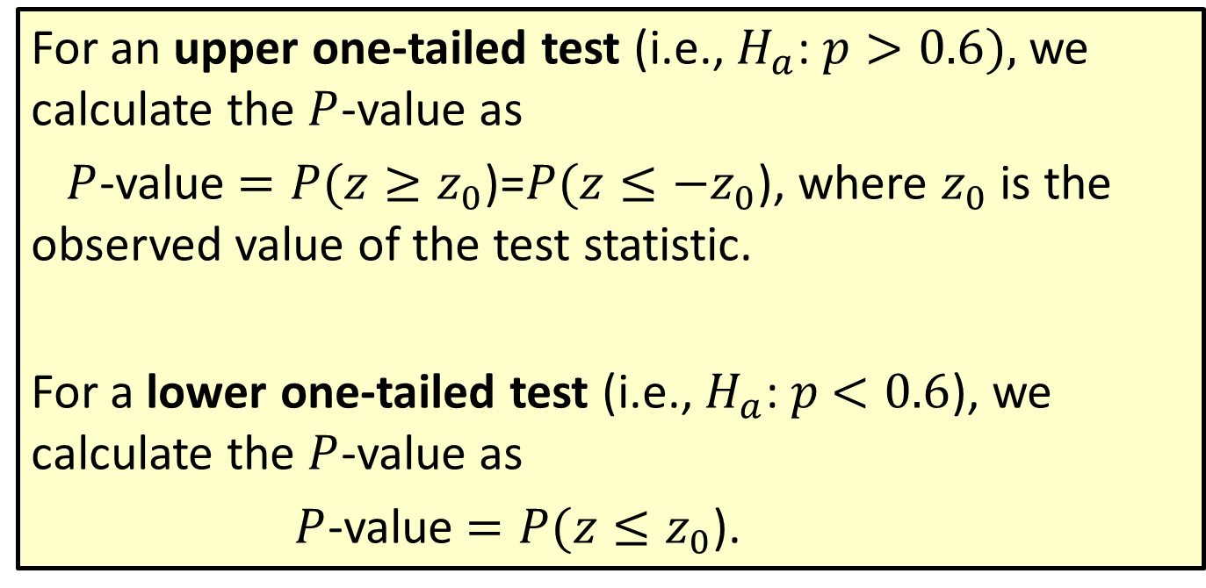

Procedure: Calculating $P$-Values for a Hypothesis Test for a Proportion
For an upper one-tailed test (i.e., $H_{a}$:$p>0.6),$we calculate the $P$-value as
$P$-value $=P(z≥z_{0}$)=$P(z≤−z_{0}$), where $z_{0}$ is the observed value of the test statistic.
For a lower one-tailed test (i.e., $H_{a}$:$p$ $<0.6$), we calculate the $P$-value as
$P$-value $=P(z≤z_{0}$).

Slide 18
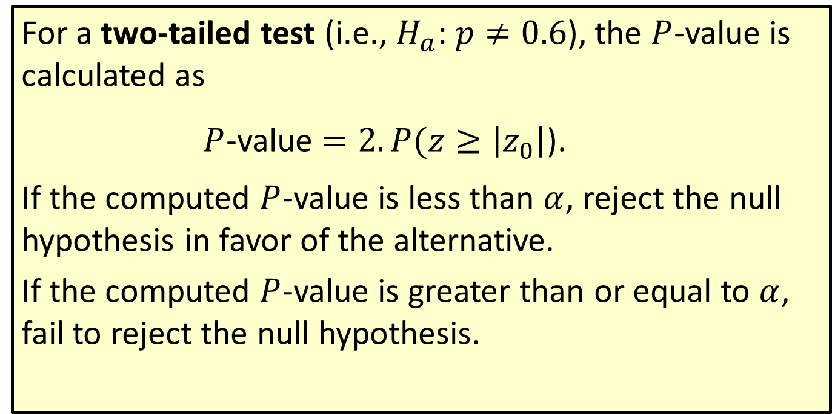

Procedure: Calculating $P$-Values for a Hypothesis Test for a Proportion (cont.)
For a two-tailed test (i.e., $H_{a}\text{:} p≠0.6$), the $P$-value is calculated as
$P$-value $=2.P(z≥\left|z_{0}\right|$).
If the computed $P$-value is less than $α$, reject the null hypothesis in favor of the alternative.
If the computed $P$-value is greater than or equal to $α$, fail to reject the null hypothesis.

Slide 19
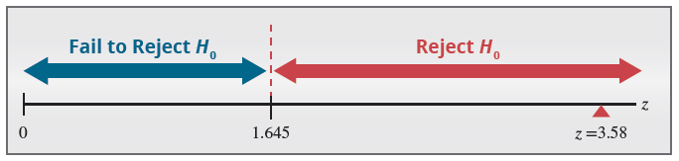
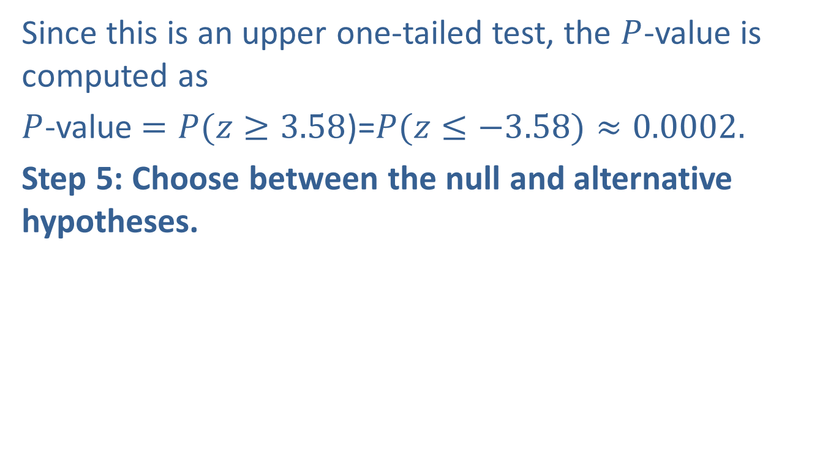
Example 11.5.1: Performing a Hypothesis Test for a New Student Registration System (cont.)
Since this is an upper one-tailed test, the $P$-value is computed as
$P$-value $=P(z≥3.58$)=$P(z≤−3.58)≈0.0002.$
Step 5: Choose between the null and alternative hypotheses.

Slide 20
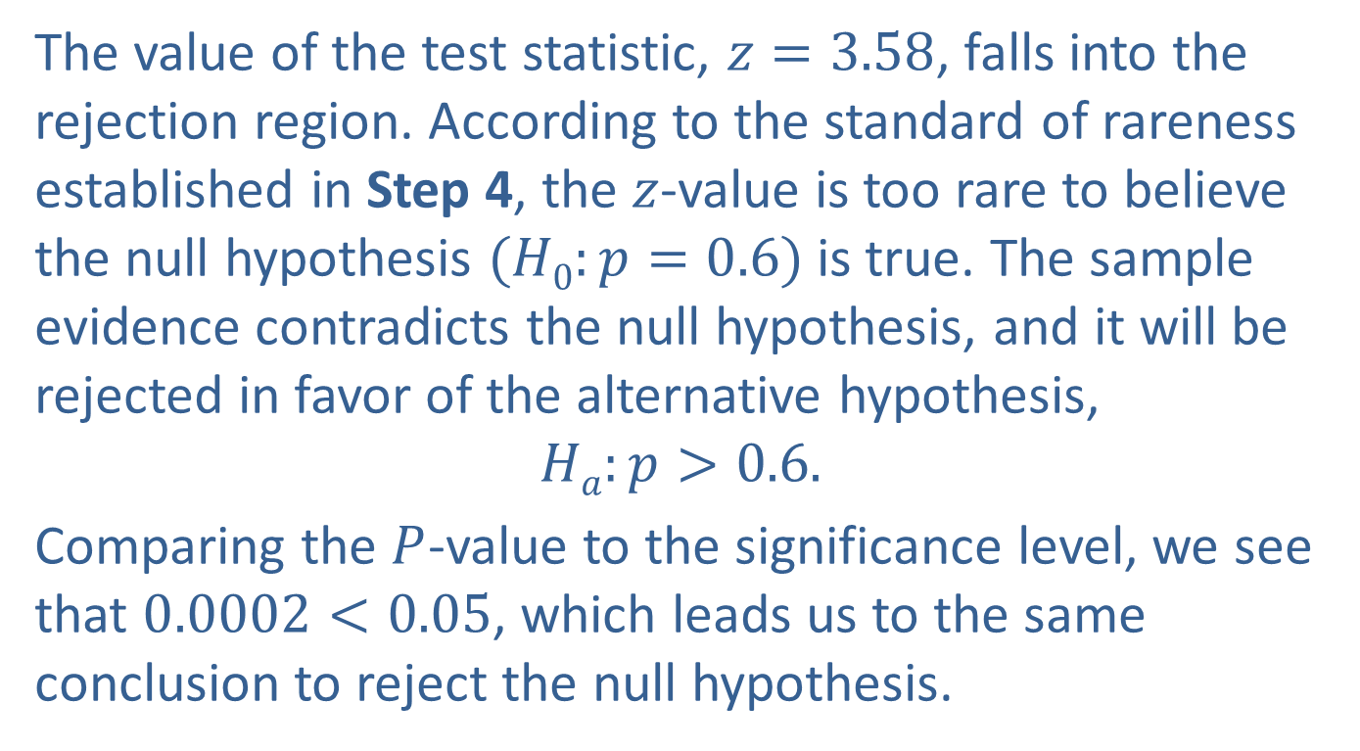
Example 11.5.1: Performing a Hypothesis Test for a New Student Registration System (cont.)
The value of the test statistic, $z=3.58$, falls into the rejection region. According to the standard of rareness established in Step 4, the $z$-value is too rare to believe the null hypothesis $(H0:p=0.6)$is true. The sample evidence contradicts the null hypothesis, and it will be rejected in favor of the alternative hypothesis,
$$Ha:p>0.6.$$
Comparing the $P$-value to the significance level, we see that $0.0002<0.05$, which leads us to the same conclusion to reject the null hypothesis.

Slide 21
Example 11.5.1: Performing a Hypothesis Test for a New Student Registration System (cont.)
Step 6: State the conclusion in terms of the original question.
There is overwhelming evidence that over 60% of the students prefer the new system at a significance level of 0.05.

Slide 22
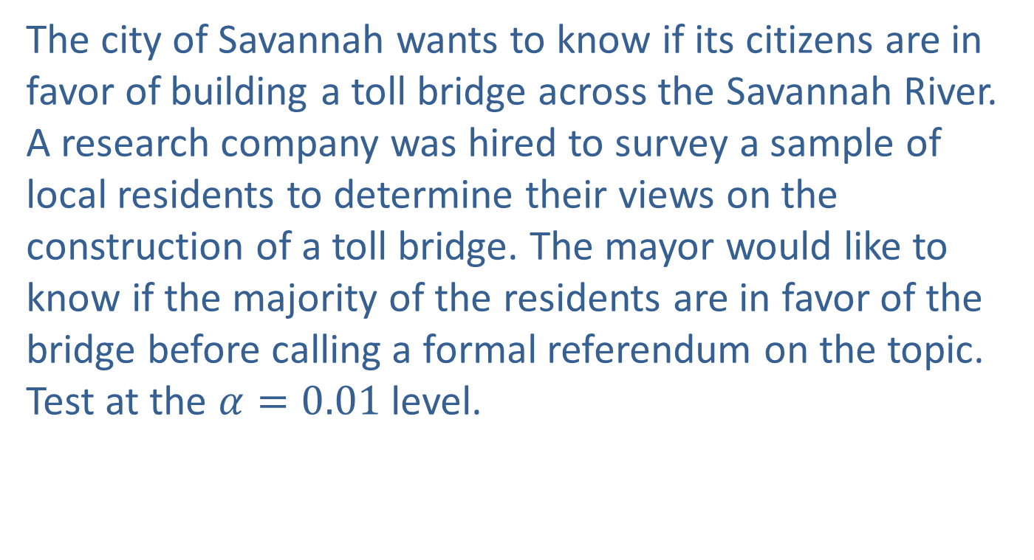
Example 11.5.2: Performing A Hypothesis Test for Residents Favoring Construction of a Toll Bridge
The city of Savannah wants to know if its citizens are in favor of building a toll bridge across the Savannah River. A research company was hired to survey a sample of local residents to determine their views on the construction of a toll bridge. The mayor would like to know if the majority of the residents are in favor of the bridge before calling a formal referendum on the topic. Test at the $α=0.01$level.

Slide 23
Example 11.5.2: Performing A Hypothesis Test for Residents Favoring Construction of a Toll Bridge (cont.)
Solution
Step 1: Determine the population parameter to be used and develop the null and alternative hypotheses.
In plain English the hypotheses are
Null Hypothesis: Half of the residents favor the new toll bridge.
Alternative Hypothesis: The majority of the residents favor the new toll bridge.
A majority would be any percentage greater than 50%.

Slide 24
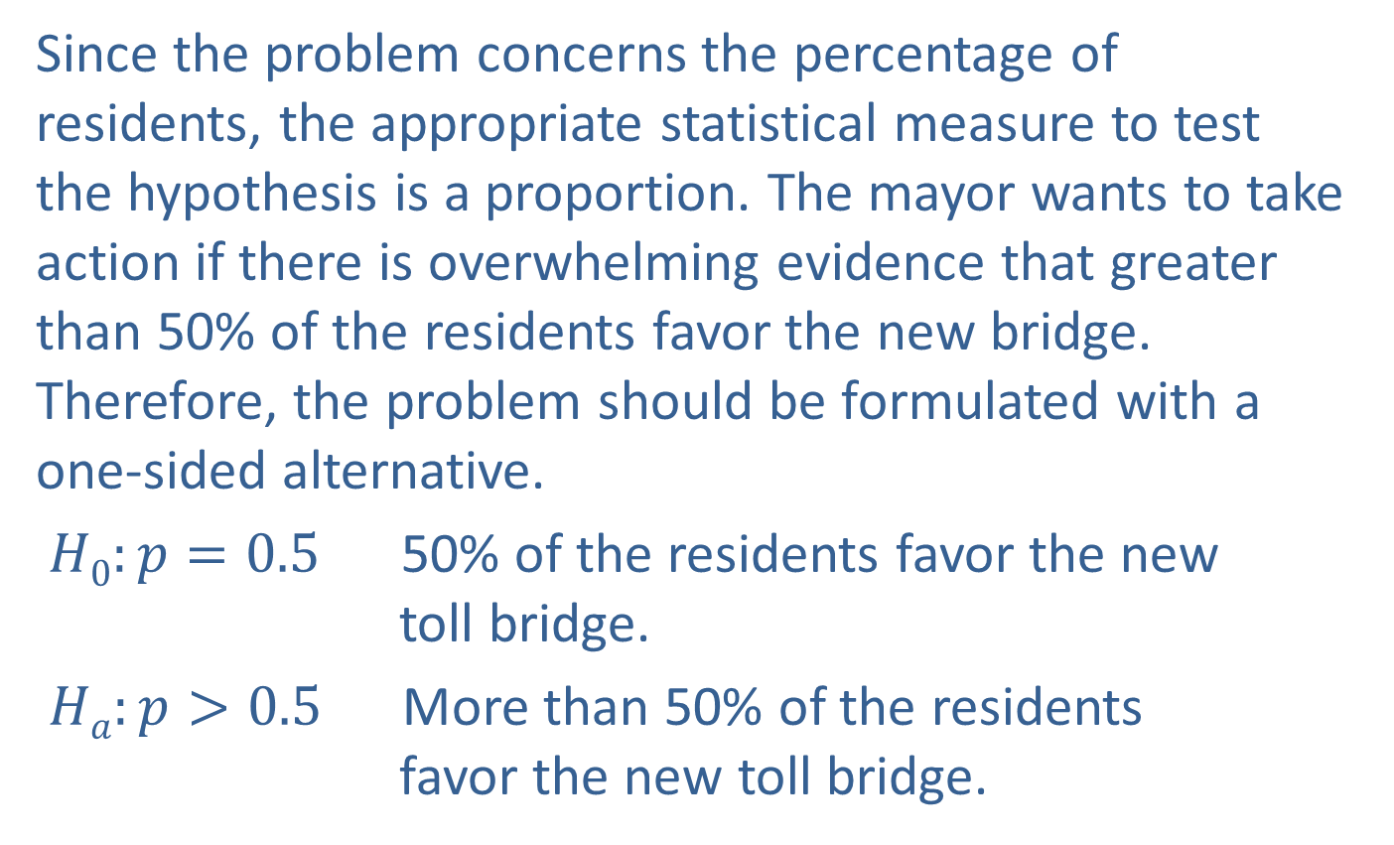
Example 11.5.2: Performing A Hypothesis Test for Residents Favoring Construction of a Toll Bridge (cont.)
Since the problem concerns the percentage of residents, the appropriate statistical measure to test the hypothesis is a proportion. The mayor wants to take action if there is overwhelming evidence that greater than 50% of the residents favor the new bridge. Therefore, the problem should be formulated with a one-sided alternative.
$H0:p=0.5$ 50% of the residents favor the new toll bridge.
$Ha:p>0.5$ More than 50% of the residents favor the new toll bridge.

Slide 25
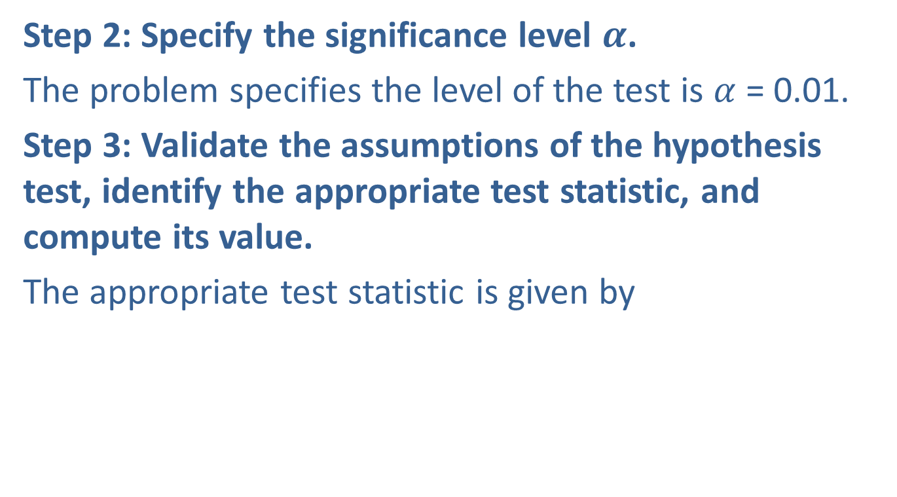
Example 11.5.2: Performing A Hypothesis Test for Residents Favoring Construction of a Toll Bridge (cont.)
Step 2: Specify the significance level $α$.
The problem specifies the level of the test is $α$ = 0.01.
Step 3: Validate the assumptions of the hypothesis test, identify the appropriate test statistic, and compute its value.
The appropriate test statistic is given by

Slide 26
Example 11.5.2: Performing A Hypothesis Test for Residents Favoring Construction of a Toll Bridge (cont.)
Suppose a random sample of 420 residents were selected and 228 favored the construction of the new bridge. First, we must check our assumptions.
Random sample
There are only two outcomes for each trial—a resident favors the toll bridge or does not—so we have a binomial random variable.

Slide 27
Example 11.5.2: Performing A Hypothesis Test for Residents Favoring Construction of a Toll Bridge (cont.)
We can proceed with the test. The proportion favoring the new bridge in the sample is
and

Slide 28
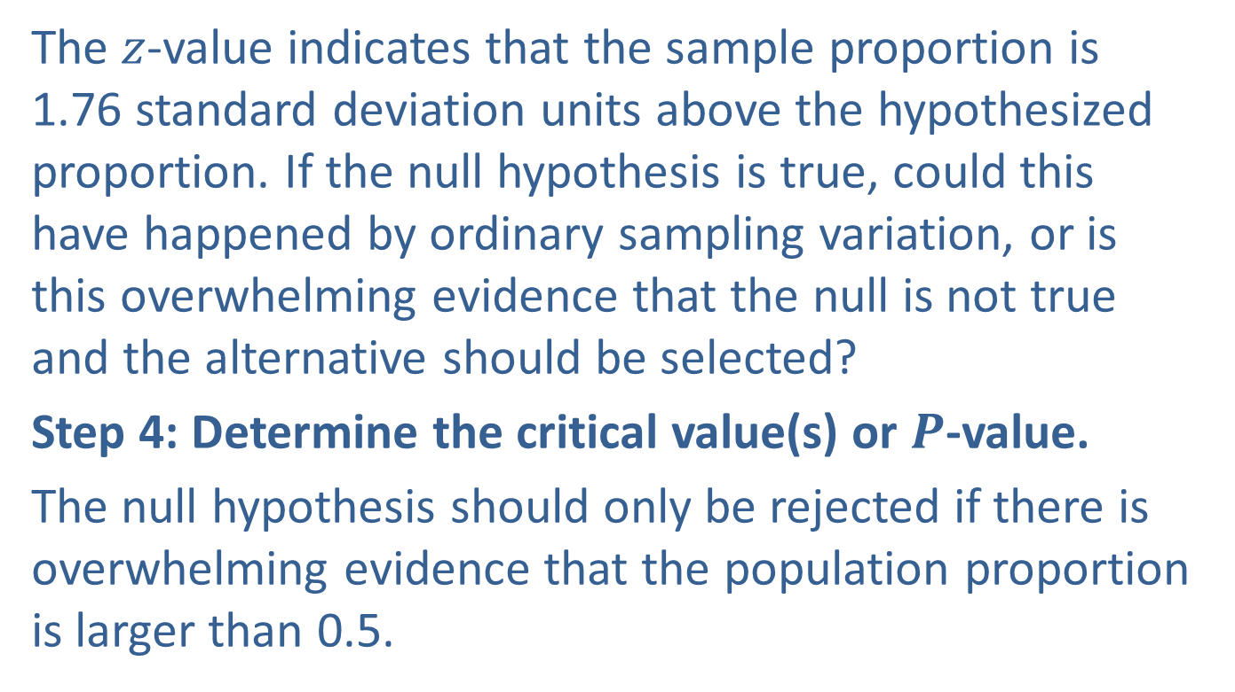
Example 11.5.2: Performing A Hypothesis Test for Residents Favoring Construction of a Toll Bridge (cont.)
The $z$-value indicates that the sample proportion is 1.76 standard deviation units above the hypothesized proportion. If the null hypothesis is true, could this have happened by ordinary sampling variation, or is this overwhelming evidence that the null is not true and the alternative should be selected?
Step 4: Determine the critical value(s) or $P$-value.
The null hypothesis should only be rejected if there is overwhelming evidence that the population proportion is larger than 0.5.

Slide 29
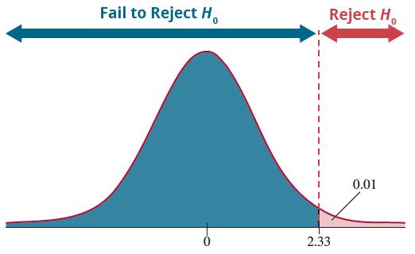

Example 11.5.2: Performing A Hypothesis Test for Residents Favoring Construction of a Toll Bridge (cont.)
Since the test is one-sided, the entire probability associated with the level of the test ($α$=0.01) will be placed in the right-hand tail of the distribution.

Slide 30
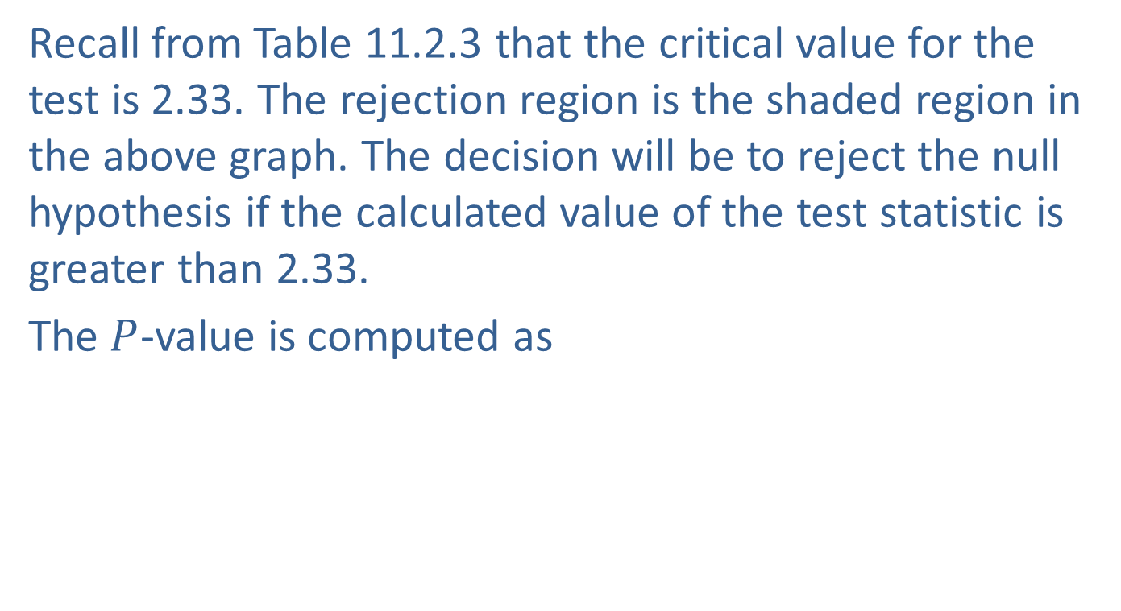
Example 11.5.2: Performing A Hypothesis Test for Residents Favoring Construction of a Toll Bridge (cont.)
Recall from Table 11.2.3 that the critical value for the test is 2.33. The rejection region is the shaded region in the above graph. The decision will be to reject the null hypothesis if the calculated value of the test statistic is greater than 2.33.
The $P$-value is computed as

Slide 31
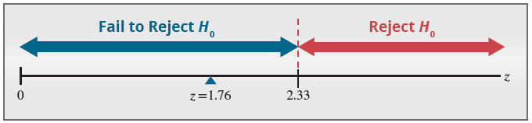
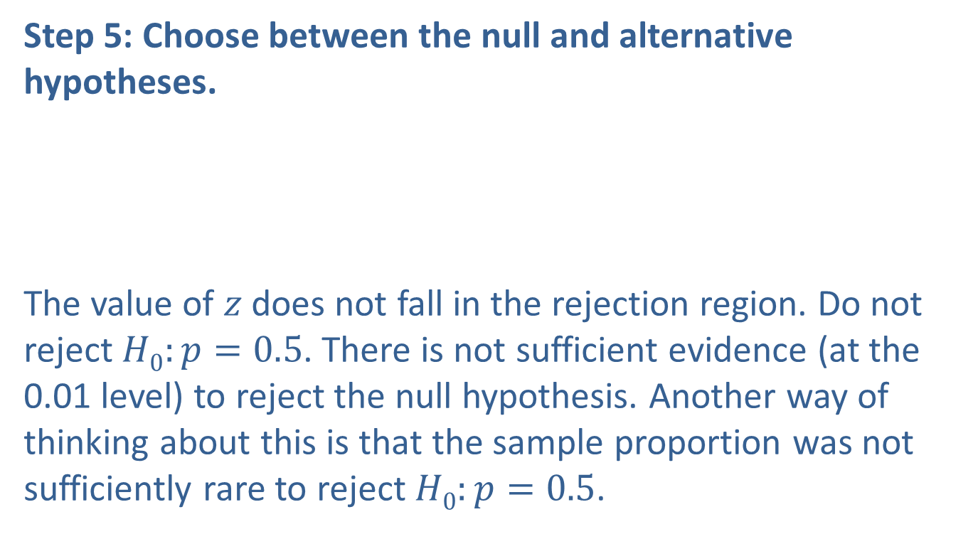
Example 11.5.2: Performing A Hypothesis Test for Residents Favoring Construction of a Toll Bridge (cont.)
Step 5: Choose between the null and alternative hypotheses.
The value of $z$ does not fall in the rejection region. Do not reject $H0:p=0.5$. There is not sufficient evidence (at the 0.01 level) to reject the null hypothesis. Another way of thinking about this is that the sample proportion was not sufficiently rare to reject $H0:p=0.5$.

Slide 32
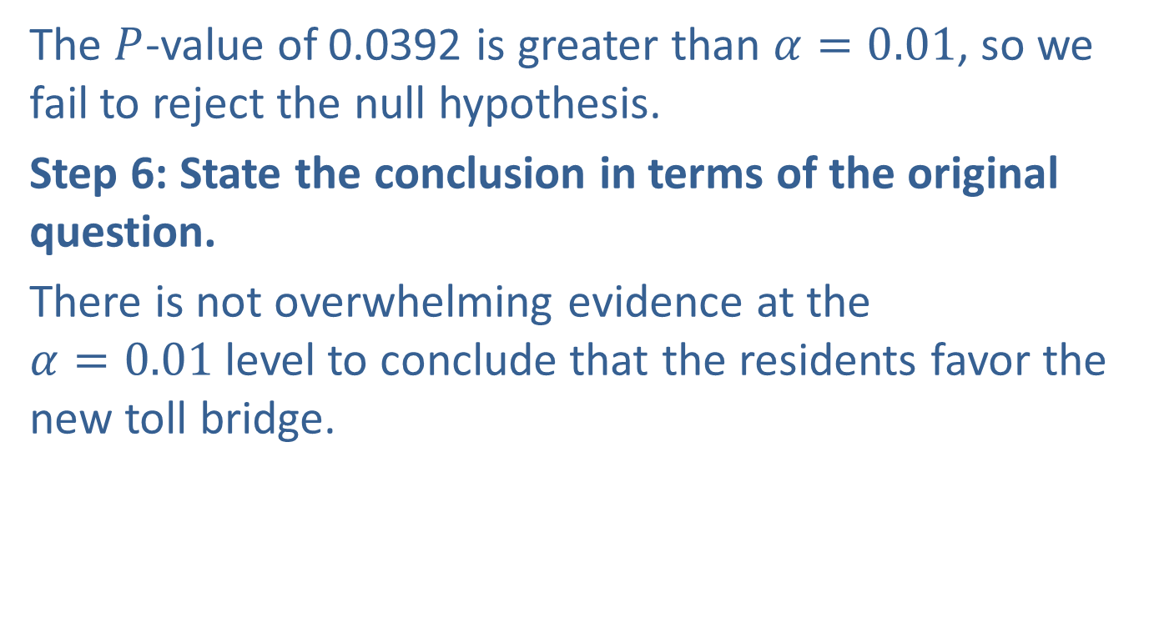
Example 11.5.2: Performing A Hypothesis Test for Residents Favoring Construction of a Toll Bridge (cont.)
The $P$-value of 0.0392 is greater than $α=0.01$, so we fail to reject the null hypothesis.
Step 6: State the conclusion in terms of the original question.
There is not overwhelming evidence at the $α=0.01$level to conclude that the residents favor the new toll bridge.

Slide 33
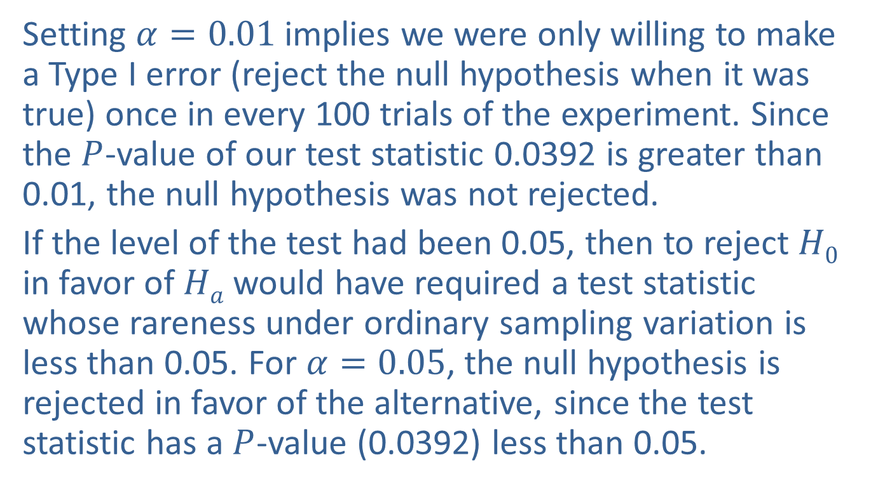
Developing the Test (cont.)
Setting $α=0.01$implies we were only willing to make a Type I error (reject the null hypothesis when it was true) once in every 100 trials of the experiment. Since the $P$-value of our test statistic 0.0392 is greater than 0.01, the null hypothesis was not rejected.
If the level of the test had been 0.05, then to reject $H0$ in favor of $Ha$ would have required a test statistic whose rareness under ordinary sampling variation is less than 0.05. For $α=0.05$, the null hypothesis is rejected in favor of the alternative, since the test statistic has a $P$-value (0.0392) less than 0.05.

Slide 34
Developing the Test (cont.)
Table 11.5.2 − If P-Value = 0.0392
Level of the Test | Reject or Fail to Reject
0.10 | Reject
0.05 | Reject
0.03 | Fail to Reject
0.01 | Fail to Reject

