Slide 1
Section 11.4
The Relationship Between Confidence Interval Estimation and Hypothesis Testing

Slide 2
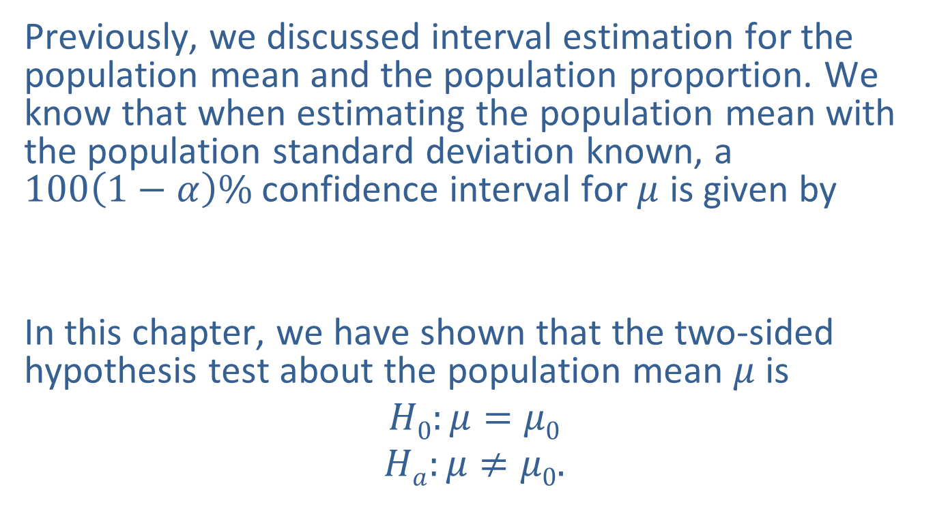
The Relationship Between Confidence Interval Estimation and Hypothesis Testing
Previously, we discussed interval estimation for the population mean and the population proportion. We know that when estimating the population mean with the population standard deviation known, a $100\left(1−α\right)\%$ confidence interval for $μ$ is given by
In this chapter, we have shown that the two-sided hypothesis test about the population mean $μ$ is
$$H0:μ=μ0$$
$$Ha:μ≠μ0.$$

Slide 3
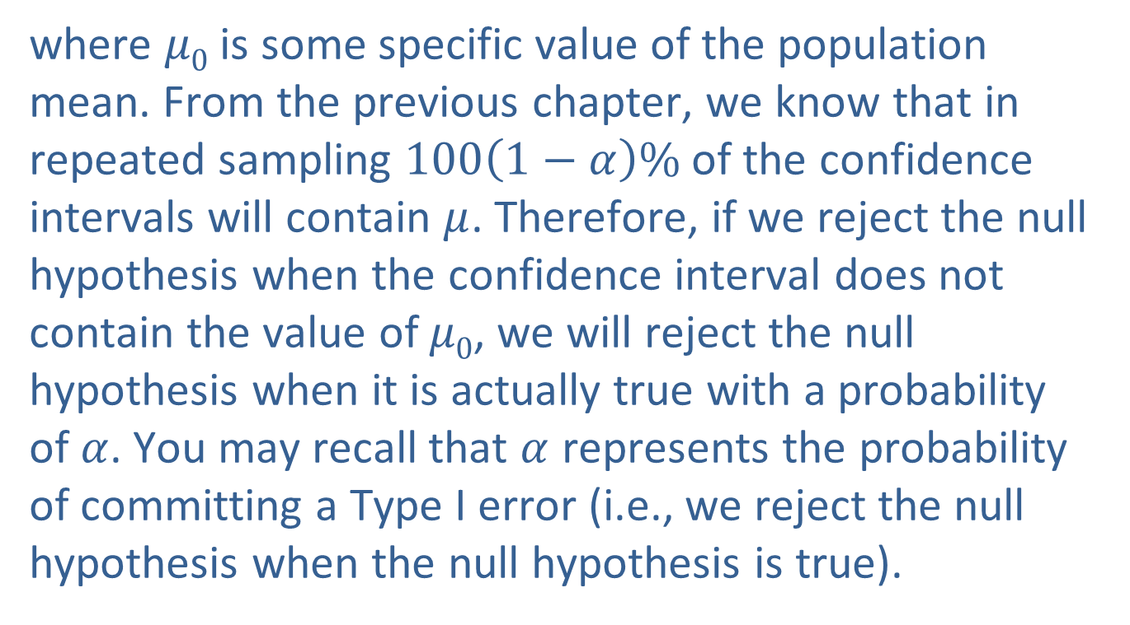
The Relationship Between Confidence Interval Estimation and Hypothesis Testing (cont.)
where $μ0$ is some specific value of the population mean. From the previous chapter, we know that in repeated sampling $100\left(1−α\right)\%$ of the confidence intervals will contain $μ$. Therefore, if we reject the null hypothesis when the confidence interval does not contain the value of $μ0$, we will reject the null hypothesis when it is actually true with a probability of$α$. You may recall that $α$ represents the probability of committing a Type I error (i.e., we reject the null hypothesis when the null hypothesis is true).

Slide 4
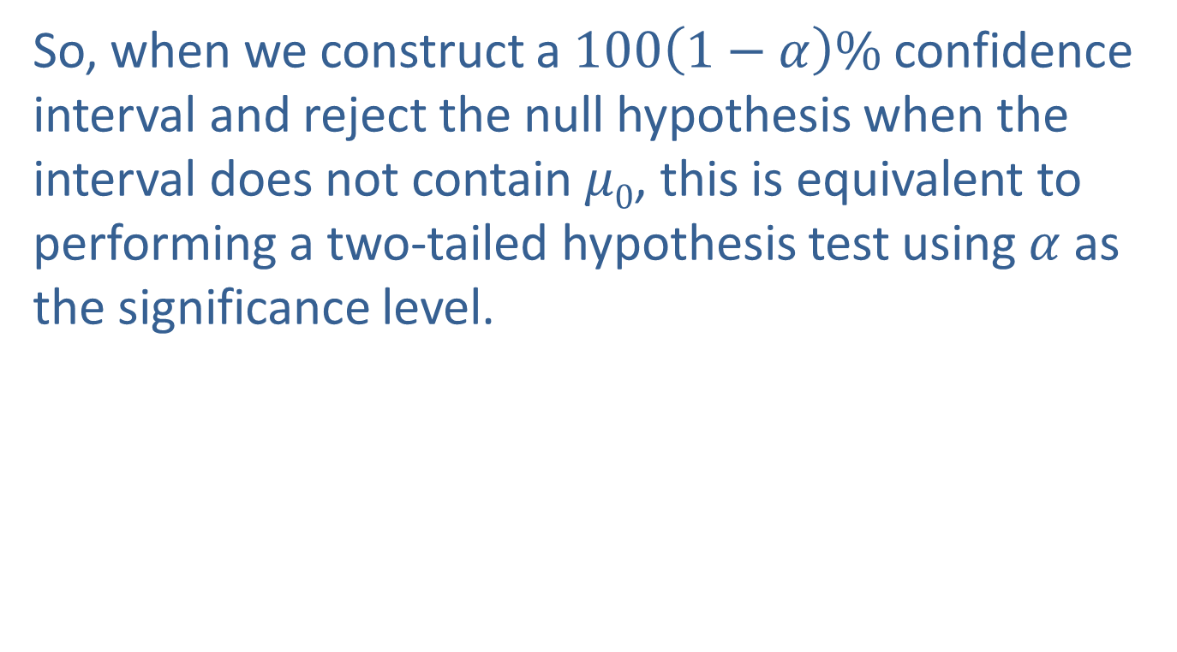
The Relationship Between Confidence Interval Estimation and Hypothesis Testing (cont.)
So, when we construct a $100\left(1−α\right)\%$ confidence interval and reject the null hypothesis when the interval does not contain $μ0$, this is equivalent to performing a two-tailed hypothesis test using $α$ as the significance level.

Slide 5
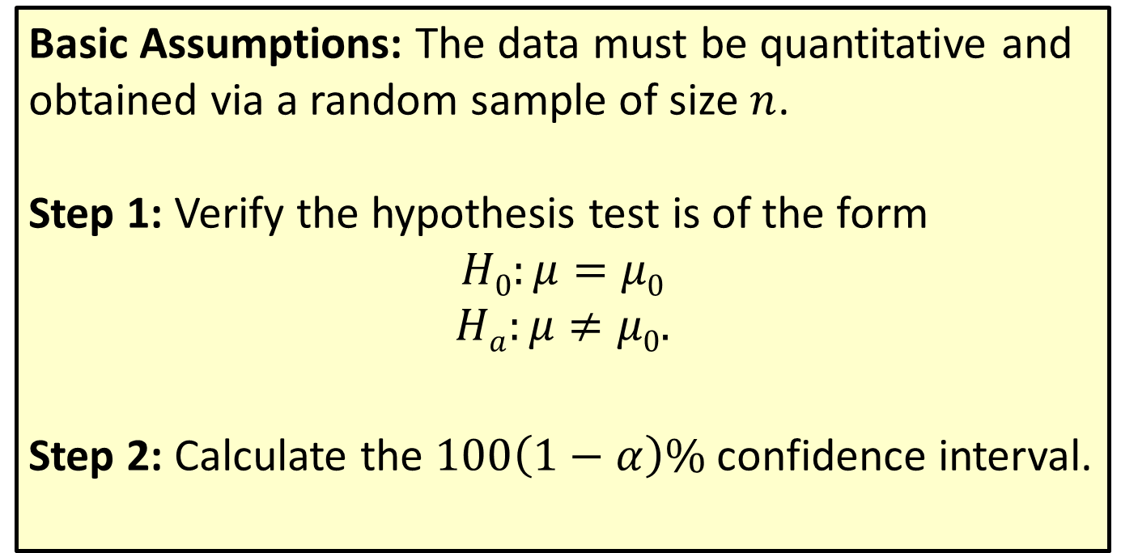
Procedure: Using a Confidence Interval to Test a Two-Sided Hypothesis
Basic Assumptions: The data must be quantitative and obtained via a random sample of size $n$.
Step 1: Verify the hypothesis test is of the form
$$H0:μ=μ0$$
$$Ha:μ≠μ0.$$
Step 2: Calculate the $100\left(1−α\right)\%$ confidence interval.

Slide 6
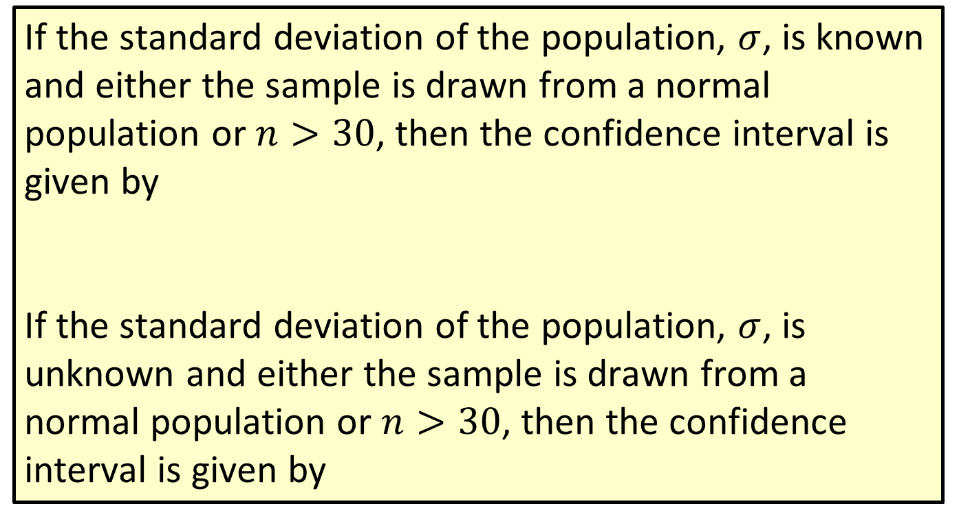
Procedure: Using a Confidence Interval to Test a Two-Sided Hypothesis (cont.)
If the standard deviation of the population, $σ$, is known and either the sample is drawn from a normal population or $n>30$, then the confidence interval is given by
If the standard deviation of the population, $σ$, is unknown and either the sample is drawn from a normal population or $n>30$, then the confidence interval is given by

Slide 7
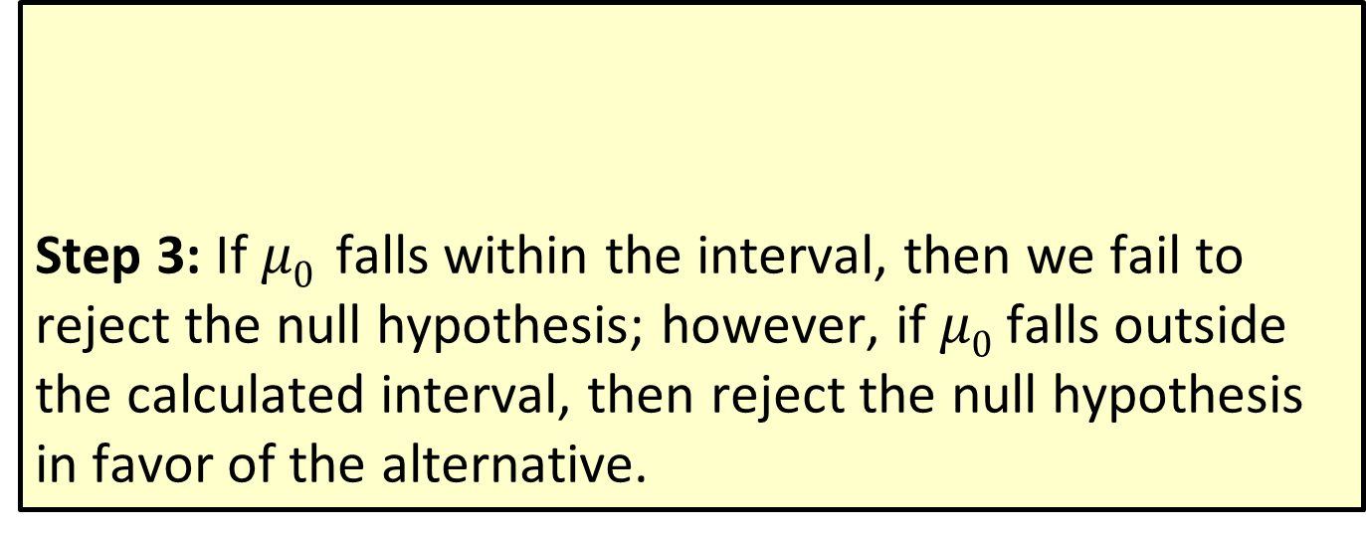
Procedure: Using a Confidence Interval to Test a Two-Sided Hypothesis (cont.)
Step 3: If $μ0$ falls within the interval, then we fail to reject the null hypothesis; however, if $μ0$ falls outside the calculated interval, then reject the null hypothesis
in favor of the alternative.

Slide 8
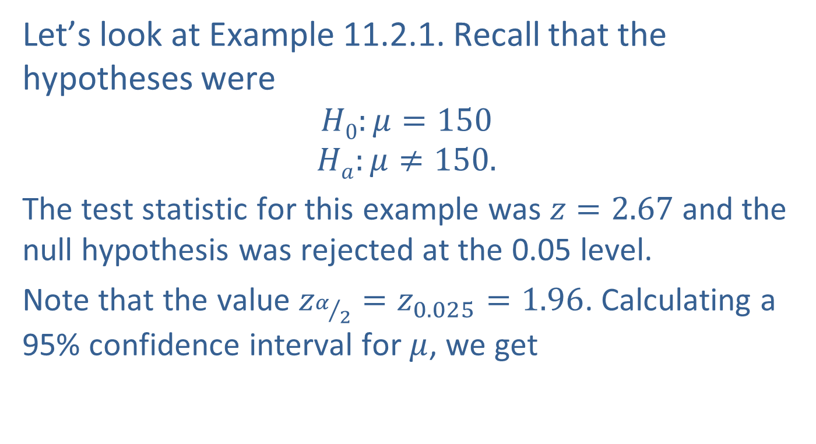
The Relationship Between Confidence Interval Estimation and Hypothesis Testing (cont.)
Let’s look at Example 11.2.1. Recall that the hypotheses were
$$H0:μ=150$$
$$Ha:μ≠150.$$
The test statistic for this example was $z=2.67$and the null hypothesis was rejected at the 0.05 level.
Note that the value $z_{α/2}=z_{0.025}=1.96$. Calculating a 95% confidence interval for $μ$, we get

Slide 9
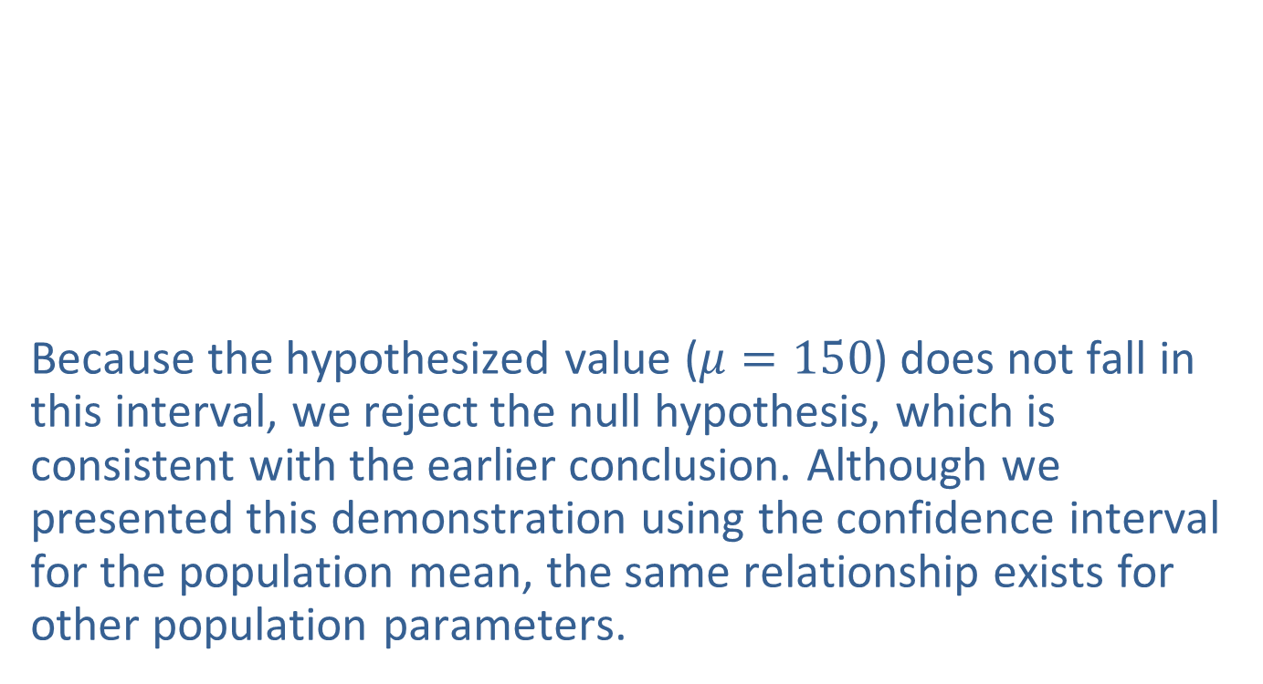
The Relationship Between Confidence Interval Estimation and Hypothesis Testing (cont.)
Because the hypothesized value ($μ=150$) does not fall in this interval, we reject the null hypothesis, which is consistent with the earlier conclusion. Although we presented this demonstration using the confidence interval for the population mean, the same relationship exists for other population parameters.

Slide 10
Practical Significance vs. Statistical Significance
A hypothesis is rarely exactly true. As the sample size becomes larger, the likelihood of rejecting the null hypothesis becomes greater.

Slide 11
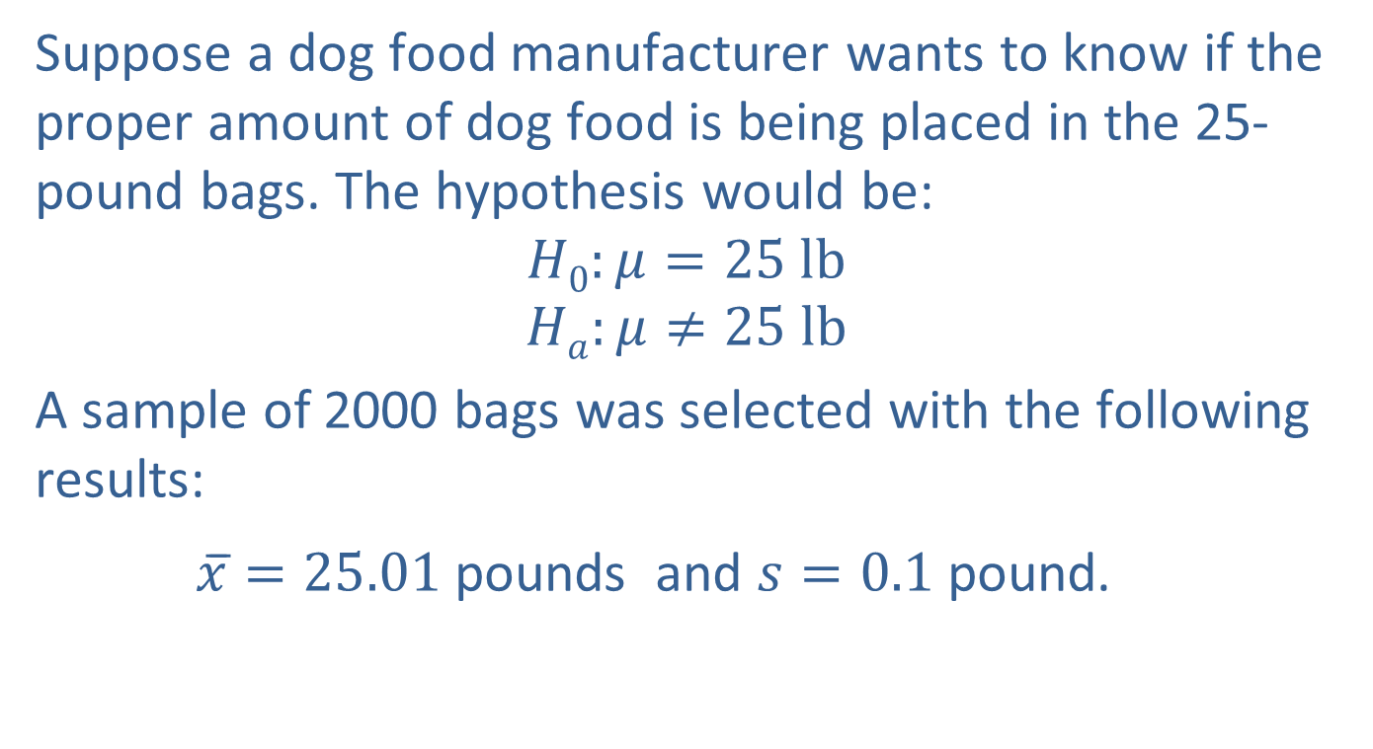
Example 11.4.1: Determining the Practical Significance of a Hypothesis Test
Suppose a dog food manufacturer wants to know if the proper amount of dog food is being placed in the 25-pound bags. The hypothesis would be:
$$H0:μ=25 lb$$
$$Ha:μ≠25 lb$$
A sample of 2000 bags was selected with the following results:
$\overline{x}̅=25.01$pounds and $s=0.1$pound.

Slide 12
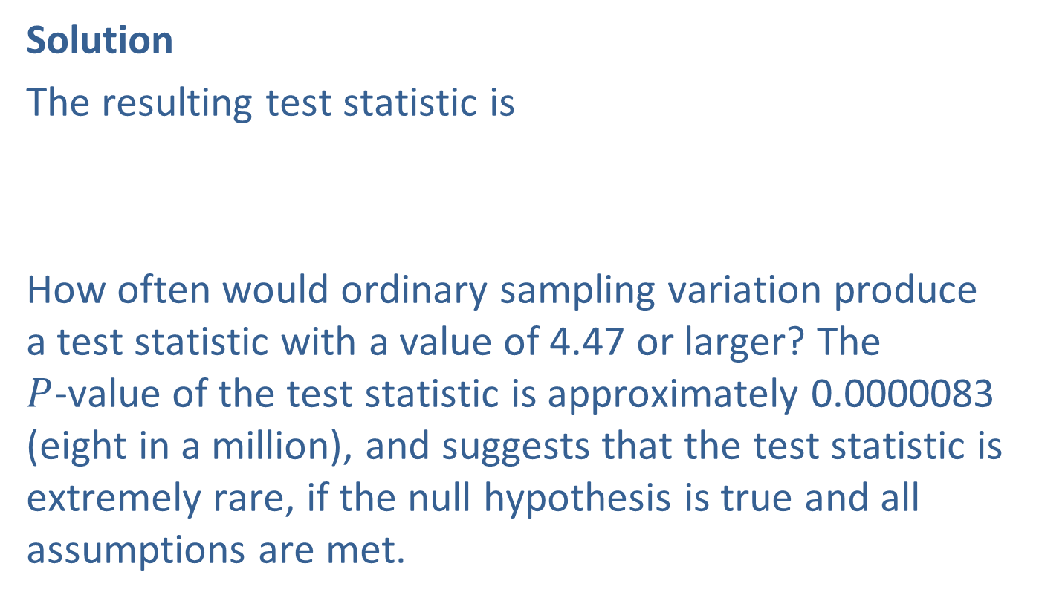
Example 11.4.1: Determining the Practical Significance of a Hypothesis Test (cont.)
Solution
The resulting test statistic is
How often would ordinary sampling variation produce a test statistic with a value of 4.47 or larger? The $P$-value of the test statistic is approximately 0.0000083 (eight in a million), and suggests that the test statistic is extremely rare, if the null hypothesis is true and all assumptions are met.

Slide 13
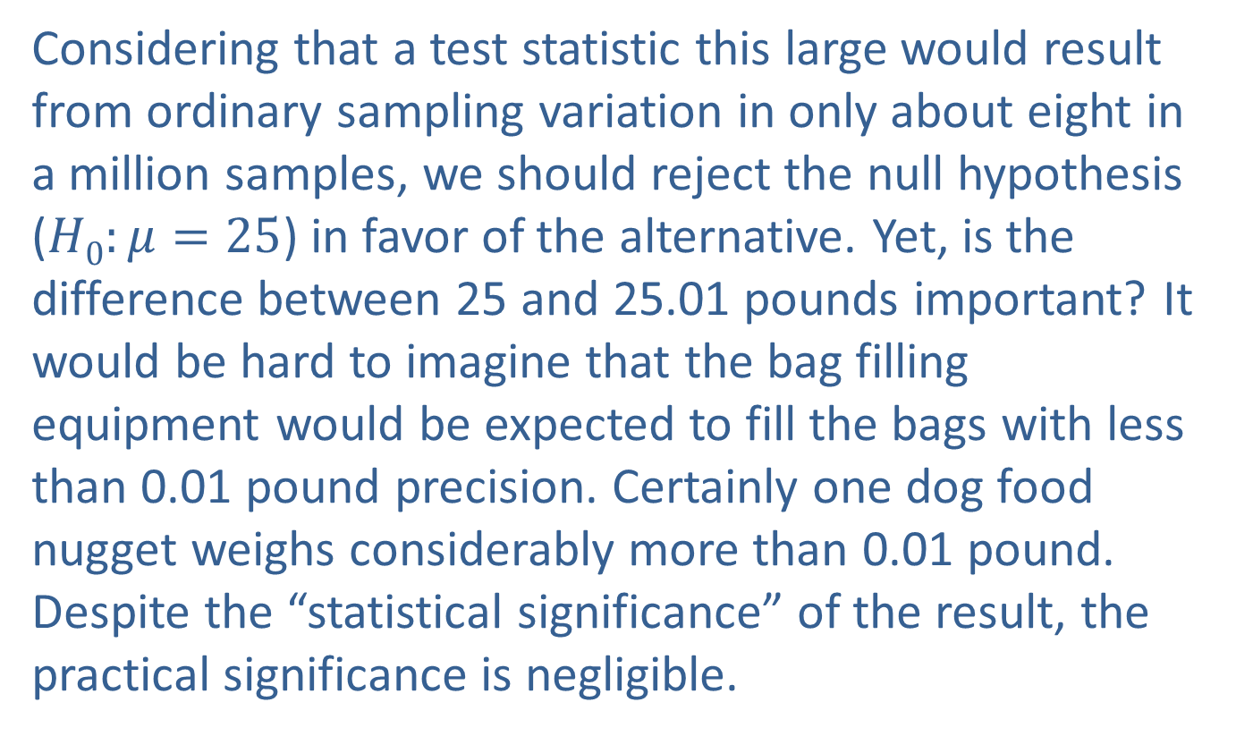
Example 11.4.1: Determining the Practical Significance of a Hypothesis Test (cont.)
Considering that a test statistic this large would result from ordinary sampling variation in only about eight in a million samples, we should reject the null hypothesis ($H0:μ=25$) in favor of the alternative. Yet, is the difference between 25 and 25.01 pounds important? It would be hard to imagine that the bag filling equipment would be expected to fill the bags with less than 0.01 pound precision. Certainly one dog food nugget weighs considerably more than 0.01 pound. Despite the “statistical significance” of the result, the practical significance is negligible.

