Slide 1
Section 11.3
Testing a Hypothesis about a
Population Mean, σ Unknown

Slide 2

Testing a Hypothesis about a Population Mean, $σ$ Unknown
The hypothesis testing strategy in the previous section assumes the sample data is drawn randomly, the population standard deviation is known, and either the population is normal or the sample size is larger than 30. However, in most instances, the population standard deviation is just as unknown as the population mean. Despite the added uncertainty, the general approach to testing a hypothesis is the same.

Slide 3
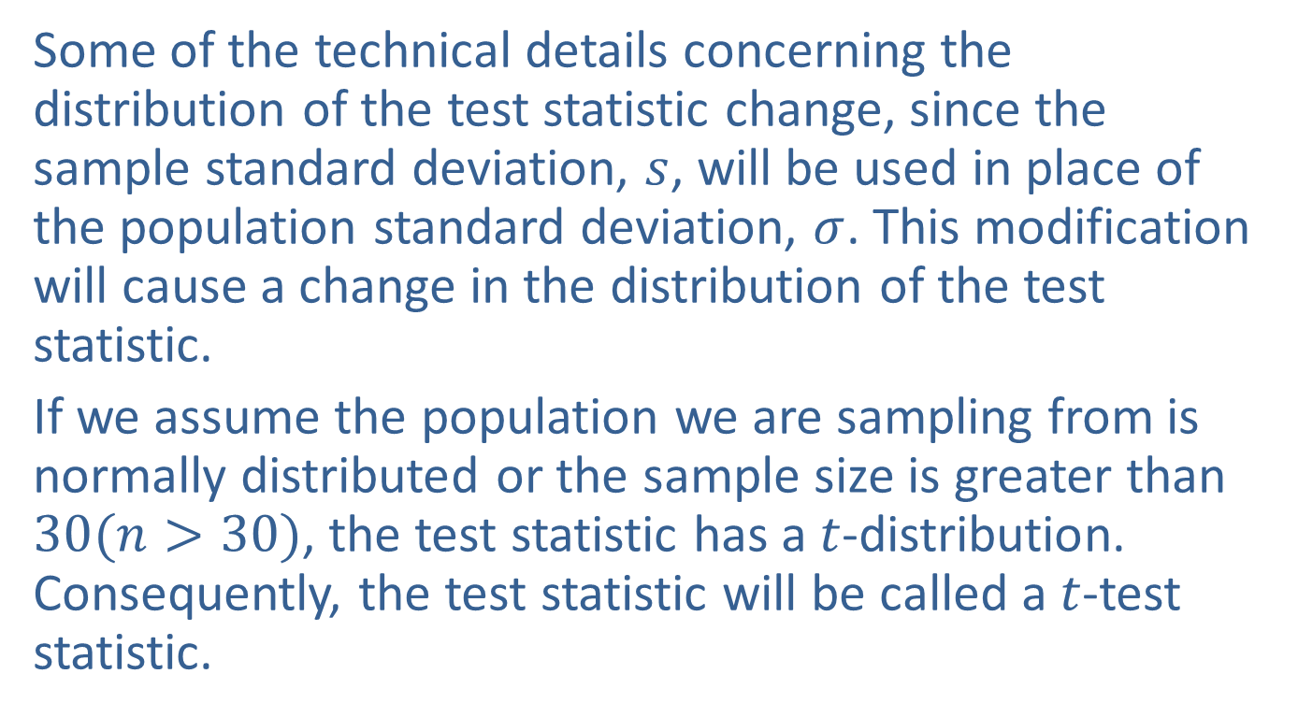
Testing a Hypothesis about a Population Mean, $σ$ Unknown
Some of the technical details concerning the distribution of the test statistic change, since the sample standard deviation, $s$, will be used in place of the population standard deviation, $σ$. This modification will cause a change in the distribution of the test statistic.
If we assume the population we are sampling from is normally distributed or the sample size is greater than $30(n>30)$, the test statistic has a $t$-distribution. Consequently, the test statistic will be called a $t$-test statistic.

Slide 4
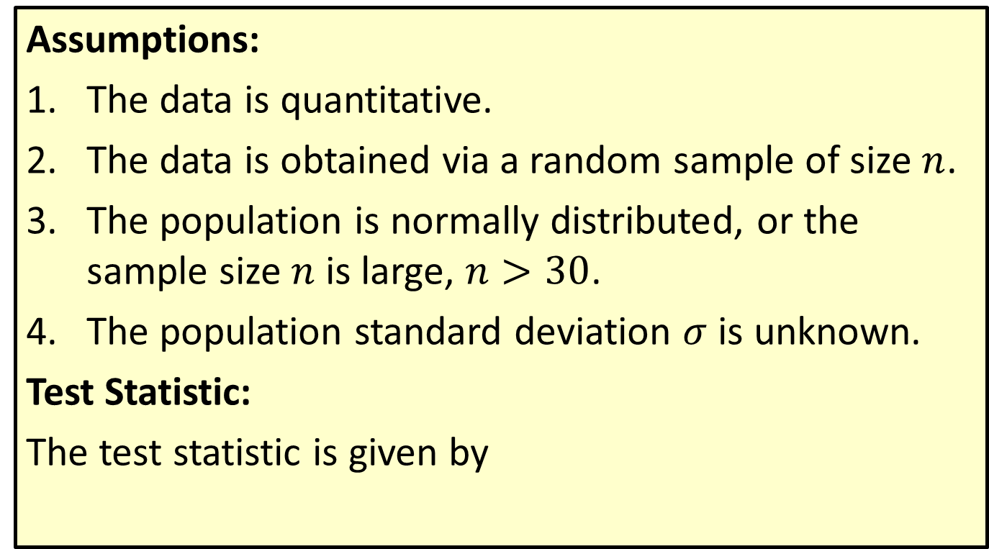

Procedure: Testing a Hypothesis About a Mean, $σ$ Unknown
Assumptions:
The data is quantitative.
The data is obtained via a random sample of size $n$.
The population is normally distributed, or the sample size $n$ is large, $n>30$.
The population standard deviation $σ$ is unknown.
Test Statistic:
The test statistic is given by

Slide 5
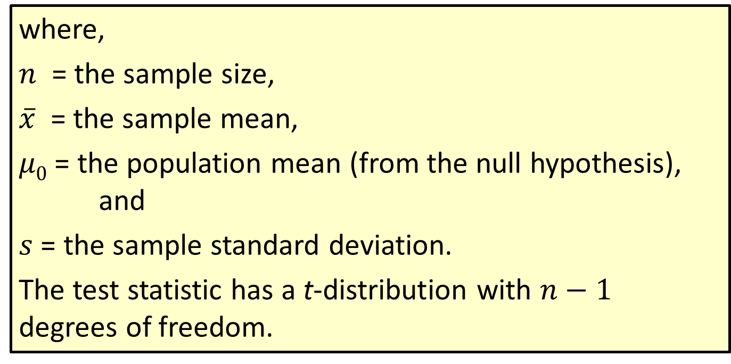

Procedure: Testing a Hypothesis About a Mean, $σ$ Unknown (cont.)
where,
$n$ = the sample size,
$\overline{x}$ = the sample mean,
$μ0$ = the population mean (from the null hypothesis), and
$s$ = the sample standard deviation.
The test statistic has a t-distribution with $n−1$ degrees of freedom.

Slide 6

Note
If technology is available to calculate $P$-values, please use it!

Slide 7
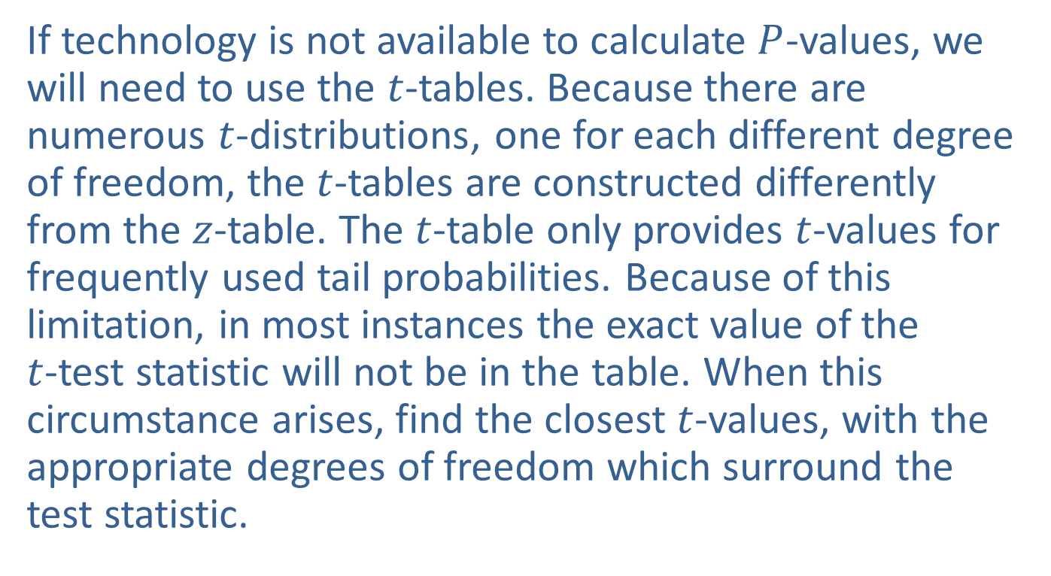

$P$-Values for $t$-Test Statistics
If technology is not available to calculate $P$-values, we will need to use the $t$-tables. Because there are numerous $t$-distributions, one for each different degree of freedom, the $t$-tables are constructed differently from the $z$-table. The $t$-table only provides $t$-values for frequently used tail probabilities. Because of this limitation, in most instances the exact value of the $t$-test statistic will not be in the table. When this circumstance arises, find the closest $t$-values, with the appropriate degrees of freedom which surround the test statistic.

Slide 8
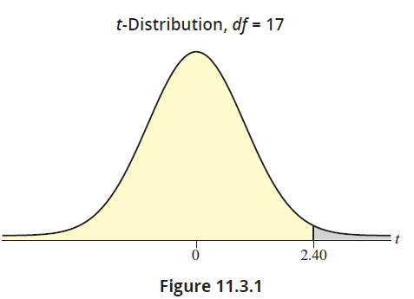

$P$-Values for $t$-Test Statistics (cont.)
For example, suppose the value of the test statistic was 2.40 with 17 degrees of freedom.

Slide 9

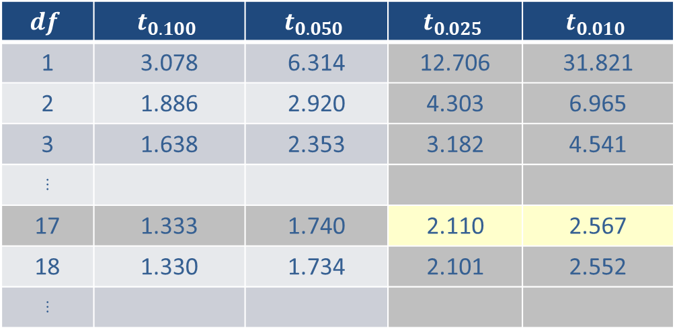
$P$-Values for $t$-Test Statistics (cont.)
The value of the test statistic falls between 2.110 (which corresponds to $α$ = 0.025) and 2.567, which corresponds to $α$= 0.01.
$$df$$ | $$t_{0.100}$$ | $$t_{0.050}$$ | $$t_{0.025}$$ | $$t_{0.010}$$
1 | 3.078 | 6.314 | 12.706 | 31.821
2 | 1.886 | 2.920 | 4.303 | 6.965
3 | 1.638 | 2.353 | 3.182 | 4.541
⋮
17 | 1.333 | 1.740 | 2.110 | 2.567
18 | 1.330 | 1.734 | 2.101 | 2.552
⋮

Slide 10
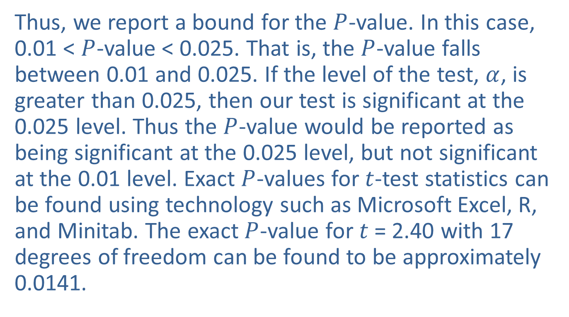
$P$-Values for $t$-Test Statistics (cont.)
Thus, we report a bound for the $P$-value. In this case, 0.01 < $P$-value < 0.025. That is, the $P$-value falls between 0.01 and 0.025. If the level of the test, $α$, is greater than 0.025, then our test is significant at the 0.025 level. Thus the $P$-value would be reported as being significant at the 0.025 level, but not significant at the 0.01 level. Exact $P$-values for $t$-test statistics can be found using technology such as Microsoft Excel, R, and Minitab. The exact $P$-value for $t$ = 2.40 with 17 degrees of freedom can be found to be approximately 0.0141.

Slide 11
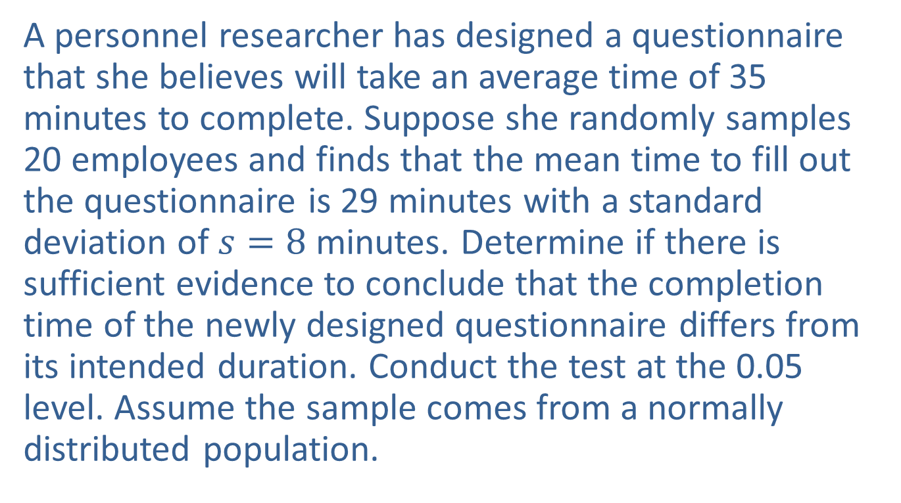
Example 11.3.1: Performing a Hypothesis Test for Time to Complete a Questionnaire
A personnel researcher has designed a questionnaire that she believes will take an average time of 35 minutes to complete. Suppose she randomly samples 20 employees and finds that the mean time to fill out the questionnaire is 29 minutes with a standard deviation of $s=8$ minutes. Determine if there is sufficient evidence to conclude that the completion time of the newly designed questionnaire differs from its intended duration. Conduct the test at the 0.05 level. Assume the sample comes from a normally distributed population.

Slide 12
Example 11.3.1: Performing a Hypothesis Test for Time to Complete a Questionnaire (cont.)
Solution
Step 1: Determine the population parameter to be used and develop the null and alternative hypotheses.
In plain English the hypotheses are as follows.
Null Hypothesis: The questionnaire takes 35 minutes to complete.
Alternative Hypothesis: It takes more or less than 35 minutes to complete.

Slide 13
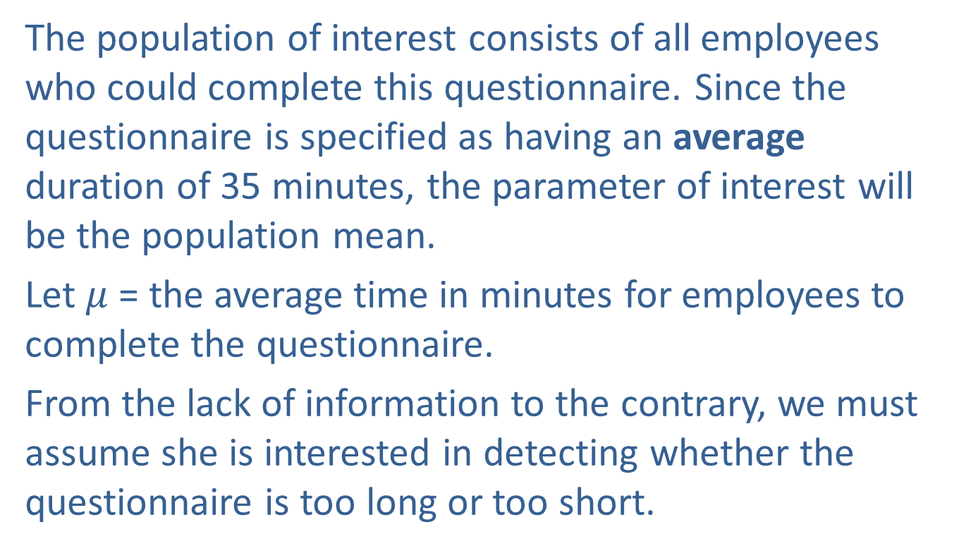
Example 11.3.1: Performing a Hypothesis Test for Time to Complete a Questionnaire (cont.)
The population of interest consists of all employees who could complete this questionnaire. Since the questionnaire is specified as having an average duration of 35 minutes, the parameter of interest will be the population mean.
Let $μ$ = the average time in minutes for employees to complete the questionnaire.
From the lack of information to the contrary, we must assume she is interested in detecting whether the questionnaire is too long or too short.

Slide 14
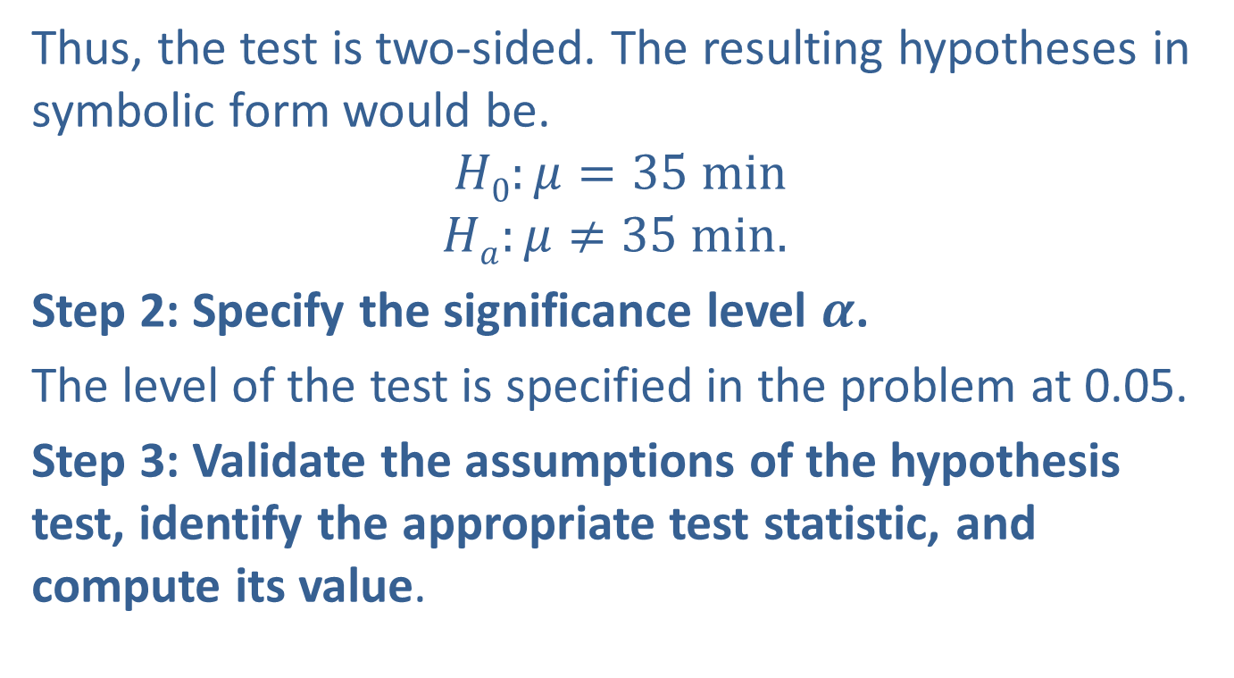
Example 11.3.1: Performing a Hypothesis Test for Time to Complete a Questionnaire (cont.)
Thus, the test is two-sided. The resulting hypotheses in symbolic form would be.
$$H0:μ=35 min$$
$$Ha:μ≠35 min.$$
Step 2: Specify the significance level $α$.
The level of the test is specified in the problem at 0.05.
Step 3: Validate the assumptions of the hypothesis test, identify the appropriate test statistic, and compute its value.

Slide 15
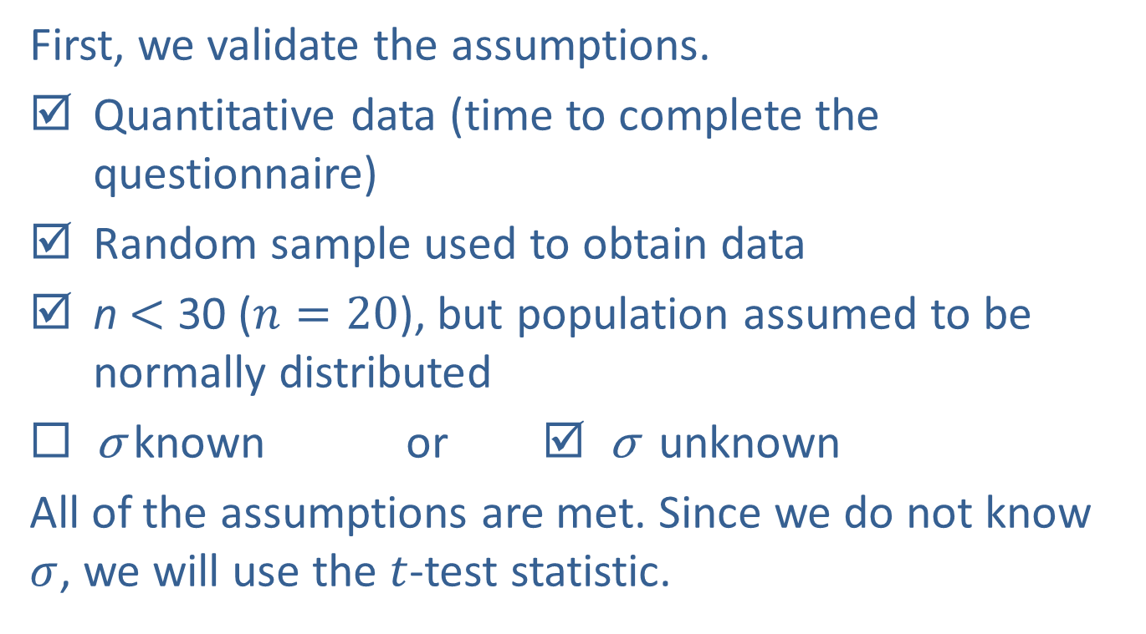
Example 11.3.1: Performing a Hypothesis Test for Time to Complete a Questionnaire (cont.)
First, we validate the assumptions.
Quantitative data (time to complete the questionnaire)
Random sample used to obtain data
n $<$ 30 ($n=20$), but population assumed to be normally distributed
◻ σ known or ☑ σ unknown
All of the assumptions are met. Since we do not know $σ$, we will use the $t$-test statistic.

Slide 16
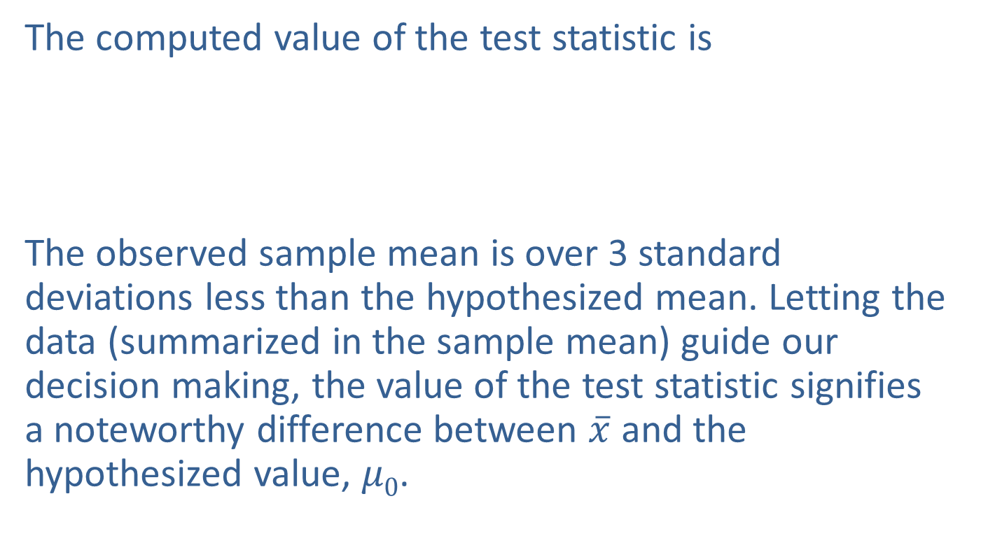
Example 11.3.1: Performing a Hypothesis Test for Time to Complete a Questionnaire (cont.)
The computed value of the test statistic is
The observed sample mean is over 3 standard deviations less than the hypothesized mean. Letting the data (summarized in the sample mean) guide our decision making, the value of the test statistic signifies a noteworthy difference between $\overline{x}$ and the hypothesized value, $μ0$.

Slide 17
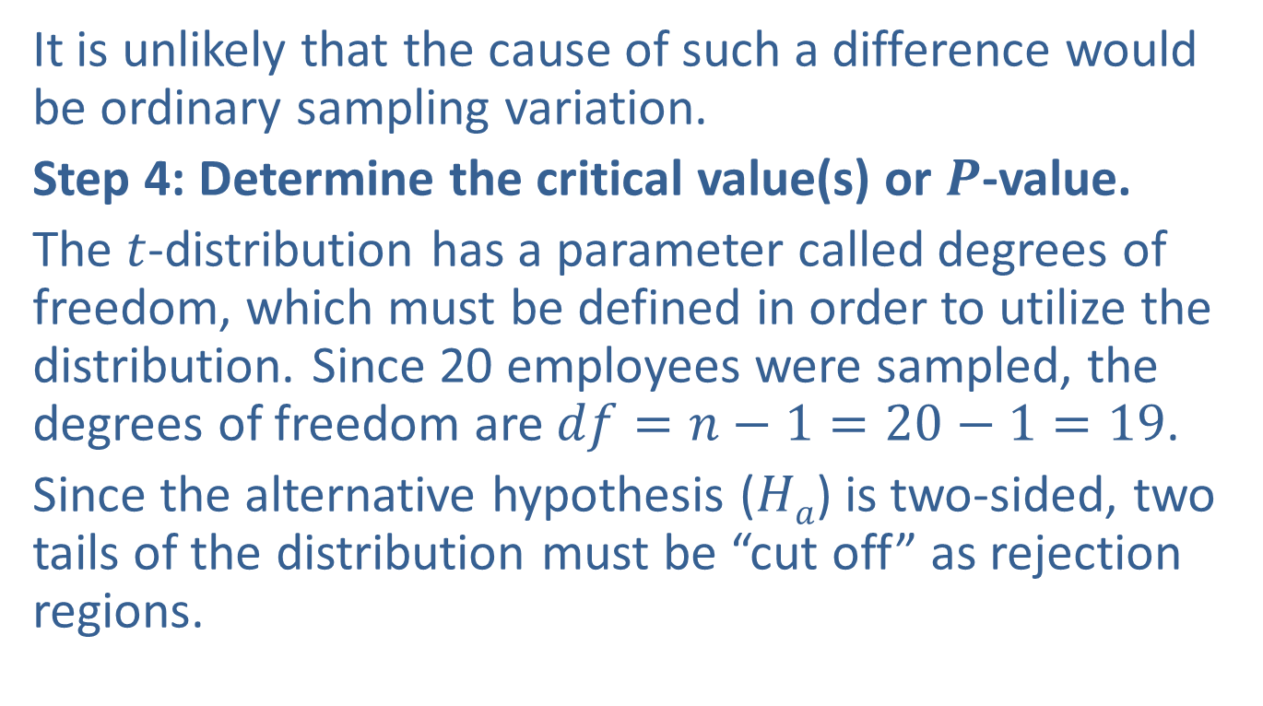
Example 11.3.1: Performing a Hypothesis Test for Time to Complete a Questionnaire (cont.)
It is unlikely that the cause of such a difference would be ordinary sampling variation.
Step 4: Determine the critical value(s) or $P$-value.
The $t$-distribution has a parameter called degrees of freedom, which must be defined in order to utilize the distribution. Since 20 employees were sampled, the degrees of freedom are $df=n−1=20−1=19$.
Since the alternative hypothesis ($Ha$) is two-sided, two tails of the distribution must be “cut off” as rejection regions.

Slide 18
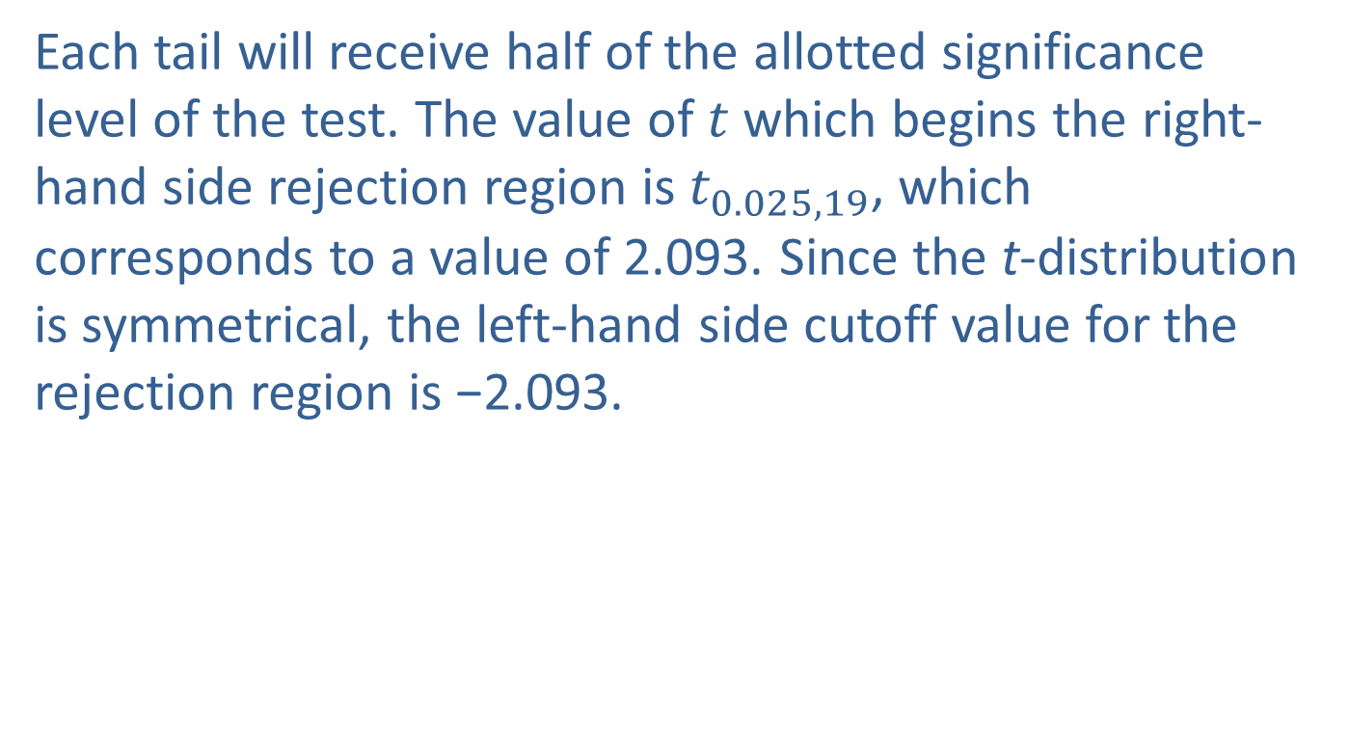
Example 11.3.1: Performing a Hypothesis Test for Time to Complete a Questionnaire (cont.)
Each tail will receive half of the allotted significance level of the test. The value of $t$ which begins the right-hand side rejection region is $t_{0.025,19}$, which corresponds to a value of 2.093. Since the t-distribution is symmetrical, the left-hand side cutoff value for the rejection region is −2.093.

Slide 19
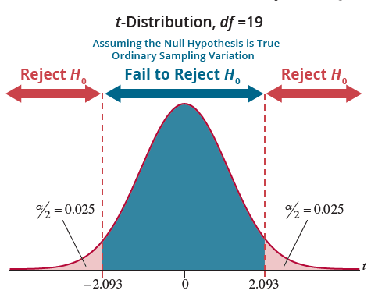
Example 11.3.1: Performing a Hypothesis Test for Time to Complete a Questionnaire (cont.)

Slide 20
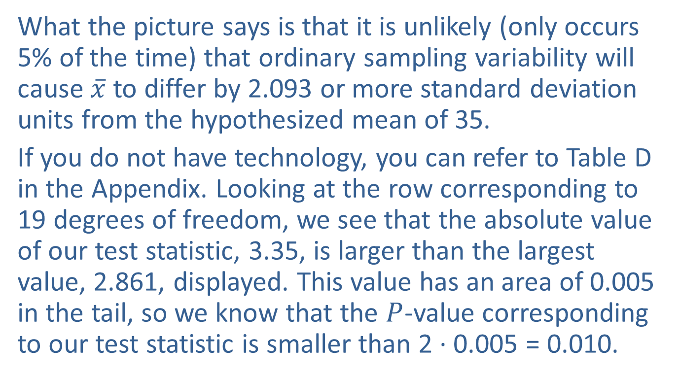
Example 11.3.1: Performing a Hypothesis Test for Time to Complete a Questionnaire (cont.)
What the picture says is that it is unlikely (only occurs 5% of the time) that ordinary sampling variability will cause $\overline{x}$ to differ by 2.093 or more standard deviation units from the hypothesized mean of 35.
If you do not have technology, you can refer to Table D in the Appendix. Looking at the row corresponding to 19 degrees of freedom, we see that the absolute value of our test statistic, 3.35, is larger than the largest value, 2.861, displayed. This value has an area of 0.005 in the tail, so we know that the $P$-value corresponding to our test statistic is smaller than 2 · 0.005 = 0.010.

Slide 21
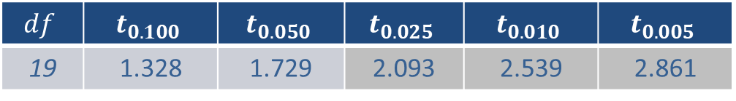
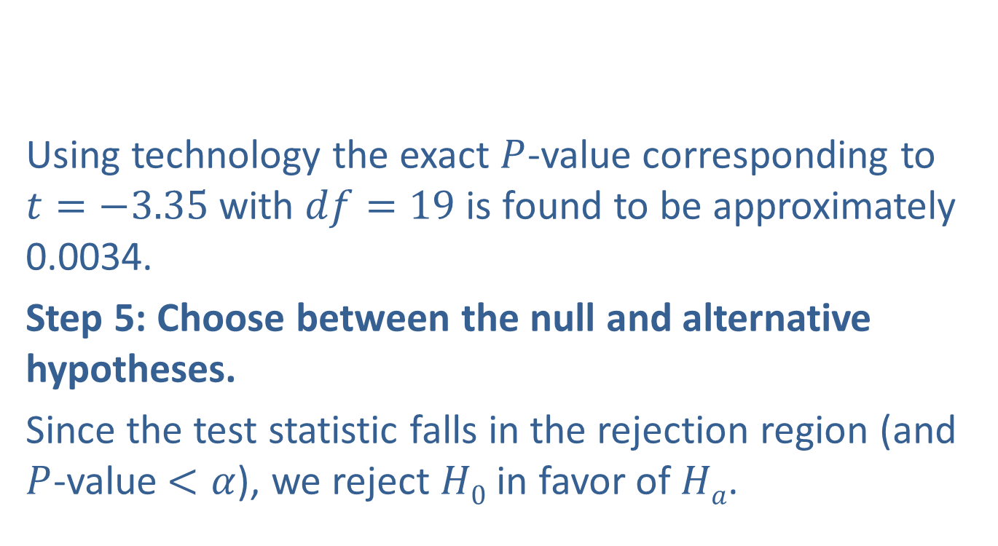
Example 11.3.1: Performing a Hypothesis Test for Time to Complete a Questionnaire (cont.)
Using technology the exact $P$-value corresponding to $t=−3.35$with $df=19$is found to be approximately 0.0034.
Step 5: Choose between the null and alternative hypotheses.
Since the test statistic falls in the rejection region (and $P$-value$<α$), we reject $H0$ in favor of $Ha$.
$$df$$ | $$t_{0.100}$$ | $$t_{0.050}$$ | $$t_{0.025}$$ | $$t_{0.010}$$ | $$t_{0.005}$$
19 | 1.328 | 1.729 | 2.093 | 2.539 | 2.861

Slide 22
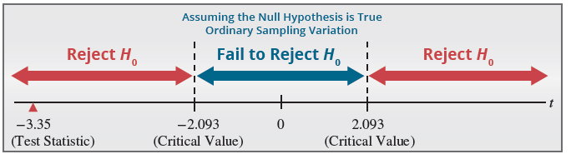
Example 11.3.1: Performing a Hypothesis Test for Time to Complete a Questionnaire (cont.)
Step 6: State the conclusion in terms of the original question.
There is sufficient evidence at the 0.05 level to conclude that the mean time to complete the questionnaire is not 35 minutes.

Slide 23
Example 11.3.1: Performing a Hypothesis Test for Time to Complete a Questionnaire (cont.)
Since the sample mean was so much less than 35 minutes, it is tempting to conclude that the questionnaire requires less than 35 minutes to complete. However, we did not test the one-sided hypothesis. If the researcher wishes to demonstrate that the completion time is significantly less than 35 minutes, we must start the process over: testing a one-sided hypothesis and obtaining new sample data.

Slide 24
Example 11.3.2: Performing a Hypothesis Test for Mean Tensile Strength
The Alexander Bolt Company produces 20 mm A-2 stainless steel bolts that have a mean tensile strength of more than 700 Megapascals (MPa), the specified quality standard. These bolts are primarily used in the manufacturing of farm implements. The company is very concerned about quality and wants to be sure that its A-2 product is above the quality standard. A sample of 20 bolts is to be randomly selected from stock and tested for tensile strength. The sample values are recorded in the table.

Slide 25
Example 11.3.2: Performing a Hypothesis Test for Mean Tensile Strength (cont.)
Design a test of hypothesis to determine if there is overwhelming evidence that the bolts have a tensile strength greater than 700 MPa.
Tensile Strength (MPa)
728 | 733 | 717 | 709
706 | 713 | 701 | 746
742 | 724 | 736 | 731
719 | 751 | 707 | 754
718 | 746 | 687 | 682

Slide 26
Example 11.3.2: Performing a Hypothesis Test for Mean Tensile Strength (cont.)
Solution
Step 1: Determine the population parameter to be used and develop the null and alternative hypotheses.
The hypotheses in plain English are:
Null Hypothesis: The 20 mm A-2 stainless steel bolts have a mean tensile strength of 700 MPa.
Alternative Hypothesis: The 20 mm A-2 stainless steel bolts have a mean tensile strength of more than 700 MPa.

Slide 27
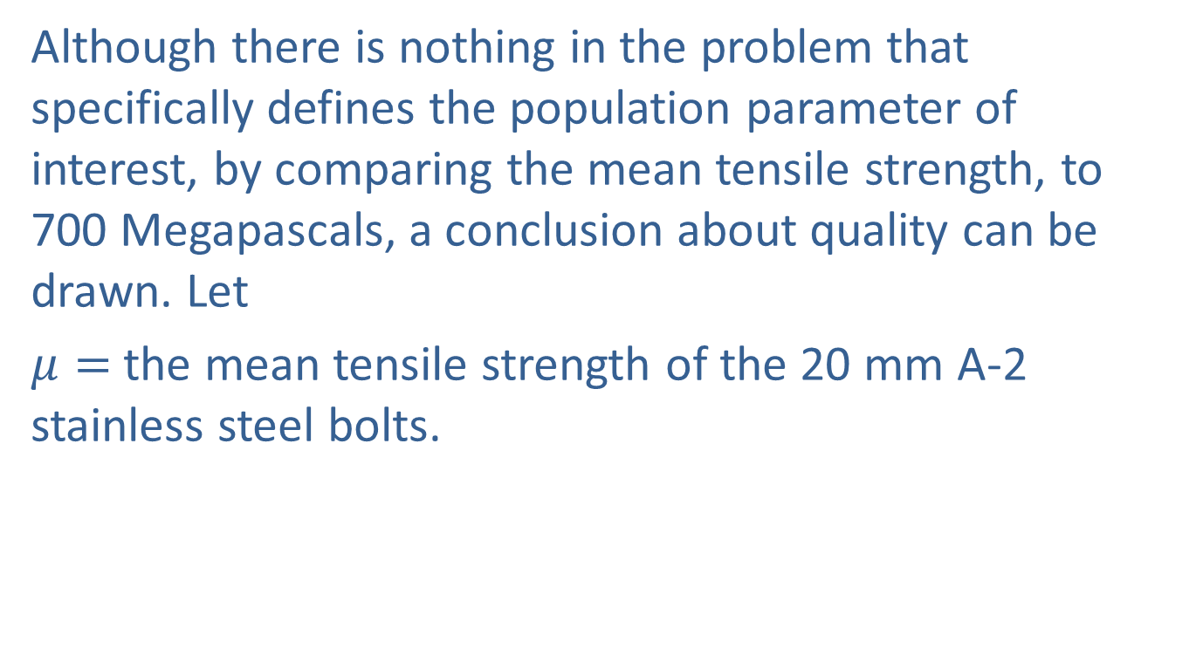
Example 11.3.2: Performing a Hypothesis Test for Mean Tensile Strength (cont.)
Although there is nothing in the problem that specifically defines the population parameter of interest, by comparing the mean tensile strength, to 700 Megapascals, a conclusion about quality can be drawn. Let
$μ=$ the mean tensile strength of the 20 mm A-2 stainless steel bolts.

Slide 28
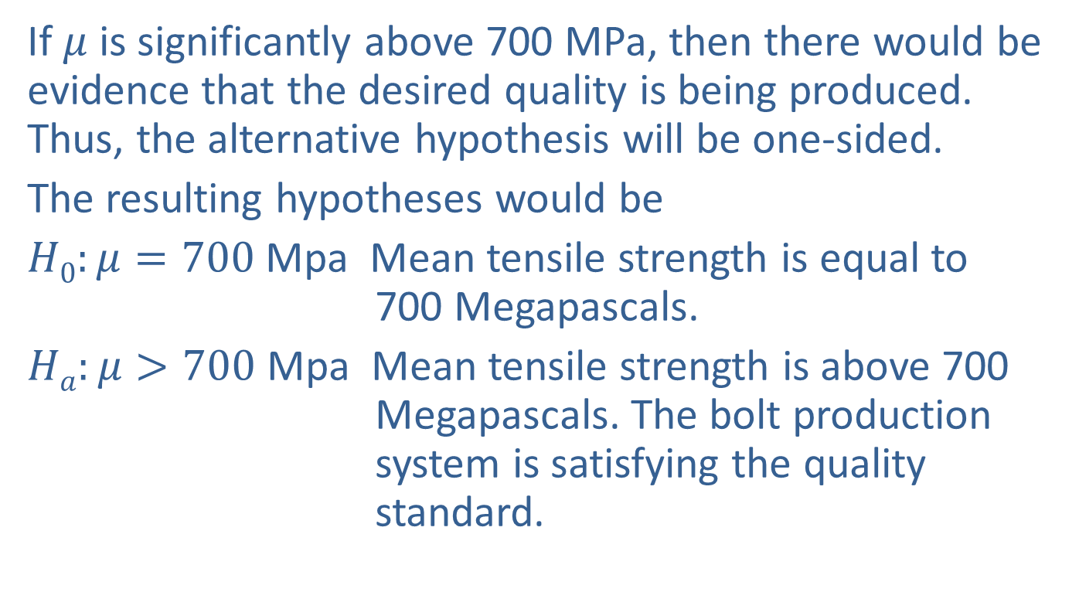
Example 11.3.2: Performing a Hypothesis Test for Mean Tensile Strength (cont.)
If $μ$ is significantly above 700 MPa, then there would be evidence that the desired quality is being produced. Thus, the alternative hypothesis will be one-sided.
The resulting hypotheses would be
$H0:μ=700$Mpa Mean tensile strength is equal to 700 Megapascals.
$Ha:μ>700$Mpa Mean tensile strength is above 700 Megapascals. The bolt production system is satisfying the quality standard.

Slide 29
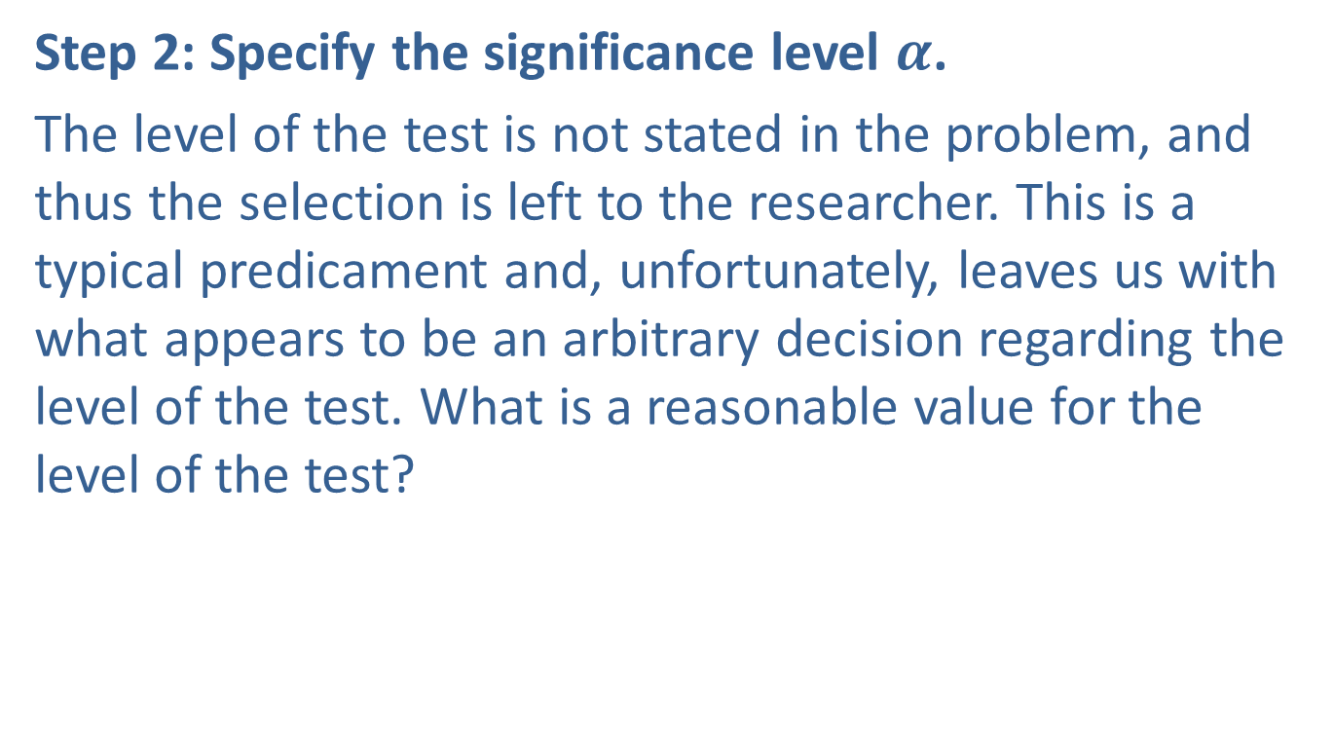
Example 11.3.2: Performing a Hypothesis Test for Mean Tensile Strength (cont.)
Step 2: Specify the significance level $α$.
The level of the test is not stated in the problem, and thus the selection is left to the researcher. This is a typical predicament and, unfortunately, leaves us with what appears to be an arbitrary decision regarding the level of the test. What is a reasonable value for the level of the test?

Slide 30
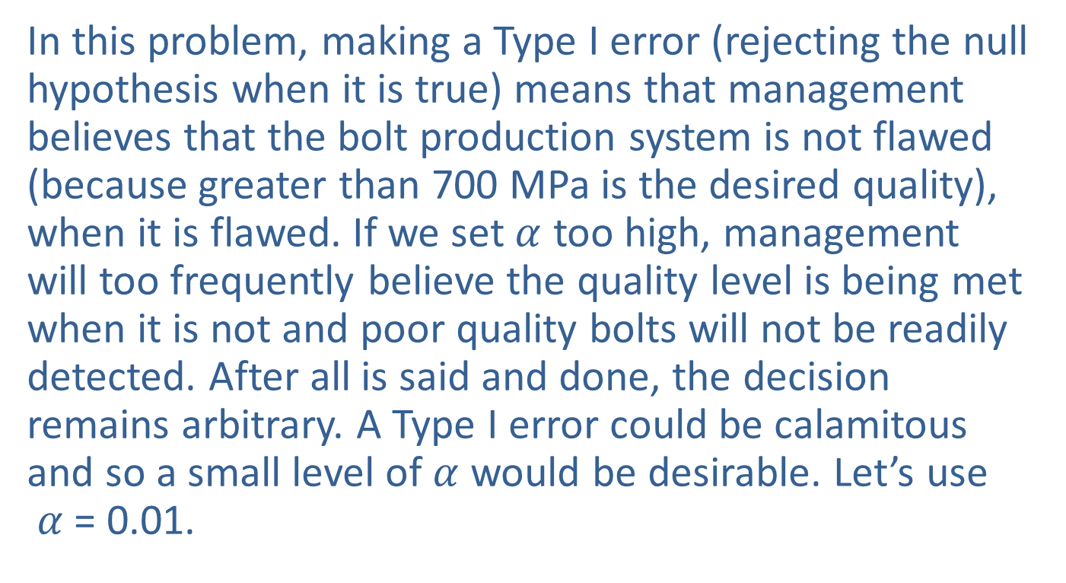
Example 11.3.2: Performing a Hypothesis Test for Mean Tensile Strength (cont.)
In this problem, making a Type I error (rejecting the null hypothesis when it is true) means that management believes that the bolt production system is not flawed (because greater than 700 MPa is the desired quality), when it is flawed. If we set $α$ too high, management will too frequently believe the quality level is being met when it is not and poor quality bolts will not be readily detected. After all is said and done, the decision remains arbitrary. A Type I error could be calamitous and so a small level of $α$ would be desirable. Let’s use $α$ = 0.01.

Slide 31

Example 11.3.2: Performing a Hypothesis Test for Mean Tensile Strength (cont.)
Step 3: Validate the assumptions of the hypothesis test, identify the appropriate test statistic, and compute its value.
First, we validate the assumptions.
Quantitative data (tensile strength)
Random sample used to obtain data
The sample size is less than 30, so we need to confirm that the population is approximately normally distributed. A normal probability plot of the data is given below.

Slide 32
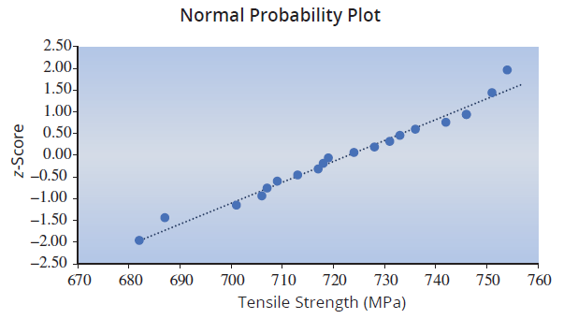
Example 11.3.2: Performing a Hypothesis Test for Mean Tensile Strength (cont.)
The plot does not indicate a significant departure from normality.
Population is approximately normally distributed
or
σ known
σ unknown

Slide 33
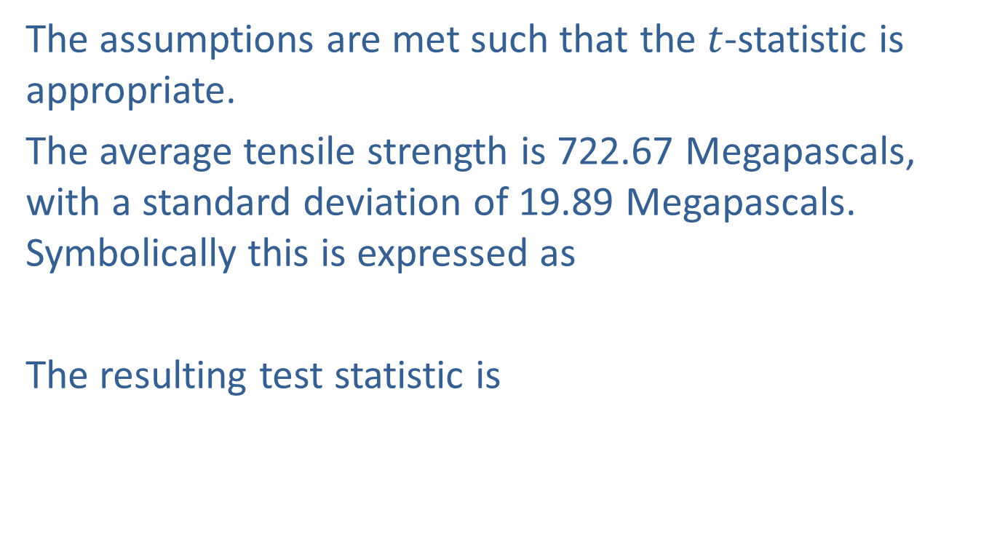
Example 11.3.2: Performing a Hypothesis Test for Mean Tensile Strength (cont.)
The assumptions are met such that the $t$-statistic is appropriate.
The average tensile strength is 722.67 Megapascals, with a standard deviation of 19.89 Megapascals. Symbolically this is expressed as
The resulting test statistic is

Slide 34
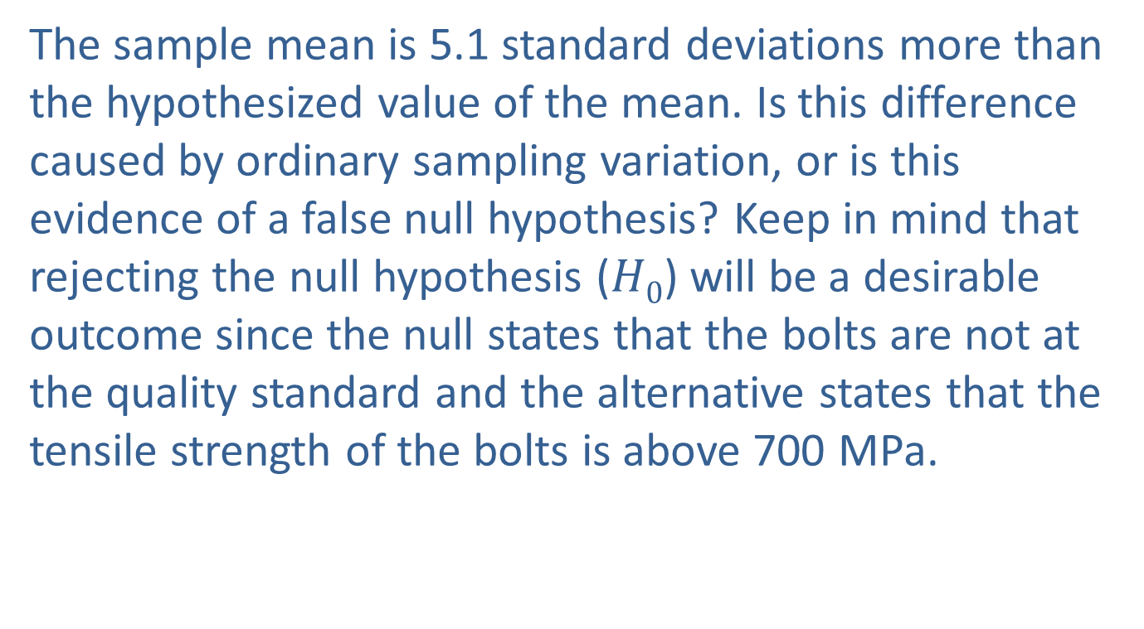
Example 11.3.2: Performing a Hypothesis Test for Mean Tensile Strength (cont.)
The sample mean is 5.1 standard deviations more than the hypothesized value of the mean. Is this difference caused by ordinary sampling variation, or is this evidence of a false null hypothesis? Keep in mind that rejecting the null hypothesis ($H0$) will be a desirable outcome since the null states that the bolts are not at the quality standard and the alternative states that the tensile strength of the bolts is above 700 MPa.

Slide 35
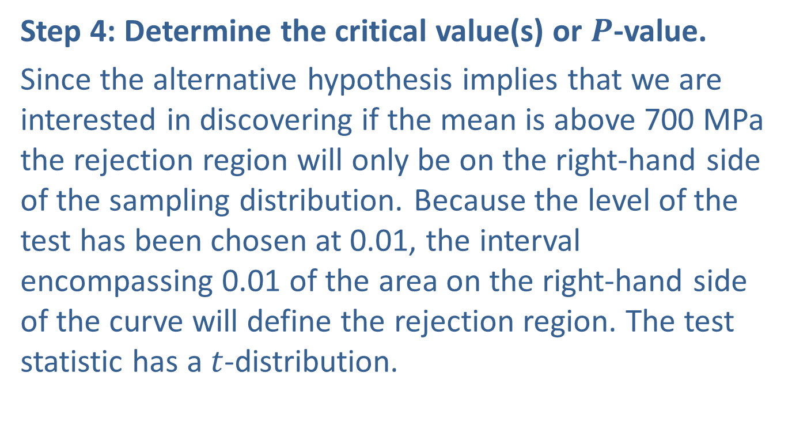
Example 11.3.2: Performing a Hypothesis Test for Mean Tensile Strength (cont.)
Step 4: Determine the critical value(s) or $P$-value.
Since the alternative hypothesis implies that we are interested in discovering if the mean is above 700 MPa the rejection region will only be on the right-hand side of the sampling distribution. Because the level of the test has been chosen at 0.01, the interval encompassing 0.01 of the area on the right-hand side of the curve will define the rejection region. The test statistic has a $t$-distribution.

Slide 36
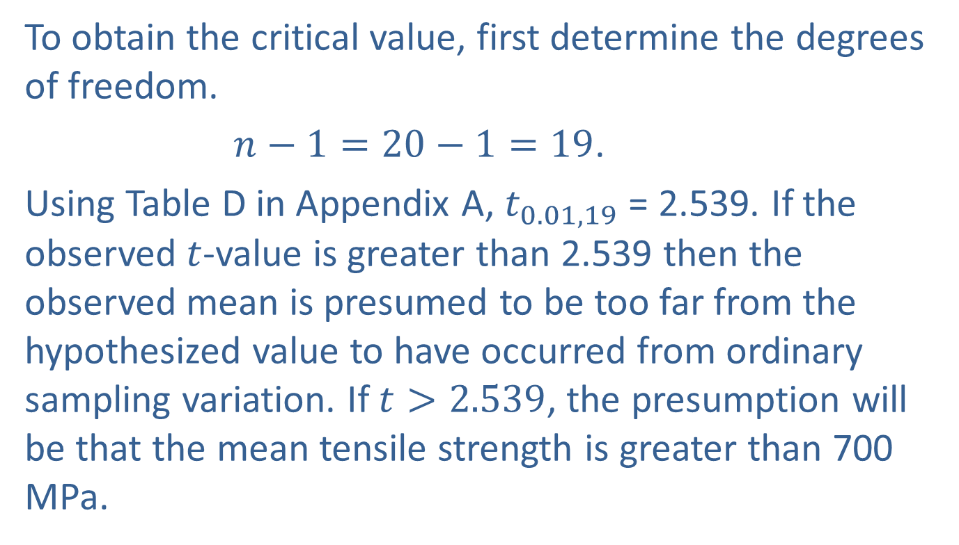
Example 11.3.2: Performing a Hypothesis Test for Mean Tensile Strength (cont.)
To obtain the critical value, first determine the degrees of freedom.
$n−1=20−1=19$.
Using Table D in Appendix A, $t_{0.01,19}$ = 2.539. If the observed $t$-value is greater than 2.539 then the observed mean is presumed to be too far from the hypothesized value to have occurred from ordinary sampling variation. If $t>2.539$, the presumption will be that the mean tensile strength is greater than 700 MPa.

Slide 37
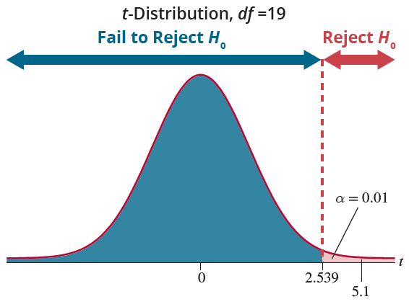
Example 11.3.2: Performing a Hypothesis Test for Mean Tensile Strength (cont.)

Slide 38
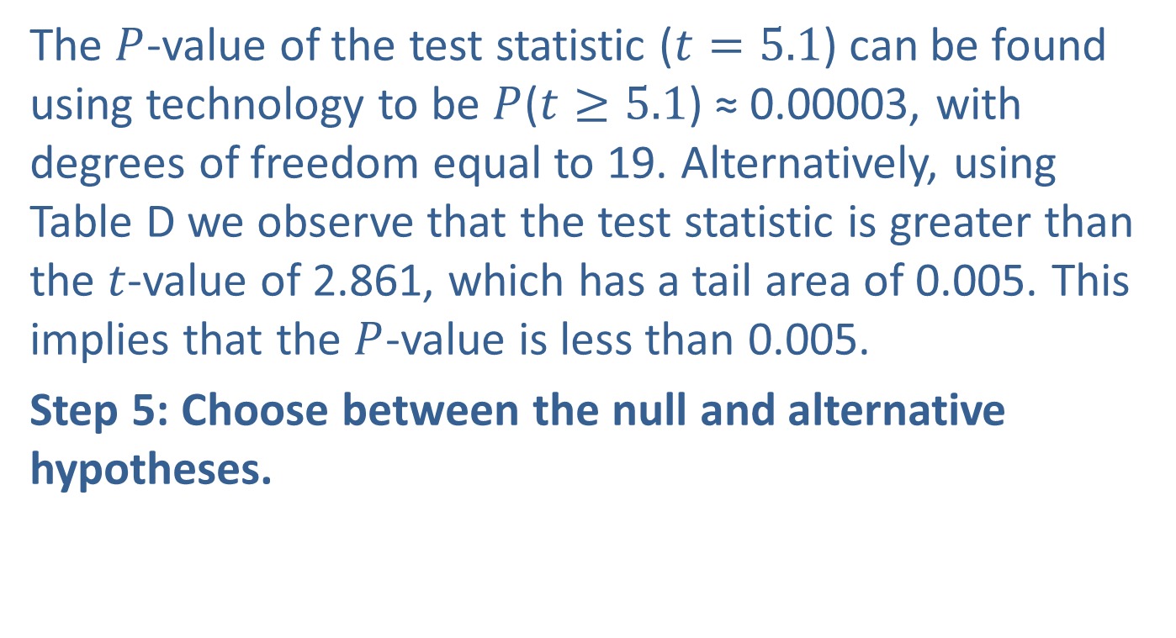
Example 11.3.2: Performing a Hypothesis Test for Mean Tensile Strength (cont.)
The $P$-value of the test statistic ($t=5.1$) can be found using technology to be $P$($t≥5.1$) ≈ 0.00003, with degrees of freedom equal to 19. Alternatively, using Table D we observe that the test statistic is greater than the $t$-value of 2.861, which has a tail area of 0.005. This implies that the $P$-value is less than 0.005.
Step 5: Choose between the null and alternative hypotheses.

Slide 39
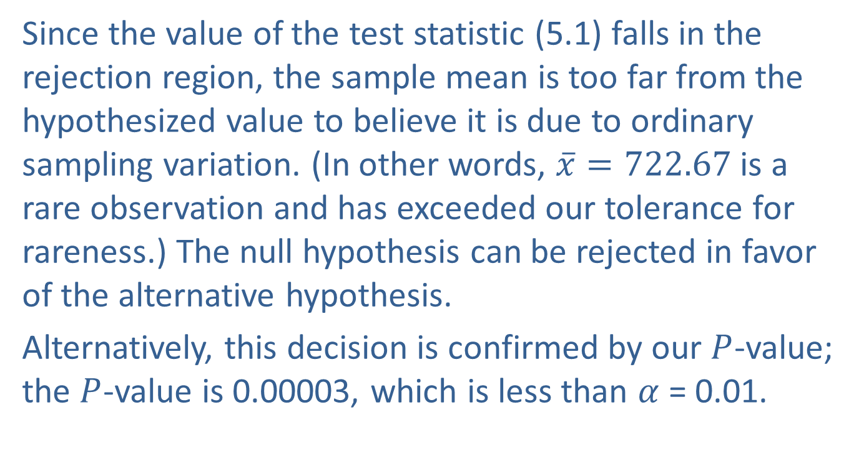
Example 11.3.2: Performing a Hypothesis Test for Mean Tensile Strength (cont.)
Since the value of the test statistic (5.1) falls in the rejection region, the sample mean is too far from the hypothesized value to believe it is due to ordinary sampling variation. (In other words, $\overline{x}=722.67$is a rare observation and has exceeded our tolerance for rareness.) The null hypothesis can be rejected in favor of the alternative hypothesis.
Alternatively, this decision is confirmed by our $P$-value; the $P$-value is 0.00003, which is less than $α$ = 0.01.

Slide 40
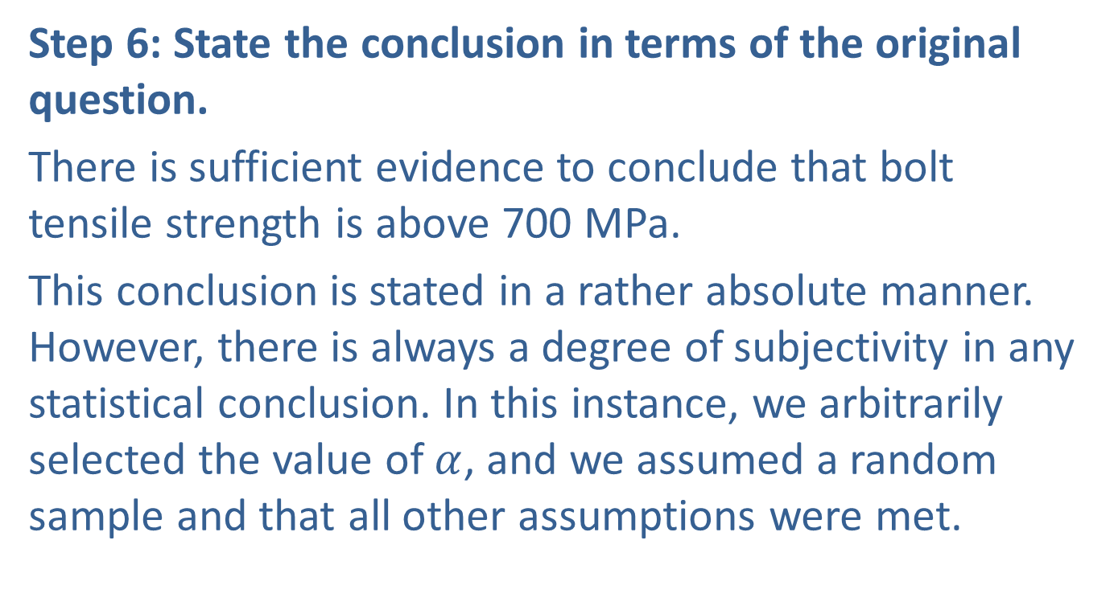
Example 11.3.2: Performing a Hypothesis Test for Mean Tensile Strength (cont.)
Step 6: State the conclusion in terms of the original question.
There is sufficient evidence to conclude that bolt tensile strength is above 700 MPa.
This conclusion is stated in a rather absolute manner. However, there is always a degree of subjectivity in any statistical conclusion. In this instance, we arbitrarily selected the value of $α$, and we assumed a random sample and that all other assumptions were met.

Slide 41

Scientific Significance, Statistical Significance, and $P$-Values
Step 6: State the conclusion in terms of the original question.
The famous statistician Karl Pearson wrote, “The aim of science is nothing short of the complete interpretation of the universe.” If Pearson is correct, then any new piece of knowledge that furthers this aim would be “scientifically significant.” How do we know when a researcher is advocating some new piece of “truth” about the universe that it is actually true?

Slide 42

Scientific Significance, Statistical Significance, and $P$-Values (cont.)
Peer reviewed scientific journals provide quality control for the scientific community and are the gatekeepers for new “truth” candidates to begin to attain the honor of “scientific significance.” How is this process connected to statistics?
For anyone using sampling and data in their research, statistical significance of their research results is the first step in the march toward scientific significance. Scientific significance moves forward when other scientists can reproduce the work of another scientist and thus confirm their results.

Slide 43
Scientific Significance, Statistical Significance, and $P$-Values (cont.)
That is why one of the hallmarks of good scientific research is the notion of reproducibility. That is, if two or more researchers performed the same experiment, they would likely reach similar conclusions, and with roughly the same level of uncertainty. Yet, in a survey of 1576 scientists in Nature, 70% of the researchers had tried and failed to reproduce another scientist’s experiments, and amazingly more than half have failed to reproduce their own experiments.

Slide 44
Scientific Significance, Statistical Significance, and $P$-Values (cont.)
In the opinion of the survey participants the number one reason for the lack of reproducibility was the selective reporting “cherry picking” of data that supports a favorite (or publishable) hypothesis. Data from a complex research experiment can produce many measures of the phenomena under consideration. When a researcher with some overarching research thesis looks at this data there will be many potential choices of hypotheses.

Slide 45
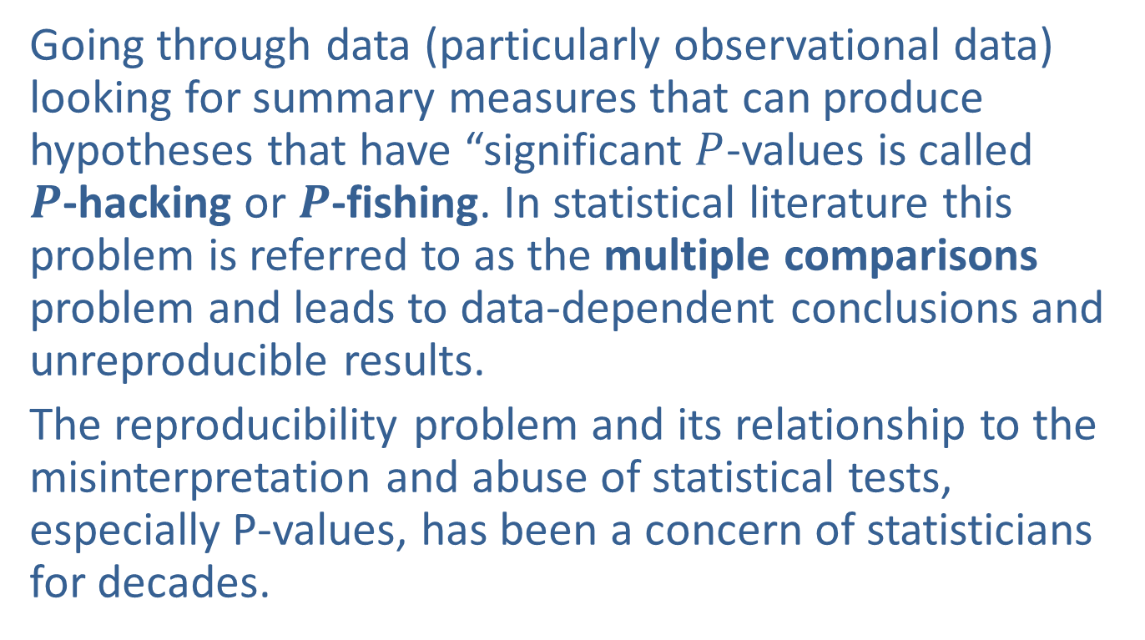
Scientific Significance, Statistical Significance, and $P$-Values (cont.)
Going through data (particularly observational data) looking for summary measures that can produce hypotheses that have “significant $P$-values is called $P$-hacking or $P$-fishing. In statistical literature this problem is referred to as the multiple comparisons problem and leads to data-dependent conclusions and unreproducible results.
The reproducibility problem and its relationship to the misinterpretation and abuse of statistical tests, especially P-values, has been a concern of statisticians for decades.

Slide 46
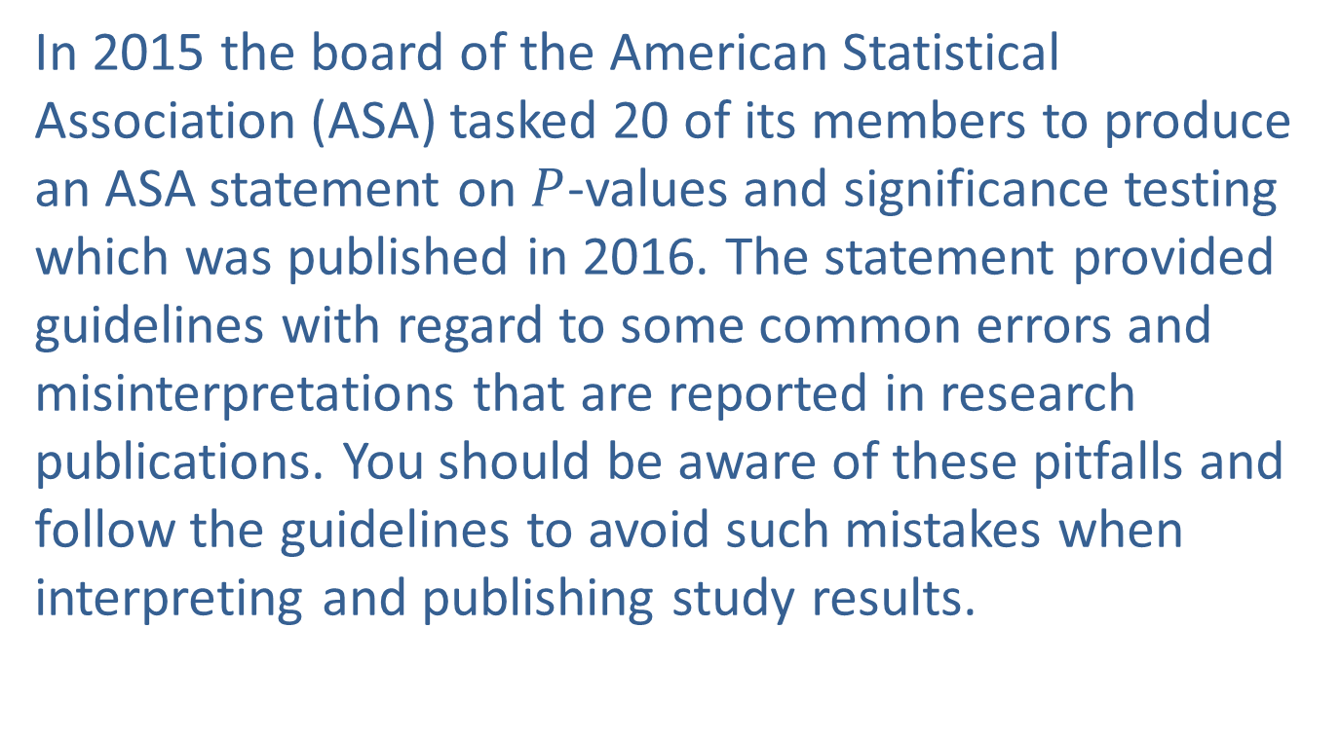
Scientific Significance, Statistical Significance, and $P$-Values (cont.)
In 2015 the board of the American Statistical Association (ASA) tasked 20 of its members to produce an ASA statement on $P$-values and significance testing which was published in 2016. The statement provided guidelines with regard to some common errors and misinterpretations that are reported in research publications. You should be aware of these pitfalls and follow the guidelines to avoid such mistakes when interpreting and publishing study results.

Slide 47

American Statistical Association Guidelines Regarding $P$-Values
P-values can indicate how incompatible the data are with a specified statistical model.
P-values do not measure the probability that the studied hypothesis is true, or the probability that the data were produced by random chance alone.
Scientific conclusions and business or policy decisions should not be based only on whether a P-value passes a specific threshold.
Proper inference requires full reporting and transparency.

Slide 48

American Statistical Association Guidelines Regarding $P$-Values (cont.)
A P-value, or statistical significance, does not measure the size of an effect or the importance of a result.
By itself, a P-value does not provide a good measure of evidence regarding a model or hypothesis.

Slide 49
Scientific Significance, Statistical Significance, and $P$-Values (cont.)
There are a complex set of assumptions in any test of hypothesis. In addition to the variability of the underlying data and the test statistic there are other assumptions concerning how the data was collected, analyzed, and reported. Essentially, hypothesis testing requires a disciplined attention to the details of the process. It starts with a definition of the null and alternative hypothesis before we begin examining the data.
You can help eliminate these issues by being a responsible researcher.

Slide 50
Scientific Significance, Statistical Significance, and $P$-Values (cont.)
When making conclusions for important decisions, you should thoroughly consider the results of the hypothesis test. Ask yourself some of the following questions:
Is my result practically significant? With very large samples, it’s easy to get a small P-value (large test statistic) even though the sample value may not be practically different than the hypothesized value.
Are the assumptions I made to perform the test justifiable?
Can I reproduce my results?

