Slide 1
Section 11.2
Testing a Hypothesis about a Population Mean, σ Known

Slide 2
Example 11.2.1: Performing a Hypothesis Test for Reading Level
Suppose the average national reading level for high school sophomores is 150 words per minute with a standard deviation of 15. A local school board member wants to know if sophomore students at Lincoln High School read at a level different from the national average for tenth graders. The level of the test is to be set at 0.05. A random sample size of 100 tenth graders from Lincoln High School has been drawn, and the resulting average is 154 words per minute.

Slide 3
Example 11.2.1: Performing a Hypothesis Test for Reading Level (cont.)
Solution
Step 1: Determine the population parameter to be used and develop the null and alternative hypotheses.
We will first define the hypotheses in plain English and then using symbols.
The hypotheses are fairly straightforward:
Null Hypothesis: Lincoln High School tenth graders are reading at the national average.
Alternative Hypothesis: They are not.

Slide 4
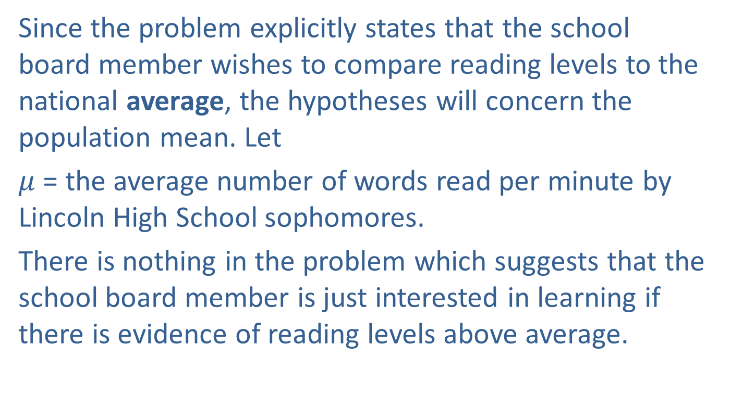
Example 11.2.1: Performing a Hypothesis Test for Reading Level (cont.)
Since the problem explicitly states that the school board member wishes to compare reading levels to the national average, the hypotheses will concern the population mean. Let
$μ$ = the average number of words read per minute by Lincoln High School sophomores.
There is nothing in the problem which suggests that the school board member is just interested in learning if there is evidence of reading levels above average.

Slide 5
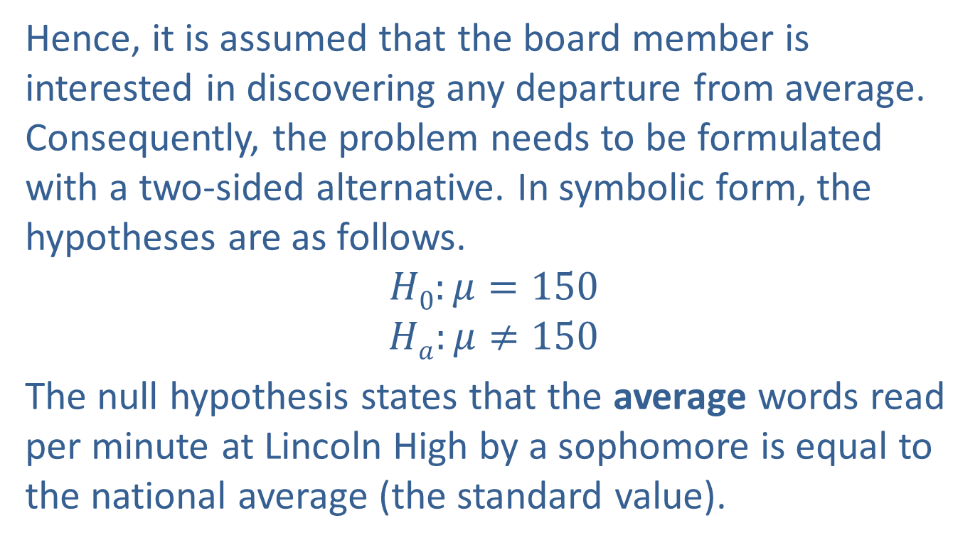
Example 11.2.1: Performing a Hypothesis Test for Reading Level (cont.)
Hence, it is assumed that the board member is interested in discovering any departure from average. Consequently, the problem needs to be formulated with a two-sided alternative. In symbolic form, the hypotheses are as follows.
$$H0:μ=150$$
$$Ha:μ≠150$$
The null hypothesis states that the average words read per minute at Lincoln High by a sophomore is equal to the national average (the standard value).

Slide 6
Example 11.2.1: Performing a Hypothesis Test for Reading Level (cont.)
The alternative states that it is not. This is an application of testing against a standard value.
For tests of a single mean there are only three possible research questions that can be asked about the population mean and they are all asked in the alternative hypothesis. The correct formulation of the hypotheses for each of these research questions is contained in Table 11.2.1.

Slide 7
Example 11.2.1: Performing a Hypothesis Test for Reading Level (cont.)
Table 11.2.1 - Hypotheses Concerning a Test about a Single Mean
 | Research Question
 | Is the population mean different from μ₀? | Is the population mean greater than μ₀? | Is the population mean less than μ₀?
Null Hypothesis, H₀ | μ = μ₀ | μ = μ₀ | μ = μ₀
Alternative Hypothesis, H_{a} | μ ≠ μ₀ | μ > μ₀ | μ < μ₀
Type of Hypothesis Test | Two-tailed | Right-tailed | Left-tailed

Slide 8
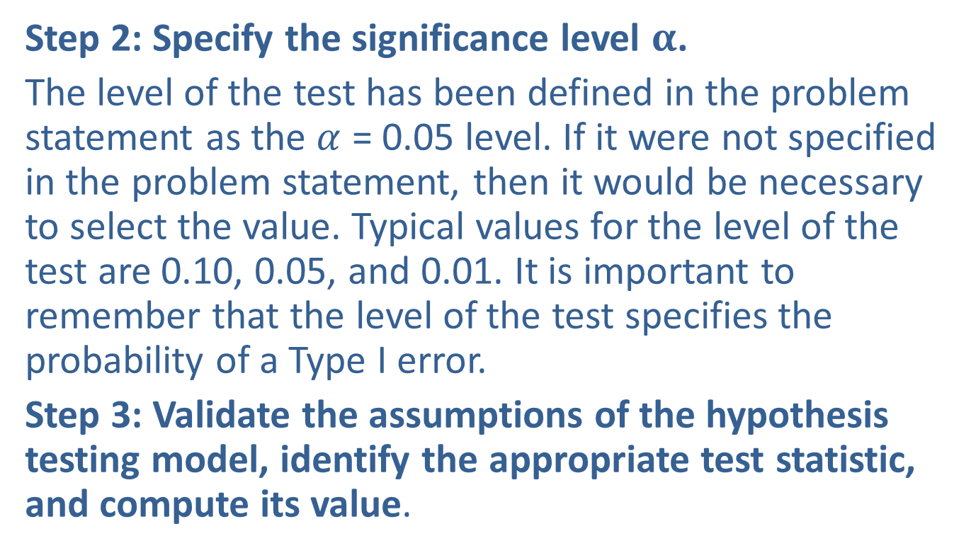
Example 11.2.1: Performing a Hypothesis Test for Reading Level (cont.)
Step 2: Specify the significance level $α$.
The level of the test has been defined in the problem statement as the $α$ = 0.05 level. If it were not specified in the problem statement, then it would be necessary to select the value. Typical values for the level of the test are 0.10, 0.05, and 0.01. It is important to remember that the level of the test specifies the probability of a Type I error.
Step 3: Validate the assumptions of the hypothesis testing model, identify the appropriate test statistic, and compute its value.

Slide 9

Procedure: Testing a Hypothesis About a Mean, σ Known
Assumptions:
The data is quantitative.
The data is obtained via a random sample of size n.
The population is normally distributed or the sample size n is large, n > 30.
The population standard deviation $σ$ is known.
Test statistic:
The test statistic is given by

Slide 10
Procedure: Testing a Hypothesis About a Mean, σ Known (cont.)
where,
n = the sample size,
= the sample mean,
μ₀ = the population mean (from the null hypothesis), and
σ = the known population standard deviation.

Slide 11
Example 11.2.1: Performing a Hypothesis Test for Reading Level (cont.)
Before proceeding with the test, we must check our assumptions.
Quantitative data
Random sample used to obtain data
n > 30 or population is normally distributed
σ known or ◻ σ unknown

Slide 12
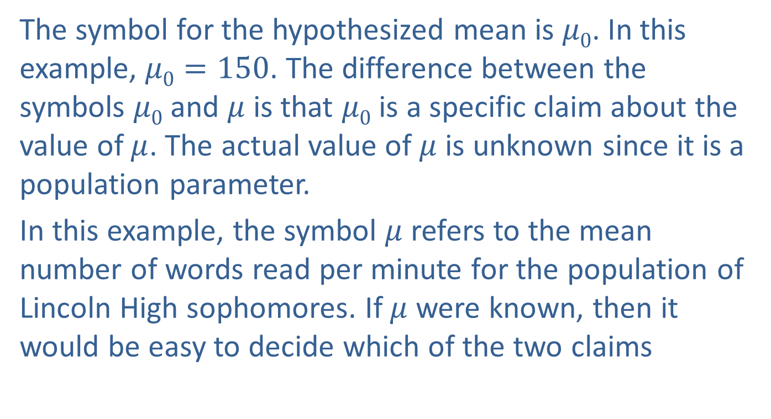

Testing a Hypothesis about a Population Mean, $σ$ Known
The symbol for the hypothesized mean is $μ0$. In this example, $μ0=150$. The difference between the symbols $μ0$ and $μ$ is that $μ0$ is a specific claim about the value of $μ$. The actual value of $μ$ is unknown since it is a population parameter.
In this example, the symbol $μ$ refers to the mean number of words read per minute for the population of Lincoln High sophomores. If $μ$ were known, then it would be easy to decide which of the two claims

Slide 13


Testing a Hypothesis about a Population Mean, $σ$ Known (cont.)
$H0:μ=150$ (null hypothesis)
$Ha:μ≠150$ (alternative hypothesis)
is correct. But, since it is not we will rely on hypothesis testing methods to make the decision.

Slide 14

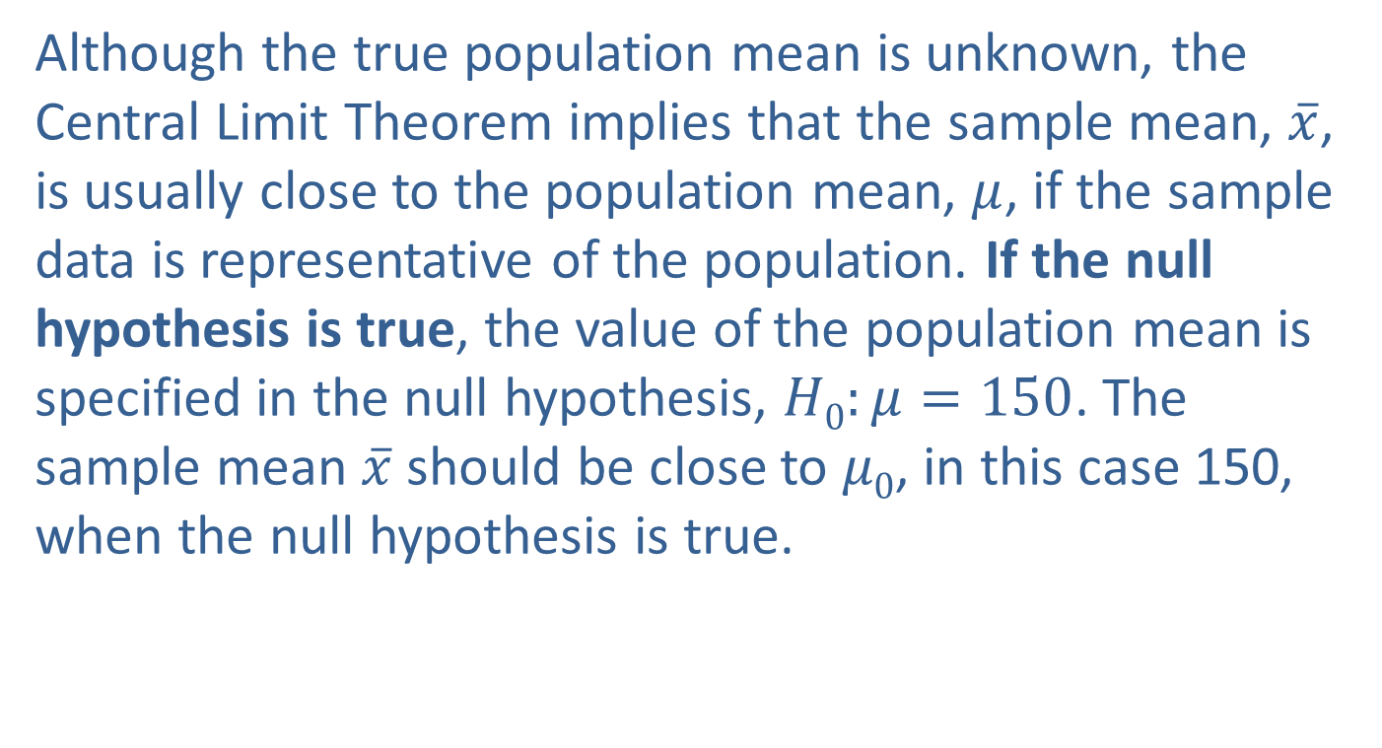
What is the Rationale for the Test Statistic?
Although the true population mean is unknown, the Central Limit Theorem implies that the sample mean, $\overline{x}$, is usually close to the population mean, $μ$, if the sample data is representative of the population. If the null hypothesis is true, the value of the population mean is specified in the null hypothesis, $H0:μ=150$. The sample mean $\overline{x}$ should be close to $μ0$, in this case 150, when the null hypothesis is true.

Slide 15

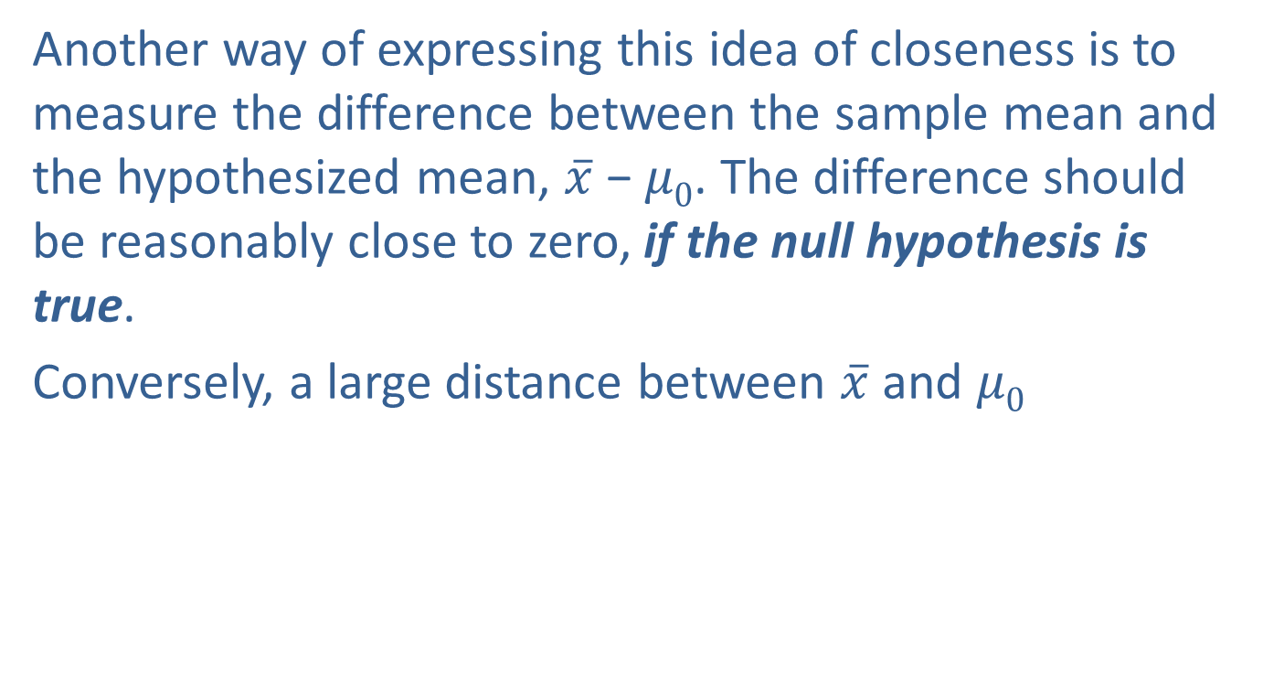
What is the Rationale for the Test Statistic? (cont.)
Another way of expressing this idea of closeness is to measure the difference between the sample mean and the hypothesized mean, $\overline{x}$ − $μ0$. The difference should be reasonably close to zero, if the null hypothesis is true.
Conversely, a large distance between $\overline{x}$ and $μ0$

Slide 16
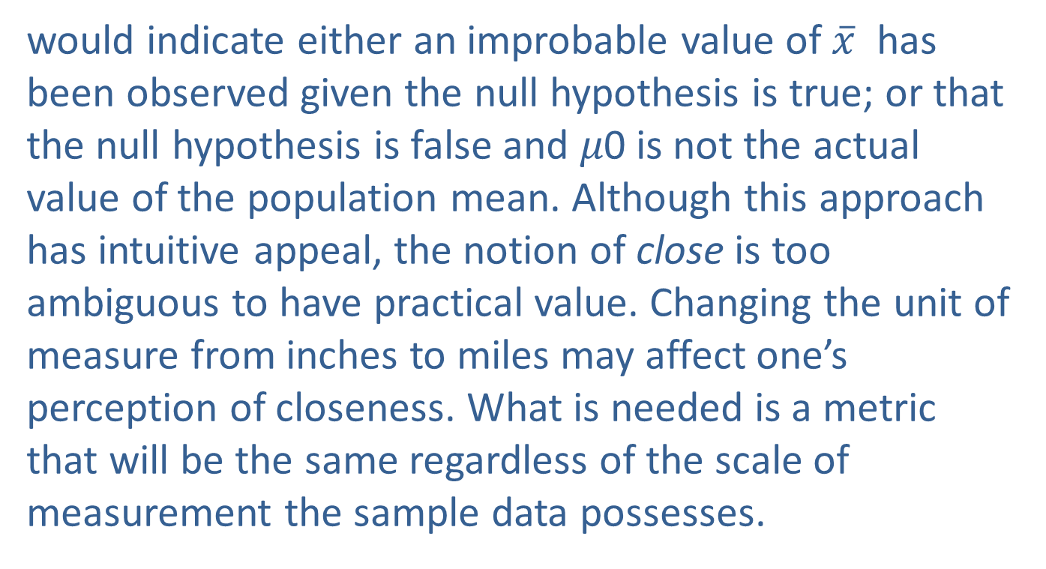
What is the Rationale for the Test Statistic? (cont.)
would indicate either an improbable value of $\overline{x}$ has been observed given the null hypothesis is true; or that the null hypothesis is false and 𝜇0 is not the actual value of the population mean. Although this approach has intuitive appeal, the notion of close is too ambiguous to have practical value. Changing the unit of measure from inches to miles may affect one’s perception of closeness. What is needed is a metric that will be the same regardless of the scale of measurement the sample data possesses.

Slide 17
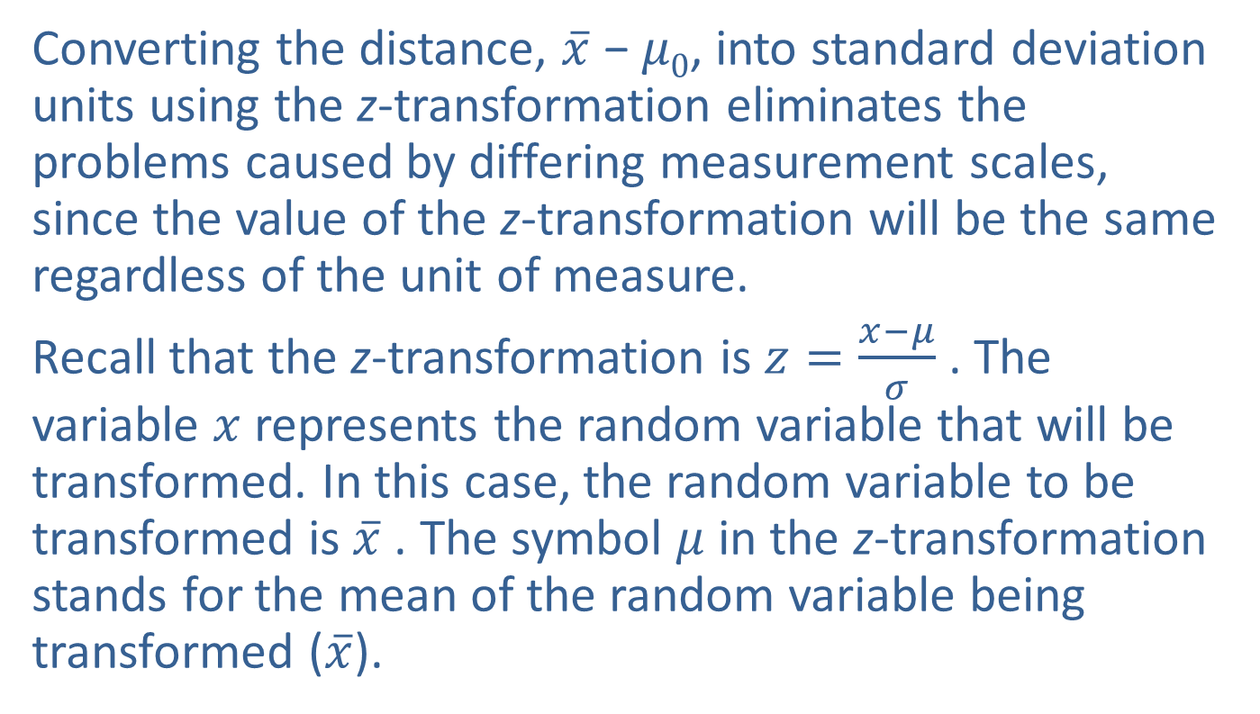
Measuring Closeness
Converting the distance, $\overline{x}$ − $μ0$, into standard deviation units using the z-transformation eliminates the problems caused by differing measurement scales, since the value of the z-transformation will be the same regardless of the unit of measure.
Recall that the z-transformation is $z=\frac{x−μ}{σ}$ . The variable $x$ represents the random variable that will be transformed. In this case, the random variable to be transformed is $\overline{x}$ . The symbol $μ$ in the z-transformation stands for the mean of the random variable being transformed ($\overline{x}$).

Slide 18
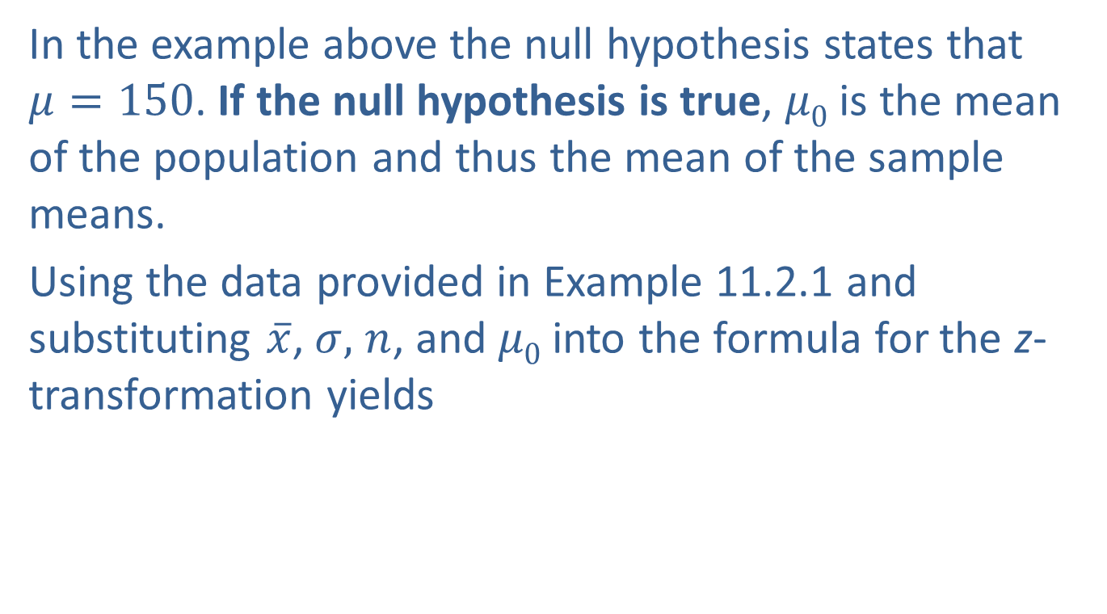
Measuring Closeness (cont.)
In the example above the null hypothesis states that $μ=150$. If the null hypothesis is true, $μ0$ is the mean of the population and thus the mean of the sample means.
Using the data provided in Example 11.2.1 and substituting $\overline{x}$, $σ,$ $n$, and $μ0$ into the formula for the z-transformation yields

Slide 19
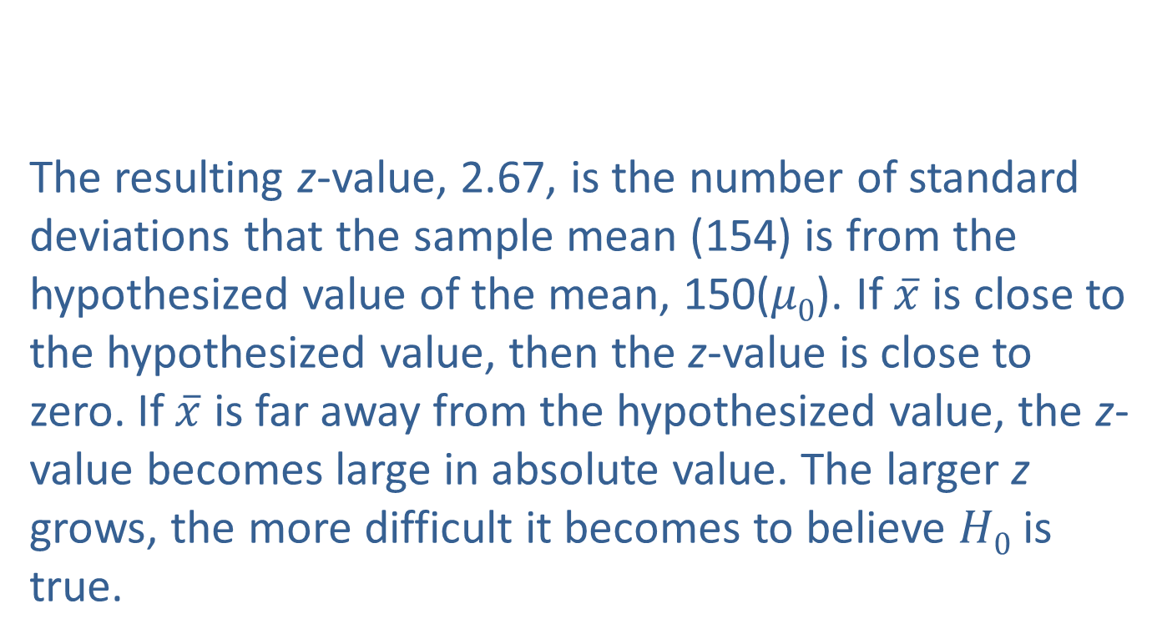
Measuring Closeness (cont.)
The resulting z-value, 2.67, is the number of standard deviations that the sample mean (154) is from the hypothesized value of the mean, 150($μ0$). If $\overline{x}$ is close to the hypothesized value, then the z-value is close to zero. If $\overline{x}$ is far away from the hypothesized value, the z-value becomes large in absolute value. The larger z grows, the more difficult it becomes to believe $H0$ is true.

Slide 20
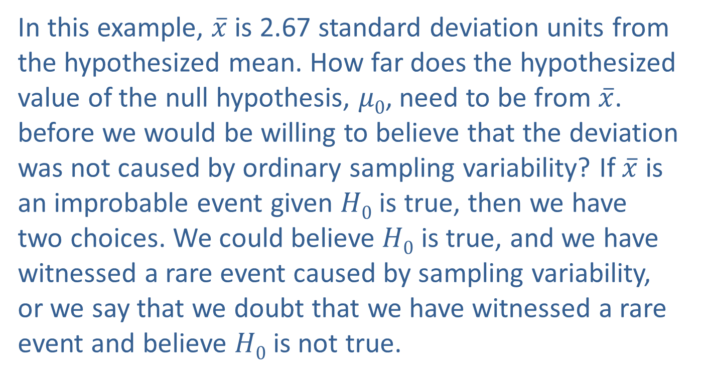
Measuring Closeness (cont.)
In this example, $\overline{x}$ is 2.67 standard deviation units from the hypothesized mean. How far does the hypothesized value of the null hypothesis, $μ0$, need to be from $\overline{x}$. before we would be willing to believe that the deviation was not caused by ordinary sampling variability? If $\overline{x}$ is an improbable event given $H0$ is true, then we have two choices. We could believe $H0$ is true, and we have witnessed a rare event caused by sampling variability, or we say that we doubt that we have witnessed a rare event and believe $H0$ is not true.

Slide 21
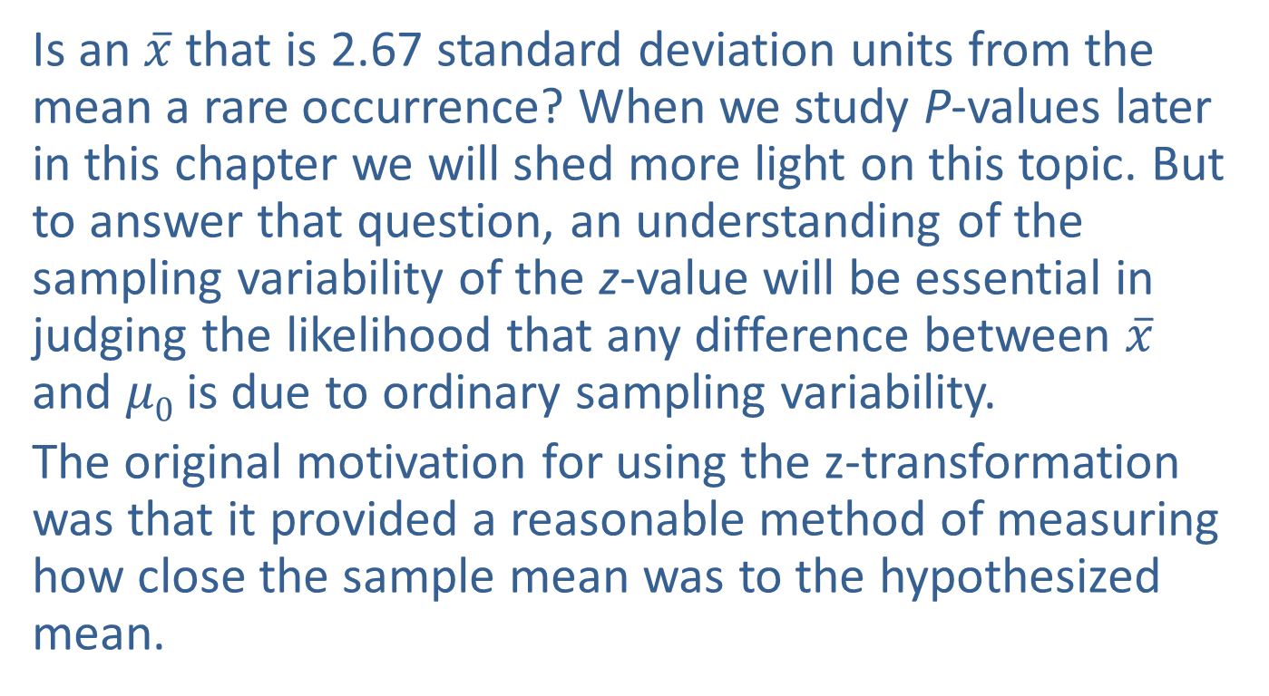
Measuring Closeness (cont.)
Is an $\overline{x}$ that is 2.67 standard deviation units from the mean a rare occurrence? When we study P-values later in this chapter we will shed more light on this topic. But to answer that question, an understanding of the sampling variability of the z-value will be essential in judging the likelihood that any difference between $\overline{x}$ and $μ0$ is due to ordinary sampling variability.
The original motivation for using the z-transformation was that it provided a reasonable method of measuring how close the sample mean was to the hypothesized mean.

Slide 22
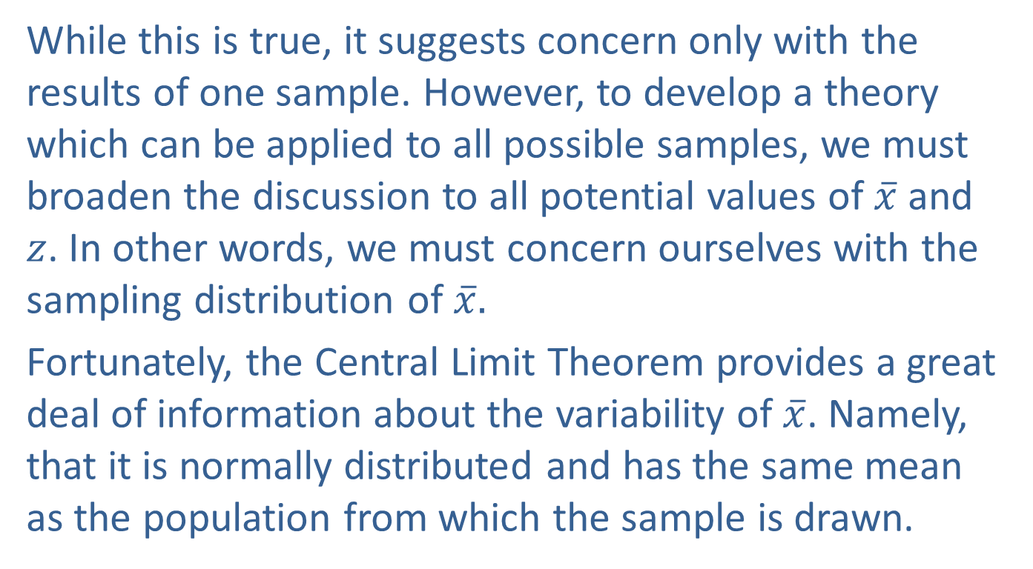
Measuring Closeness (cont.)
While this is true, it suggests concern only with the results of one sample. However, to develop a theory which can be applied to all possible samples, we must broaden the discussion to all potential values of $\overline{x}$ and $z$. In other words, we must concern ourselves with the sampling distribution of $\overline{x}.$
Fortunately, the Central Limit Theorem provides a great deal of information about the variability of $\overline{x}$. Namely, that it is normally distributed and has the same mean as the population from which the sample is drawn.

Slide 23
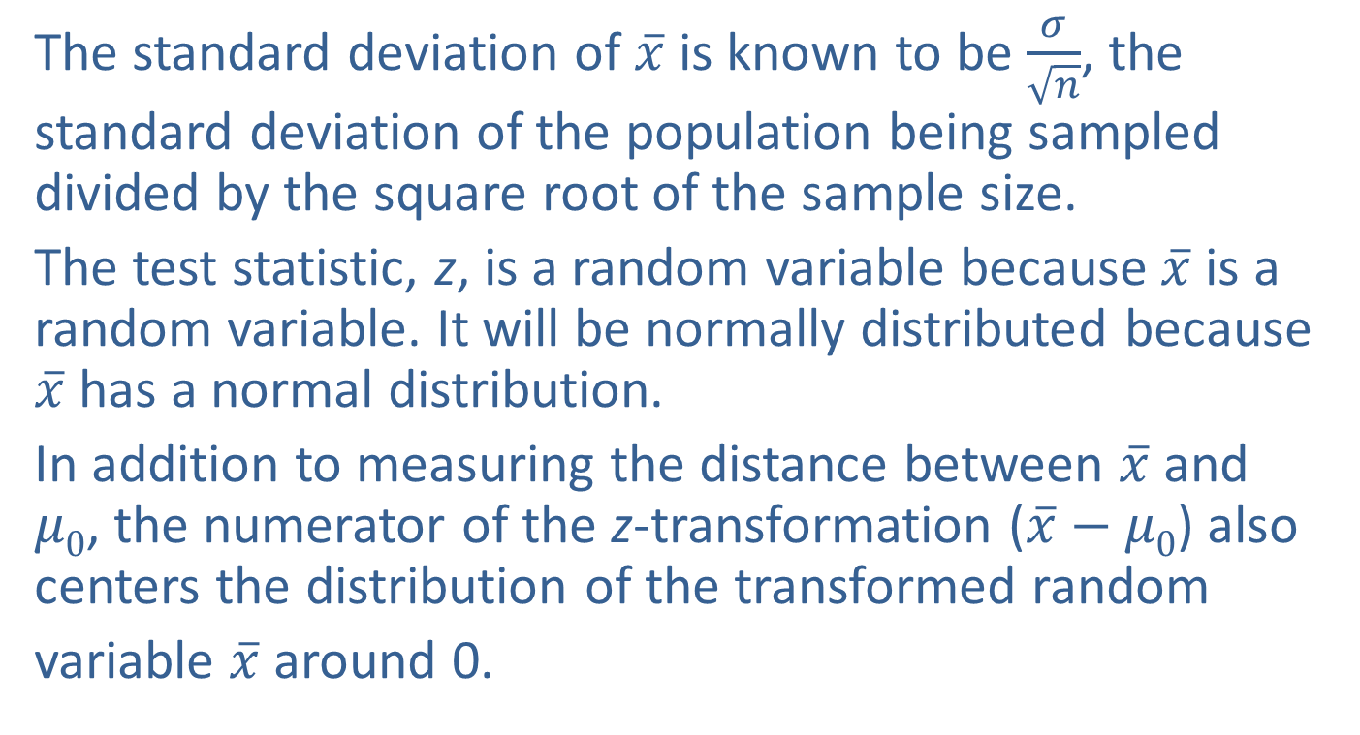
Measuring Closeness (cont.)
The standard deviation of $\overline{x}$ is known to be $\frac{σ}{\sqrt{n}}$, the standard deviation of the population being sampled divided by the square root of the sample size.
The test statistic, z, is a random variable because $\overline{x}$ is a random variable. It will be normally distributed because $\overline{x}$ has a normal distribution.
In addition to measuring the distance between $\overline{x}$ and $μ0$, the numerator of the z-transformation ($\overline{x}−$ $μ0$) also centers the distribution of the transformed random
variable $\overline{x}$ around 0.

Slide 24
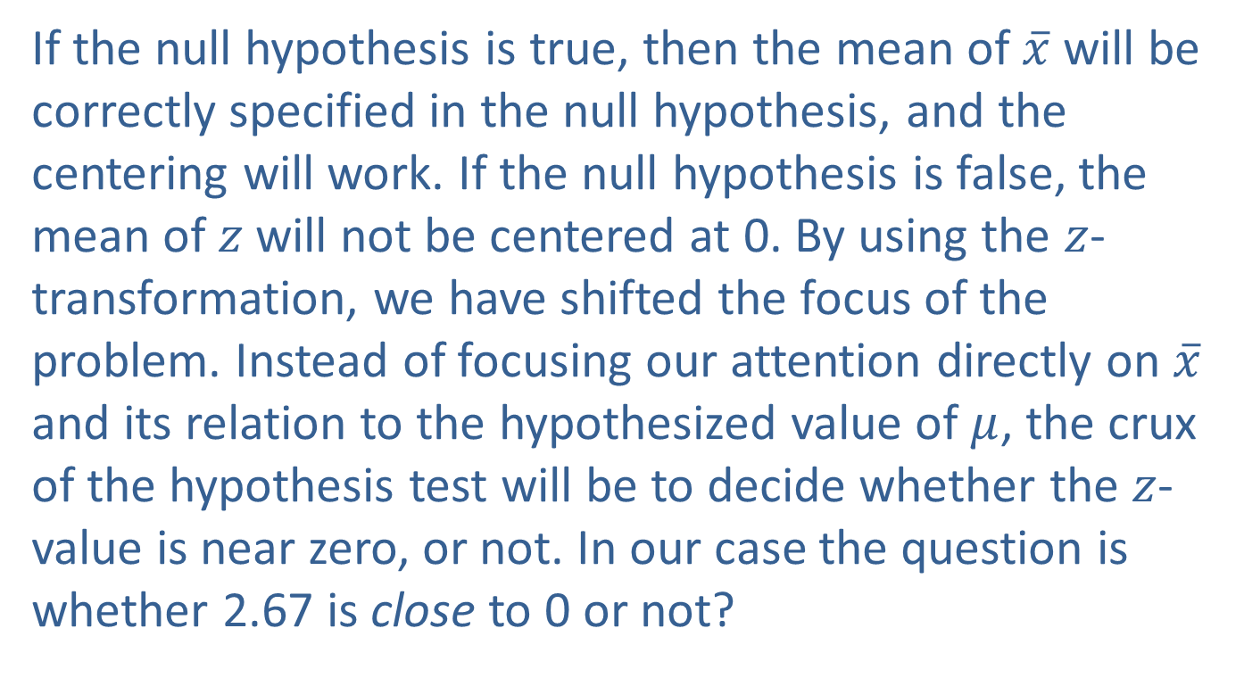
Measuring Closeness (cont.)
If the null hypothesis is true, then the mean of $\overline{x}$ will be correctly specified in the null hypothesis, and the centering will work. If the null hypothesis is false, the mean of $z$ will not be centered at 0. By using the $z$-transformation, we have shifted the focus of the problem. Instead of focusing our attention directly on $\overline{x}$ and its relation to the hypothesized value of $μ$, the crux of the hypothesis test will be to decide whether the $z$-value is near zero, or not. In our case the question is whether 2.67 is close to 0 or not?

Slide 25
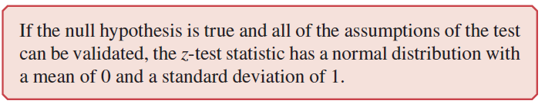
Measuring Closeness (cont.)
This question will be addressed when the decision rule is constructed.

Slide 26
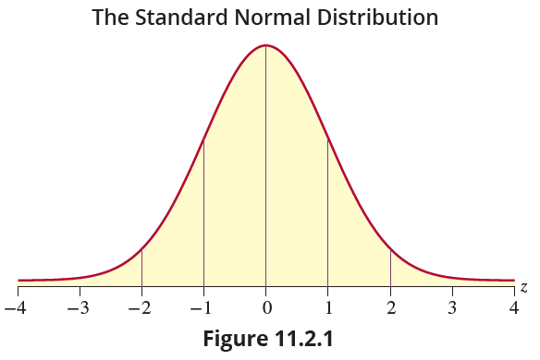
Measuring Closeness (cont.)

Slide 27
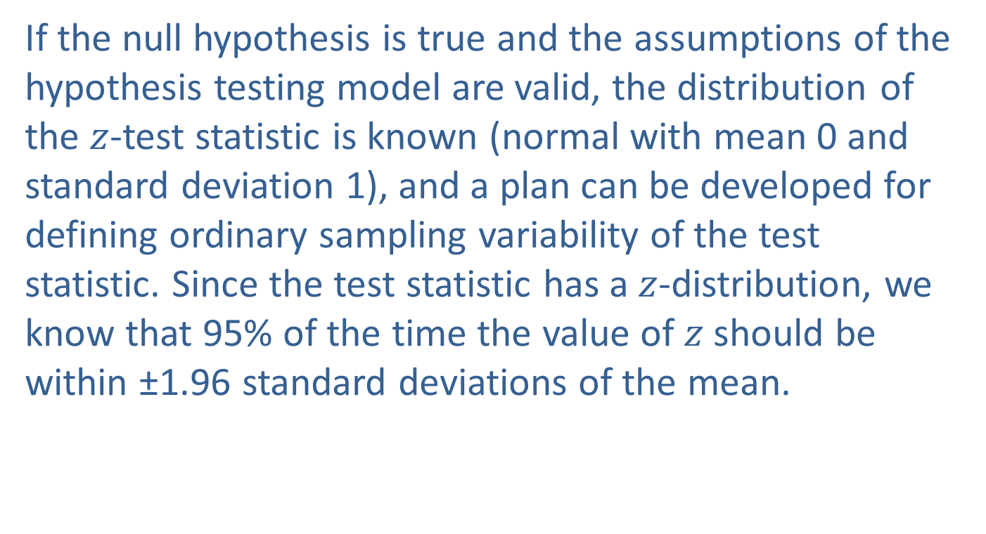
Measuring Closeness (cont.)
If the null hypothesis is true and the assumptions of the hypothesis testing model are valid, the distribution of the $z$-test statistic is known (normal with mean 0 and standard deviation 1), and a plan can be developed for defining ordinary sampling variability of the test statistic. Since the test statistic has a $z$-distribution, we know that 95% of the time the value of $z$ should be within ±1.96 standard deviations of the mean.

Slide 28
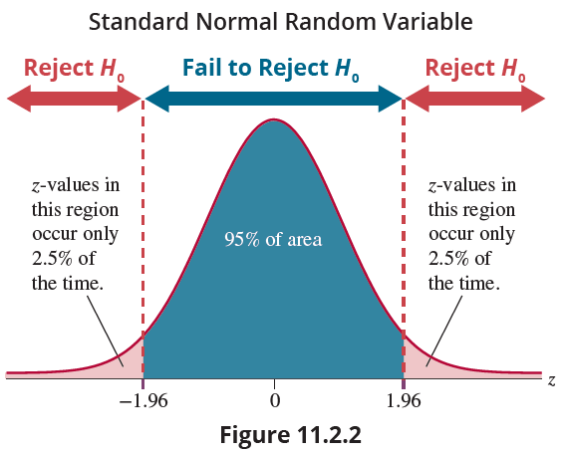
Measuring Closeness (cont.)

Slide 29
Measuring Closeness (cont.)
Figure 11.2.2 presents the distribution that represents the statistical model being tested under the assumption that the null hypothesis is true. In this problem using α = 0.05, if the sample mean is within 1.96 standard deviation units of the hypothesized value of the mean, we choose to not reject the null hypothesis because a sample mean in this range is close enough to the hypothesized value of the mean to occur as result of typical sampling variation, assuming the null hypothesis is true.

Slide 30
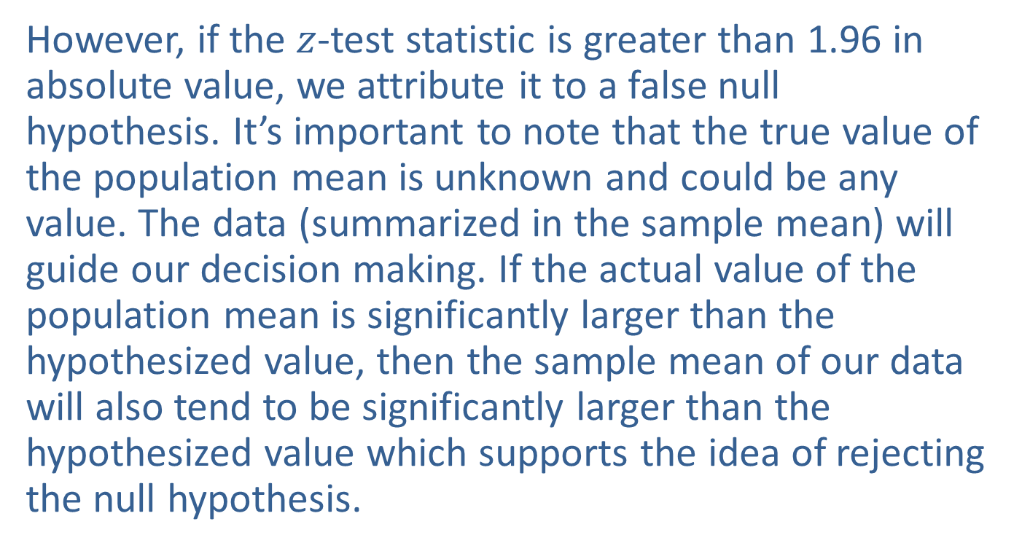
Measuring Closeness (cont.)
However, if the $z$-test statistic is greater than 1.96 in absolute value, we attribute it to a false null hypothesis. It’s important to note that the true value of the population mean is unknown and could be any value. The data (summarized in the sample mean) will guide our decision making. If the actual value of the population mean is significantly larger than the hypothesized value, then the sample mean of our data will also tend to be significantly larger than the hypothesized value which supports the idea of rejecting the null hypothesis.

Slide 31
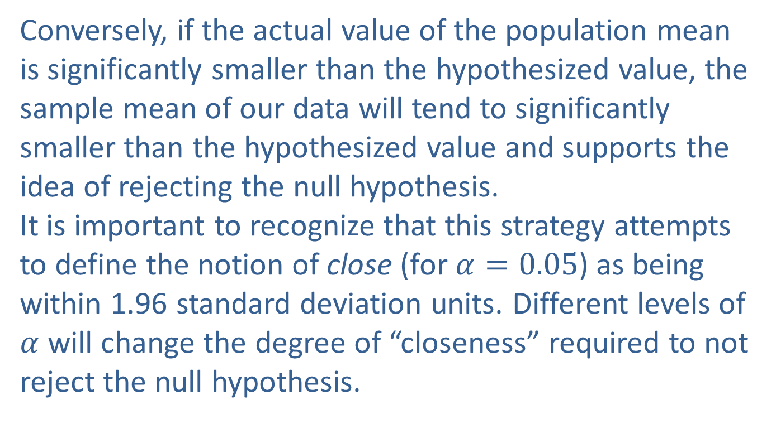
Measuring Closeness (cont.)
Conversely, if the actual value of the population mean is significantly smaller than the hypothesized value, the sample mean of our data will tend to significantly smaller than the hypothesized value and supports the idea of rejecting the null hypothesis. It is important to recognize that this strategy attempts to define the notion of close (for $α=0.05$) as being within 1.96 standard deviation units. Different levels of $α$ will change the degree of “closeness” required to not reject the null hypothesis.

Slide 32
Example 11.2.1: Performing a Hypothesis Test for Reading Level (cont.)
Step 3 (continued.): Validate the assumptions of the hypothesis testing model, identify the appropriate test statistic, and compute its value.
The random sample of 100 tenth graders revealed a mean reading rate of 154 words per minute with a standard deviation of 15 words per minute. As discussed earlier, the z-test statistic is given by

Slide 33
Example 11.2.1: Performing a Hypothesis Test for Reading Level (cont.)
The sample mean is 2.67 standard deviations from the hypothesized value. Is the sample mean too far away from the value of the mean specified in the null hypothesis for us to believe the null is true?
Step 4: Determine the critical value(s).
In determining the critical value(s) of the test statistic, we must take into account whether the alternative hypothesis is one-sided or two-sided, the level of the test, and the distribution of the test statistic.

Slide 34
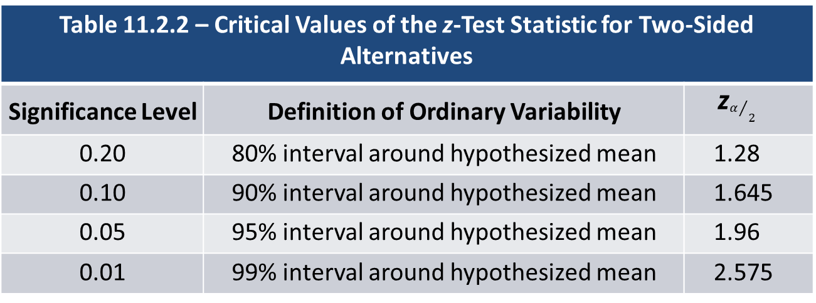
Example 11.2.1: Performing a Hypothesis Test for Reading Level (cont.)
Table 11.2.2 – Critical Values of the z-Test Statistic for Two‑Sided Alternatives
Significance Level | Definition of Ordinary Variability | z$α/2$
0.20 | 80% interval around hypothesized mean | 1.28
0.10 | 90% interval around hypothesized mean | 1.645
0.05 | 95% interval around hypothesized mean | 1.96
0.01 | 99% interval around hypothesized mean | 2.575

Slide 35
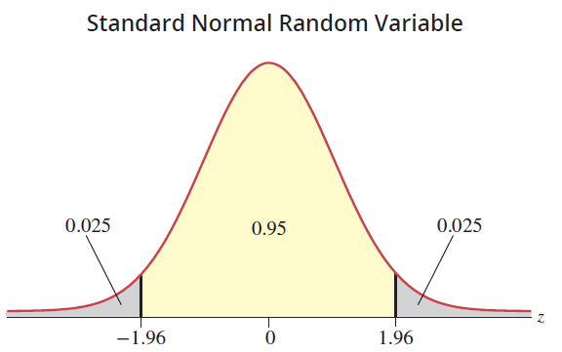
Example 11.2.1: Performing a Hypothesis Test for Reading Level (cont.)

Slide 36
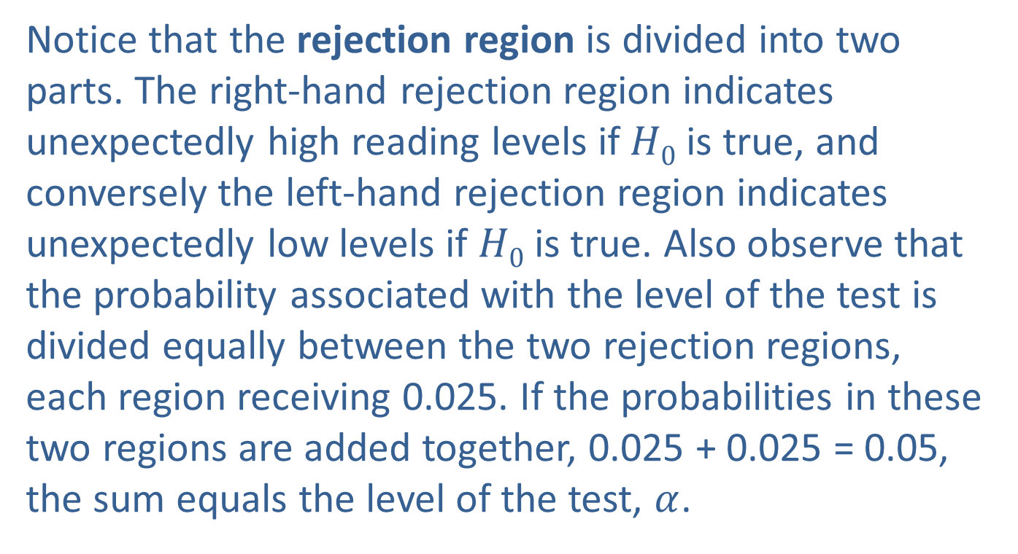
Example 11.2.1: Performing a Hypothesis Test for Reading Level (cont.)
Notice that the rejection region is divided into two parts. The right-hand rejection region indicates unexpectedly high reading levels if $H0$ is true, and conversely the left-hand rejection region indicates unexpectedly low levels if $H0$ is true. Also observe that the probability associated with the level of the test is divided equally between the two rejection regions, each region receiving 0.025. If the probabilities in these two regions are added together, 0.025 + 0.025 = 0.05, the sum equals the level of the test, $α$.

Slide 37
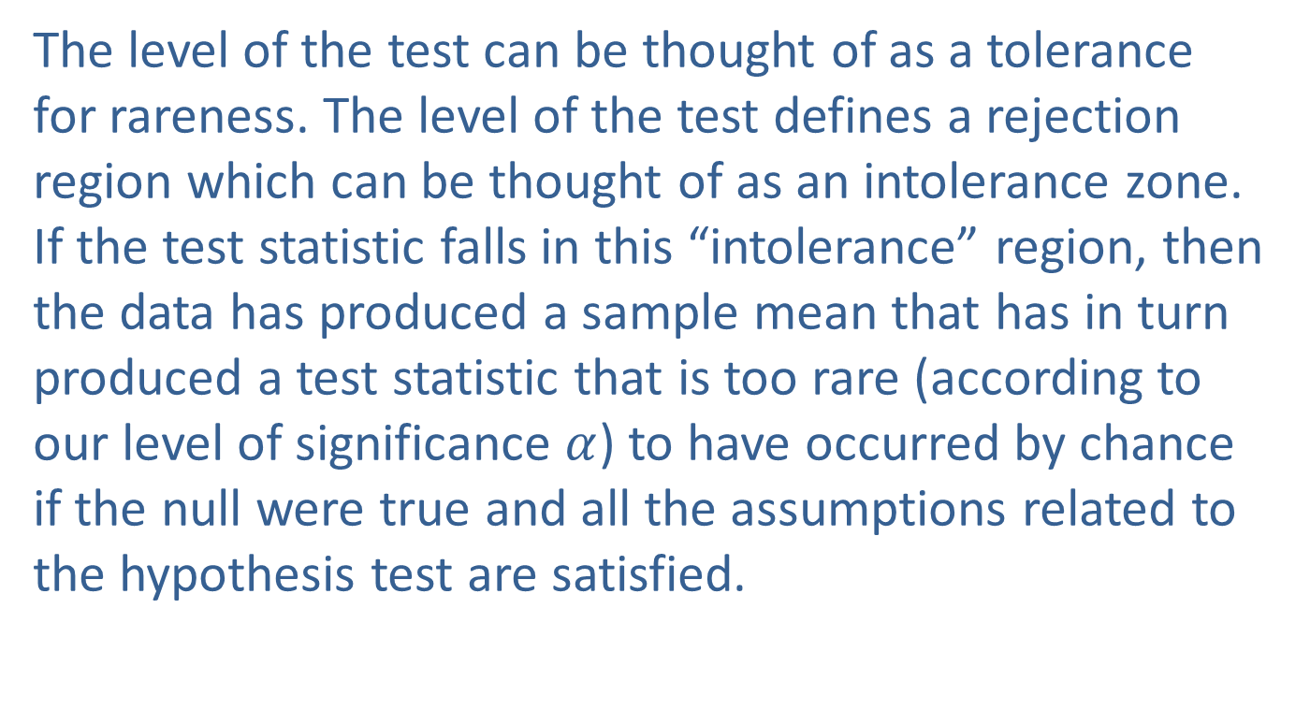
Example 11.2.1: Performing a Hypothesis Test for Reading Level (cont.)
The level of the test can be thought of as a tolerance for rareness. The level of the test defines a rejection region which can be thought of as an intolerance zone. If the test statistic falls in this “intolerance” region, then the data has produced a sample mean that has in turn produced a test statistic that is too rare (according to our level of significance $α$) to have occurred by chance if the null were true and all the assumptions related to the hypothesis test are satisfied.

Slide 38
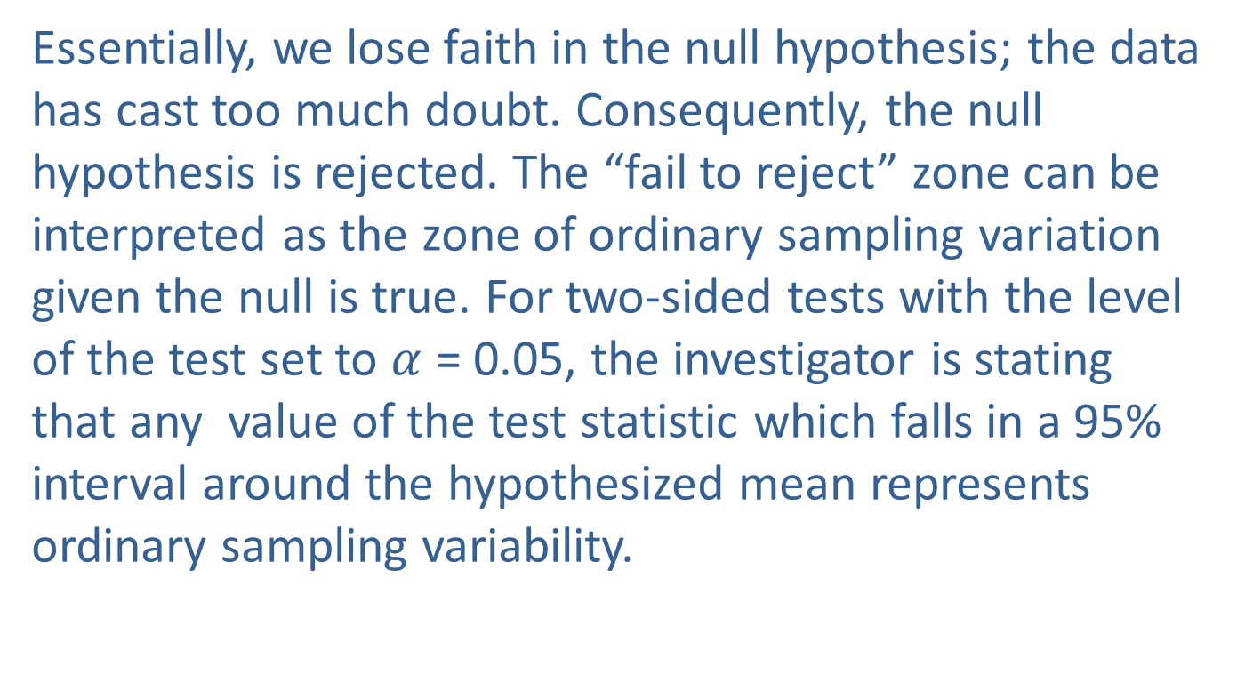
Example 11.2.1: Performing a Hypothesis Test for Reading Level (cont.)
Essentially, we lose faith in the null hypothesis; the data has cast too much doubt. Consequently, the null hypothesis is rejected. The “fail to reject” zone can be interpreted as the zone of ordinary sampling variation given the null is true. For two-sided tests with the level of the test set to $α$ = 0.05, the investigator is stating that any value of the test statistic which falls in a 95% interval around the hypothesized mean represents ordinary sampling variability.

Slide 39
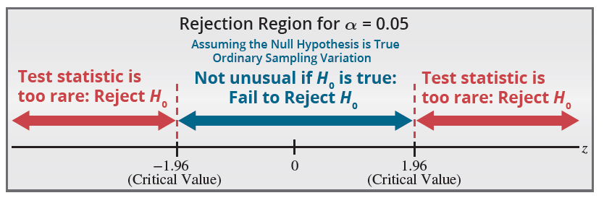

Example 11.2.1: Performing a Hypothesis Test for Reading Level (cont.)
For the $z$-test statistic, this corresponds to a critical value of 1.96 standard deviation units (see Table 11.2.2). If the test statistic falls into the ordinary sampling variation zone, the null hypothesis will not be rejected.

Slide 40
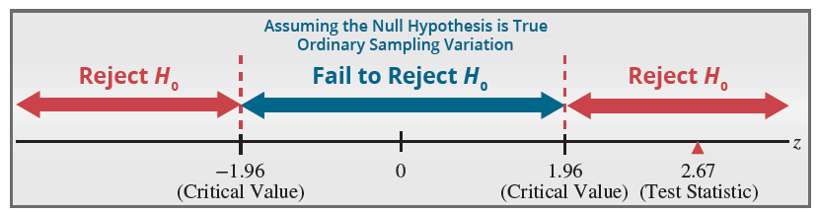
Example 11.2.1: Performing a Hypothesis Test for Reading Level (cont.)
Step 5: Choose between the null and alternative hypotheses.
The critical values of the test statistic are ±1.96. If the null were true, observing a value of z larger in absolute value than 1.96 would occur only 5% of the time.

Slide 41
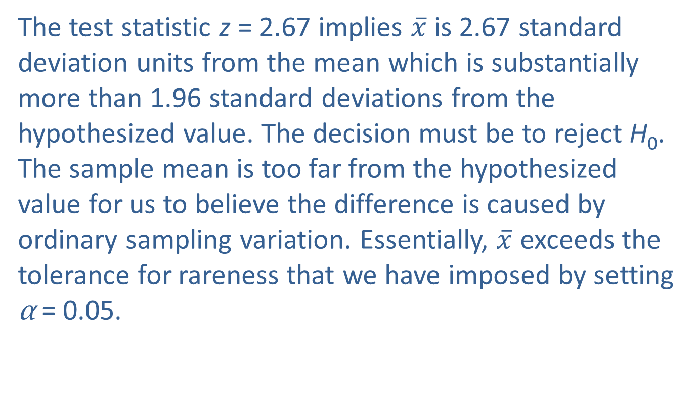
Example 11.2.1: Performing a Hypothesis Test for Reading Level (cont.)
The test statistic z = 2.67 implies $\overline{x}$ is 2.67 standard deviation units from the mean which is substantially more than 1.96 standard deviations from the hypothesized value. The decision must be to reject H₀. The sample mean is too far from the hypothesized value for us to believe the difference is caused by ordinary sampling variation. Essentially, $\overline{x}$ exceeds the tolerance for rareness that we have imposed by setting α = 0.05.

Slide 42

Example 11.2.1: Performing a Hypothesis Test for Reading Level (cont.)
Step 6: State the conclusion in terms of the original question.
There is significant evidence at the 0.05 level that tenth graders at Lincoln High do not read at the national average. It would be tempting to conclude that they read above national levels, since the sample mean is considerably above the national average.

Slide 43
Example 11.2.1: Performing a Hypothesis Test for Reading Level (cont.)
However, we did not test the hypothesis for reading overachievement; we tested reading achievement either over or under the state average, and the conclusions must be consistent with the hypotheses tested.

Slide 44
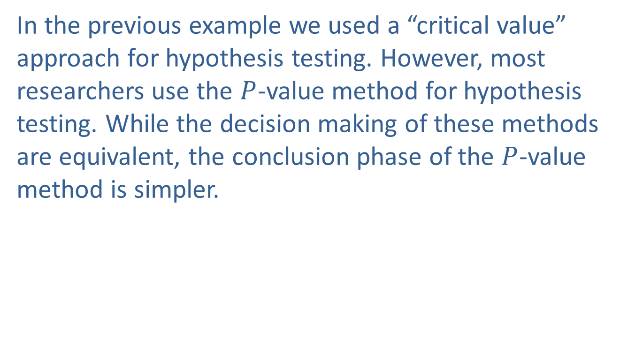
P-Values
In the previous example we used a “critical value” approach for hypothesis testing. However, most researchers use the $P$-value method for hypothesis testing. While the decision making of these methods are equivalent, the conclusion phase of the $P$-value method is simpler.

Slide 45
Definition: P-Value
A P-value is the probability of observing a value of the test statistic as extreme or more extreme than the observed one, assuming the null hypothesis is true and all the assumptions related to the hypothesis test are satisfied.

Slide 46
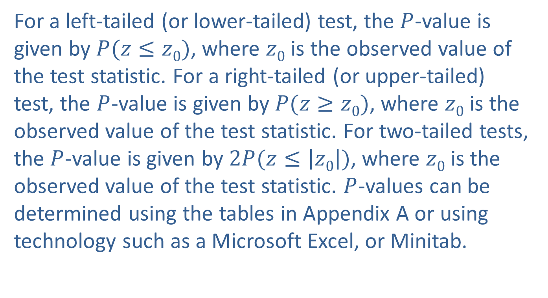
P-Values (cont.)
For a left-tailed (or lower-tailed) test, the $P$-value is given by $P(z≤z0)$, where $z0$ is the observed value of the test statistic. For a right-tailed (or upper-tailed) test, the $P$-value is given by $P(z≥z0)$, where $z0$ is the observed value of the test statistic. For two-tailed tests, the $P$-value is given by $2P(z≤\left|z0\right|)$, where $z0$ is the observed value of the test statistic. $P$-values can be determined using the tables in Appendix A or using technology such as a Microsoft Excel, or Minitab.

Slide 47
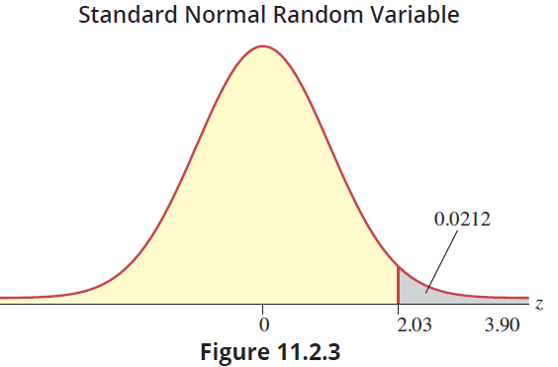

P-Values (cont.)
The following graph displays the application of the definition to the test statistic, $z=2.03$.

Slide 48
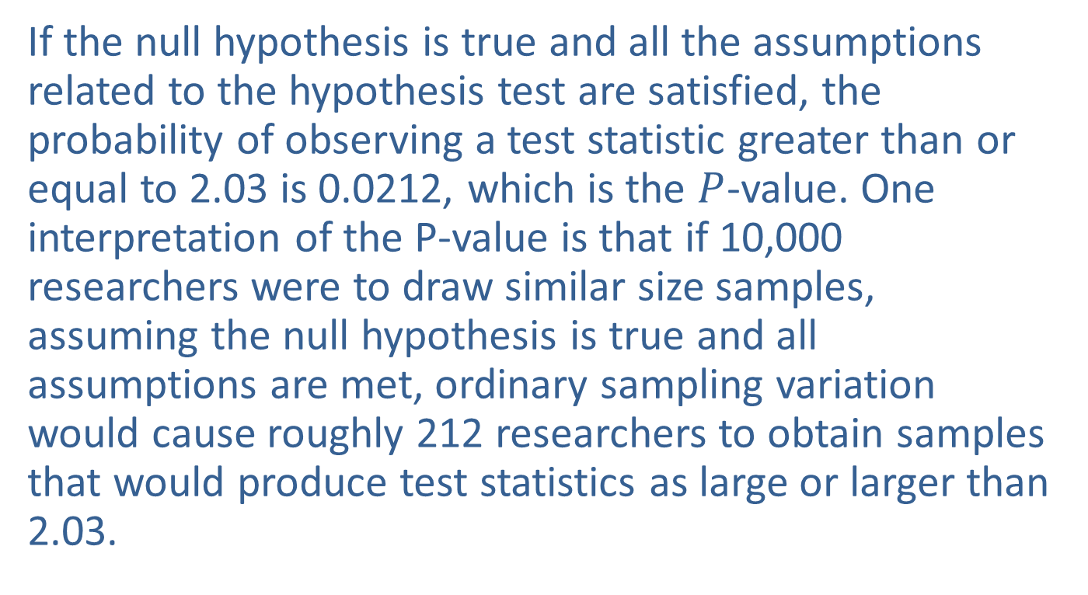
P-Values (cont.)
If the null hypothesis is true and all the assumptions related to the hypothesis test are satisfied, the probability of observing a test statistic greater than or equal to 2.03 is 0.0212, which is the $P$-value. One interpretation of the P-value is that if 10,000 researchers were to draw similar size samples, assuming the null hypothesis is true and all assumptions are met, ordinary sampling variation would cause roughly 212 researchers to obtain samples that would produce test statistics as large or larger than 2.03.

Slide 49
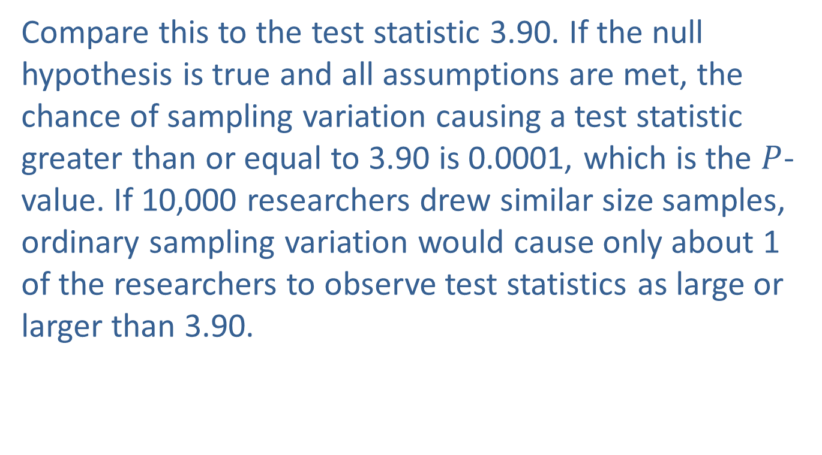
P-Values (cont.)
Compare this to the test statistic 3.90. If the null hypothesis is true and all assumptions are met, the chance of sampling variation causing a test statistic greater than or equal to 3.90 is 0.0001, which is the $P$-value. If 10,000 researchers drew similar size samples, ordinary sampling variation would cause only about 1 of the researchers to observe test statistics as large or larger than 3.90.

Slide 50
P-Values (cont.)
Virtually all statistical computer programs provide P-values in their output when hypotheses are being tested. It is a fairly easy task to utilize these values to perform a classical hypothesis test.

Slide 51
Procedure: Performing a Hypothesis Test Using P-Values
If the computed P-value is less than α, reject the null hypothesis in favor of the alternative.
If the computed P-value is greater than or equal to α, fail to reject the null hypothesis.

Slide 52
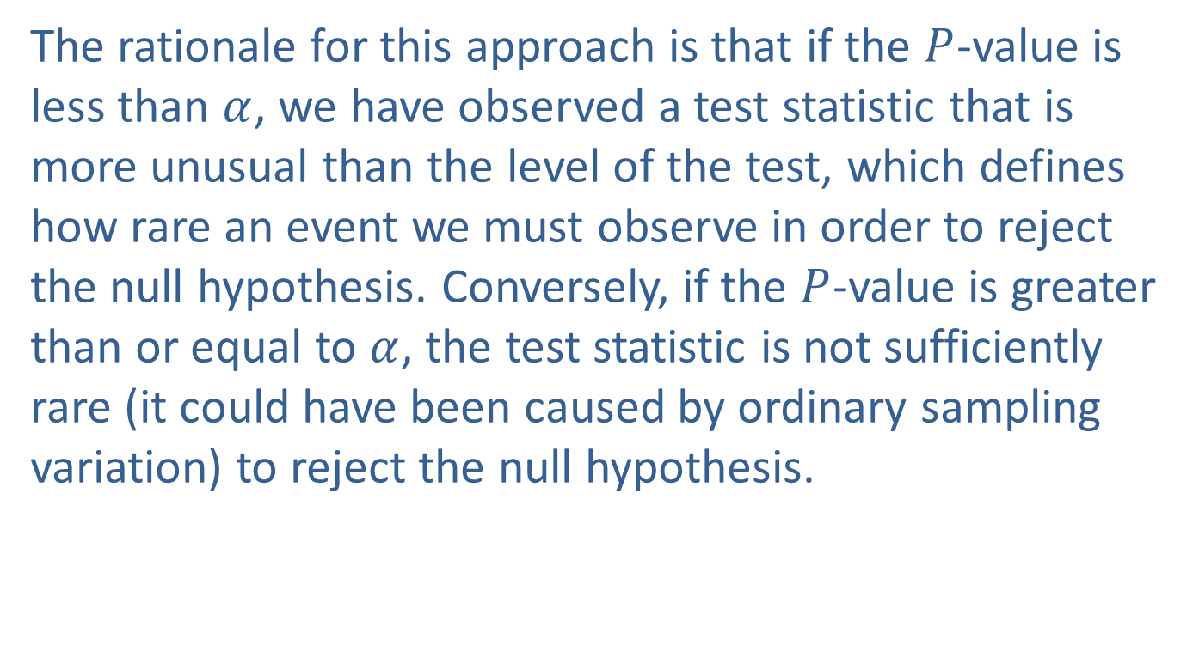
P-Values (cont.)
The rationale for this approach is that if the $P$-value is less than $α$, we have observed a test statistic that is more unusual than the level of the test, which defines how rare an event we must observe in order to reject the null hypothesis. Conversely, if the $P$-value is greater than or equal to $α$, the test statistic is not sufficiently rare (it could have been caused by ordinary sampling variation) to reject the null hypothesis.

Slide 53
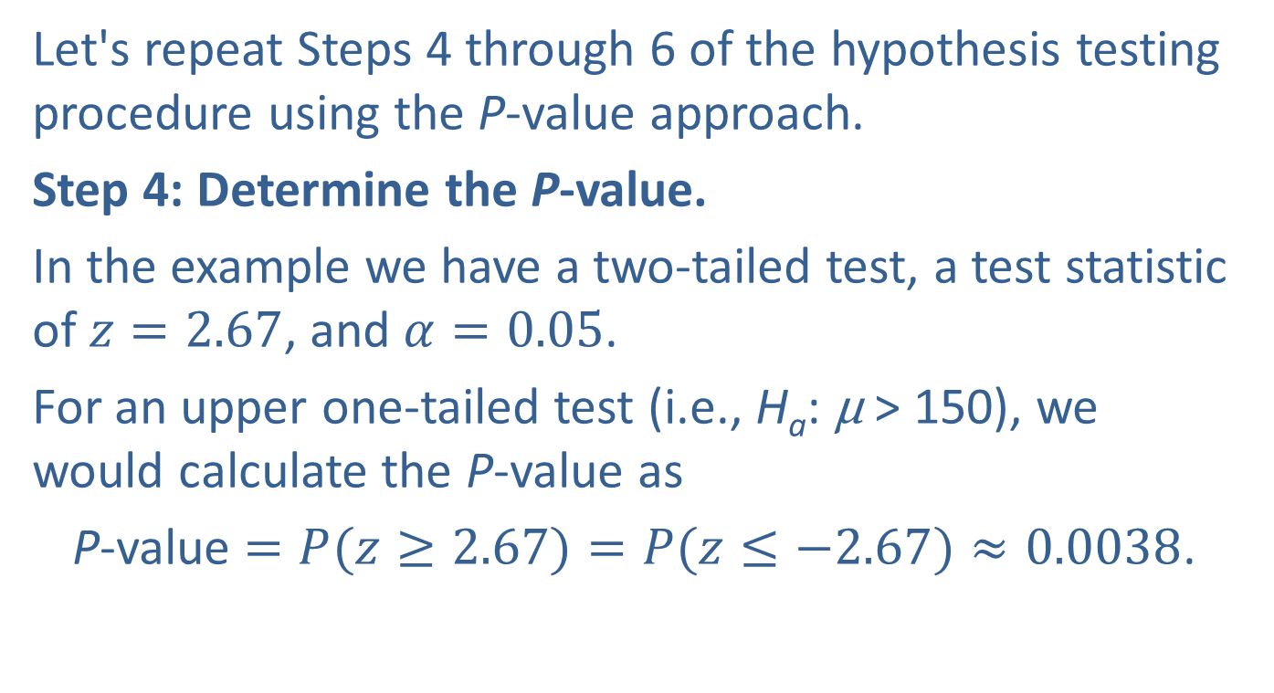
Example 11.2.1: Performing a Hypothesis Test for Reading Level (cont.)
Let's repeat Steps 4 through 6 of the hypothesis testing procedure using the P-value approach.
Step 4: Determine the P-value.
In the example we have a two-tailed test, a test statistic of $z=2.67$, and $α=0.05$.
For an upper one-tailed test (i.e., H_{a}: μ > 150), we would calculate the P-value as
P-value $=P(z≥2.67)=P(z≤−2.67)≈0.0038$.

Slide 54
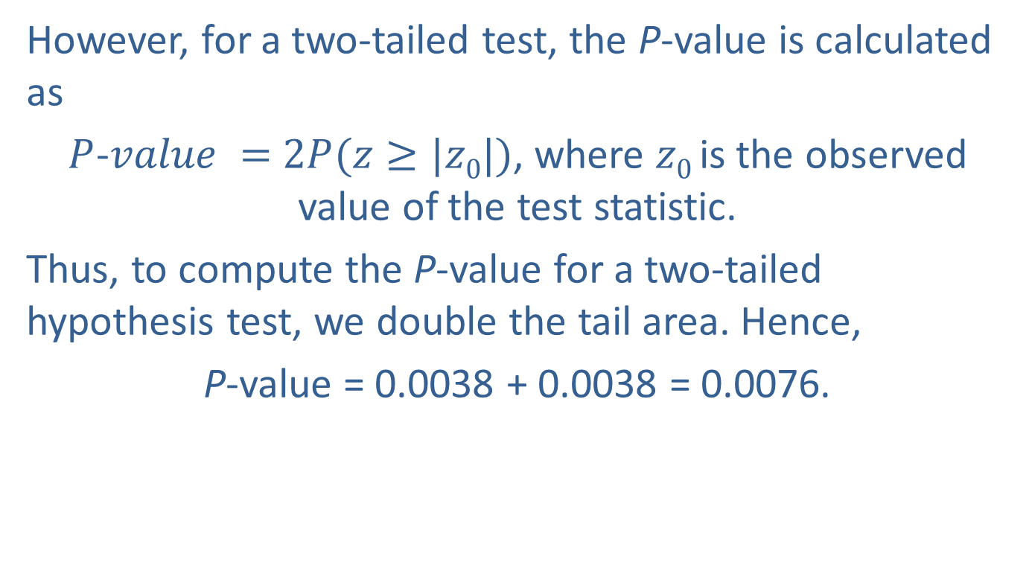
Example 11.2.1: Performing a Hypothesis Test for Reading Level (cont.)
However, for a two-tailed test, the P-value is calculated as
$P$-$value =$ $2P(z≥|z0|)$, where $z0$ is the observed value of the test statistic.
Thus, to compute the P-value for a two-tailed hypothesis test, we double the tail area. Hence,
P-value = 0.0038 + 0.0038 = 0.0076.

Slide 55
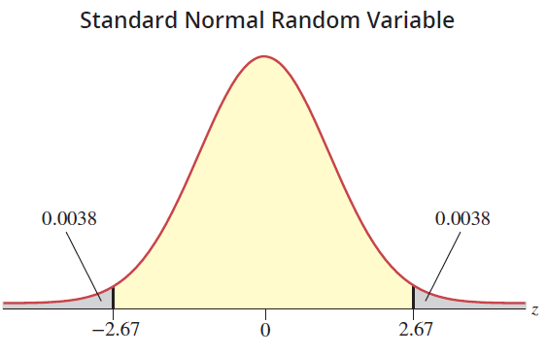

Example 11.2.1: Performing a Hypothesis Test for Reading Level (cont.)
The $P$-value of 0.0076 is the likelihood of observing a value of the test statistic greater than or equal to 2.67 or less than or equal to −2.67 given the null hypothesis is true and all assumptions are met.

Slide 56
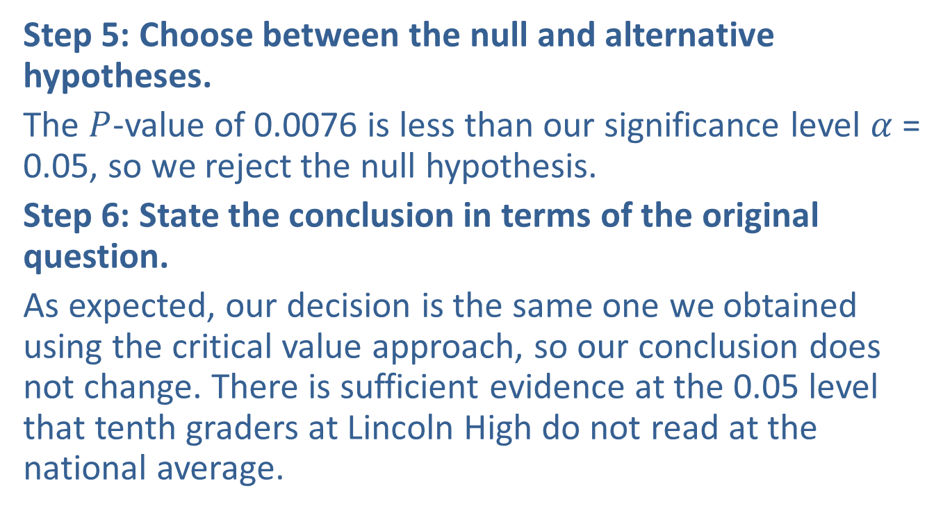
Example 11.2.1: Performing a Hypothesis Test for Reading Level (cont.)
Step 5: Choose between the null and alternative hypotheses.
The $P$-value of 0.0076 is less than our significance level $α$ = 0.05, so we reject the null hypothesis.
Step 6: State the conclusion in terms of the original question.
As expected, our decision is the same one we obtained using the critical value approach, so our conclusion does not change. There is sufficient evidence at the 0.05 level that tenth graders at Lincoln High do not read at the national average.

Slide 57
Example 11.2.2: Performing a Hypothesis Test for the Life of a Computer Chip
A microprocessor designer has developed a new fabrication process which he believes will increase the usable life of a chip. Currently the usable life is 16,000 hours with a standard deviation of 2500 hours. Test the hypothesis that the process increases the usable life of a chip, at the 0.01 level. A random sample of 1000 microprocessors will be tested. Assume the standard deviation of the life of the new chips will be equal to the standard deviation of the current chips.

Slide 58
Example 11.2.2: Performing a Hypothesis Test for the Life of a Computer Chip (cont.)
Solution
Step 1: Determine the population parameter to be used and develop the null and alternative hypotheses.
We first state the hypotheses in plain English.
Null Hypothesis: The new fabrication does not increase the usable life of the chip.
Alternative Hypothesis: The new fabrication increases the usable life of the chip.

Slide 59
Example 11.2.2: Performing a Hypothesis Test for the Life of a Computer Chip (cont.)
Once again, the population mean is a suitable parameter to test this hypothesis. If the mean life of the newly fabricated chip is greater than the mean life of the standard chip, all other things being equal, the newly fabricated chip would be better. Let
μ = the mean life of the newly fabricated chips.
The goal is to determine if there is sufficient evidence that the new fabrication process produces chips with longer life. The hypothesis will be one-sided.

Slide 60
Example 11.2.2: Performing a Hypothesis Test for the Life of a Computer Chip (cont.)
In symbolic form the hypotheses are as follows.
If the purpose is to demonstrate that there is overwhelming evidence in support of a hypothesis, that hypothesis should be placed in the alternative hypothesis. In this example, the aim is to determine if there is sufficient evidence to conclude that the new chip has a longer life.
The mean life of the newly fabricated chip is equal to the life of the standard chip.
The newly fabricated chip has a longer mean life than the standard chip.

Slide 61
Example 11.2.2: Performing a Hypothesis Test for the Life of a Computer Chip (cont.)
Step 2: Specify the significance level α.
The level of the test is given in the problem to be α = 0.01. If it were not given, the investigator would choose the level.
Step 3: Validate the assumptions of the hypothesis test, identify the appropriate test statistic, and compute its value.
First, we validate the assumptions.

Slide 62
Example 11.2.2: Performing a Hypothesis Test for the Life of a Computer Chip (cont.)
Quantitative data (the number of hours of usable life of a chip)
Random sample used to obtain data
n > 30 (n = 1000)
σ known or ◻ σ unknown
All of the assumptions of the z-test statistic are met.
Suppose a random sample of 1000 microprocessors has a mean life of 16,200 hours. The resulting test statistic,

Slide 63
Example 11.2.2: Performing a Hypothesis Test for the Life of a Computer Chip (cont.)
indicates that the sample mean life of new microprocessors is more than 2.5 standard deviations larger than the mean life of current microprocessors. Letting the data guide our decision-making, it is unlikely that ordinary sampling variation could have caused the sample mean to be more than 2.5 standard deviations from the hypothesized value?

Slide 64
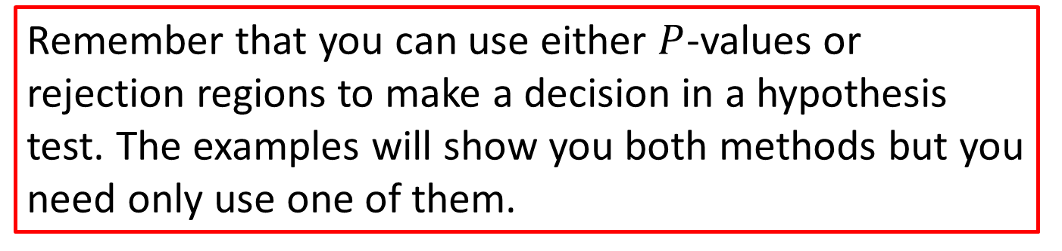
Note
Remember that you can use either $P$-values or rejection regions to make a decision in a hypothesis test. The examples will show you both methods but you need only use one of them.

Slide 65
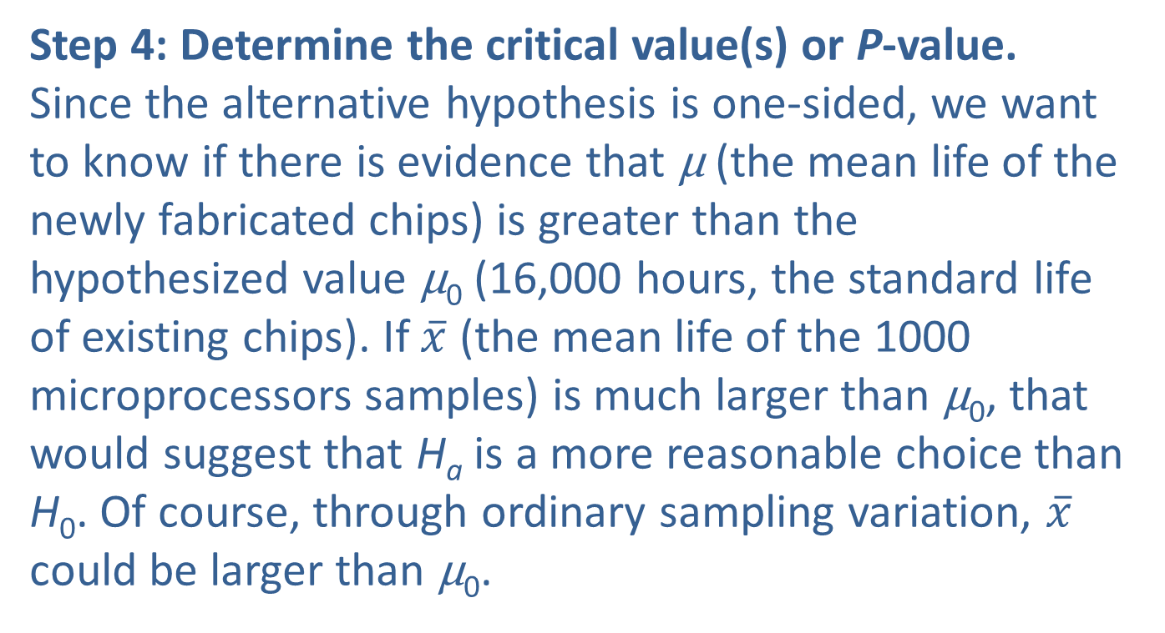
Example 11.2.2: Performing a Hypothesis Test for the Life of a Computer Chip (cont.)
Step 4: Determine the critical value(s) or P-value. Since the alternative hypothesis is one-sided, we want to know if there is evidence that μ (the mean life of the newly fabricated chips) is greater than the hypothesized value μ₀ (16,000 hours, the standard life of existing chips). If $\overline{x}$ (the mean life of the 1000 microprocessors samples) is much larger than μ₀, that would suggest that H_{a} is a more reasonable choice than H₀. Of course, through ordinary sampling variation, $\overline{x}$ could be larger than μ₀.

Slide 66

Example 11.2.2: Performing a Hypothesis Test for the Life of a Computer Chip (cont.)
How much greater than μ₀ does $\overline{x}$ have to be in order for us to believe that mean life of the newly fabricated chips is greater than 16,000 hours and select H_{a}?
Table 11.2.3 – Critical Values of the z-Test Statistic for One‑Sided (Greater Than) Alternatives
Significance Level | Definition of Ordinary Variability | z_{α}
0.20 | Lower 80% of the distribution | 0.84
0.10 | Lower 90% of the distribution | 1.28
0.05 | Lower 95% of the distribution | 1.645
0.01 | Lower 99% of the distribution | 2.33

Slide 67
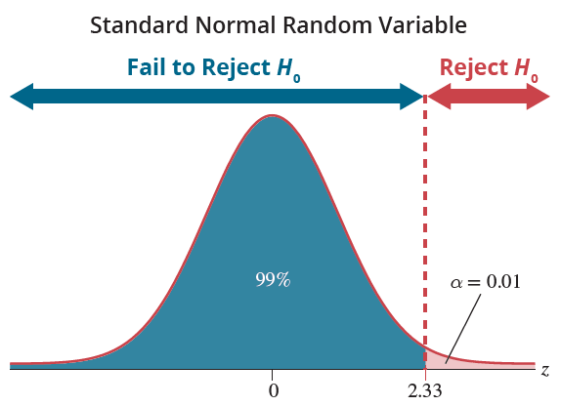
Example 11.2.2: Performing a Hypothesis Test for the Life of a Computer Chip (cont.)
The z-test statistic has a standard normal distribution; so critical values are determined from the probability distribution of the standard normal distribution.

Slide 68
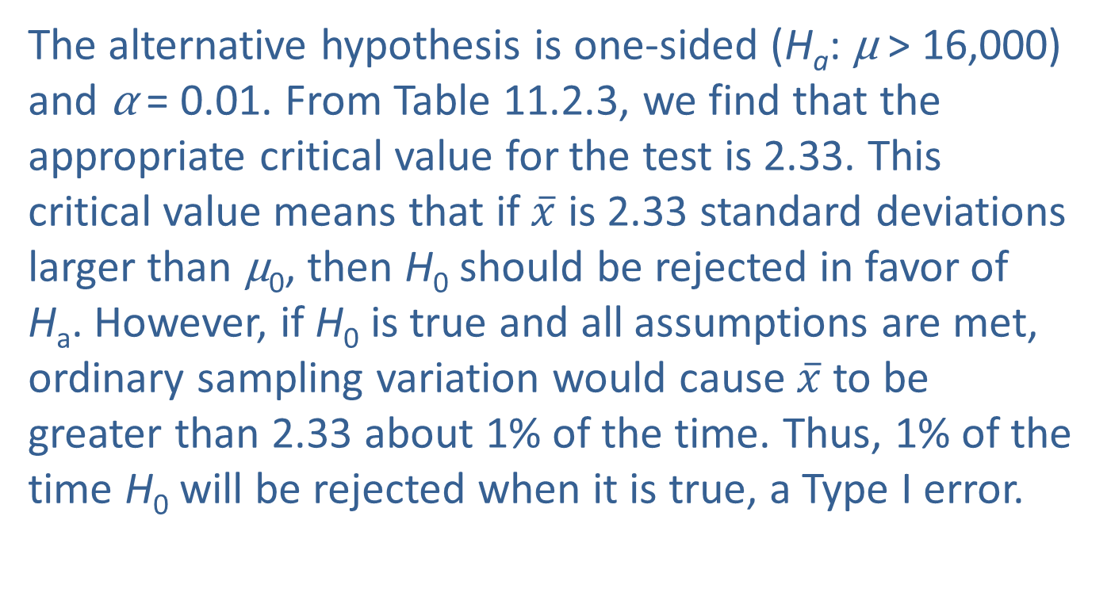
Example 11.2.2: Performing a Hypothesis Test for the Life of a Computer Chip (cont.)
The alternative hypothesis is one-sided (H_{a}: μ > 16,000) and α = 0.01. From Table 11.2.3, we find that the appropriate critical value for the test is 2.33. This critical value means that if $\overline{x}$ is 2.33 standard deviations larger than μ₀, then H₀ should be rejected in favor of H_{a}. However, if H₀ is true and all assumptions are met, ordinary sampling variation would cause $\overline{x}$ to be greater than 2.33 about 1% of the time. Thus, 1% of the time H₀ will be rejected when it is true, a Type I error.

Slide 69
Example 11.2.2: Performing a Hypothesis Test for the Life of a Computer Chip (cont.)
To locate the critical value of z for a one-sided “greater-than” alternative, find the value of z that cuts off α worth of probability in the right-hand tail of the distribution. The critical values for “greater than” alternative hypotheses are given in Table 11.2.3 for typical values of α.
To determine the P-value for the test we proceed as follows.
P-value = P(z ≥ 2.53 ) = P(z ≤ −2.53) ≈ 0.0057.

Slide 70
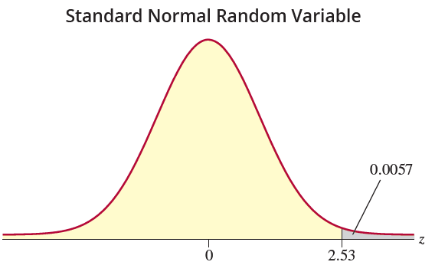
Example 11.2.2: Performing a Hypothesis Test for the Life of a Computer Chip (cont.)
Step 5: Choose between the null and alternative hypotheses.
Since the test statistic value of 2.53 is larger than the critical value, 2.33, the conclusion is to reject H₀ in favor of H_{a}.

Slide 71
Example 11.2.2: Performing a Hypothesis Test for the Life of a Computer Chip (cont.)
Note that the P-value of 0.0057 is less than the significance level, α = 0.01, also leading us to the decision to reject H₀ in favor of H_{a}.
Step 6: State the conclusion in terms of the original question.
There is sufficient evidence at the α = 0.01 level to conclude that the new fabricating technique is superior and leads to longer chip life.

Slide 72
Procedure: One-Sided "Less Than" Alternatives
For tests which are based on a test statistic which has a standard normal distribution and “less than” alternatives, find the value of z that cuts off α worth of probability in the left-hand tail of the distribution. The critical values for “less than” alternative hypotheses are given in Table 11.2.4 for typical values of α.

Slide 73
Procedure: One-Sided "Less Than" Alternatives (cont.)
Table 11.2.4 – Critical Values of the z-Test Statistic for One‑Sided (Less Than) Alternatives
Significance Level | Definition of Ordinary Variability | −z_{α}
0.20 | Upper 80% of the distribution | −0.84
0.10 | Upper 90% of the distribution | −1.28
0.05 | Upper 95% of the distribution | −1.645
0.01 | Upper 99% of the distribution | −2.33

Slide 74

Procedure: One-Sided "Less Than" Alternatives (cont.)
The figure above shows the rejection region for a test with a one-sided “less than” alternative hypothesis, and a significance level of 0.20.

Slide 75
Procedure: One-Sided "Less Than" Alternatives (cont.)
For this test, the null hypothesis will be rejected if the calculated value of the test statistic is less than −0.84. The P-value is given by P(z ≤ z₀), where z₀ is the observed value of the test statistic.

