Slide 1
Section 11.1
Introduction to Hypothesis Testing

Slide 2
Definition: Hypothesis Testing
A hypothesis is a statement or claim about a characteristic of one or more populations.
A hypothesis test is a procedure, based on sample evidence, that is used to test a statement or claim about a characteristic of one or more populations.

Slide 3
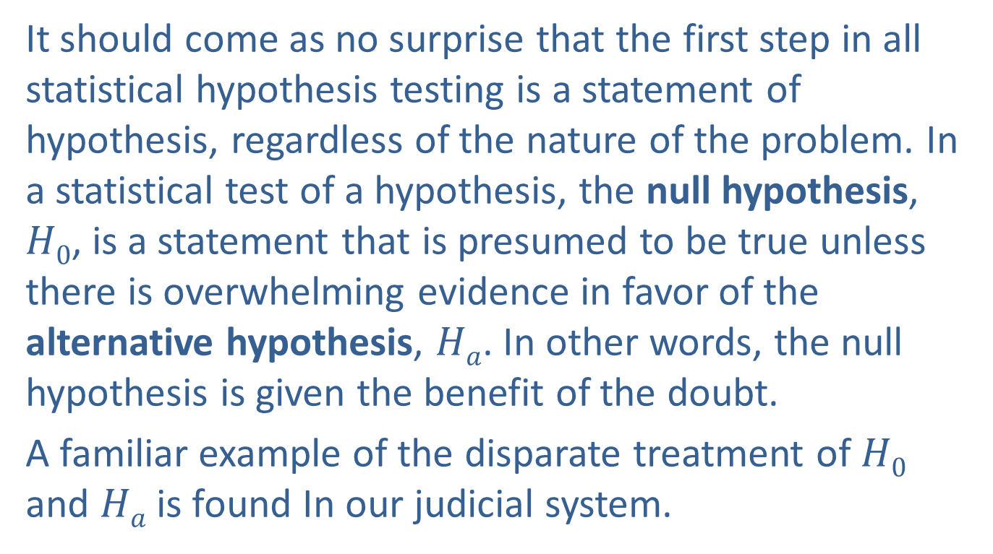
Introduction to Hypothesis Testing
It should come as no surprise that the first step in all statistical hypothesis testing is a statement of hypothesis, regardless of the nature of the problem. In a statistical test of a hypothesis, the null hypothesis, $H0$, is a statement that is presumed to be true unless there is overwhelming evidence in favor of the alternative hypothesis, $Ha$. In other words, the null hypothesis is given the benefit of the doubt.
A familiar example of the disparate treatment of $H0$ and $Ha$ is found In our judicial system.

Slide 4
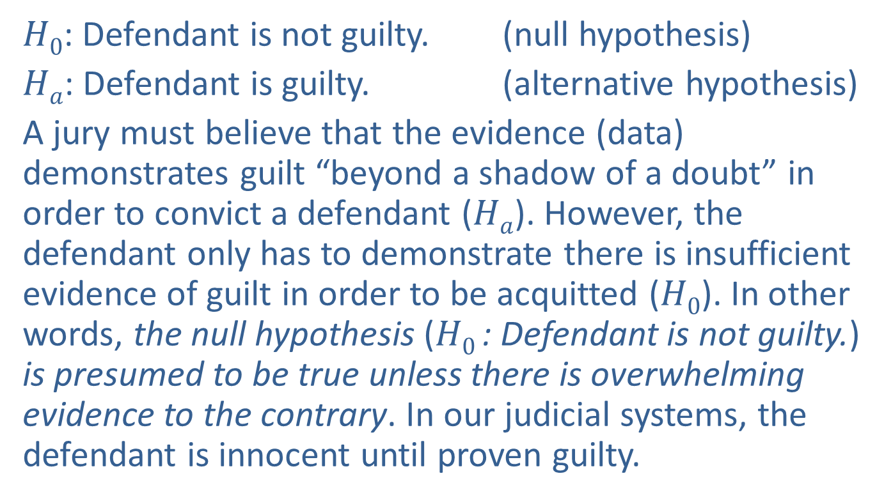
Introduction to Hypothesis Testing (cont.)
$H0$: Defendant is not guilty. (null hypothesis)
$Ha$: Defendant is guilty. (alternative hypothesis)
A jury must believe that the evidence (data) demonstrates guilt “beyond a shadow of a doubt” in order to convict a defendant ($Ha$). However, the defendant only has to demonstrate there is insufficient evidence of guilt in order to be acquitted ($H0$). In other words, the null hypothesis ($H0$: Defendant is not guilty.) is presumed to be true unless there is overwhelming evidence to the contrary. In our judicial systems, the defendant is innocent until proven guilty.

Slide 5
Introduction to Hypothesis Testing (cont.)
This example is somewhat abstract. In order to conduct a hypothesis test using statistical methods, the hypothesis must be stated in terms of statistical measures such as the population mean, population proportion, or population variance. The practice of statistics is an inductive process. Statistical hypothesis testing systematizes the inductive process for selecting between two hypotheses, ultimately leading to the choice of one hypothesis over the other.

Slide 6
Example 11.1.1: Determining the Null and Alternative
Hypotheses for a Test of the Population Mean
A molecular biologist has been investigating several species of wild potato plants and believes she has discovered genetic properties that will increase the yield of the standard species. She has genetically engineered these new properties into the standard variety and produced a new variety. The standard species yields an average of 2.34 pounds per plant. She would like to know if her new plant has superior yield.

Slide 7
Example 11.1.1: Determining the Null and Alternative
Hypotheses for a Test of the Population Mean (cont.)
The answer to this question can be investigated by testing the following rival hypotheses.
The new variety does not have superior yield. (presumed to be true unless overwhelming evidence to the contrary)
The new variety does have superior yield.
To apply statistical methodology to answer this question, the preceding hypotheses must be translated into a problem statement concerning a statistical measure (e.g., mean, proportion, or variance).

Slide 8
Example 11.1.1: Determining the Null and Alternative
Hypotheses for a Test of the Population Mean (cont.)
The statistical measure will be used in the definition of a criterion to decide the issue. There is a great deal of variability in the yields of potato plants. Comparing mean yield per plant of the new variety with the standard variety would provide a reasonable method of evaluating the new variety. The mean yield of the standard variety is known to be 2.34 pounds. However, the mean of the new variety is unknown, and that uncertainty is what makes the problem difficult.

Slide 9
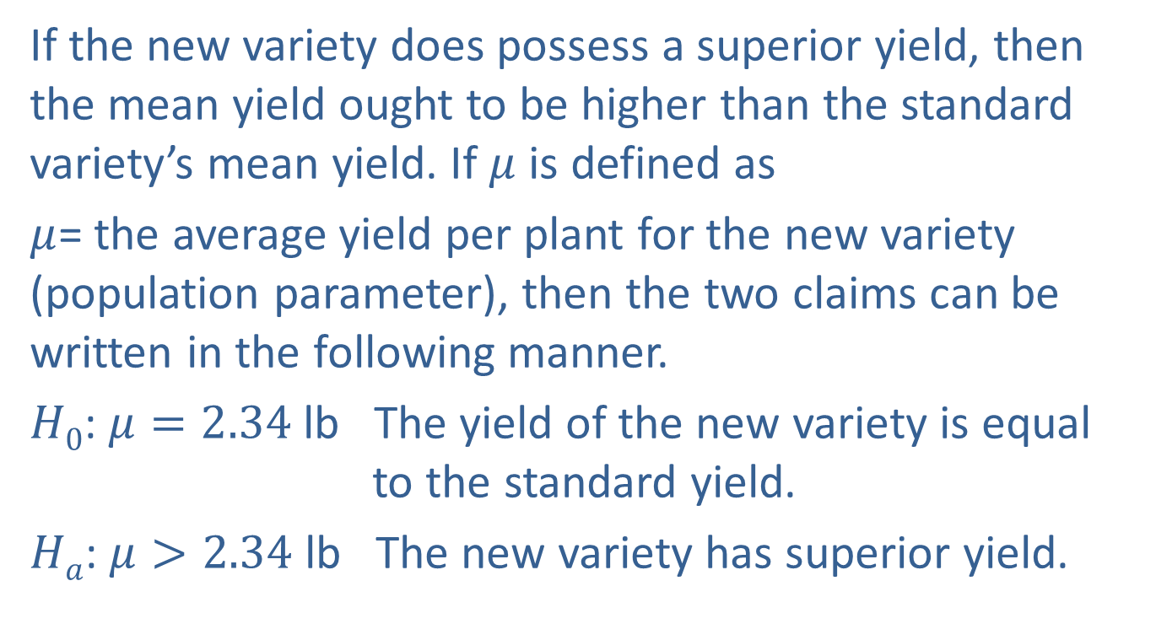
Example 11.1.1: Determining the Null and Alternative
Hypotheses for a Test of the Population Mean (cont.)
If the new variety does possess a superior yield, then the mean yield ought to be higher than the standard variety’s mean yield. If $μ$ is defined as
$μ$= the average yield per plant for the new variety (population parameter), then the two claims can be written in the following manner.
$H0$: $μ=2.34$ lb The yield of the new variety is equal to the standard yield.
$Ha$: $μ>2.34$ lb The new variety has superior yield.

Slide 10
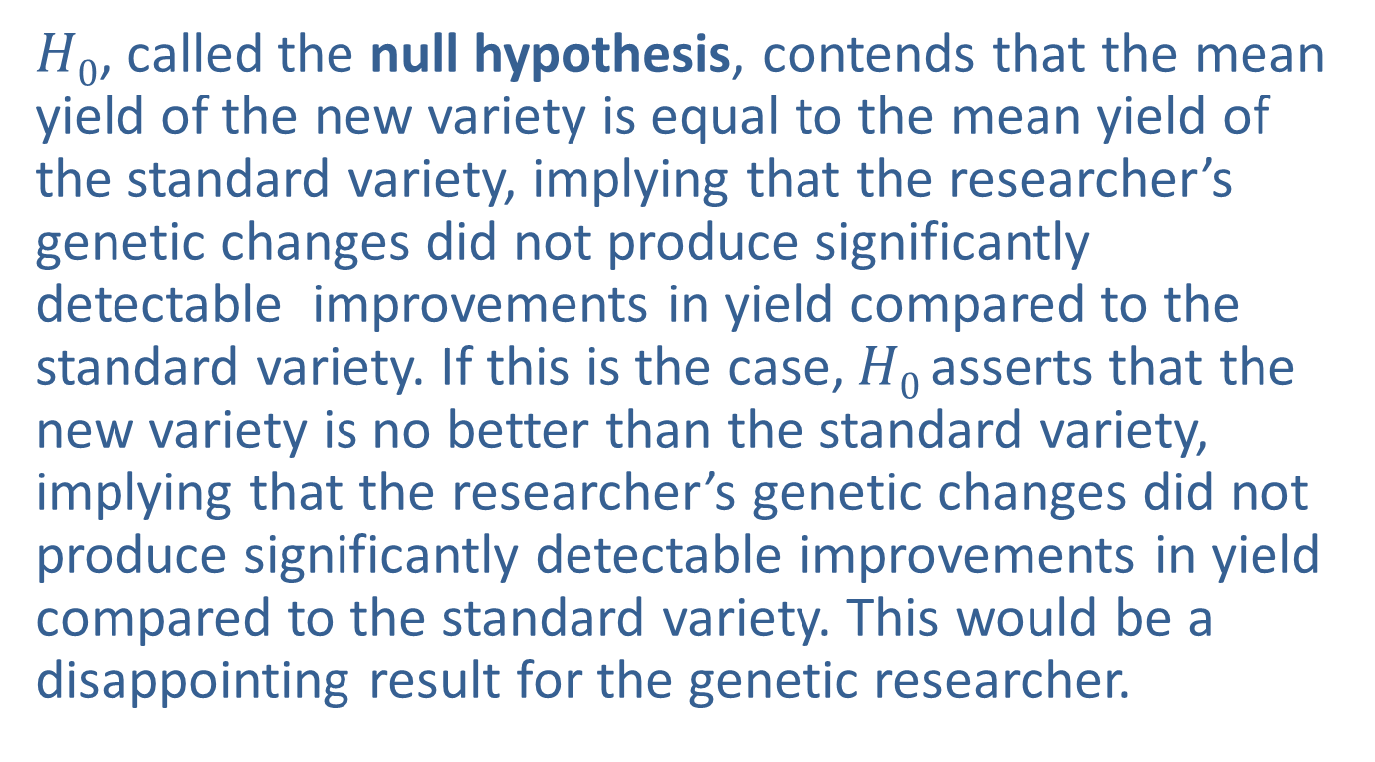
Example 11.1.1: Determining the Null and Alternative
Hypotheses for a Test of the Population Mean (cont.)
$H0$, called the null hypothesis, contends that the mean yield of the new variety is equal to the mean yield of the standard variety, implying that the researcher’s genetic changes did not produce significantly detectable improvements in yield compared to the standard variety. If this is the case, $H0$asserts that the new variety is no better than the standard variety, implying that the researcher’s genetic changes did not produce significantly detectable improvements in yield compared to the standard variety. This would be a disappointing result for the genetic researcher.

Slide 11
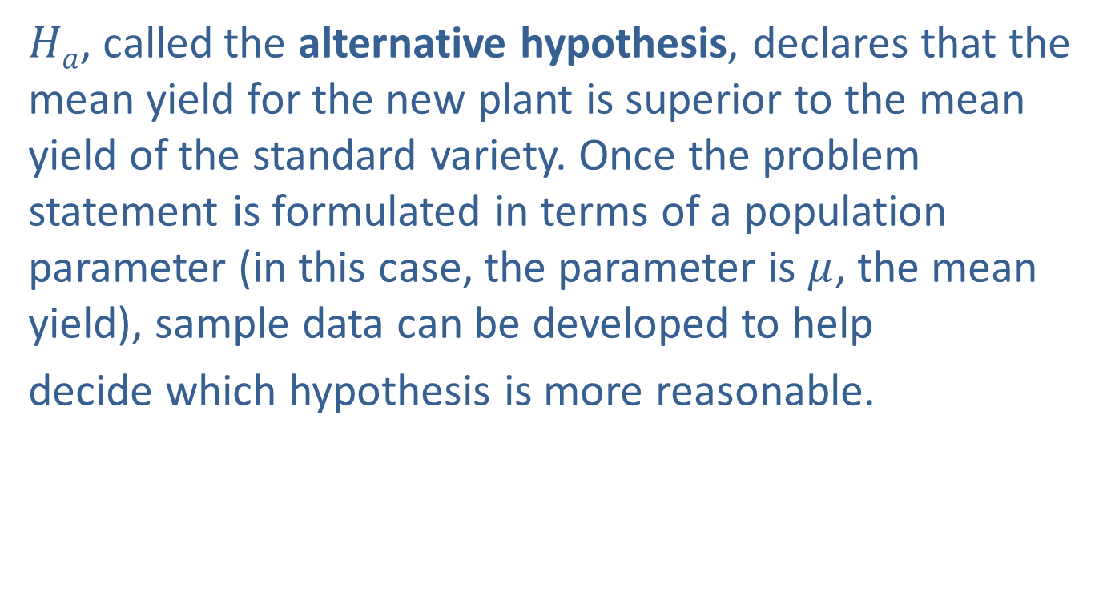
Example 11.1.1: Determining the Null and Alternative
Hypotheses for a Test of the Population Mean (cont.)
$Ha$, called the alternative hypothesis, declares that the mean yield for the new plant is superior to the mean yield of the standard variety. Once the problem statement is formulated in terms of a population parameter (in this case, the parameter is $μ$, the mean yield), sample data can be developed to help
decide which hypothesis is more reasonable.

Slide 12
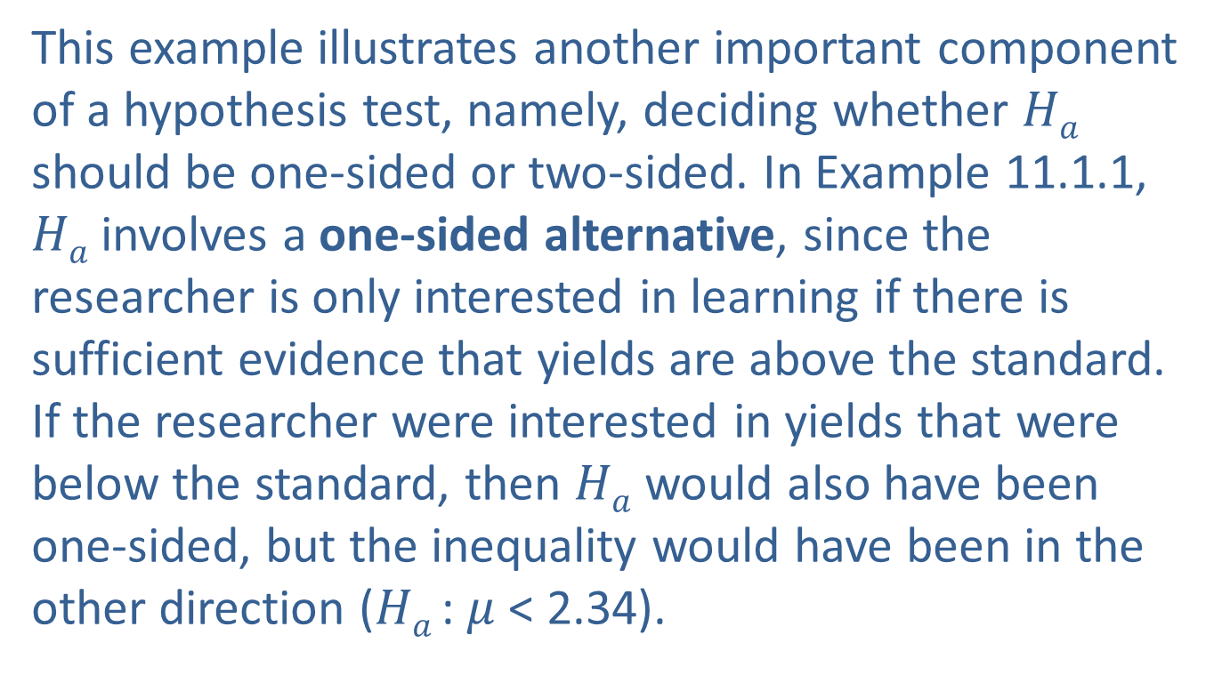
Introduction to Hypothesis Testing (cont.)
This example illustrates another important component of a hypothesis test, namely, deciding whether $Ha$ should be one-sided or two-sided. In Example 11.1.1, $Ha$ involves a one-sided alternative, since the researcher is only interested in learning if there is sufficient evidence that yields are above the standard. If the researcher were interested in yields that were below the standard, then $Ha$ would also have been one-sided, but the inequality would have been in the other direction ($Ha$: $μ$ < 2.34).

Slide 13
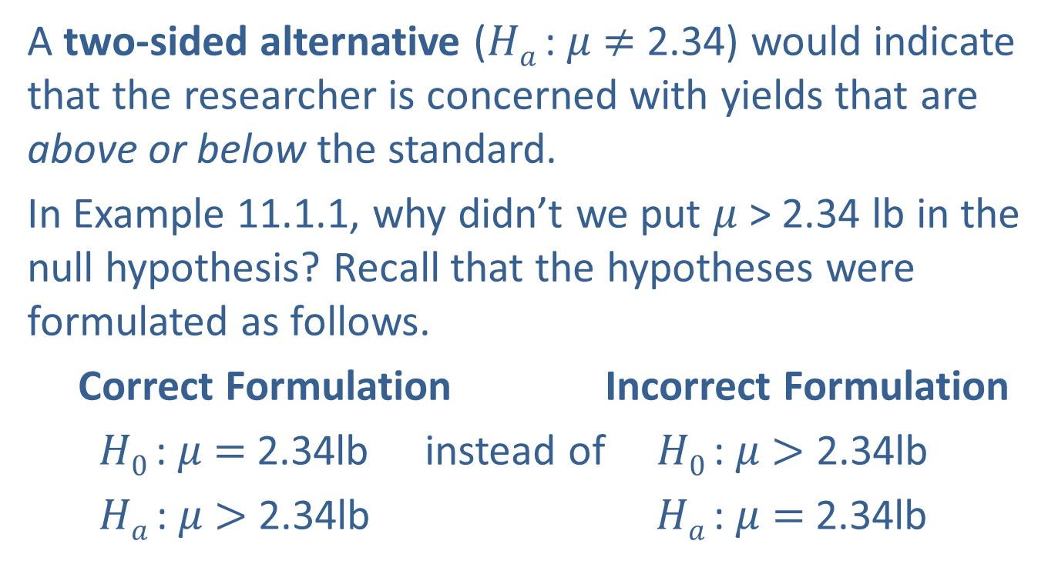
Introduction to Hypothesis Testing (cont.)
A two-sided alternative ($Ha$: $μ$ $≠$ 2.34) would indicate that the researcher is concerned with yields that are above or below the standard.
In Example 11.1.1, why didn’t we put $μ$ > 2.34 lb in the null hypothesis? Recall that the hypotheses were formulated as follows.
Correct Formulation Incorrect Formulation
$H0$: $μ$ $=$ 2.34lb instead of $H0$: $μ$ $>$ 2.34lb
$Ha$: $μ$ $>$ 2.34lb $Ha$: $μ$ $=$ 2.34lb

Slide 14
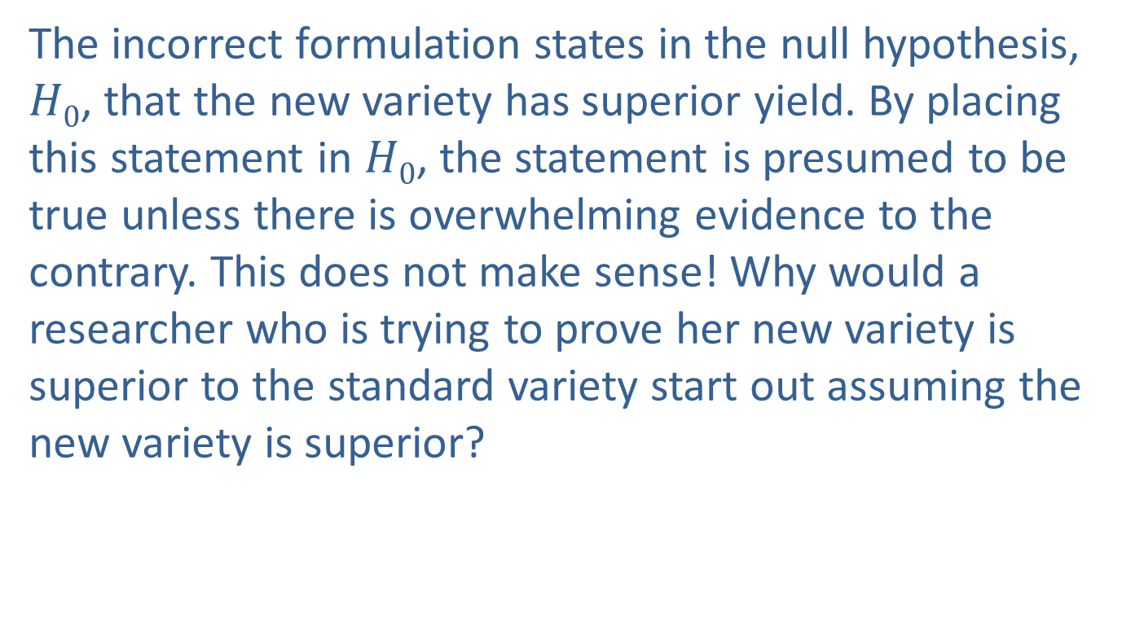

The Incorrect Formulation of the Null Hypothesis, $H0$: $μ$ > 2.34
The incorrect formulation states in the null hypothesis, $H0$, that the new variety has superior yield. By placing this statement in $H0$, the statement is presumed to be true unless there is overwhelming evidence to the contrary. This does not make sense! Why would a researcher who is trying to prove her new variety is superior to the standard variety start out assuming the new variety is superior?

Slide 15
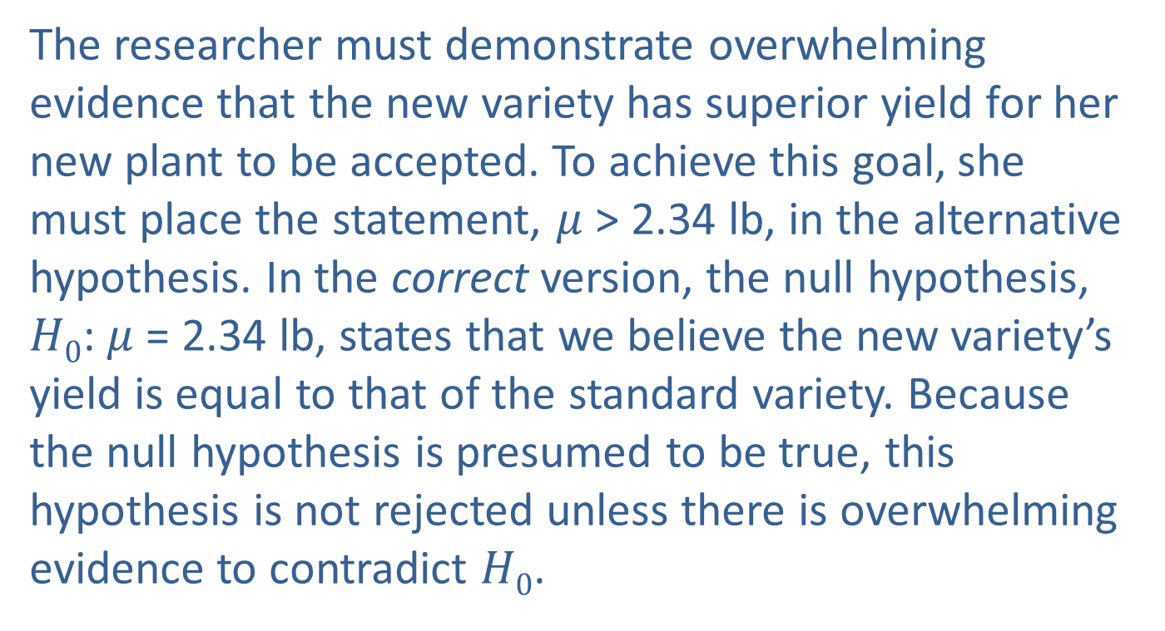

The Correct Formulation of the Null Hypothesis, $H0$: $μ$ = 2.34
The researcher must demonstrate overwhelming evidence that the new variety has superior yield for her new plant to be accepted. To achieve this goal, she must place the statement, $μ$ > 2.34 lb, in the alternative hypothesis. In the correct version, the null hypothesis, $H0$: $μ$ = 2.34 lb, states that we believe the new variety’s yield is equal to that of the standard variety. Because the null hypothesis is presumed to be true, this hypothesis is not rejected unless there is overwhelming evidence to contradict $H0$.

Slide 16
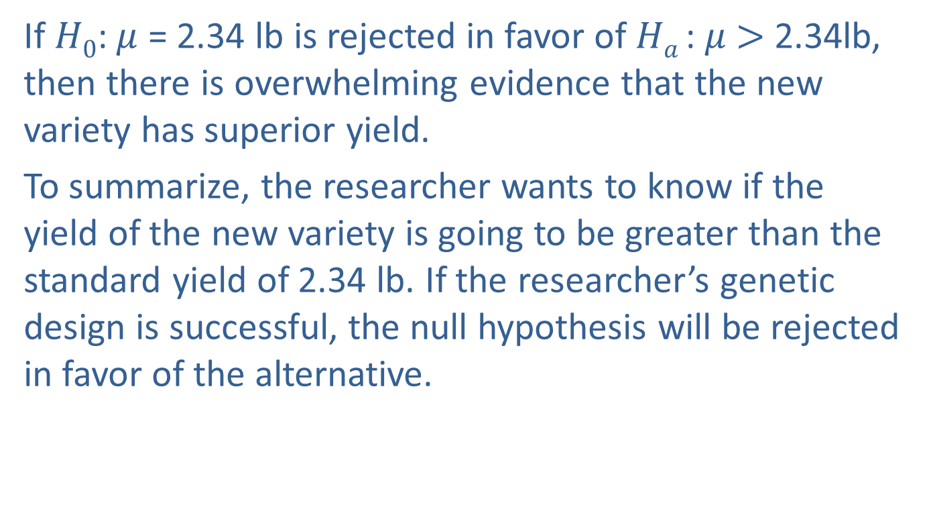

The Correct Formulation of the Null Hypothesis, $H0$: $μ$ = 2.34 (cont.)
If $H0$: $μ$ = 2.34 lb is rejected in favor of $Ha$: $μ$ $>$ 2.34lb, then there is overwhelming evidence that the new variety has superior yield.
To summarize, the researcher wants to know if the yield of the new variety is going to be greater than the standard yield of 2.34 lb. If the researcher’s genetic design is successful, the null hypothesis will be rejected in favor of the alternative.

Slide 17
The Correct Formulation of the Null Hypothesis, $H0$: $μ$ = 2.34 (cont.)
Rejecting the null in favor of the alternative means the sample data overwhelmingly supports the idea that the newly developed variety of potato yields more potatoes (in weight) than the standard variety. Failing to reject the null hypothesis would mean that there is insufficient evidence to warrant concluding the new potato has superior yield.
This type of formulation is typical of a test of a hypothesis in a research hypothesis, testing a new theory or idea against an established one.

Slide 18
The Correct Formulation of the Null Hypothesis, $H0$: $μ$ = 2.34 (cont.)
In many research hypothesis tests, the investigator hopes to reject the null hypothesis in order to demonstrate the significance of a new idea. It is often the case that if there is a standard value for a population parameter, the null hypothesis states that the population parameter is equal to the standard value.
When formulating hypotheses, remember that the equality statement will always be contained in the null hypothesis. That is, the null hypothesis will contain =, whereas the alternative hypothesis will contain <, >, or ≠.

Slide 19
Definition: Properties of H₀ and H_{a}
The null hypothesis, denoted H₀, is a statement about the value of a population parameter. This statement is assumed to be true unless we find sample evidence that indicates it is not. If the sample evidence is strong enough to indicate it is not true, then we reject the null hypothesis. Otherwise, we fail to reject the null hypothesis.

Slide 20
Definition: Properties of H₀ and H_{a} (cont.)
The alternative hypothesis, denoted H_{a} or H₁, is also a statement about the value of a population parameter. It is the statement or claim that we are trying to find evidence to support.

Slide 21
Example 11.1.2: Determining the Null and Alternative Hypotheses for a Two-Tailed Test of the Population Mean
Suppose a potato chip manufacturer is concerned that the bagging equipment is not functioning properly when filling 10-ounce bags. He wants to test a hypothesis that will help determine if there is a problem with the bagging equipment. What are the correct hypotheses?

Slide 22
Example 11.1.2: Determining the Null and Alternative Hypotheses for a Two-Tailed Test of the Population Mean (cont.)
Solution
Since the standard value in this problem is 10 ounces, the null hypothesis is H₀: μ = 10 oz. The bagging equipment ordinarily functions properly; thus the manufacturer requires overwhelming evidence that the machine is overfilling or underfilling the bags before shutting down the equipment.
When the alternative hypothesis allows values above and below the standard value, it is called a two-sided alternative.

Slide 23
Example 11.1.2: Determining the Null and Alternative Hypotheses for a Two-Tailed Test of the Population Mean (cont.)
In this case, the manufacturer hopes that he fails to reject the null hypothesis, since that would suggest that his equipment is putting the right amount in the bags. This type of hypothesis is quite common in quality control and other kinds of system monitoring.

Slide 24
Example 11.1.3: Determining the Null and Alternative Hypotheses for a Right-Tailed Test of the Population Proportion
Martha Brandon wants to assess her candidacy in a forthcoming race for the state senate. She is an incumbent and wants to raise sufficient support to retain her seat. How should she formulate an appropriate hypothesis to determine if there is overwhelming evidence she will retain her seat?
Solution
The correct formulation of the hypotheses is
Martha does not have sufficient support to retain her seat.
Martha does have sufficient support to retain her seat.

Slide 25
Example 11.1.3: Determining the Null and Alternative Hypotheses for a Right-Tailed Test of the Population Proportion (cont.)
where p = the fraction of voters that will vote for her.
This problem differs significantly from the other two examples. The problem’s formulation requires the use of a different statistical measure, p, the population proportion. The crucial value of the proportion is 0.5, since in order to retain the seat she must obtain more than half of the votes cast (assuming there is only one other candidate). The null hypothesis contends that she does not have sufficient support to retain her seat. Why would she want to presume that she will lose the election?

Slide 26
Example 11.1.3: Determining the Null and Alternative Hypotheses for a Right-Tailed Test of the Population Proportion (cont.)
If the null hypothesis is rejected in favor of the alternative, H_{a}: p > 0.5, there is overwhelming evidence that she has the blessing of more than half the voters.
The alternative is one-sided, since the intent of the study is to learn if she will win. (A two-sided alternative would imply interest in finding out if she will win or lose the election, a rather meaningless idea.) She hopes the conclusion of the test will be to reject the null hypothesis, since that implies that there is overwhelming sample evidence that she will receive more than half the votes cast.

Slide 27
Procedure: Formulating Hypothesis Testing Problems
To be successful at formulating hypothesis testing problems you must be able to:
Determine the appropriate statistical measure to test the desired hypothesis (population mean, proportion, or variance).
Determine the appropriate value to use in the null hypothesis. (This may be stated in the problem as a standard value or may need to be deduced from the information at hand.)

Slide 28
Procedure: Formulating Hypothesis Testing Problems (cont.)
Decide whether the alternative should be one-sided or two-sided.

Slide 29
Reaching a Conclusion−Making a Choice
The point of a hypothesis test is to select one of the competing hypotheses (H₀ or H_{a}) as the correct decision. Once you have reached a conclusion, there will remain a possibility that the inference (decision) is incorrect. The idea of performing the correct statistical test, exactly following the procedure, and still possibly making an incorrect decision may be bothersome. Uncertainty, however, is a part of every statistical inference and all inductive processes.

Slide 30
How Uncertain Are Our Conclusions?
Errors can happen in two ways. In statistical terminology, we call these Type I errors and Type II errors.

Slide 31
Definition: Errors in Hypothesis Testing
Rejecting H₀ when in fact H₀ is the correct choice is called a Type I error.
Failing to reject H₀ when in fact H_{a} is the correct choice is called a Type II error.

Slide 32
How Uncertain Are Our Conclusions? (cont.)
In a statistical test of hypothesis, we can only control for Type I errors. This fact often influences how we construct hypotheses.

Slide 33
Example 11.1.4: Formulating the Hypotheses
Suppose Jeremy was in a car accident and a doctor in the emergency room believes he is dead. Jeremy’s body has been sent to a mortician for preparation. Preparation, in this context, is a euphemism for draining the blood out of his body and replacing it with fluids which retard deterioration. If Jeremy isn’t dead when he gets to the mortician, he will be dead after he is prepared. How should the mortician frame the hypothesis when he/she begins to work on Jeremy’s body?

Slide 34
Example 11.1.4: Formulating the Hypotheses (cont.)
Solution
Formulation A
H₀: Jeremy is dead.
H_{a}: Jeremy is alive.
Type I error using Formulation A
To have an error you must make a mistake. Suppose this is what happened.
Truth: H₀: Jeremy is dead.
Mortician’s Decision: H_{a}: Jeremy is alive.

Slide 35
Example 11.1.4: Formulating the Hypotheses (cont.)
In order to have a Type I error, you must reject the null hypothesis when it is true. In this case, the mortician believes Jeremy is alive even though he is actually dead. What’s the consequence to the mortician?
Consequence: None, since Jeremy is already dead. From Jeremy’s vantage point, or the lack of it in this case, no problem. R.I.P.

Slide 36
Example 11.1.4: Formulating the Hypotheses (cont.)
Type II error using Formulation A
Mortician’s Decision: H₀: Jeremy is dead.
Truth: H_{a}: Jeremy is alive.
A Type II error means failing to reject the null, when it is false. If the null is false, then the alternative is true. Jeremy is alive. Good news! Unfortunately, the mortician thought he was dead.
Consequence: Jeremy will die as soon as preparations begin.

Slide 37
Example 11.1.4: Formulating the Hypotheses (cont.)
For the two errors, which has the worst consequence? Clearly, the Type II error has the worst consequence. Does Formulation A place the most serious error as a Type I? Not if life matters! Let’s try another formulation.

Slide 38
Example 11.1.4: Formulating the Hypotheses (cont.)
Formulation B
H₀: Jeremy is alive.
H_{a}: Jeremy is dead.
Type I error using Formulation B
Truth: H₀: Jeremy is alive.
Mortician’s Decision: H_{a}: Jeremy is dead.
The mortician believes Jeremy is dead when, in fact, he is alive. He is prepared.
Consequence: Jeremy will die. R.I.P.

Slide 39
Example 11.1.4: Formulating the Hypotheses (cont.)
Type II error using Formulation B
Mortician’s Decision: H₀: Jeremy is alive.
Truth: H_{a}: Jeremy is dead.
The mortician believes Jeremy is alive, when in fact, he is dead.
Consequence: None, since Jeremy is already dead.
Formulation B is the correct formulation of the problem, since the most serious consequence (death!) is the result of a Type I error. That’s good, because the probability of a Type I error can be controlled in the hypothesis testing procedure.

Slide 40
How Uncertain Are Our Conclusions? (cont.)
Admittedly, the last example was rather bleak, but it does demonstrate an important consideration when formulating hypotheses that is worth repeating. Formulate the hypotheses so that the most serious consequence of a mistaken decision is associated with a Type I error.

Slide 41
Definition: α, Type I Error
The probability of a Type I error is denoted by α (the Greek letter alpha), and is referred to as the level of the test, or the significance level of the test.

Slide 42
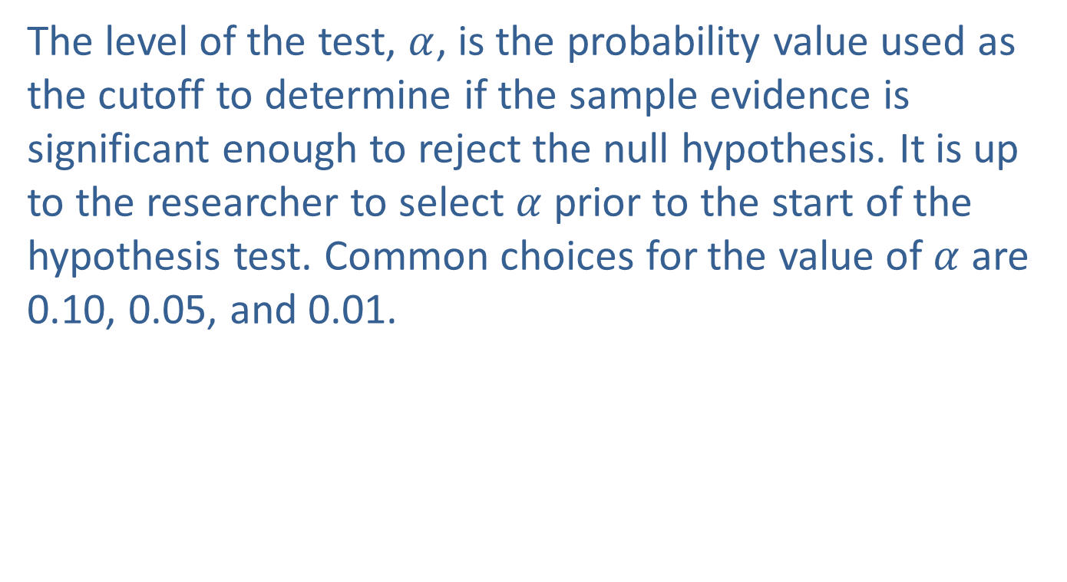
How Uncertain Are Our Conclusions? (cont.)
The level of the test, $α$, is the probability value used as the cutoff to determine if the sample evidence is significant enough to reject the null hypothesis. It is up to the researcher to select $α$ prior to the start of the hypothesis test. Common choices for the value of $α$ are 0.10, 0.05, and 0.01.

Slide 43
Definition: β, Type II Error
The probability of a Type II error is denoted by β (the Greek letter beta). Unfortunately, the value of β depends on the actual value of the population parameter and thus cannot be determined unless the actual value of the population parameter is known, which is rarely the case.

Slide 44
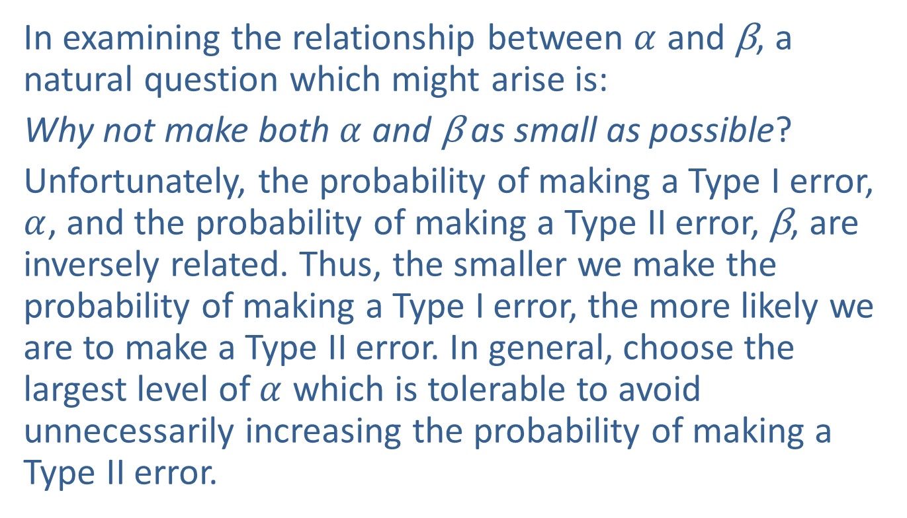
How Uncertain Are Our Conclusions? (cont.)
In examining the relationship between $α$ and β, a natural question which might arise is:
Why not make both $α$ and β as small as possible?
Unfortunately, the probability of making a Type I error, $α$, and the probability of making a Type II error, β, are inversely related. Thus, the smaller we make the probability of making a Type I error, the more likely we are to make a Type II error. In general, choose the largest level of $α$ which is tolerable to avoid unnecessarily increasing the probability of making a Type II error.

Slide 45
A Procedure for Hypothesis Testing
The hypothesis testing procedure is a method for choosing between two competing hypotheses. Although the procedure will change for different kinds of hypotheses, there are common elements among all tests.

Slide 46
Properties: Elements of Hypothesis Testing
Let the data guide our decision-making by collecting a random sample of data from the population and use it to calculate a test statistic.
The null hypothesis is presumed to be true unless sample data produces overwhelming evidence to the contrary. That is, the test statistic is calculated under the assumption that the null hypothesis is true.

Slide 47
Properties: Elements of Hypothesis Testing (cont.)
The form of the test statistic will change depending upon the population parameter used in the hypothesis statement, μ, p, or σ ² (as well as with the assumptions about knowledge of the population).
Simple hypothesis testing models related to a single population parameter are explored in this chapter. Each model will have its own set of assumptions depending on the population parameter of interest and the underlying distribution of the population.

Slide 48
Properties: Elements of Hypothesis Testing (cont.)
In later chapters we will look at more complicated hypothesis testing models with multiple parameters which will also have a unique set of assumptions. If the researcher’s goal is to attach statistical significance to the conclusions of the hypothesis test, it is critically important to validate the assumptions of the hypothesis testing model.

Slide 49
Properties: Elements of Hypothesis Testing (cont.)
The conclusion of the hypothesis test results is making a choice to either reject or fail to reject the null hypothesis. Note that we do not accept the null hypothesis; we only conclude that there is insufficient evidence to support the alternative.
There is no way to be absolutely certain your decision is correct, no matter which hypothesis is selected.

Slide 50
A Procedure for Hypothesis Testing (cont.)
An exact procedure for testing a hypothesis is given below. In examining this procedure, you will notice we have already discussed the first two steps. The next two steps (3 & 4) define a decision rule, which is a criterion used to determine whether the null or the alternative hypothesis will be chosen. As you look over these steps, do not be overly concerned if you do not understand everything. You will learn by following the examples.

Slide 51
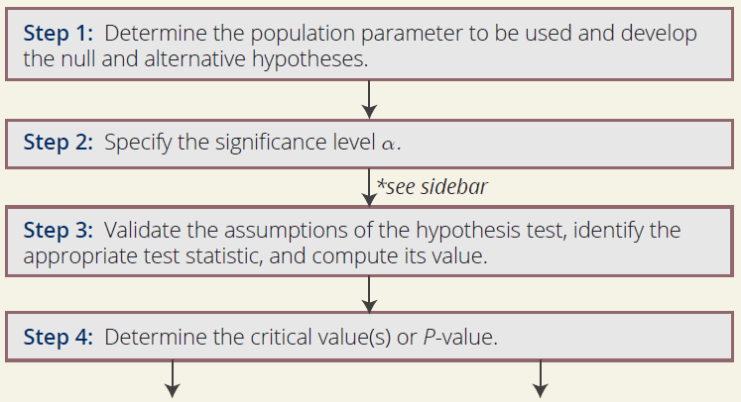
Procedure: Steps in the Hypothesis Test

Slide 52
Note
Between Step 2 and 3 of the hypothesis testing procedure, it is typical to collect sample data from the population and prepare it for analysis. However, for the problems presented in this textbook, the required data has already been provided, so this step is not necessary for our purposes.
In real-world scenarios, gathering sample data can be a challenging undertaking.

Slide 53
Note (cont.)
In fact, according to data science literature, approximately 80% of the time required to perform a statistical analysis is devoted to collecting, extracting, preparing, cleaning, and organizing the sample data, with only 20% of the time dedicated to the actual statistical analysis.

Slide 54
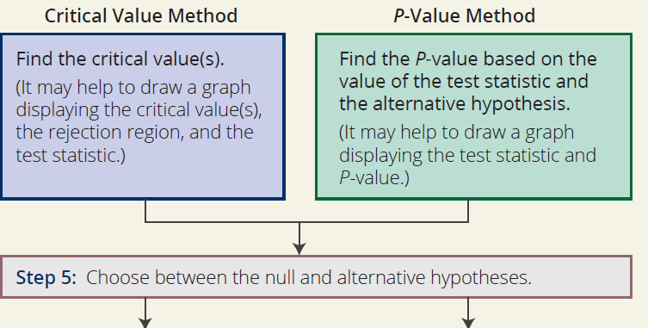
Procedure: Steps in the Hypothesis Test (cont.)

Slide 55
Note
Note at Step 4 there are two options; you can find the critical value of the test statistic or the P-value of the test statistic. Both methods will always produce equivalent results; meaning, the decision regarding the hypothesis test will always be the same with both methods. We will often cover both methods in an example to illustrate this. Even though we may show a critical value and a P-value, only one of these is required to make the decision to reject or fail to reject the null hypothesis. You or your instructor may have a preference of one method over another.

Slide 56
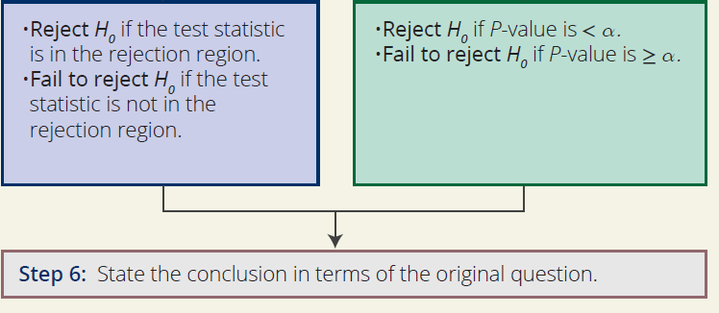
Procedure: Steps in the Hypothesis Test (cont.)

