Slide 1
Section 10.5
Estimating the Population Standard Deviation or Variance

Slide 2
Note
The requirement of normality is very strict, regardless of sample size, as large errors may result.

Slide 3
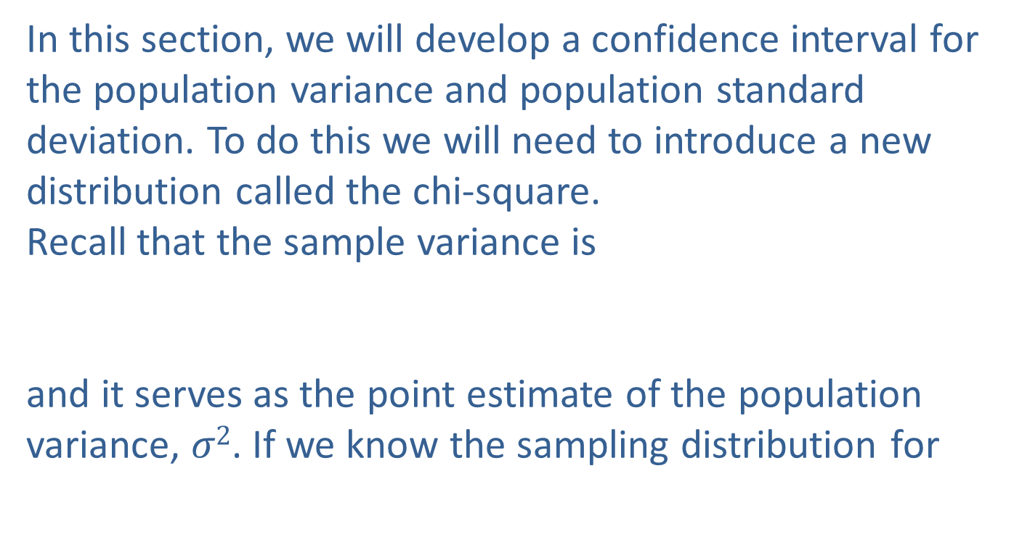
Estimating the Population Standard Deviation or Variance
In this section, we will develop a confidence interval for the population variance and population standard deviation. To do this we will need to introduce a new distribution called the chi-square.
Recall that the sample variance is
and it serves as the point estimate of the population variance, $σ2$. If we know the sampling distribution for

Slide 4
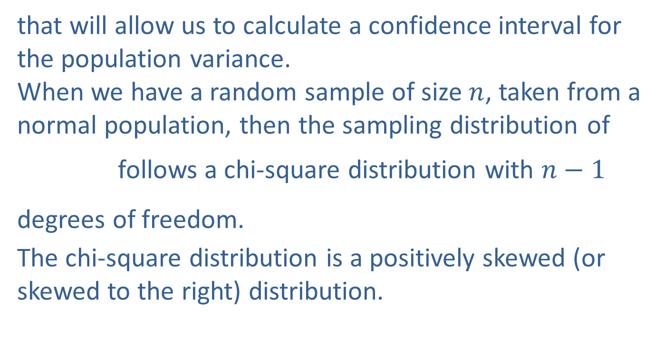
Estimating the Population Standard Deviation or Variance (cont.)
that will allow us to calculate a confidence interval for the population variance.
When we have a random sample of size $n$, taken from a normal population, then the sampling distribution of
follows a chi-square distribution with $n−1$ degrees of freedom.
The chi-square distribution is a positively skewed (or skewed to the right) distribution.

Slide 5
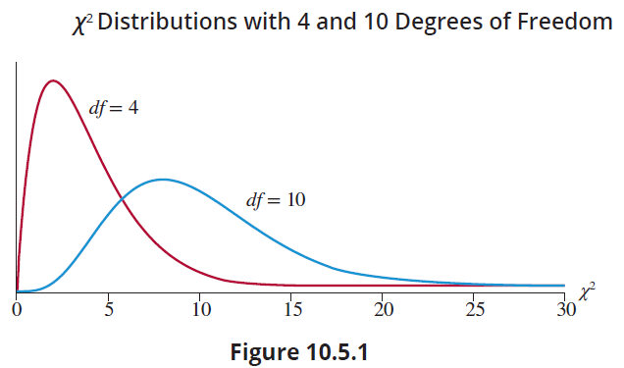
Estimating the Population Standard Deviation or Variance (cont.)
Like the t-distribution, the shape of the distribution is a function of its degrees of freedom. See Figure 10.5.1, which illustrates the chi-square distributions with 4 and 10 degrees of freedom.

Slide 6
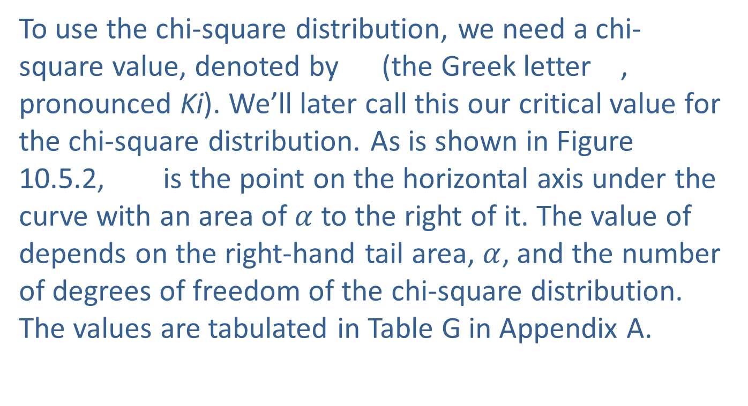
Estimating the Population Standard Deviation or Variance (cont.)
To use the chi-square distribution, we need a chi-square value, denoted by (the Greek letter , pronounced Ki). We’ll later call this our critical value for the chi-square distribution. As is shown in Figure 10.5.2, is the point on the horizontal axis under the curve with an area of $α$ to the right of it. The value of depends on the right-hand tail area, $α$, and the number of degrees of freedom of the chi-square distribution. The values are tabulated in Table G in Appendix A.

Slide 7
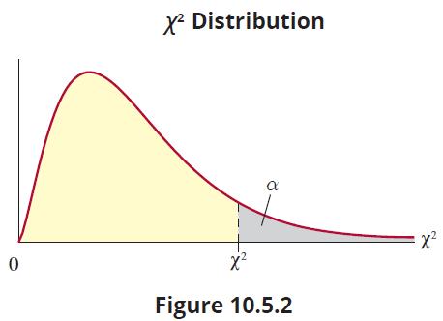
Estimating the Population Standard Deviation or Variance (cont.)
Looking at the chi‑square table, the rows correspond to the appropriate number of degrees of freedom (the first column listed down the left side of the table), while the columns represent the right-hand tail area.

Slide 8
Estimating the Population Standard Deviation or Variance (cont.)
Using Table G in Appendix A, suppose we want to find the chi-square value that gives us a right-hand tail area of 0.05 with 5 degrees of freedom. To do this, we would look down the leftmost column for 5 degrees of freedom and then the column labeled Doing so, we find that is 11.070.

Slide 9
Estimating the Population Standard Deviation or Variance (cont.)
1 | 2.706 | 3.841 | 5.024 | 6.635 | 7.879
2 | 4.605 | 5.991 | 7.378 | 9.210 | 10.597
3 | 6.251 | 7.815 | 9.348 | 11.345 | 12.838
4 | 7.779 | 9.488 | 11.143 | 13.277 | 14.860
5 | 9.236 | 11.070 | 12.833 | 15.086 | 16.750
6 | 10.645 | 12.592 | 14.449 | 16.812 | 18.548

Slide 10
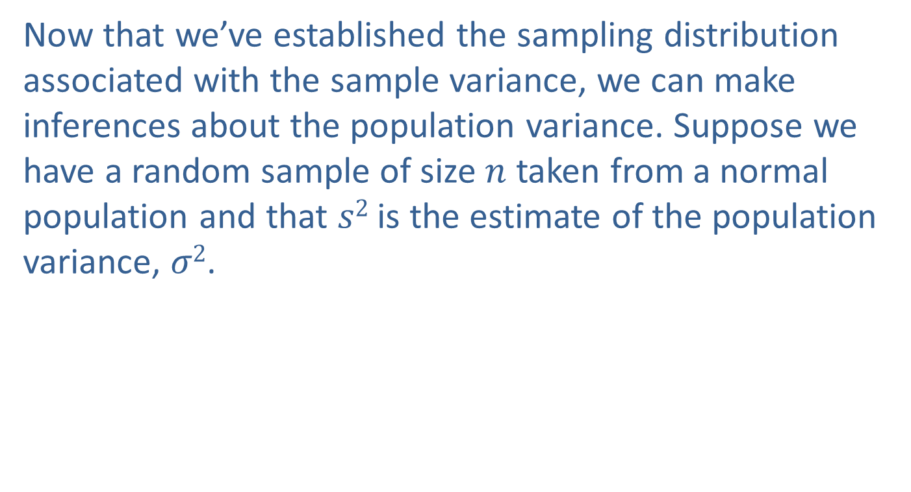
Estimating the Population Standard Deviation or Variance (cont.)
Now that we’ve established the sampling distribution associated with the sample variance, we can make inferences about the population variance. Suppose we have a random sample of size $n$ taken from a normal population and that $s2$ is the estimate of the population variance, $σ2$.

Slide 11
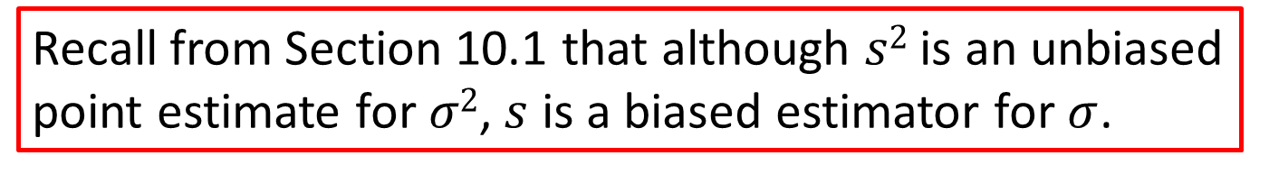
Note
Recall from Section 10.1 that although $s2$ is an unbiased point estimate for $σ2$, $s$ is a biased estimator for $σ$.

Slide 12
Formula: 100(1 − α)% Confidence Interval for σ ²
A 100(1 − α)% confidence interval for σ ² is given by
where and are points under the curve of the chi-square distribution with n − 1 degrees of freedom.

Slide 13
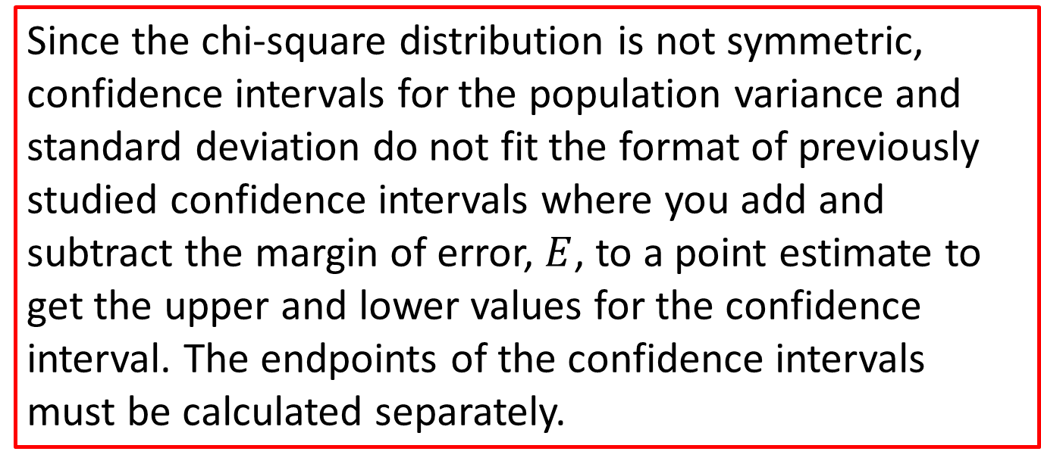
Note
Since the chi-square distribution is not symmetric, confidence intervals for the population variance and standard deviation do not fit the format of previously studied confidence intervals where you add and subtract the margin of error, $E$, to a point estimate to get the upper and lower values for the confidence interval. The endpoints of the confidence intervals must be calculated separately.

Slide 14
Estimating the Population Standard Deviation or Variance (cont.)
The confidence interval for the population standard deviation is found by taking the square root of the endpoints of the confidence interval for the population variance.

Slide 15
Formula: 100(1 − α)% Confidence Interval for σ
A 100(1 − α)% confidence interval for σ is given by
where and are points under the curve of the chi-square distribution with n − 1 degrees of freedom.

Slide 16
Example 10.5.1: Determining a Confidence Interval for the Population Standard Deviation
The quality control supervisor of a bottling plant is concerned about the variance of fill per bottle. Regulatory agencies specify that the standard deviation of the amount of fill should be less than 0.1 ounce. To determine whether the process is meeting this specification, the supervisor randomly selects ten bottles, weighs the contents of each, and finds that the sample standard deviation of these measurements is 0.04. Compute a 95% confidence interval for the standard deviation of ounces of fill for the bottling plant.

Slide 17
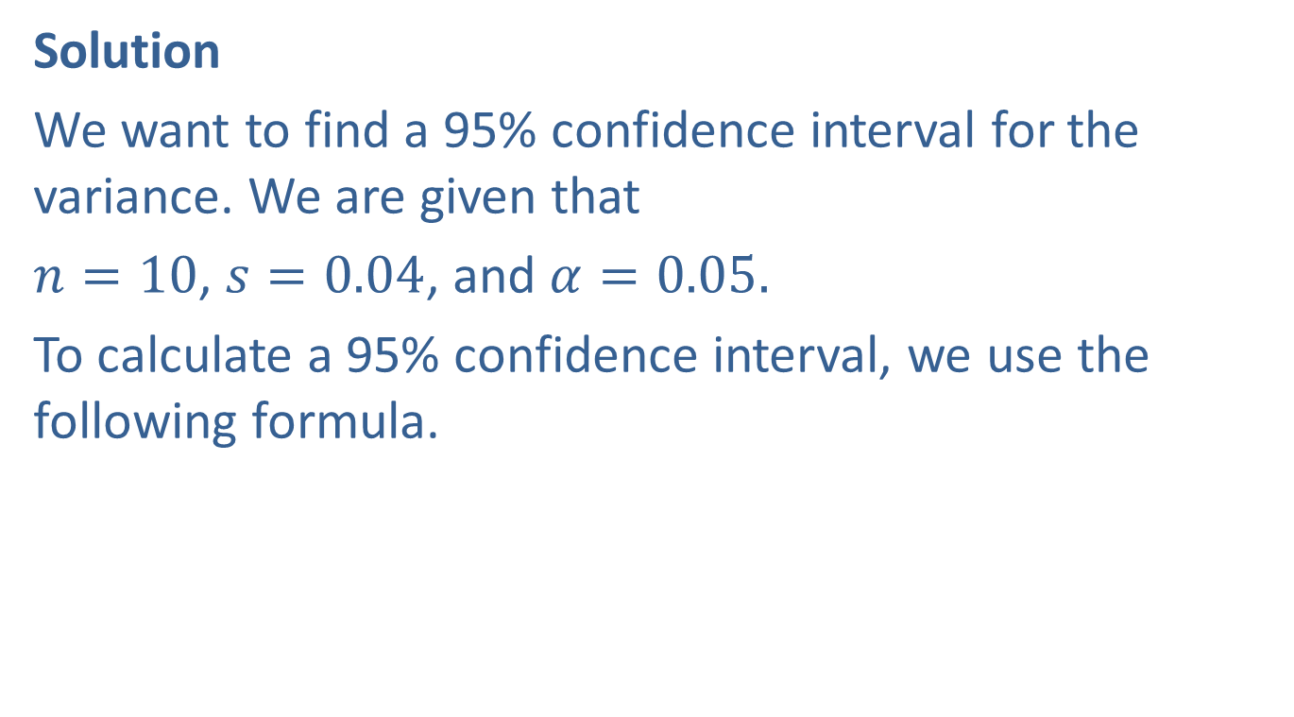
Example 10.5.1: Determining a Confidence Interval for the Population Standard Deviation (cont.)
Solution
We want to find a 95% confidence interval for the variance. We are given that
$n=10$, $s=0.04$, and $α=0.05.$
To calculate a 95% confidence interval, we use the following formula.

Slide 18
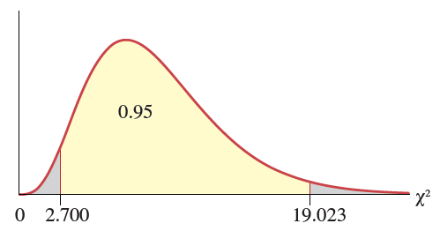

Example 10.5.1: Determining a Confidence Interval for the Population Standard Deviation (cont.)
Thus, we need to find the values of and for
$n−1=10−1=9$ degrees of freedom.
Using Table G in Appendix A, at 9 degrees of freedom,

Slide 19
Example 10.5.1: Determining a Confidence Interval for the Population Standard Deviation (cont.)
Substituting the values in the formula above, we have
So, a 95% confidence interval for the variance of fill of the bottles is between 0.000757 ounce² and 0.00533 ounce². However, the problem mentions the tolerance
for the standard deviation of fill.

Slide 20
Example 10.5.1: Determining a Confidence Interval for the Population Standard Deviation (cont.)
So, to ensure that we make our interpretation in terms of the problem, to find a 95% confidence interval for the standard deviation, we take the square root of the endpoints of the confidence interval for the variance, yielding
The 95% confidence interval for the standard deviation of fill for the bottles is between 0.0275 ounce and 0.0730 ounce, indicating that the process meets the specifications of being less than 0.1 ounce.

