Slide 1
Section 10.4
Estimating the Population Proportion

Slide 2
Note
Proportions have various equivalent formats, including fractions, decimals, and percentages.

Slide 3
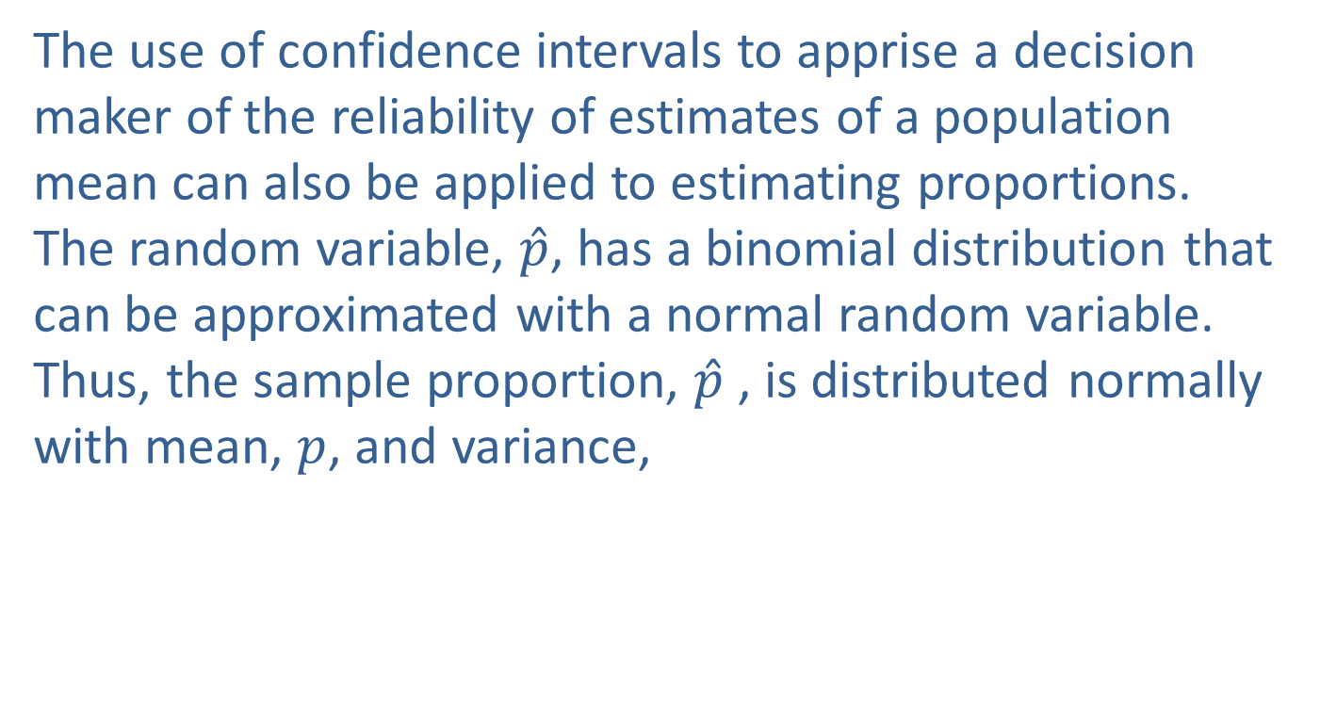
Interval Estimation of a Population Attribute
The use of confidence intervals to apprise a decision maker of the reliability of estimates of a population mean can also be applied to estimating proportions. The random variable, $\hat{p}$, has a binomial distribution that can be approximated with a normal random variable. Thus, the sample proportion, $\hat{p}$ , is distributed normally with mean, $p$, and variance,

Slide 4
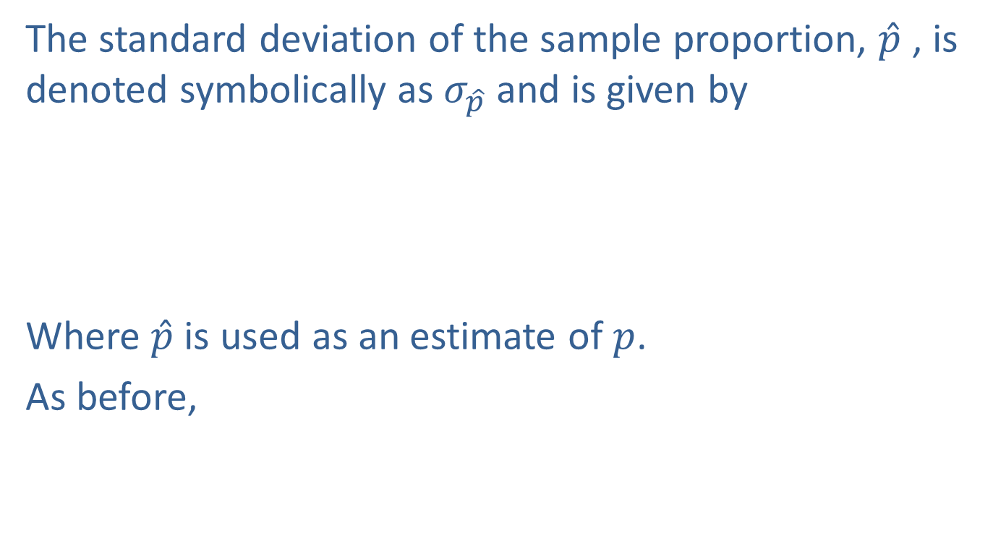
Interval Estimation of a Population Attribute (cont.)
The standard deviation of the sample proportion, $\hat{p}$ , is denoted symbolically as $σ_{\hat{p}}$ and is given by
Where $\hat{p}$ is used as an estimate of $p$.
As before,

Slide 5
Interval Estimation of a Population Attribute (cont.)
Substituting
results in
Manipulating the inequalities results in

Slide 6
Interval Estimation of a Population Attribute (cont.)
which suggests that the interval,
would be a good choice of a 95% confidence interval for the population proportion. As before, the probability that the interval will contain the true population proportion is 0.95 before a specific sample is drawn. After a specific sample is drawn, the only available information about the interval is that the technique which generated it will bound the true proportion 95% of the time.

Slide 7
Formula: 100(1 − α)% Confidence Interval for the Population Proportion
If the sample size is sufficiently large, i.e., and the confidence interval for the population proportion is given by the expression
where is the distance from the point estimate to the end of the interval in standard deviation units, and is the standard deviation of For this confidence interval, where

Slide 8
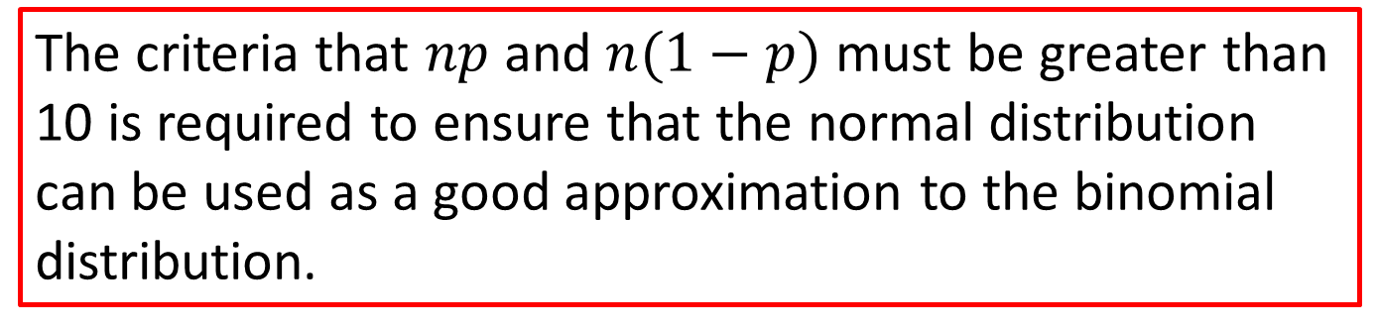
Note
The criteria that $np$ and $n(1−p)$ must be greater than 10 is required to ensure that the normal distribution can be used as a good approximation to the binomial distribution.

Slide 9
Example 10.4.1: Determining a 95% Confidence Interval for the Proportion of Radio Listeners
Suppose a sample of 410 randomly selected radio listeners revealed that 48 listened to WXQI. Find a 95% confidence interval for the proportion of radio listeners that listen to WXQI.
Solution
A point estimate of the proportion that listen to WXQI is calculated by

Slide 10
Example 10.4.1: Determining a 95% Confidence Interval for the Proportion of Radio Listeners (cont.)
Note our sample is large enough such that To obtain an interval estimate, we first calculate the appropriate z-value and and Note that the sample proportion is used in place of p in the computation of For any realistic problem, this will always be the case.

Slide 11
Example 10.4.1: Determining a 95% Confidence Interval for the Proportion of Radio Listeners (cont.)
Fortunately, unless and p are far apart, the value of will not be greatly affected.
Computing the confidence interval results in
0.0859 0.1171 0.1483

Slide 12
Example 10.4.1: Determining a 95% Confidence Interval for the Proportion of Radio Listeners (cont.)
We are 95% confident in the procedure that created this interval. One interpretation is that we are 95% confident that the true proportion of radio listeners that listen to WXQI is between 0.0859 and 0.1483, or between 8.6% and 14.8% approximately. Another interpretation would be that we are 95% confident that the point estimate, 0.1171, has a margin of error of 0.0312. A maximum error of only 0.0312 with 95% confidence suggests a rather high level of accuracy in the estimation of the proportion.

Slide 13
Precision and Sample Size for Estimating the Population Proportion
Just as for the population mean, a specific level of accuracy in estimating a population proportion is desirable. Suppose, for example, that a direct-mail marketer would like to estimate the fraction of a mailing list that will purchase the company’s product. To be profitable, a purchase response of at least 0.008 is required. Because the proportion to be estimated is of such a small magnitude, a high degree of precision in estimating the proportion is necessary.

Slide 14
Precision and Sample Size for Estimating the Population Proportion (cont.)
How large a sample would be required if the population proportion (the actual proportion of persons on the mailing list that will buy the product) is to be estimated with an accuracy of 0.002? We are saying that we want our maximum error to be less than two one-thousandths. That would seem to be a highly precise estimate. But, the quantity we are trying to estimate (the proportion of people on the list that will buy our product) could easily be near 0.008. The maximum error is about 25% as large as the value we are trying to estimate.

Slide 15
Precision and Sample Size for Estimating the Population Proportion (cont.)
When we estimate extremely small quantities, highly precise estimates are necessary. The technique for deriving the sample size parallels the discussion of the sample mean. Setting one-half the entire width of the confidence interval equal to the maximum allowable error yields
Solving for n yields

Slide 16
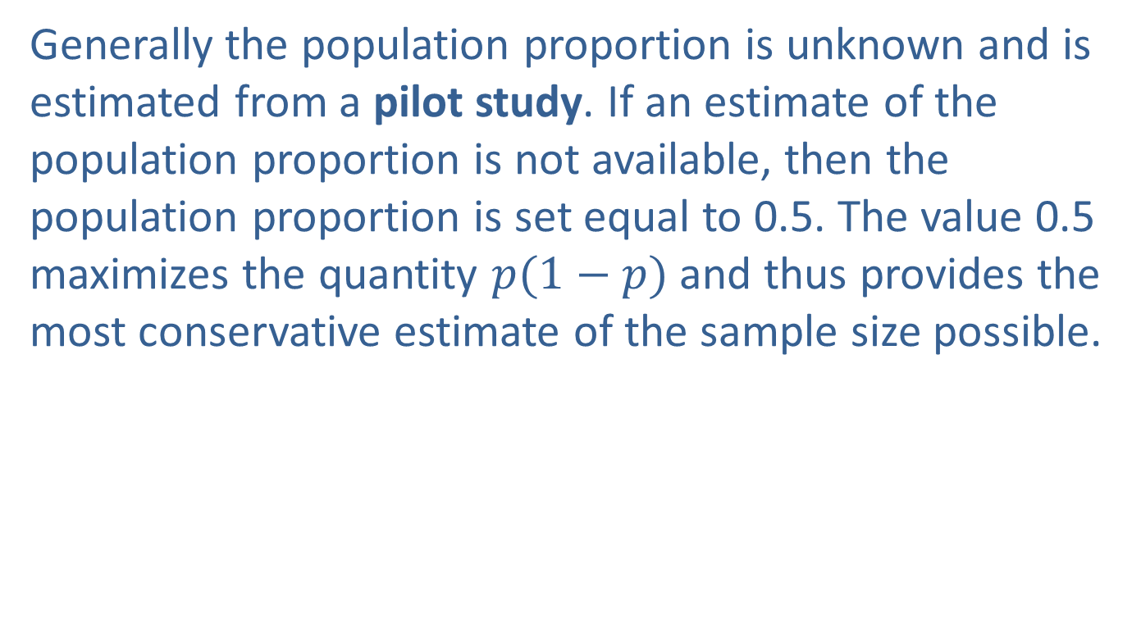
Precision and Sample Size for Estimating the Population Proportion (cont.)
Generally the population proportion is unknown and is estimated from a pilot study. If an estimate of the population proportion is not available, then the population proportion is set equal to 0.5. The value 0.5 maximizes the quantity $p(1−p)$and thus provides the most conservative estimate of the sample size possible.

Slide 17
Note
For a great example, see the game “Direct Mail” in the Appendix of the Hawkes Learning courseware. When you play the game, you will confront estimation problems of this nature.

Slide 18
Definition: Pilot Study
A pilot study serves as an initial, small-scale investigation carried out to provide researchers with valuable insights on the optimal approach for conducting a larger-scale project.

Slide 19
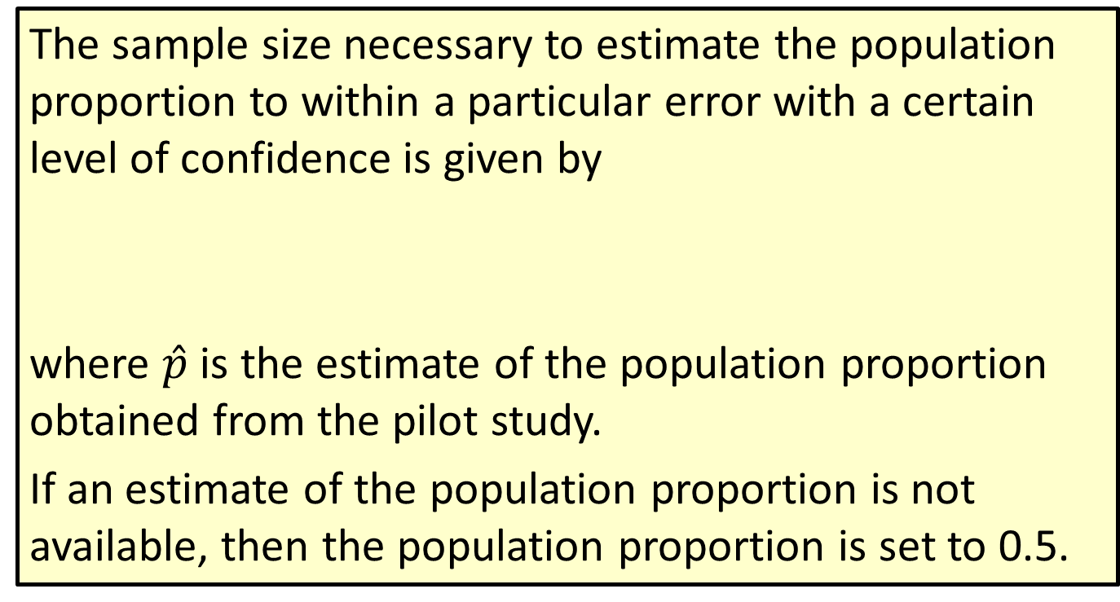
Formula: Sample Size Determination for Estimating a Population Proportion
The sample size necessary to estimate the population proportion to within a particular error with a certain level of confidence is given by
where $\hat{p}$ is the estimate of the population proportion obtained from the pilot study.
If an estimate of the population proportion is not available, then the population proportion is set to 0.5.

Slide 20
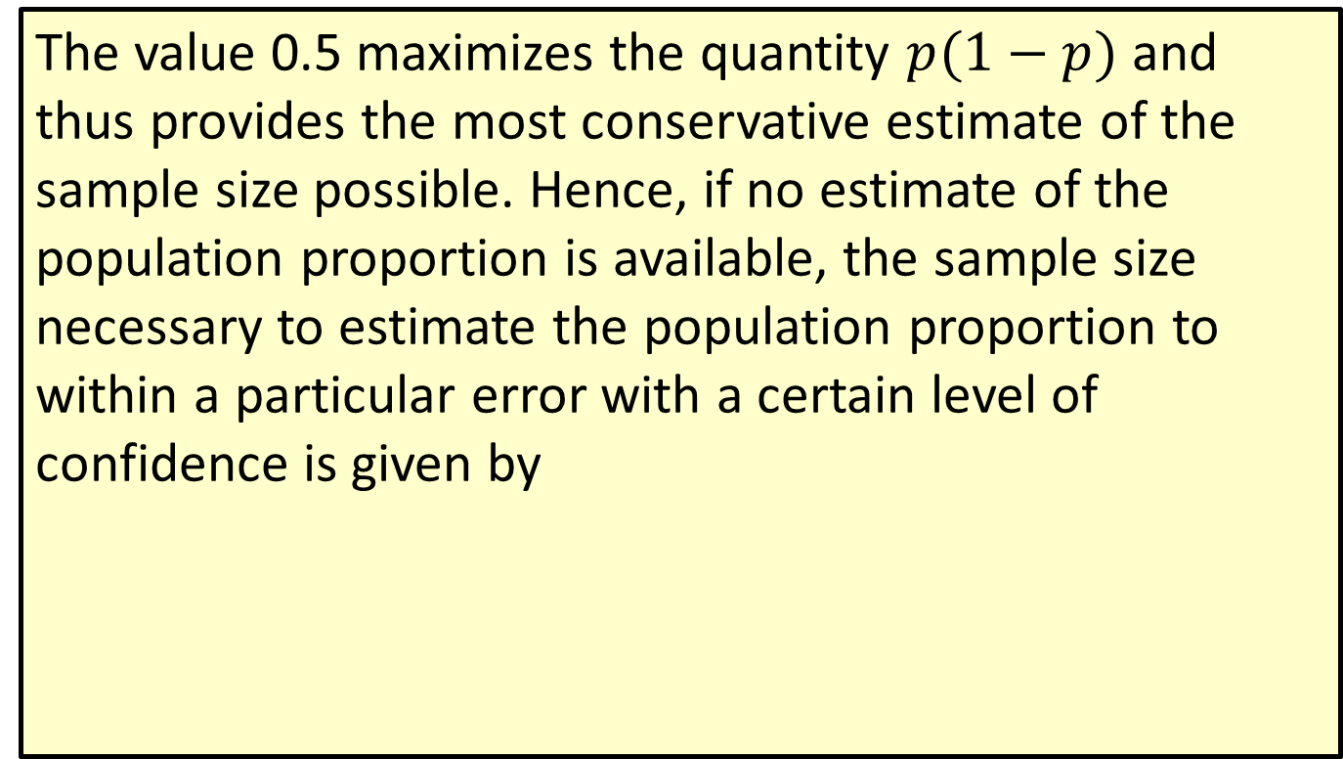
Formula: Sample Size Determination for Estimating a Population Proportion (cont.)
The value 0.5 maximizes the quantity $p(1−p)$ and thus provides the most conservative estimate of the sample size possible. Hence, if no estimate of the population proportion is available, the sample size necessary to estimate the population proportion to within a particular error with a certain level of confidence is given by

Slide 21
Precision and Sample Size for Estimating the Population Proportion (cont.)
By selecting a level of confidence and an error, a sample size can be determined that will likely (at the level of confidence) produce an estimate with at least the desired accuracy. Remember to always round the sample size to the next largest integer to ensure the desired level of accuracy.

Slide 22
Example 10.4.2: Determining the Sample Size Needed to Estimate the Proportion of Buyers
How large a sample would be required to estimate the proportion of buyers on a mailing list with an accuracy of 0.002 and a 95% degree of confidence, if the true proportion is approximately 0.008?
Solution
From the statement of the problem we have

Slide 23
Example 10.4.2: Determining the Sample Size Needed to Estimate the Proportion of Buyers (cont.)
Using the sample size determination expression and the values above yields
Thus, to be 95% confident that the proportion is estimated with an error of at most 0.002 requires a sample size of 7622.

Slide 24
Example 10.4.3: Determining the Sample Size Needed to Estimate the Proportion of the Market Held
Using Example 10.4.1, suppose that radio station WXQI desires to estimate the proportion of the market they hold with a maximum error of 0.01 and a confidence of 0.95. How large a sample would be required to estimate the fraction of listeners to within the desired level of accuracy? Since we don’t know the true population proportion, let’s assume the previous point estimate of 0.1171 is the true proportion.

Slide 25
Example 10.4.3: Determining the Sample Size Needed to Estimate the Proportion of the Market Held (cont.)
Solution
So, we have
Using the sample size determination expression and the values above yields

Slide 26
Example 10.4.3: Determining the Sample Size Needed to Estimate the Proportion of the Market Held (cont.)
Thus, to be 95% confident that the proportion of listeners is estimated with an accuracy of at least 0.01 would require a sample size of 3972.

Slide 27
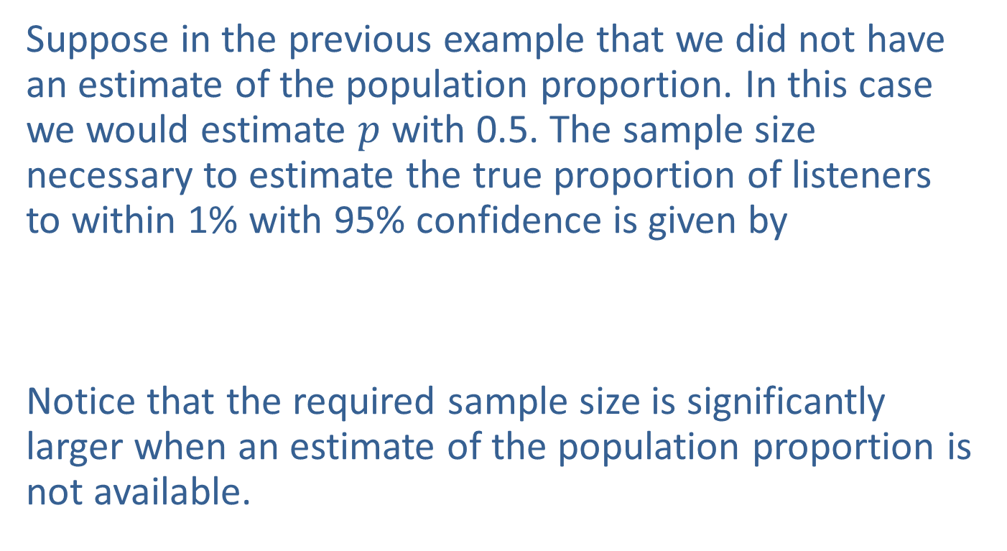
Precision and Sample Size for Estimating the Population Proportion (cont.)
Suppose in the previous example that we did not have an estimate of the population proportion. In this case we would estimate $p$ with 0.5. The sample size necessary to estimate the true proportion of listeners to within 1% with 95% confidence is given by
Notice that the required sample size is significantly larger when an estimate of the population proportion is not available.

Slide 28
Precision and Sample Size for Estimating the Population Proportion (cont.)
The value of drawing random samples resides in the ability to assess the reliability of sample inferences. Reliability is expressed in probability. That is why so much of the text has been devoted to probabilistic ideas.

