Slide 1
Section 10.3
Estimating the Population Mean, σ Unknown

Slide 2

Interval Estimation of the Population Mean for a Normal Population with σ Unknown
If $σ$ is not known and either the population is normally distributed or $n>30$, the derivation of the confidence interval must be changed slightly.

Slide 3
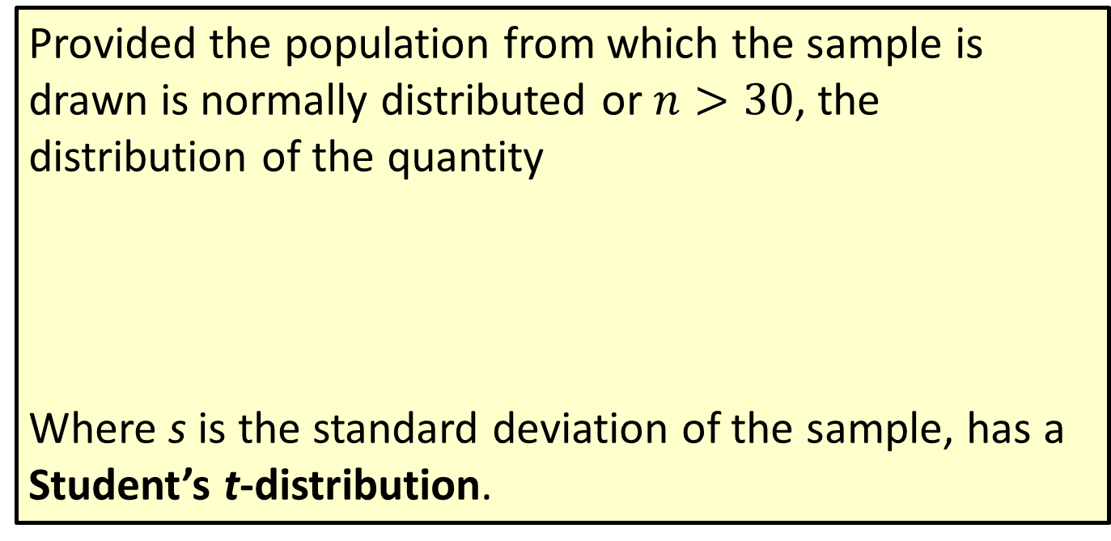
Formula: Student’s t-Distribution
Provided the population from which the sample is drawn is normally distributed or $n>30$, the distribution of the quantity
Where s is the standard deviation of the sample, has a Student’s t-distribution.

Slide 4
Interval Estimation of the Population Mean for a Normal Population with σ Unknown (cont.)
The t-distribution is very much like the normal distribution (see Figure 10.3.1). It is a symmetrical, bell-shaped distribution with slightly thicker tails than a normal distribution. The shape of the t-distribution approaches the normal distribution as the degrees of freedom, the one parameter of the t-distribution, becomes larger.

Slide 5
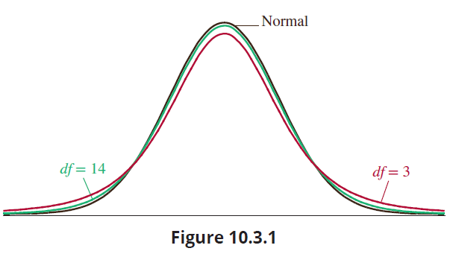
Interval Estimation of the Population Mean for a Normal Population with σ Unknown (cont.)

Slide 6
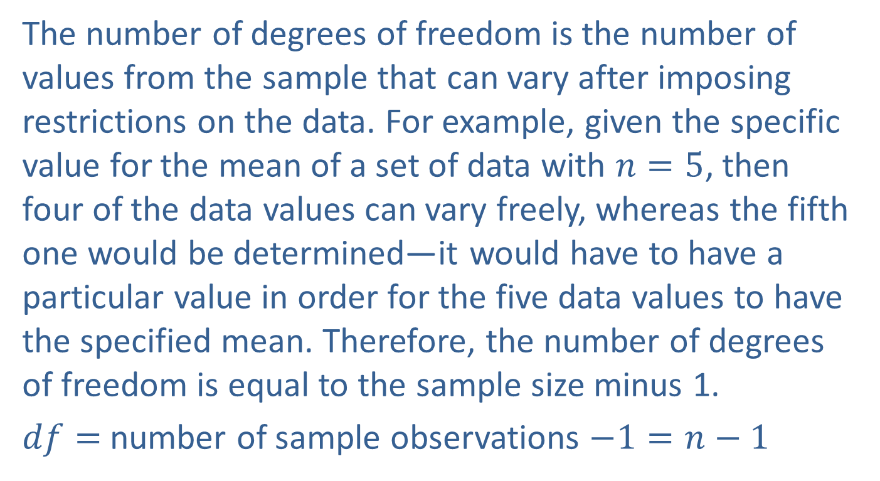
Interval Estimation of the Population Mean for a Normal Population with σ Unknown (cont.)
The number of degrees of freedom is the number of values from the sample that can vary after imposing restrictions on the data. For example, given the specific value for the mean of a set of data with $n=5$, then four of the data values can vary freely, whereas the fifth one would be determined—it would have to have a particular value in order for the five data values to have the specified mean. Therefore, the number of degrees of freedom is equal to the sample size minus 1.
$df=$ number of sample observations $−1=n−1$

Slide 7
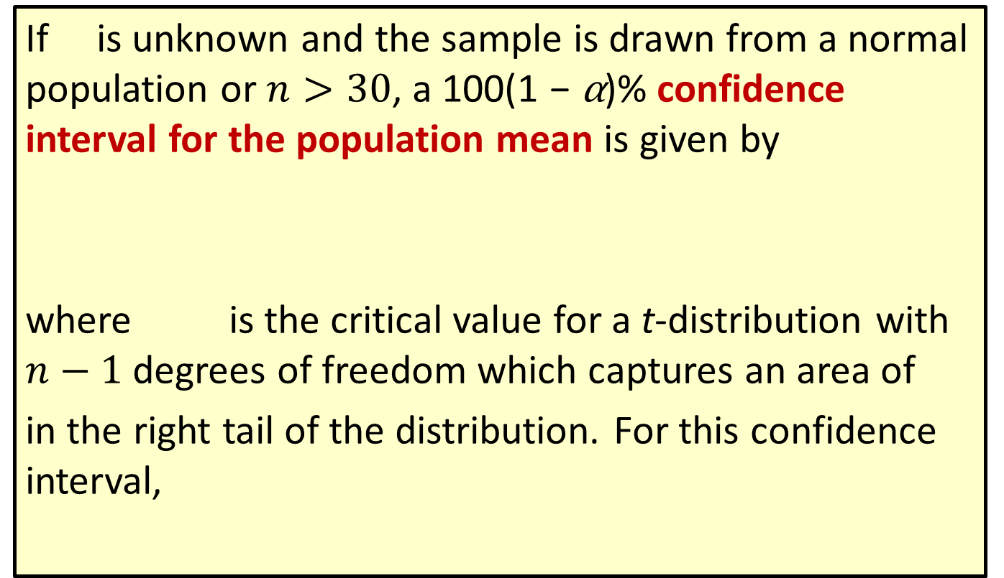

Formula: 100(1 − $α$)% Confidence Interval for the Population Mean, σ Unknown
If is unknown and the sample is drawn from a normal population or $n>30$, a 100(1 − α)% confidence interval for the population mean is given by
where is the critical value for a t-distribution with $n−1$ degrees of freedom which captures an area of
in the right tail of the distribution. For this confidence interval,

Slide 8

Interval Estimation of the Population Mean for a Normal Population with σ Unknown (cont.)
The form of the confidence interval is identical to the previous confidence interval for the mean of a population except that the $z$ has been replaced by a $t$ and $σ$ has been replaced by $s$. The interpretation of the confidence interval is identical to the previous interval.

Slide 9

Example 10.3.1: Determining a Confidence Interval for Number of Hours Worked
A random sample of hours worked in a week by student interns is drawn from a normal population with unknown mean and variance. The seven data values sampled are as follows.
Construct a 95% confidence interval for the population mean.

Slide 10

Example 10.3.1: Determining a Confidence Interval for Number of Hours Worked (cont.)
Solution
Since we have $n<30$, we should confirm the sample comes from an approximately normal distribution.

Slide 11
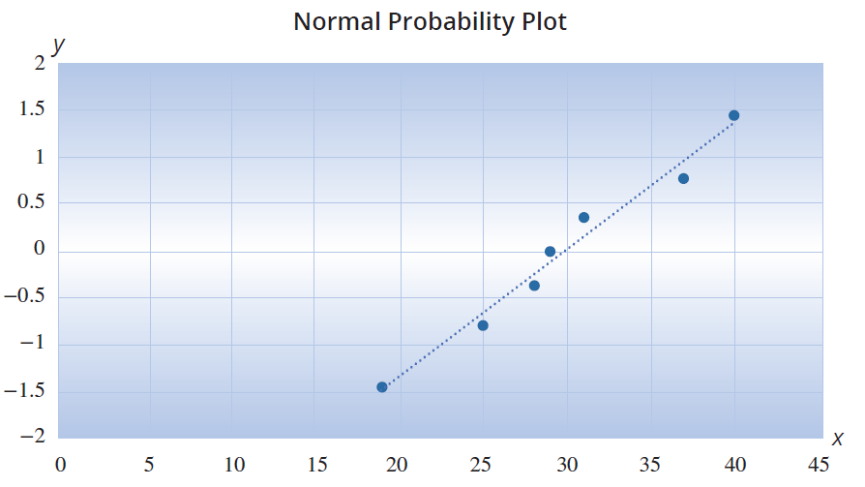
Example 10.3.1: Determining a Confidence Interval for Number of Hours Worked (cont.)

Slide 12
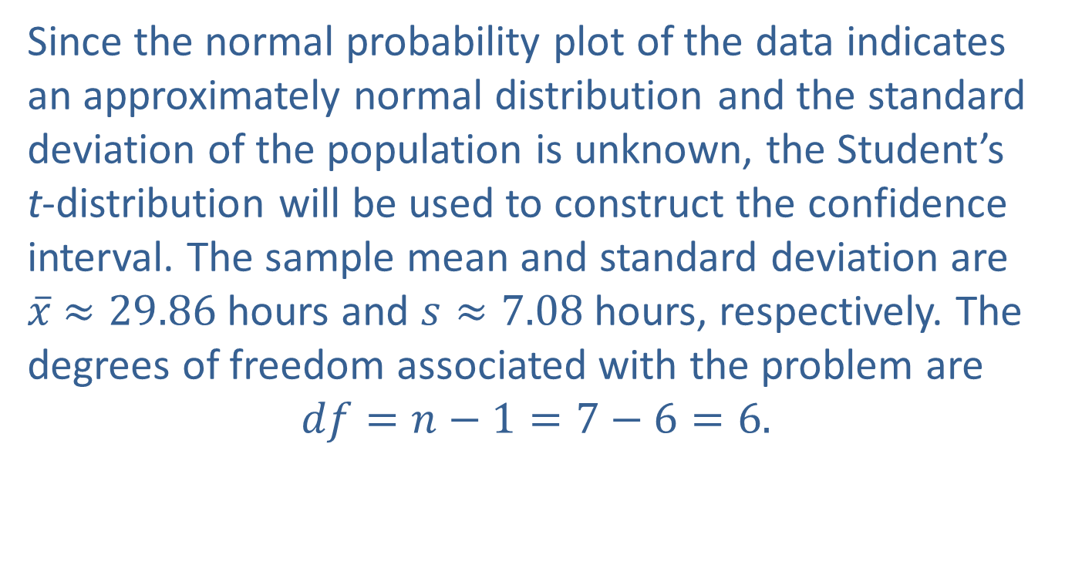
Example 10.3.1: Determining a Confidence Interval for Number of Hours Worked (cont.)
Since the normal probability plot of the data indicates an approximately normal distribution and the standard deviation of the population is unknown, the Student’s t-distribution will be used to construct the confidence interval. The sample mean and standard deviation are $\overline{x}$ $≈29.86$hours and $s≈7.08$hours, respectively. The degrees of freedom associated with the problem are
$$df=n−1=7−6=6.$$

Slide 13
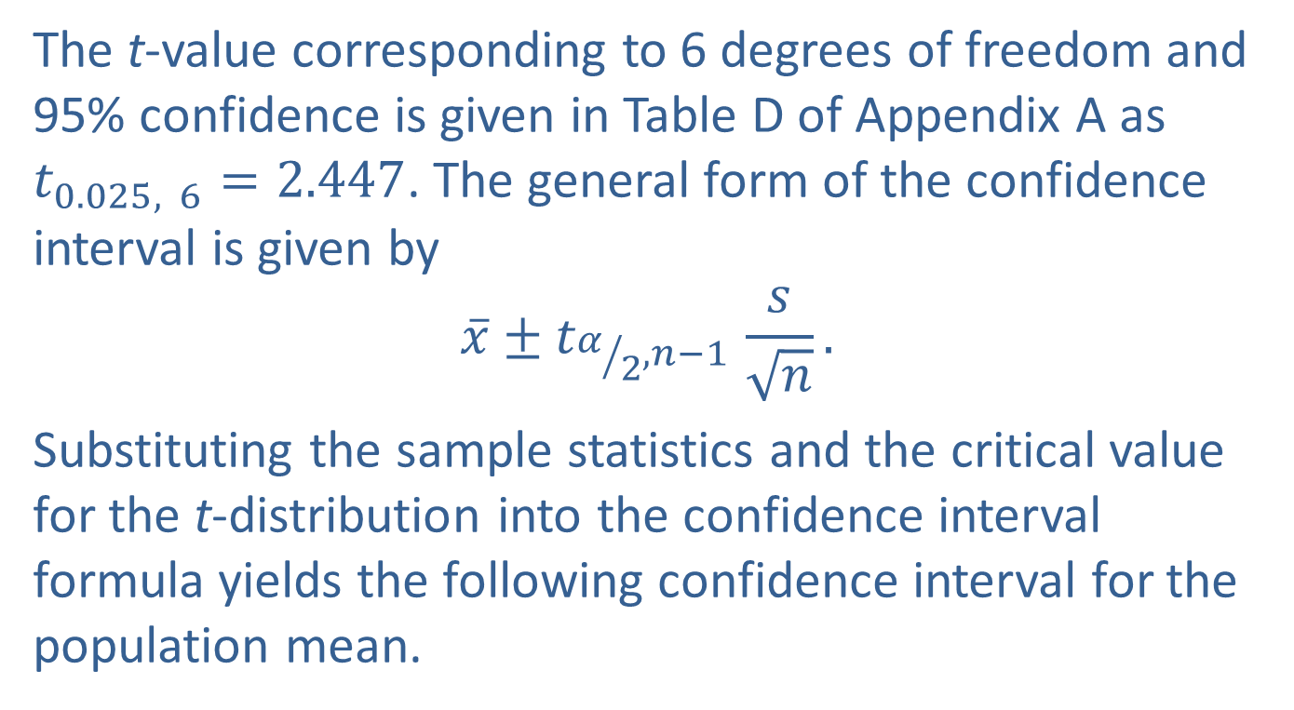
Example 10.3.1: Determining a Confidence Interval for Number of Hours Worked (cont.)
The t-value corresponding to 6 degrees of freedom and 95% confidence is given in Table D of Appendix A as $t_{0.025, 6}=2.447$. The general form of the confidence interval is given by
$$\overline{x}±t_{α/2,{n−1}^{ }}\frac{s}{\sqrt{n}}.$$
Substituting the sample statistics and the critical value for the t-distribution into the confidence interval formula yields the following confidence interval for the population mean.

Slide 14
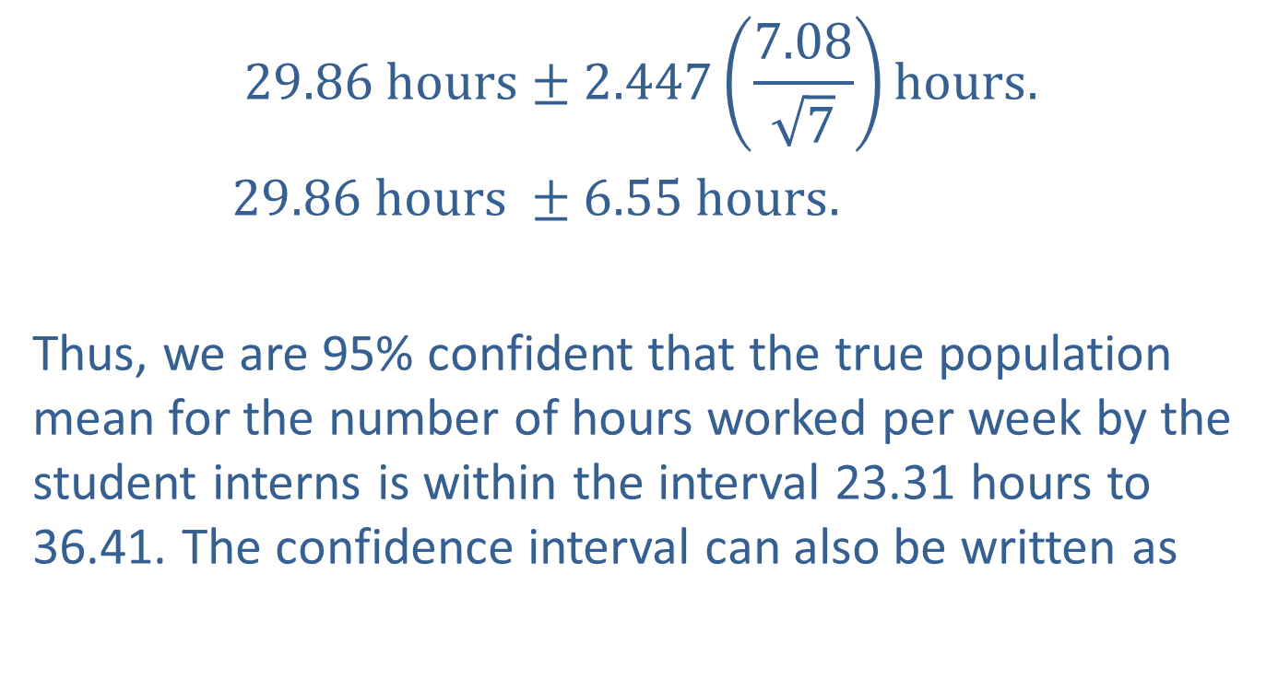
Example 10.3.1: Determining a Confidence Interval for Number of Hours Worked (cont.)
$$29.86 hours±2.447\left(\frac{7.08}{\sqrt{7}}\right)hours.$$
$29.86 hours ±6.55 hours.$
Thus, we are 95% confident that the true population mean for the number of hours worked per week by the student interns is within the interval 23.31 hours to 36.41. The confidence interval can also be written as

Slide 15
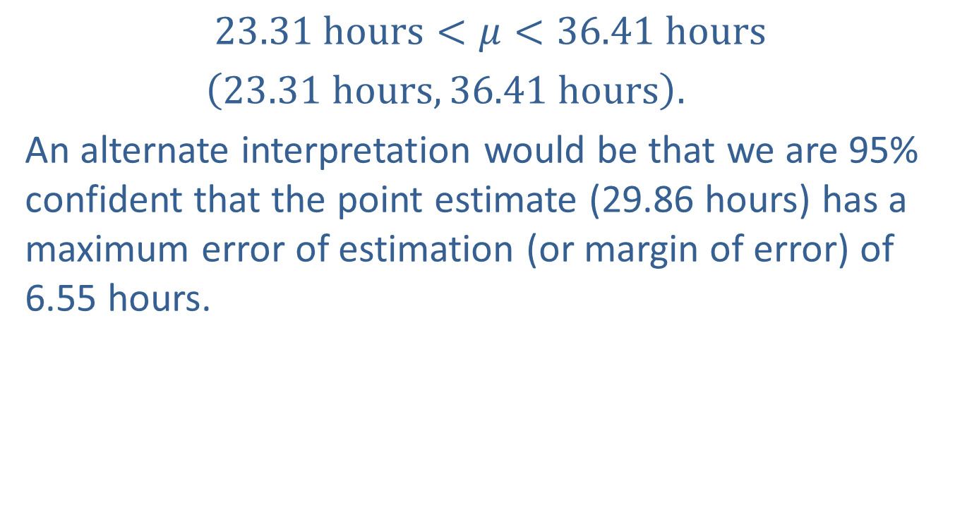
Example 10.3.1: Determining a Confidence Interval for Number of Hours Worked (cont.)
$$23.31 hours<μ<36.41 hours$$
$\left(23.31 hours, 36.41 hours\right).$
An alternate interpretation would be that we are 95% confident that the point estimate (29.86 hours) has a maximum error of estimation (or margin of error) of 6.55 hours.

Slide 16
Example 10.3.2: Determining a Confidence Interval for Completion Time
A manufacturing company is interested in the amount of time it takes to complete a certain stage of the production process. The project manager randomly samples 10 products as they come from the production line and notes the time of completion. The average completion time is 23.45 minutes with a sample standard deviation of 4.32 minutes. Based on this sample, construct a 95% confidence interval for the average completion time for that stage in the production process and interpret the results.

Slide 17
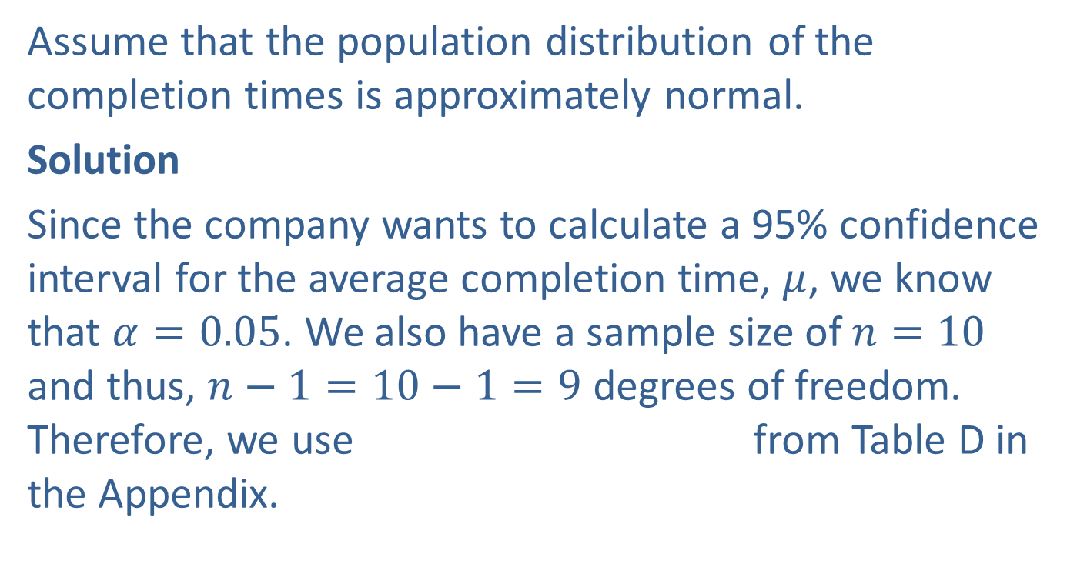
Example 10.3.2: Determining a Confidence Interval for Completion Time (cont.)
Assume that the population distribution of the completion times is approximately normal.
Solution
Since the company wants to calculate a 95% confidence interval for the average completion time, $μ$, we know that $α=0.05$. We also have a sample size of $n=10$ and thus, $n−1=10−1=9$ degrees of freedom. Therefore, we use from Table D in the Appendix.

Slide 18
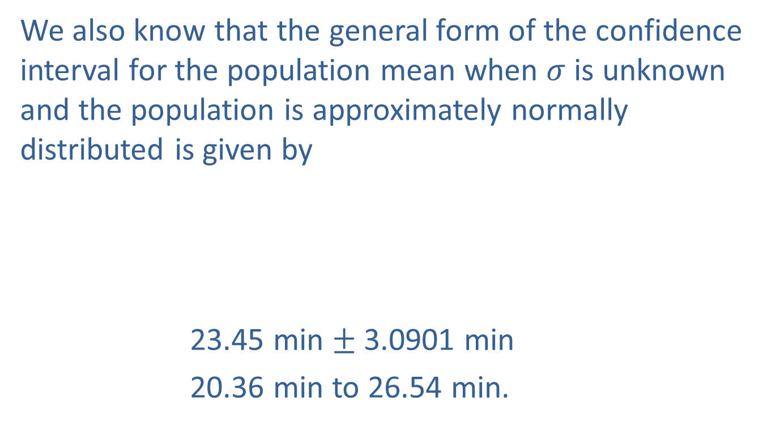
Example 10.3.2: Determining a Confidence Interval for Completion Time (cont.)
We also know that the general form of the confidence interval for the population mean when $σ$ is unknown and the population is approximately normally distributed is given by
23.45 min $±$ 3.0901 min
20.36 min to 26.54 min.

Slide 19
Example 10.3.2: Determining a Confidence Interval for Completion Time (cont.)
Thus, we are 95% confident that the true average completion time of that stage of the production process is between 20.36 minutes and 26.54 minutes.

Slide 20
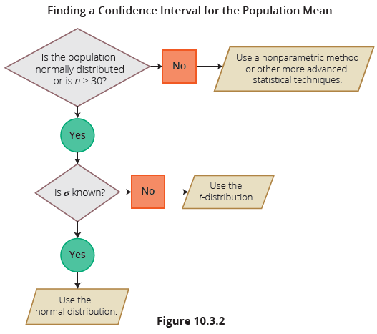
Interval Estimation of the Population Mean:
A Summary

Slide 21
Precision and Sample Size for Estimating the
Population Mean
The more accurate an estimate, the greater its potential value in decision making. The only way to accurately determine an unknown population parameter is to perform a census, though this is usually impractical because of cost or time considerations. Realistically, the best interval estimate a decision maker could hope for would be an interval with a small width and possessing a large amount of confidence. The width of the confidence interval defines the precision with which the population mean is estimated; the smaller the interval, the greater the precision.

Slide 22
Precision and Sample Size for Estimating the
Population Mean (cont.)
If the width of a confidence interval could be controlled, we could achieve estimates with a level of accuracy that is appropriate for the decision at hand. This is precisely what we plan to do in the next section.

Slide 23

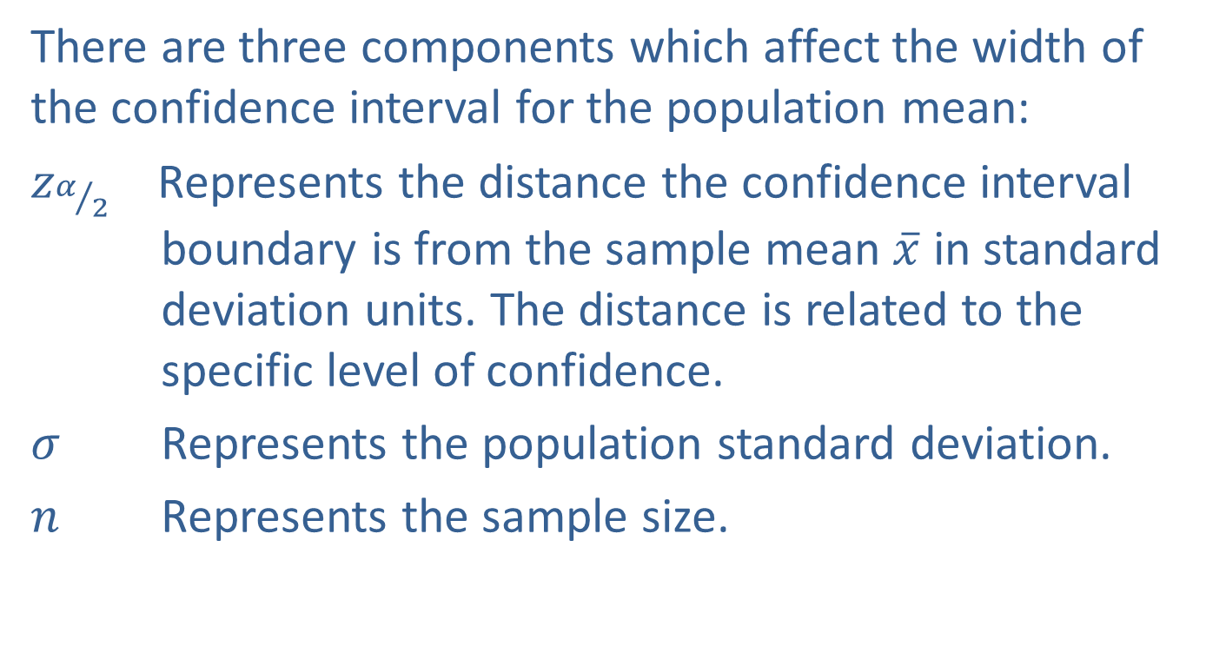
Sample Size for $σ$ Known
There are three components which affect the width of the confidence interval for the population mean:
$z_{α/2}$ Represents the distance the confidence interval boundary is from the sample mean $\overline{x}$ in standard deviation units. The distance is related to the specific level of confidence.
$σ$ Represents the population standard deviation.
$n$ Represents the sample size.

Slide 24
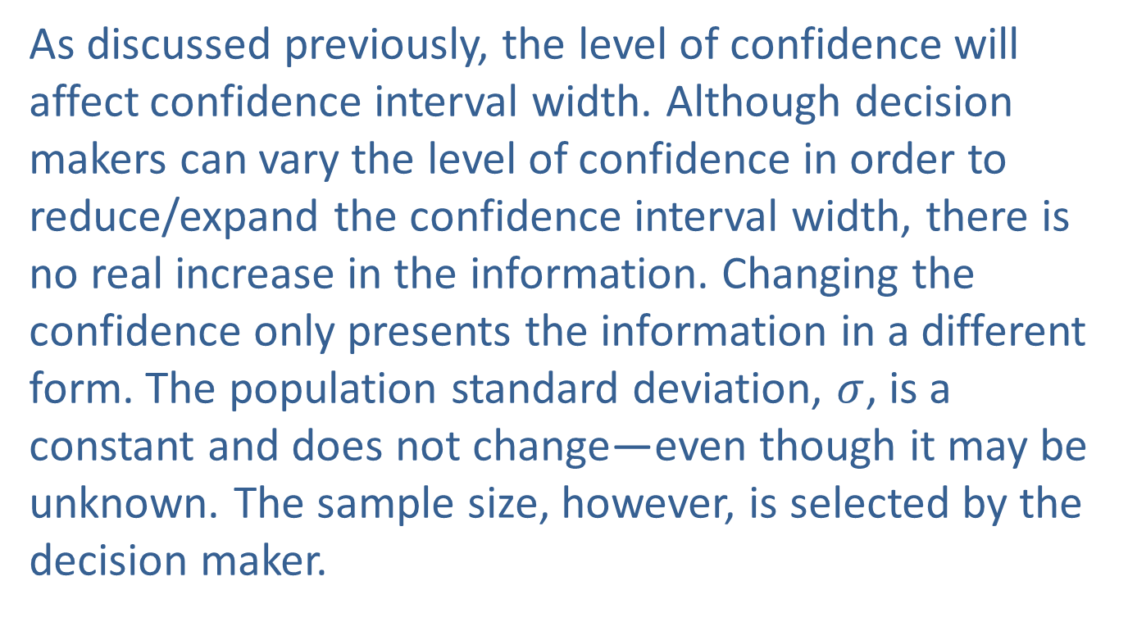

Sample Size for $σ$ Known (cont.)
As discussed previously, the level of confidence will affect confidence interval width. Although decision makers can vary the level of confidence in order to reduce/expand the confidence interval width, there is no real increase in the information. Changing the confidence only presents the information in a different form. The population standard deviation, $σ$, is a constant and does not change—even though it may be unknown. The sample size, however, is selected by the decision maker.

Slide 25
Sample Size for $σ$ Known (cont.)
The larger the sample, the smaller the width of the resulting confidence interval for some given level of confidence. Since the sample size can be enlarged, which reduces the width of the confidence interval, how large should the sample be? Taking too large a sample wastes money, while taking too small a sample produces an estimator that does not possess sufficient reliability.

Slide 26
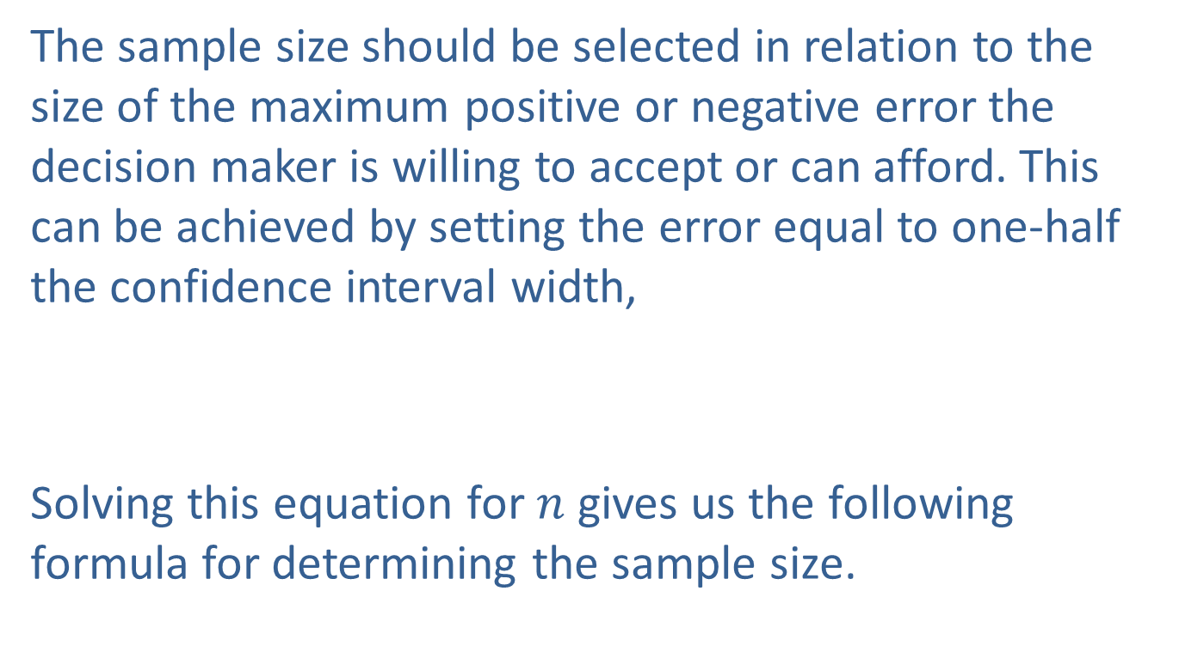
Sample Size for $σ$ Known (cont.)
The sample size should be selected in relation to the size of the maximum positive or negative error the decision maker is willing to accept or can afford. This can be achieved by setting the error equal to one-half the confidence interval width,
Solving this equation for $n$ gives us the following formula for determining the sample size.

Slide 27
Formula: Sample Size Determination for Estimating a
Population Mean

Slide 28
Sample Size for $σ$ Known (cont.)
By selecting a level of confidence and the maximum error, the relationship can be used to determine the sample size necessary to estimate the population mean with the desired accuracy. In order to assure the desired level of confidence, always round the value obtained for the sample size up to the next integer.

Slide 29
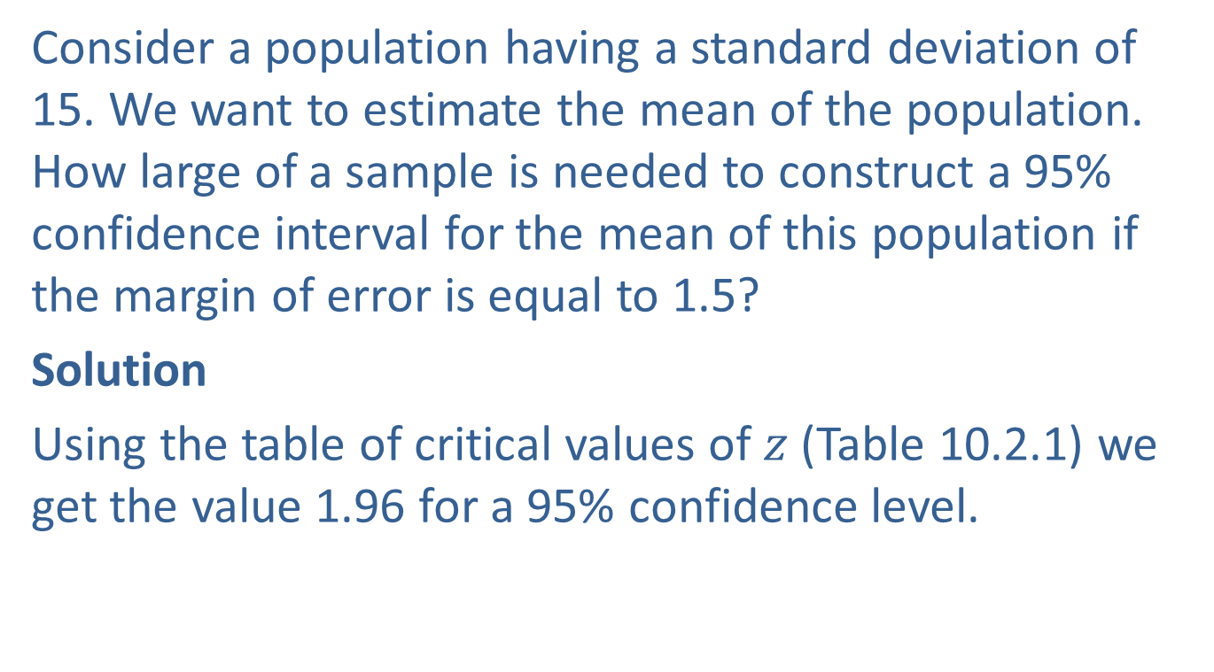
Example 10.3.3: Determining the Sample Size Needed for a 95% Confidence Interval of the Mean
Consider a population having a standard deviation of 15. We want to estimate the mean of the population. How large of a sample is needed to construct a 95% confidence interval for the mean of this population if the margin of error is equal to 1.5?
Solution
Using the table of critical values of $z$ (Table 10.2.1) we get the value 1.96 for a 95% confidence level.

Slide 30
Example 10.3.3: Determining the Sample Size Needed for a 95% Confidence Interval of the Mean (cont.)
We require a sample size of 385 to ensure that we get at least a 95% confidence interval with a margin of error equal to 1.5.

Slide 31
Example 10.3.4: Determining the Sample Size Needed for 90% Confidence of the Mean Amount of Cleaning Fluid
Suppose that a quality control manager at a Chemical Company wishes to measure the average amount of cleaning fluid the company is placing in their 12-ounce bottles. From previous studies, they believe their population standard deviation to be 0.3 ounces. How large a sample must be taken in order to be 90% confident of estimating the mean cleaning fluid in a 12-ounce bottle to within 0.05 ounces?

Slide 32
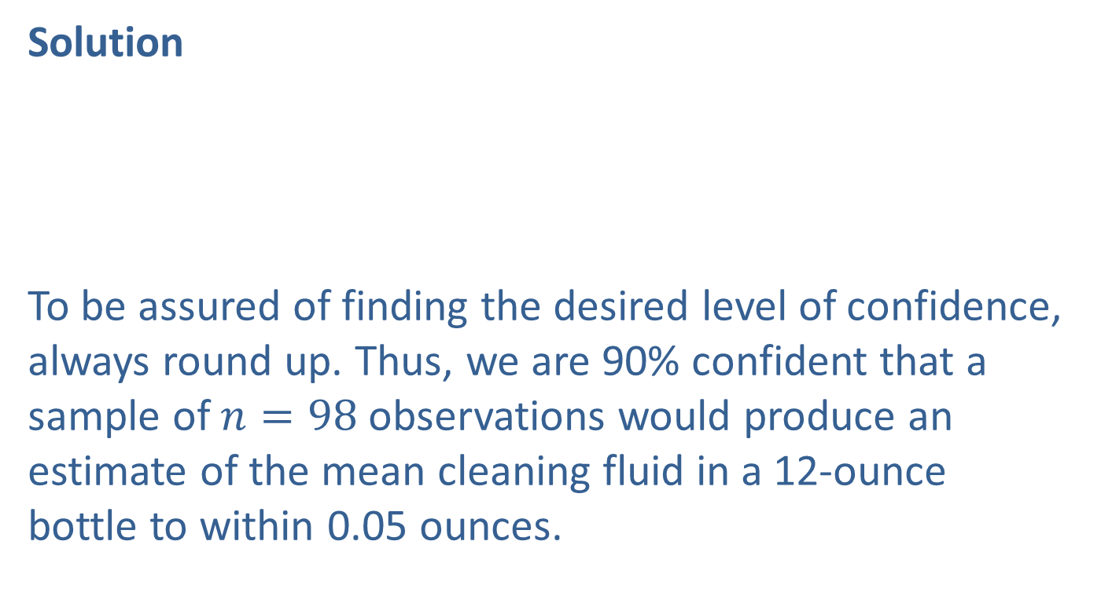
Example 10.3.4: Determining the Sample Size Needed for 90% Confidence of the Mean Amount of Cleaning Fluid (cont.)
Solution
To be assured of finding the desired level of confidence, always round up. Thus, we are 90% confident that a sample of $n=98$observations would produce an estimate of the mean cleaning fluid in a 12-ounce bottle to within 0.05 ounces.

Slide 33
Example 10.3.4: Determining the Sample Size Needed for 90% Confidence of the Mean Amount of Cleaning Fluid (cont.)
Being able to know the accuracy of your estimate is one of the significant benefits of inferential statistics. In this case, if 98 bottles are measured, we will be 90% confident that the resulting sample mean is within five one-hundredths of an ounce of the true mean. That’s close.

Slide 34
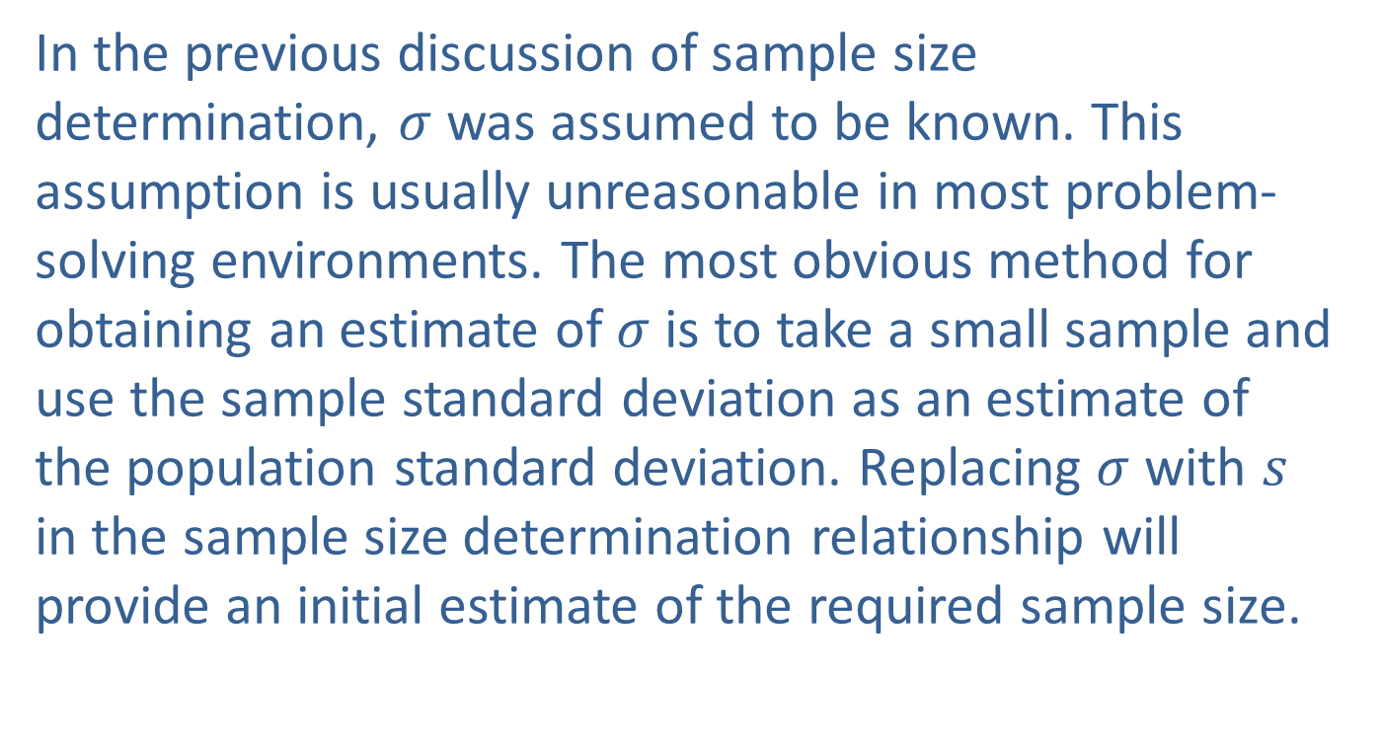
Sample Size for $σ$ Known (cont.)
In the previous discussion of sample size determination, $σ$ was assumed to be known. This assumption is usually unreasonable in most problem-solving environments. The most obvious method for obtaining an estimate of $σ$ is to take a small sample and use the sample standard deviation as an estimate of the population standard deviation. Replacing $σ$ with $s$ in the sample size determination relationship will provide an initial estimate of the required sample size.

Slide 35
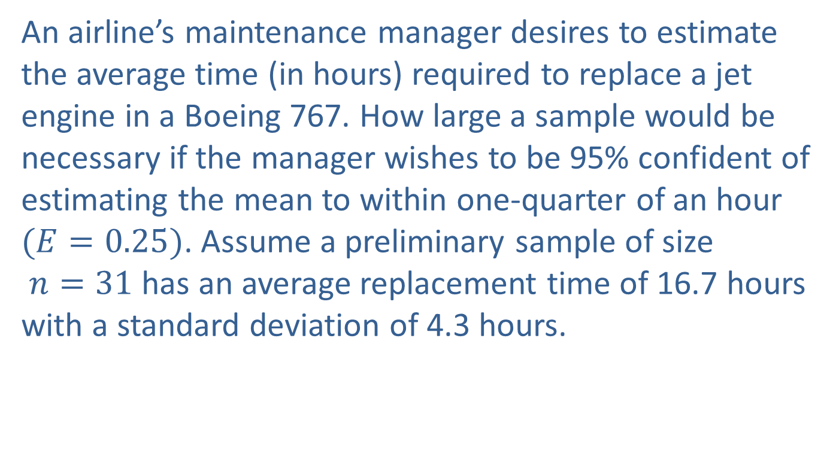
Example 10.3.5: Determining the Sample Size Needed for 95% Confidence of the Mean Time Required to Replace a Jet Engine
An airline’s maintenance manager desires to estimate the average time (in hours) required to replace a jet engine in a Boeing 767. How large a sample would be necessary if the manager wishes to be 95% confident of estimating the mean to within one-quarter of an hour $(E=0.25)$. Assume a preliminary sample of size $n=31$has an average replacement time of 16.7 hours with a standard deviation of 4.3 hours.

Slide 36
Example 10.3.5: Determining the Sample Size Needed for 95% Confidence of the Mean Time Required to Replace a Jet Engine (cont.)
Solution
Using the results from the initial sample,
Notice that while the sample data values are being collected they can be used to improve the estimate of the population standard deviation.

Slide 37
Example 10.3.5: Determining the Sample Size Needed for 95% Confidence of the Mean Time Required to Replace a Jet Engine (cont.)
For example, suppose the sample standard deviation after sampling the first 100 observations was 4.1. Using this estimate of s instead of 4.3 results in a sample size of 1034 compared to the original specification of 1137. The notion of modifying the sample size estimate as additional data is observed can be applied at regular intervals during the sampling process until the estimate of the standard deviation stabilizes.

