Slide 1
Section 10.2
Estimating the Population Mean, σ Known

Slide 2
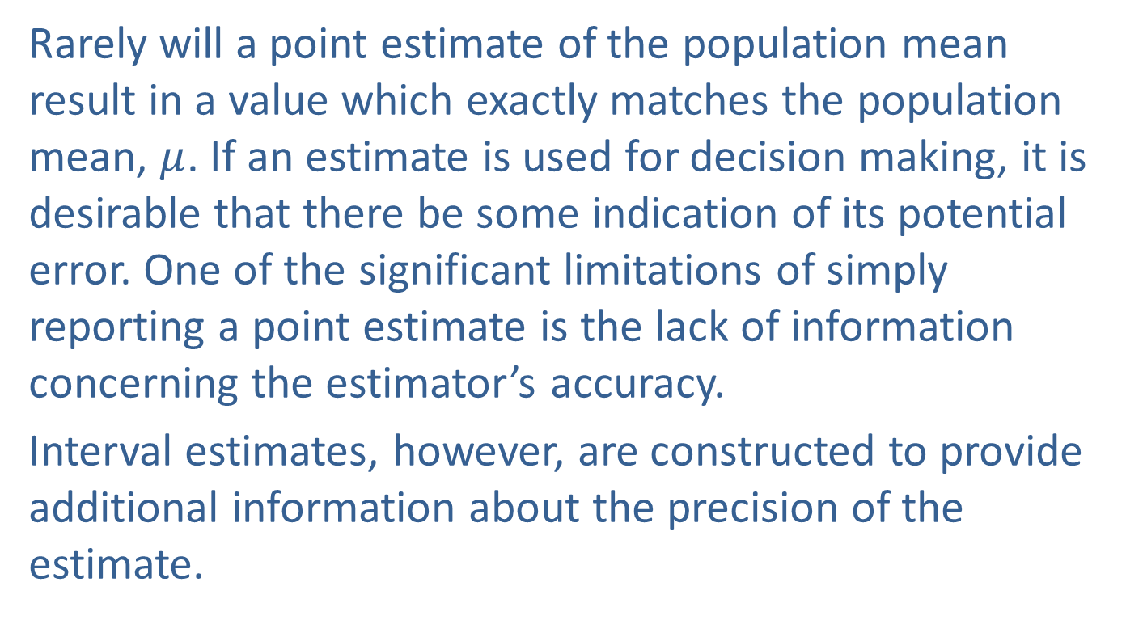
Estimating the Population Mean, σ Known
Rarely will a point estimate of the population mean result in a value which exactly matches the population mean, $μ$. If an estimate is used for decision making, it is desirable that there be some indication of its potential error. One of the significant limitations of simply reporting a point estimate is the lack of information concerning the estimator’s accuracy.
Interval estimates, however, are constructed to provide additional information about the precision of the estimate.

Slide 3
Estimating the Population Mean, σ Known (cont.)
An interval estimator is made by developing an upper and a lower boundary for an interval that will hopefully contain the population parameter. It would be easy to construct an interval estimator that would always contain the population parameter: for example, the interval from negative infinity to positive infinity. But this particular estimator would not contain any useful information about the location of the population parameter. In interval estimation, the smaller the interval for a given level of confidence, the better the estimator.

Slide 4
Note
It is important to note that confidence and probability are conceptually related, but they are not the same thing.

Slide 5
Definition: Interval Estimate
An interval estimate defines an upper and lower boundary for an interval that will hopefully contain the population parameter with a given confidence level.

Slide 6
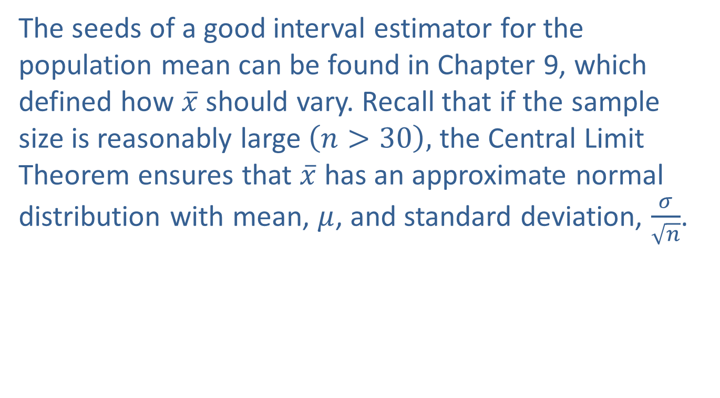
Estimating the Population Mean, σ Known (cont.)
The seeds of a good interval estimator for the population mean can be found in Chapter 9, which defined how $\overline{x}$ should vary. Recall that if the sample size is reasonably large $\left(n>30\right),$ the Central Limit Theorem ensures that $\overline{x}$ has an approximate normal distribution with mean, $μ$, and standard deviation, $\frac{σ}{\sqrt{n}}$.

Slide 7
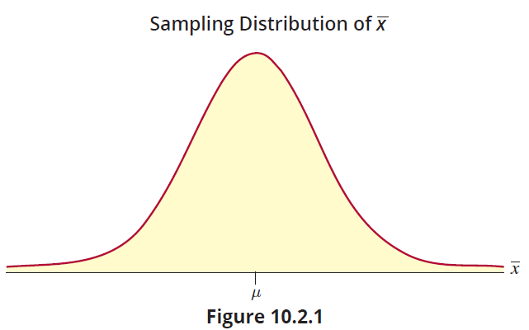
Estimating the Population Mean, σ Known (cont.)

Slide 8
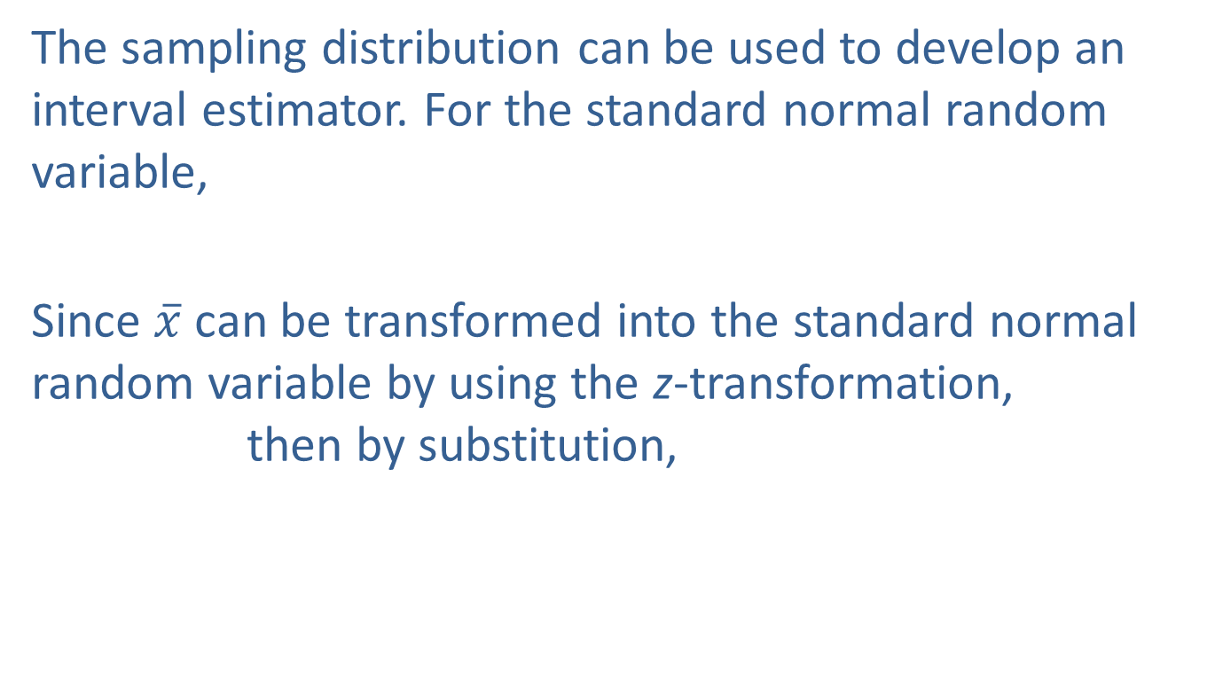
Estimating the Population Mean, σ Known (cont.)
The sampling distribution can be used to develop an interval estimator. For the standard normal random variable,
Since $\overline{x}$ can be transformed into the standard normal random variable by using the z-transformation, then by substitution,

Slide 9
Estimating the Population Mean, σ Known (cont.)
and with some algebraic manipulation we obtain
If the sample size is greater than 30, there is a 0.95 probability that the sample mean will be within 1.96 standard deviations of the population mean before a particular sample is selected.

Slide 10
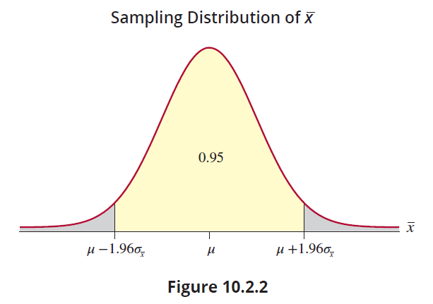
Estimating the Population Mean, σ Known (cont.)

Slide 11
Estimating the Population Mean, σ Known (cont.)
Since we discussed the sampling distribution of the sample mean in Chapter 9, the idea of defining the probability that the sample mean should fall within some specified distance of the population mean is not a new one. The expression above does suggest a specific form for the interval since it provides an interval and the associated probability that the population mean will fall within the interval

Slide 12
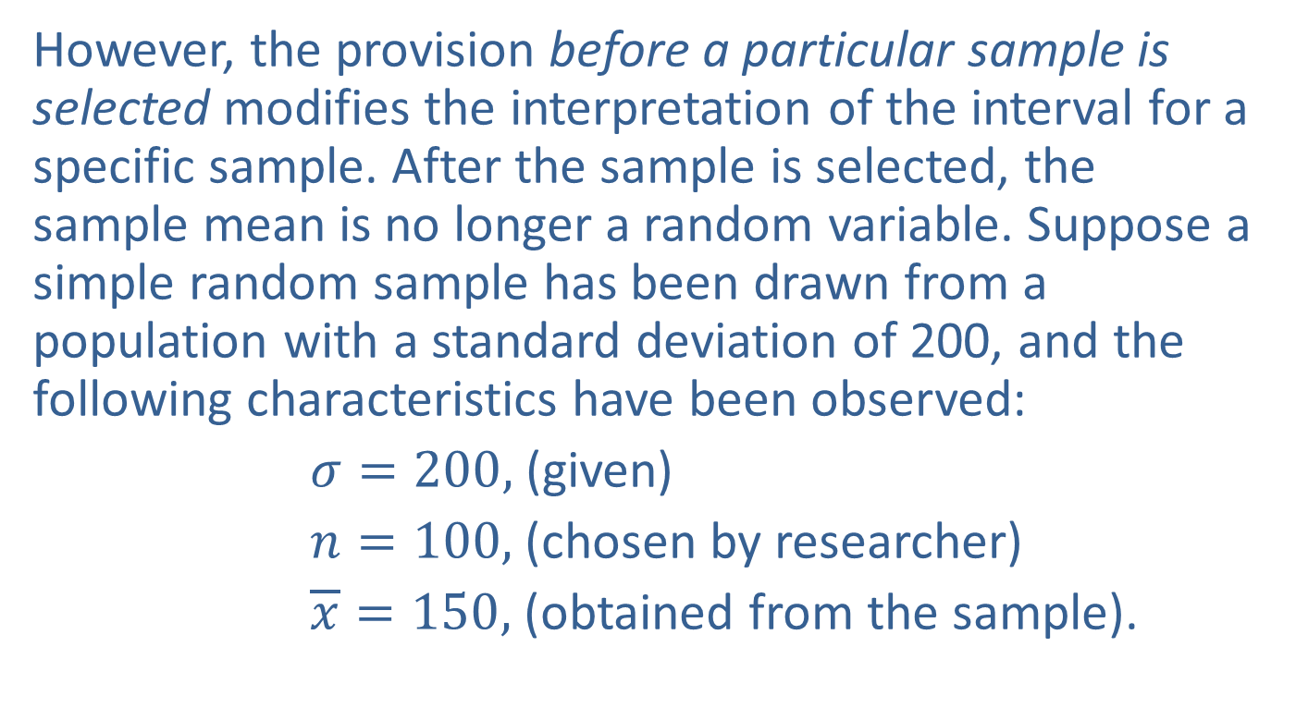
Estimating the Population Mean, σ Known (cont.)
However, the provision before a particular sample is selected modifies the interpretation of the interval for a specific sample. After the sample is selected, the sample mean is no longer a random variable. Suppose a simple random sample has been drawn from a population with a standard deviation of 200, and the following characteristics have been observed:
$σ=200,$ (given)
$n=100,$ (chosen by researcher)
$\overline{x}=150,$ (obtained from the sample).

Slide 13
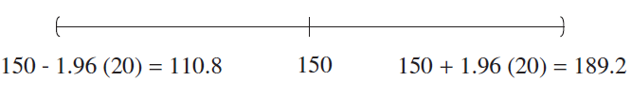
Estimating the Population Mean, σ Known (cont.)
Remember,
The resulting interval would be
That is,

Slide 14
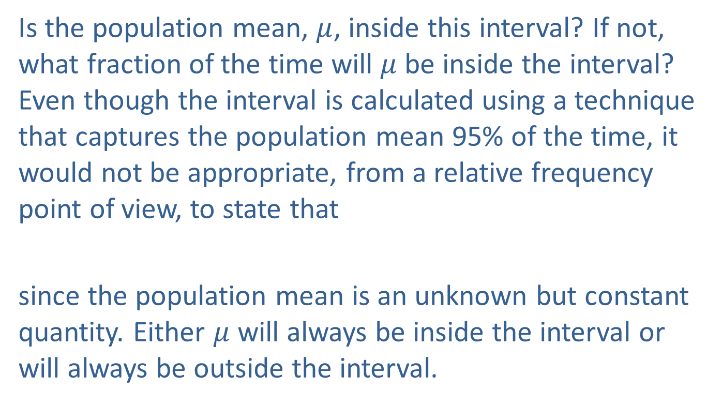
Estimating the Population Mean, σ Known (cont.)
Is the population mean, $μ$, inside this interval? If not, what fraction of the time will $μ$ be inside the interval? Even though the interval is calculated using a technique that captures the population mean 95% of the time, it would not be appropriate, from a relative frequency point of view, to state that
since the population mean is an unknown but constant quantity. Either $μ$ will always be inside the interval or will always be outside the interval.

Slide 15
Estimating the Population Mean, σ Known (cont.)
Then what information do we have about the interval? Since it was constructed from a technique that will include the true population mean in the interval 0.95 of the time, we are 95% confident in the technique. Hence, the term confidence interval is used to describe the method of construction rather than a particular interval.

Slide 16
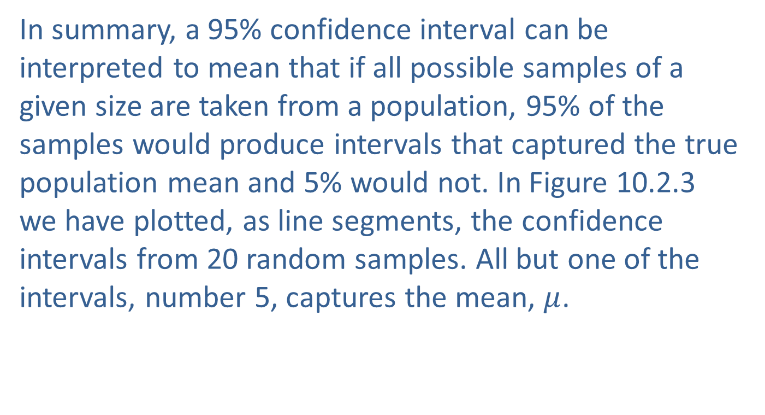
Estimating the Population Mean, σ Known (cont.)
In summary, a 95% confidence interval can be interpreted to mean that if all possible samples of a given size are taken from a population, 95% of the samples would produce intervals that captured the true population mean and 5% would not. In Figure 10.2.3 we have plotted, as line segments, the confidence intervals from 20 random samples. All but one of the intervals, number 5, captures the mean, $μ$.

Slide 17
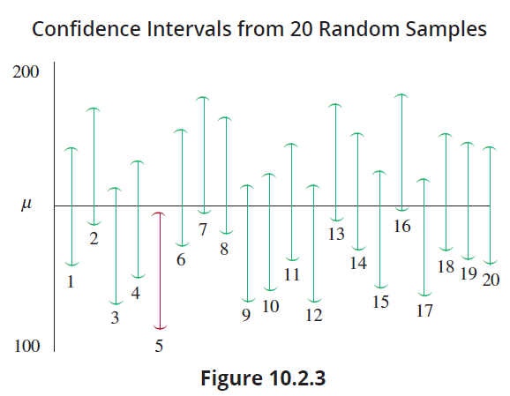
Estimating the Population Mean, σ Known (cont.)
So far we have examined only the 95% confidence interval, yet the idea is a general one and can be extended to any specified degree of confidence.

Slide 18
Estimating the Population Mean, σ Known (cont.)
In a practical sense, the selection of the degree of confidence depends upon the importance of the decision for which the confidence interval will be utilized. If we are launching a space vehicle, we would want to be very certain that the vehicle would have sufficient fuel to return safely. For other decisions, we might be willing to accept an 80% confidence of correctly estimating the population mean, especially if the cost of gathering additional data is large.

Slide 19
Formula: 100(1 − α)% Confidence Interval for the Population Mean, σ Known
If σ is known and the sample is drawn from a normal population or n > 30, a 100(1 − α )% confidence interval for the population mean is given by

Slide 20
Estimating the Population Mean, σ Known (cont.)
The expression, , creates the “generalized” confidence interval shown below.
The confidence interval can also be written as

Slide 21

Estimating the Population Mean, σ Known (cont.)
The term represents the z-value required to obtain an area of 1−$α$ centered under the standard normal curve. The z-values for obtaining various 1− $α$ areas centered under the standard normal curve are given in Table 10.2.1 and graphed in Figure 10.2.4.
Table 10.2.1 - Critical Values of z
Confidence (1 −α)
0.80 | 1.28
0.90 | 1.645
0.95 | 1.96
0.99 | 2.575

Slide 22
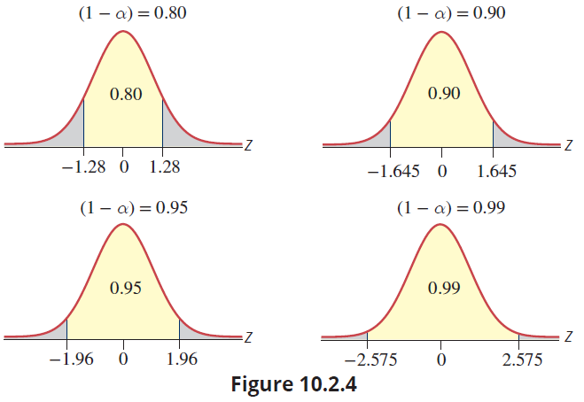
Estimating the Population Mean, σ Known (cont.)

Slide 23
Estimating the Population Mean, σ Known (cont.)
The role of the z-value in the confidence interval formula is to move the boundary points for the confidence interval the number of standard deviation units from the sample mean necessary to achieve the desired level of confidence. As the confidence interval formula demonstrates, the larger the desired confidence, the greater the number of standard deviations that must be used to form the boundary points for the confidence interval.

Slide 24
Example 10.2.1: Determining a Confidence Interval for the Power of a Car Engine
A random sample of 100 car engines has a mean power of 425 horsepower (hp). Construct 80%, 90%, 95%, and 99% confidence intervals for the population mean if the standard deviation of the population is 12 hp.
Solution
Since the random sample is from a population with a known standard deviation and n is greater than 30, we use the standard normal distribution to construct the confidence intervals.

Slide 25


Example 10.2.1: Determining a Confidence Interval for the Power of a Car Engine (cont.)
n = 100, and
80% Confidence Interval
90% Confidence Interval

Slide 26


Example 10.2.1: Determining a Confidence Interval for the Power of a Car Engine (cont.)
95% Confidence Interval
99% Confidence Interval

Slide 27
Estimating the Population Mean, σ Known (cont.)
The intervals in Example 10.2.1 illustrate that to achieve more confidence we must pay a price. Notice that for 90% confidence level the interval width is approximately 4 units (426.947 − 423.026 ≈ 4) while at a 99% confidence level the interval width is approximately 6 units (428.091 − 421.909 ≈ 6). For a given sample size the only way to achieve greater confidence is to widen the interval. However, the resulting information provides a less precise location of the population mean.

Slide 28
Estimating the Population Mean, σ Known (cont.)
Changing the sample size will also influence the width of the confidence interval. Intuitively, this makes sense because as more information is provided about the population, through increasing the size of the sample, the more precisely that we will estimate the location of the population mean. Using the information from Example 10.2.1 and an alternative sample size of 36 (n = 36), compare the widths of the intervals for 90% confidence.

Slide 29


Estimating the Population Mean, σ Known (cont.)
90% Confidence Interval

Slide 30
Estimating the Population Mean, σ Known (cont.)
The width when n = 36 is equal to 6.58 which is larger than that of the larger sample (n = 100), for the same confidence level. Later in Section 10.3 this relationship between the sample size and the precision for an interval estimate of the population mean will be developed further.
So far, the confidence interval has been discussed as a way of placing bounds on the location of a parameter with a specific degree of confidence.

Slide 31
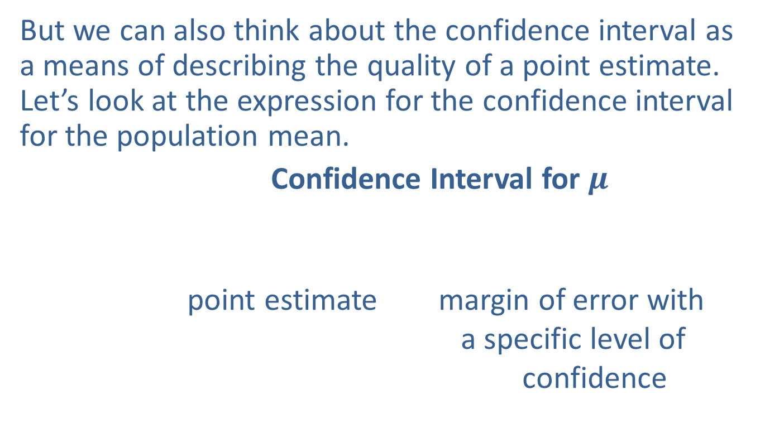
Estimating the Population Mean, σ Known (cont.)
But we can also think about the confidence interval as a means of describing the quality of a point estimate. Let’s look at the expression for the confidence interval for the population mean.
Confidence Interval for $μ$
point estimate margin of error with
a specific level of
confidence

Slide 32
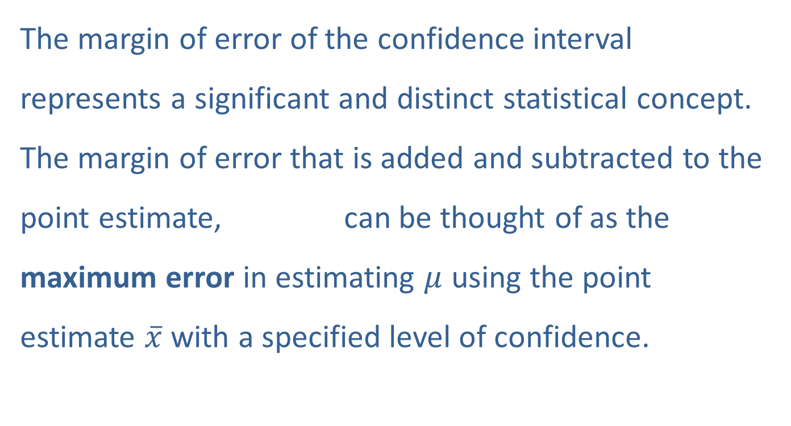
Estimating the Population Mean, σ Known (cont.)
The margin of error of the confidence interval represents a significant and distinct statistical concept. The margin of error that is added and subtracted to the point estimate, can be thought of as the maximum error in estimating $μ$ using the point estimate $\overline{x}$ with a specified level of confidence.

Slide 33
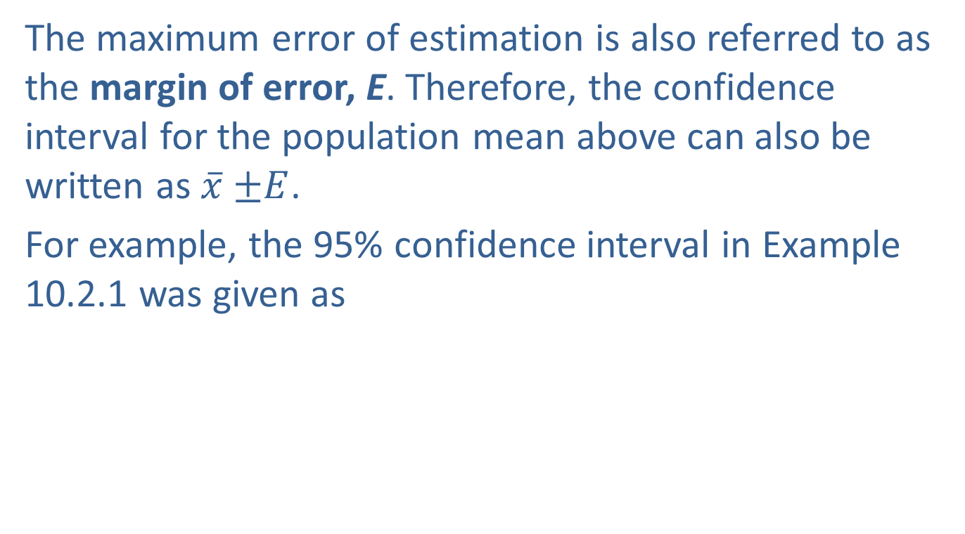
Estimating the Population Mean, σ Known (cont.)
The maximum error of estimation is also referred to as the margin of error, E. Therefore, the confidence interval for the population mean above can also be written as $\overline{x}$ $±E$.
For example, the 95% confidence interval in Example 10.2.1 was given as

Slide 34

Estimating the Population Mean, σ Known (cont.)
We could say that we are 95% confident that the point estimate of $μ$, $\overline{x}$ =425, has an error of estimation no larger than 2.352 hp (or a margin of error of 2.352 hp). Being able to assess the error of an estimate is one of the most useful applications of statistical methods.

Slide 35
Example 10.2.2: Determining a Confidence Interval for Product Testing a Soccer Ball
A production manager of a soccer ball production line is interested in investigating the maximum pressure the balls can sustain. Suppose a random sample of 20 soccer balls is selected, and the balls are put through a pressure test to determine the psi at which the bladder will burst. It is known from past experiences that the pressure at which a ball’s bladder ruptures is normally distributed with a standard deviation of 2.7 psi.

Slide 36
Example 10.2.2: Determining a Confidence Interval for Product Testing a Soccer Ball (cont.)
Of the 20 balls tested the sample mean pressure necessary to burst the bladder of the soccer ball is found to be 17.38 psi. Calculate a 95 percent confidence interval for the population mean pressure necessary to rupture the bladder of the company’s soccer ball. Interpret the results.
Solution
From the information given, we know that

Slide 37
Example 10.2.2: Determining a Confidence Interval for Product Testing a Soccer Ball (cont.)
We can use Table 10.2.1 to find the value of z, 1.96. Inputting these values into the confidence interval formula, we get.
These values are the endpoints for the 95% confidence interval.

Slide 38
Example 10.2.2: Determining a Confidence Interval for Product Testing a Soccer Ball (cont.)
Therefore, we are 95% confident that the population mean psi necessary to burst the company’s soccer ball is between 16.197 and 18.563 psi. It is important to remember that “confidence” is not the same as probability. We are confident in the interval estimation process. The true value of the mean is either in the specified interval (16.197, 18.563) or not—so the probability that the interval contains the true value of the mean is either 1 or 0.

