Slide 1
Section 10.1
Point Estimation of Population Parameters

Slide 2
Definition: Estimator
An estimator is a strategy or rule that is used to estimate a population parameter. If the rule is applied to a specific set of data, the result is an estimate.

Slide 3
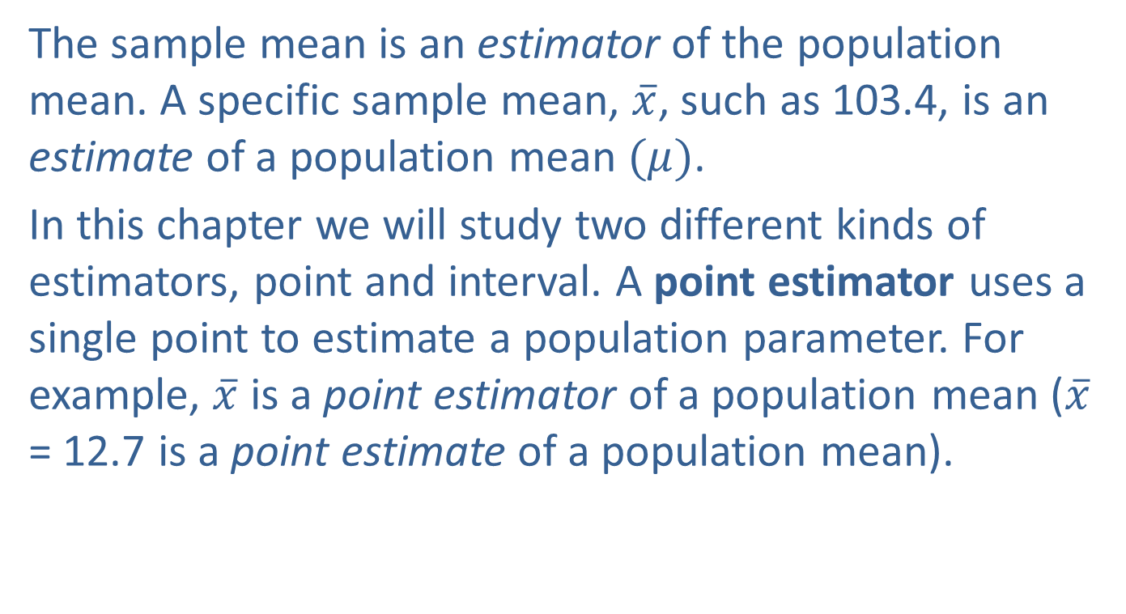
Point Estimators
The sample mean is an estimator of the population mean. A specific sample mean, $\overline{x}$, such as 103.4, is an estimate of a population mean $(μ)$.
In this chapter we will study two different kinds of estimators, point and interval. A point estimator uses a single point to estimate a population parameter. For example, $\overline{x}$ is a point estimator of a population mean ($\overline{x}$ = 12.7 is a point estimate of a population mean).

Slide 4
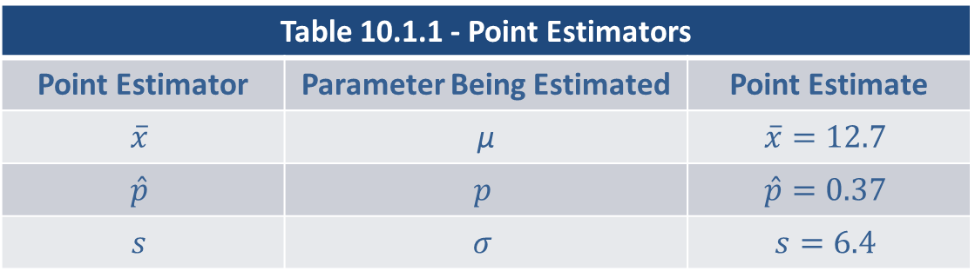
Point Estimators (cont.)
Table 10.1.1 - Point Estimators
Point Estimator | Parameter Being Estimated | Point Estimate
$$\overline{x}$$ | µ | $$\overline{x}=12.7$$
$$\hat{p}$$ | $$p$$ | $$\hat{p}=0.37$$
$$s$$ | $$σ$$ | $$s=6.4$$

Slide 5
Note
As estimation begins with the collection of data, where a fundamental assumption for all statistical inference models is that the data for the inference is credible—measured correctly (accurate) and unbiased. Without credible data, any results from your inference are unsound.

Slide 6
Point Estimation of the Population Mean
Like other statistical inference methods, estimation begins with the collection of data. Two important questions come to mind.
How should the data be used to estimate the population mean?
How can you tell a good estimator from a bad one?
Good estimators conform to the rules of horseshoes: the closer, the better. If the objective is to estimate a population mean, closeness is measured in terms of the distance the estimate is from the actual population mean.

Slide 7
Point Estimation of the Population Mean (cont.)
One of the more puzzling questions is “How can you judge how accurate your estimate is without knowing the true value of the population parameter?” It’s like shooting an arrow at a bull’s-eye, without being able to see it. If you can’t see the bull’s-eye, how do you know how close you are? In statistics, we measure “closeness of the estimator to the true value” with a concept called mean square error.

Slide 8
Formula: Mean Squared Error
An estimator’s average squared distance from the true parameter is referred to as its mean squared error (MSE). The mean squared error for the sample mean is given by:

Slide 9
Point Estimation of the Population Mean (cont.)
A perfect estimator would have a mean squared error of zero, but there is no such thing as a perfect estimator. Since statistical estimators depend on data which is randomly drawn, estimates are random variables and will seldom be equal to the true population characteristic. The goal is to find an estimator whose average squared error is the smallest. Unfortunately, there are an infinite number of possible estimators and without restricting the kinds of estimators that will be considered, very little progress can be made.

Slide 10
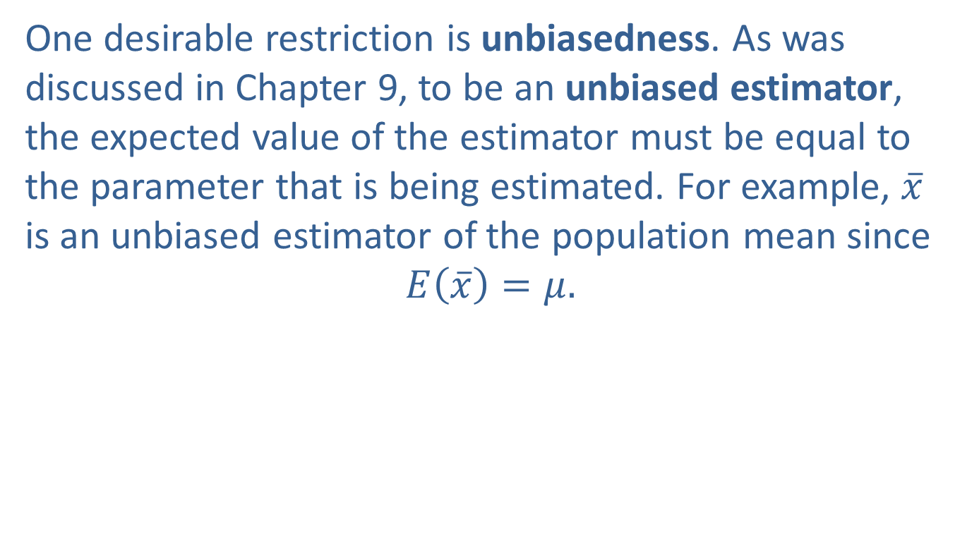
Point Estimation of the Population Mean (cont.)
One desirable restriction is unbiasedness. As was discussed in Chapter 9, to be an unbiased estimator, the expected value of the estimator must be equal to the parameter that is being estimated. For example, $\overline{x}$ is an unbiased estimator of the population mean since
$$E\left(\overline{x}\right)=μ.$$

Slide 11
Point Estimation of the Population Mean (cont.)
Unfortunately, there are many estimators that are unbiased estimators of the population mean, including the sample mean, sample median, or any single sample value. Among unbiased estimators of the population mean, the sample mean has the smallest mean squared error. There is no other unbiased estimator that can consistently do a better job of estimating the population mean.

Slide 12
Point Estimation of the Population Mean (cont.)
The fact that the sample mean is a good estimator of the population mean should not be surprising, since you would expect most sample statistics to be reasonably good estimators of their population counterparts. One of the exceptions is the sample range, which is a poor estimator of the population range. In summary, the best estimator is the one that is unbiased and has the smallest mean squared error.

Slide 13
Example 10.1.1: Determining the Best Estimator for the Population Mean Cost of an Apple iPhone
The latest version of the Apple iPhone was recently released. The cost of the most recent model of the iPhone at several major cell phone providers is found below. What would be the best point estimate of the average cost of the entire population of this model.
$958 $930 $1000 $999 $1025 $999 $959 $1016 $1085 $979

Slide 14
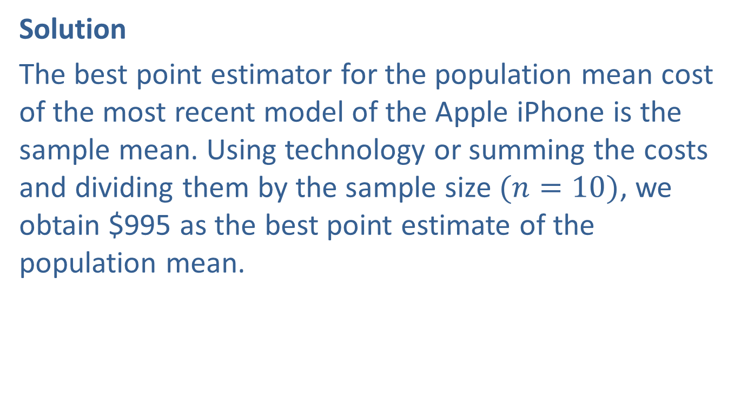
Example 10.1.1: Determining the Best Estimator for the Population Mean Cost of an Apple iPhone (cont.)
Solution
The best point estimator for the population mean cost of the most recent model of the Apple iPhone is the sample mean. Using technology or summing the costs and dividing them by the sample size $(n=10)$, we obtain $995 as the best point estimate of the population mean.

Slide 15
Point Estimation of the Population Proportion
An attribute is a characteristic that members of a population either possess or do not possess. Attributes are almost always measured as the proportion of the population that possess the characteristic.
Many decisions require a measure of a population attribute. Television and radio stations base their advertising charges on ratings reflecting the percentage of television viewers who are watching a particular program. A political analyst wants to know the fraction of voters who favor a particular candidate.

Slide 16
Point Estimation of the Population Proportion (cont.)
A social researcher needs the fraction of teachers who believe group learning is a beneficial instructional method. An insurance company is interested in estimating the fraction of their policies that will result in claims. A quality control engineer is interested in the percentage defective in a lot of goods. A marketing researcher demands the fraction of persons on a mailing list that will purchase the product as a result of a direct mail marketing campaign. The items in italics are measures of attributes of some population.

Slide 17
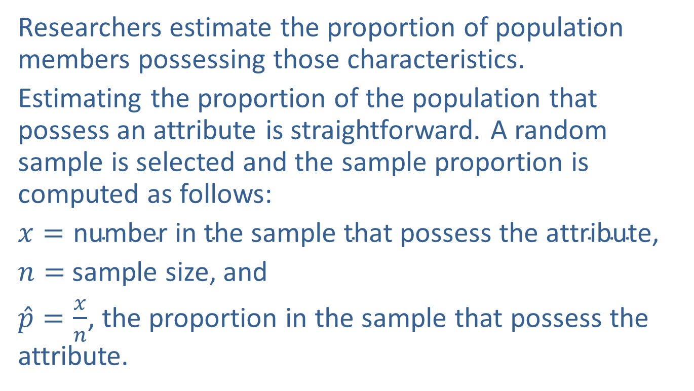
Point Estimation of the Population Proportion (cont.)
Researchers estimate the proportion of population members possessing those characteristics.
Estimating the proportion of the population that possess an attribute is straightforward. A random sample is selected and the sample proportion is computed as follows:
$x=\text{number} \text{in} \text{the} \text{sample} \text{that} \text{possess} \text{the} \text{attribute}$,
$n=$ sample size, and
$\hat{p}=\frac{x}{n}$, the proportion in the sample that possess the attribute.

Slide 18
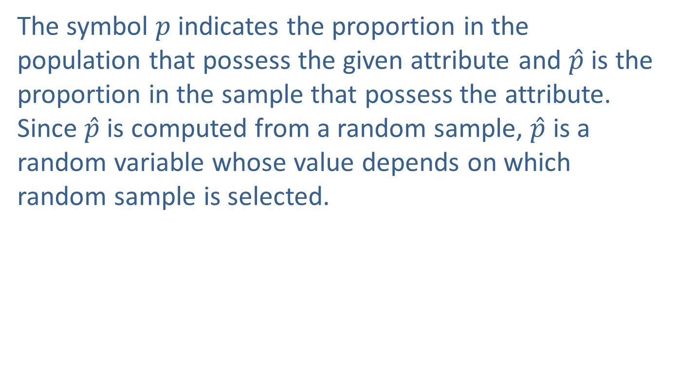
Point Estimation of the Population Proportion (cont.)
The symbol $p$ indicates the proportion in the population that possess the given attribute and $\hat{p}$ is the proportion in the sample that possess the attribute. Since $\hat{p}$ is computed from a random sample, $\hat{p}$ is a random variable whose value depends on which random sample is selected.

Slide 19
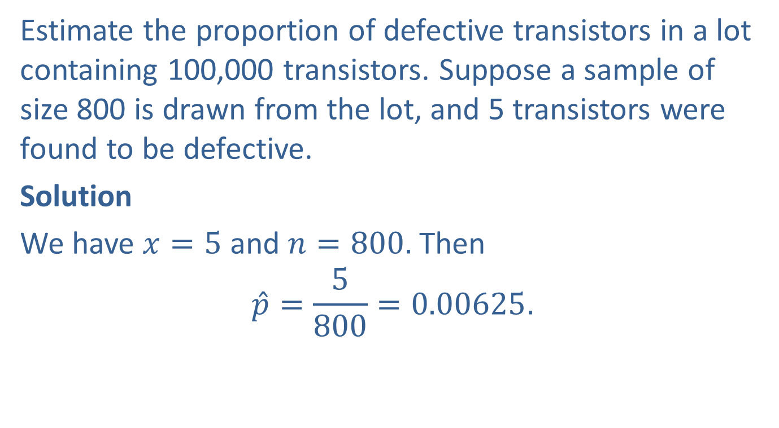
Example 10.1.2: Determining a Point Estimate for the Proportion of Defective Transistors
Estimate the proportion of defective transistors in a lot containing 100,000 transistors. Suppose a sample of size 800 is drawn from the lot, and 5 transistors were found to be defective.
Solution
We have $x=5$ and $n=800.$ Then
$$\hat{p}=\frac{5}{800}=0.00625.$$

Slide 20
Example 10.1.2: Determining a Point Estimate for the Proportion of Defective Transistors (cont.)
A natural question to ask is, “How good is the estimate of the fraction of defective transistors?” The answer to this question naturally arises in the discussion of interval estimation for proportions.

Slide 21
Point Estimation of the Population Standard Deviation
One aspect of improving quality is to reduce variability in a product or service, thus making it more consistent. For example, if you were investing money into the stock market, would you look at only the average rate of return of the stock or would you also be interested in its volatility (variability)? In the investment world, variation is associated with the risk of an investment. The greater the variation, the greater the risk associated with the investment.

Slide 22
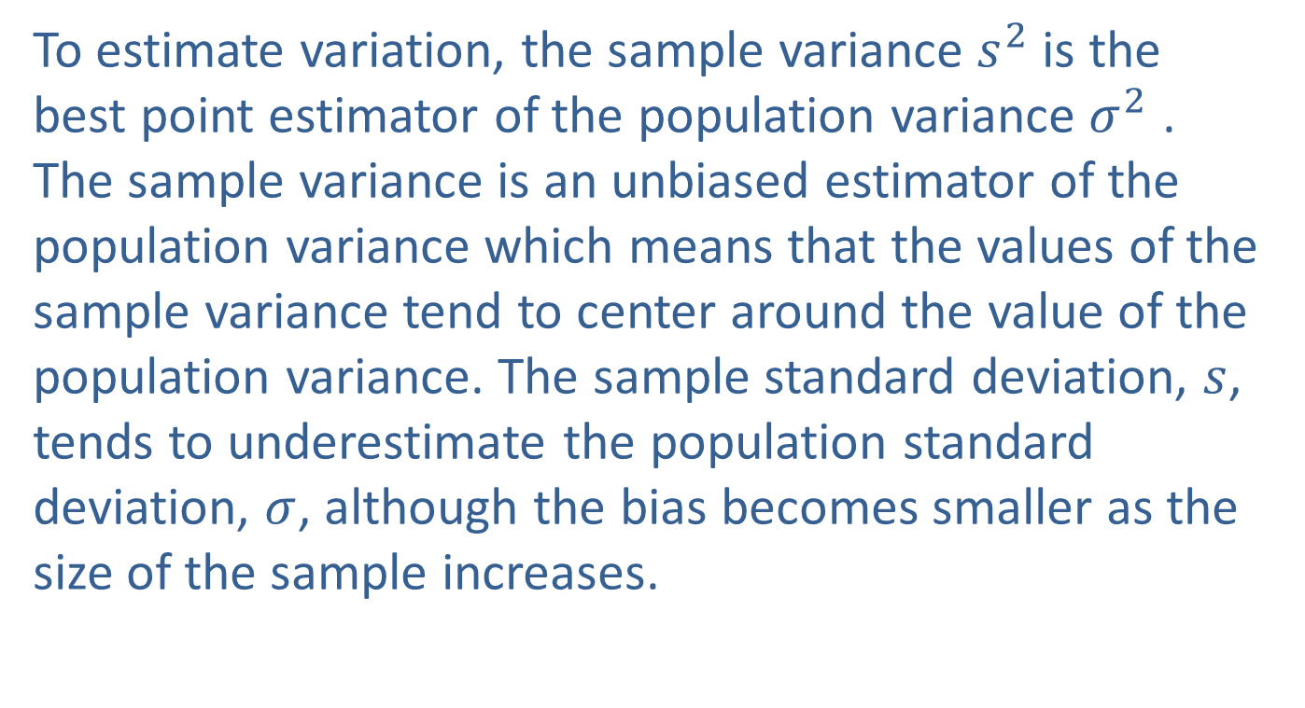
Point Estimation of the Population Standard Deviation (cont.)
To estimate variation, the sample variance $s^{2}$ is the best point estimator of the population variance $σ^{2}$ . The sample variance is an unbiased estimator of the population variance which means that the values of the sample variance tend to center around the value of the population variance. The sample standard deviation, $s$, tends to underestimate the population standard deviation, $σ$, although the bias becomes smaller as the size of the sample increases.

Slide 23
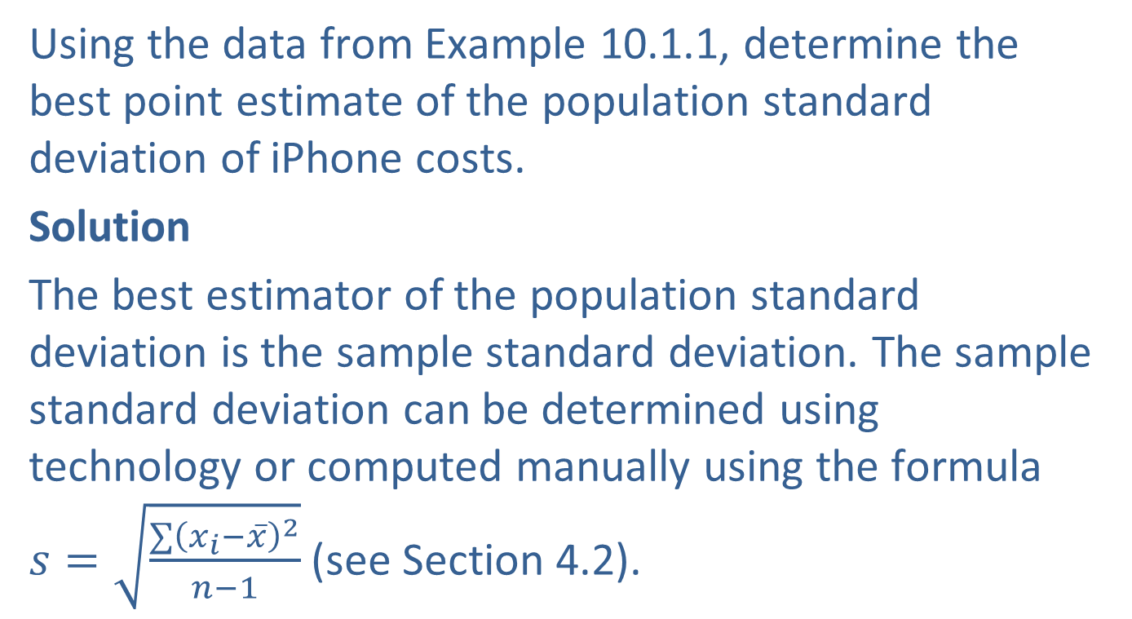
Example 10.1.3: Determining the Best Estimator of the Population Standard Deviation of Apple iPhone Costs
Using the data from Example 10.1.1, determine the best point estimate of the population standard deviation of iPhone costs.
Solution
The best estimator of the population standard deviation is the sample standard deviation. The sample standard deviation can be determined using technology or computed manually using the formula $s=\sqrt{\frac{∑{\left(x_{i}−\overline{x}\right)}^{2}}{n−1}}$ (see Section 4.2).

Slide 24
Example 10.1.3: Determining the Best Estimator of the Population Standard Deviation of Apple iPhone Costs (cont.)
The sample standard deviation using either method is 43.004. Therefore, the best estimate of the population standard deviation of iPhone costs is approximately $43.

