Slide 1
Sections 1.1 – 1.5
1.1 Introduction to Statistical Thinking
1.2 Basic Statistical Concepts
1.3 Descriptive versus Inferential Statistics
1.4 The Value of Statistical Literacy
1.5 Statistics and Related Fields as a Career

Slide 2
Empiricism, Data, and Statistics
In prehistoric times our ancestors developed practical knowledge from their senses interacting with the external world. Our humanoid kin used their senses to informally collect information that helped them detect patterns in their environment to form expectations about the world and to find regularities that could benefit them. Philosophers took this “common-sense” strategy of creating practical knowledge from observation and developed it into a general theory of how humans acquire knowledge and called it empiricism.

Slide 3
Empiricism, Data, and Statistics
Empiricism rests on the idea that nature is governed by laws or principles that create predictable patterns which can be discovered through careful observation. Thus, classical empiricism is a belief that human knowledge comes mainly from the five senses through systematic observation. When these observations are measured and recorded, they become descriptions of the world around us that we call data. To a modern empiricist, data is the lifeblood of knowledge.

Slide 4
Empiricism, Data, and Statistics
Technology has produced a world empiricists love. Data, in the form of observation and recorded measurements, are pouring out of everything electronic: phones, cars, computers, medical equipment, telescopes, social media sites, and a multitude of other places. The data provide a glimpse of an underlying small slice of reality and every data set has a story embedded in it about that reality. To an empiricist, data represent an opportunity to unravel that story.

Slide 5
Empiricism, Data, and Statistics
Over the last 500 years, many quantitative and visualization tools were developed by researchers trying to reveal the stories of their data. Collectively, these tools and concepts for describing, building relationships, and drawing conclusions from empirical data eventually became known as statistics. Statistics is a science greatly respected by empiricists. It is the quantitative technology for empirical science. It’s important to realize that whenever you utilize statistics you are stepping into the shoes of an empiricist— trying to reveal the story of your data.

Slide 6
Empiricism, Data, and Statistics
Empiricism, at its core, embraces humility and recognizes that human knowledge is subject to change—a perspective that is aligned with the scientific method. Whether a researcher is trying to establish groundbreaking new knowledge or modify existing understandings, the fundamental assertion of empiricism is that knowledge is established only when confirmed by verifiable evidence such as controlled experiments, data, and statistical analyses.

Slide 7
Empiricism, Data, and Statistics
Consequently, empiricists have the same question for anyone with a theory or a claim: Will you show me the data that supports your conclusions? When an empiricist asks this question, there is an implication that the questioner will have some idea of how to untangle the data’s story. This is why statistics is an important part of so many collegiate curricula.

Slide 8
Empiricism, Data, and Statistics
As we delve into the world of statistics, remember that it’s not just about numbers and formulas; it’s about cultivating an empirical mindset, which means scrutinizing how the data is measured, collected, and analyzed.
This mindset empowers you to interpret the world in a way that is grounded in evidence, enabling you to make informed decisions and construct arguments that are not only persuasive but also substantiated by real-world data.

Slide 9
Empiricism, Data, and Statistics
Who are the empiricists today? They are scientists, businesspersons, the medical community that practices evidence-based medicine, engineers, agriculturalists, sports organizations, and anyone who believes that data is a way to knowledge. Another perhaps surprising group of empiricists are the researchers developing the artificial intelligence models including the large language models such as ChatGPT. Its understanding of the world is based on the patterns and relationships that it has learned from the data the model has been trained on.

Slide 10
Empiricism, Data, and Statistics
By the time you finish your statistics course, we hope to welcome you to the empiricists society and provide tools and concepts that will enable you to find some truth in whatever you decide to pursue.

Slide 11
1.1 Introduction to Statistical Thinking
Science operates on faith in Nature’s regularity. There is an underlying assumption that the causes of “natural laws” and the patterns they produce can be discovered with empirical data. This conviction in the utility of empirical data to expose Nature’s mechanisms became a beacon for early scholars, even when formal statistical methods were not yet in existence.

Slide 12
Introduction to Statistical Thinking (cont.)
The belief driving these early statisticians was that statistical methods could serve as a key to unlock patterns in large-scale phenomena, whether they were embodied in societal trends, the physics of the universe, or the intricate dynamics of human health. They envisioned statistics as a tool not just for describing these phenomena, but also for predicting and influencing future outcomes. But few of these early statisticians envisioned how statistics would ultimately affect science and decision making.

Slide 13
Introduction to Statistical Thinking (cont.)
Because statistical reasoning is fundamental to the process that validates new ideas, the statistician’s craft has become firmly embedded not only in the process of science but any endeavor where new ideas are being created and need to be confirmed. Essentially, statistics is the decision-making arm of science—it evaluates the evidence for the scientific community. It is the strength of the body of statistical evidence from carefully designed experiments that will ultimately convince the scientific community to accept or reject a new theory.

Slide 14
Statistics and Critical Thinking
Statistics is not just used by science. The capacity to reason with data should be part of everyone’s critical thinking skill set because keeping up with the “best evidence” in any field is part of making conscientious and thoughtful decisions. Most of the “evidence” you will evaluate will be a story derived from data interpreted in statistical form. Being able to speak intelligently about data and learning to ask the right questions about it, coupled with understanding its statistical interpretation, will likely be an important competence in your career.

Slide 15
Statistics and Critical Thinking (cont.)
“The value of a college education is not the learning of many facts but the training of the mind to think.”
— Albert Einstein

Slide 16
Statistics and Critical Thinking (cont.)
In addition, so many parts of our lives are touched by statistical thinking tools. Just about every large scale manufacturing process is governed by statistical process control, which means many of the things you buy are touched by statistics. The statistics-based methodology known as ‘design of experiments’ has been utilized not only in the development of the seeds used to grow our food, but also in the practice of medicine, where it has been instrumental in optimizing treatments, studying disease patterns, and facilitating the development of new drugs.

Slide 17
Statistics and Critical Thinking (cont.)
Cars, cell phones, airplanes, and refrigerators are designed using the statistics of reliability and are monitored by statistical process control when they are manufactured. The insurance we buy to protect ourselves financially is created by statisticians called actuaries. Almost all sports teams use statistics for developing strategy and making personnel decisions.

Slide 18
Statistics and Critical Thinking (cont.)
The application of statistics concerns itself not with absolutes, but with likelihoods, so we will be studying the language of probability along the way to learning about statistics. In addition, we will be discussing randomness and providing tools to help comprehend and characterize it. Being able to extract value from data in the world of randomness leads to a skill set that is sophisticated, powerful, and in demand.

Slide 19
Statistics and Data are Modern Instruments of Rationality
Empiricism was defined as a way to discover knowledge. But what exactly is knowledge? The philosopher Plato (427 BCE – 347 BCE) defined knowledge to be “justified true belief.” This definition of knowledge remains one of the fundamental definitions today. The scientific pursuit of knowledge rests on the ideals of rationality and reason. What is rationality? What is reason? Are they the same thing? No simple definition can exactly define these complex ideas. Nevertheless, here are a few definitions illuminating the relationship between the two.

Slide 20
Definition: Rationality
Google definition: “The quality of being based on or in accordance with reason or logic.”
Merriam-Webster: “The quality or state of being agreeable to reason.”
Cambridge Dictionary: “The quality of being based on clear thought and reason, or of making decisions based on clear thought and reason.”

Slide 21
Statistics and Data are Modern Instruments of Rationality (cont.)
The thread of thought in these definitions seems to be that rationality is obtained through the use of reason. Of course, this begs the question, what is reason? Fortunately, there are two very old and commonly accepted methods of reasoning, deductive and inductive, dating back to Plato’s student, Aristotle.

Slide 22
Deductive Reasoning
Deduction has been a trustworthy method of generating new knowledge for a very long time, and it is one of the methods of reasoning used in the philosophical approach of rationalism. It is a kind of rationality that is based on traditional logic and mathematics. Deductive reasoning is top-down thinking. You start with a general principle(s)—similar to axioms in mathematics—as a starting point and use logic to deduce a conclusion. It is the kind of reasoning you used when developing proofs in your geometry course in high school.

Slide 23
Deductive Reasoning (cont.)
A syllogism is an example of simple deductive reasoning. There is a first and second premise and finally a conclusion which follows logically from these premises. If the first and second premise are true, and the rules of logic are correctly followed, then the conclusion will be true.
Aristotle wrote the following example of a syllogism:
Major premise: All men are mortal.
Minor premise: Socrates is a man.
Conclusion: Socrates is mortal.

Slide 24
Deductive Reasoning (cont.)
Another example is:
Major premise: All mammals are warm-blooded.
Minor premise: Humans are mammals.
Conclusion: Humans are warm-blooded.
One of the potential problems of deductive reasoning is overgeneralization. For example, based on your experience with dogs you believe that all dogs are friendly.

Slide 25
Deductive Reasoning (cont.)
Major Premise: All dogs are friendly.
Minor premise: Your new neighbor has a dog.
Conclusion: Your neighbor’s dog is friendly.
However, on your first encounter with your neighbor’s dog you were savagely attacked. The problem is the overgeneralization in the major premise—some might call it naiveté.
How do you prevent faulty conclusions from becoming part of the scientific body of knowledge?

Slide 26
Deductive Reasoning (cont.)
One of the benefits of the scientific process that Francis Bacon conceived is the peer review process, which is designed to prevent faulty reasoning and unsupported claims from circulating in the scientific community. In this process other experts in your field evaluate your work looking for flaws in the assumed premises, the logic of your conclusions, or the interpretation of the data. If no other expert can find defects in the conclusions, they are presumed to be correct, for now, until more data or future research perhaps may refute them.

Slide 27
Deductive Reasoning (cont.)
The proofs that you see in mathematics-related subjects are complex forms of deductive reasoning. Similarly, the theoretical side of any discipline that uses mathematical models is defined by a sophisticated use of mathematics to deduce theory—which may or may not be true and is ultimately confirmed or not by inductive reasoning.

Slide 28
Inductive Reasoning
Inductive reasoning is the process of deriving general principles (conclusions) from repeated facts or observations—that is, the particular to the general. Induction is a significant component of empiricism. Sir Francis Bacon’s book Novum Organum, “New Method,” in 1620 proposed a method of inductive reasoning and introduced the term “empirical” (from the Greek word empeiria, meaning experience) to the English language. This work and the inductive method were highly influential on the development of science and the evolution of the scientific method.

Slide 29
Inductive Reasoning (cont.)
Induction embraces the philosophical principle “what is true of the many is true of the whole” and can be thought of as bottom-up thinking. All applications of statistical inference use inductive reasoning.
Let’s consider an example. Down syndrome (DS) is a relatively common disorder in humans. Geneticists tell us that individuals with DS have three copies of chromosome 21 instead of two. How did they reach this conclusion?

Slide 30
Inductive Reasoning (cont.)
A French geneticist in 1959 analyzed chromosomes of individuals with what was believed to be Down syndrome and observed an extra copy of chromosome 21 in each of them. This discovery was later confirmed by further studies using more advanced techniques. Is this absolute proof that an extra copy of chromosome 21 is the only cause of DS? At some time in the future, could a person exhibit DS and not have an extra copy of chromosome 21?

Slide 31
Inductive Reasoning (cont.)
Unlike deductive reasoning, induction is not guaranteed to produce absolutely true conclusions. Thus, inductive inference must be associated with probable conclusions and some degree of uncertainty. As the data increases, the more probable the inductive conclusion. Probability is the language of uncertainty and will be used to define the degree of belief we have in our conclusions. Being able to express uncertainty in a precise manner is one of the reasons we study probability in a statistics course before statistical inference.

Slide 32
Inductive Reasoning (cont.)
Inductive reasoning in one of the standards used to determine whether someone’s beliefs about the world are “justified.” As the statistician R. A. Fisher said, “inductive inference is the only process known to us by which essentially new knowledge comes into the world… (and was a) … contribution to the intellectual development of mankind”. As the philosopher Robert Audi put it, induction is empiricism’s “role ... in grounding rationality.”

Slide 33
1.2 Basic Statistical Concepts
Statistics has its roots in empiricism. The practice of empiricism requires a focus—what do you want to learn more about? This focus defines a fundamental concept in statistics, the population.

Slide 34
Definition: Population
A population is the total set of subjects or things we are interested in studying.

Slide 35
Basic Statistical Concepts (cont.)
The notion of a population is a very general concept. Populations are defined by what a researcher is studying and can come in all shapes and sizes. If you are researching Hank Aaron’s major league batting performance, then the population would consist of all 12,364 of Aaron’s major league at bats. If someone is studying toucans in Brazil, then all the toucans in Brazil would constitute the population. If you are studying students at your college, then all the students attending your college represent a population.

Slide 36
Basic Statistical Concepts (cont.)
A list of all members of a population is called a population frame.

Slide 37
Definition: Frame
A list containing all members of the population is referred to as a frame.

Slide 38
Basic Statistical Concepts (cont.)
According to the Census Bureau in 2020 there are about 332 million people in the United States. The frame for the population of the United States would be a rather long list containing about 332 million names. Although a previous census would be a good start in developing a frame for the US population, it is doubtful that an exact frame could ever be developed at a given point in time since there is one new birth every 8 seconds, and one death every 12 seconds.

Slide 39
Basic Statistical Concepts (cont.)
There are just too many people being born, dying, and immigrating over a 10-year period to get an exact frame for the US population. But for problems that deal with smaller populations, frames are easily developed. For example, if your statistics class were the population you were studying, the final class roster would be the frame for the population.

Slide 40
Definition: Census
A strict definition of a census is a survey that includes all the elements or units in the frame.

Slide 41
Basic Statistical Concepts (cont.)
In every study the researcher is interested in information about the population. A measurement that describes some aspect of the entire population is called a population parameter. The idea of a parameter is a very important concept in statistics. Much of statistics is about estimating and making decisions concerning population parameters.

Slide 42
Definition: Population Parameters
A measurement that describes some aspect of the entire population is called a population parameter. A population can have many parameters.

Slide 43
Basic Statistical Concepts (cont.)
Parameters are a form of data reduction. Hank Aaron’s lifetime batting average of .305 is a population parameter of Aaron’s at bats roughly reflecting the proportion of times Aaron reached base by striking the ball in play. It is also a way of reducing the 12,364 at bats to a summary measure of hitting performance—this is sometimes referred to as a metric. Other parameters of Aaron’s batting performance would be the percentage of walks, singles, doubles, triples, home runs, strikeouts and many more.

Slide 44
Basic Statistical Concepts (cont.)
For a presidential election, some population parameters in which candidates and pollsters will be interested are:
The percentage of eligible voters who will vote on Election Day.
The percentage of voters who will vote for a specific candidate.
The percentage of men who favor a candidate.
The percentage of women who favor a candidate.

Slide 45
Basic Statistical Concepts (cont.)
The percentage of people in the 18–25 age group who favor a candidate.
The average income of voters who favor a candidate.
The parameters mentioned in the examples above are either averages or percentages. However, there are many other measures such as the maximum or minimum value of the population characteristic or how much a population characteristic varies that would also be considered population parameters.

Slide 46
Basic Statistical Concepts (cont.)
For a specific population at a specific point in time, population parameters do not change; they are fixed numbers. Seldom will the value of a population parameter be known since the value involves using all of the measurements of the entire population frame which are usually too expensive or time consuming—maybe even impossible—to determine. It is the statistician’s job to discover these values. This is done by taking a sample and using the sample measurements to create an estimate of the desired population measurement.

Slide 47
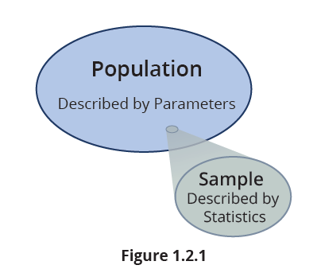
Basic Statistical Concepts (cont.)
This sounds like the beginning of an inductive process!

Slide 48
Definition: Sample
A sample is a subset of the population which is used to gain insight about the population. Samples are used to represent a larger group, the population.

Slide 49
Definition: Statistic
A statistic is a fact or characteristic about the sample.

Slide 50
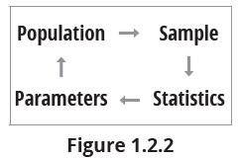
Basic Statistical Concepts (cont.)
For any given sample a statistic is a fixed number. Because there are lots of different potential samples that could be drawn from a population, statistics will vary depending on the sample selected. Because we almost never know a population parameter, statistics are used as estimates of population parameters. See Figure 1.6.1.

Slide 51
Basic Statistical Concepts (cont.)
Studying an entire population can be an expensive proposition. In 2020 the United States census cost the government $14.2 billion. Because of the enormous expense, even the United States government with its vast resources does not undertake a census of its citizens but once every ten years. Yet amazingly accurate information about the population, even large populations like the United States, can be found by using a relatively small sample.

Slide 52
Basic Statistical Concepts (cont.)
If the sample is a good representation of the population, then the conclusions reached using sample data will likely be reasonable for the population. A statistician faces the interesting problem of developing a representative sample, without spending an inordinate amount of time or money.
Political pollsters spend much of their resources developing a representative sample of Americans who will cast their votes on Election Day. After the sample is identified, the problem becomes one of obtaining candidate preferences from the selected voters.

Slide 53
Basic Statistical Concepts (cont.)
Tallying the responses and computing the actual percentages will take a computer at most a few seconds. After the estimates of the population parameters are calculated, one of the interesting statistical questions is, how good are the estimates? If we cannot determine how much faith we should place in our estimates, it will be difficult to use the estimates to make decisions. The process of selecting samples and determining the reliability of our estimates is a large part of what statistics is about.

Slide 54
1.3 Descriptive versus Inferential Statistics
The science of statistics is divided into two categories, descriptive and inferential. Descriptive methods describe and summarize data and are used as a method of discovery. Inferential methods aid in making decisions and predictions about population parameters and processes for which it is impractical to obtain measurements on all population members.

Slide 55
Descriptive Statistics
The emphasis in descriptive statistics is analyzing observed measurements, usually from a sample. Descriptive methods provide a powerful means of summarizing and simplifying data sets. We use descriptive statistics to begin telling the data’s story by answering questions like:
What is a typical value for the measurements?
How much variation do the measurements possess?
What is the shape or distribution of the measurements?

Slide 56
Descriptive Statistics (cont.)
Are there any extreme values in the measurements and, if so, what does that tell us?
What is the relative position of a particular measurement in the group of data?
What kind of relationship exists, if any, when there are two (or more) variables and how strong is the relationship?

Slide 57
Definition: Descriptive Statistics
Descriptive statistics is the collection, organization, analysis, and presentation of data.

Slide 58
Descriptive Statistics (cont.)
The application of descriptive statistical tools is usually ad hoc; that is, the exact method of analysis changes from one problem to the next. Sometimes the application of descriptive statistics can raise as many questions as it answers. And when that happens, statistics is working at its best as a problem-solving or process-improvement tool.
The importance of descriptive statistics as a data storytelling tool relates to the amount of data to be comprehended.

Slide 59
Descriptive Statistics (cont.)
If there are only two observations, say 6 and 4, there is very little story to tell and descriptive statistical aids are of little value. However, the 1208 observations representing the cost of tuition at 1208 colleges and universities in 2021-2022 from Table 1.3.1 suggest a potential story. Individually inspecting 1208 tuition values would produce very little useful knowledge. To comprehend a large set of data, it must be summarized. That is the function of descriptive statistical techniques. Descriptive techniques are the most common statistical applications.

Slide 60
Descriptive Statistics (cont.)
A summary is a simplification of the “whole story.” But sometimes summaries can oversimplify, so it is important to be aware of potential misinterpretations and choose summary statistics carefully. Sometimes the choice for a summary statistic depends on the type of variable that is measured/used, or it can depend on the distribution of the population’s data.

Slide 61
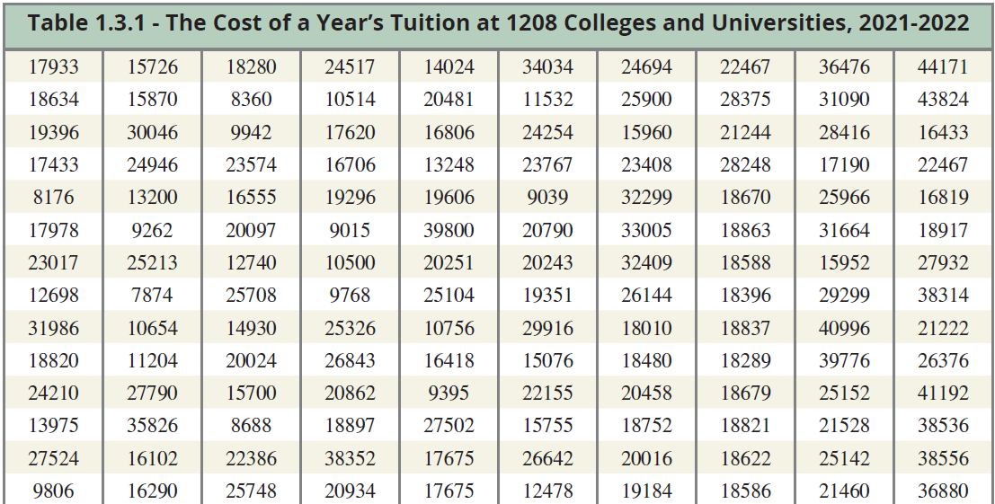
Descriptive Statistics (cont.)

Slide 62
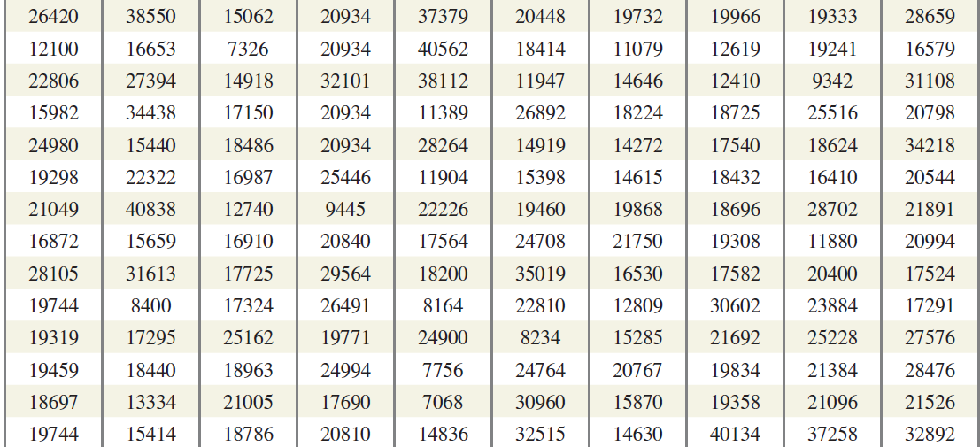
Descriptive Statistics (cont.)

Slide 63
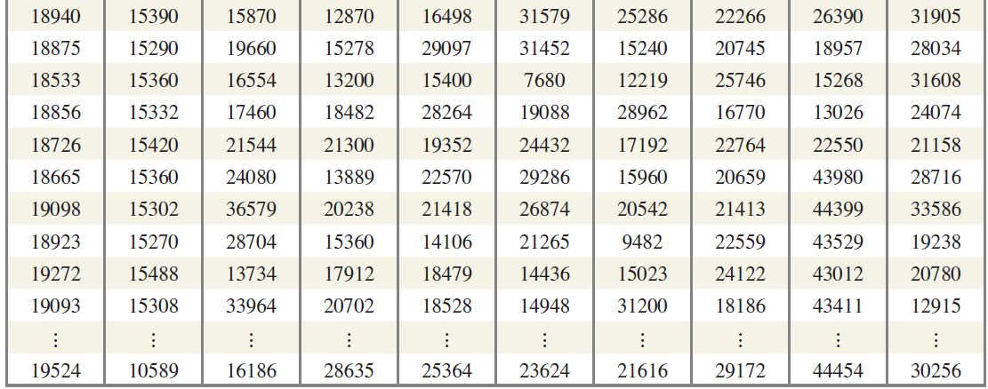
Descriptive Statistics (cont.)

Slide 64
Inferential Statistics
The scope of reality can be vast. Historically, the ozone layer over most of the Earth’s surface is about 3 millimeters thick. A problem such as trying to assess the ozone thickness over the entire surface of the earth at a point in time would be an impossible sample space to measure. There is no way to know the actual thickness of the ozone layer except by an inductive process: namely sampling, data collection, and statistical inference.

Slide 65
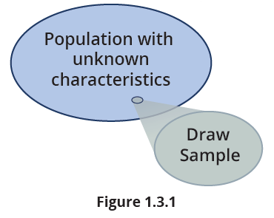
Inferential Statistics (cont.)

Slide 66
Inferential Statistics (cont.)
Inferential statistics is about estimating and making inferences (empirically supported judgments) about population parameters. It is a classical application of inductive reasoning. Increasing the sample size tends to improve the precision and reliability of the estimated population parameters.

Slide 67
Definition: Inferential Statistics
The objective of inferential statistics is to make reasonable estimates of population characteristics using sample data.

Slide 68
Inferential Statistics (cont.)
If data were free, it would be preferable to have measurements of the entire population, but in most cases the required data is either not obtainable or would be much too costly to obtain. For example, to be absolutely certain that all car air bags will work satisfactorily when needed would require each new car to be crash tested. If 100 percent testing were a requirement, cars with air bags would be a scarce commodity.

Slide 69
Inferential Statistics (cont.)
Fortunately for automobile manufacturers, statistical sampling techniques can reliably estimate, with a high degree of confidence, what fraction of air bags that will inflate.

Slide 70
1.4 The Value of Statistical Literacy
Part of being an intelligent human being is the desire to learn the truth about the world we live in. But as Oscar Wilde said in The Importance of Being Earnest:
“The truth is rarely pure and never simple.”
What is the connection between beliefs and truth and why does it matter? The crux of empiricism is evidenced-based belief. Beliefs often serve as our subjective interpretations of truth. Beliefs dictate our actions and shape how we perceive and interact with the world.

Slide 71
The Value of Statistical Literacy (cont.)
However, it’s crucial to recognize that beliefs do not necessarily align with objective truth. It is important to exercise humility and critical thinking in forming our beliefs and discerning their continued validity over time.
This text champions a form of data-driven empiricism that emphasizes the importance of using empirical evidence—particularly data—to form beliefs, make decisions, and understand the world.

Slide 72
The Value of Statistical Literacy (cont.)
Statistics provides the analytical framework (the technology) for extracting meaningful insights from data and making evidence-based decisions. From scientific breakthroughs and business innovations to effective public policies, statistics has paved the way for evidence-based solutions across diverse fields, and even more crucially, will continue to do so as the ocean of data we generate grows exponentially.

Slide 73
The Value of Statistical Literacy (cont.)
Unfortunately, in your lifetime you will encounter statistical arguments designed to deceive, influence, manipulate, and sometimes defraud. Defending oneself against deceptive or manipulative statistical arguments can be challenging, especially for those with only an introductory knowledge of statistics. However, there are several strategies that individuals can employ to critically evaluate such arguments.

Slide 74
Note
There is an interesting channel on YouTube called This is Statistics. www.youtube.com/user/ThisIsStats

Slide 75
Procedure: Strategies to Critically Evaluate Statistical Arguments
Understand core statistical ideas: Get comfortable with important ideas like the potential for sampling bias, statistical significance, how variability in the data interacts with statistical analysis, and that correlation does not imply causation.
Ask critical questions: When presented with statistical arguments, ask critical questions about the data, methodology, and interpretation. For example:
What is the source of the data?

Slide 76
Procedure: Strategies to Critically Evaluate Statistical Arguments (cont.)
How was the data collected and processed?
Are there any potential biases in the data or sampling method?
Were appropriate statistical tests used, and are the results statistically significant?
What are the assumptions underlying the statistical models used?
Are there alternative explanations or interpretations of the data?

Slide 77
Procedure: Strategies to Critically Evaluate Statistical Arguments (cont.)
Verify sources: Verify the credibility and expertise of the individuals or organizations presenting the statistical arguments. Be cautious of biased sources or those with conflicts of interest.
Seek independent analysis: Seek evaluations or critiques of the statistical arguments from reputable independent sources. Independent experts or peer-reviewed studies may offer valuable insights or alternative perspectives. Additionally, as artificial intelligence advances, it can be beneficial in identifying potential flaws or strengths in statistical studies.

Slide 78
Procedure: Strategies to Critically Evaluate Statistical Arguments (cont.)
Maintain a healthy skepticism: Be sure to cast a critical eye towards statistical claims that seem too good to be true or driven by an agenda—even those that align with your own biases or agendas.

Slide 79
The Value of Statistical Literacy (cont.)
Ultimately, the methods of statistics are based on reasonable and relatively simple ideas. The implementation of those ideas may be complex but looking beyond the formulas (and there are many of them) into the underlying concepts is an important part of developing statistical intuition.

Slide 80
The Value of Statistical Literacy (cont.)
And, of course, there is no substitute for practicing the art of statistics with data, recognizing patterns, trends, and relationships in data, and making sense of statistical results in a practical, intuitive way.
One of the most difficult tasks in statistics is recognizing exactly what statistical method(s) is appropriate for a given problem. Having a good conceptual understanding of what each method seeks to accomplish is a significant part of building intuition. The details of a statistical method are initially not important, as they represent the “how.”

Slide 81
The Value of Statistical Literacy (cont.)
It is the “what”—the “concept” behind the method—that is important in making the connection between the problem and the statistical method. After the connection has been made, the assumptions and the details of the methods become important. Another part of statistical literacy is the technical side, especially verifying that the assumptions of the statistical method have been met. Of course, most statistical methods require tedious calculation, so another important facet of statistical literacy is the ability to use a statistical software package.

Slide 82
The Consequences of Insufficient Statistical Literacy: The MMR Vaccine Controversy
A lack of statistical literacy can have significant consequences. In February of 1998, Dr. Andrew Wakefield and several colleagues published a paper in the prestigious British medical journal The Lancet. This paper claimed to have identified a new syndrome that they called “autistic enterocolitis,” which the authors suggested might be caused by the Mumps-Measles-Rubella (MMR) vaccine. The paper reported on a study of 12 children with this syndrome and suggested a link between the onset of autistic symptoms and the timing of MMR vaccination.

Slide 83
The Consequences of Insufficient Statistical Literacy: The MMR Vaccine Controversy (cont.)
The press reported these findings worldwide. Prior to the publication of this paper, MMR vaccination rates were above 90% but fell below 80% in the early 2000s in the UK, U.S., Australia and parts of Europe.
The Wakefield article has been widely criticized by the scientific community as a failure of scientific rigor and ethical standards. The General Medical Council (GMC) in the UK found that Wakefield received funding from lawyers who were seeking to sue vaccine manufacturers and had failed to disclose this conflict of interest.

Slide 84
The Consequences of Insufficient Statistical Literacy: The MMR Vaccine Controversy (cont.)
Consequently, the Lancet withdrew the publication from its journal. The scientific community has overwhelmingly rejected Wakefield’s MMR claims, and numerous studies have since shown no link between the MMR vaccine and autism. However, the damage had been done. A 2003 study showed that widespread media coverage of this flawed paper led to a decline in vaccination rates for all vaccines.

Slide 85
The Consequences of Insufficient Statistical Literacy: The MMR Vaccine Controversy (cont.)
What were the costs of this paper? The Wakefield paper linking the MMR vaccine to autism has been estimated to have led to a significant drop in MMR vaccine uptake in England, the U.S., and parts of Europe resulting in a large measles outbreak that caused hospitalizations and deaths. The economic costs are estimated to be in the billions of dollars. Additionally, the paper eroded public trust in vaccines and the scientific community, contributing to ongoing vaccine hesitancy and misinformation.

Slide 86
The Consequences of Insufficient Statistical Literacy: The MMR Vaccine Controversy (cont.)
Could this have been avoided? The study had several significant statistical problems. The issues present in the Wakefield study were not overly complex; rather, they were concerns that a proficient statistics student could have potentially identified and questioned. These included:
Small sample size: The study included only 12 children.
Selection bias: The individuals involved in the study were not chosen at random, suggesting that they might not accurately reflect the broader population of children who were administered the MMR vaccine.

Slide 87
The Consequences of Insufficient Statistical Literacy: The MMR Vaccine Controversy (cont.)
Lack of a control group: The study lacked a control group composed of unvaccinated children, complicating the task of contrasting autism prevalence between those who received the MMR vaccine and those who did not.
Confounding factors: The study did not adequately account for other factors that could be associated with both MMR vaccination and autism, such as family history of autism, which could have influenced the study’s results.

Slide 88
The Consequences of Insufficient Statistical Literacy: The MMR Vaccine Controversy (cont.)
Poor statistical analysis: The statistical analysis in the study was flawed, with inappropriate methods used to analyze the data, and selective reporting of results.
The Wakefield study and its consequences demonstrate the importance of a statistically literate society.

Slide 89
1.5 Statistics and Related Fields as a Career
Your career will essentially be a choice of the kinds of problems you desire to solve. Because the amount of data being stored in the world is doubling every two years, we can anticipate many highly compensated job opportunities (i.e., problem solving opportunities) for individuals with the skill set to tangle with data. And there is a significant shortage of data analytic talent. In 2023, a search of LinkedIn for jobs in data-related roles showed 185,000 results for data engineers, 120,000 results for data scientists, and 75,000 results for data architects.

Slide 90
Note
Check out the video entitled Statisticians in Other Fields on the This is Statistics YouTube channel.

Slide 91
Statistics and Related Fields as a Career (cont.)
Even if you pursue a career outside the world of data, data-driven decision making is rapidly becoming an expectation. The more important and difficult the problems you choose to solve, the more likely your problem-solving tool bag will need to contain data manipulation abilities, computing skills, and at least a fundamental knowledge of statistics.

Slide 92
Statistics and Related Fields as a Career (cont.)
That is why Hal Varian, Google’s chief economist, said in 2009,
I keep saying the sexy job in the next 10 years will be statisticians. People think I’m joking but who would’ve guessed that computer engineers would’ve been the sexy job of the 1990s? The ability to take data—to be able to understand it, to process it, to extract value from it, to visualize it, to communicate it—that’s going to be a hugely important skill in the next decades.

Slide 93
Statistics and Related Fields as a Career (cont.)
Although Varian’s comment was made over a decade ago, it is still true. The growth of cheap and pervasive data along with the availability of inexpensive high-performance computing power increases the demand for individuals who can extract value from data. Applied statisticians are uniquely positioned to do this, as they are trained to work with complex data sets, build statistical models, explain their findings to others and make recommendations based on those findings. This skill set is highly valued in many different industries.

Slide 94
Statistics and Related Fields as a Career (cont.)
Additionally, the rise of Big Data and the increasing importance of machine learning and artificial intelligence has only increased the demand for data scientists, statisticians, and other data professionals. As more and more industries and sectors become data-driven, the need for individuals who can work with data and extract insights from it will only continue to grow.
Figure 1.5.1 depicts the number of statistics degrees conferred in the U.S. by year and by degree. It also illustrates the growing interest in the field of statistics.

Slide 95
Statistics and Related Fields as a Career (cont.)
PhD statisticians usually have a strong theoretical orientation, but their numbers are not growing nearly as fast as those with more applied Master’s and Bachelor’s degrees in statistics. Many industry experts are worried that the U.S. isn’t producing enough highly-trained individuals with applied statistical skills. As a result, companies are providing considerable incentives in the form of lucrative salaries to convince people that careers in statistics and data science are well worth their while.

Slide 96
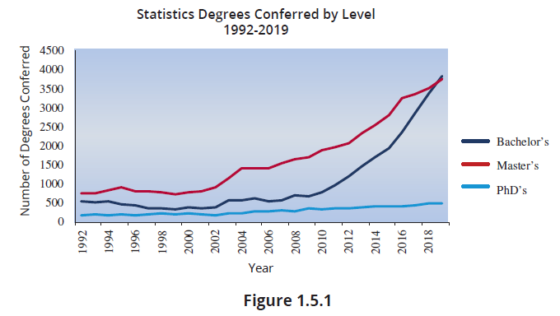
Statistics and Related Fields as a Career (cont.)

Slide 97
Statistics and Related Fields as a Career (cont.)
There are several fields that are related to applied statistics. Here are a few examples:
Data Science: Data science involves the use of statistical and computational methods to extract insights and knowledge from data. It combines skills in programming, machine learning, and data visualization with a solid foundation in statistical concepts.

Slide 98
Statistics and Related Fields as a Career (cont.)
Biostatistics: Biostatistics involves the application of statistical methods to biological and health-related data. Biostatisticians work in areas such as clinical trials, epidemiology, and public health.
Econometrics: Econometrics involves the use of statistical methods to analyze economic data. Econometricians work in areas such as finance, market research, and policy analysis.

Slide 99
Statistics and Related Fields as a Career (cont.)
Business Analytics: Business analytics involves the use of statistical methods to extract insights and knowledge from business data. Business analysts work in areas such as marketing, operations, and strategy.
Actuarial Science: Actuarial science is a field of study that involves the use of mathematical and statistical methods to analyze and manage financial risks, especially in the insurance industry.

Slide 100
Statistics and Related Fields as a Career (cont.)
In the next chapter we will begin our journey into statistics by discussing some of the reasons there is so much data being produced.

