Slide 1
Section 7.1
Statistics: Mean, Median, Mode, and Range

Slide 2
Definition: Terms Used in the Study of Statistics
Data: Value(s) measuring some characteristic of interest such as income, height, weight, grade point averages, scores on tests, and so on. (We will consider only numerical data.)
Statistic: A single number describing some characteristic of the data.
Mean: The sum of all the data divided by the number of data items. (The arithmetic average of the data.)

Slide 3
Definition: Terms Used in the Study of Statistics (cont.)
Median: The middle of the data after the data have been arranged in order (smallest to largest or vice versa). (The median may or may not be one of the data items.)
Mode: The data item(s) that appears the most number of times. (A set of data may have more than one mode.)
Range: The difference between the largest and smallest data items.

Slide 4
Calculating Mean, Median, Mode, and Range
Group A
Annual Income for 8 Individuals
$28,000 | $22,000 | $25,000 | $27,000
$45,000 | $80,000 | $25,000 | $30,000
Table 1
Group B
The Time (in Minutes) of 11 Movies
100 min | 90 min | 113 min | 110 min | 88 min | 90 min
155 min | 88 min | 105 min | 93 min | 90 min
Table 2

Slide 5
Example 1: Application: Finding the Mean
Find the mean annual income for the families in Group A.
Solution
The mean is the average of the data. Therefore, we add the salaries and divide the sum by 8.

Slide 6

Example 1: Application: Finding the Mean (cont.)
35,250
Mean annual income
Add:
Divide:
2 0
-1 6
$$−0$$
$282,000
The mean annual income is $35,250.

Slide 7
Procedure: Finding the Median
1. Arrange the data in order, either from smallest to largest or largest to smallest.
a. If there is an odd number of items, the median is the middle item.
b. If there is an even number of items, the median is found by calculating the average of the two middle items. (Note: This value may or may not be in the data.)

Slide 8
Example 2: Application: Finding the Median
Find the median annual income for the 8 people individuals in Group A and the median time for the movies in Group B.
Solution
First, we arrange both sets of data in order from smallest to largest.

Slide 9
Example 2: Application Finding the Median (cont.)
Group A (Incomes)
$22,000
$25,000
$25,000
$27,000
$28,000
$30,000
$45,000
$80,000
The median is between
$27,000 and $28,000.

Slide 10
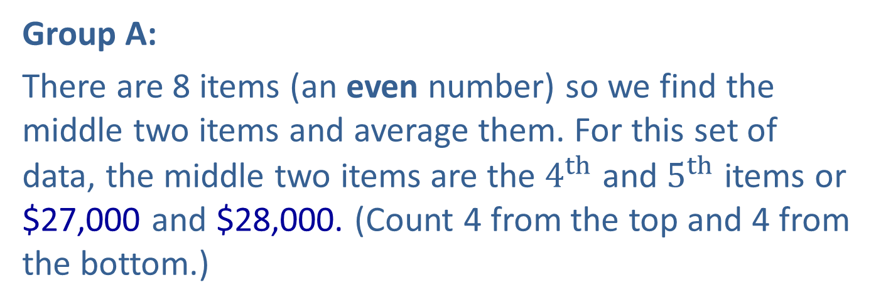
Example 2: Application Finding the Median (cont.)
Group A:
There are 8 items (an even number) so we find the middle two items and average them. For this set of data, the middle two items are the $4^{th}$ and $5^{th}$ items or $27,000 and $28,000. (Count 4 from the top and 4 from the bottom.)
median income
Thus, the median annual income is $27,500.

Slide 11
Example 2: Application Finding the Median (cont.)
Group B (Movie Times)
88 min
88 min
90 min
90 min
90 min
93 min
100 min
105 min
9. 110 min
10. 113 min
11. 155 min
The median is 93 min.

Slide 12
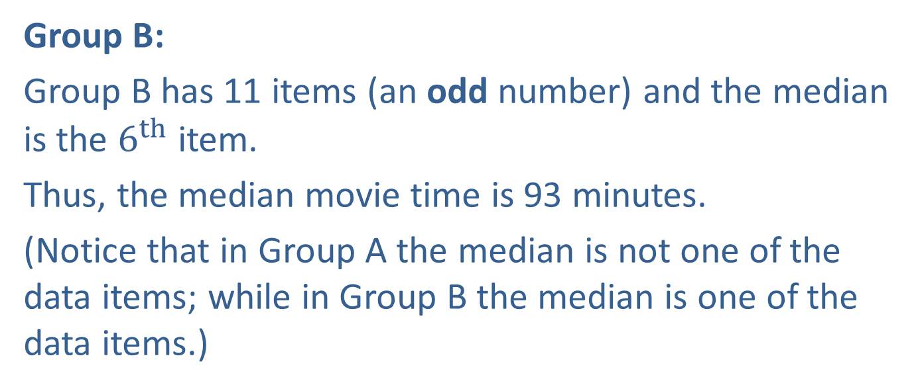
Example 2: Application Finding the Median (cont.)
Group B:
Group B has 11 items (an odd number) and the median is the $6^{th}$ item.
Thus, the median movie time is 93 minutes.
(Notice that in Group A the median is not one of the data items; while in Group B the median is one of the data items.)

Slide 13
Example 3: Application: Finding the Mode and Range
For Group A and Group B, find a. the mode b. the range.
Solution
From the arranged data in Example 2, we can find the mode by determining the most frequent item in each group.
Group A: The mode is $25,000. ($25,000 occurs twice and no other item occurs more than once.)
Group B: The mode is 90 minutes. (90 min occurs three times and no other item occurs more than twice.)

Slide 14
Example 3: Application: Finding the Mode and Range (cont.)
Again referring to the arranged data in Example 2, we can calculate each range as follows.
range = (largest value) − (smallest value)
Group A: Range = $80,000 − $22,000 = $58,000
Group B: Range = 155 − 88 = 67 minutes

Slide 15
Completion Example 4: Application: Using the Mean to Find a Missing Value
Suppose that your grade in this class is the mean of 5 exam scores: 4 sectional exams and 1 comprehensive final exam, with each exam scored on an equal basis of 100 points. On the first 4 exams, you have scores of 85, 78, 82, and 70. What is the lowest score you can get on the final exam and still earn a grade of B in the course? (Assume that to get a B your mean score must be between 80 and 89.)

Slide 16
Completion Example 4: Application: Using the Mean to Find a Missing Value (cont.)
Solution
Solve the problem by first finding the total number of points needed to obtain a mean of 80 on 5 exams. Then calculate the number of points accumulated on the first four exams. Finally, subtract the number of points accumulated from the total needed. This will give the number of points needed on the final exam.

Slide 17
Completion Example 4: Application: Using the Mean to Find a Missing Value (cont.)
Find the total number of points needed for a B. Since the 5 exams are to have a mean score of 80 (or more), then the total number of points must be at least the following product.
Minimum total points needed for a B

Slide 18
Completion Example 4: Application: Using the Mean to Find a Missing Value (cont.)
Calculate the number of points you have accumulated on the first 4 exams.
Points accumulated

Slide 19
Completion Example 4: Application: Using the Mean to Find a Missing Value (cont.)
To obtain a mean of 80 (or more) on your 5 exams, you need the following score on the final exam.
Thus, you need at least a score of 85 on your final exam to earn a grade of B for the course.
(Note: We will see an algebraic approach to solving problems of this type in Chapter 9.)
Total points needed
Points accumulated
Points needed on the final exam

Slide 20
Note
Of the four statistics mentioned in this section, the mean and median are most commonly used. Many people feel that the mean (or arithmetic average) is relied on too much in reporting central tendencies. A few very large (or very small) data items can distort the mean as a picture of a central tendency. As you can see in the Group A data, the median of $27,500 is probably more representative of the data than the mean of $35,250. Note how the one income of $80,000 raises the mean considerably.

Slide 21
Note (cont.)
When you read an article in a magazine or newspaper that reports means or medians, you should now have a better understanding of the implications.

