Slide 1
Section 6.4
Circles

Slide 2
Definition: Circles
Circle: The set of all points in a plane that are some fixed distance from a fixed point called the center of the circle.
Radius: The distance from the center of a circle to any point on the circle. (The letter r is used to represent the radius of a circle.)

Slide 3
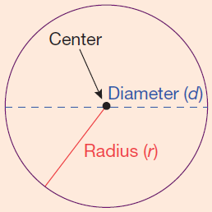
Definition: Circles (cont.)
Diameter: The distance from one point on a circle to another point on the circle measured through the center. (The letter d is used to represent the diameter of a circle and d = 2r.)
Circumference: Perimeter of (or distance around) a circle.

Slide 4
Formula: Formulas for Circles
Circumference: C = 2π r and C = π d
Area:

Slide 5
Note
The Greek letter π (pi) is the symbol used for the
constant 3.1415926535… . This number is an infinite,
nonrepeating decimal number. For our purposes, we
will use π ≈ 3.14 (accurate to hundredths). However,
you should always be aware that 3.14 is only an
approximation for π and that related answers are only
approximations.

Slide 6
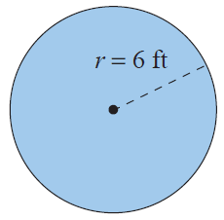
Example 1: Calculating the Circumference and Area of a Circle
Calculate
the circumference and
the area of a circle with a radius of 6 ft.
Solution
Use the formula for circumference:
The circumference is 37.68 ft.

Slide 7
Example 1: Calculating the Circumference and Area of a Circle (cont.)
Use the formula for area:
The area is 113.04 ft².

Slide 8
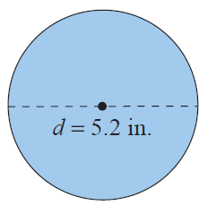
Example 2: Calculating the Circumference and Area of a Circle
Calculate a. the circumference and b. the area of a circle with a diameter of 5.2 in.
Solution
Use the formula for circumference:
The circumference is 16.328 in.

Slide 9
Example 2: Calculating the Circumference and Area of a Circle (cont.)
Use the formula for area:
In this case,
The area is 21.2264 in².

Slide 10
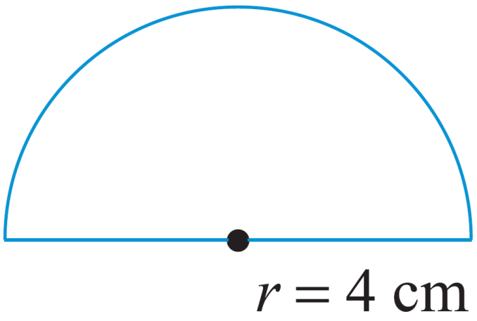
Example 3: Calculating the Perimeter
Calculate the perimeter of the figure shown: a semicircle (half of a circle) and a diameter. The radius is 4 ft long.
Solution
In order to find the perimeter of the figure, find the perimeter of the semicircle and then add the diameter.

Slide 11
Example 3: Calculating the Perimeter (cont.)
Length of semicircle
Diameter
Perimeter = semicircle + diameter
= 12.56 cm + 8 cm = 20.56 cm
The perimeter is 20.56 cm.

Slide 12
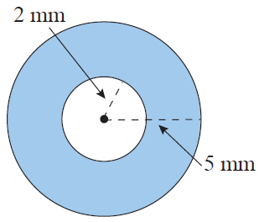
Example 4: Calculating the Area of a Washer
Calculate the area of the washer (shaded portion) with dimensions as shown in the figure.
Solution
Subtract the area of the inside (smaller) circle from the area of the outside (larger) circle.

Slide 13
Example 4: Calculating the Area of a Washer (cont.)
The area of the washer is 65.94 mm².

Slide 14
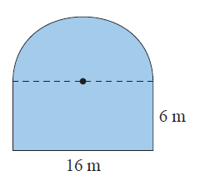
Example 5: Calculating Perimeter and Area
Calculate a. the perimeter and b. the area of the figure shown here with a rectangular base and a semicircle attached to the top. The rectangle has a length of 16 m and a width of 6 m.

Slide 15
Example 5: Calculating Perimeter and Area (cont.)
Solution
The perimeter of the figure is the sum of the lengths of three sides of the rectangle and the length of the semicircle. (Note: The diameter of the semicircle is 16 m.)
Sum of the lengths of three sides of the rectangle
= 6 m + 16 m + 6 m = 28 m
Length of semicircle =
Perimeter of the figure = 28 m + 25.12 m = 53.12 m

Slide 16
Example 5: Calculating Perimeter and Area (cont.)
Calculate the area of the rectangle then add the area of the semicircle.
Area of rectangle
Area of semicircle
In this case,

Slide 17
Example 5: Calculating Perimeter and Area (cont.)
Area of the figure = 96 m + 100.48 m
The perimeter of the figure is 53.12 m and the area of the figure is .

Slide 18
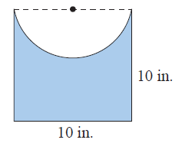
Example 6: Calculating Perimeter and Area
Calculate a. the perimeter and b. the area of the figure shown here with a square base and a semicircle cut out of one side. One side of the square is 10 in. long.

Slide 19
Example 6: Calculating Perimeter and Area (cont.)
Solution
The perimeter of the figure is the sum of the lengths of three sides of the square and the length of the semicircle. (Note: The diameter of the semicircle is 10 in.)
Sum of the lengths of three sides of the square
= 10 in. + 10 in. + 10 in. = 30 in.
Length of semicircle
Perimeter of the figure = 30 in. + 15.7 in. = 45.7 in.

Slide 20
Example 6: Calculating Perimeter and Area (cont.)
Calculate the area of the square then subtract the area of the semicircle.
Area of square
Area of semicircle
In this case,

Slide 21
Example 6: Calculating Perimeter and Area (cont.)
= 60.75 in.²
Area of the figure = 100 in.² – 39.25 in.² The perimeter of the figure is 45.7 in. and the area of the figure is
60.75 in.²

