Slide 1
Section 6.2
Perimeter

Slide 2
Definition: Polygon
A polygon is a closed plane figure, with three or more sides, in which each side is a line segment.
Each point where two sides meet is called a vertex.
Note: A closed figure begins and ends at the same point.

Slide 3
Definition: Perimeter
The perimeter P of a polygon is the sum of the lengths of its sides.

Slide 4
Finding the Perimeter of a Polygon
From the Metric System | From the US Customary System
millimeter (mm) | inch (in.)
centimeter (cm) | foot (ft)
meter (m) | yard (yd)
kilometer (km) | mile (mi)
Table 1

Slide 5
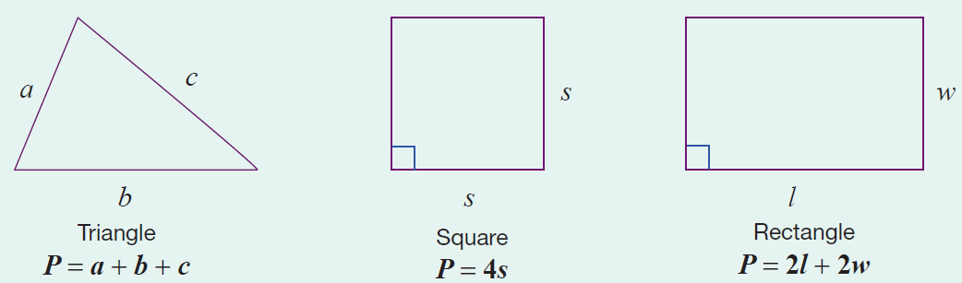
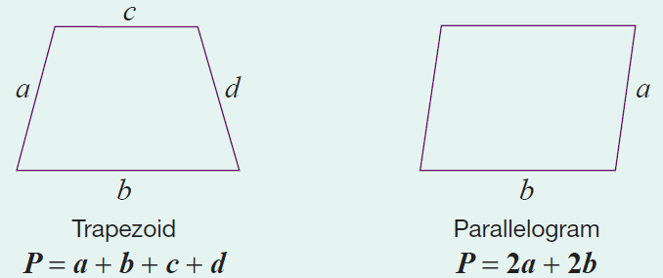
Formula: Perimeter Formulas for Five Polygons
Note that each formula represents the sum of the lengths of the sides.

Slide 6
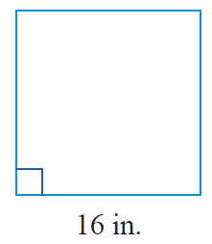
Example 1: Calculating the Perimeter of a Square
Calculate the perimeter of a square with sides of length 16 in.
Solution
Using the formula for the perimeter of a square, we have the following.
The perimeter of the square is 64 in.

Slide 7
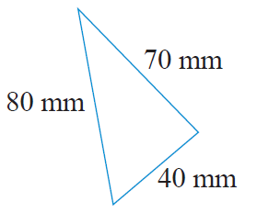
Example 2: Calculating the Perimeter of a Triangle
Calculate the perimeter of a triangle with sides of length 40 mm, 70 mm, and 80 mm.
Solution
First draw a figure and label the lengths
of the sides.
Now, using the formula for the perimeter of a triangle, we have the following.
The perimeter of the triangle is 190 mm.

Slide 8
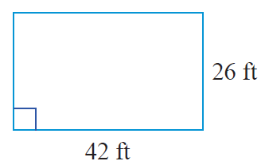
Example 3: Calculating the Perimeter of a Rectangle
Calculate the perimeter of the rectangle.
Solution
Using the formula for the perimeter of a rectangle, we have the following.
The perimeter of the rectangle is 136 ft.

Slide 9
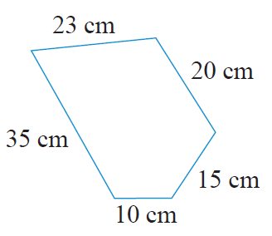
Example 4: Calculating the Perimeter of a Polygon
Calculate the perimeter of the polygon.
(Note: A 5-sided polygon is called a pentagon.)

Slide 10
Example 4: Calculating the Perimeter of a Polygon (cont.)
Solution
The perimeter of any polygon is found by adding the lengths of the sides. Thus, for this pentagon we have the following.
The perimeter of the polygon is 103 cm.

Slide 11
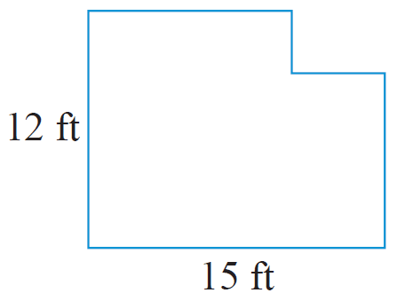
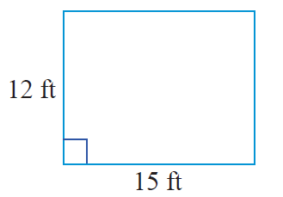
Example 5: Calculating the Perimeter of a Polygon
Calculate the perimeter of the polygon.
Solution
If a rectangle has length 15 ft and width 12 ft, then its perimeter is as follows.

Slide 12
Example 5: Calculating the Perimeter of a Polygon (cont.)
Now, if a small rectangle is cut from one corner of the original rectangle, then a new shape is formed. An interesting fact is that, regardless of the size of the cut out rectangle, this new shape will have the same perimeter as the original rectangle. This is because the length and width of the segments of the indented corner are the same as those of the cut out.

Slide 13
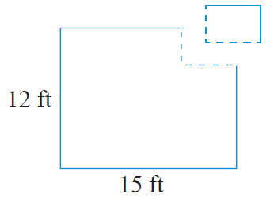
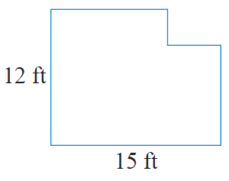
Example 5: Calculating the Perimeter of a Polygon (cont.)
Thus, the perimeter of the polygon is 54 ft.

Slide 14
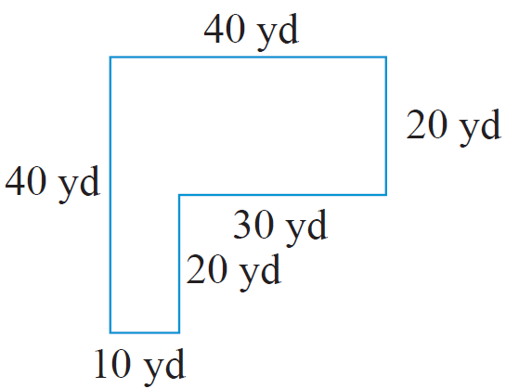
Example 6: Application: Calculating the Perimeter of a Polygon
For security, a chain link fence is to be built on the edge of a property surrounding a new warehouse. The property is L-shaped as shown.
How many yards of fencing will be needed?
How much will be spent on fencing if the fencing that was chosen costs $12.50 per yard?

Slide 15
Example 6: Application: Calculating the Perimeter of a Polygon (cont.)
Solution
As the fence is to be put up along the edge of the property, the amount of fencing needed is equivalent to the perimeter of the property.
They will need 160 yd of fencing.

Slide 16
Example 6: Application: Calculating the Perimeter of a Polygon (cont.)
The cost of the fencing will be $2000.

