Slide 1
Section 6.1
Types of Random Variables

Slide 2
Definition: Random Variable
A random variable is a numerical outcome of a random process.

Slide 3
Definition: Probability Distribution
A probability distribution is a model that describes a specific kind of random process.

Slide 4
Definition: Discrete Random Variable
A discrete random variable is a random variable which has a countable number of possible outcomes.

Slide 5
Procedure: Discrete Random Variables
When describing a discrete random variable, you should do the following.
1. State the variable.
2. List all of the possible values of the variable.
3. Determine the probabilities of these values.

Slide 6
Example 1: Identifying Random Variables—Slide 1
Random Phenomenon: Toss a six-sided die and observe the outcome of the toss.
1. ​Identify the random variable: X = outcome of the toss of a six-sided die.
2. Range of values: Integers between 1 and 6, inclusive.
​In this instance,​

Slide 7
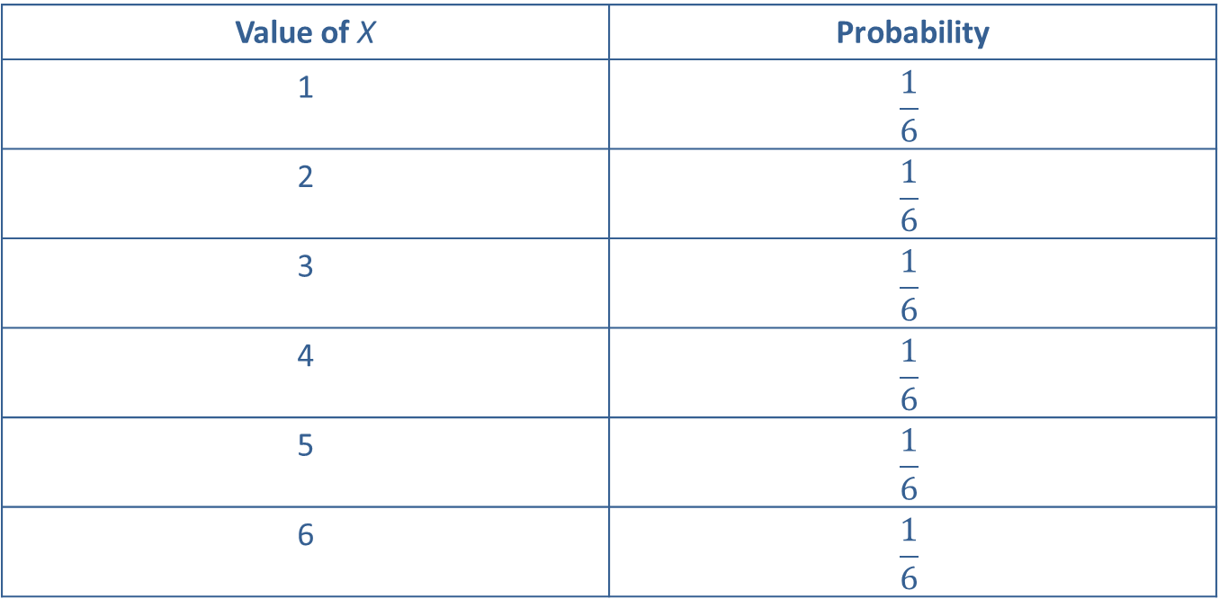
Example 1: Identifying Random Variables—Slide 2
Table 1 – Tossing a Die
Value of X | Probability
1 | $$\frac{1}{6}$$
2 | $$\frac{1}{6}$$
3 | $$\frac{1}{6}$$
4 | $$\frac{1}{6}$$
5 | $$\frac{1}{6}$$
6 | $$\frac{1}{6}$$

Slide 8
Example 1: Identifying Random Variables —Slide 3
3. Probability distribution: The outcomes of the toss of a six-sided die and their probabilities are given in Table 1. The probabilities are deduced using the classical method and the assumption of a fair die.
Not all discrete random variables have probability distributions that are easy to determine. In Examples 2 and 3, neither random variable has an easily determined probability distribution.

Slide 9
Example 2: Identifying Random Variables
Random Phenomenon: Suppose we observe the number of defective integrated circuits received in a batch of 1000.
1. Identify the random variable: X = the number of defective integrated circuits in a batch of 1000.
2. Range of values: Integers between 0 and 1000, where N = 1000. If symbols were chosen to represent the values they could be given as
That is, there could be 0 defective circuits or they could all (1000) be defective.
3. Probability distribution: Unknown.

Slide 10
Example 3: Identifying Random Variables
Random Phenomenon: A stock market analyst is interested in the number of stocks on the New York Stock Exchange (NYSE) that increased in price on the previous day. She realizes that the number that increases is a random variable. She will have to develop a description of the randomness in order to study the stocks.
1. Identify the random variable: X = number of stocks that increased in price.
2. Range of values: Integers between 0 and the number of stocks trading on the NYSE on the previous day.
3. Probability distribution: Unknown, but could be estimated using a relative frequency distribution from Section 5.2 in conjunction with historical data of the NYSE.

Slide 11
Definition: Continuous Random Variable
A continuous random variable is a random variable whose measurements can assume any one of a countless number of values in an interval.

Slide 12
Example 4: Identifying Random Variables
Random Phenomenon: Sylars Watch Manufacturer has a process that indicates that all watches will be assembled between 20 to 45 minutes. Obviously, the time to assemble a watch will be a function of the style and other accoutrements that are selected by the customer. Since time is measured on a continuous scale and the variability of watch assembly is not predictable due to different workers, the overall time to assemble a watch is considered to be a continuous random variable.
1. Identify the random variable: X = time to assemble a watch.
2. Range of values: Between 0 and ∞. Note that X is measured on a continuous scale.
3. Probability distribution: Unknown.

Slide 13
Note
For continuous random variables, we specify probabilities with probability density functions.

