Slide 1
Section 4.2
Measures of Dispersion

Slide 2
Definition: Variability
Variability is the amount an individual observation or set of observations fluctuates about the mean or center of a set of data.

Slide 3
Definition: Deviation From The Mean
The distance that a value is from the mean of the data set is called a deviation from the mean.

Slide 4
Deviation From The Mean
Table 1 – Calculating Deviation from the Mean
Data Set: 3, 12, 20, 15, 0 | Mean = 10
Data values | Deviations from the Mean (Data – Mean = Deviations )
3 | 3 – 10 = –7
12 | 12 – 10 = 2
20 | 20 – 10 = 10
15 | 15 – 10 = 5
0 | 0 – 10 = –10

Slide 5
Definition: Range
The range is the difference between the largest and smallest data values.

Slide 6
Example 1: Calculating the Range of Sodas Consumed—Slide 1
The Pop Bottling Company wanted to know the monthly consumption of sodas by families living nearby. A random sample of nine homes were taken. The data below represent the number of sodas consumed in the last month by the families surveyed. Calculate the range of the following data set.
4, 6, 16, 9, 24, 8, 0, 12, 1

Slide 7
Example 1: Calculating the Range of Sodas Consumed—Slide 2
Solution
The largest value equals 24 and the smallest value equals 0. Thus, the range is calculated as follows.
Range = 24 − 0 = 24

Slide 8
Formula: Mean Absolute Deviation
The sample mean absolute deviation (MAD) is given by

Slide 9
Example 2: Calculating the Mean Absolute Deviation of Run Times—Slide 1
Suppose six people participated in a 1000-meter run. Their times, measured in minutes, are given below.
4, 10, 9, 11, 9, 7
The mean time is approximately 8.3 minutes. Find the mean absolute deviation.

Slide 10
Example 2: Calculating the Mean Absolute Deviation of Run Times—Slide 2
Solution
In Table 2 we do the basic calculations needed to compute the mean absolute deviation.

Slide 11
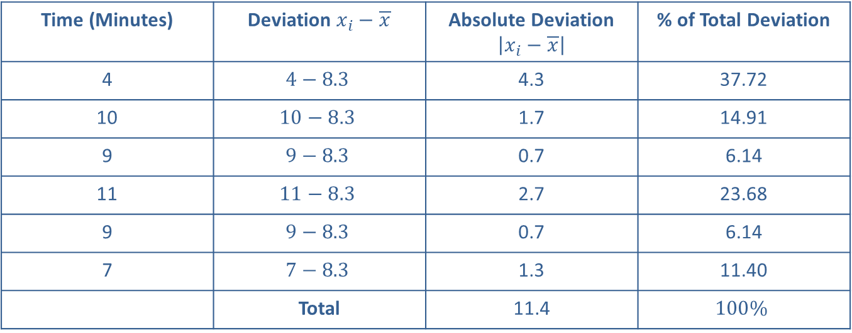
Example 2: Calculating the Mean Absolute Deviation of Run Times—Slide 3
Table 2 – Calculating Mean Absolute Deviation
Time (Minutes) | Deviation $x_{i}−\overline{x}$ | Absolute Deviation $\left|x_{i}−\overline{x}\right|$ | % of Total Deviation
4 | $$4−8.3$$ | 4.3 | 37.72
10 | $$10−8.3$$ | 1.7 | 14.91
9 | $$9−8.3$$ | 0.7 | 6.14
11 | $$11−8.3$$ | 2.7 | 23.68
9 | $$9−8.3$$ | 0.7 | 6.14
7 | $$7−8.3$$ | 1.3 | 11.40
 | Total | 11.4 | $$100\%$$

Slide 12
Example 2: Calculating the Mean Absolute Deviation of Run Times—Slide 4
Thus, on average, the values are 1.9 units from the mean. Note that the contribution to the sum of the deviations is proportional to the size of the deviation. That is, if one absolute deviation is twice as large as another, it contributes twice as much to the value of the statistic. For example, compare the data point 7, which is 1.3 units from the mean, to the data point 11, which is 2.7 units from the mean.

Slide 13
Example 2: Calculating the Mean Absolute Deviation of Run Times—Slide 5
The percentage contribution to the total deviation is 11.40% for 7 and 23.68% for 11, which is in proportion to their respective distances from the mean. A variability measure in which each data value contributes proportionally to its distance from the mean seems reasonable.

Slide 14
Example 3: Calculating the Mean Absolute Deviation of Run Times with an Outlier—Slide 1
Suppose the value 200 is added to the data set given in Example 2.
The mean is drastically affected, increasing from 8.3 to 35.7. In Table 3 we redo the basic calculations for the mean absolute deviation. What effect, if any, does the value of 200 have on the MAD?

Slide 15
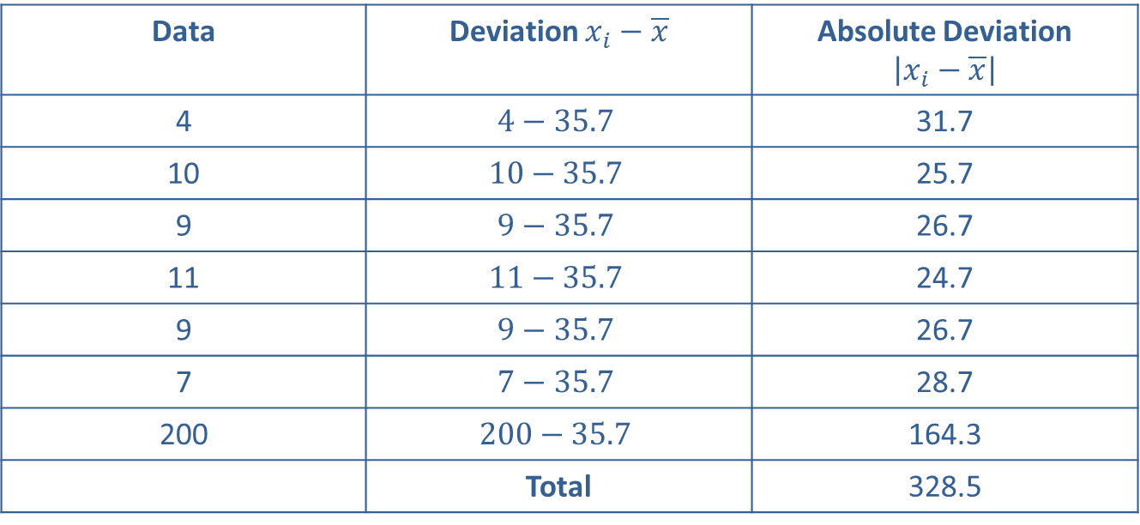
Example 3: Calculating the Mean Absolute Deviation of Run Times with an Outlier—Slide 2
Solution
Table 3 – Calculating Mean Absolute Deviation
Data | Deviation $x_{i}−\overline{x}$ | Absolute Deviation $\left|x_{i}−\overline{x}\right|$
4 | $$4−35.7$$ | 31.7
10 | $$10−35.7$$ | 25.7
9 | $$9−35.7$$ | 26.7
11 | $$11−35.7$$ | 24.7
9 | $$9−35.7$$ | 26.7
7 | $$7−35.7$$ | 28.7
200 | $$200−35.7$$ | 164.3
 | Total | 328.5

Slide 16
Example 3: Calculating the Mean Absolute Deviation of Run Times with an Outlier—Slide 3
The mean absolute deviation changes dramatically, increasing to 46.9, which is calculated by the sum of the absolute deviations (328.5) divided by the sample size (7). Therefore, the mean absolute deviation is sensitive to outliers and is not a resistant measure. The mean absolute deviation is a very intuitive measure of variation.

Slide 17
Formula: Variance
The variance of a data set containing the complete set of population data is given by
where μ is the population mean of the data set, N is the size of the population, and x _{i} is a particular value in the data set. σ² is pronounced sigma squared, and is called the population variance.
The variance of a data set containing sample data is given by
Where
is the mean of the sample data, n is the size of the sample,
and x _{i} is a particular value in the sample. s² is called the sample variance.

Slide 18
Example 4: Calculating the Sample Variance of Run Times—Slide 1
Given the following times in minutes of six persons running a 1000-meter course, compute the sample variance.
4, 10, 9, 11, 9, 7

Slide 19
Example 4: Calculating the Sample Variance of Run Times—Slide 2
Solution
We previously computed the mean of this sample as 8.3. In Table 4 we do the basic calculations needed to compute the sample variance.

Slide 20
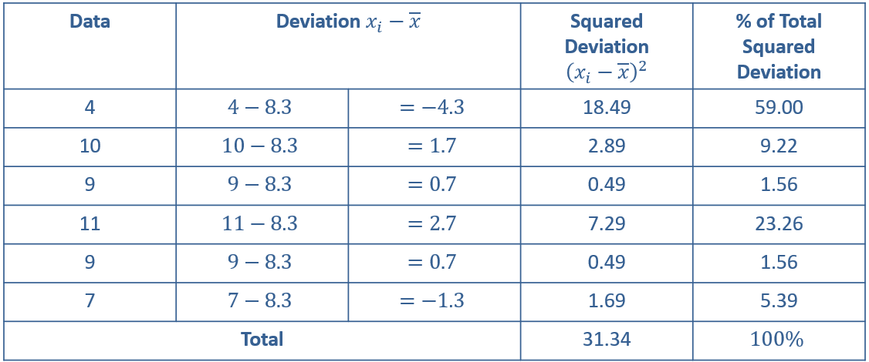
Example 4: Calculating the Sample Variance of Run Times—Slide 3
Table 4 – Calculating the Sample Variance

Slide 21
Example 4: Calculating the Sample Variance of Run Times—Slide 4
Thus the average squared deviation of the data is 6.268 minutes squared. The phrase "minutes squared" in the last sentence may seem a bit odd. No one carries out transactions in square minutes, or square dollars, or square tons, so it is difficult to interpret the significance of the measurement in this form. That is why the standard deviation exists. It converts the measure into the original units by taking the square root of the variance. The standard deviation for the previous data is then

Slide 22
Definition: Standard Deviation
The standard deviation is the square root of the variance.

Slide 23
Definition: Empirical Rule—Slide 1
The empirical rule describes the variability of a set of measurements for a bell-shaped distribution.

Slide 24
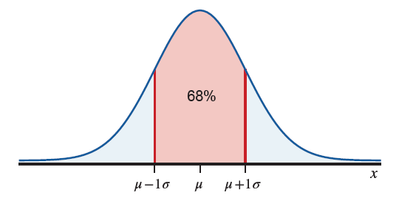
Empirical Rule—Slide 2
Figure 1 – One Sigma

Slide 25
Empirical Rule—Slide 3
One sigma rule: If the distribution of the data is bell-shaped, about 68% of the data should lie within one standard deviation of the mean.
A deviation of more than one sigma from the mean is to be expected about once in every three observations.

Slide 26
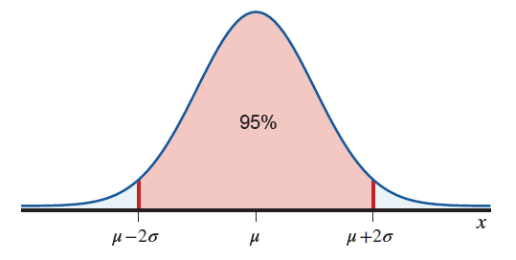
Empirical Rule—Slide 4
Figure 2 – Two Sigma

Slide 27
Empirical Rule—Slide 5
Two sigma rule: If the distribution of data is bell-shaped, about 95% of the data should lie within two standard deviations of the mean.
A deviation of more than two sigma from the mean is to be expected about once in every twenty observations.

Slide 28
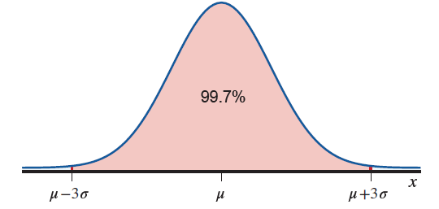
Empirical Rule—Slide 6
Figure 3 – Three Sigma

Slide 29
Empirical Rule—Slide 7
Three sigma rule: If the distribution of the data is bell-shaped, about 99.7% of the observations should lie within three standard deviations of the mean.
A deviation of more than three sigma from the mean is to be expected about once in every 333 observations, slightly more than 0.3% of the time.

Slide 30
Definition: Chebyshev'S Theorem
Chebyshev's Theorem is a general rule that describes the variability of any set of data regardless of the shape of its distribution.

Slide 31
Example 5: Applying the Empirical Rule to Stock Earnings—Slide 1
Suppose a group of high technology stocks has an average earnings per share of $6.26, with a standard deviation of $1.37. If the data possess a bell-shaped distribution, which interval contains 68% of the earnings? Which interval contains about 95% of the earnings?

Slide 32
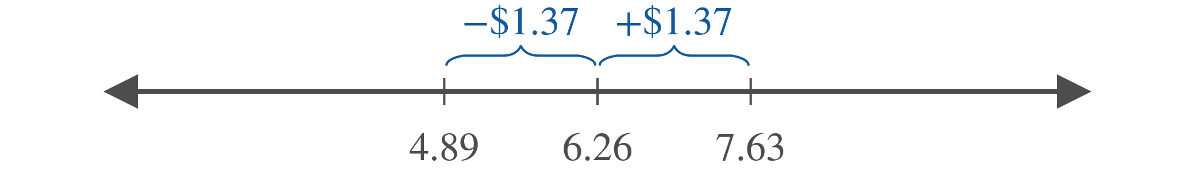
Example 5: Applying the Empirical Rule to Stock Earnings—Slide 2
Solution
Using the one sigma rule, we will capture 68% of the

Slide 33
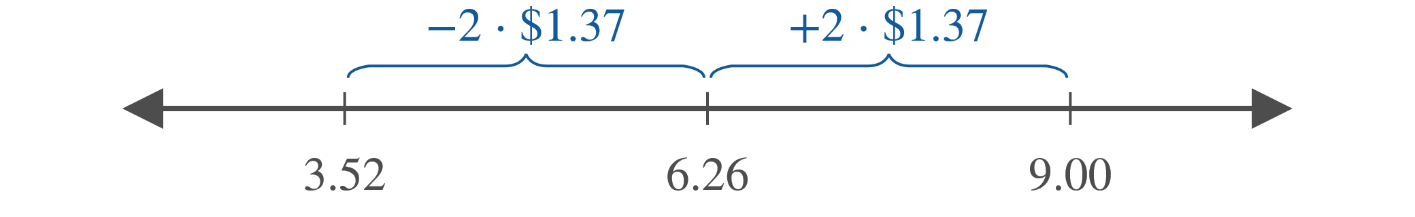
Example 5: Applying the Empirical Rule to Stock Earnings—Slide 3
Using the one sigma rule results in an interval from $6.26 − $1.37 to $6.26 + $ 1.37.
Doing the arithmetic produces an interval from $4.89 to $7.63.
To capture 95% of the earnings, use the two sigma rule,
Doing the arithmetic results in an
interval from $3.52 to $9.00.

Slide 34
Example 5: Applying the Empirical Rule to Stock Earnings—Slide 4
Note that to increase the percentage of data captured from 68% to 95% requires an interval that is twice as large.

Slide 35
Theorem: Chebyshev's Theorem
The proportion of any data set lying within k standard deviations of the mean is at least

Slide 36
Example 6: Applying Chebyshev's Theorem to College Tuition and Fees—Slide 1
The distribution histogram of tuition and fees of US colleges and universities in 2019–2020 is shown in Figure 4. The mean of the data is $7498, while the standard deviation is $3639. What can we conclude from Chebyshev's Theorem using k = 2?

Slide 37
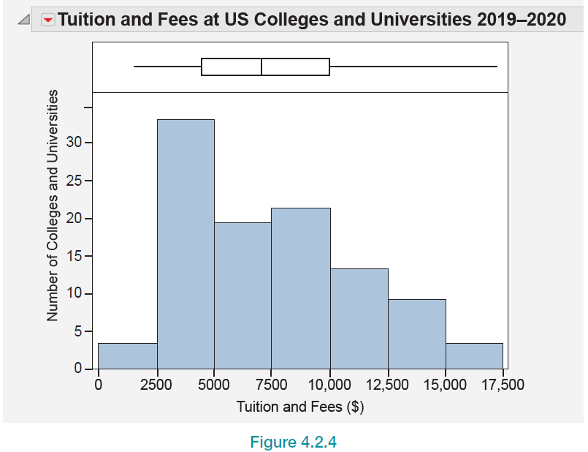
Example 6: Applying Chebyshev's Theorem to College Tuition and Fees—Slide 2
Figure 4

Slide 38
Example 6: Applying Chebyshev's Theorem to College Tuition and Fees—Slide 3
Solution
Because we are interested in k = 2, we will look at the values two standard deviations above and below the mean.
Two standard deviations above the mean is
and two standard deviations below the mean is
Therefore, by Chebyshev's Theorem, we can say that at least 75% of the tuition and fees of colleges and universities in the United States are between $220 and $14,776 for 2019–2020.

Slide 39
Formula: Coefficient of Variation
The coefficient of variation, another statistical measure, compares the variation in data sets.
For population data, the coefficient of variation is defined as
and for sample data,

