Slide 1
Section 12.2
Assumptions in an ANOVA Test

Slide 2
Procedure: ANOVA Assumptions
In order for an analysis of variance to be valid, the following three assumptions must hold.
1. ​The distributions of all k populations of interest are approximately normal.
2. The variances of all k populations are equal.
3. The sample observations are randomly selected and independent.

Slide 3
Note
There is a simple “rule of thumb” that you can use to check the variance assumption. If the largest standard deviation is no more than twice the smallest, then the presumption is that the assumption holds.

Slide 4
Example 1: Validating Assumptions for
ANOVA—Slide 1
Let's return to Example 1 of section 12.1 where we compared the media use screen time between Tweens, Teens, and Adults. We concluded that the average amount of time spent on screens is significantly different between the three groups. As indicated in this section, we have three primary assumptions when performing an Analysis of Variance (ANOVA). Specific to this example, the assumptions are
1. The distributions of the three populations (i.e., the three age groups) are approximately normal.
2. The variances of all three populations are equal.
3. ​The sample observations are randomly selected and independent.

Slide 5
Example 1: Validating Assumptions for
ANOVA—Slide 2
Solution
Let's discuss and validate each of these assumptions. Given that the three age groups do not overlap and that it's stated that the samples are randomly selected, the assumption of independence between the three groups holds.
The assumptions of normality and homogeneity of variances are not as easy to show. The assumption of normality can be shown using descriptive statistics. See the histogram and box plot in the JMP output for the screen time for each of the age groups.

Slide 6
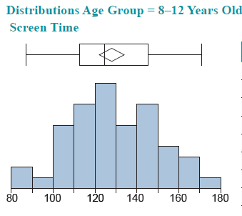
Example 1: Validating Assumptions for
ANOVA—Slide 3

Slide 7
Example 1: Validating Assumptions for
ANOVA—Slide 4
Quantiles
Summary Statistics
100.0% | maximum | 171
99.5% |  | 171
97.5% |  | 169.35
90.0% |  | 156
75.0% | quartile | 145.25
50.0% | median | 124.5
25.0% | quartile | 112.75
10.0% |  | 103
2.5% |  | 87.275
0.5% |  | 87
0.0% | minimum | 87
Mean | 128
Std Dev | 20.895268
Std Err Mean | 2.9550372
Upper 95% Mean | 133.93837
Lower 95% Mean | 122.06163
N | 50

Slide 8
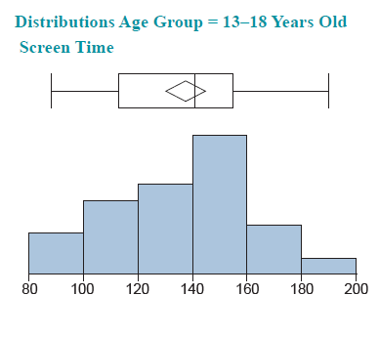
Example 1: Validating Assumptions for
ANOVA—Slide 5

Slide 9
Example 1: Validating Assumptions for
ANOVA—Slide 6
Quantiles
Summary Statistics
100.0% | maximum | 190
99.5% |  | 190
97.5% |  | 187.525
90.0% |  | 175.7
75.0% | quartile | 155
50.0% | median | 141
25.0% | quartile | 117.75
10.0% |  | 97.3
2.5% |  | 89.375
0.5% |  | 88
0.0% | minimum | 88
Mean | 137.48
Std Dev | 25.570423
Std Err Mean | 3.6162039
Upper 95% Mean | 144.74703
Lower 95% Mean | 130.21297
N | 50

Slide 10
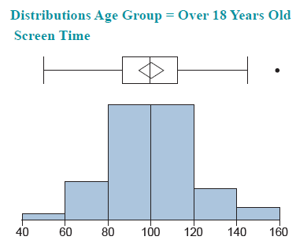
Example 1: Validating Assumptions for
ANOVA—Slide 7

Slide 11
Example 1: Validating Assumptions for
ANOVA—Slide 8
Quantiles
Summary Statistics
100.0% | maximum | 159
99.5% |  | 159
97.5% |  | 155.15
90.0% |  | 121.9
75.0% | quartile | 112.25
50.0% | median | 99.5
25.0% | quartile | 86.75
10.0% |  | 75
2.5% |  | 53.025
0.5% |  | 50
0.0% | minimum | 50
Mean | 100.12
Std Dev | 20.323546
Std Err Mean | 2.8741835
Upper 95% Mean | 105.89589
Lower 95% Mean | 94.344112
N | 50
Figure 3

Slide 12
Example 1: Validating Assumptions for
ANOVA—Slide 9
The histogram for each of the age groups appears to follow a bell-shaped curve (i.e., a normal distribution). Additionally, if you observe the continuous fit to the data in the JMP output below, you will see that each of the continuous fits appears to follow a normal distribution for each age group. Lastly, JMP offers a Goodness-of-Fit Test which is a formal test of normality for each age group. The null hypothesis of the test is
H ₀: The data are from a normal distribution.

Slide 13
Example 1: Validating Assumptions for
ANOVA—Slide 10
Thus, small P-values listed under Prob < W (associated with the Shapiro-Wilk test) and under Simulated
p-Value (associated with the Anderson-Darling test) indicate that the data are less likely to have come from a normal distribution. As can be seen in the output, the P-values associated with the Goodness-of-Fit Test for each age group yield a P-value greater than 0.05, which implies that we would fail to reject the null hypothesis at a 0.05 significance level and conclude that the data follow a normal distribution.

Slide 14
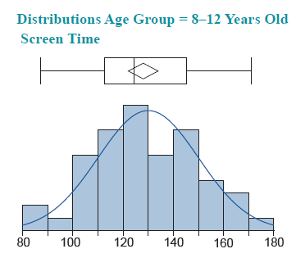
Example 1: Validating Assumptions for
ANOVA—Slide 11
Compare Distributions
Show | Distribution |  | AICc | BIC | -2*LogLikelihood
☑ | Normal |  | 449.10145 | 452.67017 | 444.84613

Slide 15
Example 1: Validating Assumptions for ANOVA—Slide 12
Quantiles
Summary Statistics
100.0% | maximum | 171
99.5% |  | 171
97.5% |  | 169.35
90.0% |  | 156
75.0% | quartile | 145.25
50.0% | median | 124.5
25.0% | quartile | 112.75
10.0% |  | 103
2.5% |  | 87.275
0.5% |  | 87
0.0% | minimum | 87
Mean | 128
Std Dev | 20.895268
Std Err Mean | 2.9550372
Upper 95% Mean | 133.93837
Lower 95% Mean | 122.06163
N | 50

Slide 16
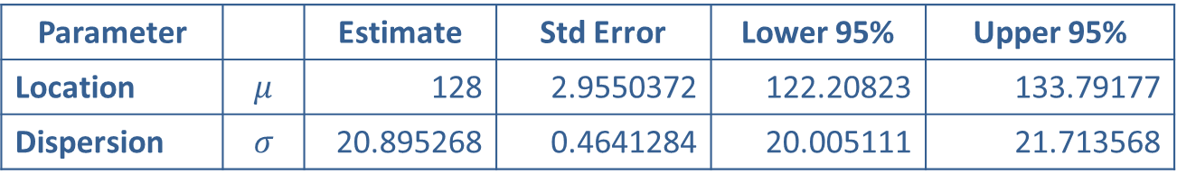
Example 1: Validating Assumptions for ANOVA—Slide 13
Fitted Normal Distribution
Parameter |  | Estimate | Std Error | Lower 95% | Upper 95%
Location | $$μ$$ | 128 | 2.9550372 | 122.20823 | 133.79177
Dispersion | $$σ$$ | 20.895268 | 0.4641284 | 20.005111 | 21.713568
Goodness-of-Fit Test
Measures
-2*LogLikelihood | 444.84613
AICc | 449.10145
BIC | 452.67017
 | W | Prob<W
Shapiro-Wilk | 0.9815568 | 0.6192
 | A2 | Simulated p-Value
Anderson-Darling | 0.2769295 | 0.6692

Slide 17
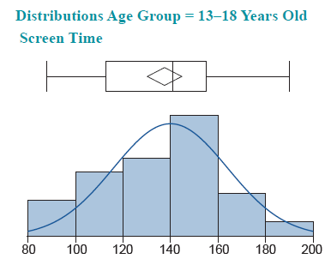

Example 1: Validating Assumptions for
ANOVA—Slide 14
Compare Distributions

Slide 18
Example 1: Validating Assumptions for ANOVA—Slide 15
Quantiles
Summary Statistics
100.0% | maximum | 190
99.5% |  | 190
97.5% |  | 187.525
90.0% |  | 175.7
75.0% | quartile | 155
50.0% | median | 141
25.0% | quartile | 117.75
10.0% |  | 97.3
2.5% |  | 89.375
0.5% |  | 88
0.0% | minimum | 88
Mean | 137.48
Std Dev | 25.570423
Std Err Mean | 3.6162039
Upper 95% Mean | 144.74703
Lower 95% Mean | 130.21297
N | 50

Slide 19
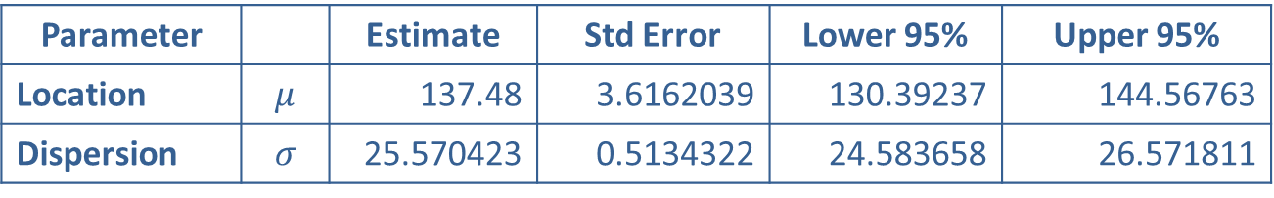
Example 1: Validating Assumptions for
ANOVA—Slide 16
Fitted Normal Distribution
Parameter |  | Estimate | Std Error | Lower 95% | Upper 95%
Location | $$μ$$ | 137.48 | 3.6162039 | 130.39237 | 144.56763
Dispersion | $$σ$$ | 25.570423 | 0.5134322 | 24.583658 | 26.571811
Goodness-of-Fit Test
Measures
-2*LogLikelihood | 465.03749
AICc | 469.29281
BIC | 472.86153
 | W | Prob<W
Shapiro-Wilk | 0.9716919 | 0.2708
 | A2 | Simulated p-Value
Anderson-Darling | 0.4978111 | 0.1920

Slide 20
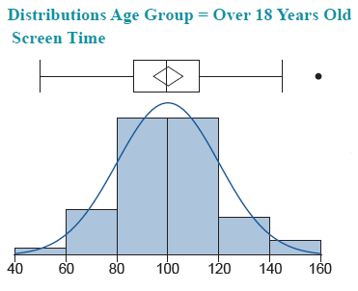

Example 1: Validating Assumptions for
ANOVA—Slide 17
Compare Distributions

Slide 21
Example 1: Validating Assumptions for
ANOVA—Slide 18
Quantiles
Summary Statistics
100.0% | maximum | 159
99.5% |  | 159
97.5% |  | 155.15
90.0% |  | 121.9
75.0% | quartile | 112.25
50.0% | median | 99.5
25.0% | quartile | 86.75
10.0% |  | 75
2.5% |  | 53.025
0.5% |  | 50
0.0% | minimum | 50
Mean | 100.12
Std Dev | 20.323546
Std Err Mean | 2.8741835
Upper 95% Mean | 105.89589
Lower 95% Mean | 94.344112
N | 50

Slide 22
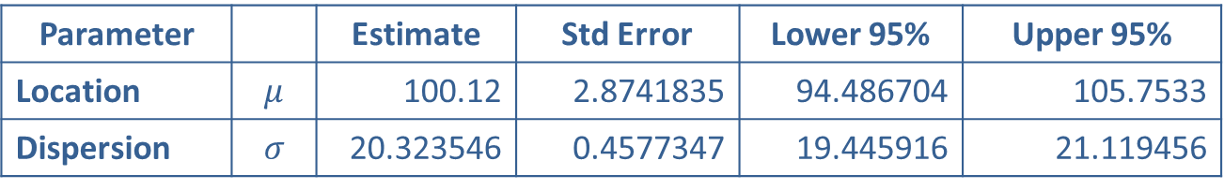
Example 1: Validating Assumptions for
ANOVA—Slide 19
Fitted Normal Distribution
Parameter |  | Estimate | Std Error | Lower 95% | Upper 95%
Location | $$μ$$ | 100.12 | 2.8741835 | 94.486704 | 105.7533
Dispersion | $$σ$$ | 20.323546 | 0.4577347 | 19.445916 | 21.119456
Goodness-of-Fit Test
Measures
-2*LogLikelihood | 442.07187
AICc | 446.32719
BIC | 449.89591
 | W | Prob<W
Shapiro-Wilk | 0.9858148 | 0.8060
 | A2 | Simulated p-Value
Anderson-Darling | 0.2258447 | 0.8188
Figure 4

Slide 23
Example 1: Validating Assumptions for
ANOVA—Slide 20
The last assumption that needs to be validated is that of homogeneous variances. That is, we performed the ANOVA under the assumption that
against the alternative hypothesis that at least one of the variances is different, which can be written as

Slide 24
Example 1: Validating Assumptions for
ANOVA—Slide 21
To test the equality of the variances, we will use the procedure discussed in Section 11.5 when we compared two variances. In this particular situation, since we have three group variances (in general, we can have three or more groups when performing ANOVA), we want to compare the largest variance to the smallest variance. That is, we will test using a null hypothesis of:

Slide 25
Example 1: Validating Assumptions for
ANOVA—Slide 22
against an alternative of
represents the largest variance of the
three age groups and
represents the smallest
variance of the three age groups. The rationale is that if there is not a significant difference between the largest and smallest variances, then there won't be a significant difference among all group variances.

Slide 26
Example 1: Validating Assumptions for
ANOVA—Slide 23
Of course, if there is a significant difference between the largest and smallest variances, then our assumption is violated, and we may need to do one of the following: transform the data by taking the natural log or square root of the responses; use nonparametric procedures; or use some alternative statistics such as Welch's or Brown-Forsythe procedures which use an alternative F-statistic to determine if you have statistical significance.
Understanding that the data are collected from three independent normally distributed populations and that we are testing the ratio of two variances, the test statistic is given by

Slide 27
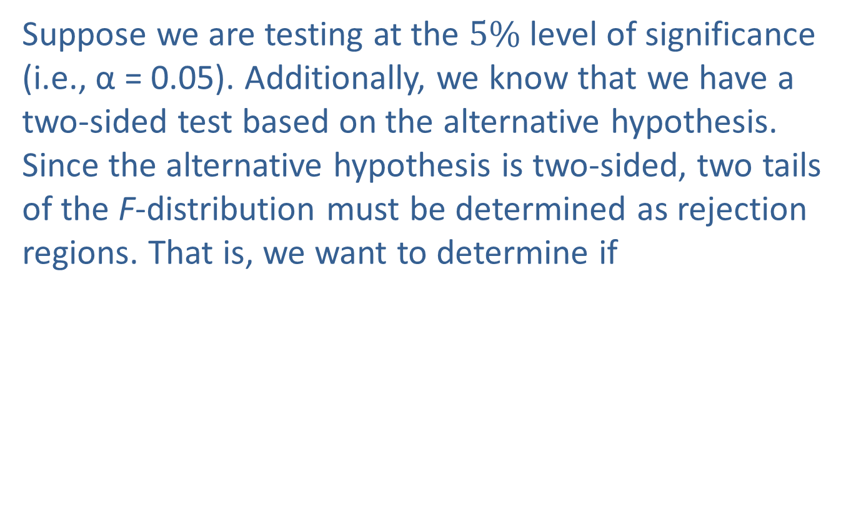
Example 1: Validating Assumptions for
ANOVA—Slide 24
Suppose we are testing at the $5\%$ level of significance (i.e., α = 0.05). Additionally, we know that we have a two-sided test based on the alternative hypothesis. Since the alternative hypothesis is two-sided, two tails of the F-distribution must be determined as rejection regions. That is, we want to determine if
These critical values are

Slide 28
Example 1: Validating Assumptions for
ANOVA—Slide 25
The rejection region is that we will reject the null hypothesis if the F-test statistic is less than or equal to 0.5675 or if the F-test statistic is greater than or equal to 1.7622.
As can be seen in the JMP output, the standard deviation (and thus, the variance) is largest for the group of teens (13–18 years old) and the standard deviation is smallest for the adults (more than 18 years old).

Slide 29
Example 1: Validating Assumptions for
ANOVA—Slide 26
The test statistic is given by
Since the test statistic does not fall in the rejection region, we fail to reject the null hypothesis and conclude that there is no evidence to indicate that the variances of screen time among tweens, teens, and adults are significantly different.

