Slide 1
Section 10.6
Testing a Hypothesis about a Population Variance

Slide 2
Formula: χ²-Test Statistic
If we have a random sample of size n taken from a normal population, then the sampling distribution of the test statistic is given by
which has a chi-square distribution with n − 1 degrees of freedom.

Slide 3
Example 1: Performing a Hypothesis Test for a Population Variance—Slide 1
A drug manufacturer believes that the manufacturing process is in control if the standard deviation of the dosage in each tablet is at most 0.10 milligram. The quality control manager is willing to shut down the manufacturing process if there is overwhelming evidence that the process has excessive variation. A sample of 30 tablets is evaluated and the sample standard deviation is found to be 0.14 milligram. Assuming that the data are collected from a normal population, should the quality control manager shut down the manufacturing process? Use α = 0.01.

Slide 4
Example 1: Performing a Hypothesis Test for a Population Variance—Slide 2
Solution
Step 1: Determine the null hypothesis. In this process, select the appropriate statistical measure, such as the population mean, proportion, or variance.
The null hypothesis is that the manufacturing process does not have excessive variation. Since the issue in this example is variation and specifically discusses the standard deviation, the hypothesis can be stated in terms of the variance. The null hypothesis is written as

Slide 5
Example 1: Performing a Hypothesis Test for a Population Variance—Slide 3
Step 2: Determine the alternative hypothesis and whether it should be one-sided or two-sided.
Most hypothesis tests concerning a variance will be one-sided. Small variation is desirable, while too much variation is undesirable. Because we are interested in determining if there is evidence that the process has excessive variation, the test will be one-tailed. The alternative hypothesis is written as

Slide 6
Example 1: Performing a Hypothesis Test for a Population Variance—Slide 4
Step 3: Select the appropriate test statistic based on the information at hand and the assumptions you are willing to make.
The test statistic will change rather dramatically. In the previous test statistics, the goal was to measure how far the sample statistic,
was from the
hypothesized value. The test statistic for a population variance is given by

Slide 7
Example 1: Performing a Hypothesis Test for a Population Variance—Slide 5
Let's look at the pieces of this statistic. The term
refers to the hypothesized value of the variance. In this sample,
The actual variance of the population is unknown. But the sample variance, s², should be reasonably close to the unknown population variance, σ². If the null is true,
then
and the ratio
should be near 1,
since s² should be close to

Slide 8
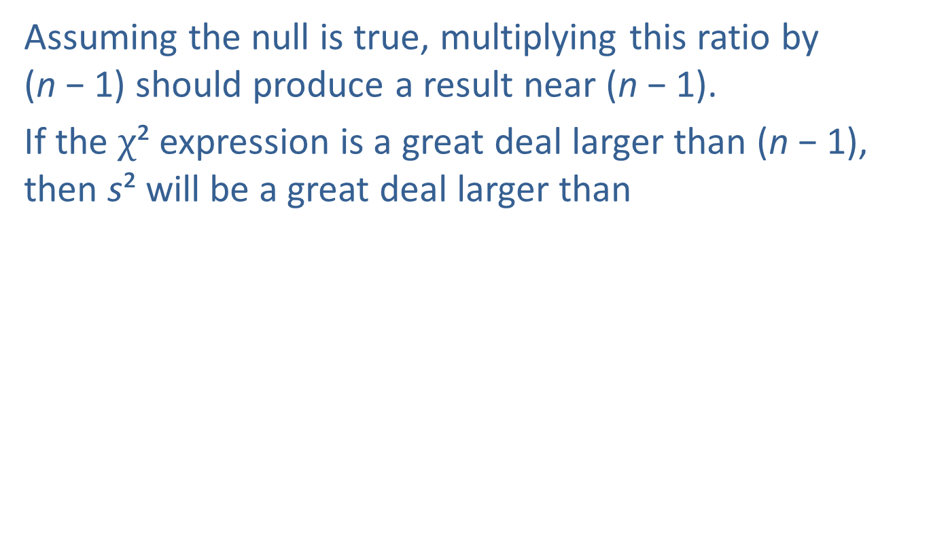
Example 1: Performing a Hypothesis Test for a Population Variance—Slide 6
Assuming the null is true, multiplying this ratio by
(n − 1) should produce a result near (n − 1).
If the χ² expression is a great deal larger than (n − 1), then s² will be a great deal larger than
Such an event would cast doubt on the validity of the null hypothesis.

Slide 9
Example 1: Performing a Hypothesis Test for a Population Variance—Slide 7
Step 4: Determine the critical value of the test statistic. Two factors must be considered.
1. The type of alternative hypothesis: two-sided, one-sided left, one-sided right.
2. The specification of α, the significance level of the test.
The role of the critical value in this test is no different from other hypothesis tests discussed earlier. It defines a range of values for the test statistic, the rejection region, that will be too rare to have likely occurred from ordinary sampling variability.

Slide 10
Example 1: Performing a Hypothesis Test for a Population Variance—Slide 8
From a probabilistic standpoint, the level of the test defines the size of the rejection region. Should the value of the test statistic fall in this region, the null hypothesis will be rejected. Determining the critical value will require knowledge of the sample size. The company studied a sample of 30 tablets. Since the level of the test is 0.01 and there are df = 30 − 1 = 29 degrees of freedom, the critical value is 49.588 (see the Chi Square Table). The test statistic will exceed this value because of ordinary variation only 1% of the time.

Slide 11
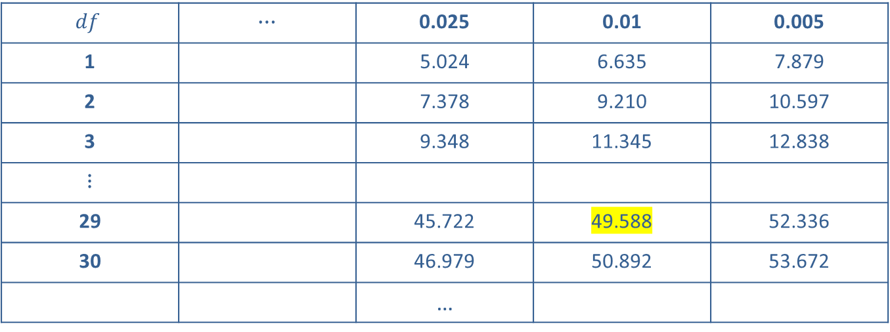
Example 1: Performing a Hypothesis Test for a Population Variance—Slide 9
Area to the Right of the Critical Value of χ²
$$df$$ | ⋯ | 0.025 | 0.01 | 0.005
1 |  | 5.024 | 6.635 | 7.879
2 |  | 7.378 | 9.210 | 10.597
3 |  | 9.348 | 11.345 | 12.838
⋮
29 |  | 45.722 | 49.588 | 52.336
30 |  | 46.979 | 50.892 | 53.672
 |  | …

Slide 12
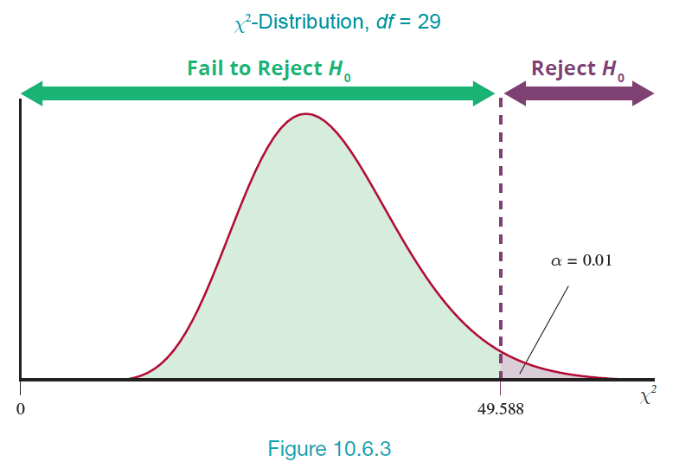
Example 1: Performing a Hypothesis Test for a Population Variance—Slide 10
Figure 3

Slide 13
Example 1: Performing a Hypothesis Test for a Population Variance—Slide 11
Step 5: Collect the sample data and compute the value of the test statistic.
A sample of 30 tablets is evaluated, and the sample standard deviation is found to be 0.14 milligram.

Slide 14
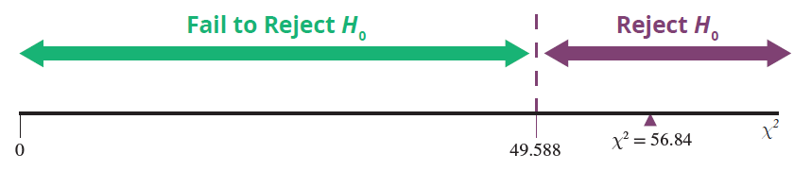
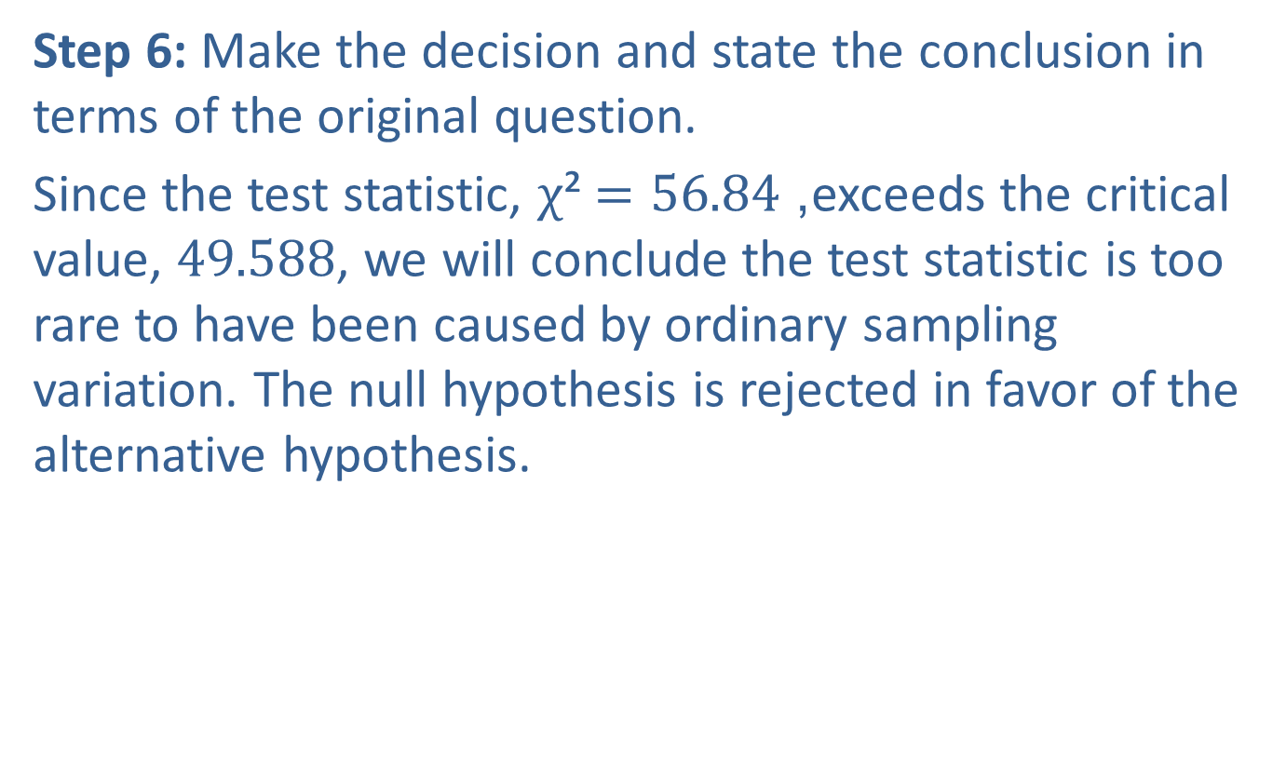
Example 1: Performing a Hypothesis Test for a Population Variance—Slide 12
Step 6: Make the decision and state the conclusion in terms of the original question.
Since the test statistic, χ² $=56.84$, exceeds the critical value, 49.588, we will conclude the test statistic is too rare to have been caused by ordinary sampling variation. The null hypothesis is rejected in favor of the alternative hypothesis.

Slide 15
Example 1: Performing a Hypothesis Test for a Population Variance—Slide 13
Conclusion and Interpretation: There is overwhelming evidence that the process variation exceeds the desired level. The quality control manager will likely shut down the manufacturing process.

