Slide 1
HAWKES LEARNING
Finalizing a Paragraph

Slide 2
Submitting
Pre-writing
Drafting
Revising
Editing
Submitting
HAWKES LEARNING

Slide 3
Finalizing a Paragraph
Uploading/Printing
Formatting
&
HAWKES LEARNING

Slide 4
Formatting
Page Margins
Font
Line Spacing
Page Size
Colors
Images
HAWKES LEARNING

Slide 5
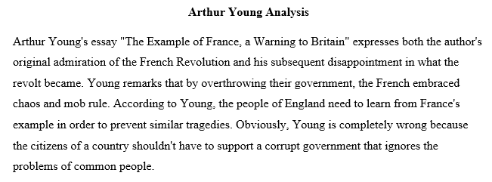
Formatting
HAWKES LEARNING

Slide 6
Uploading and Printing
Preparing to Submit
Grammar
Spelling
Style
Guidelines
HAWKES LEARNING

Slide 7




HAWKES LEARNING

