Slide 1
Section 8.8
Graphing Systems of Linear Inequalities

Slide 2
Objectives
Solve systems of linear inequalities graphically.

Slide 3
Solve Systems of Linear Inequalities
To Solve a System of Two Linear Inequalities
1. For each inequality, graph the boundary line and shade the appropriate half-plane. (Refer to Section 4.6 to review this process.)
2. Determine the region of the graph that is common to both half-planes (the region where the shading overlaps).
(This region is called the intersection of the two half-planes and is the solution set of the system.)

Slide 4
Solve Systems of Linear Inequalities
To Solve a System of Two Linear Inequalities (cont.)
3. To check, pick one test-point in the intersection and verify that it satisfies both inequalities.
Note: If there is no intersection, then the system has no solution.

Slide 5
Example 1: Graphing Systems of Linear Inequalities
a. Graph the points that satisfy the system of
inequalities:
Solution
Step 1: For x ≤ 2, the points are to the left of and on the line x = 2.
Step 2: For y ≥ –x + 1, the points are above and on the line y = −x + 1.

Slide 6
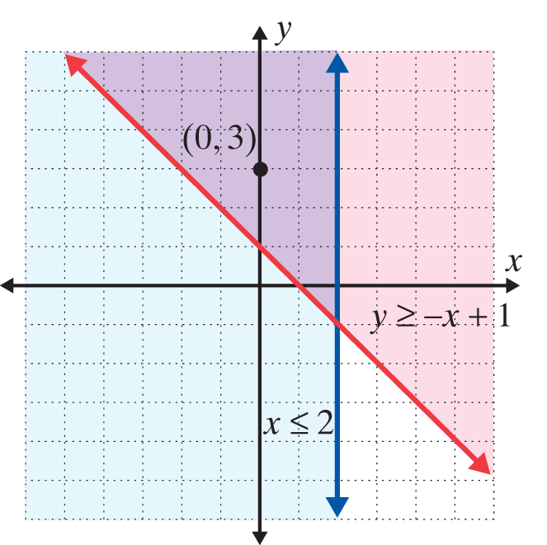
Example 1: Graphing Systems of Linear Inequalities (cont.)
Step 3: Determine the region that is common to both half-planes. In this case, we test the point (0, 3). On the graph below, the solution is the purple-shaded region and its boundary lines.
0 ≤ 2 A true statement
3 ≥ −0 + 1 A true statement

Slide 7
Example 1: Graphing Systems of Linear Inequalities (cont.)
b. Solve the system of linear inequalities graphically:
Solution
Step 1: Solve each inequality for y:
Step 2: For y ≤ −2x + 6, the points are below and on the line y = −2x + 6.

Slide 8
Example 1: Graphing Systems of Linear Inequalities (cont.)
Step 3: For y < −x + 4, the points are below but not on the line y = −x + 4.
Step 4: Determine the region that is common to both half-planes. Note that the line y = −x + 4 is dashed to indicate that the points on the line are not included. In this case, we test the point (0, 0). On the graph, the solution is the purple-shaded region and its boundary lines.

Slide 9
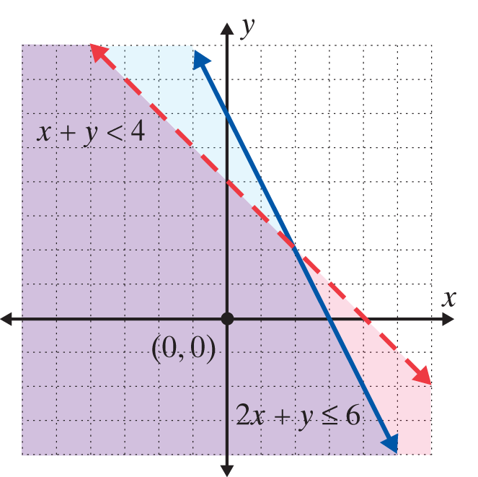
Example 1: Graphing Systems of Linear Inequalities (cont.)
2 ⋅ 0 + 0 ≤ 6 A true statement
0 + 0 < 4 A true statement

Slide 10
Example 1: Graphing Systems of Linear Inequalities (cont.)
c. Solve the system of linear inequalities graphically:
Solution
Step 1: For y ≥ x, the points are above and on the line y = x.
Step 2: For y ≤ x + 2, the points are below and on the line y = x + 2.

Slide 11
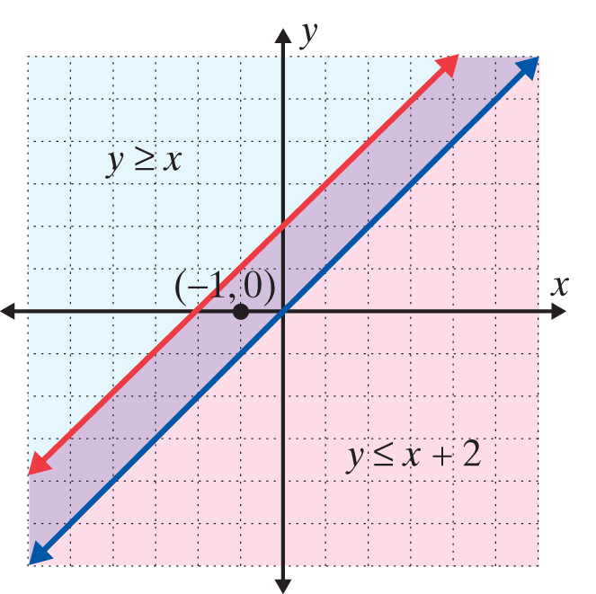
Example 1: Graphing Systems of Linear Inequalities (cont.)
Step 3: The solution set consists of the boundary lines and the region between them.

Slide 12
Solve Systems of Linear Inequalities
Notes
When the boundary lines are parallel there are three possibilities:
1. The common region will be in the form of a strip between two lines (as in Example 1c).
2. The common region will be a half-plane, as the solution to one inequality will be entirely contained within the solution of the other inequality.
3. There will be no common region which means there is no solution.

Slide 13
Example 2: Using a Graphing Calculator to Solve a System of Linear Inequalities
Use a TI-84 Plus graphing calculator to graph the following system of linear inequalities:
Solution
Step 1: Solve each inequality for y:
Note: Solving 2x − y ≤ 0 for y can be written as 2x ≤ y and then as y ≥ 2x.

Slide 14

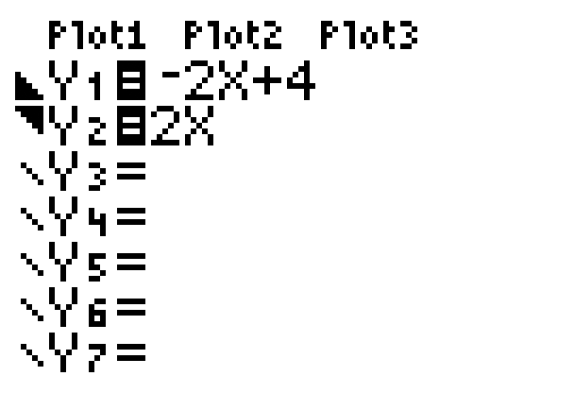

Example 2: Using a Graphing Calculator to Solve a System of Linear Inequalities (cont.)
Steps 2 and 3: Press the key and enter both functions and the corresponding symbols as they appear here:
(Remember: To shade your graphs, position the cursor over the slash next to Y₁ (or Y₂) and hit repeatedly
until the appropriate shading is displayed.)

Slide 15

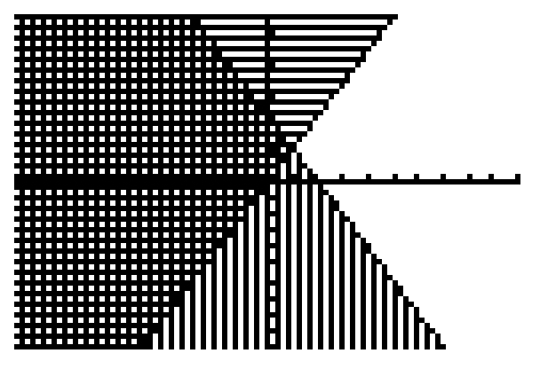
Example 2: Using a Graphing Calculator to Solve a System of Linear Inequalities (cont.)
Step 4: Press . The display should appear as follows. The solution is the cross-hatched region and the points on the line 2x − y = 0.

Slide 16
Practice Problems
Solve the systems of two linear inequalities graphically.

Slide 17
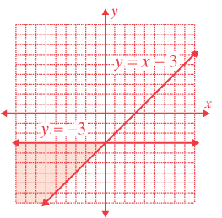
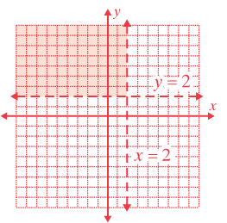
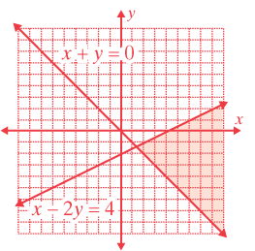
Practice Problem Answers
1. 2.
3.

