Slide 1
Section 8.7
Matrices and Gaussian Elimination

Slide 2
Objectives
Write a system of equations as a coefficient matrix and an augmented matrix.
Transform a matrix into triangular form by using elementary row operations.
Solve systems of linear equations by using the Gaussian elimination method.

Slide 3
Elementary Row Operations
Elementary Row Operations
1. Interchange two rows.
2. Multiply a row by a nonzero constant.
3. Add a multiple of a row to another row.
If any elementary row operation is applied to a matrix, the new matrix is said to be row-equivalent to the original matrix.

Slide 4
Example 1: Coefficient and Augmented Matrices
write the corresponding coefficient matrix and the corresponding augmented matrix.
Solution

Slide 5
Example 1: Coefficient and Augmented Matrices (cont.)
b. In the augmented matrix in Example 1a, interchange
rows 1 and 2 and multiply row 3 by
Solution

Slide 6
Example 1: Coefficient and Augmented Matrices (cont.)
Solution

Slide 7
Example 1: Coefficient and Augmented Matrices (cont.)
d. In the augmented matrix in Example 1c, add −3 times row 1 to row 2. (Note that row 1 is unchanged in the resulting matrix. Only row 2 is changed.)
Solution

Slide 8
General Notation for a Matrix and a System of Equations
Notes
We will see in dealing with polynomials later that a₁₁ can be read simply as “a sub eleven.” However, with matrices, we need to indicate the row and column corresponding to the entry. If there are more than nine rows or columns, then commas are used to separate the numbers as a_{10,10}. You will see the commas in use on your calculator.

Slide 9
Gaussian Elimination
Strategy for Gaussian Elimination
1. Write the augmented matrix for the system.
2. Use elementary row operations to transform the matrix into row echelon form.
3. Solve the corresponding system of equations by using back substitution.

Slide 10
Example 2: Gaussian Elimination
Solve the following system of linear equations by using the Gaussian elimination method with back substitution.
Solution
Step 1: Write the augmented matrix.
(The following steps show how to use elementary row operations to get the matrix in row echelon form with 0 in the lower left corner.)

Slide 11
Example 2: Gaussian Elimination (cont.)
Step 2: Multiply row 1 by so that the entry in the
upper left corner will be 1. This will help to get 0 below the 1 in the next step.
Step 3: To get 0 in the lower left corner, add −5 times row 1 to row 2.

Slide 12
Example 2: Gaussian Elimination (cont.)
Step 4: Now multiply row 2 by

Slide 13
Example 2: Gaussian Elimination (cont.)
Step 5: The last matrix (in triangular form) in Step 4 represents the following system of linear equations.
The last equation gives y = −2.

Slide 14
Example 2: Gaussian Elimination (cont.)
Back substitute to find the value for x.
Thus the solution is (1, −2).

Slide 15
Example 3: Gaussian Elimination
Solve the following system of linear equations by using the Gaussian elimination method with back substitution.

Slide 16
Example 3: Gaussian Elimination (cont.)
Solution
Step 1: Write the augmented matrix.

Slide 17
Example 3: Gaussian Elimination (cont.)
Step 2: Exchange row 1 and row 3 so that the entry in the upper left corner will be 1.

Slide 18
Example 3: Gaussian Elimination (cont.)
Step 3: To get a 0 under the 1 in Column 1, add row 1 to row 2.

Slide 19
Example 3: Gaussian Elimination (cont.)
Step 4: To get a₃₁ to be 0, add −2 times row 1 to row 3.

Slide 20
Example 3: Gaussian Elimination (cont.)
Step 5: Add row 2 to row 3 to arrive at triangular form.

Slide 21
Example 3: Gaussian Elimination (cont.)
Step 6: Then multiply row 3 by

Slide 22
Example 3: Gaussian Elimination (cont.)
Step 7: The triangular matrix in Step 6 represents the following system of linear equations.
From the last equation, we have z = 6.

Slide 23
Example 3: Gaussian Elimination (cont.)
Back substitution into the equation y + 3z = 20 gives:
Back substitution into the equation x − y + 2z = 14 gives:
Thus the solution is (4, 2, 6).

Slide 24
Example 4: Using a Graphic Calculator to Solve Systems of Equations
Use a TI-84 Plus calculator to solve the following system of linear equations.

Slide 25


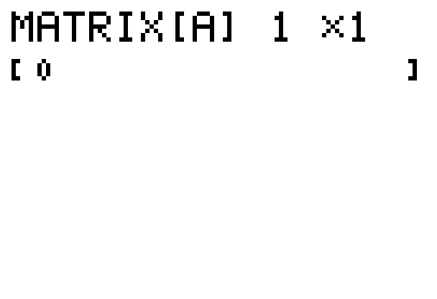
Example 4: Using Graphic Calculator to Solve Systems of Equations (cont.)
Solution:
Step 1: Press > MATRIX and move to the EDIT menu.
Press . The following display will appear.

Slide 26


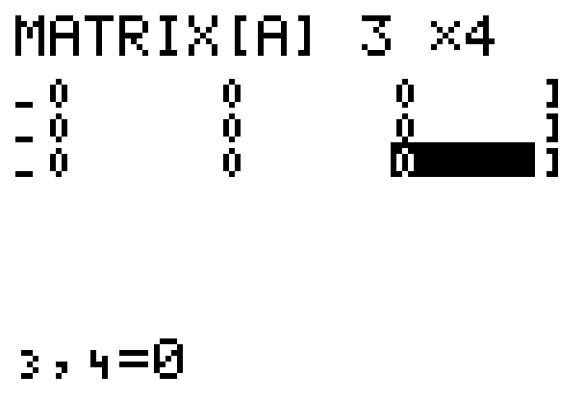
Example 4: Using Graphic Calculator to Solve Systems of Equations (cont.)
Step 2: The augmented matrix is a 3 × 4 matrix. So, in the top line enter , press , enter
, press and the display will appear as shown.
Note: If other numbers are
already present on the
display, just type over them.
The calculator will adjust
automatically.

Slide 27
Example 4: Using Graphic Calculator to Solve Systems of Equations (cont.)
Step 3: Move the cursor to the upper left entry position and enter the coefficients and constants in the matrix. As you enter each number press and the cursor will automatically move to the next position in the matrix. Note that the double subscripts appear at the bottom of the display as each number is entered. The final display for matrix [A] should appear as shown.

Slide 28
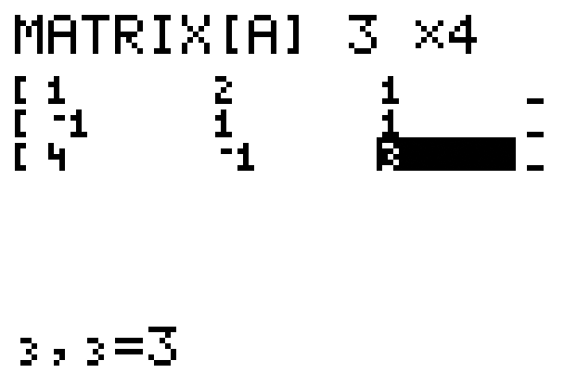
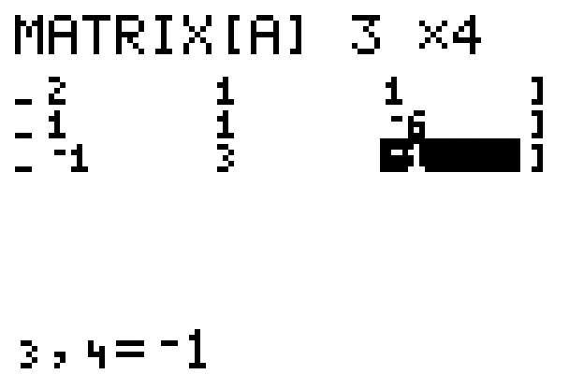
Example 4: Using Graphic Calculator to Solve Systems of Equations (cont.)
Note: The display only shows three columns at a time.

Slide 29
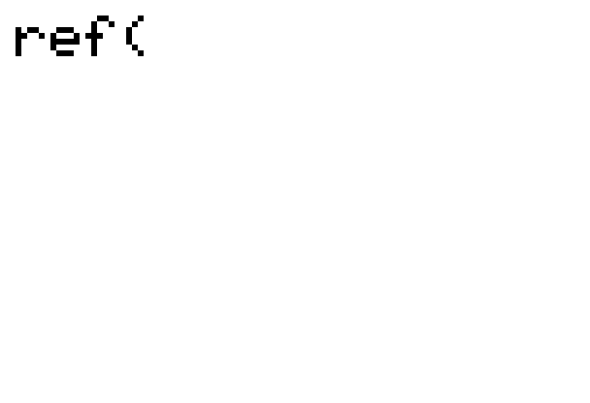
Example 4: Using Graphic Calculator to Solve Systems of Equations (cont.)
Step 4: Press > QUIT, press > MATRIX again, go to MATH; move the cursor down to A:ref(; press . The display will appear as shown.

Slide 30

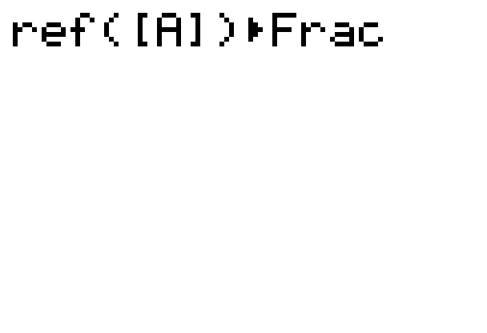
Example 4: Using Graphic Calculator to Solve Systems of Equations (cont.)
Step 5: Press > MATRIX again; press (this selects the matrix A); enter a right parenthesis); press the key; and choose 1:>Frac by pressing . The display will appear as shown.
Note: You must select the matrix from the matrix menu. The calculator will not recognize the matrix if you manually type in [A].

Slide 31
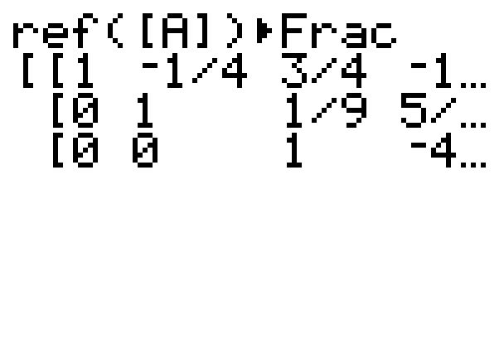
Example 4: Using Graphic Calculator to Solve Systems of Equations (cont.)
Step 6: Press and the row echelon form of matrix will appear as follows.
Note: To see the rest of the matrix move the cursor on the screen to the right.
With back substitution we get the following solution (3, 1, −4).

Slide 32
Practice Problem
Solve the following system of linear equations by using the Gaussian elimination method with back substitution.

Slide 33
Practice Problem Answer

