Slide 1
Section 8.4
Applications: Distance-Rate-Time, Number Problems, Amounts and Costs

Slide 2
Objectives
Use systems of linear equations to solve the following types of applied problems:
  distance-rate-time,
  numbers, and
  amounts and costs.

Slide 3

Example 1: Distance-Rate-Time (Rates Unknown)
A small plane flew 300 miles in 2 hours flying with the wind. Then on the return trip, flying against the wind, it traveled only 200 miles in 2 hours. What were the wind speed and the speed of the plane? (Note: The “speed of the plane” means how fast the plane would be flying with no wind.)
Solution
Let s = speed of plane
and w = wind speed

Slide 4
Example 1: Distance-Rate-Time (Rates Unknown) (cont.)
When flying with the wind, the plane’s actual rate will
increase to s + w. When flying against the wind, the
plane’s actual rate will decrease to s − w. (Note: If the
wind had been strong enough, the plane could actually
have been flying backward, away from its destination.)
Rate × Time = Distance
With the wind | s + w | 2 | 2(s + w)
Against the wind | s – w | 2 | 2(s – w)

Slide 5
Example 1: Distance-Rate-Time (Rates Unknown) (cont.)
The system of linear equations is
with the wind
against the wind
Speed of plane

Slide 6
Example 1: Distance-Rate-Time (Rates Unknown) (cont.)
Back substitute s = 125 into one of the original equations.
2(125 + w) = 300
125 + w = 150
w = 25
The speed of the plane was 125 mph, and the wind speed was 25 mph.
Wind speed

Slide 7
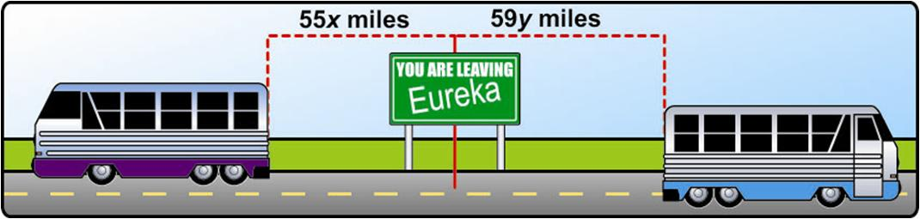
Example 2: Distance-Rate-Time (Times Unknown)
Two buses leave a bus station traveling in opposite
directions. One leaves at noon and the second leaves at
1 PM. The first one travels at an average speed of 55 mph and the second one at an average speed of
59 mph. At what time will the buses be 226 miles apart?

Slide 8
Example 2: Distance-Rate-Time (Times Unknown) (cont.)
Solution Let x = time of travel for first bus
and y = time of travel for second bus
The system of linear equations is
Rate × Time = Distance
Bus 1 | 55 | x | 55x
Bus 2 | 59 | y | 59y
The first bus travels 1 hour longer than the second.
The sum of the distances is 226 miles.

Slide 9
Example 2: Distance-Rate-Time (Times Unknown) (cont.)
Substitution gives
This gives x = 1.5 + 1 = 2.5.
Thus the first bus travels 2.5 hours and the second bus travels 1.5 hours. The buses will be 226 miles apart at 2:30 P.M.

Slide 10
Example 3: Number Problem
The sum of two numbers is 80 and their difference is 10. What are the two numbers?
Solution Let x = one number
and y = the other number.
The system of linear equations is
The sum is 80.
The difference is 10.

Slide 11
Example 3: Number Problem (cont.)
Solving by addition gives
Back substituting 45 for x in the first equation gives:
The two numbers are 45 and 35.
Check 45 + 35 = 80 and 45 – 35 = 10

Slide 12
Example 4: Counting Coins
Mike has $1.05 worth of change in nickels and
quarters. If he has twice as many nickels as quarters,
how many of each type of coin does he have?
Solution
We use two equations – one relating the number of coins and the other relating the value of the coins. (The value of each nickel is 5 cents and the value of each quarter is 25 cents.)

Slide 13
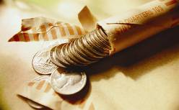
Example 4: Counting Coins (cont.)
Let n = number of nickels
and q = number of quarters.
Coins | # of coins | Value | Total value
Nickels | n | 0.05 | 0.05n
Quarters | q | 0.25 | 0.25q

Slide 14
Example 4: Counting Coins (cont.)
The system of linear equations is
Note carefully that in the first equation q is multiplied by 2 because the number of nickels is twice the number of quarters. Therefore, n is bigger.
There are two times as many nickels as quarters.
The total amount of money is $1.05.

Slide 15

Example 4: Counting Coins (cont.)
The first equation is already solved for n, so substituting 2q for n in the second equation gives
Mike has 3 quarters and 6 nickels.
Multiply the equation by 100.
Number of quarters
Number of nickels

Slide 16
Example 5: Calculating Age
Kathy is 6 years older than her sister, Sue. In 3 years,
she will be twice as old as Sue. How old is each girl
now?
Solution
We use two equations – one relating their ages now and the other relating their ages in 3 years.
Let K = Kathy’s age now
and S = Sue’s age now.

Slide 17
Example 5: Calculating Age (cont.)
Then the system of linear equations is
Rewrite the second equation in standard form and solve by addition.
The difference in their ages is 6 years.
In 3 years each age is increased by 3 and Kathy is twice as old as Sue.
Second equation in standard form

Slide 18
Example 5: Calculating Age (cont.)
Back substitute S = 3 into one of the original equations.
Kathy is 9 years old; Sue is 3 years old.
Sue’s current age
Kathy’s current age

Slide 19
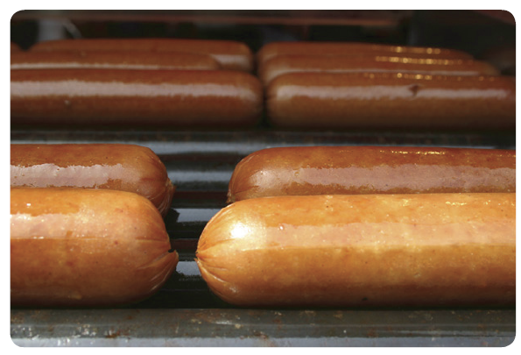
Example 6: Amounts and Costs
Three hot dogs and two orders of French fries cost $10.30. Four hot dogs and four orders of fries cost $15.60. What is the cost of a hot dog? What is the cost of an order of fries?
Solution
Let x = cost of one hot dog
and y = cost of one order of fries.

Slide 20
Example 6: Amounts and Costs (cont.)
Then the system of linear equations is
Both equations are in standard form. Solve using the addition method.
Three hot dogs and two orders of French fries cost $10.30.
Four hot dogs and four orders of fries cost $15.60.
Cost of one hot dog

Slide 21
Example 6: Amounts and Costs (cont.)
Back substitute x = 2.50 into one of the original equations.
One hot dog costs $2.50 and one order of fries costs $1.40.
Cost of one order of fries

Slide 22
Solving Systems of Equations as They Relate to Applied Problems
Notes
You should consider making tables similar to those illustrated in Examples 1, 2, and 4 when working with applications. These tables can help you organize the information in a more understandable form.

