Slide 1
Section 2.7
Applications with Percent

Slide 2
Objectives
Find percents of numbers.
Find fractional parts of numbers.
Solve word problems involving decimals, fractions, and percents.

Slide 3
The Basic Percent Equation
The Basic Formula R · B = A
R = RATE or percent (as a decimal or fraction)
B = BASE (number we are finding the percent of)
A = AMOUNT (a part of the base)
“of ” means to multiply.
“is ” means equal (=).
The relationship among R, B, and A is given in the equation

Slide 4
Example 1: Percent of a Number
a. What is 72% of 800?
Solution
R = 0.72 and B = 800 and A is unknown.
So 576 is 72% of 800.

Slide 5
Example 1: Percent of a Number (cont.)
b. 57% of what number is 163.191?
Solution
R = 0.57 and B is unknown and A is 163.191.
So 57% of 286.3 is 163.191.

Slide 6
Example 1: Percent of a Number (cont.)
c. What percent of 180 is 45?
Solution
R is unknown and B is 180 and A is 45.
So 25% of 180 is 45.

Slide 7
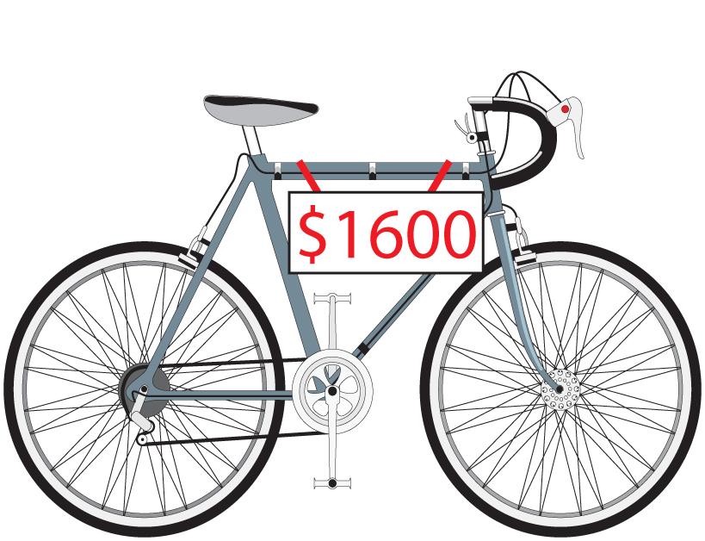
Example 2: Discounts
A bicycle was purchased at a discount of 25% of its original price of $1600. What was the sale price?
Solution
There are two ways to approach this problem. One way is to find the discount and then subtract this amount from $1600. Another way is to subtract 25% from 100% to get 75% and then find 75% of $1600.

Slide 8
Example 2: Discounts (cont.)
Here, we will calculate the discount and then subtract from the original price.
Original Price − Discount = $1600 − $400 = $1200
The sale price for the bicycle was $1200.
Sale price

Slide 9
Example 3: Sales Tax
Suppose 6% sales tax was added to the sale price $1200 of the bicycle in Example 2. What was the total paid for the bicycle?
Solution
The sales tax must be calculated on the sale price and then added to the sale price.

Slide 10
Example 3: Sales Tax (cont.)
Total Paid = Sale Price + Sales Tax
= $1200 + $72
= $1272
The total paid for the bicycle, including sales tax, was $1272.

Slide 11
Example 4: Commission
A saleswoman earns a salary of $1200 a month plus a commission of 8% on whatever she sells after she has sold $8000 in furniture. What did she earn the month she sold $25,000 worth of furniture?
Solution
First subtract $8000 from $25,000 to find the amount on which the commission is based.
$25,000 − $8000 = $17,000

Slide 12
Example 4: Commission (cont.)
Now find the amount of the commission.
Now add the commission to her salary to find what she earned that month.
$1200 + $1360 = $2560 earned for the month

Slide 13
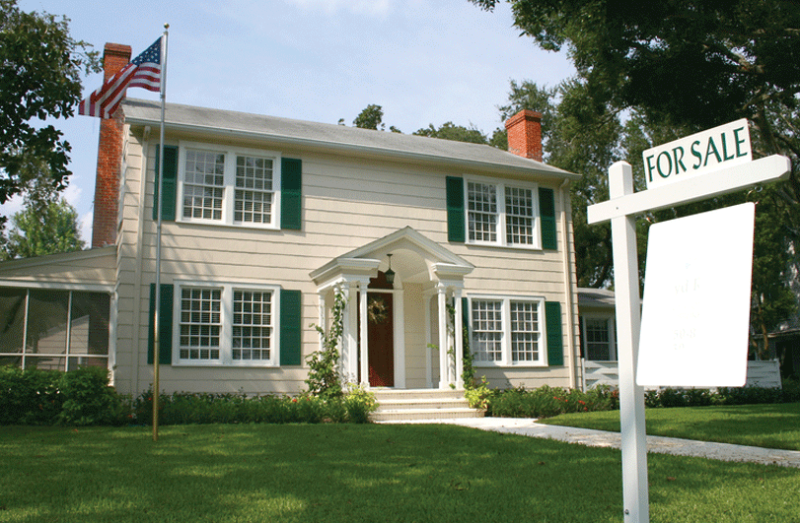
Example 5: Commission
The Berrys sold their house. After paying the real estate agent a commission of 6% of the selling price and then paying $1486 in other costs and $90,000 on the mortgage, they received $49,514. What was the selling price of the house?
Solution
Use the relationship:
selling price − cost = profit (S − C = P).

Slide 14
Example 5: Commission (cont.)
Let S = selling price
cost = 0.06S + 1486 + 90,000

Slide 15
Example 5: Commission (cont.)
Check:
The selling price was $150,000.

Slide 16
Example 6: Percent of Profit
Calculate the percent of profit for both a. and b. and tell which is the better investment.
a. $300 profit on an investment of $2400
b. $500 profit on an investment of $5000
Solution
Set up ratios and find the corresponding percents.

Slide 17
Example 6: Percent of Profit (cont.)
Clearly, $500 is more than $300, but 12.5% is greater than 10% and investment a. is the better investment.

Slide 18
Practice Problems
1. Write 0.3 as a percent.
2. Write 6.4% as a decimal.
3. Write as a percent.
4. Find 12% of 200.
5. Find the percent of profit if $480 is made on an investment of $1500.

Slide 19
Practice Problem Answers
1. 30%
2. 0.064
3. 20%
4. 24
5. 32%

