Slide 1
Section 11.6
Common Logarithms and Natural Logarithms

Slide 2
Objectives
Understand that base 10 logarithms are called common logarithms.
Use a calculator to find the values of expressions with common logarithms.
Understand that base e logarithms are called natural logarithms.
Use a calculator to find the values of expressions with natural logarithms.
Use a calculator to find inverse logarithms (called antilogs) for common and for natural logarithms.

Slide 3
Example 1: Translations Between Exponential Form and Logarithmic Form Using Common Logarithms
Exponential Form Logarithmic Form
a. |  | ⇔ | log 10,000 = 4 | This is a common logarithm that equals 4.
b. |  | ⇔ | log 0.01 = −2 | This is a common logarithm that equals −2.
c. |  | ⇔ | log 6.3 = x | This is a common logarithm that equals x.

Slide 4



Common Logarithms (Base 10 Logarithms)
Using a Calculator to Evaluate Common Logarithms (Base 10)
To evaluate a common logarithm on a TI-84 Plus graphing calculator:
1. Press the key. log( will appear on the display.
2. Enter the number and a right-hand parenthesis,
.
3. Press .

Slide 5
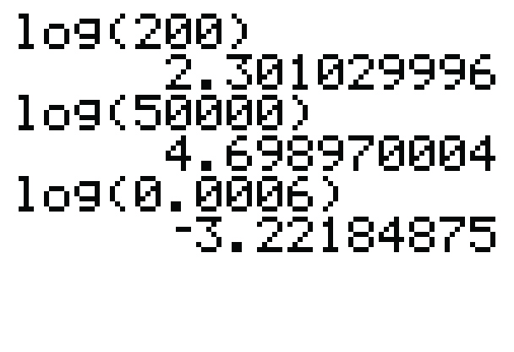
Example 2: Evaluating Common Logarithms Using a TI-84 Plus Graphing Calculator
Use a TI-84 Plus graphing calculator to find the values of the following common logarithms.
a. log 200 b. log 50,000 c. log 0.0006
Solutions From the display we see the results (accurate to 8 or 9 decimal places).

Slide 6

Using a TI-84 Plus Graphing Calculator to find the Inverse Log of N
Using a Calculator to Find the Inverse Log of N
To evaluate the inverse log of N on a TI-84 Plus graphing calculator:
1. Press and . The expression 10^( will appear on the display.
2. Enter the value of N and a right-hand parenthesis
.
3. Press .

Slide 7
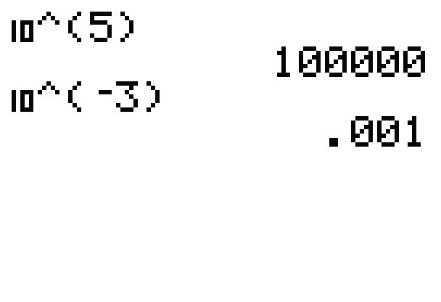
Example 3: Using a TI-84 Plus Graphing Calculator to find the Inverse Log of N
Use a TI-84 Plus graphing calculator to find the inverse log of N for each expression. (That is, find the value of x.)
a. log x = 5 b. log x = −3
c. log x = 2.4142 d. log x = 16.5
Solutions Thus the calculator gives,

Slide 8
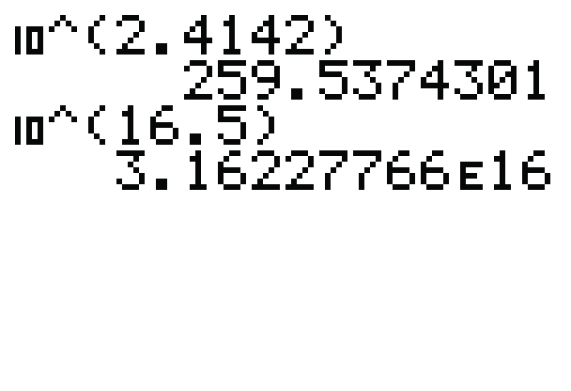
Example 3: Using a TI-84 Plus Graphing Calculator to find the Inverse Log of N (cont.)
The letter E in the solution is the calculator version of scientific notation. Thus

Slide 9
Example 4: Translations Between Exponential Form and Logarithmic Form Using Natural Logarithms
Exponential Form Logarithmic Form
a. |  | ⇔ | ln 3.21 = t | This is a natural logarithm that equals t.
b. |  | ⇔ | ln 1 = 0 | This is a natural logarithm that equals 0.
c. |  | ⇔ | ln n = 2 | This is a natural logarithm that equals 2.

Slide 10

Natural Logarithms (Base e Logarithms)
Using a Calculator to Evaluate Natural Logarithms (Base e)
To evaluate a natural logarithm on a TI-84 Plus graphing calculator:
1. Press the key. ln( will appear on the display.
2. Enter the number and a right-hand parenthesis,
.
3. Press .

Slide 11
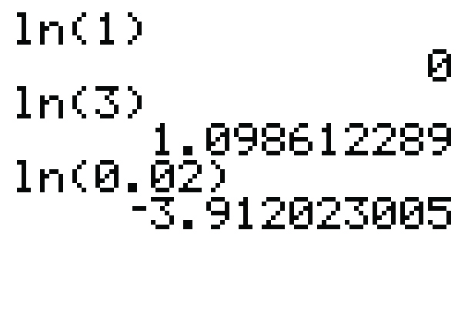
Example 5: Evaluating Natural Logarithms Using a TI-84 Plus Graphing Calculator
Use a TI-84 Plus graphing calculator to find the values of the following natural logarithms.
a. ln 1 b. ln 3 c. ln 0.02
Solutions From the display we see the results (accurate to 9 decimal places).
a. ln 1 = 0
b. ln 3 ≈ 1.098612289
c. ln 0.02 ≈ −3.912023005

Slide 12
Finding the Inverse of a Natural Logarithm (Base e)
Using a Calculator to Find the inverse of ln of N
To evaluate the inverse ln of N on a TI-84 Plus graphing calculator:
1. Press and . The expression e^( will appear on the display.
2. Enter the value of N and a right-hand parenthesis
.
3. Press .

Slide 13
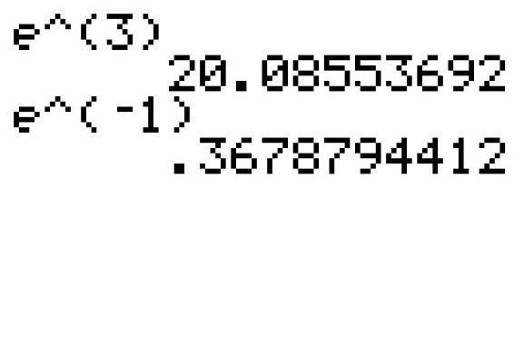
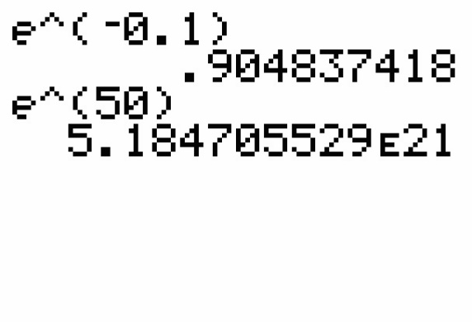
Example 6: Use a TI-84 Plus graphing calculator to find the inverse ln of N
Use a TI-84 Plus graphing calculator to find the inverse ln of N for each expression. (That is, find the value of x.)
a. ln x = 3 b. ln x = −1
c. ln x = −0.1 d. ln x = 50
Solutions Thus the calculator gives,

Slide 14
Practice Problems
Express each equation in logarithmic form.
Express each equation in exponential form.

Slide 15
Practice Problems (cont.)
Use a calculator to evaluate each logarithm (accurate to 4 decimal places).
Use a calculator to find the value of x in each equation (accurate to 4 decimal places).

Slide 16
Practice Problem Answers

