Slide 1
Section 7.8
Using a Graphing Calculator to Solve Equations

Slide 2
Properties: Zeros of Polynomial Functions
1. Nonconstant linear functions have 1 distinct zero. (The graph crosses the x-axis once.)
2. Quadratic functions have 2 distinct zeros, 1 distinct zero, or none. (The graph crosses the x-axis twice, just touches the x-axis, or doesn’t cross at all.)
3. Cubic functions have 3 distinct zeros, 2 distinct zeros, or 1 distinct zero. (The graph crosses the x-axis three times, crosses once and just touches once, or crosses just once.)

Slide 3
Note
When a polynomial is second-degree or higher, the same factor may occur multiple times. This means that the corresponding zero may appear more than once. That is, if a binomial factor is squared, then the corresponding zero is said to be of multiplicity 2. If the factor is cubed, then the corresponding zero is of multiplicity 3, and so on. For example, consider P(x) = x³ – 3x² − 24x + 80 = (x + 5)(x – 4)² . There are technically three zeros, −5, 4, and 4.

Slide 4
Note (cont.)
Since 4 appears twice, 4 is a zero of multiplicity 2 and the only distinct zeros are −5 and 4. As we will see, this has a major effect on the appearance and behavior of the corresponding graph of the function.

Slide 5
Example 1: Using One Graph to Solve a Polynomial Equation
Use a graphing calculator to solve the equation
Solution
Begin by manipulating the equation so that one side is 0. Press and enter the indicated function on the nonzero side for Y1. The zeros of this function are the roots of the original equation.

Slide 6
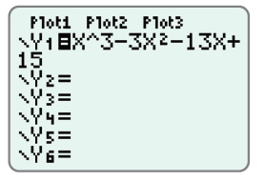
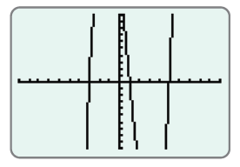
Example 1: Using One Graph to Solve a Polynomial Equation (cont.)
The display should appear as follows.
Press . With the standard window, the graph will appear as follows.

Slide 7
Example 1: Using One Graph to Solve a Polynomial Equation (cont.)
Note: You may want to increase the y-values on the window to see a more complete graph. This will not change the zeros.
Press to select CALC. On the CALCULATE menu, select zero. Follow the sequence of commands to find the following zeros (and therefore the solutions to the equation).

Slide 8
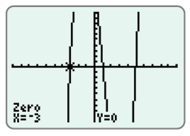
Example 1: Using One Graph to Solve a Polynomial Equation (cont.)
x = −3, x = 1, and x = 5
Note: See Section 4.5 for a more in-depth explanation of the zero function. With the command, you will find only approximations of the zeros.

Slide 9
Example 2: Using Two Graphs to Solve a Polynomial Equation
Use a graphing calculator to solve the equation
Solution
Begin by pressing and entering the functions indicated on each side of the equation for Y1 and Y2. Next, find the points of intersection of these two graphs using the intersect feature. The x-values of these points are the roots of the original equation.

Slide 10
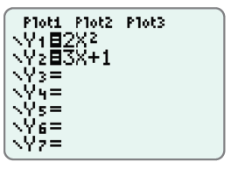

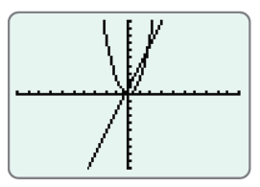
Example 2: Using Two Graphs to Solve a Polynomial Equation (cont.)
The display should appear as follows.
Press . With the standard window, the graph will appear as follows.

Slide 11
Example 2: Using Two Graphs to Solve a Polynomial Equation (cont.)
Press to select CALC. On the CALCULATE menu, select intersect and follow the sequence of commands. You will find the following approximate x-values of the points of intersection (and therefore the approximate solutions to the equation).

Slide 12
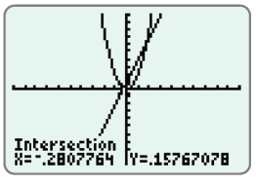
Example 2: Using Two Graphs to Solve a Polynomial Equation (cont.)
x ≈ −.28 and x ≈ 1.78
(accurate to the nearest hundredth)
Note: See Section 5.1 for an explanation of the intersect function.

Slide 13
Example 3: Using Two Graphs to Solve an Absolute Value Equation
Use a graphing calculator to solve the absolute value equation
Solution
Begin by pressing and entering the functions indicated on each side of the equation for Y1 and Y2. This includes the constant function on the right-hand side. Next, find the points of intersection of these two graphs. The x-values of these points are the roots of the original equation. The absolute value command can be found by pressing and navigating to the NUM menu.

Slide 14
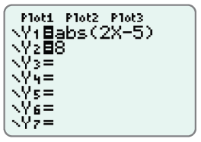
Example 3: Using Two Graphs to Solve an Absolute Value Equation (cont.)
On the NUM menu, choose abs (.
The display should appear as follows.

Slide 15
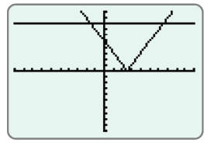
Example 3: Using Two Graphs to Solve an Absolute Value Equation (cont.)
With the standard window, the graphs will appear as follows.

Slide 16
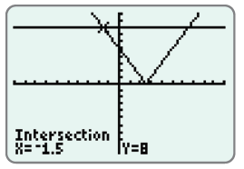

Example 3: Using Two Graphs to Solve an Absolute Value Equation (cont.)
Press to select CALC. On the CALCUATE menu, select intersect and follow the sequence of commands. You will find the following x-values at the points of intersection (and therefore the solutions to the equation).
Note: These values of x are exact. The command will not give these exact values.
x = −1.5 and x = 6.5

Slide 17
Example 4: Using a Graphing Calculator to Solve Absolute Value Inequalities
Use a graphing calculator to solve each absolute value inequality.
Both inequalities can be solved using the graphs found in Example 3.
Solution
Start by changing the window for a clearer view. Use the interval [−10, 10] for x and the interval [−1, 15] for y.

Slide 18
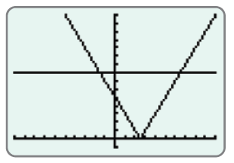
Example 4: Using a Graphing Calculator to Solve Absolute Value Inequalities (cont.)
Press and enter the appropriate values for Xmin, Xmax, Ymin, and Ymax. The graph will now appear more zoomed in, as shown here.

Slide 19
Example 4: Using a Graphing Calculator to Solve Absolute Value Inequalities (cont.)
a. From Example 3, we know that the intersections occur at x = −1.5 and x = 6.5. Looking at the graphs, we see that the graph of the absolute value is below the line y = 8 on the interval (−1.5, 6.5). Thus, the interval (−1.5, 6.5) is the solution set for
b. Looking at the graph, we see that the graph of the absolute value is above the line y = 8 on the intervals (−∞, −1.5) and (6.5, ∞). Thus, the interval (−∞, −1.5)∪(6.5, ∞) is the solution set for

