Slide 1
Section 5.10
Systems of Linear Inequalities

Slide 2
Procedure: Solving a System of Two Linear Inequalities
For each inequality, graph the boundary line and shade the appropriate half-plane.
Determine the region of the graph that is common to both half-planes (the region where the shading overlaps). (This region is called the intersection of the two half-planes and is the solution set of the system.

Slide 3
Procedure: Solving a System of Two Linear Inequalities (cont.)
To check the solution, pick one test-point in the intersection and verify that it satisfies both inequalities.
Note: If there is no intersection, then the system has no solution.

Slide 4
Example 1: Solving Systems of Linear Inequalities
Solve the system of linear inequalities graphically:
Solution
Step 1: For x ≤ 2, the points are to the left of and on the line x = 2. For y ≥ −x + 1, the points are above and on the line y = −x + 1.
Step 2: Determine the region that is common to both half-planes.

Slide 5
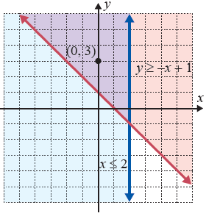
Example 1: Solving Systems of Linear Inequalities (cont.)
Step 3: In this case, we test the point (0, 3). In the following graph, the solution is the region where the shading overlaps, along with the boundary lines of that region.
A true statement
A true statement

Slide 6
Example 2: Solving Systems of Linear Inequalities
Solve the system of linear inequalities graphically:
Solution
First, solve each inequality for y:
Step 1: For y ≤ −2x + 6, the points are below and on the line y = −2x + 6. For y < −x + 4, the points are below but not on the line y = −x + 4.

Slide 7
Example 2: Solving Systems of Linear Inequalities (cont.)
Step 2: Determine the region that is common to both half-planes. Note that the line y = −x + 4 is dashed to indicate that the points on the line are not included.
Step 3: In this case, we test the point (0, 0). In the following graph, the solution is the region where the shading overlaps and the portion of the solid boundary line, where

Slide 8
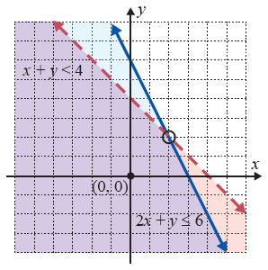
Example 2: Solving Systems of Linear Inequalities (cont.)
A true statement
A true statement

Slide 9
Example 3: Solving Systems of Linear Inequalities
Solve the system of linear inequalities graphically:
Solution
Step 1: For y ≥ x, the points are above and on the line y = x. For y ≤ x + 2, the points are below and on the line y = x + 2.
Step 2: Determine the region that is common to both half-planes.

Slide 10
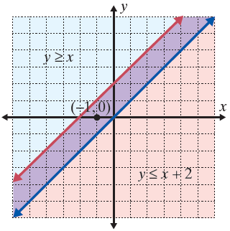
Example 3: Solving Systems of Linear Inequalities (cont.)
Step 3: We test point (−1, 0).
The solution set consists
of the boundary lines
and the region between
them.

Slide 11
Properties: Possible Solutions to Parallel Systems of
Linear Inequalities
When the boundary lines are parallel, there are three possibilities:
The common region will be in the form of a strip between two lines (as in Example 3).
The common region will be a half-plane, as the solution to one inequality will be entirely contained within the solution of the other inequality.
There will be no common region, which means there is no solution.

Slide 12
Example 4: Graphing Systems of Linear Inequalities
Use a graphing calculator to graph the system of linear
inequalities:
Solution
Step 1: First, solve each inequality for y:
Note: Solving 2x − y ≤ 0 for y can be written as 2x ≤ y and then as y ≥ 2x .

Slide 13
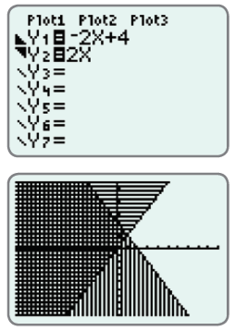
Example 4: Graphing Systems of Linear Inequalities (cont.)
Step 2: Press the key and enter
both functions and the
corresponding symbols
as they appear here.
Remember, to shade your
graphs, position the cursor
over the slash next to Y1
(or Y2) and press
repeatedly until the
desired graphing symbol is
displayed.

Slide 14
Example 4: Graphing Systems of Linear Inequalities (cont.)
Step 3: Press . The graph should appear as shown. The solution is the cross-hatched region and the points on the line 2x − y = 0, where x < 1.

