Slide 1
Section 4.4
Point-Slope Form

Slide 2
Example 1: Graphing a Line Given a Point and the Slope
Graph the line with slope and which passes
through the point (2, 5).
Solution
Start from the point (2, 5) and locate another point on
the line using the slope as There are
many ways to proceed.
Here are two possible ways:
1. Move 4 units right and 3 units down, or
2. Move 3 units down and 4 units right.

Slide 3
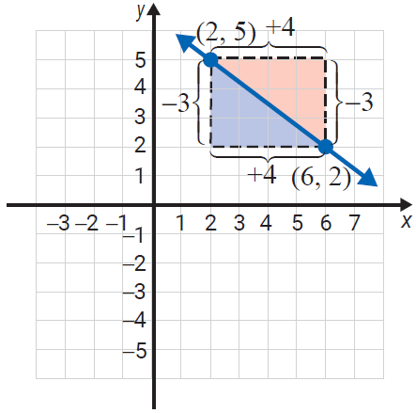
Example 1: Graphing a Line Given a Point and the Slope (cont.)
Either way, you arrive at the
same point (6,2).
This means that we can move
from the given point either
with the rise first or the run
first.

Slide 4
Definition: Point-Slope Form
An equation of the form
is called the point-slope form for the equation of a line
that contains the point and has slope m.

Slide 5
Example 2: Finding Equations of Lines Using the Slope and a Point
Find the equation of the line with a slope of and
which passes through the point (2, 3). Graph the line
using the point and slope.
Solution
Substitute the values into the point-slope form.

Slide 6
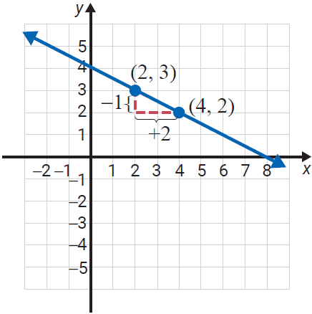
Example 2: Finding Equations of Lines Using the Slope and a Point (cont.)

Slide 7
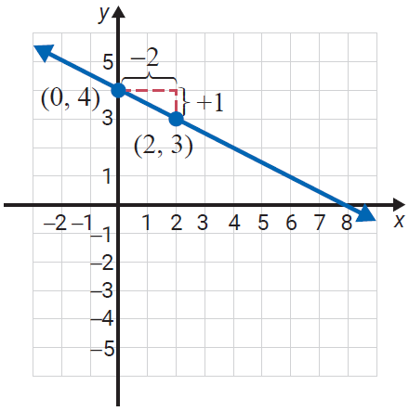
Example 2: Finding Equations of Lines Using the Slope and a Point (cont.)
With a negative slope, either the rise is negative and the run is positive, or the rise is positive and the run is negative. In either case, as the previous figure and the following figure illustrate, the line is the same.

Slide 8
Procedure: Finding the Equation of a Line Given Two Points
To find the equation of a line given two points on the
line:
1. Use the formula (where x₂ ≠ x₁) to find
the slope.
2. Use this slope, m, and either point in the
point-slope formula to find the
equation.

Slide 9
Example 3: Finding Equations Given Two Points
Find the equation of the line containing the two points
Solution
First, find the slope.
Now, use one of the given points and the point-slope
form for the equation of a line. (Note: (−1, 2) and
(4, −2) are shown to illustrate that either point may be used.)

Slide 10
Example 3: Finding Equations Given Two Points (cont.)

Slide 11
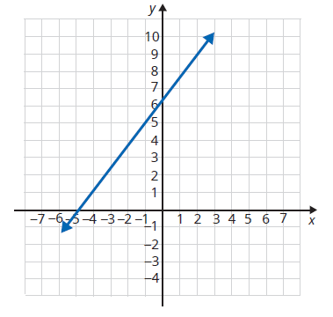
Example 4: Finding Equations of Lines Using a Graph
Write an equation in standard form for the following line.
Solution
First, we must identify two points
on the line. From the graph, we
can see that (2, 9) and (–1,5) are
points on the line. Next, we find
the slope of the line as follows.

Slide 12
Example 4: Finding Equations of Lines Using a Graph (cont.)
Now, we substitute the values into point‑slope form and then rewrite the equation in standard form.

Slide 13
Definition: Parallel and Perpendicular Lines
Parallel lines are lines that never intersect and that have the same slope.
Perpendicular lines are lines that intersect at 90° (right) angles and have slopes that are negative reciprocals of each other. Horizontal lines are perpendicular to vertical lines.

Slide 14
Note
All vertical lines (undefined slopes) are parallel to one another. All horizontal lines (zero slopes) are also parallel to one another. Vertical and horizontal lines are perpendicular to each other.

Slide 15
Example 5: Finding Equations of Parallel Lines
Find the equation of the line through the point (3, 2)
and parallel to the line 5x + 3y = 1. Graph both lines.
Solution
First, solve for y to find the slope of the given line.

Slide 16
Example 5: Finding Equations of Parallel Lines (cont.)
Now, use the point-slope form with
and

Slide 17
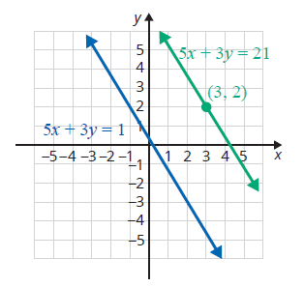
Example 5: Finding Equations of Parallel Lines (cont.)

Slide 18
Example 6: Finding Equations of Perpendicular Lines
Find the equation of the line through the point (3, 2)
and perpendicular to the line 5x + 3y = 1. Graph both
lines.
Solution
We know from Example 5 that the slope of the line
5x + 3y = 1 is Thus, any line perpendicular to this
line must have slope (the negative reciprocal of

Slide 19
Example 6: Finding Equations of Perpendicular Lines (cont.)
Now, using the point-slope form with
and we have the following.

Slide 20
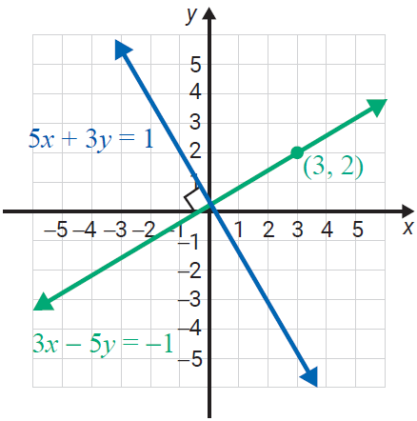
Example 6: Finding Equations of Perpendicular Lines (cont.)

Slide 21
Properties: Summary of Formulas and Properties of Lines
Ax + By = C standard form
slope of a line
y = mx + b slope-intercept form
point-slope form
y = b horizontal line, slope 0

Slide 22
Properties: Summary of Formulas and Properties of Lines (cont.)
x = a vertical line, undefined slope
parallel lines have the same slope
perpendicular lines have slopes that are negative
reciprocals of each other

