Slide 1
Section 3.4
Solving Linear Inequalities in One Variable

Slide 2
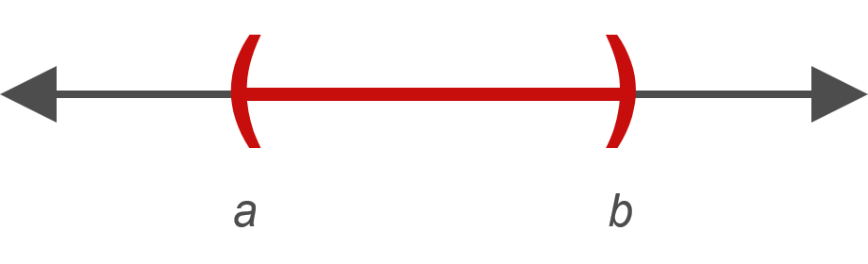
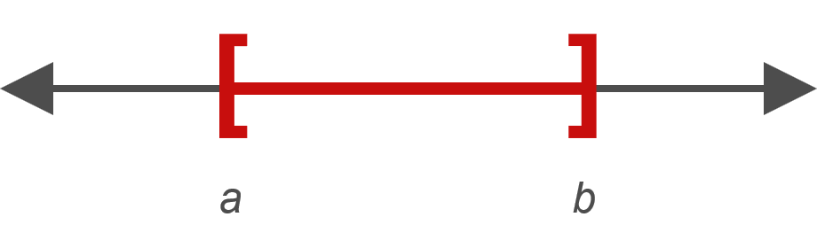
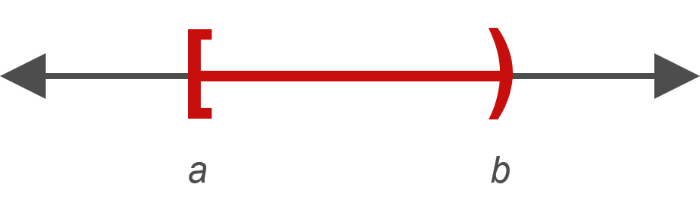
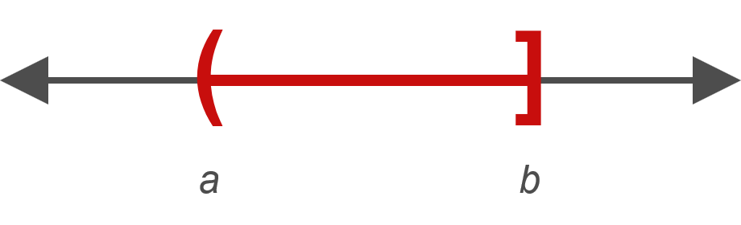
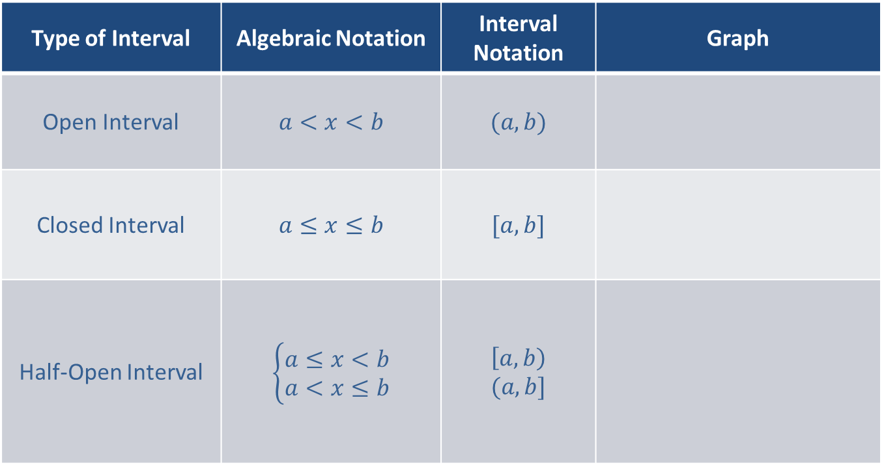
Types of Intervals
Type of Interval | Algebraic Notation | Interval Notation | Graph
Open Interval | $$a<x<b$$ | $$(a, b)$$
Closed Interval | $$a≤x≤b$$ | $$[a, b]$$
Half-Open Interval | $$\left\{\begin{aligned}a≤x<b \\ a<x≤b\end{aligned}\right.$$ | $$\left[a, b\right) \\ (a, b]$$

Slide 3
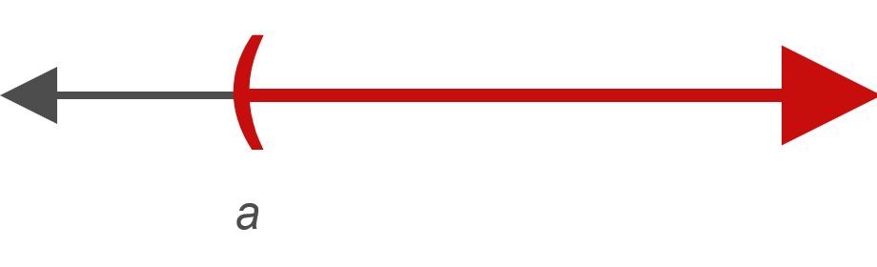
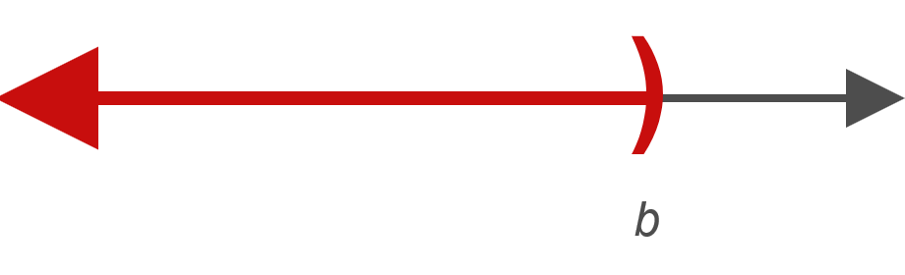
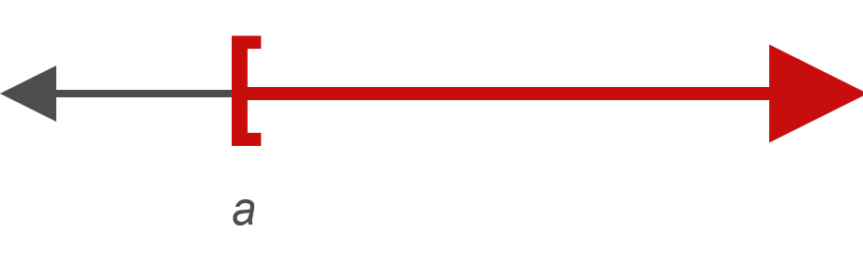
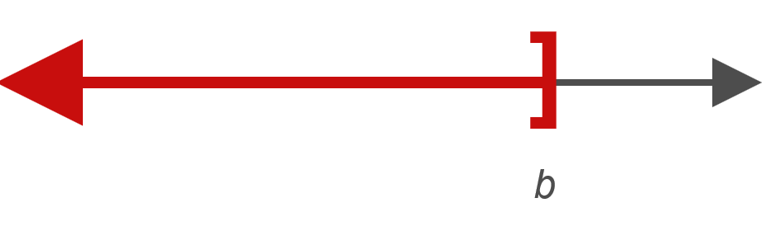
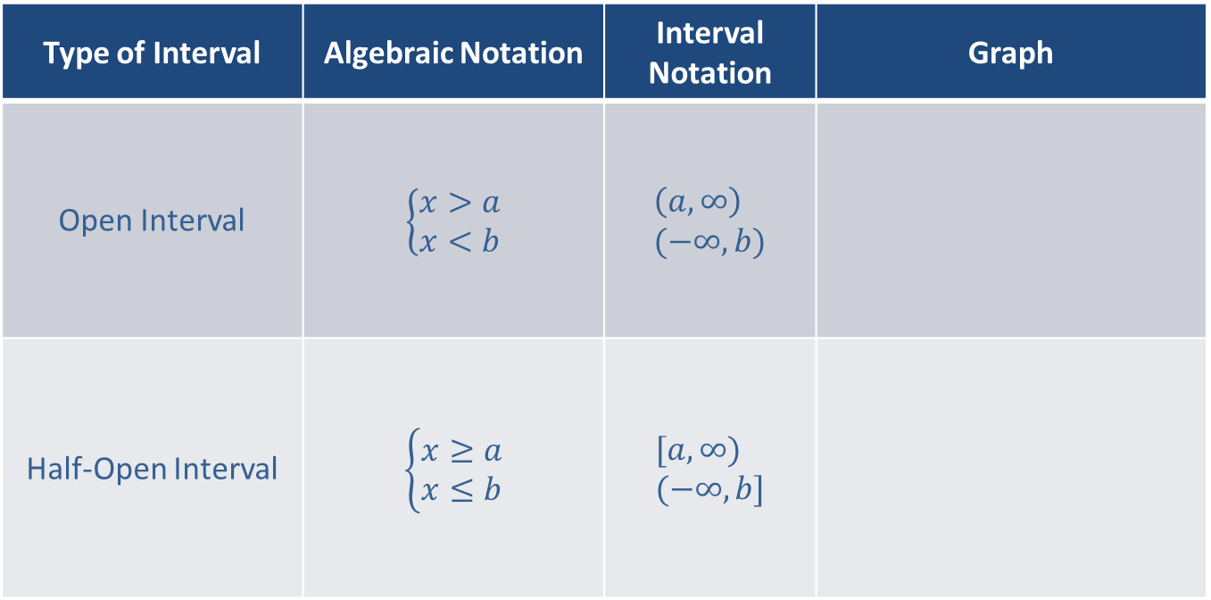
Types of Intervals (cont.)
Type of Interval | Algebraic Notation | Interval Notation | Graph
Open Interval | $$\left\{\begin{aligned}x>a \\ x<b\end{aligned}\right.$$ | $$\left(a,∞\right) \\ (−∞,b)$$
Half-Open Interval | $$\left\{\begin{aligned}x≥a \\ x≤b\end{aligned}\right.$$ | $$[a,∞) \\ (−∞,b]$$

Slide 4


Example 1: Graphing Intervals
Graph the open interval $(3,∞)$.
Solution

Slide 5
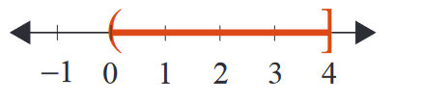

Example 2: Graphing Intervals
Graph the half-open interval $0<x≤4$.
Solution

Slide 6
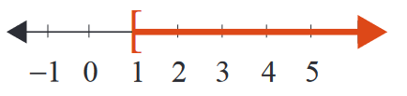
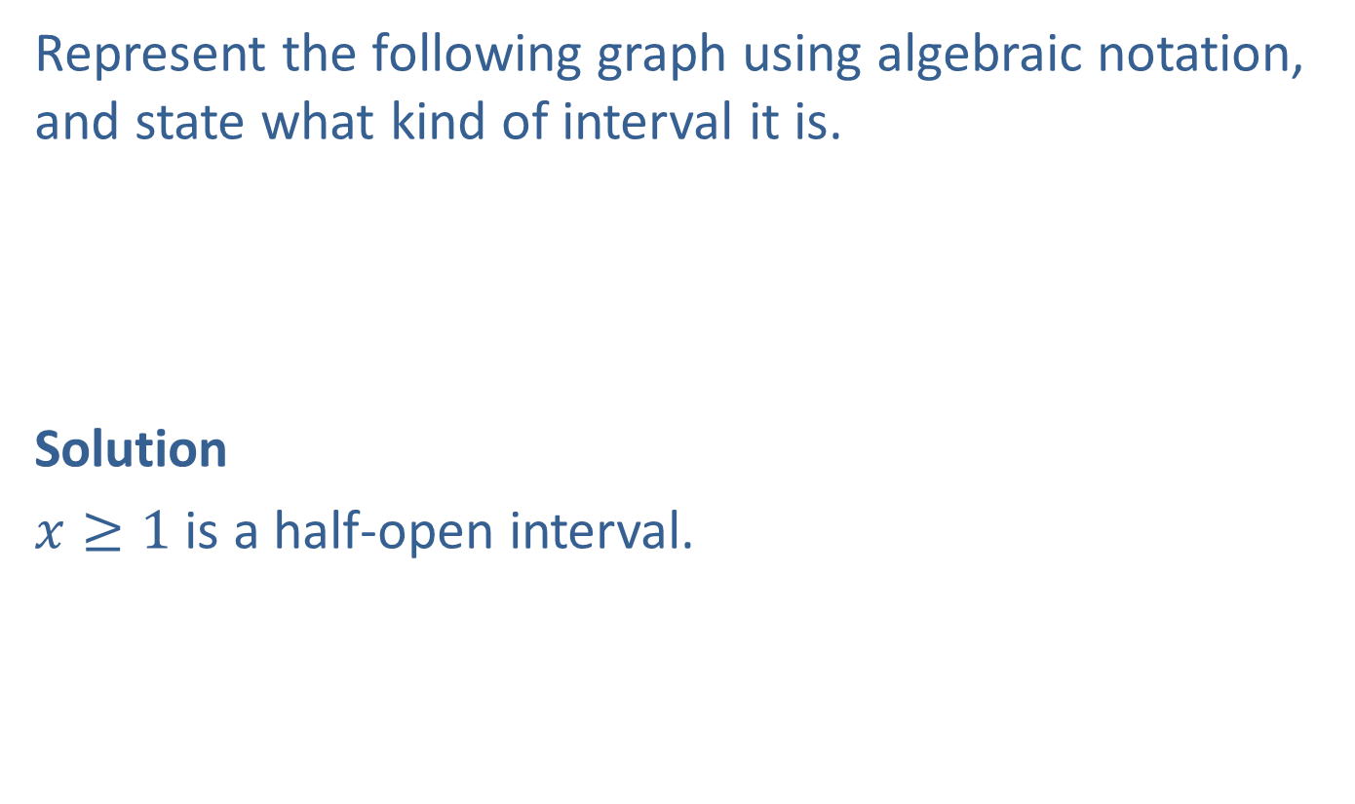
Example 3: Graphing Intervals
Represent the following graph using algebraic notation, and state what kind of interval it is.
Solution
$x≥1$ is a half-open interval.

Slide 7

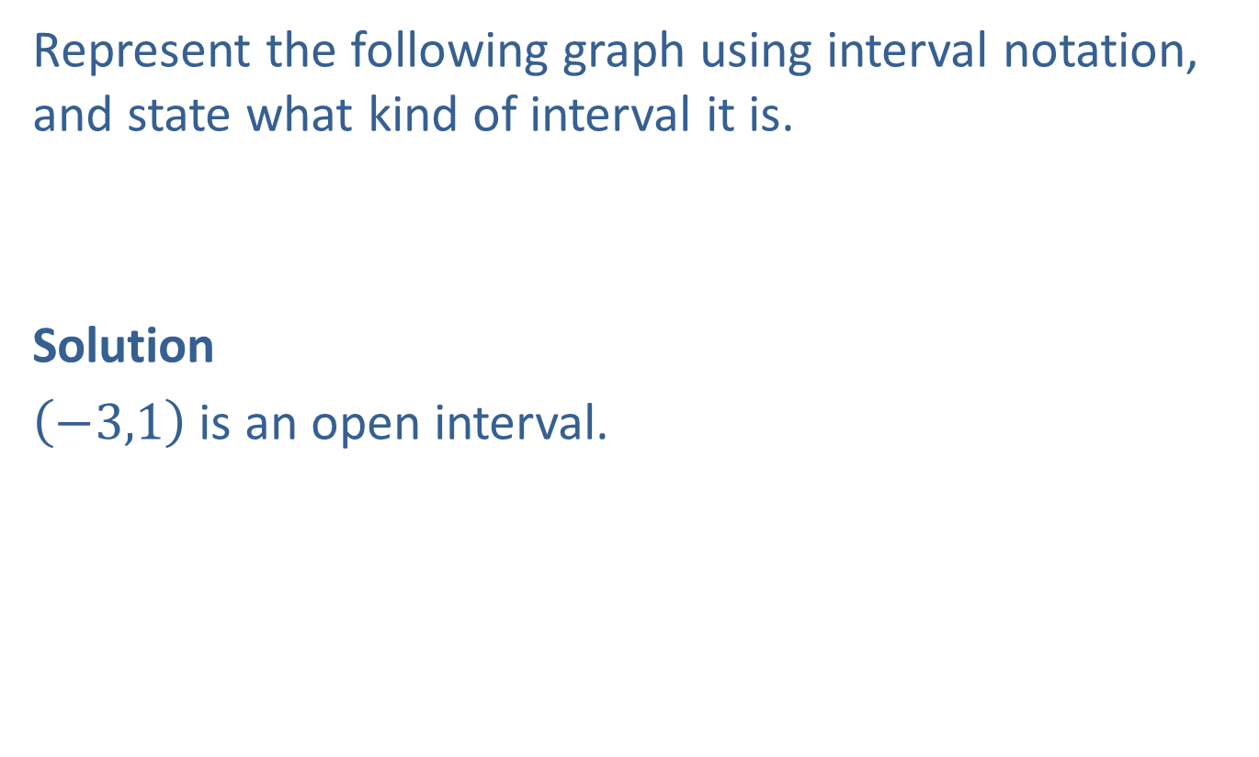
Example 4: Graphing Intervals
Represent the following graph using interval notation, and state what kind of interval it is.
Solution
$\left(−3,1\right)$ is an open interval.

Slide 8
Properties: Addition Principle for Solving Linear Inequalities
If A and B are algebraic expressions and C is a real number, then the inequalities
A < B
and
A + C < B + C
are equivalent.
(If a real number is added to both sides of an inequality, the new inequality is equivalent to the original.)

Slide 9

Example 5: Solving an Inequality and Graphing the Solution Set
Solve the inequality y ─ 3.2 ≥ 5.6 and graph the solution set. Write the solution set using interval notation.
Solution
y is in

Slide 10
Example 6: Solving an Inequality and Graphing the Solution Set
Solve the inequality and graph the solution set. Write the solution set using interval notation.
Solution

Slide 11

Example 6: Solving an Inequality and Graphing the Solution Set (cont.)
t is in

Slide 12
Properties: Multiplication Principle for Solving Linear Inequalities
If A and B are algebraic expressions and C is a positive real number, then the inequalities
A < B
and
AC < BC
are equivalent.

Slide 13
Properties: Multiplication Principle for Solving Linear Inequalities (cont.)
If A and B are algebraic expressions and C is a negative real number, then the inequalities
A < B
and
AC > BC
are equivalent.
(In other words, if both sides are multiplied by a negative number, then the sense of the inequality is reversed.)

Slide 14

Example 7: Solving an Inequality and Graphing the Solution Set
Solve the inequality 5x > 15 and graph the solution set. Write the solution set using interval notation.
Solution
x is in

Slide 15
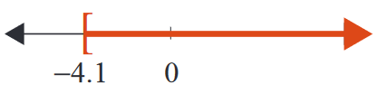
Example 8: Solving an Inequality and Graphing the Solution Set
Solve the inequality ─3x ≤ 12.3 and graph the solution set. Write the solution set using interval notation.
Solution
x is in

Slide 16
Procedure: Solving Linear Inequalities
​Combine like terms on each side of the inequality symbol.
​Use the addition principle of inequality to add the opposites of constants or variable expressions to both sides so that constants are on one side and variables on the other.
​Use the multiplication (or division) principle of inequality to multiply both sides by the reciprocal of the coefficient of the variable (or divide both sides by the coefficient itself). The coefficient of the variable will become +1. If this coefficient is negative, be sure to reverse the sense of the inequality.
​A quick (and generally satisfactory) check is to select any one number in your solution set and substitute it into the original inequality. If the statement is false, you need to look for an error in your solution.

Slide 17
Example 9: Solving Linear Inequalities
Solve the inequality 6x + 5 ≤ ─1 and graph the solution set. Write the solution set using interval notation.
Solution

Slide 18
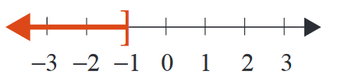
Example 9: Solving Linear Inequalities (cont.)
x is in

Slide 19
Example 9: Solving Linear Inequalities (cont.)
Check
As a check, pick a number in the solution interval and substitute it into the original inequality. For example, choose −3 and substitute it for x.
Note that it is not possible to check every number in an interval with infinitely many solutions. But a true result, as shown here, gives confidence in the solution interval.

Slide 20
Example 10: Solving Linear Inequalities
Solve the linear inequality 6 ─ 4x ≤ x + 1 and graph the solution set. Write the solution set using interval notation.
Solution

Slide 21
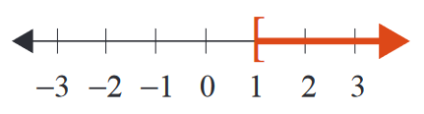
Example 10: Solving Linear Inequalities (cont.)
x is in

Slide 22
Completion Example 11: Solving Linear Inequalities
Supply the reasons for each step in solving the linear inequality and graph the solution set. Write the solution set using interval notation.
Solution

Slide 23

Completion Example 11: Solving Linear Inequalities (cont.)
Graph the interval on a number line.
x is in

Slide 24
Example 12: Solving Compound Inequalities
Solve the compound inequality – 5 ≤ 4x – 1 < 11 and graph the solution set. Write the solution set using interval notation.
Solution

Slide 25
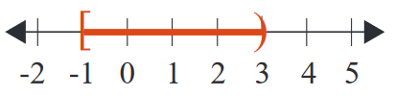
Example 12: Solving Compound Inequalities (cont.)
The solution set is the half-open interval

Slide 26
Example 13: Solving Compound Inequalities
Solve the compound inequality 5 ≤ ─3 ─ 2x ≤ 13 and graph the solution set. Write the solution set using interval notation. Assume that x is a real number.
Solution

Slide 27
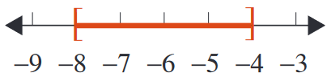
Example 13: Solving Compound Inequalities (cont.)
The solution set is the closed interval

Slide 28
Example 14: Application: Using Inequalities
A math student has grades of 85, 98, 93, and 90 on four examinations. If he must average 90 or better to receive an A for the course, what scores can he receive on the final exam and earn an A? (Assume that the final exam counts the same as the other exams.)
Solution
Let x = the score on final exam.
The average is found by adding the scores and dividing by 5.

Slide 29
Example 14: Application: Using Inequalities (cont.)
If the student scores 84 or more on the final exam, he will average 90 or more and receive an A in math.

Slide 30
Example 15: Application: Using Inequalities
Taylor is at the local fair and purchases 30 ride tickets. She wants to get her money’s worth and she only has time to go on 8 rides. The rollercoaster requires 5 tickets to board and the merry-go-round requires 3 tickets to board. What is the maximum number of times she can ride the rollercoaster?
Solution
Let x = number of rollercoaster rides,
then 8 − x = number of merry-go-round rides.

Slide 31
Example 15: Application: Using Inequalities (cont.)
Taylor cannot use more than 30 tickets.
Taylor can go on the rollercoaster ride at most 3 times.

