Slide 1
Section 3.2
Perimeter, Area, and Volume

Slide 2
Definition: Polygon
A polygon is a closed plane figure, with three or more sides, in which each side is a line segment.
Each point where two sides meet is called a vertex.
Note: A closed figure begins and ends at the same point.

Slide 3
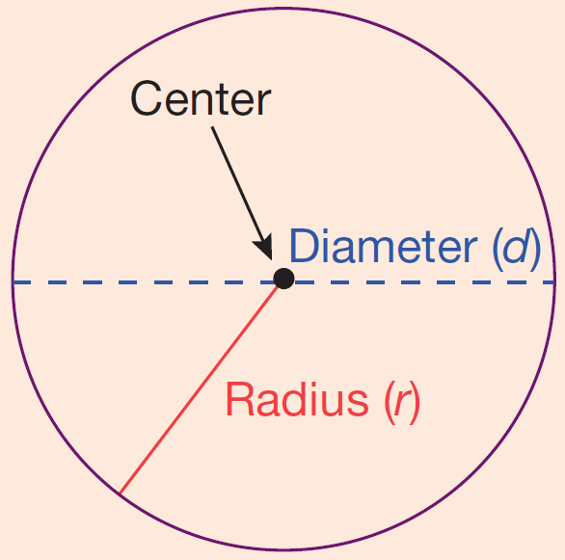
Definition: Circles
Circle: The set of all points in a plane
that are some fixed distance from a
fixed point called the center of the
circle.
Radius: The distance from the center
of a circle to any point on the circle.
(The letter r is used to represent the radius of a circle.)

Slide 4
Definition: Circles (cont.)
Diameter: The distance from one point
on a circle to another point on the
circle measured through the center.
(The letter d is used to represent the
diameter of a circle and d = 2r.)
Circumference: Perimeter of (or distance around) a circle.

Slide 5
Note
The Greek letter is the symbol used for the constant 3.1415926535…. This number is an infinite nonrepeating decimal number. For our purposes, we will use (accurate to hundredths). However, you should always be aware that 3.14 is only an approximation for and that related answers are only approximations.

Slide 6
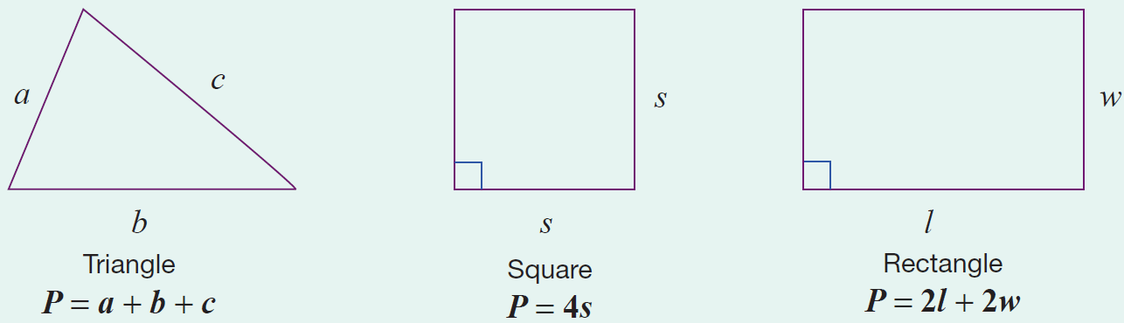
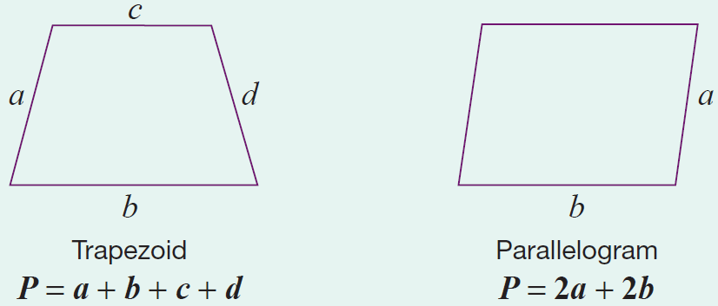
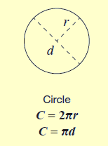
Formula: Formulas for Perimeter
Note that each formula represents the sum of the lengths of the sides.

Slide 7
Basic Units of Length
From the Metric System | From the US Customary System
millimeter (mm) | inch (in.)
centimeter (cm) | foot (ft)
meter (m) | yard (yd)
kilometer (km) | mile (mi)
Table 1

Slide 8
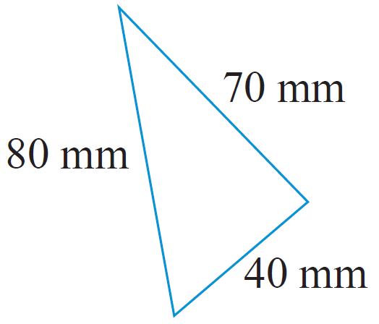
Example 1: Calculating the Perimeter of a Triangle
Calculate the perimeter of a triangle with sides of length 40 mm, 70 mm, and 80 mm.
Solution
First draw a figure and label the lengths
of the sides.
Now, using the formula for the perimeter of a triangle, we have the following.
The perimeter of the triangle is 190 mm.

Slide 9
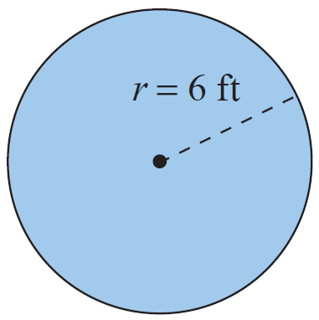
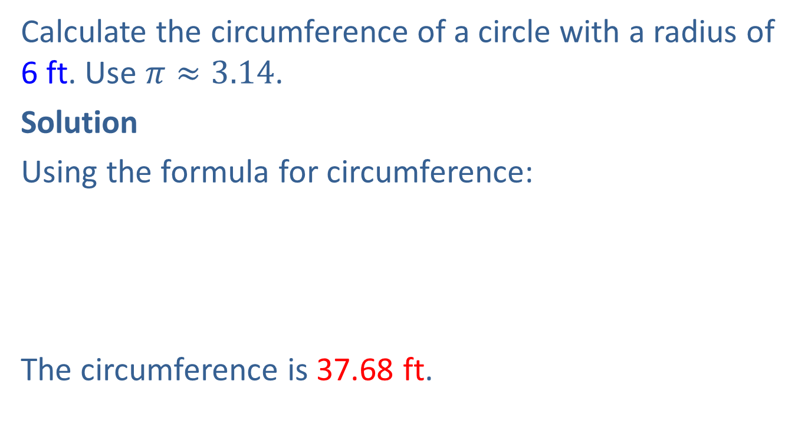
Example 2: Calculating the Circumference of a Circle
Calculate the circumference of a circle with a radius of 6 ft. Use $π≈3.14$.
Solution
Using the formula for circumference:
The circumference is 37.68 ft.

Slide 10
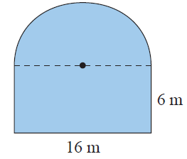
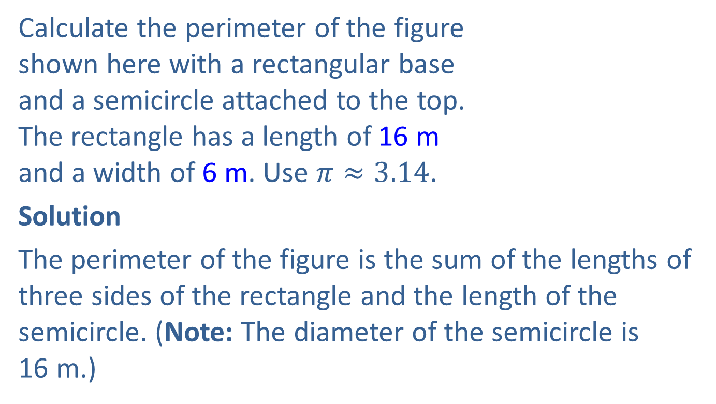
Example 3: Calculating the Perimeter
Calculate the perimeter of the figure
shown here with a rectangular base
and a semicircle attached to the top.
The rectangle has a length of 16 m
and a width of 6 m. Use $π≈3.14$.
Solution
The perimeter of the figure is the sum of the lengths of three sides of the rectangle and the length of the semicircle. (Note: The diameter of the semicircle is
16 m.)

Slide 11
Example 3: Calculating the Perimeter (cont.)
Sum of the lengths of three sides of the rectangle
= 6 m + 16 m + 6 m
Length of semicircle
Perimeter of the figure
= 28 m
= 28 m + 25.12 m
= 53.12 m

Slide 12
Basic Units of Area
From the Metric System From the US Customary System
square millimeters (mm²) | square inches (in.²)
square centimeters (cm²) | square feet (ft²)
square meters (m²) | square yards (yd²)
square kilometers (km²) | square miles (mi²)
Table 2

Slide 13
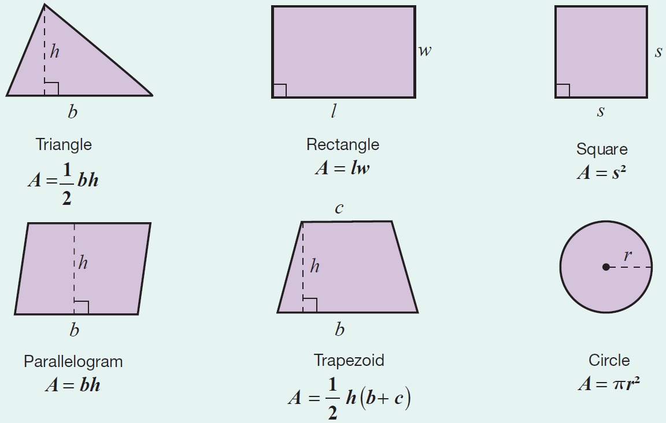
Formula: Formulas for Area

Slide 14
Note
The letter h is used to represent the height of the figure. The height is also called the altitude and is perpendicular to the base.

Slide 15
Example 4: Calculating the Area of a Triangle Using a Formula
Calculate the area of a triangle with height 4 in. and base 10 in. (Be sure to label the answer in square inches.)
Solution
Now, using the formula for the area of a triangle, we have the following.
The area of the triangle is 20 in.²

Slide 16
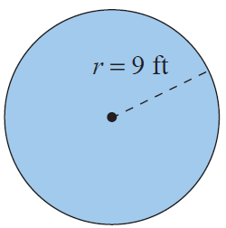

Example 5: Calculating the Area of a Circle
Calculate the area of a circle with a radius of 9 ft. Use $π≈3.14$.
Solution
Using the formula for area:
The area is 254.34 ft².

Slide 17
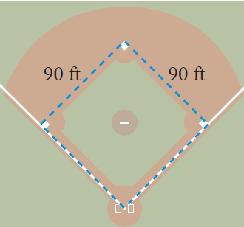
Example 6: Application: Calculating Perimeter and Area
A baseball infield is in the shape of a square 90 ft on each side.
What is the perimeter of the infield?
What is the area of the infield?

Slide 18
Example 6: Application: Calculating Perimeter and Area (cont.)
Solution
The perimeter of the infield is 360 ft and the area is .

Slide 19
Basic Units of Volume
From the Metric System | From the US Customary System
cubic millimeters (mm³) | cubic inches (in.³)
cubic centimeters (cm³) | cubic feet (ft³)
cubic meters (m³) | cubic yards (yd³)
Table 3

Slide 20
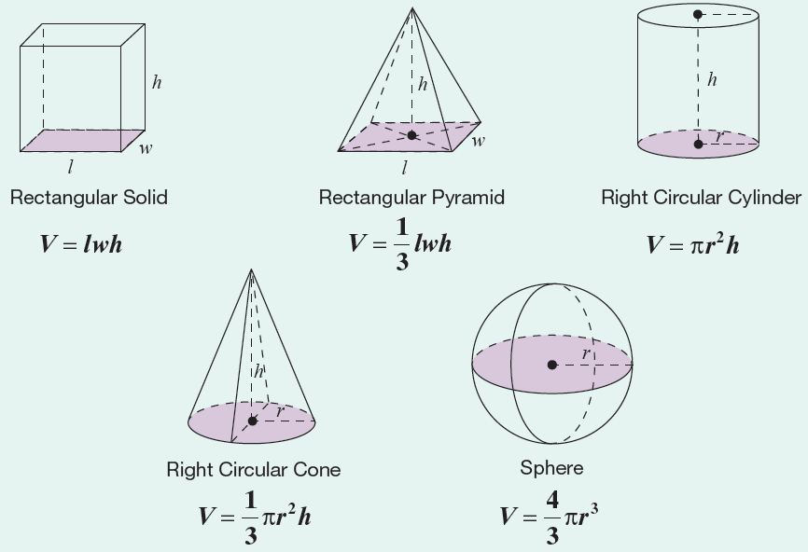
Formula: Formulas for Volume

Slide 21
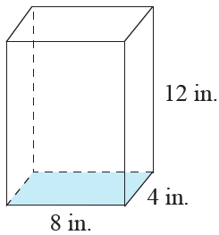
Example 7: Calculating the Volume of a Rectangular Solid
Calculate the volume of a rectangular solid with length 8 in., width 4 in., and height 12 in.
Solution
Using the formula for the volume of a
rectangular solid, we have the following.
The volume of the rectangular solid is

Slide 22
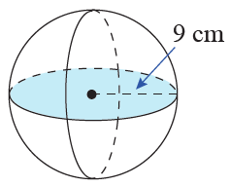
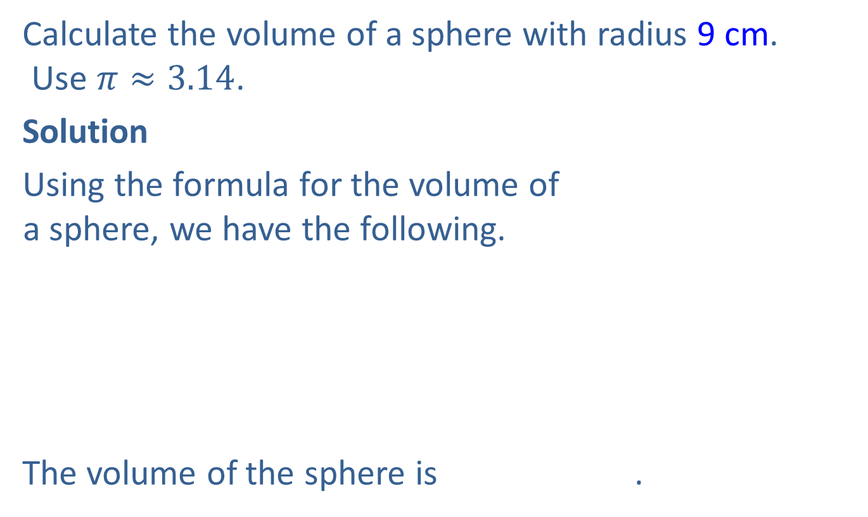
Example 8: Calculating the Volume of a Sphere
Calculate the volume of a sphere with radius 9 cm.
Use $π≈3.14$.
Solution
Using the formula for the volume of
a sphere, we have the following.
The volume of the sphere is .

Slide 23
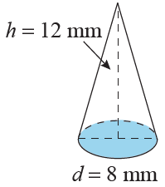
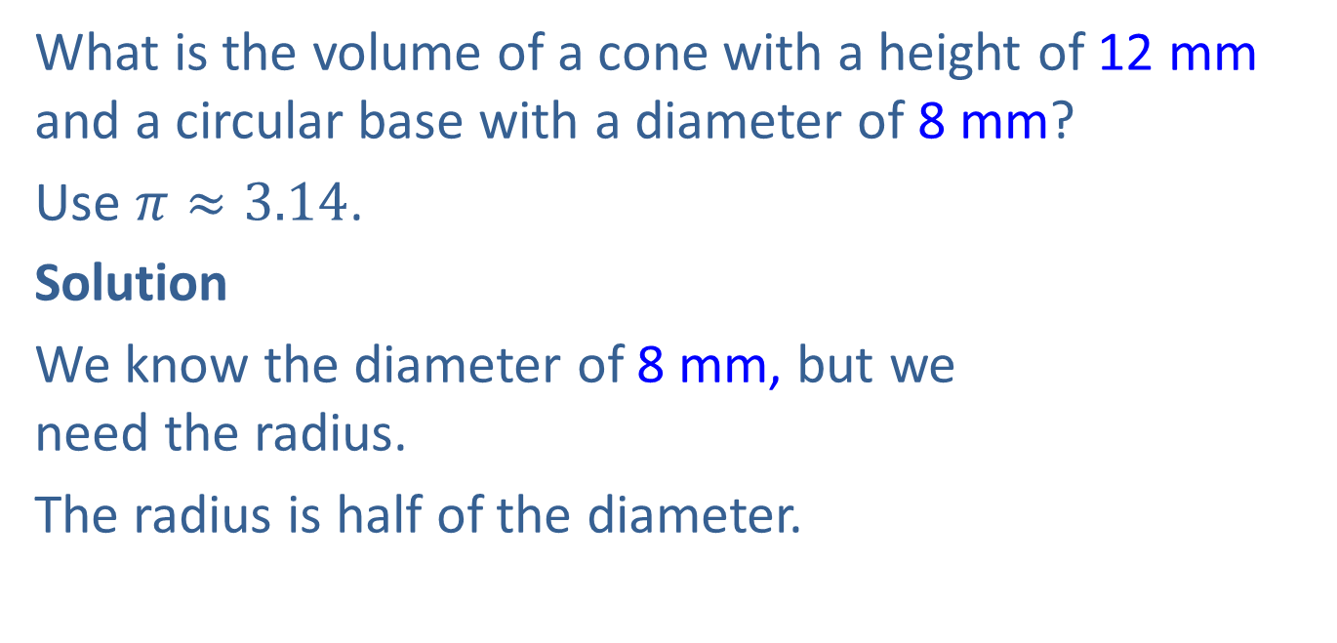
Example 9: Calculating the Volume of a Cone
What is the volume of a cone with a height of 12 mm and a circular base with a diameter of 8 mm?
Use $π≈3.14$.
Solution
We know the diameter of 8 mm, but we
need the radius.
The radius is half of the diameter.

Slide 24
Example 9: Calculating the Volume of a Cone (cont.)
So, applying the formula for the volume of a cone, we have the following.
The volume of the cone is

