Slide 1
Section 2.3
Solving Linear Equations:
x + b = c and ax = c

Slide 2
Definition: Linear Equation in x
If a, b, and c are constants and a ≠ 0 then a linear equation in x is an equation that can be written in the form

Slide 3
Note
A linear equation in x is also called a first-degree equation in x because the variable x can be written with the exponent 1. That is,

Slide 4
Example 1: Checking Given Solutions in Equations
Determine whether the given real number is a solution to the given equation by substituting for the variable and checking to see if the resulting equation is true or false.
x + 5 = −2 given that x = −7
1.4 + z = 0.5 given that z = −1.1
5.6 − y = 2.9 given that y = 2.7
|z| − 14 = −3 given that z = −10

Slide 5
Example 1: Checking Given Solutions in Equations (cont.)
Solution
(–7) + 5 = –2 is true, so −7 is a solution.
1.4 + (–1.1) = 0.5 is false because
1.4 + (−1.1) = 0.3 ≠ 0.5. So, −1.1 is not a solution.
c. 5.6 − (2.7) = 2.9 is true, so 2.7 is a solution.
d. |−10| − 14 = −3 is false because
|−10| − 14 = 10 − 14 = − 4 ≠ −3. So, −10 is not a solution.

Slide 6
Note
Notice that parentheses were used around negative numbers in the substitutions. This should be done to keep operations properly separated, particularly when negative numbers are involved.

Slide 7
Properties: Addition Principle of Equality
If the same algebraic expression is added to both sides of an equation, the new equation has the same solutions as the original equation. Symbolically, if A, B, and C are algebraic expressions, then the equations
A = B
and
A + C = B + C
have the same solutions.

Slide 8
Procedure: Solving Linear Equations that Simplify to the Form x + b = c
Combine like terms on both sides of the equation.
Use the addition principle of equality and add the opposite of the constant b to both sides of the equation. The objective is to isolate the variable on one side of the equation (either the left side or the right side) with a coefficient of +1.
Check your answer by substituting it for the variable in the original equation.

Slide 9
Example 2: Solving Linear Equations of the Form x + b = c
Solve the equation: x − 3 = 7
Solution
Check

Slide 10
Example 3: Solving Linear Equations of the Form x + b = c
Solve the equation:
Solution
Check

Slide 11
Example 4: Solving Linear Equations of the Form x + b = c
Solve the equation:
Solution
Check

Slide 12

Example 5: Solving Linear Equations of the Form x + b = c
Solve the equation: x$−\frac{2}{5}=\frac{3}{10}$
Solution

Slide 13
Example 5: Solving Linear Equations of the Form x + b = c (cont.)
Check

Slide 14

Example 6: Simplifying and Solving Linear Equations
Simplify and solve: $3z−2z+2=3+8$
Solution

Slide 15
Example 6: Simplifying and Solving Linear Equations (cont.)
Check

Slide 16
Completion Example 7: Simplifying and
Solving Linear Equations
Supply the reasons for each step in solving the equation.
Solution
Write the equation.
Combine like terms on both sides of the equation.
Add 1.5 (the opposite of −1.5) to both sides of the equation.
Simplify.

Slide 17
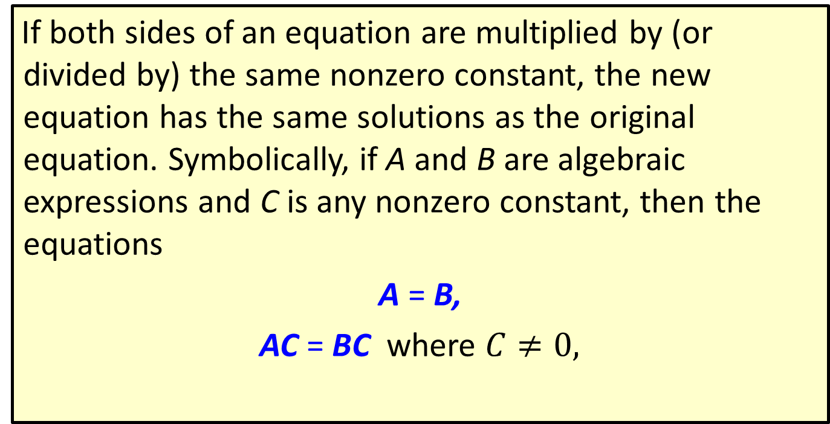
Properties: Multiplication (or Division) Principle of Equality
If both sides of an equation are multiplied by (or divided by) the same nonzero constant, the new equation has the same solutions as the original equation. Symbolically, if A and B are algebraic expressions and C is any nonzero constant, then the equations
A = B,
AC = BC where $C≠0,$

Slide 18
Properties: Multiplication (or Division) Principle of Equality (cont.)
and where
have the same solutions.

Slide 19
Procedure: Solving Linear Equations that Simplify to the Form ax = c
Combine like terms on both side of the equation.
Use the multiplication (or division) principle of equality and multiply both sides of the equation by the reciprocal of the coefficient of the variable (or divide both sides by the coefficient itself). The coefficient of the variable will become +1.
Check your answer by substituting it for the variable in the original equation.

Slide 20
Example 8: Solving Linear Equations of the Form ax = c
Solve the linear equation: 5x = 20
Solution

Slide 21
Example 8: Solving Linear Equations of the Form ax = c (cont.)
Check
Multiplying by the reciprocal of the coefficient is the same as dividing by the coefficient itself. So, we can
multiply both sides by , as we did, or we can divide
both sides by 5.

Slide 22
Example 8: Solving Linear Equations of the Form ax = c (cont.)
In either case, the coefficient of x becomes +1.

Slide 23
Example 9: Solving Linear Equations of the Form ax = c
Solve the linear equation: 1.1x + 0.2x = 12.2 − 3.1
Solution
When decimal coefficients or constants are involved, you might want to use a calculator to perform some of the arithmetic.
Use a calculator or pencil and paper to divide.

Slide 24
Example 9: Solving Linear Equations of the Form ax = c (cont.)
Check

Slide 25
Example 10: Solving Linear Equations of the Form ax = c
Solve the linear equation:
Solution

Slide 26
Example 10: Solving Linear Equations of the Form ax = c (cont.)
Check

Slide 27
Completion Example 11: Solving Equations of the Form ax = c
Supply the reasons for each step in solving the equation.

Slide 28
Completion Example 11: Solving Equations of the Form ax = c (cont.)
Solution
Write the equation.
Multiply both sides by
Simplify.

Slide 29
Example 12: Application: Solving Linear Equations
The original price of a Blu-Ray player was reduced by $45.50. The sale price was $165.90. Solve the equation y − 45.50 = 165.90 to determine the original price of the Blu-Ray player.

Slide 30
Example 12: Application: Solving Linear Equations (cont.)
Solution
y − 45.50 = 165.90
y − 45.50 + 45.50 = 165.90 + 45.50
Use the addition principle of equality
by adding 45.50 to both sides.
y = 211.40
Simplify.
The original price of the Blu-Ray player was $211.40.

