Slide 1
Section 12.1
Translations and Reflections

Slide 2
Example 1: Using f(x) Notation
For the function find:
f(3) b. f(a) c. f(a + 1)
Solution
a.
b.

Slide 3
Example 1: Using f(x) Notation (cont.)
c. Replace x with a + 1 and simplify.

Slide 4
Example 2: Finding the Difference Quotient f(x+h) − f(x)/h
Find the difference quotient for the function
Solution
Substituting gives the following.

Slide 5
Example 3: Finding the Difference Quotient f(x+h) − f(x)/h
Find the difference quotient for the function
Solution
Substituting gives the following.

Slide 6
Example 3: Finding the Difference Quotient f(x+h) − f(x)/h (cont.)
Expand (x + h)²
and multiply by 2.
Factor out h.

Slide 7
Procedure: Horizontal and Vertical Translations
Given the graph of y = f(x), the graph of y = f(x−h) + k is
a horizontal translation of h units and
a vertical translation of k units
of the graph of y = f(x).
Draw the graph of y = f(x) in relation to (h, k) as if (h, k) were the origin, (0, 0). This new graph will be the graph of y = f(x−h) + k.

Slide 8
Example 4: Graphing Horizontal and Vertical Translations of y = |x|
Graph the function Use the graph in Figure 5 as a reference.
Solution
Here (h, k) = (3, 2), so there is a horizontal translation of 3 units right and 2 units up. In effect, (3, 2) is now the vertex of the new graph just as (0, 0) is the vertex of the original graph. You should check that the points shown on the graph here do indeed satisfy the function.

Slide 9
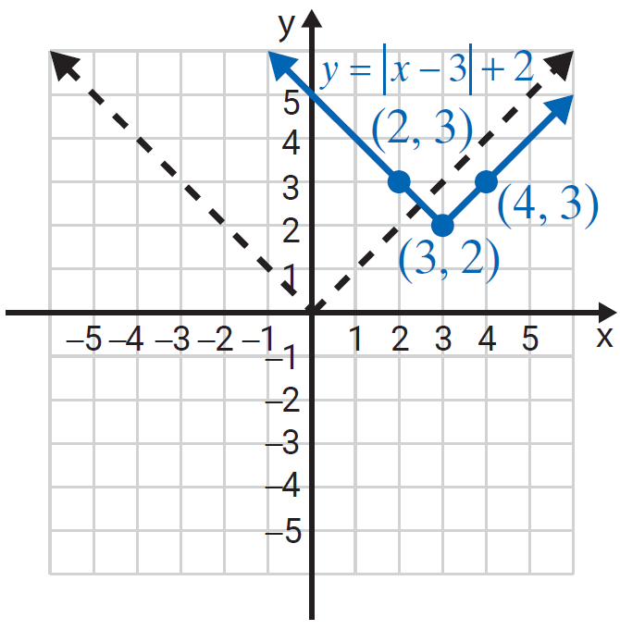
Example 4: Graphing Horizontal and Vertical Translations of y = |x| (cont.)

Slide 10
Example 5: Graphing Horizontal and Vertical Translations of y = |x|
Graph the function
Solution
Here (h, k) = (−4, −1), so the horizontal translation is −4 (4 units left) and the vertical translation is −1 (1 unit down). The effect is that the vertex is now at the point (−4, −1).

Slide 11
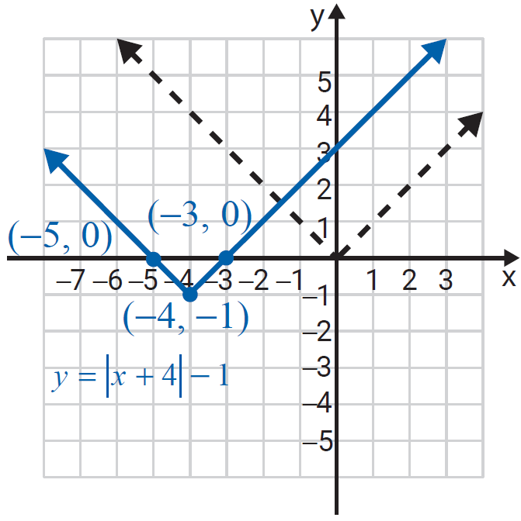
Example 5: Graphing Horizontal and Vertical Translations of y = |x| (cont.)

Slide 12
Example 6: Graphing Horizontal and Vertical Translations of y = |x|
Graph the function
Solution
Here (h, k) = (−2, 7), so the horizontal translation is −2 (2 units left) and the vertical translation is 7 (7 units up). The effect is that the vertex is now at the point (−2, 7).

Slide 13
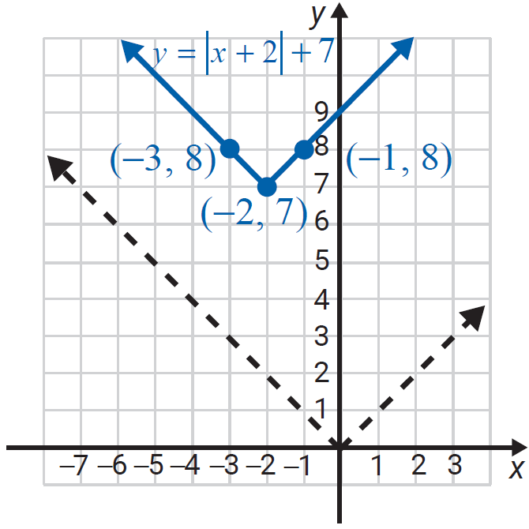
Example 6: Graphing Horizontal and Vertical Translations of y = |x| (cont.)

Slide 14
Example 7: Graphing Reflections and Translations of y = |x|
Graph the function
Solution
The reflection is performed first, followed by the translations.
Here (h, k) = (−2, 5), and the graph is reflected across the x-axis. We show step-by-step how to “arrive” at the graph. (You may do these steps mentally and graph only the last step.)

Slide 15
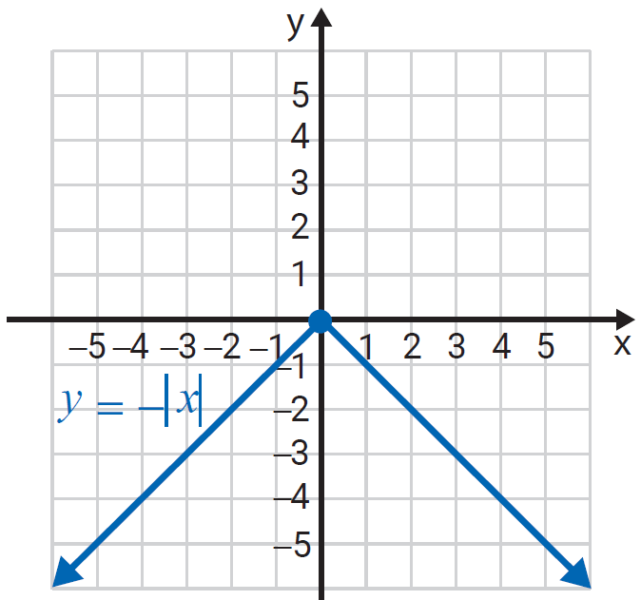
Example 7: Graphing Reflections and Translations of y = |x| (cont.)
Step 1: Graph the reflection

Slide 16
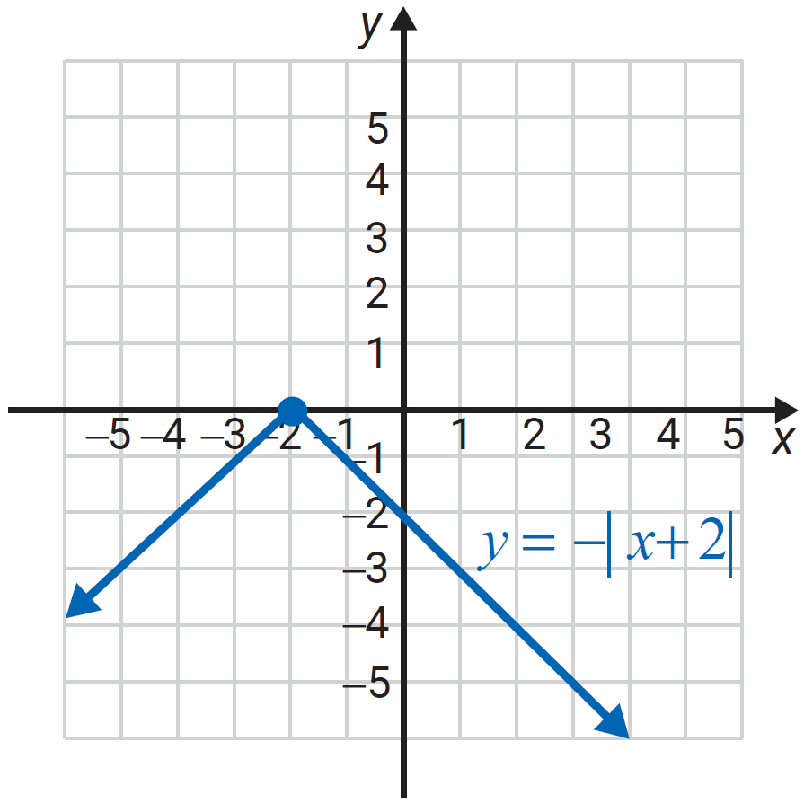
Example 7: Graphing Reflections and Translations of y = |x| (cont.)
Step 2: Translate the graph 2 units to the left.

Slide 17
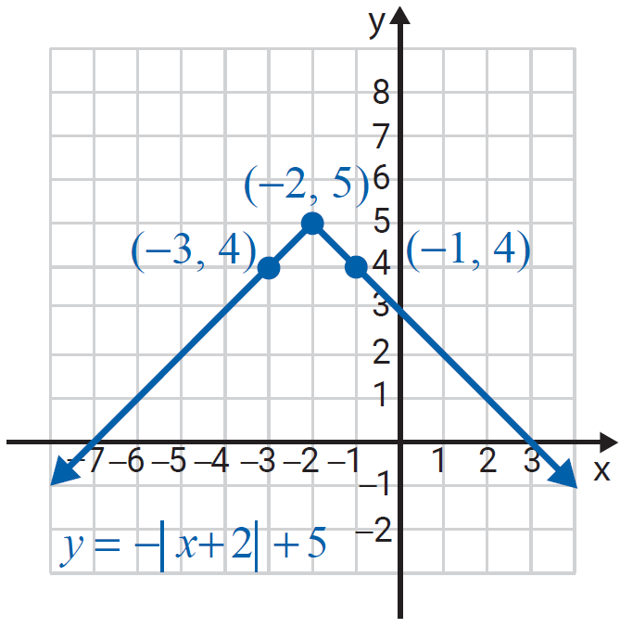
Example 7: Graphing Reflections and Translations of y = |x| (cont.)
Step 3: Translate the graph 5 units up.

Slide 18
Example 8: Graphing Translations of a Function Given its Graph
The graph of is given. Graph the function
Solution
If is written then is the same as So and there is a horizontal translation of 2 units to the right and a vertical translation of 1 unit up.

Slide 19
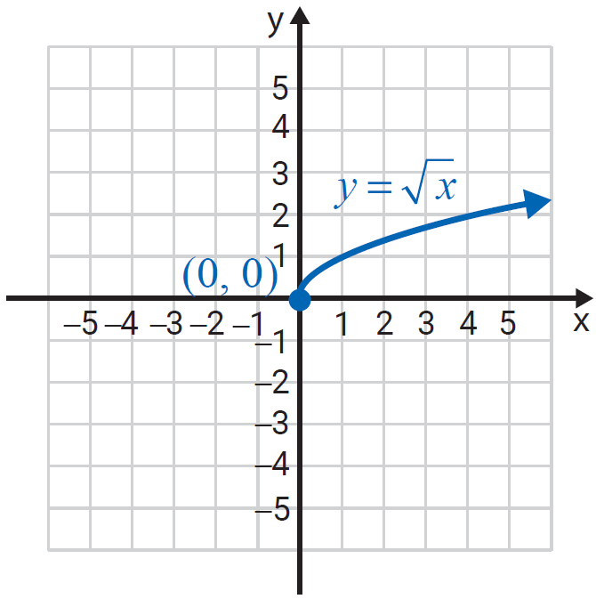
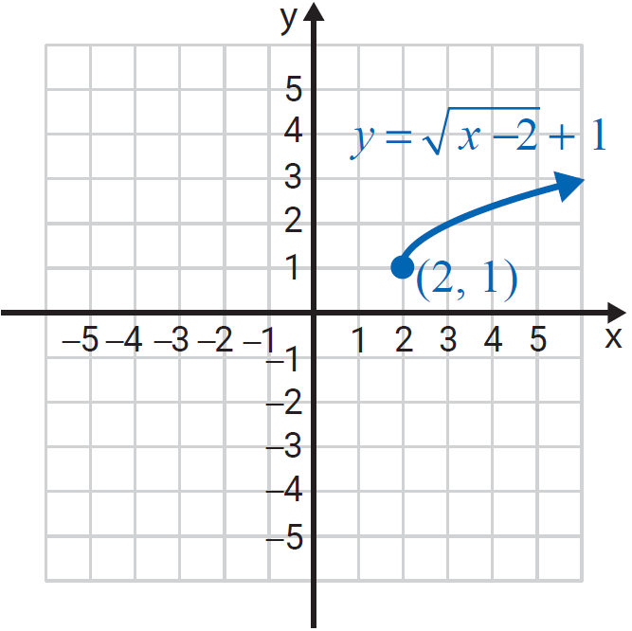
Example 8: Graphing Translations of a Function Given its Graph (cont.)

Slide 20
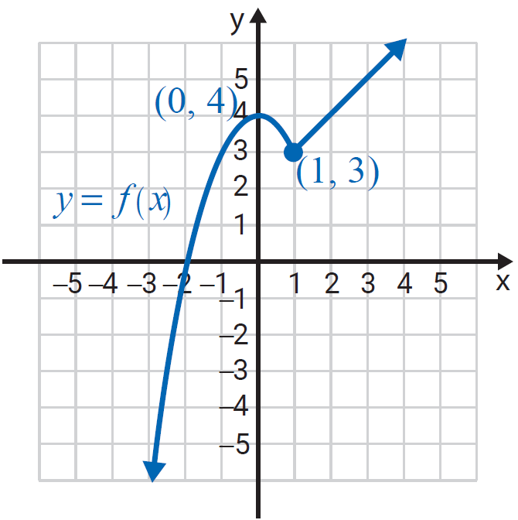
Example 9: Graphing Translations of a Function Given its Graph
The graph of is given. Graph the function

Slide 21
Example 9: Graphing Translations of a Function Given its Graph (cont.)
Solution
Here so translate the graph horizontally 3 units to the right and vertically −2 units down. (Add 3 to each x-value and −2 to each y-value.)

Slide 22
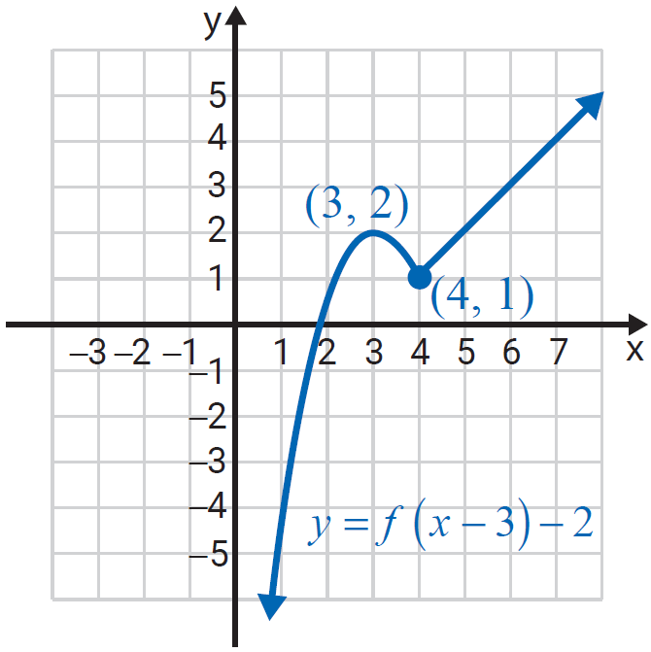
Example 9: Graphing Translations of a Function Given its Graph (cont.)

