Slide 1
Section 11.7
Logarithmic and Exponential Equations and Change-of-Base

Slide 2
Properties: Properties of Real Exponents
If a and b are positive real numbers and x and y are any real numbers, then
1. b⁰ = 1 5.
2. 6.
3. b^{x} ⋅ b^{y} = b^{x + y} 7.
4.

Slide 3
Properties: Properties of Equations with Exponents and Logarithms
For b > 0 and b ≠ 1,
If b^{x} = b^{y}, then x = y.
If x = y, then b^{x} = b^{y}.
If log_{b} x = log_{b} y, then x = y (x > 0 and y > 0).
If x = y, then log_{b} x = log_{b} y (x > 0 and y > 0).

Slide 4
Example 1: Solving Exponential Equations with the Same Base
Solve each equation for x.
a. b.
Solution
Both bases are 2.
The exponents are equal because the bases are the same.
Solve for x.

Slide 5
Example 1: Solving Exponential Equations with the Same Base (cont.)
Here the bases are different.
Rewrite both sides so that the bases are the same.
Use the property
The exponents are equal because the bases are the same.
Solve for x.

Slide 6
Example 2: Solving Exponential Equations with Different Bases
Solve each of the following exponential equations by taking the log (or ln) of both sides or using the definition of logarithm as an exponent.
a. 10^{3x} = 2.1 b. 6^{x} = 18 c. 5^{2x − 1} = 10^{x}
Solution
First, take the log of both sides. Then use the definition of logarithm as an exponent.
Take the log of both sides.

Slide 7
Example 2: Solving Exponential Equations with Different Bases (cont.)
Use a calculator to find a decimal approximation:
Power rule
By the definition of a common logarithm

Slide 8
Example 2: Solving Exponential Equations with Different Bases (cont.)
The base is 6, not 10 or e, but we can solve by taking the log of both sides or by taking the ln of both sides. The result is the same.
Taking the log of both sides: Taking the ln of both sides:

Slide 9
Example 2: Solving Exponential Equations with Different Bases (cont.)
Using a calculator: Using a calculator:
Take the log of both sides.
Power rule

Slide 10
Example 2: Solving Exponential Equations with Different Bases (cont.)
As a decimal approximation,
Distributive property; log10 = 1
Arrange x-terms on one side.
Factor out the x.
Using rounded values

Slide 11
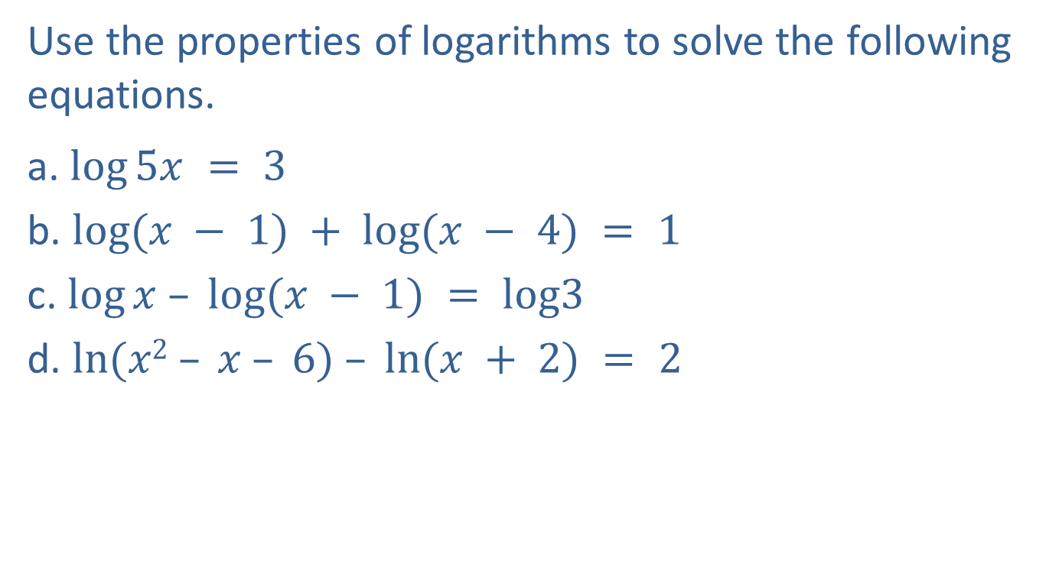
Example 3: Solving Logarithmic Equations
Use the properties of logarithms to solve the following equations.
a. $log⁡5x = 3$
b. $log⁡(x − 1) + log⁡(x − 4) = 1$
c. $log⁡x – log⁡(x − 1) = log3$
d. $ln⁡(x2 – x – 6) – ln⁡(x + 2) = 2$

Slide 12
Example 3: Solving Logarithmic Equations (cont.)
Solution
a.
Definition of a common logarithm
Checking will show that the equation is defined at x = 200.

Slide 13
Example 3: Solving Logarithmic Equations (cont.)
Product rule
Definition of a common logarithm
Solve by factoring.
Checking x = −1 yields log(−1 −1 ) = log(−2), which is undefined.

Slide 14
Example 3: Solving Logarithmic Equations (cont.)
Quotient rule
If log_{b}x = log_{b}y, then x = y.
Solve for x.

Slide 15
Example 3: Solving Logarithmic Equations (cont.)
Quotient rule
Factor the numerator.
Simplify.
Change to exponential form with base e.

Slide 16

Example 3: Solving Logarithmic Equations (cont.)
Or, using a calculator,
$x = 3 + e2 ≈ 3 + 7.3891$
$= 10.3891.$

Slide 17
Formula: Change-of-Base Formula
For a, b, x > 0 and a, b ≠ 1,

Slide 18
Example 4: Using the Change-of-Base Formula
Use the change-of-base formula to evaluate the following expressions.
a. log₂ 3.42 b. log₃ 0.3333
Solution
This expression can be evaluated using either base 10 or base e since both are easily available on a calculator.
Change-of-base formula

Slide 19

Example 4: Using the Change-of-Base Formula (cont.)
(Use a calculator to show that $\frac{log3.42}{log2}$ gives the same result.)
Using rounded values
In exponential form:

Slide 20
Example 4: Using the Change-of-Base Formula (cont.)
Change-of-base formula
Using rounded values

Slide 21
Example 5: Using the Change-of-Base Formula
Use the change-of-base formula to find the value of x (accurate to the nearest ten-thousandth) in the equation 5^{x} = 16.
Solution
Because the base is 5, we can take log₅ of both sides.
(This method is not necessary, but it does show how the change-of-base formula can be used.)

Slide 22
Example 5: Using the Change-of-Base Formula (cont.)
Change-of-base formula

