Slide 1
Section 11.3
Exponential Functions

Slide 2
Definition: Exponential Functions
An exponential function is a function of the form
where b > 0, b ≠ 1, and x is any real number.

Slide 3
Note
The two conditions b > 0 and b ≠ 1 found in the definition are important. We must have b > 0 so that b^{x} is defined for all real numbers x. For example, we do not consider y = (−2)^{x} to be an exponential because
is not a real number. Also, b ≠ 1 because the function y = 1^{x} = 1 is not considered an exponential function for all real numbers x.

Slide 4
Note
Because and so on, for fractions between 0 and 1, we can write
an exponential function with a fractional base between 0 and 1 (these are exponential decay functions) in the form of an exponential function with a base greater than 1 and a negative exponent.

Slide 5
Note (cont.)
Thus, we write
and

Slide 6
Definition: General Concepts of Exponential Functions
For b > 1:
b^{x} > 0
b^{x} increases to the right and is called an exponential growth function.
b⁰ = 1, so (0, 1) is the y‑intercept.

Slide 7
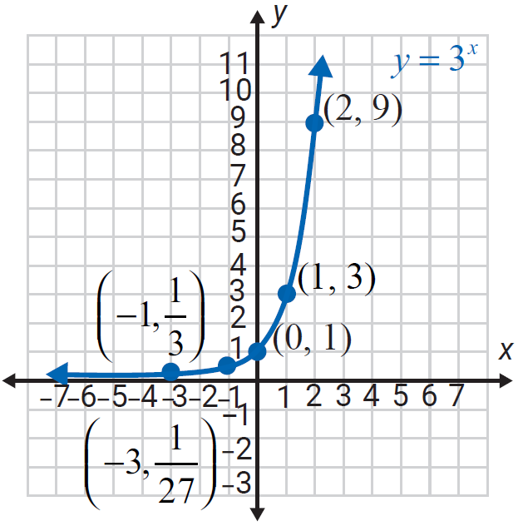
Definition: General Concepts of Exponential Functions (cont.)
4. b^{x} approaches the x‑axis for negative values of x.
(The x‑axis is a horizontal asymptote. See Figure 3.)
Figure 3

Slide 8
Definition: General Concepts of Exponential Functions (cont.)
For 0 < b < 1:
b^{x} > 0
b^{x} decreases to the right and is called an exponential decay function.
b⁰ = 1, so (0, 1) is the y‑intercept.

Slide 9
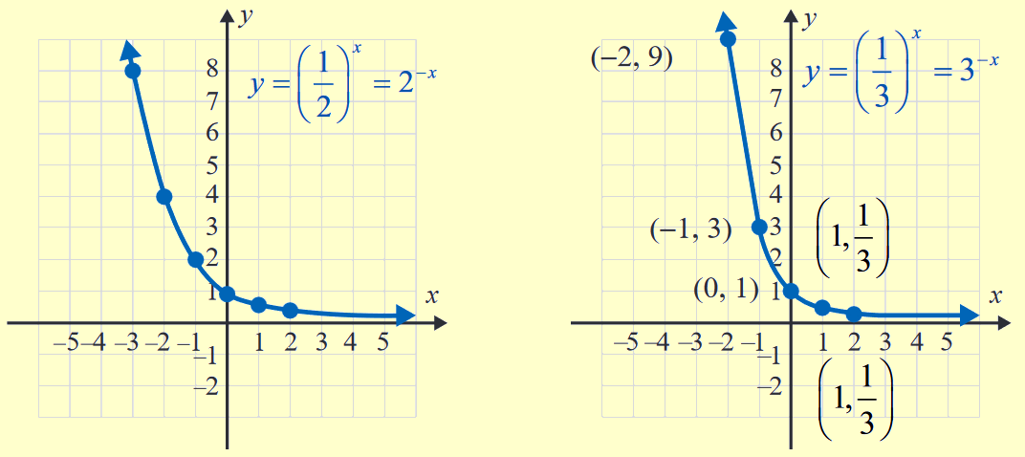
Definition: General Concepts of Exponential Functions (cont.)
4. b^{x} approaches the x‑axis for positive values of x. (The
x‑axis is a horizontal asymptote. See Figures 5a and
5b.)
Figure 5a
Figure 5b

Slide 10
Example 1 Application: Calculating Bacterial Growth
A scientist has 10,000 bacteria present when t = 0. She knows the bacteria grow according to the function where t is measured in hours. How many bacteria will be present at the end of one day?
Solution
Substitute t = 24 hours and y₀ = 10,000 into the function.
At the end of one day, there will be 40,960,000 bacteria.

Slide 11

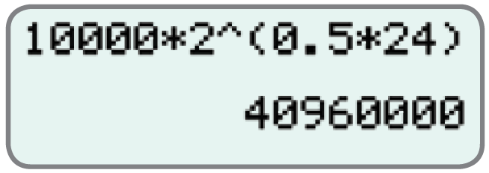
Calculators
Calculating Bacterial Growth
You could also use your calculator to calculate the result by entering the numbers as shown in the following display. Press to get the result.

Slide 12
Example 2 Application: Calculating Bacterial Growth
Use the formula for exponential growth, to determine the exponential function that fits the following information: y₀ = 5000 bacteria with 135,000 bacteria present after 3 days.
Solution
Use where t is measured in days. Substitute 135,000 for y, 3 for t, and 5000 for y₀ , then solve for b.

Slide 13
Example 2 Application: Calculating Bacterial Growth (cont.)
The function is

Slide 14
Formula: Compound Interest
Compound interest on a principal P invested at an annual interest rate r (in decimal form) for t years that is compounded n times per year can be calculated using the following formula, where A is the amount accumulated.

Slide 15
Example 3 Application: Calculating Compound Interest
If P dollars are invested at a rate of interest r (in decimal form) compounded annually (once a year, n = 1) for t years, the formula for the amount A
becomes Find the value of
$1000 invested at r = 6% = 0.06 for 3 years.

Slide 16
Example 3 Application: Calculating Compound Interest (cont.)
Solution
We have P = 1000, r = 0.06, and t = 3.
The account will have $1191.02 invested in it after 3 years.

Slide 17
Example 4 Application: Calculating Compound Interest
What will be the value of a principal investment of $1000 invested at 6% for 3 years if interest is compounded monthly (12 times per year)?
Solution
Use the formula for compound interest.
We have P = 1000, r = 0.06, n = 12, and t = 3.

Slide 18
Example 4 Application: Calculating Compound Interest (cont.)
Simplify using a calculator.
The value of the account after 3 years will be $1196.68.

Slide 19
Example 5 Application: Calculating Compound Interest
Find the value of A if $1000 is invested at 6% for 3 years and interest is compounded daily (365 times per year).
Solution
Use the formula for compound interest.
We have P = 1000, r = 0.06, n = 365, and t = 3.

Slide 20
Example 5 Application: Calculating Compound Interest (cont.)
Simplify using a calculator.
After three years, there will be $1197.20 in the account.

Slide 21
Definition: The Number e
The number e is defined to be
e = 2.718281828459 …

Slide 22
Formula: Continuously Compounded Interest
Continuously compounded interest on a principal P invested at an annual interest rate r for t years can be calculated using the following formula, where A is the amount accumulated.

Slide 23
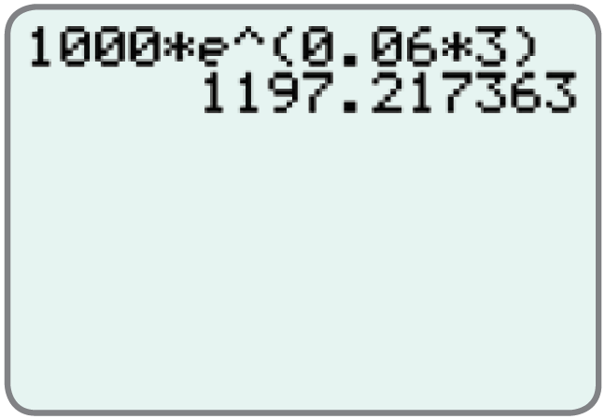

Example 6: Using a Graphing Calculator to Calculate Continuously Compounded Interest
Find the value of $1000 invested at 6% for 3 years if interest is compounded continuously. (In this case, P = $1000, r = 6% = 0.06, and t = 3.)
Solution
To find the value of
enter the numbers as shown
and press to get the
result.

Slide 24


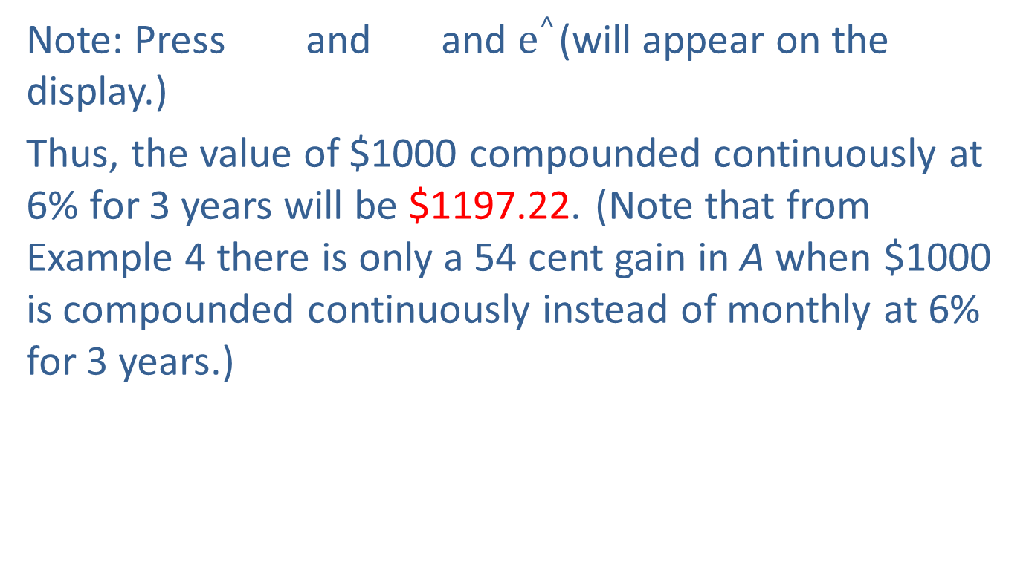
Example 6: Using a Graphing Calculator to Calculate Continuously Compounded Interest (cont.)
Note: Press and and $e^{^}$(will appear on the display.)
Thus, the value of $1000 compounded continuously at 6% for 3 years will be $1197.22. (Note that from Example 4 there is only a 54 cent gain in A when $1000 is compounded continuously instead of monthly at 6% for 3 years.)

