Slide 1
Section 1.3
Addition and Subtraction with Fractions

Slide 2
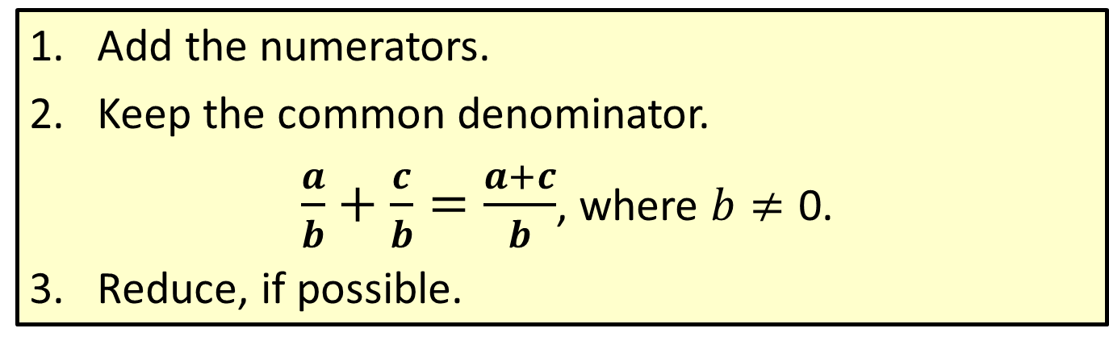
Procedure: Adding Fractions with the Same Denominator
​Add the numerators.
​Keep the common denominator.
$\frac{a}{b}+\frac{c}{b}=\frac{a+c}{b}$, where $b≠\text{0}$.
​Reduce, if possible.

Slide 3

Example 1: Adding Fractions with the Same Denominator
Add: $\frac{1}{5}+\frac{2}{5}$
Solution
$$\frac{1}{5}+\frac{2}{5}=\frac{1+2}{5}=\frac{3}{5}$$

Slide 4

Example 2: Adding Fractions with the Same Denominator
Add: $\frac{1}{11}+\frac{2}{11}+\frac{3}{11}$
Solution
$$\frac{1}{11}+\frac{2}{11}+\frac{3}{11}=\frac{1+2+3}{11}=\frac{6}{11}$$

Slide 5
Procedure: Adding Fractions with Different Denominators
​Find the least common denominator (LCD).
​Change each fraction into an equivalent fraction with that denominator.
​Add the new fractions.
​Reduce, if possible.

Slide 6
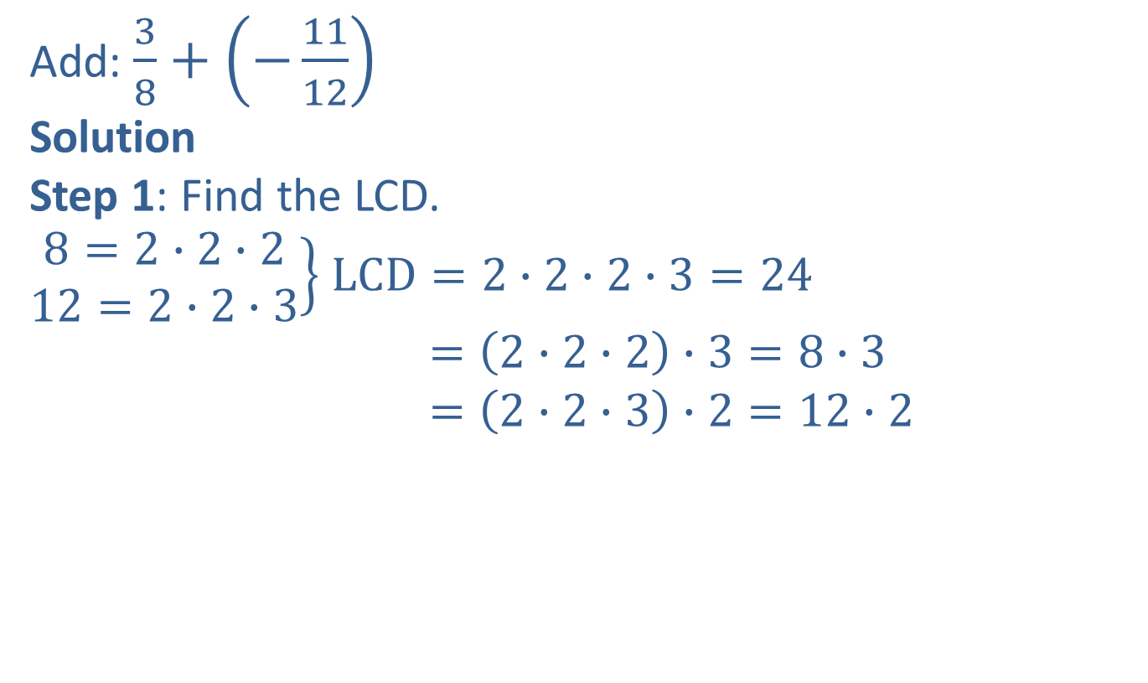
Example 3: Adding Fractions with Different Denominators
Add: $\frac{3}{8}+\left(−\frac{11}{12}\right)$
Solution
Step 1: Find the LCD.
$\left.\begin{aligned}8=2∙2∙2 \\ 12=2∙2∙3\end{aligned}\right\}$ $LCD=2∙2∙2∙3=24$
$=\left(2∙2∙2\right)∙3=8∙3$
$=\left(2∙2∙3\right)∙2=12∙2$
Note: You might not need to use prime factorizations to find the LCD. If the denominators are numbers that are familiar to you, then you might be able to find the LCD simply by inspection.

Slide 7



Example 3: Adding Fractions with Different Denominators (cont.)
Step 2: Find fractions equivalent to $\frac{3}{8}$ and $−\frac{11}{12}$ with denominator 24.
$$\frac{3}{8}=\frac{3}{8}∙\frac{3}{3}=\frac{9}{24}$$
$$−\frac{11}{12}=−\frac{11}{12}∙\frac{2}{2}=−\frac{22}{24}$$
Multiply by $\frac{3}{3} because 8∙3=24.$
Multiply by $\frac{2}{2} because 12∙2=24.$

Slide 8

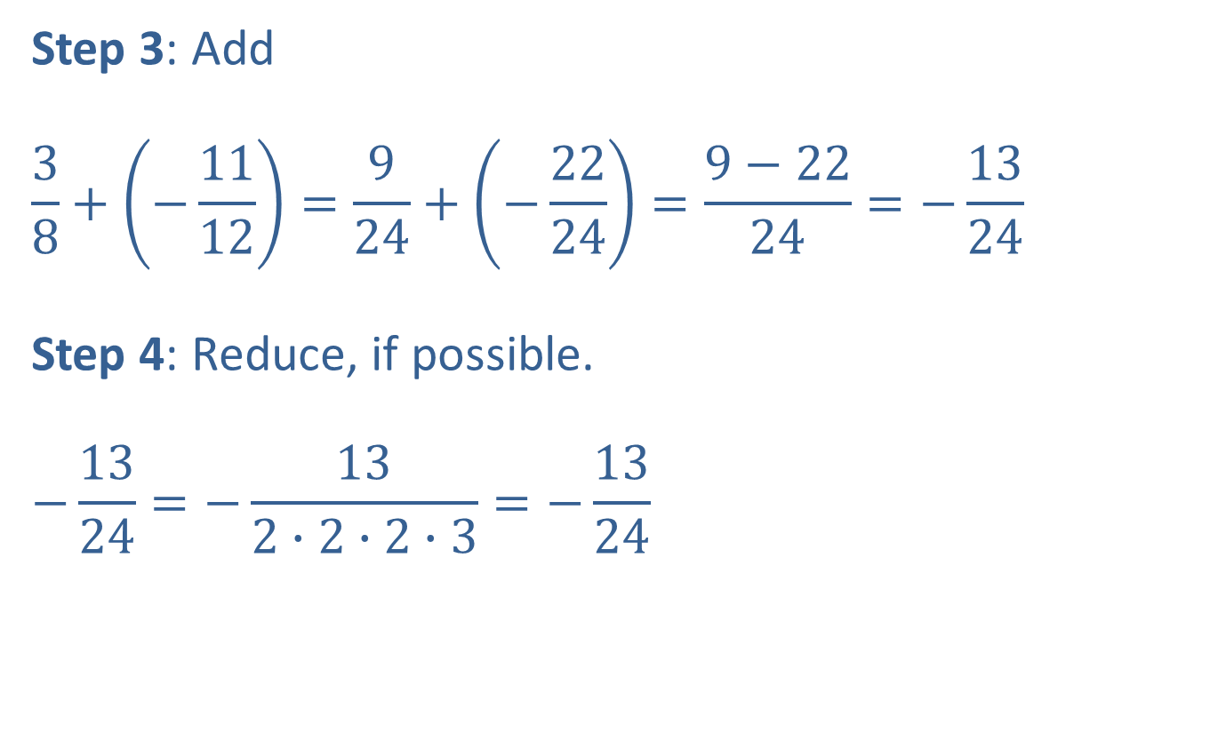
Example 3: Adding Fractions with Different Denominators (cont.)
Step 3: Add
$$\frac{3}{8}+\left(−\frac{11}{12}\right)=\frac{9}{24}+\left(−\frac{22}{24}\right)=\frac{9−22}{24}=−\frac{13}{24}$$
Step 4: Reduce, if possible.
$$−\frac{13}{24}=−\frac{13}{2∙2∙2∙3}=−\frac{13}{24}$$
The fraction cannot be reduced because $13$ and $24$ have only $1$ as a common factor.

Slide 9
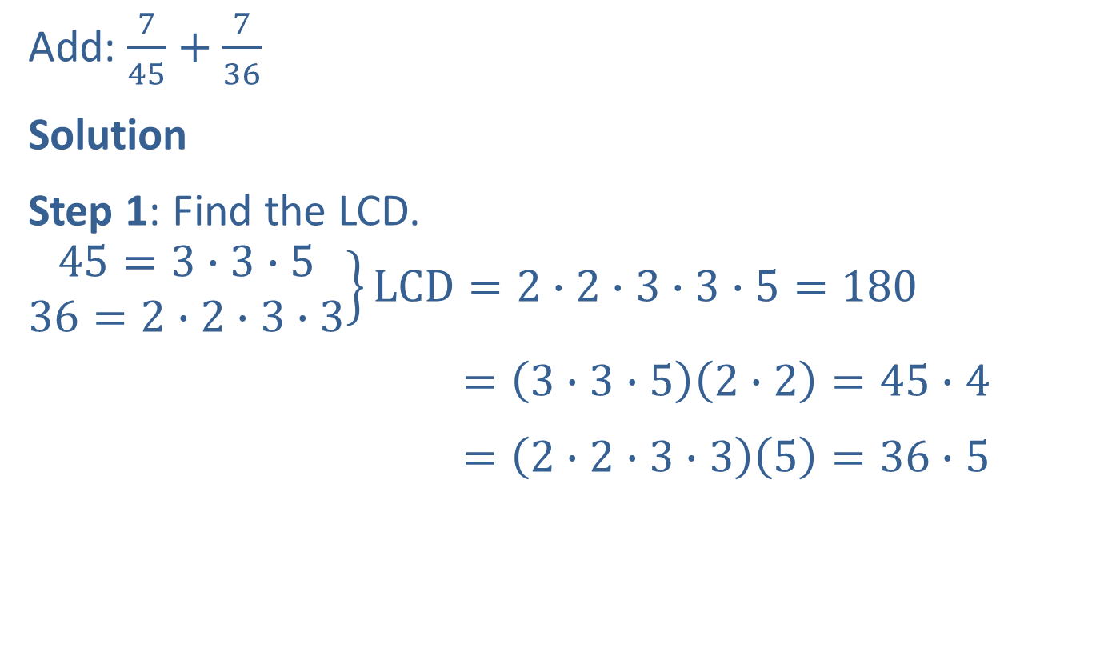
Example 4: Adding Fractions with Different Denominators
Add: $\frac{7}{45}+\frac{7}{36}$
Solution
Step 1: Find the LCD.
$$\left.\begin{aligned}45=3∙3∙5 \\ 36=2∙2∙3∙3\end{aligned}\right\}LCD=2∙2∙3∙3∙5=180$$
$=\left(3∙3∙5\right)\left(2∙2\right)=45∙4$
$=\left(2∙2∙3∙3\right)\left(5\right)=36∙5$

Slide 10
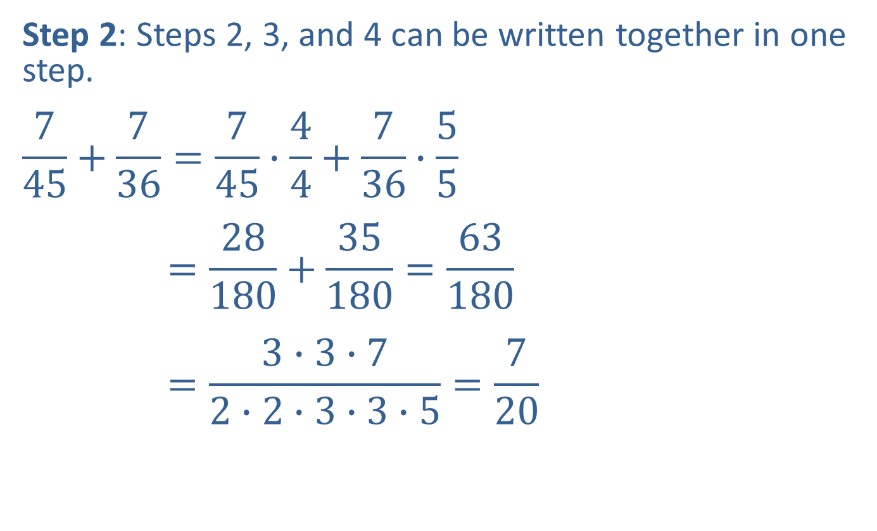
Example 4: Adding Fractions with Different Denominators (cont.)
Step 2: Steps 2, 3, and 4 can be written together in one step.
$$\frac{7}{45}+\frac{7}{36}=\frac{7}{45}∙\frac{4}{4}+\frac{7}{36}∙\frac{5}{5}$$
$$=\frac{28}{180}+\frac{35}{180}=\frac{63}{180}$$
$$=\frac{3∙3∙7}{2∙2∙3∙3∙5}=\frac{7}{20}$$

Slide 11
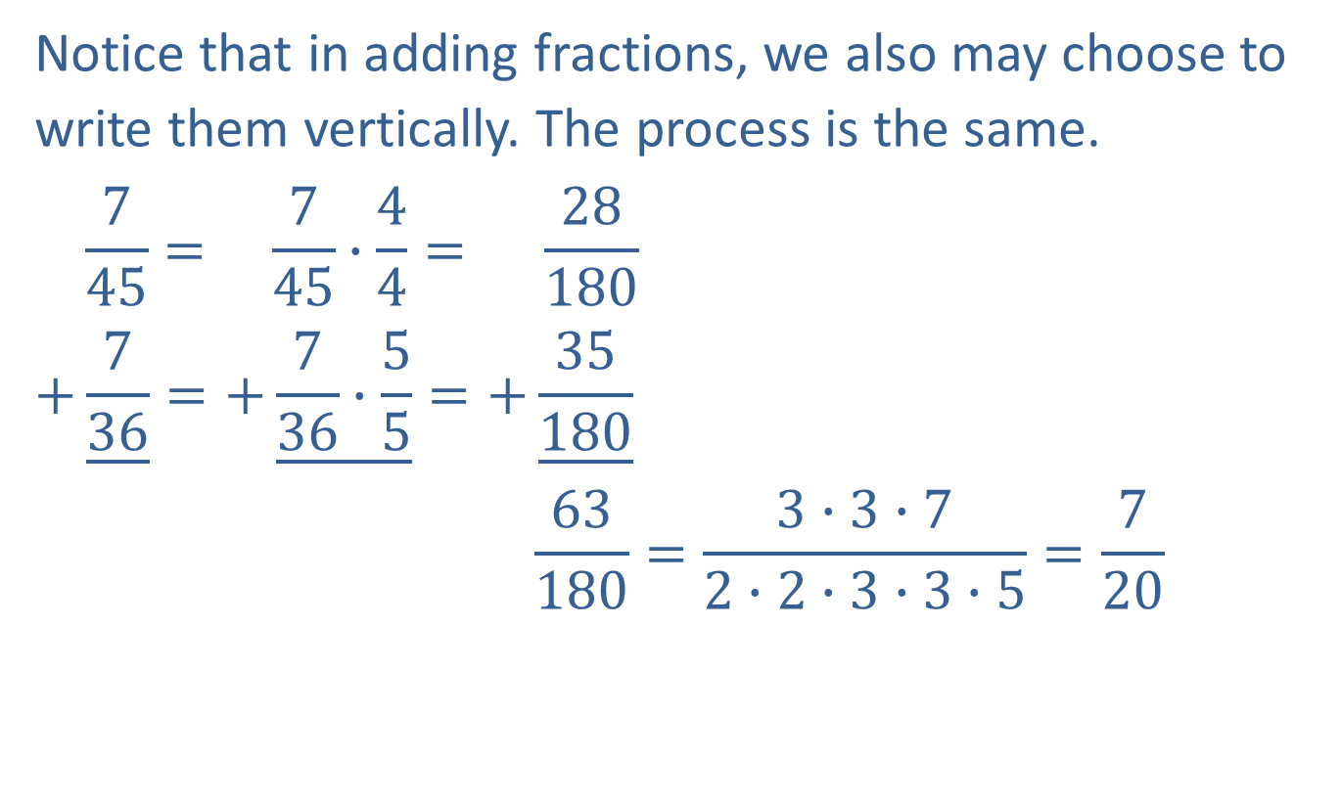
Example 4: Adding Fractions with Different Denominators (cont.)
Notice that in adding fractions, we also may choose to write them vertically. The process is the same.
$$\frac{7}{45}= \frac{7}{45}∙\frac{4}{4}= \frac{28}{180}$$
$$+\underline{\frac{7}{36}}=+\underline{\frac{7}{36}∙\frac{5}{5}}=+\underline{\frac{35}{180}}$$
$$\frac{63}{180}=\frac{3∙3∙7}{2∙2∙3∙3∙5}=\frac{7}{20}$$

Slide 12
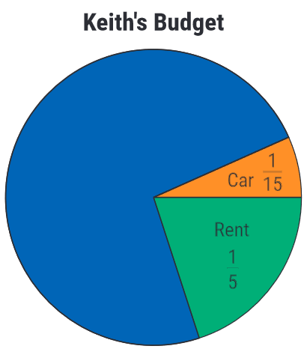

Example 5: Application: Adding Fractions
If Keith's total income for the year was $\$48,000$ and he spent $\frac{1}{5}$ of his income on rent and $\frac{1}{15}$ of his income on his car, what total amount did he spend on these two items?

Slide 13

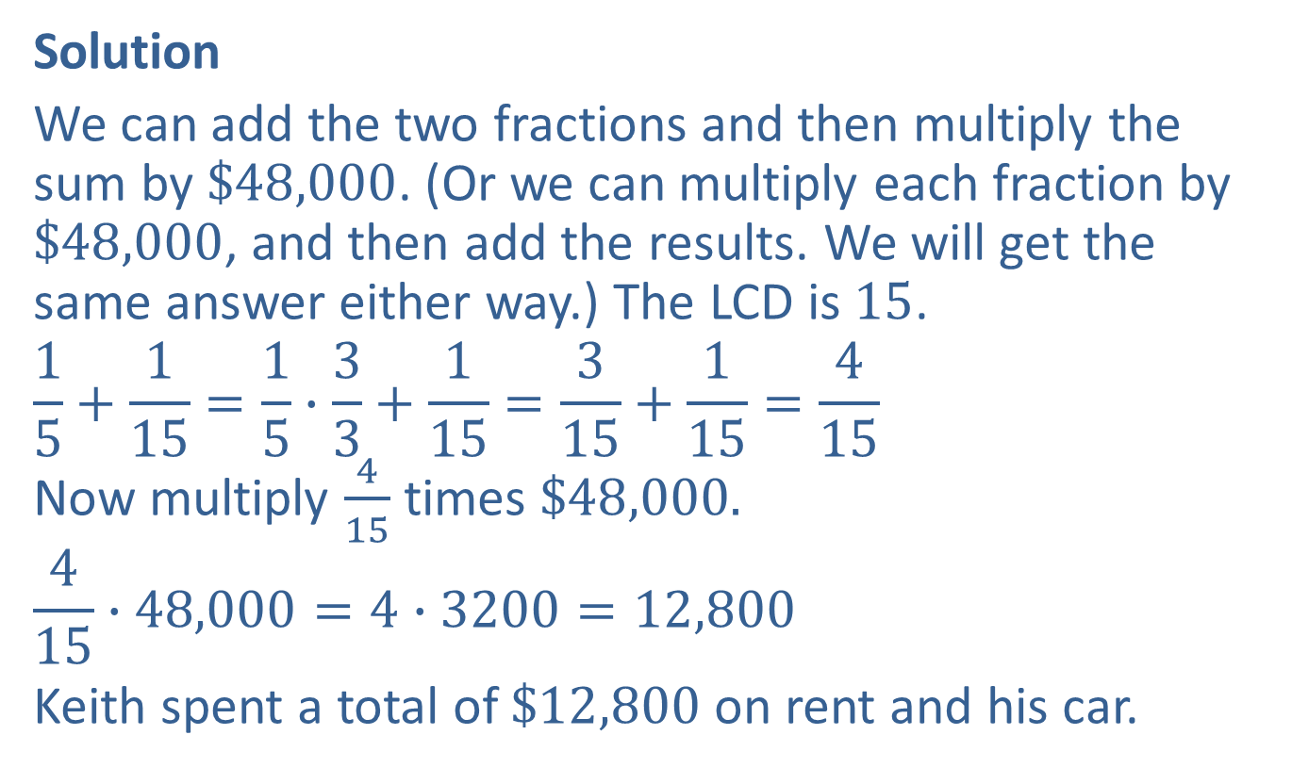

Example 5: Application: Adding Fractions (cont.)
Solution
We can add the two fractions and then multiply the sum by $\$48,000$. (Or we can multiply each fraction by $\$48,000$, and then add the results. We will get the same answer either way.) The LCD is $15$.
$$\frac{1}{5}+\frac{1}{15}=\frac{1}{5}∙\frac{3}{3}+\frac{1}{15}=\frac{3}{15}+\frac{1}{15}=\frac{4}{15}$$
Now multiply $\frac{4}{15}$ times $\$48,000.$
$$\frac{4}{15}∙48,000=4∙3200=12,800$$
Keith spent a total of $\$12,800$on rent and his car.
$$3200$$
$$1$$

Slide 14
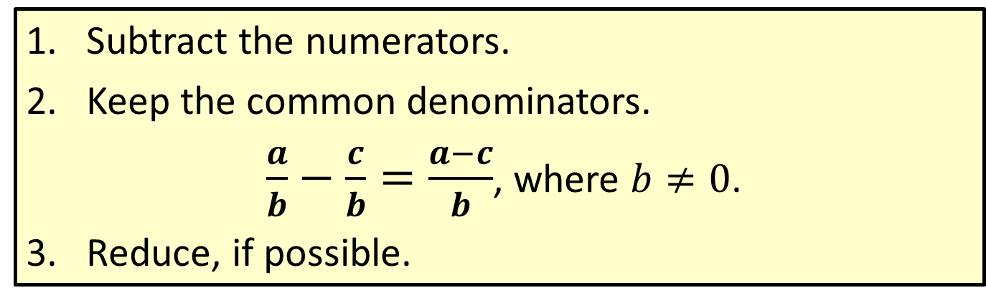
Procedure: Subtracting Fractions with the Same Denominator
​Subtract the numerators.
​Keep the common denominators.
$\frac{a}{b}−\frac{c}{b}=\frac{a−c}{b}$, where $b≠0$.
​Reduce, if possible.

Slide 15
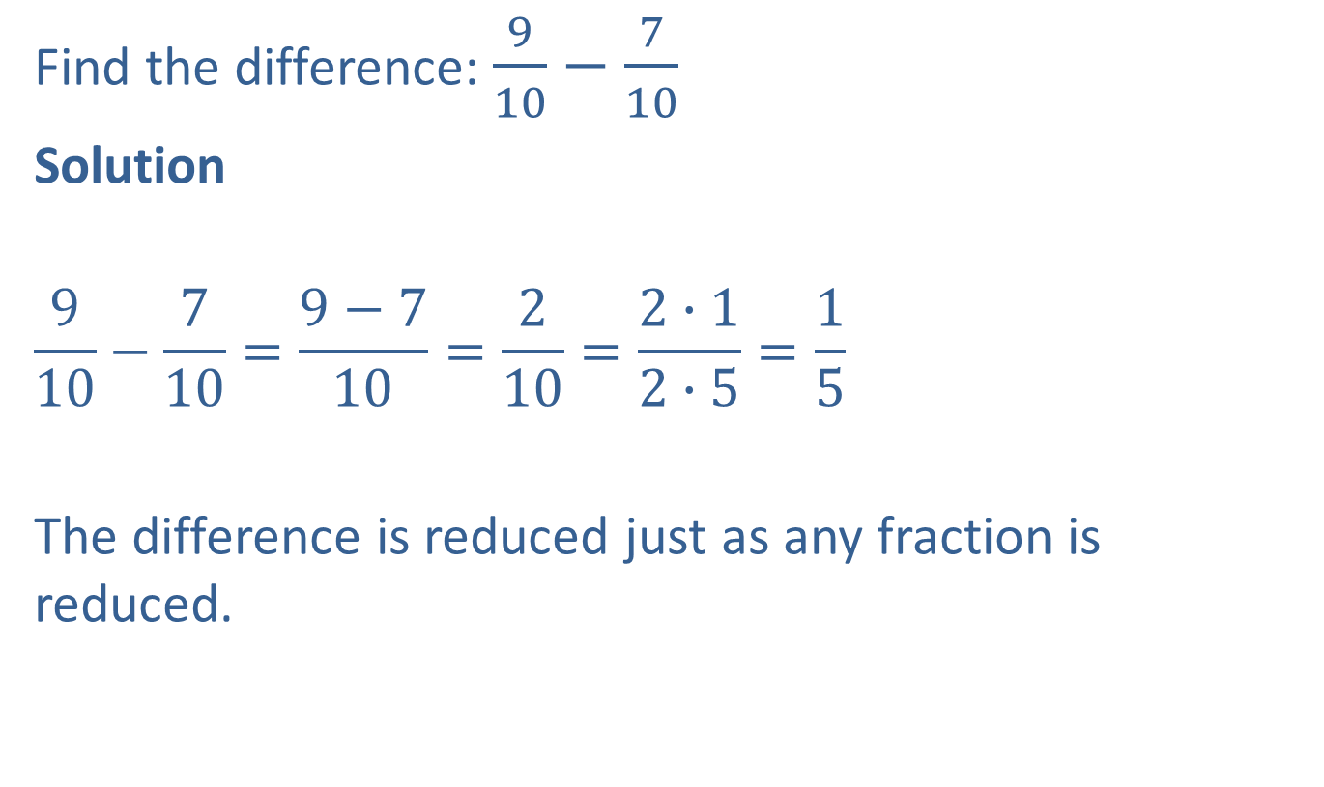
Example 6: Subtracting Fractions with the Same Denominator
Find the difference: $\frac{9}{10}−\frac{7}{10}$
Solution
$$\frac{9}{10}−\frac{7}{10}=\frac{9−7}{10}=\frac{2}{10}=\frac{2∙1}{2∙5}=\frac{1}{5}$$
The difference is reduced just as any fraction is reduced.

Slide 16
Procedure: Subtracting Fractions with Different Denominators
​Find the least common denominator (LCD).
​Change each fraction to an equivalent fraction with that denominator.
​Subtract the new fractions.
​Reduce, if possible.

Slide 17
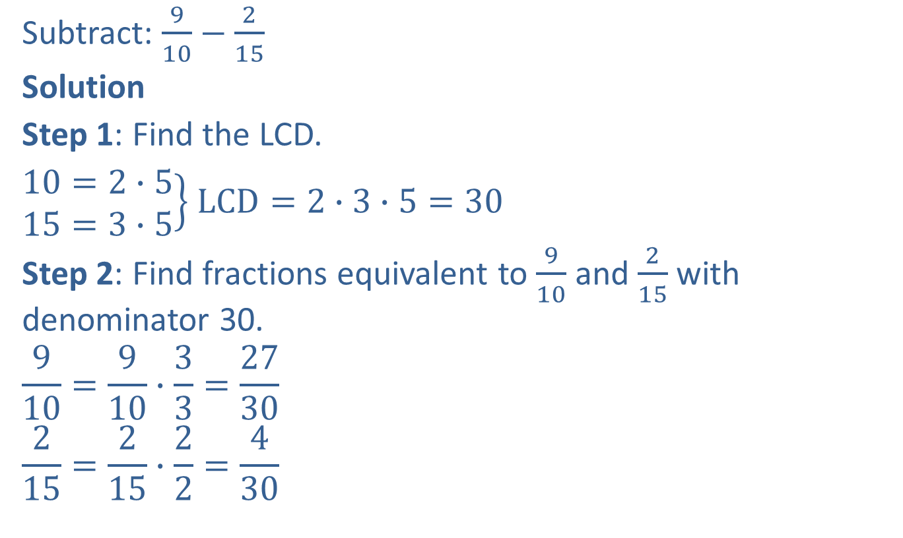
Example 7: Subtracting Fractions with Different Denominators
Subtract: $\frac{9}{10}−\frac{2}{15}$
Solution
Step 1: Find the LCD.
$\left.\begin{aligned}10=2∙5 \\ 15=3∙5\end{aligned}\right\}$ $LCD=2∙3∙5=30$
Step 2: Find fractions equivalent to $\frac{9}{10}$ and $\frac{2}{15}$ with denominator 30.
$$\frac{9}{10}=\frac{9}{10}∙\frac{3}{3}=\frac{27}{30}$$
$$\frac{2}{15}=\frac{2}{15}∙\frac{2}{2}=\frac{4}{30}$$

Slide 18
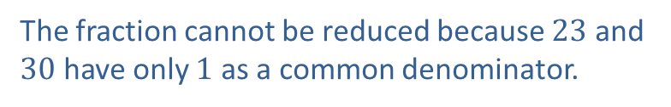

Example 7: Subtracting Fractions with Different Denominators (cont.)
Step 3: Subtract.
$$\frac{9}{10}−\frac{2}{15}=\frac{27}{30}−\frac{4}{30}=\frac{23}{30}$$
Step 4: Reduce, if possible.
$$\frac{23}{30}=\frac{23}{2∙3∙5}=\frac{23}{30}$$
The fraction cannot be reduced because $23$ and $30$ have only $1$ as a common denominator.

Slide 19

Example 8: Subtracting Fractions with Different Denominators
Subtract: $\frac{7}{20}−\frac{3}{28}$
Solution
Step 1: Find the LCD.
$\left.\begin{aligned}20=2∙2∙5 \\ 28=2∙2∙7\end{aligned}\right\}LCD=2∙2∙5∙7=140$

Slide 20
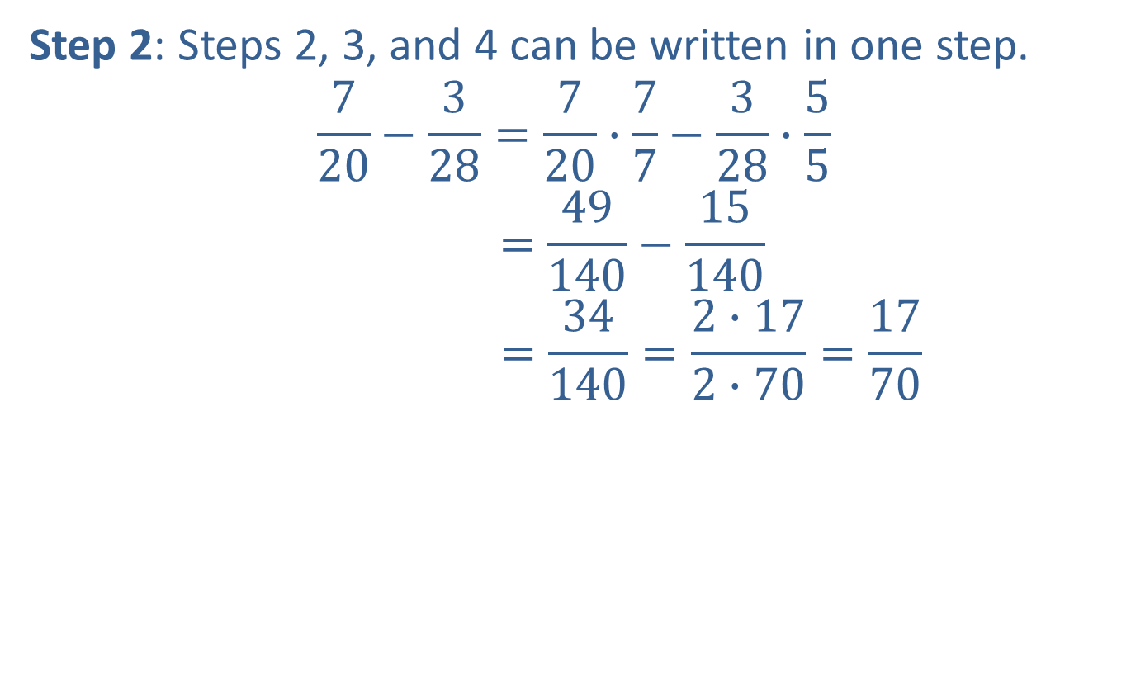
Example 8: Subtracting Fractions with Different Denominators (cont.)
Step 2: Steps 2, 3, and 4 can be written in one step.
$$\frac{7}{20}−\frac{3}{28}=\frac{7}{20}∙\frac{7}{7}−\frac{3}{28}∙\frac{5}{5}$$
$$=\frac{49}{140}−\frac{15}{140}$$
$$=\frac{34}{140}=\frac{2∙17}{2∙70}=\frac{17}{70}$$

Slide 21
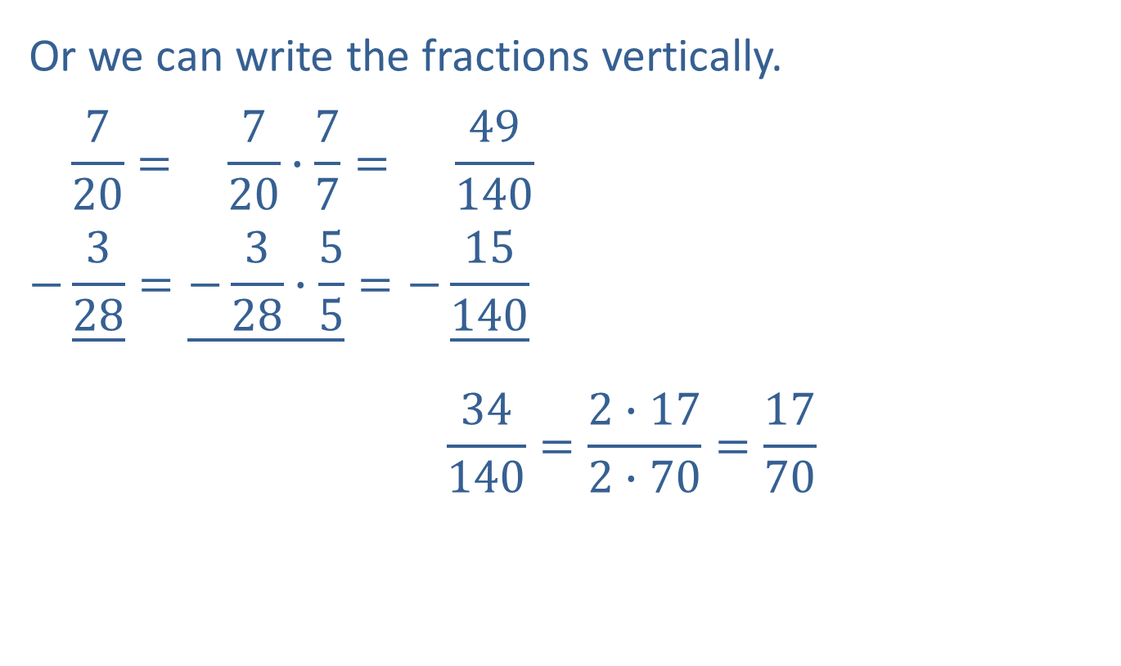
Example 8: Subtracting Fractions with Different Denominators (cont.)
Or we can write the fractions vertically.
$$\frac{7}{20}= \frac{7}{20}∙\frac{7}{7}= \frac{49}{140}$$
$$−\underline{\frac{3}{28}}=\underline{−\frac{3}{28}∙\frac{5}{5}}=−\underline{\frac{15}{140}}$$
$$\frac{34}{140}=\frac{2∙17}{2∙70}=\frac{17}{70}$$

