Slide 1
Section 1.2
Multiplication and Division with Fractions

Slide 2
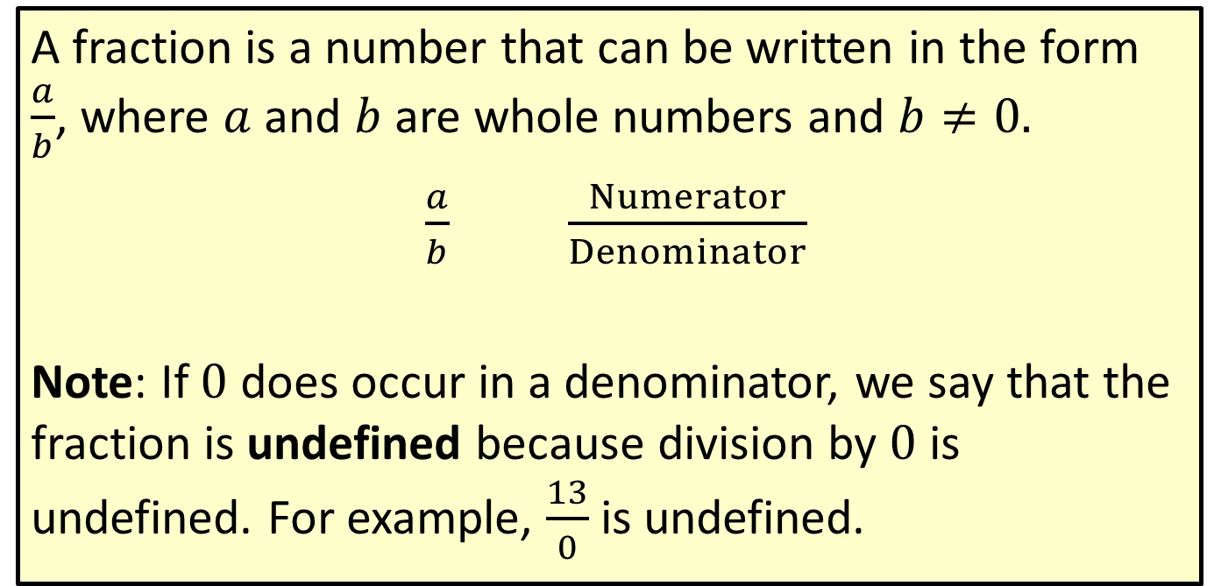
Definition: Fraction
A fraction is a number that can be written in the form $\frac{a}{b}$, where $a$ and $b$ are whole numbers and $b≠0.$
$\frac{a}{b}$ $\frac{Numerator}{Denominator}$
Note: If $0$ does occur in a denominator, we say that the fraction is undefined because division by $0$ is undefined. For example, $\frac{13}{0}$is undefined.

Slide 3
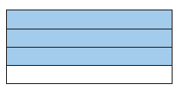
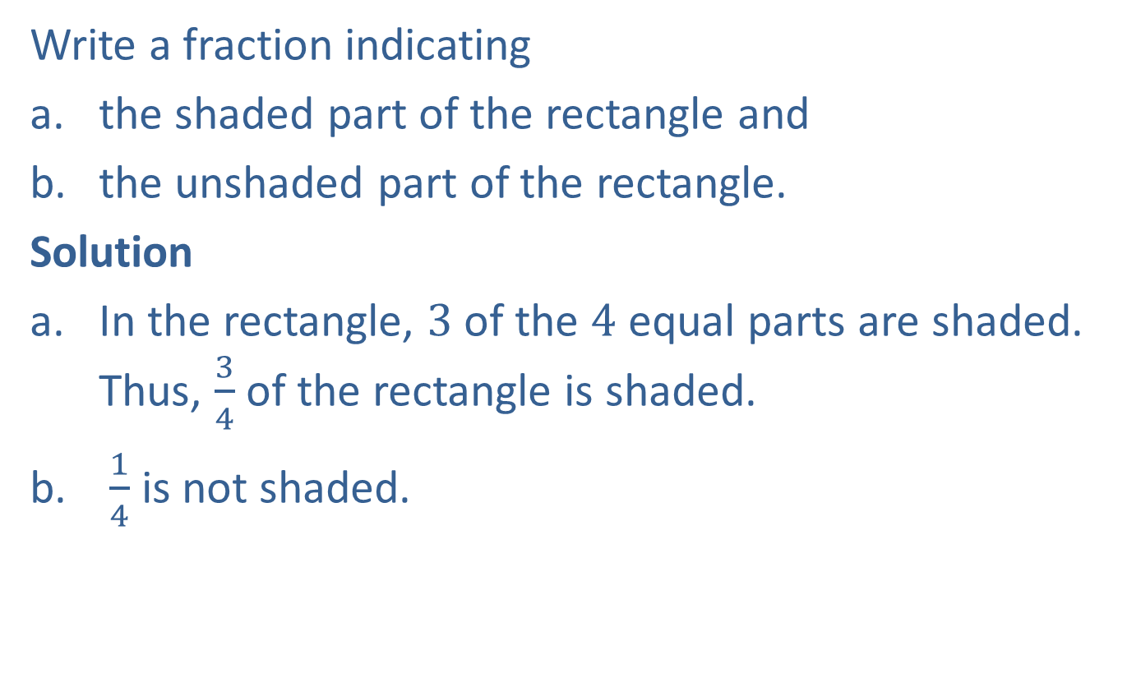
Example 1: Understanding Fractions
Write a fraction indicating
​the shaded part of the rectangle and
​the unshaded part of the rectangle.
Solution
In the rectangle, $3$ of the $4$ equal parts are shaded. Thus, $\frac{3}{4}$ of the rectangle is shaded.
$\frac{1}{4}$ is not shaded.

Slide 4
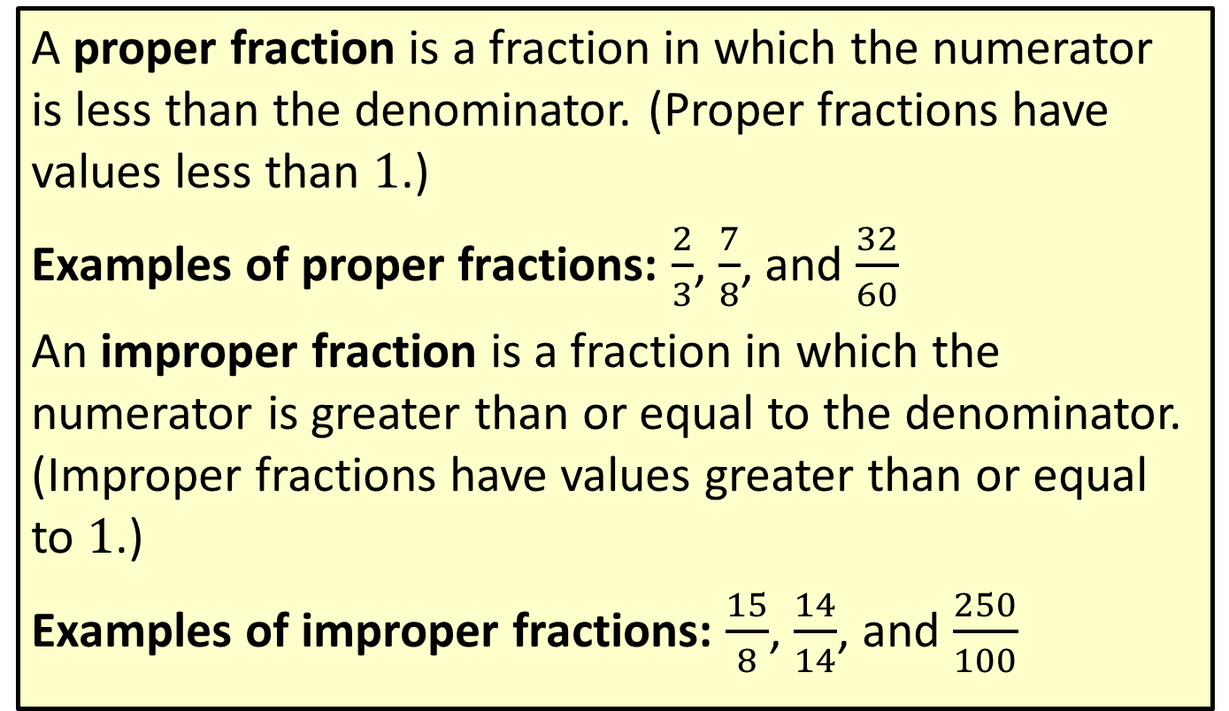
Definition: Proper Fractions and Improper Fractions
A proper fraction is a fraction in which the numerator is less than the denominator. (Proper fractions have values less than 1.)
Examples of proper fractions: $\frac{2}{3}$, $\frac{7}{8}$, and $\frac{32}{60}$
An improper fraction is a fraction in which the numerator is greater than or equal to the denominator. (Improper fractions have values greater than or equal to 1.)
Examples of improper fractions: $\frac{15}{8}$, $\frac{14}{14}$, and $\frac{250}{100}$

Slide 5
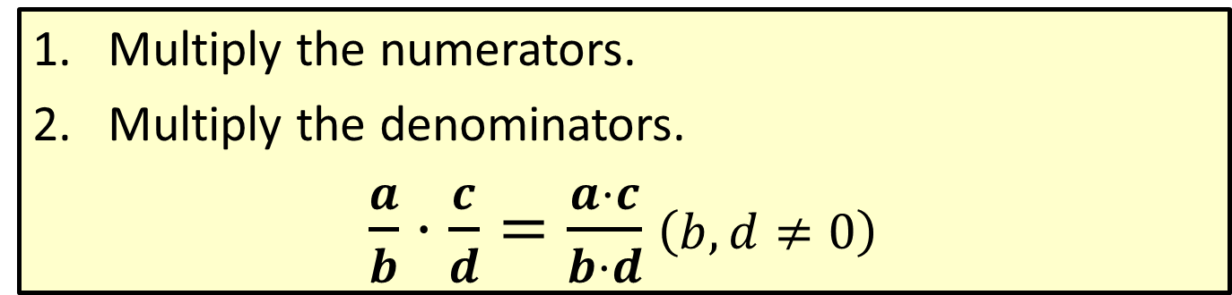
Procedure: Multiplying Fractions
​Multiply the numerators.
​Multiply the denominators.
​$\frac{a}{b}⋅\frac{c}{d}=\frac{a⋅c}{b⋅d}$ $\left(b,d≠0\right)$

Slide 6

Example 2: Multiplying Fractions
Find the product of $\frac{1}{3}$ and $\frac{2}{7}$.
Solution
$$\frac{1}{3}∙\frac{2}{7}=\frac{1∙2}{3∙7}=\frac{2}{21}$$

Slide 7

Example 3: Multiplying Fractions
Find $\frac{2}{5}$ of $\frac{7}{3}$.
Solution
$$\frac{2}{5}∙\frac{7}{3}=\frac{2∙7}{5∙3}=\frac{14}{15}$$

Slide 8

Example 4: Multiplying Fractions
Multiply.
​$\frac{4}{13}⋅3$
​$\frac{9}{8}⋅0$
​$\frac{4}{3}⋅\frac{5}{3}⋅\frac{2}{7}$
Solution
a. $\frac{4}{13}∙3=\frac{4}{13}∙\frac{3}{1}=\frac{4∙3}{13∙1}=\frac{12}{13}$

Slide 9

Example 4: Multiplying Fractions (cont.)
b. $\frac{9}{8}∙0=\frac{9}{8}∙\frac{0}{1}=\frac{9∙0}{8∙1}=\frac{0}{8}=0$
c. $\frac{4}{3}∙\frac{5}{3}∙\frac{2}{7}=\frac{4∙5∙2}{3∙3∙7}=\frac{40}{63}$

Slide 10
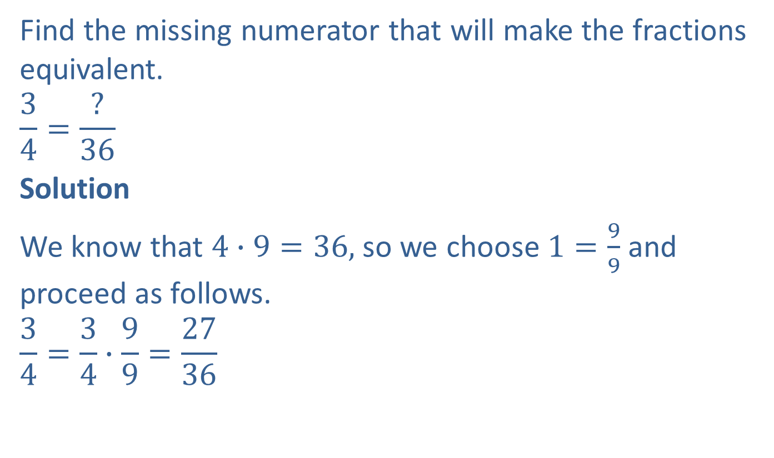
Example 5: Finding Equivalent Fractions
Find the missing numerator that will make the fractions equivalent.
$$\frac{3}{4}=\frac{?}{36}$$
Solution
We know that $4∙9=36,$ so we choose $1=\frac{9}{9}$ and proceed as follows.
$$\frac{3}{4}=\frac{3}{4}∙\frac{9}{9}=\frac{27}{36}$$

Slide 11

Example 5: Finding Equivalent Fractions (cont.)
Thus, $\frac{3}{4}$ and $\frac{27}{36}$ are two forms of the same number, and we say we have found a fraction equivalent to $\frac{3}{4}.$

Slide 12
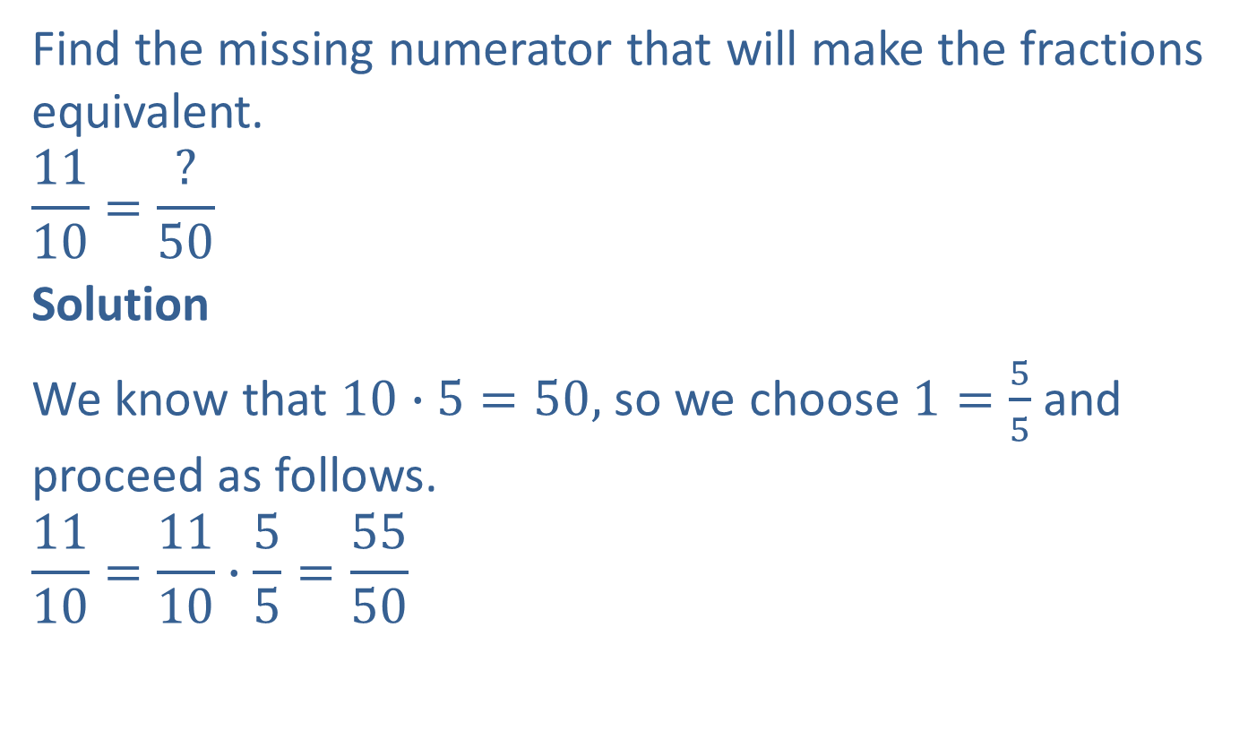
Example 6: Finding Equivalent Fractions
Find the missing numerator that will make the fractions equivalent.
$$\frac{11}{10}=\frac{?}{50}$$
Solution
We know that $10∙5=50,$ so we choose $1=\frac{5}{5}$ and proceed as follows.
$$\frac{11}{10}=\frac{11}{10}∙\frac{5}{5}=\frac{55}{50}$$

Slide 13
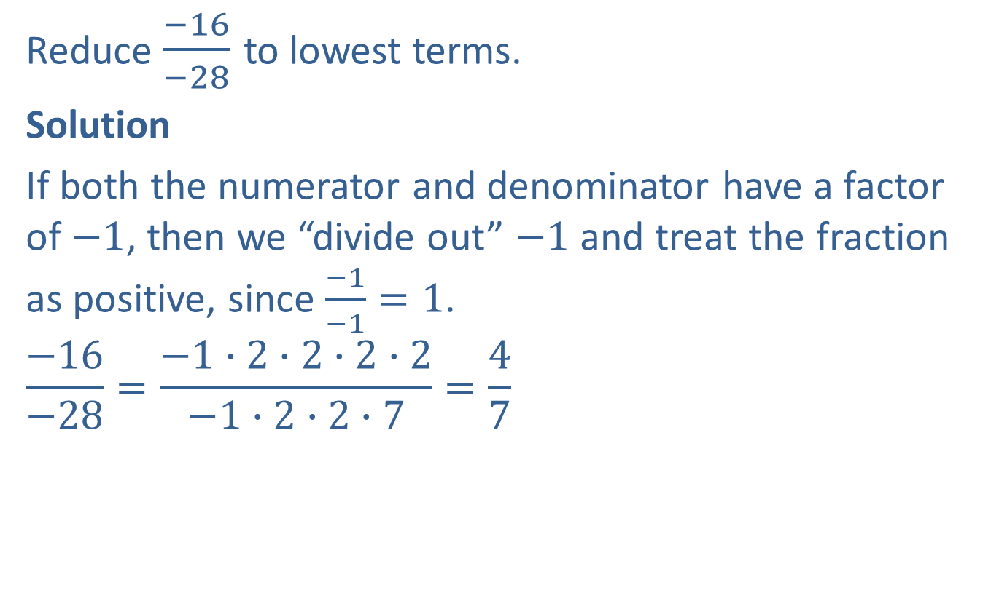
Example 7: Reducing Fractions to Lowest Terms
Reduce $\frac{−16}{−28}$ to lowest terms.
Solution
If both the numerator and denominator have a factor of $−1$, then we “divide out” $−1$ and treat the fraction as positive, since $\frac{−1}{−1}=1$.
$$\frac{−16}{−28}=\frac{−1∙2∙2∙2∙2}{−1∙2∙2∙7}=\frac{4}{7}$$

Slide 14
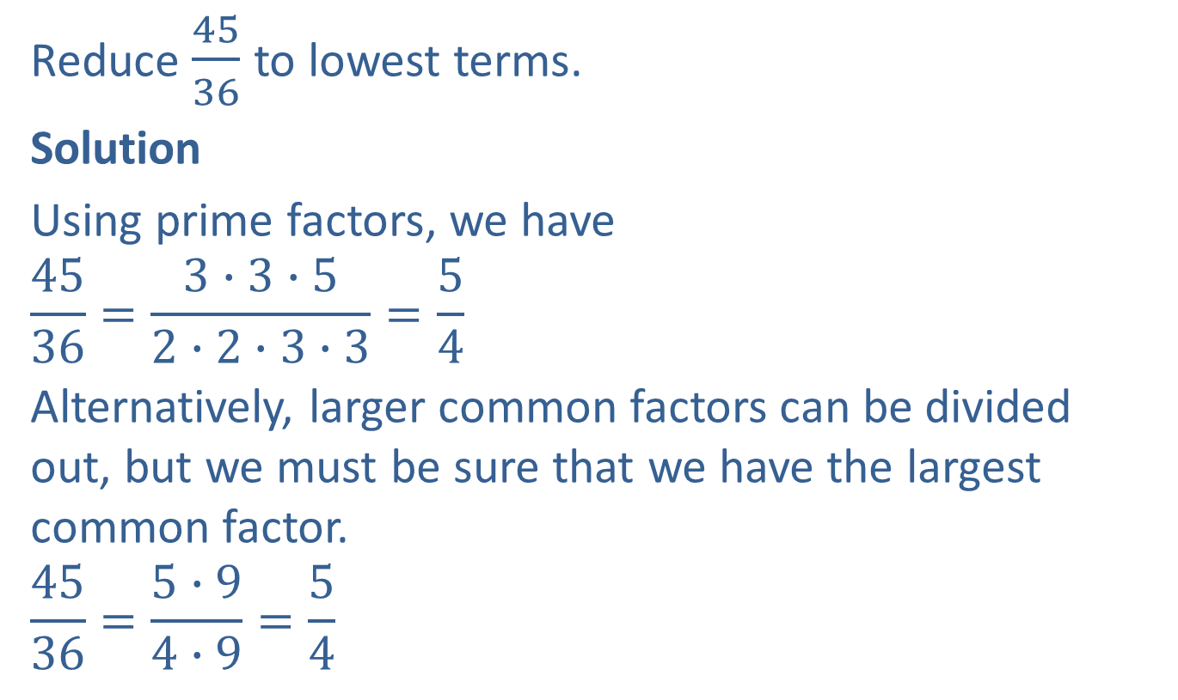
Example 8: Reducing Fractions to Lowest Terms
Reduce $\frac{45}{36}$ to lowest terms.
Solution
Using prime factors, we have
$$\frac{45}{36}=\frac{3∙3∙5}{2∙2∙3∙3}=\frac{5}{4}$$
Alternatively, larger common factors can be divided out, but we must be sure that we have the largest common factor.
$$\frac{45}{36}=\frac{5∙9}{4∙9}=\frac{5}{4}$$
Note that the answer is a reduced improper fraction.

Slide 15
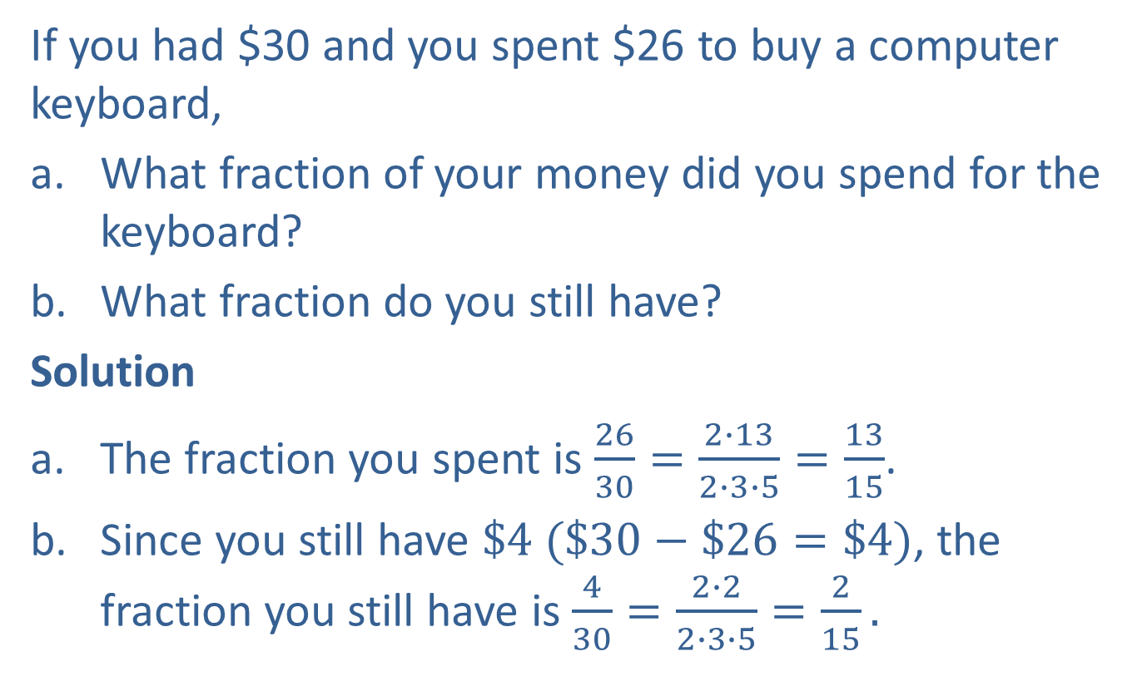
Example 9: Application: Writing and Reducing Fractions
If you had $30 and you spent $26 to buy a computer keyboard,
What fraction of your money did you spend for the keyboard?
What fraction do you still have?
Solution
The fraction you spent is $\frac{26}{30}=\frac{2∙13}{2∙3∙5}=\frac{13}{15}$.
Since you still have $\$4$ $(\$30−\$26=\$4)$, the fraction you still have is $\frac{4}{30}=\frac{2∙2}{2∙3∙5}=\frac{2}{15}.$

Slide 16

Example 10: Multiplying and Reducing Fractions
Multiply and reduce to lowest terms: $\frac{18}{35}⋅\frac{21}{12}$
Solution
$$\frac{18}{35}∙\frac{21}{12}=\frac{2∙3∙3∙3∙7}{5∙7∙2∙2∙3}=\frac{9}{10}$$

Slide 17

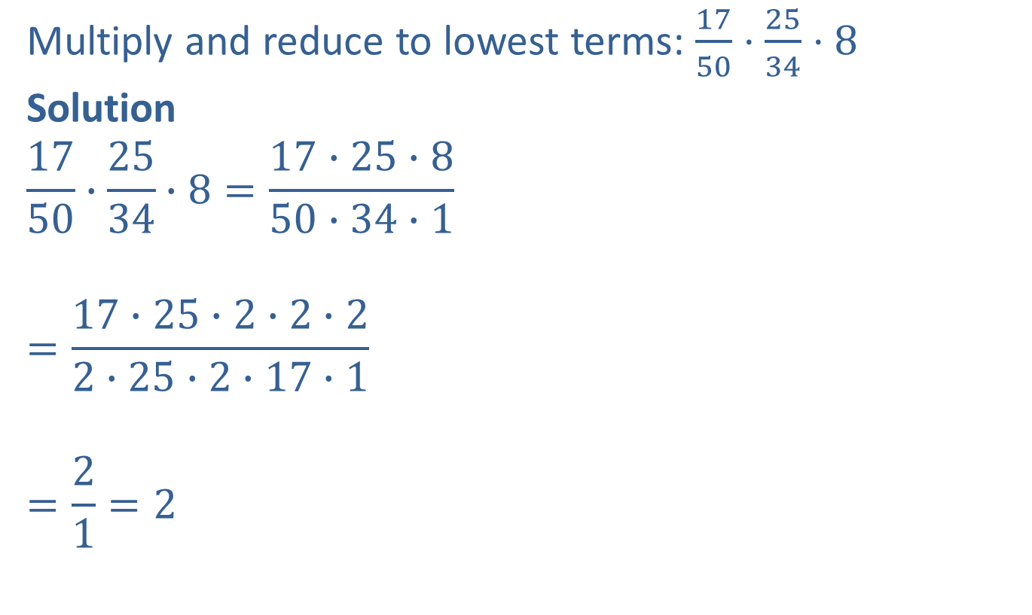
Example 11: Multiplying and Reducing Fractions
Multiply and reduce to lowest terms: $\frac{17}{50}⋅\frac{25}{34}⋅8$
Solution
$$\frac{17}{50}∙\frac{25}{34}∙8=\frac{17∙25∙8}{50∙34∙1}$$
$$=\frac{17∙25∙2∙2∙2}{2∙25∙2∙17∙1}$$
$$=\frac{2}{1}=2$$
Note that $8=\frac{8}{1}.$
In this example, 25 is a common factor that is not a prime number.

Slide 18

Example 12: Multiplying and Reducing Fractions
Multiply and reduce to lowest terms: $\frac{3}{35}⋅\frac{15}{4}⋅\frac{7}{9}$
Solution
$$\frac{3}{35}∙\frac{15}{4}∙\frac{7}{9}=\frac{3∙3∙5∙7∙1}{5∙7∙2∙2∙3∙3}=\frac{1}{4}$$

Slide 19
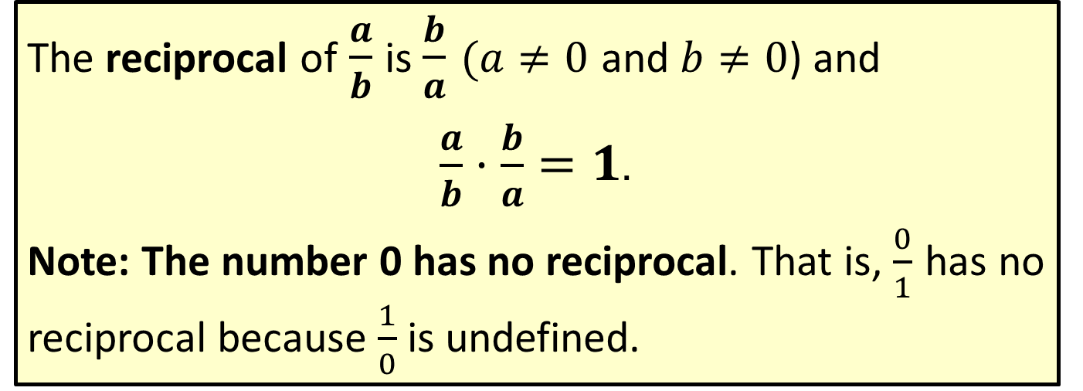
Definition: Reciprocal
The reciprocal of $\frac{a}{b}$ is $\frac{b}{a}$ $(a≠0$ and $b≠0$) and
$\frac{a}{b}⋅\frac{b}{a}=1$.
Note: The number 0 has no reciprocal. That is, $\frac{0}{1}$ has no reciprocal because $\frac{1}{0}$ is undefined.

Slide 20
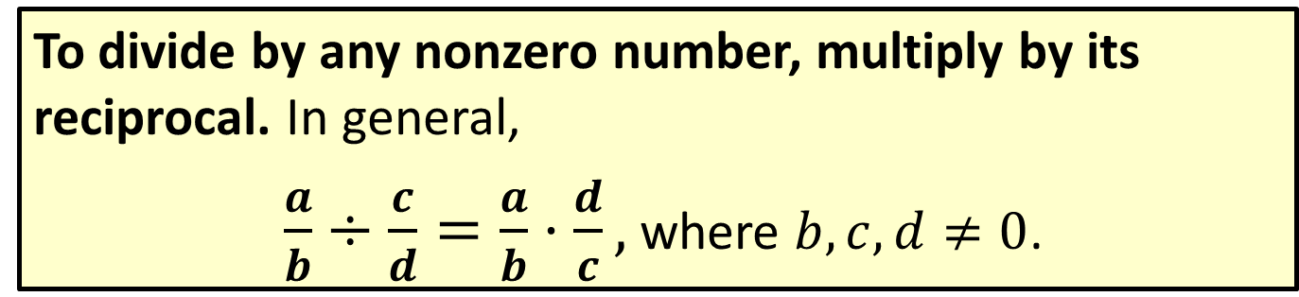
Procedure: Dividing Fractions
To divide by any nonzero number, multiply by its reciprocal. In general,
$\frac{a}{b}÷\frac{c}{d}=\frac{a}{b}⋅\frac{d}{c},$ where $b,c,d≠0$.

Slide 21

Example 13: Dividing Fractions
Divide:
​$\frac{2}{3}÷\frac{5}{8}$
​$−\frac{3}{4}÷\left(−4\right)$
Solution
The reciprocal of $\frac{5}{8}$ is $\frac{8}{5}$, so we multiply by $\frac{8}{5}$.
$\frac{2}{3}÷\frac{5}{8}=$ $\frac{2}{3}∙$ $\frac{8}{5}=\frac{16}{15}$

Slide 22

Example 13: Dividing Fractions (cont.)
The reciprocal of $−4$ is $−\frac{1}{4}$, so we multiply by $−\frac{1}{4}$. $−\frac{3}{4}÷\left(−4\right)=−\frac{3}{4}\left(−\frac{1}{4}\right)=\frac{3}{16}$
  A negative number divided by a negative number is a positive number.

Slide 23
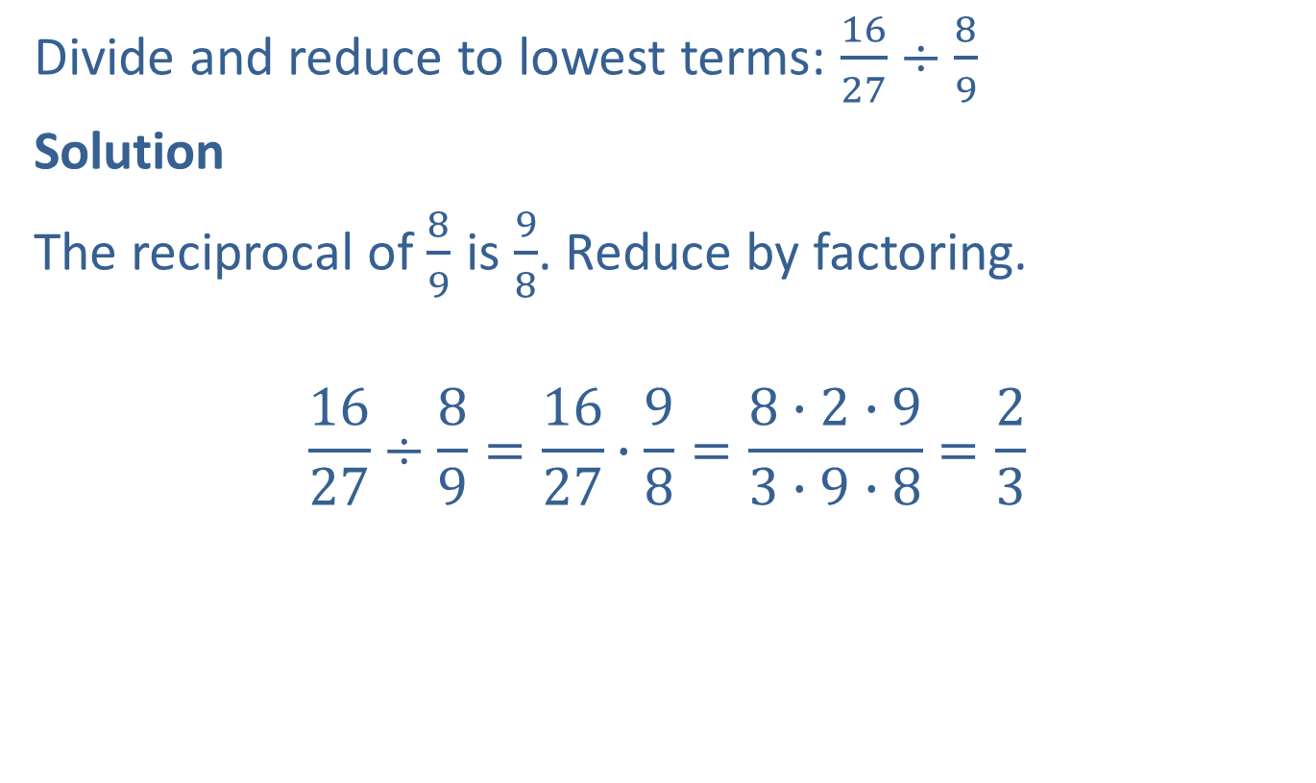
Example 14: Dividing and Reducing Fractions
Divide and reduce to lowest terms: $\frac{16}{27}÷\frac{8}{9}$
Solution
The reciprocal of $\frac{8}{9}$ is $\frac{9}{8}$. Reduce by factoring.
$$\frac{16}{27}÷\frac{8}{9}=\frac{16}{27}∙\frac{9}{8}=\frac{8∙2∙9}{3∙9∙8}=\frac{2}{3}$$

Slide 24
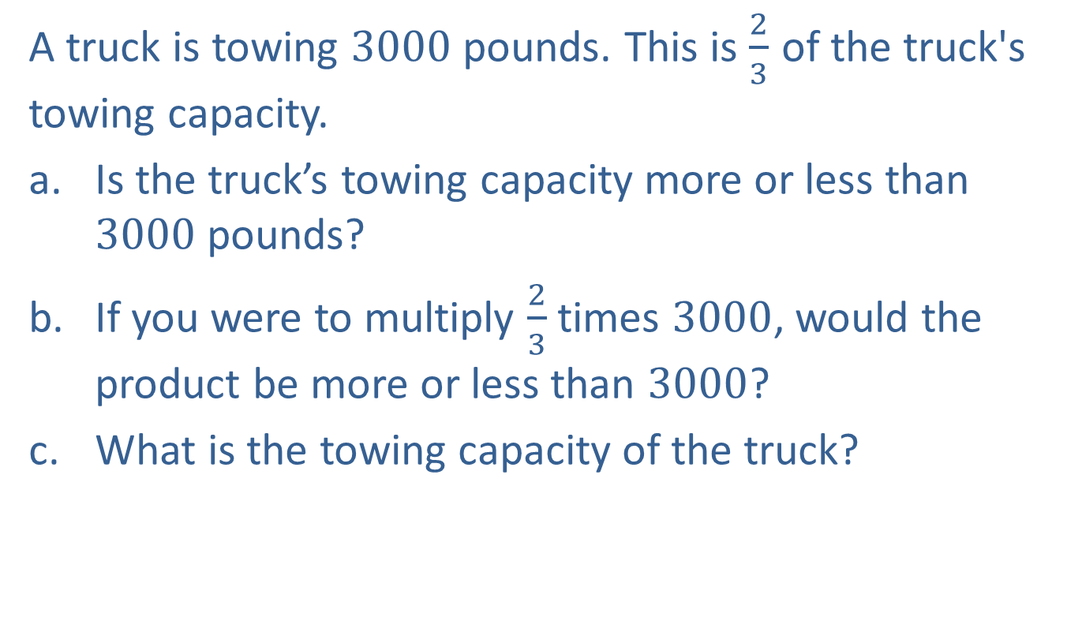
Example 15: Application: Multiplying and Dividing Fractions
A truck is towing 3000 pounds. This is $\frac{2}{3}$ of the truck's towing capacity.
Is the truck’s towing capacity more or less than $3000$ pounds?
If you were to multiply $\frac{2}{3}$ times $3000$, would the product be more or less than $3000$?
What is the towing capacity of the truck?

Slide 25
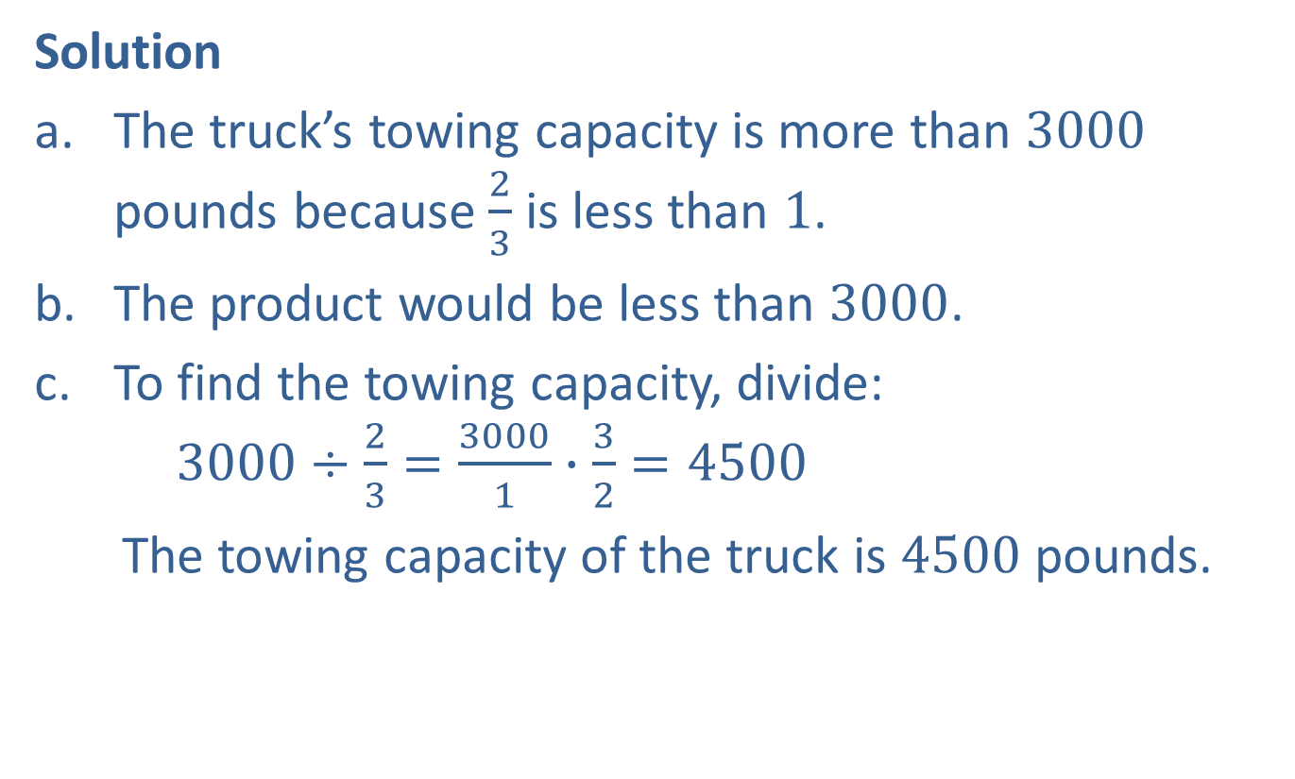
Example 15: Application: Multiplying and Dividing Fractions (cont.)
Solution
The truck’s towing capacity is more than $3000$ pounds because $\frac{2}{3}$ is less than $1$.
The product would be less than $3000$.
To find the towing capacity, divide: $3000÷\frac{2}{3}=\frac{3000}{1}∙\frac{3}{2}=4500$
The towing capacity of the truck is $4500$ pounds.

