Slide 1
Section A.5
Introduction to Sets

Slide 2
Example 1: Writing Sets Using Roster Notation
Write each set in roster notation.
Set Y consists of the first five natural numbers.
Set A consists of the even positive integers less than twelve.
Set M consists of the negative whole numbers greater than negative six.

Slide 3
Example 1: Writing Sets Using Roster Notation (cont.)
Solution

Slide 4
Symbols of Equality and Inequality
Reading from left to right:
= is equal to ≠ is not equal to
< is less than ≤ is less than or equal to
> is greater than ≥ is greater than or equal to

Slide 5
Properties: Properties of Inequality (or Order)
For real numbers a, b, and c, the following two properties are true.
Trichotomy Property: Exactly one of the following is true: a < b, a = b, or a > b.
Transitive Property: If a < b and b < c, then a < c.
Note: The transitive property also applies to >, ≥, and ≤.

Slide 6
Example 2: Identifying Properties of Inequality
State the property of inequality that is illustrated.
If x < 3 and 3 < y, then x < y.
If a is a real number, then either a = 5, a > 5, or a < 5.
Solution
Transitive property
Trichotomy property

Slide 7
Example 3: Writing Sets Using Set-Builder Notation
Write each set in set-builder notation.
C is the set of real numbers greater than two.
D is the set of real numbers less than or equal to negative twenty-three.
Solution

Slide 8
Example 4: Writing Sets
Consider the following list of numbers: 2, 3, 5, 7, 11. Write the set P, which consists of these five numbers, using
a word description,
roster notation, and
set-builder notation.
Solution
P is the set of the first five prime numbers.

Slide 9
Example 4: Writing Sets (cont.)

Slide 10
Example 5: Using the Symbols ∈ and ∉
Fill in the blank with the symbol ∈ or ∉ to make a true statement.
34 ____ F
2 ____ F
Solution
34 ∉ F
2 ∈ F

Slide 11


Using Set-Builder Notation and Graphs to Indicate Sets of Real Numbers
Set-Builder Notation | Word Description | Graph
 | The set of all x such that x is less than or equal to a.
 | The set of all x such that x is greater than b.

Slide 12

Using Set-Builder Notation and Graphs to Indicate Sets of Real Numbers (cont.)
Set-Builder Notation | Word Description | Graph
(Note: This is also known as the union, denoted ∪, of two sets of numbers.) | The set of all x such that x is less than a or x is greater than or equal to b.

Slide 13

Using Set-Builder Notation and Graphs to Indicate Sets of Real Numbers (cont.)
Set-Builder Notation | Word Description | Graph
(Note: This is also known as the intersection, denoted ∩, of two sets of numbers.) | The set of all x such that x is greater than a and x is less than b.

Slide 14
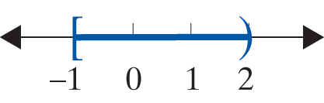
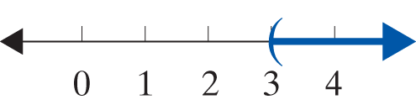
Example 6: Graphing Sets on a Number Line
Graph the given sets on a number line.
a. b.
Solution

Slide 15
Example 7: Graphing Sets on a Number Line
Graph the given sets on a number line.
a. b.
Solution
Note the use of the word and to indicate an intersection ∩. The word and implies that the values of x that satisfy the set must satisfy both inequalities. The two inequalities x ≤ 2 and x ≥ 0 are graphed as follows.

Slide 16
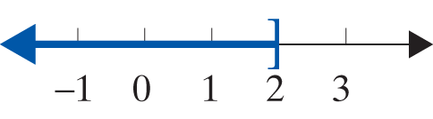
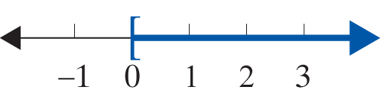
Example 7: Graphing Sets on a Number Line (cont.)
The set describes the points that these two graphs have in common, which consists of the overlap between the two graphs. This overlap results in the following graph.

Slide 17
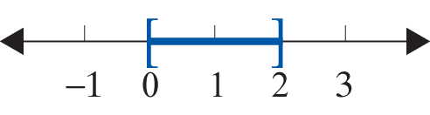
Example 7: Graphing Sets on a Number Line (cont.)
This shows that another way to write
is

Slide 18
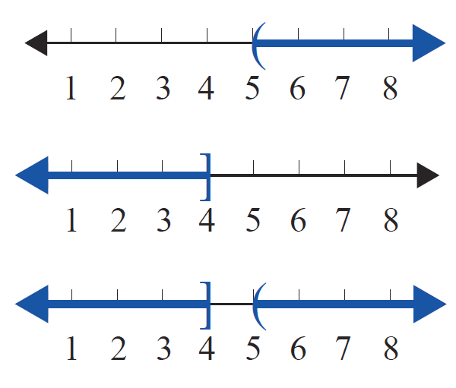
Example 7: Graphing Sets on a Number Line (cont.)
b. Note the use of the word or to indicate a union ∪. The word or implies that the values of x that satisfy the set must be in at least one of the inequalities. The two inequalities x > 5 and x ≤ 4 are graphed as follows.

Slide 19
Example 7: Graphing Sets on a Number Line (cont.)
The describes the union of these two graphs. This union results in the following graph.

